Slide 1
5. Sequence Diagram – Prod
Nissan SSO → Web App → Template-based document generation → S3 → Outlook
User
Nissan SSO
Web App
AWS S3
Outlook Connector
Admin
Login
Authenticate / token
Access granted
Select template + enter details
Load approved template
Generate + store files/logs
Share generated file
Deliver to Outlook
Admin: create / update templates User: use approved templates only

Slide 2
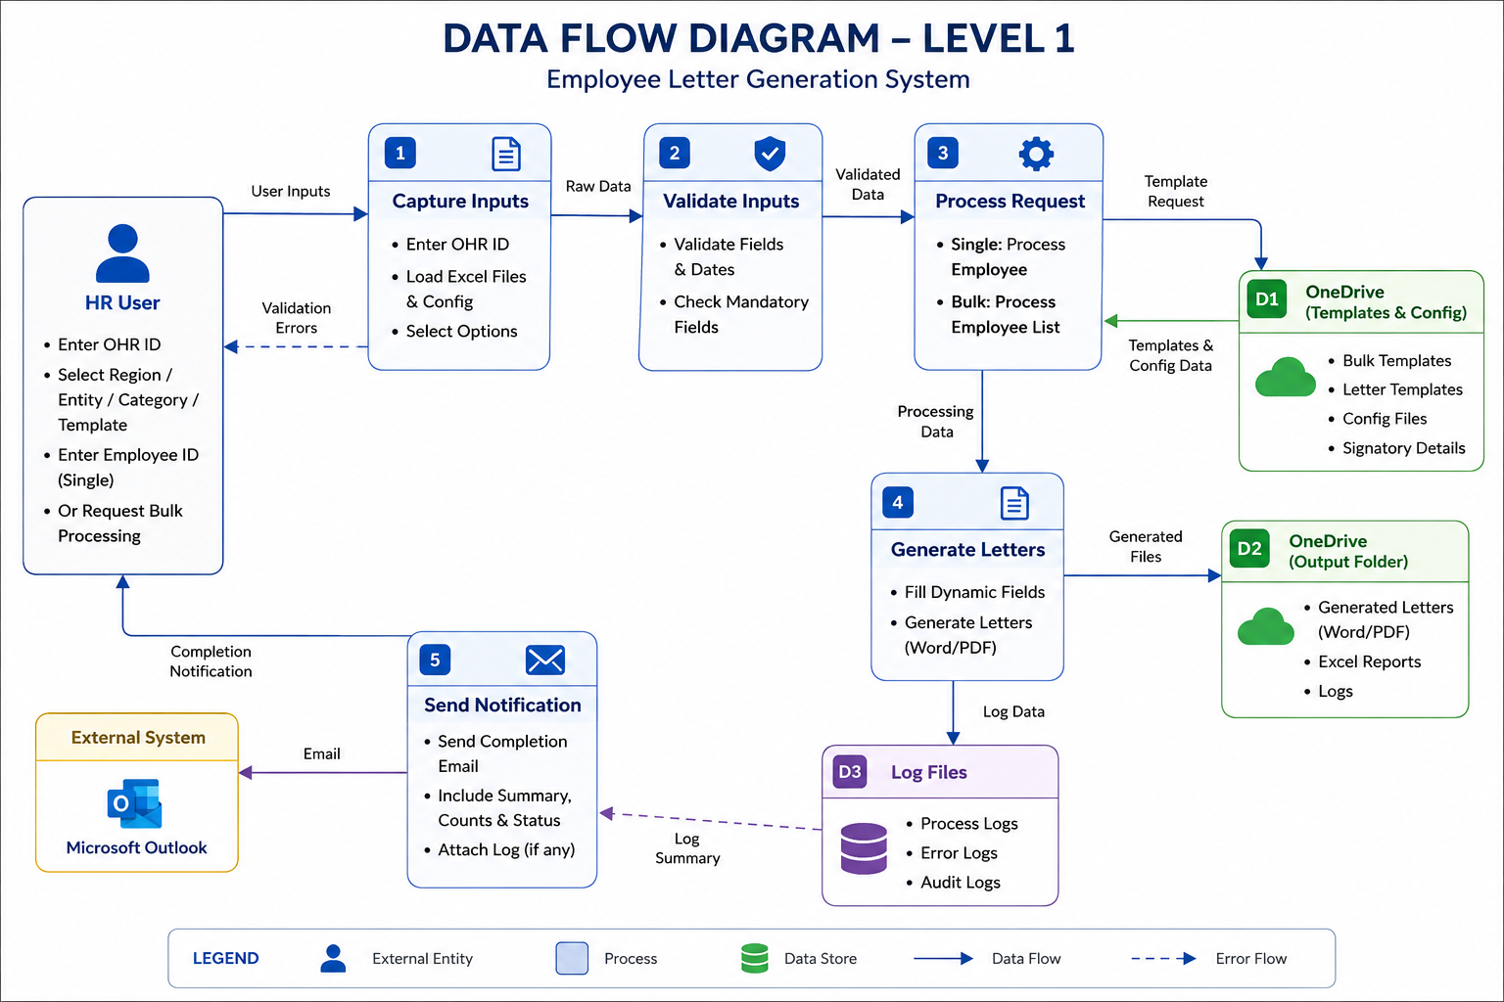
6. Data Flow Diagram
Role-based web application with centralized S3 storage and Outlook delivery
USER Nissan SSO login
WEB APP User workspace
TEMPLATE STORE Approved versions
AWS S3 Files + logs
SSO token
Use template
Save
Generated files + logs
Admin only
Share
Delivery status
ADMIN PORTAL Template management
OUTLOOK CONNECTOR Email / file sharing
ACCESS CONTROL • User: authenticate with Nissan SSO, create documents, use approved templates, receive output • Admin: all user capabilities + create/edit/publish templates and manage template versions • AWS S3: system-controlled storage for generated files and application logs • Outlook Connector: system-controlled delivery to the user’s Outlook

