Slide 1
PNG Animator
Team Steele
Edward Flick Brett Marcott
Micah Morgan Kye Rabon
Colby Russell Zach Bartlett

Slide 2

PNG
We wanted to take a collection of PNG's and build a short animation
Portable Network Graphics
Bitmapped Image Format
Still Images

Slide 3
APNG
Our goal was to create software which converts PNG's to an APNG and vice versa
Animated Portable Network Graphics
Animated file format
Plays a short animation composed of PNG image data
Extension to PNG
Similar to an animated GIF

Slide 4
PNG Animator
Animate
Suspend
Converts a series of PNG images into an APNG
An XML file is used as input specifying information used for the animation
Converts an APNG to a series of PNG's
Outputs an XML file containing information extracted from the animation

Slide 5
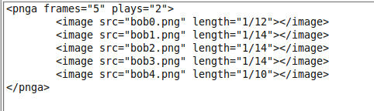
XML
Example...
XML is used as a user interface
XML schema provides a standard input structure for use with a graphical user interface (additional feature)
The XML document contains information for total number of frames, number of total plays for the animation, and a list of paths with filenames for each frame along with the length of time each frame is displayed

Slide 6


What is the purpose?
Animated portions for GUI's
Throbbers
  Used to indicate that a program is performing an action
  Web Browsers
  Mobile Applications
  Progress Bars

Slide 7


APNG over GIF
GIF limited to...
  256 colors per frame
  1 Bit Alpha Transparency
  Messy frame edges
APNG on the other hand...
  16 million color range
  Full Alpha Transparency

Slide 8
Remaining Issues
CRC algorithm efficiency
Compatability with older Firefox versions

Slide 9
What's next?
Manipulate Frame Control Chunks
  Dispose and blend
Handle PNG ancillary chunks
  Transparency
  Colour
Accept various compression and filter types
GUI for easy file manipulation

