Slide 1
PNG Animator
Team Steele
Edward Flick Brett Marcott
Micah Morgan Kye Rabon
Colby Russell Zach Bartlett

Slide 2

PNG
We wanted to take a collection of PNG's and build a short animation
Portable Network Graphics
Bitmapped Image Format
Still Images

Slide 3
APNG
Our goal was to create software which converts PNG's to an APNG and vice versa
Animated Portable Network Graphics
Animated file format
Plays a short animation composed of PNG image data
Extension to PNG
Similar to an animated GIF

Slide 4
PNG Animator
Animate
Suspend
Converts a series of PNG images into an APNG
An XML file is used as input specifying information used for the animation
Converts an APNG to a series of PNG's
Outputs an XML file containing information extracted from the animation

Slide 5
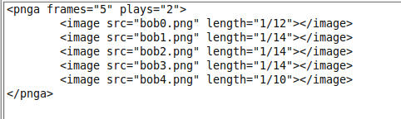
XML
Example...
XML is used as a user interface
XML schema provides a standard input structure for use with a graphical user interface (additional feature)
The XML document contains information for total number of frames, number of total plays for the animation, and a list of paths with filenames for each frame along with the length of time each frame is displayed

Slide 6
XML
We had an adequate existing xml library for parsing and serializing
XML makes the input easy to read
XML makes the code easier to read
ex.
(xml-readnode “pnga”)
(xml-serialize-dom pnga)

Slide 7


APNG over GIF
GIF limited to...
  256 colors per frame
  1 Bit Alpha Transparency
  Messy frame edges
APNG on the other hand...
  16 million color range
  Full Alpha Transparency

Slide 8
PNGA/S

Slide 9
PNGA/S Modular Architecture
apngBuilder & apngExploder
  Modules for Animation and Suspension
  Deal with the reorganization and verification of PNG and APNG Data “Chunks”
XmlUtils
  Deals with input and output of xml “views” of the Animation and Suspension process.

Slide 10
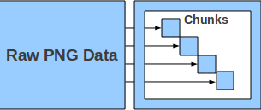
PNGA/S Modular Architecture
PngUtils
  In-depth handling of chunk data
    Chunk creation and parsing
    Type conversions (numbers)
    Byte-list and Chunk-type checking
    CRC calculation and verification

Slide 11
Remaining Issues
CRC algorithm efficiency
Compatability with older Firefox versions

Slide 12
What's next?
Manipulate Frame Control Chunks
  Dispose and blend
Handle PNG ancillary chunks
  Transparency
  Colour
Accept various compression and filter types
GUI for easy file manipulation

