Slide 1
Genomics
Dr. rer. nat. Diego Mauricio Riaño Pachón
Laboratório de Biologia Computacional, Evolutiva e de Sistemas
Centro de Energia Nuclear na Agricultura
Universidade de São Paulo
diego.riano@cena.usp.br
http://diriano.github.io/

Slide 2
Use long reads
Two (three) tecnologies readily available:
PacBio CLR (Continuous Long Reads)
PacBio CCS (HiFi) (Circular Consensus Sequences)
Oxford Nanopore Technologies

Slide 3
Key points for long read sequencing
Fresh material. Or collect and freeze it
Extraction of HMW DNA
For ONT eliminate short reads with circulomics
If doing the sequencing yourself with ONT get used to nanopore problems
Server, plenty of RAM and CPU. GPU in nanopore, required for basecalling
Try diferent assemblers.
Polish your assemblies, Always. Speciallly if only using long reads of high error rate.
Scaffold genome using HiC or genetic/physical (bionano) maps

Slide 4
Some problems when assemblying a genome (plants)
Genome Size (get na idea of the size of your genome!)
Ploidy
Heterozigozity (out/in-breeder), phasing
Repeats! Plants usualy have lots of TEs, read length important to resolve repeats

Slide 5
Assembler: No size fits all!
Everything on the market: OLC, de Bruiijn, Greedy
Minimap2/miniasm
WTDBJ2
FlyE
Shasta
CANU
FALCON
MaSurCA

Slide 6
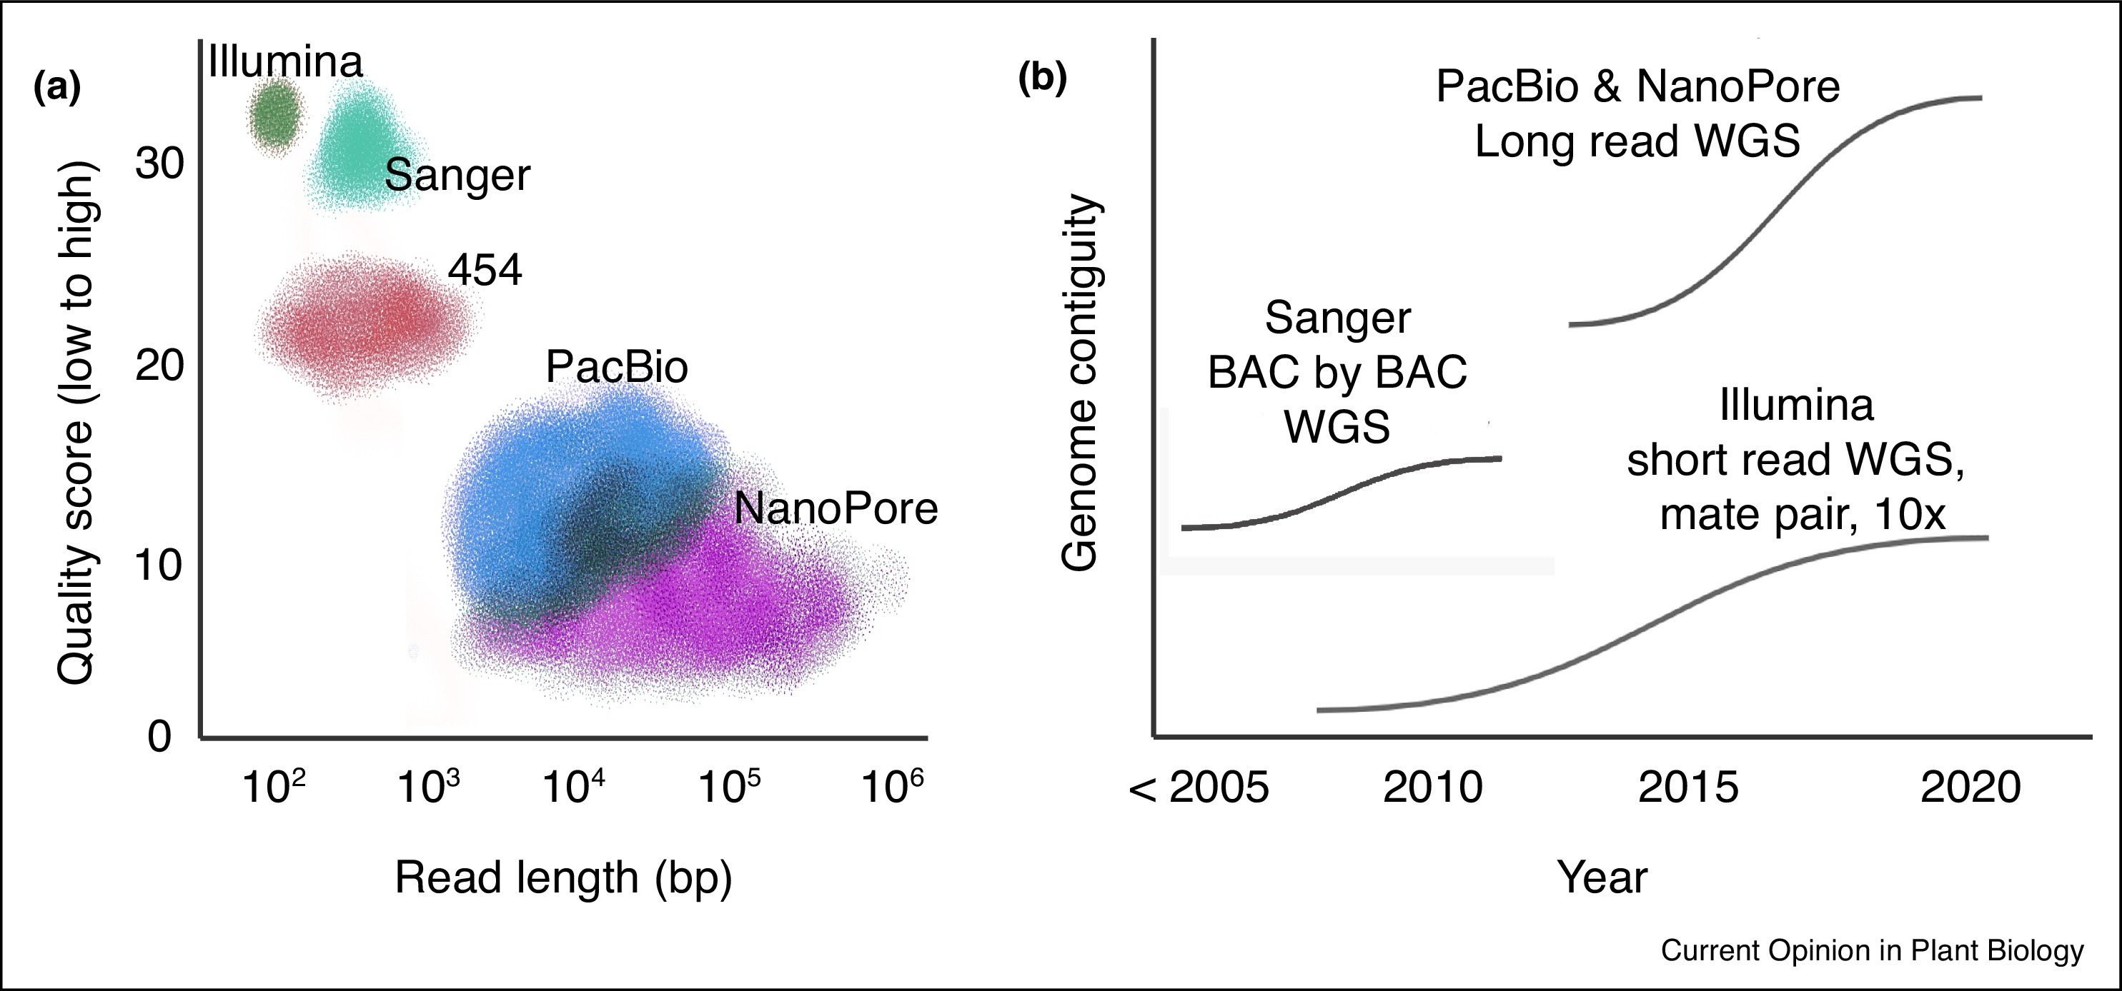
Advances in sequencing technology
Read length vs quality
Contiguity
https://www.sciencedirect.com/science/article/pii/S1369526619301244
Notes:
(a) Sanger and Illumina sequencing technologies have short read lengths but high per base quality. Long read sequencing technologies (PacBio and NanoPore) have reads that can exceed 1 Mb but have a much lower per base quality. (b) Long read sequencing technologies have driven the largest improvements in genome contiguity, or completeness, over the last ∼5 years. These are schematic depictions of sequencing technologies and not actual data.

Slide 7
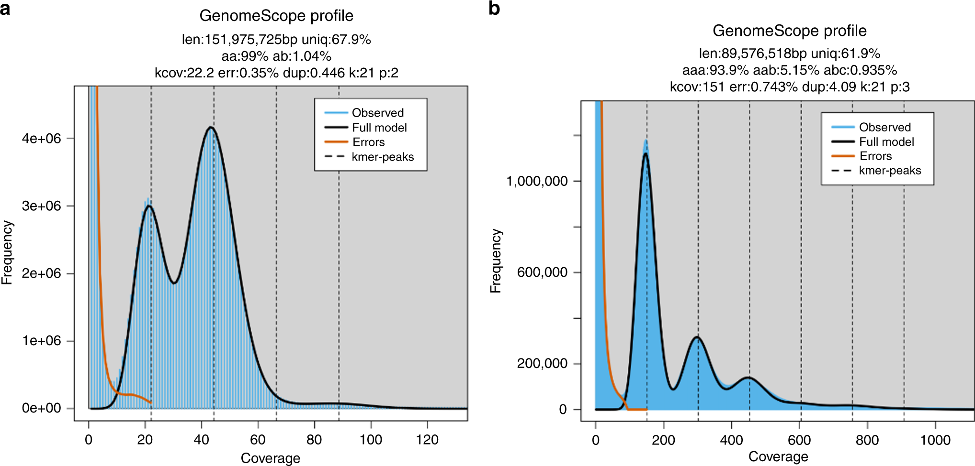
Genome size & Heterozygosity et al.:GenomeScope
GenomeScope2.0 can deal with different values of ploidy , but you must know the ploidy in advance!
https://www.nature.com/articles/s41467-020-14998-3
Notes:
K-mer spectra and fitted models for (a) diploid Arabidopsis thaliana and (b) triploid Meloidogyne enterolobii. Note that the diploid plot has two major peaks, while the triploid plot has three major peaks. Both also have high frequency putative error k-mers with coverage near 1.

Slide 8
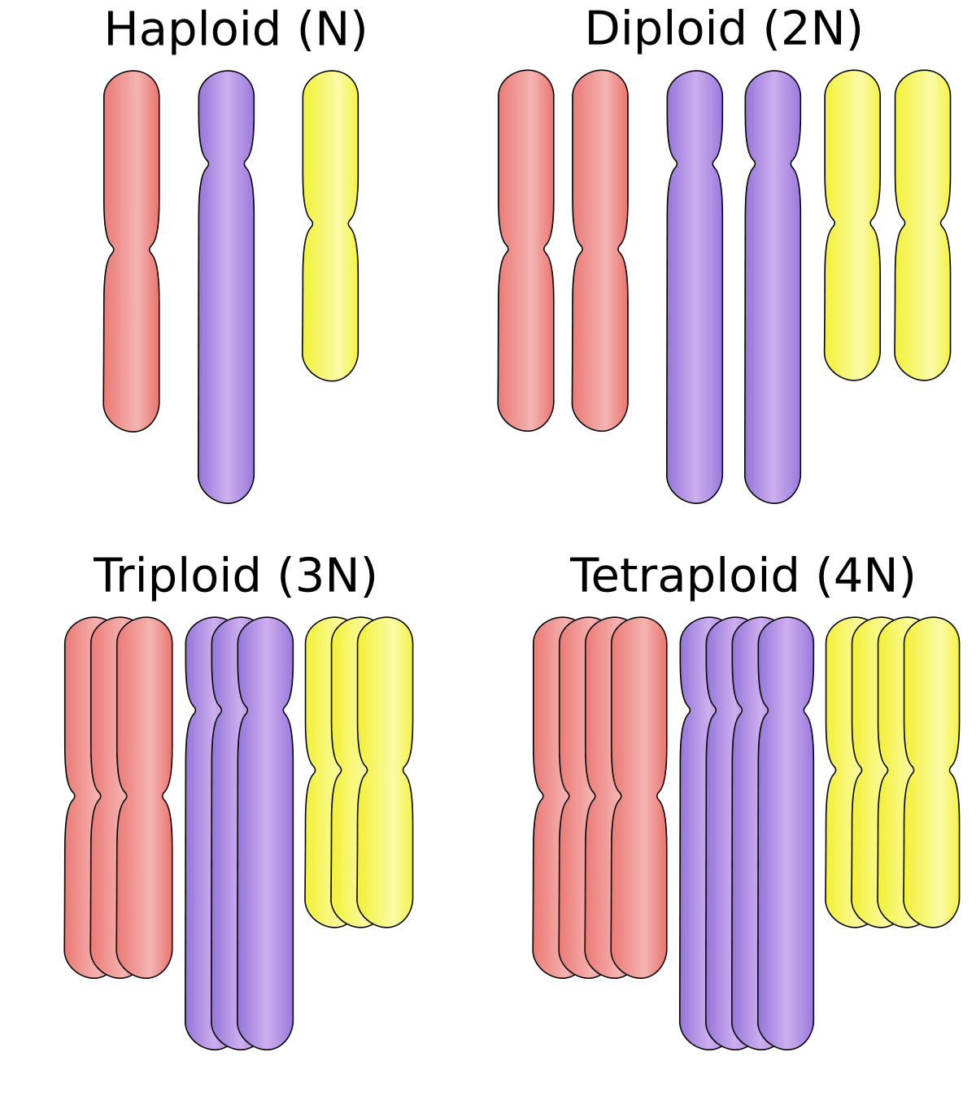
About Ploidy
Haploid (N)
Diploid (2N)
Polyploid
Diploid
Haploid
Monoploid
Triploid (3N)
Tetraploid (3N)
We have NGS genomic data, let’s the data speak!

Slide 9
If you have a monoploid reference genome you can use ploidyNGS

Slide 10
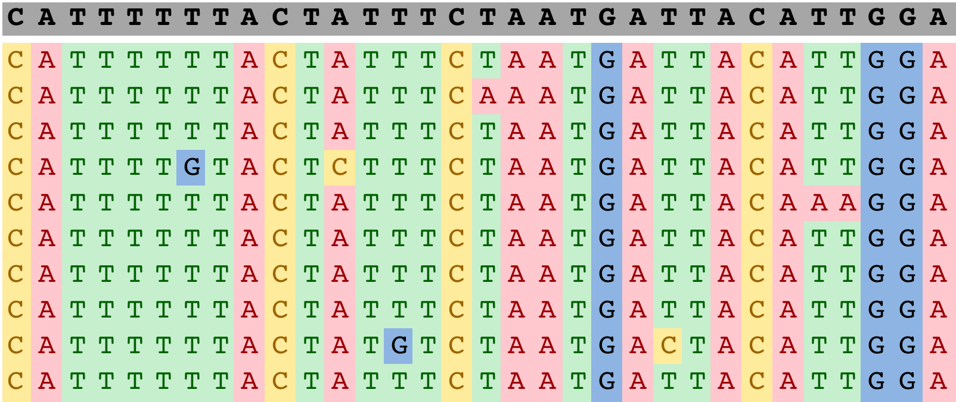
ploidyNGS: Let the data tell you about the ploidy of your organism
Results
We need the alignment of the genomic NGS reads to the genome sequence in BAM format
Reference Genome
NGS Reads
Then we count the fraction of reads supporting each base (“allele”) at every position in the alignment file (BAM)

Slide 11
ploidyNGS: Haploid case
Results
Monomorphic positions
In the haploid case we expect most positions in the alignment to be monomorphic or have a low frequency of other bases (“Alleles”), that mostly arise form sequencing errors or mapping errors
Abundance of the most frequent “allele”

Slide 12
ploidyNGS: Haploid case
Results
Monomorphic positions
Sequencing errors
In the haploid case we expect most positions in the alignment to be monomorphic or have a low frequency of other bases (“Alleles”), that mostly arise form sequencing errors or mapping errors
Abundance of the most frequent “allele”
Abundance of the second most frequent “allele”

Slide 13
ploidyNGS: Haploid case
Results
Monomorphic positions
Sequencing errors
In the haploid case we expect most positions in the alignment to be monomorphic or have a low frequency of other bases (“Alleles”), that mostly arise form sequencing errors or mapping errors

Slide 14
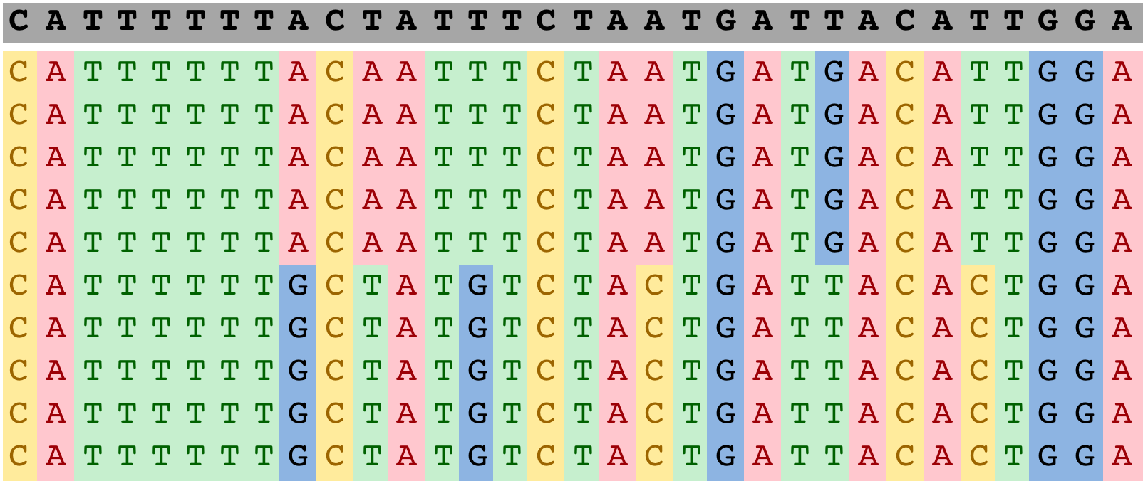
ploidyNGS: Diploid case
Results
Polymorphic positions
In the diploid case we expect that in the polymorphic positions that both, the most frequent and second most frequent, “alleles” appear each with 50% of the reads in that position.

Slide 15
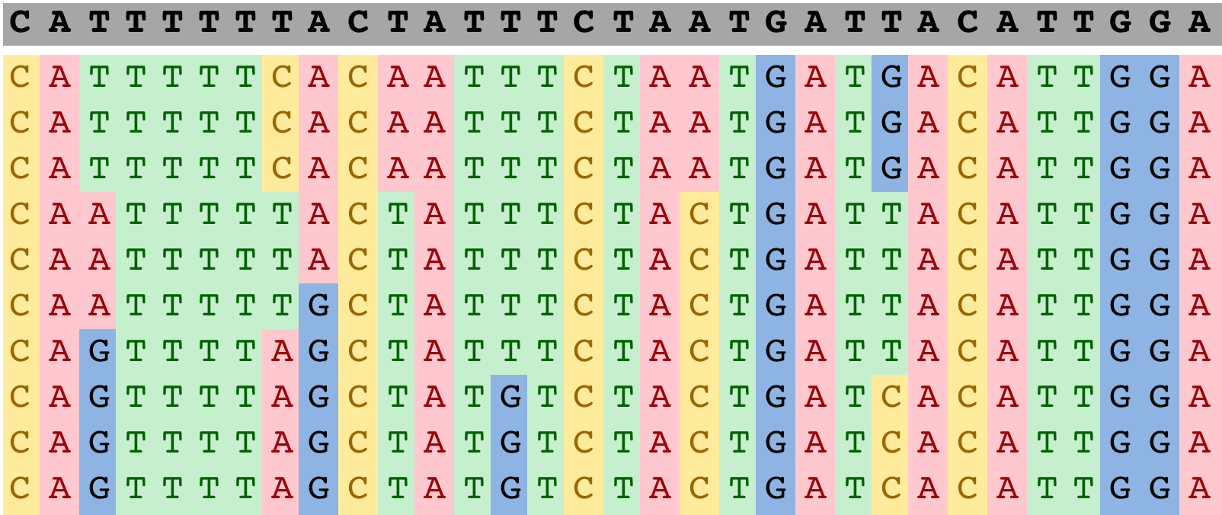
ploidyNGS: Triploid case
Results
Polymorphic positions
In the triploid case we have two possible options for the polymorphic positions:
3 “alleles” present each with 33% of the reads
2 “alleles” present one with 66% and 33% of the reads

Slide 16
If you DO NOT have a reference genome, try to infer ploidy directly from your reads using kmer statistics with SmudgePlots

Slide 17
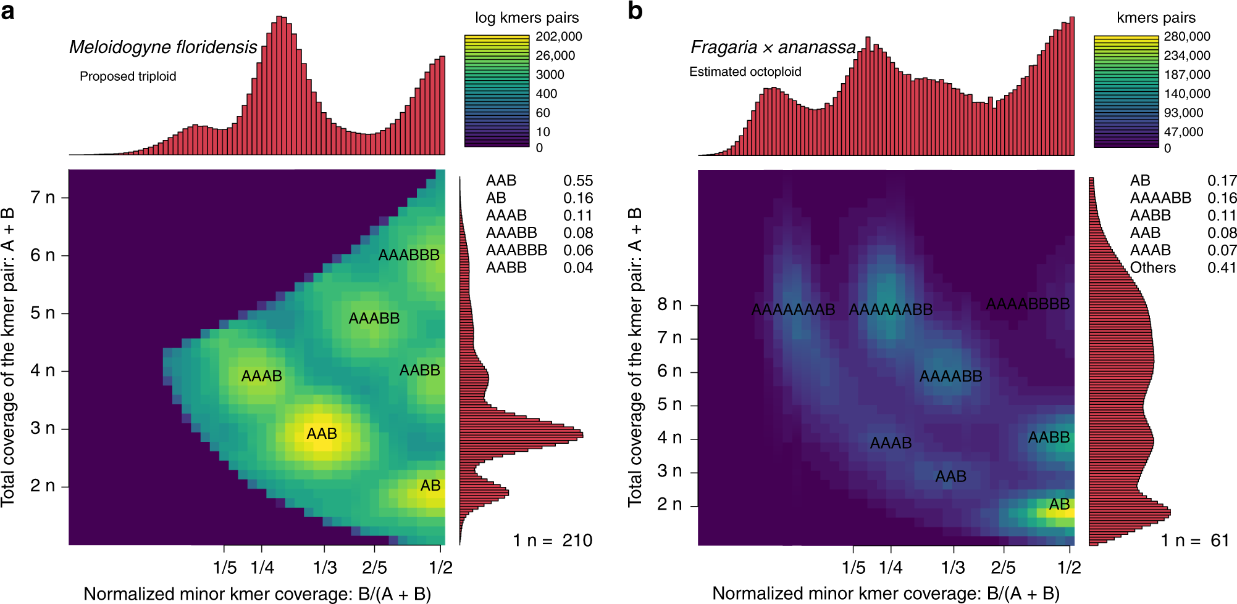
Ploidy: Smudgeplots
https://www.nature.com/articles/s41467-020-14998-3
Notes:
Smudgeplots for (a) the triploid root-knot nematode Meloidogyne floridensis and (b) the octaploid strawberry Fragaria × ananassa.
Take pairs of kmers (above a minimum kmer coverage threshold) that differ by exactly one nucleotide. These kmers should be homologous and represented different alleles or different paralogues. If they are alleles, they could be used to estimate ploidy.
The two kmers in the pair are called A and B, covA is greater or equal than covB

Slide 18
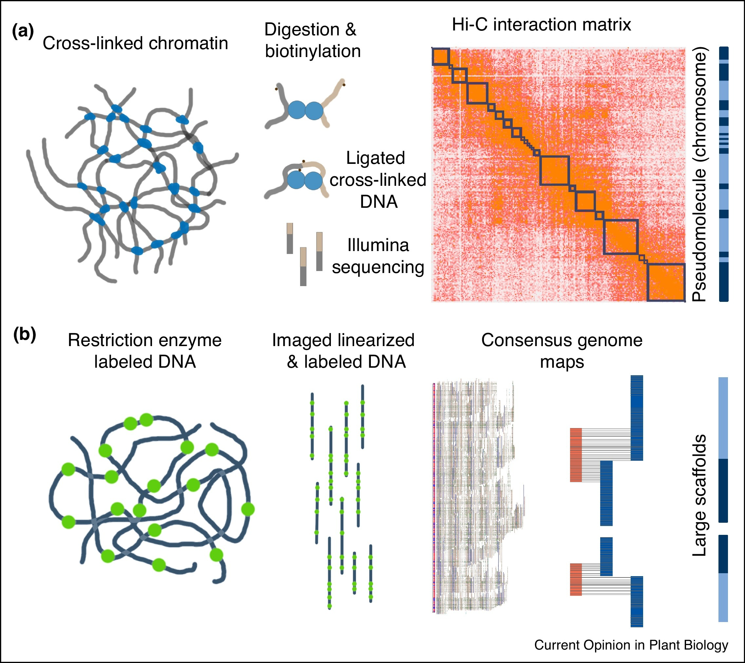
Scaffolding
https://www.sciencedirect.com/science/article/pii/S1369526619301244
Notes:
Figure 2. Leading strategies for scaffolding long read assemblies. (a) High throughput chromatin conformation capture (Hi-C) relies on the proximity of interactions from cross-linked chromatin to order contigs. Chromatin is cross-linked, digested with restriction enzymes and biotinylated, and the two chromatin ends are ligated and purified using streptaviadin beads. The resulting library is sequenced and aligned to the genome to build a Hi-C interaction matrix for scaffolding contigs into pseudomolecules. (b) Optical maps utilize restriction enzymes and single molecule imaging to create a physical map of the genome. Long fragments of DNA are nicked using a restriction enzyme and labeled. DNA molecules are linearized and imaged, and fingerprints for each molecule are combined to create a consensus genome map. Contigs are overlaid on the genome map based on in silico digestion and anchored into scaffolds or pseudomolecules.

Slide 19
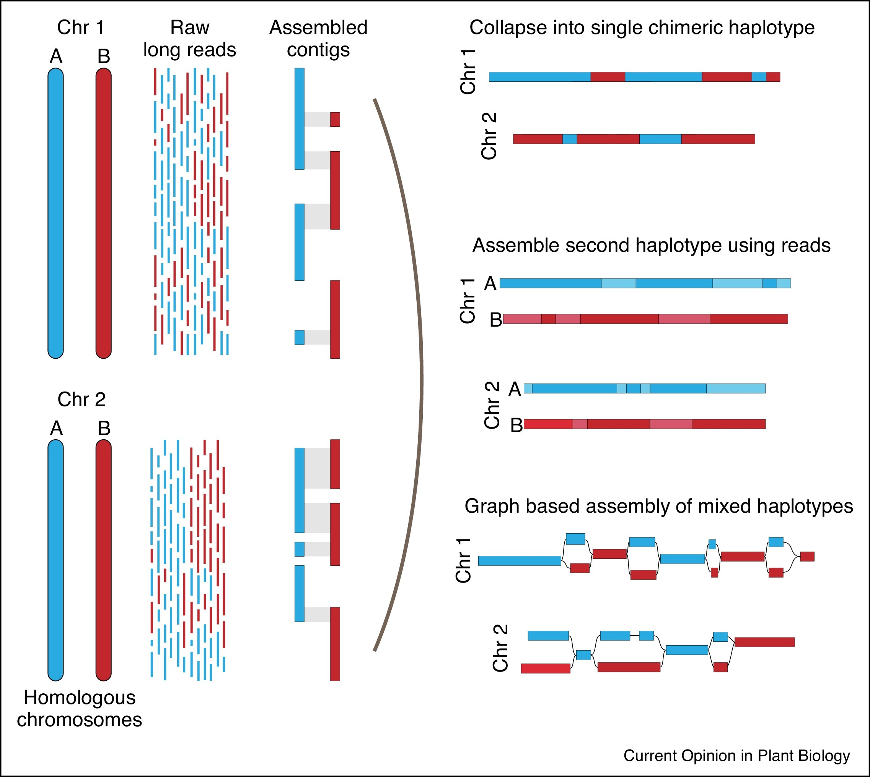
Assembly of haplotypes
https://www.sciencedirect.com/science/article/pii/S1369526619301244
Notes:
Figure 3. Assembly approaches for sequencing and phasing heterozygous genomes. Long read assemblies allow assembly of multiple haplotypes from homologous chromosomes in heterozygous regions. The primary and alternative haplotypes can be collapsed into a single, non-redundant but chimeric pseudomolecule for simplicity of downstream analyses (top). Raw reads can be mapped to the contigs to resolve missing haplotype regions to create a phased, diploid assembly (middle). Partial haplotypes can be retained and labeled in a graph-based assembly (bottom).

Slide 20
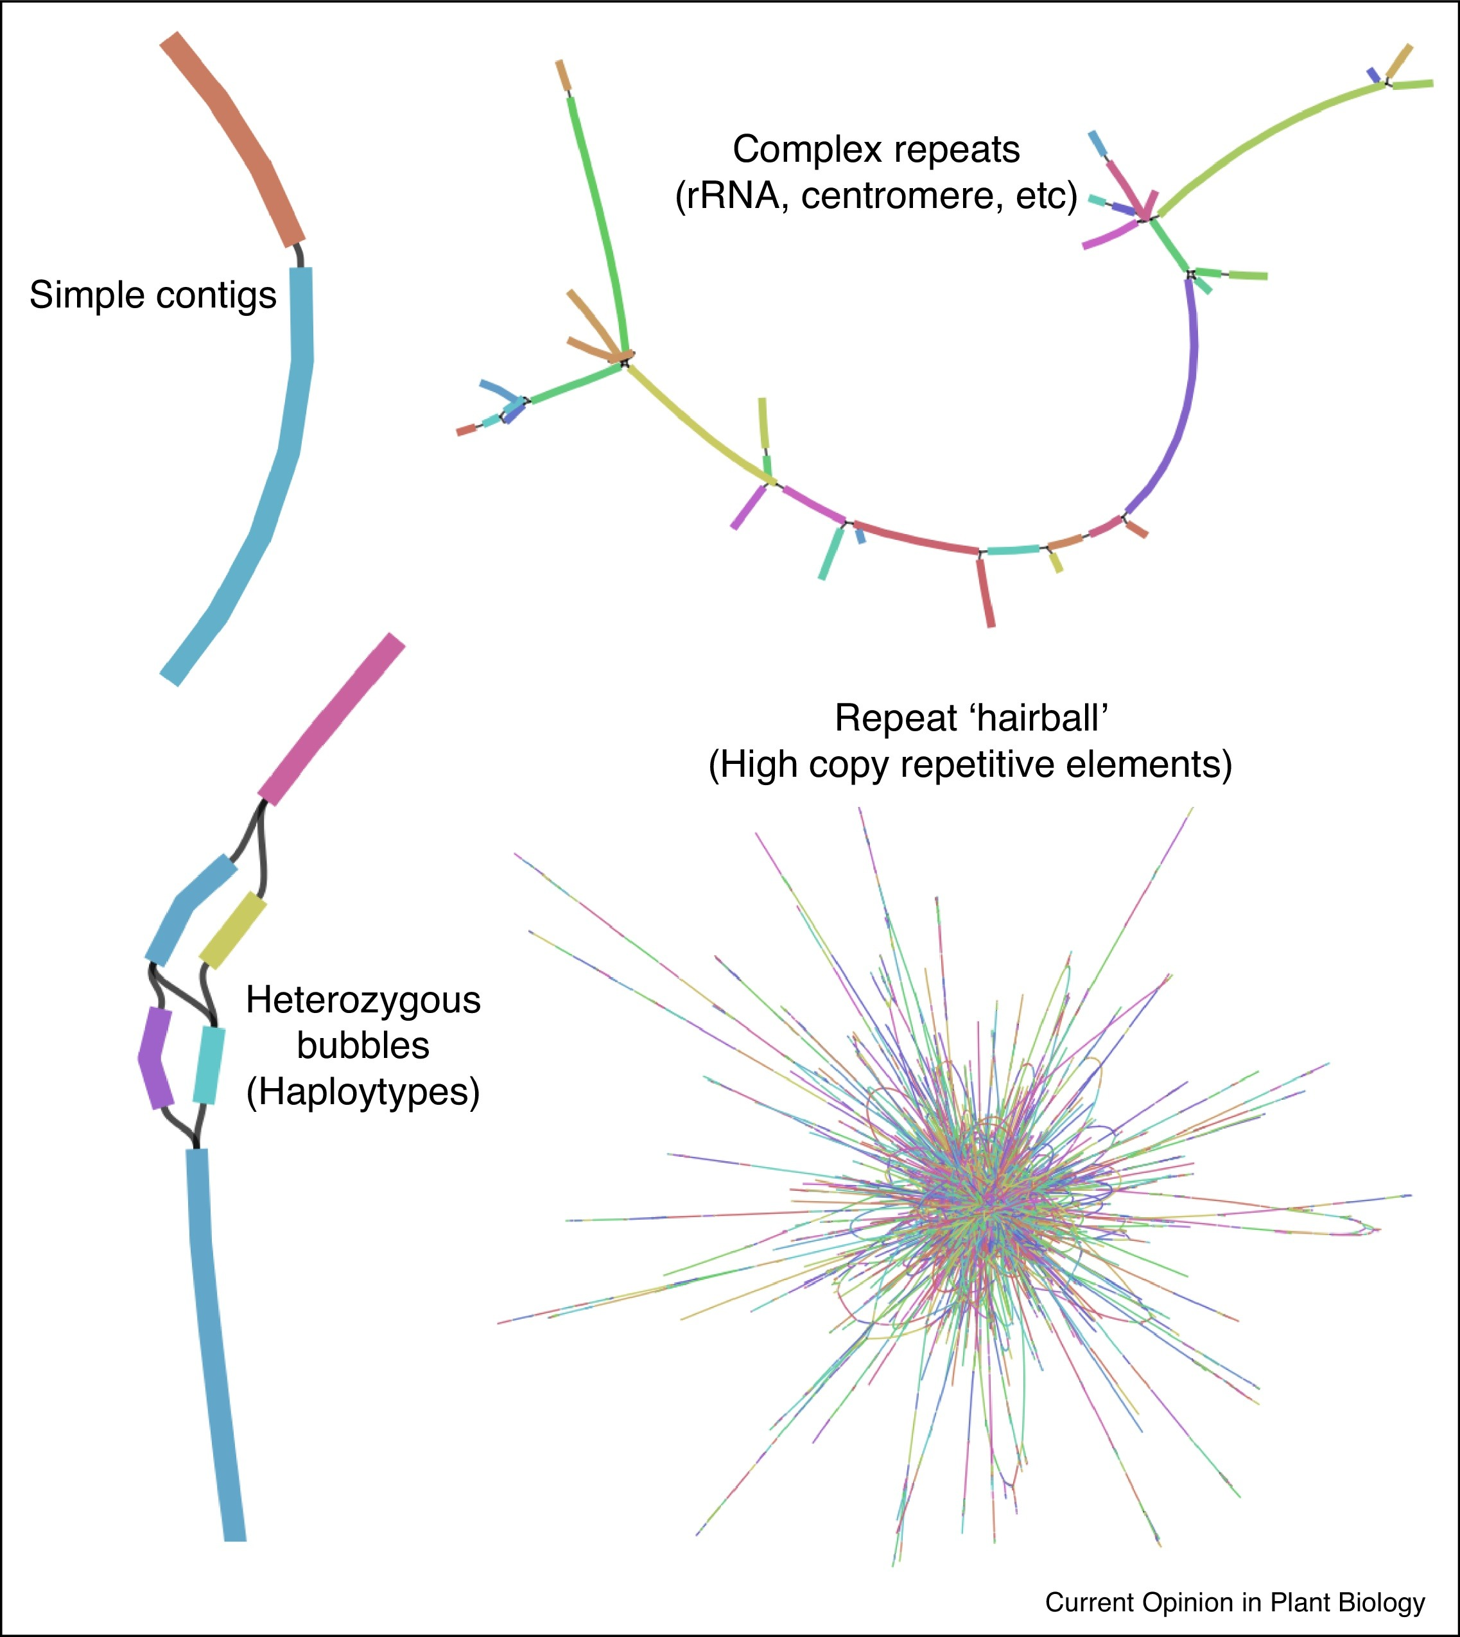
Repeats and heterozygosity
https://www.sciencedirect.com/science/article/pii/S1369526619301244
Notes:
Figure 3. Assembly approaches for sequencing and phasing heterozygous genomes. Long read assemblies allow assembly of multiple haplotypes from homologous chromosomes in heterozygous regions. The primary and alternative haplotypes can be collapsed into a single, non-redundant but chimeric pseudomolecule for simplicity of downstream analyses (top). Raw reads can be mapped to the contigs to resolve missing haplotype regions to create a phased, diploid assembly (middle). Partial haplotypes can be retained and labeled in a graph-based assembly (bottom).

Slide 21
Re-sequencing vs de novo
In most cases re-sequencing is not Worth the loss of information and incorrect conclusions (due to re-arrangements)
As costs continue to decrease, and algoriths for de novo assembly improve, de novo assembly is the best path in most cases. With a combination of 2nd and 3rd NGS Technologies and the use of long-range informations (bionano/HiC)

Slide 22

That´s all for today folks

