Slide 1
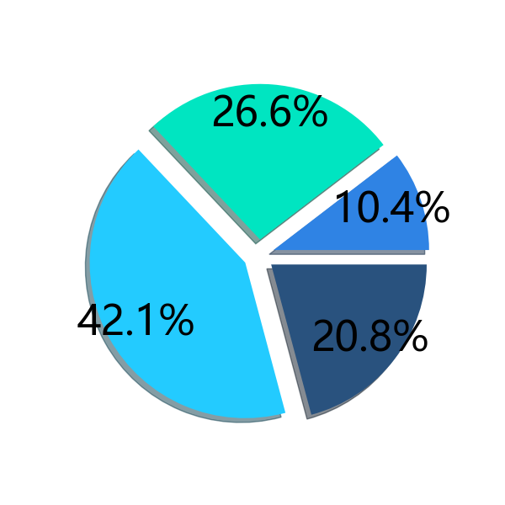



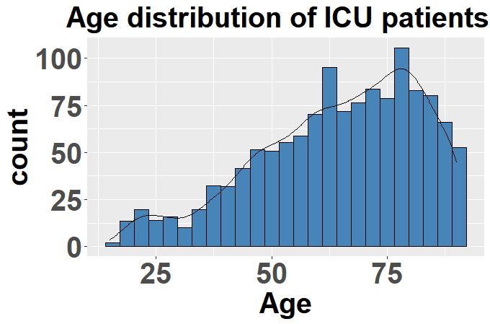
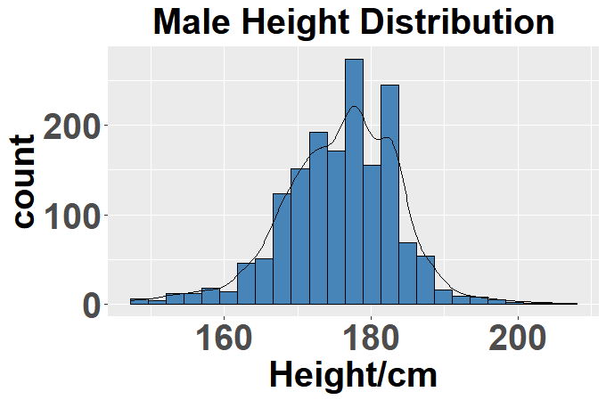
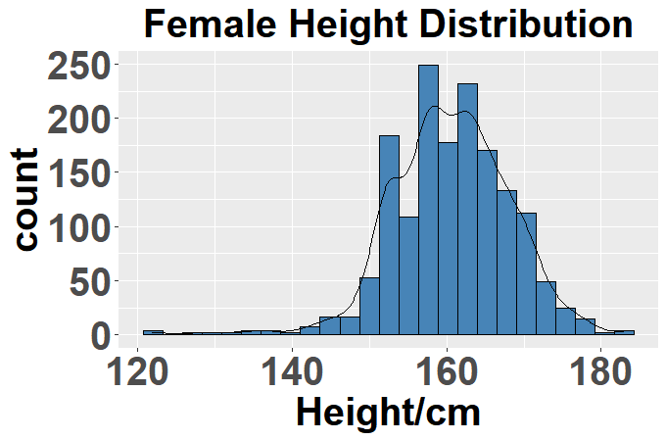
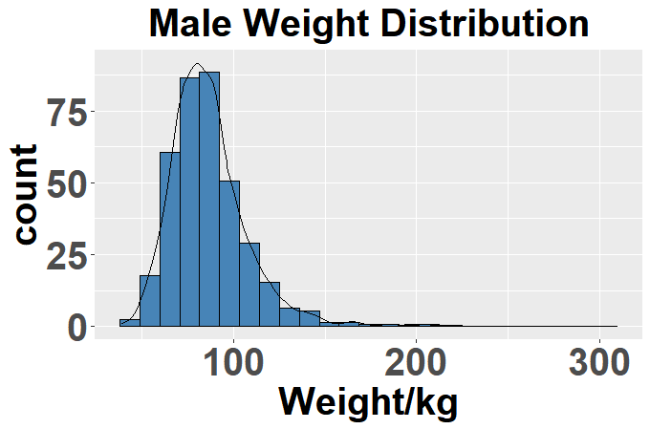
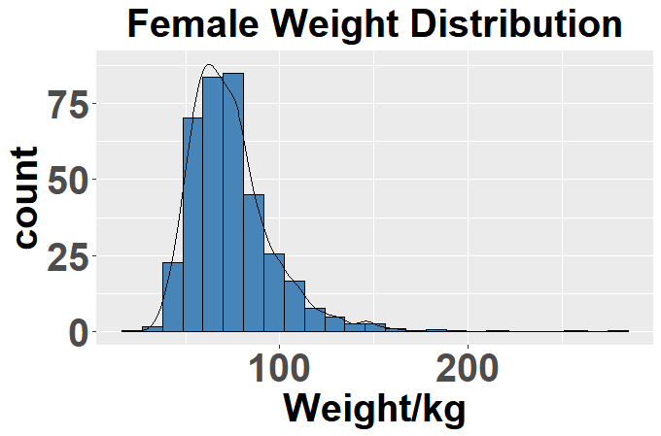




set-a 属性变量描述性统计分析
40-60
Under 40
60-80
Age
Gender
Over 80
56.14%
43.76%
Height
ICUType
Weight
14.42%
21.84%
37.02%
26.69%
Type1:Coronary Care Unit
Type2:Cardiac Surgery Recovery Unit
Type3:Medical ICU
Type4:Surgical ICU

Slide 2
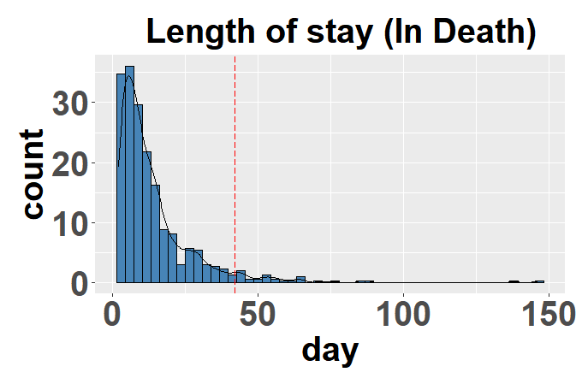
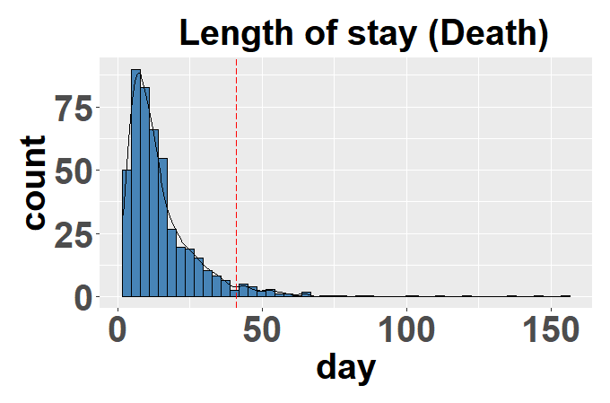

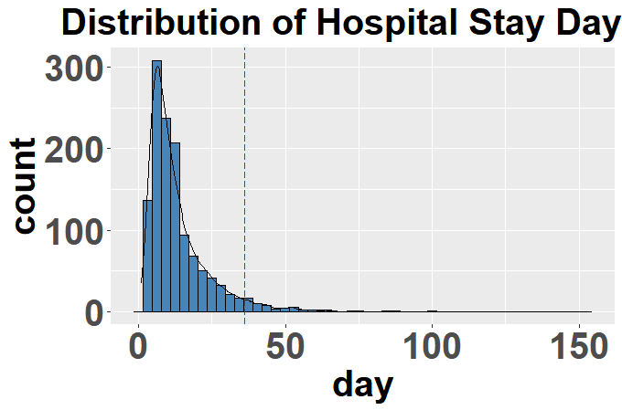
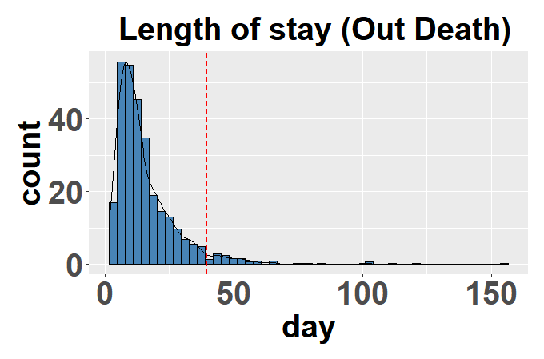

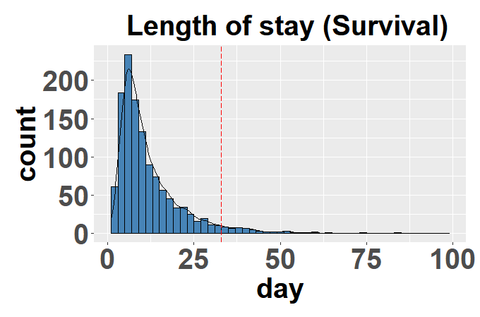
set-a 存活情况描述性统计分析
37.6%
Mean:14.4765
1473人
Mean:15.3518
62.4%
Mean:13.6617
36.8%
Mean:15.8846
Mean:12.6634
63.1%

Slide 3
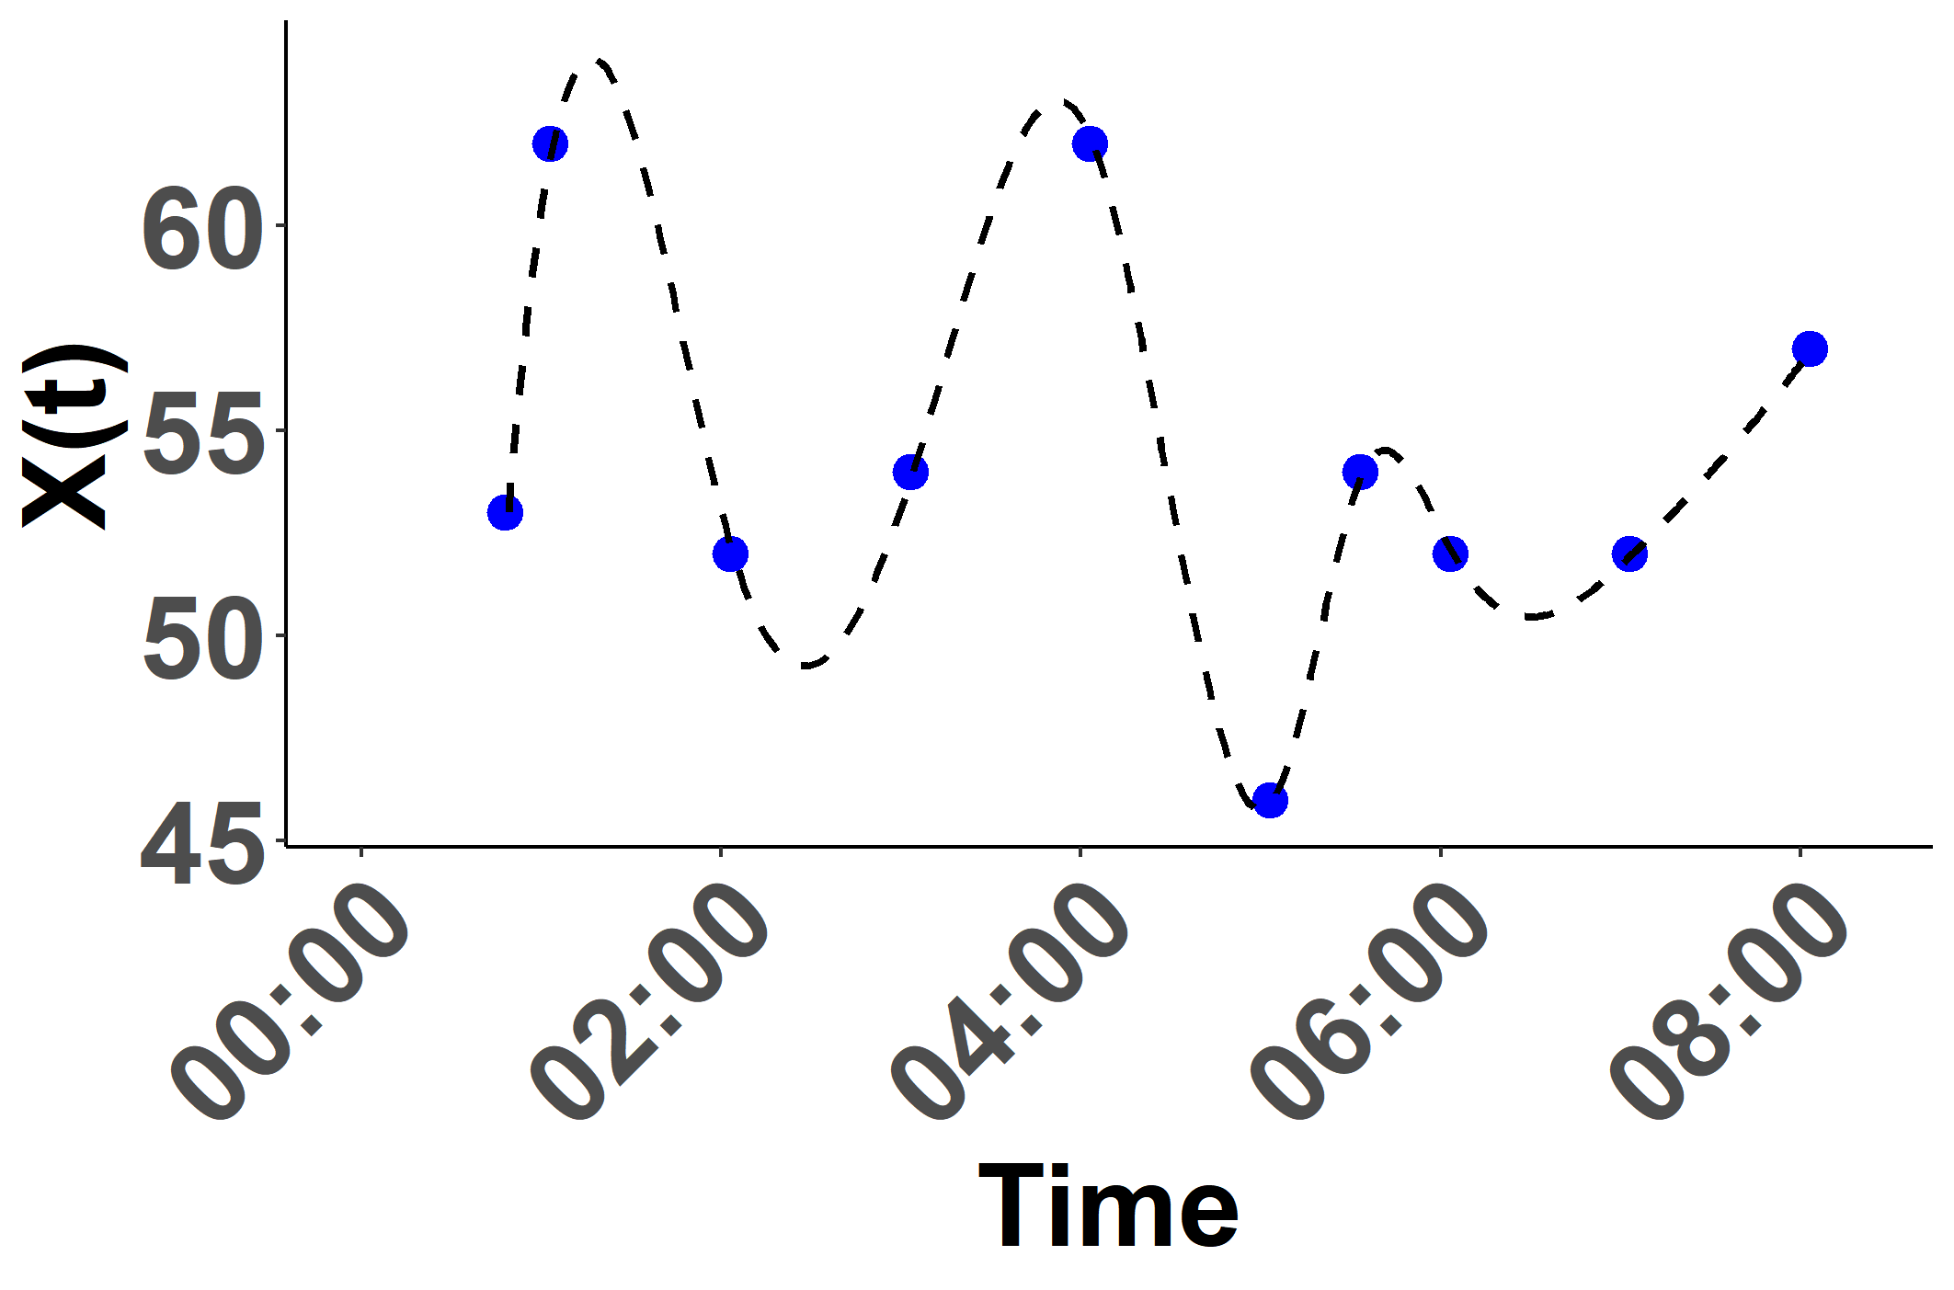
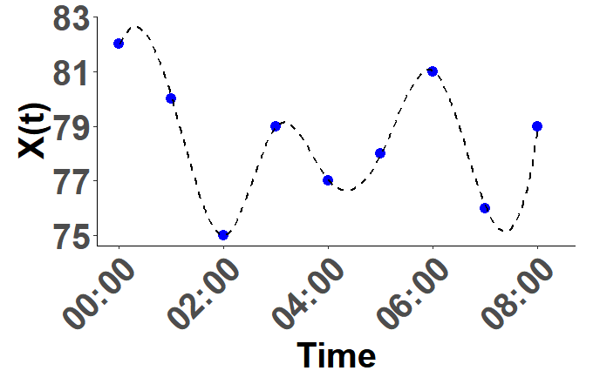
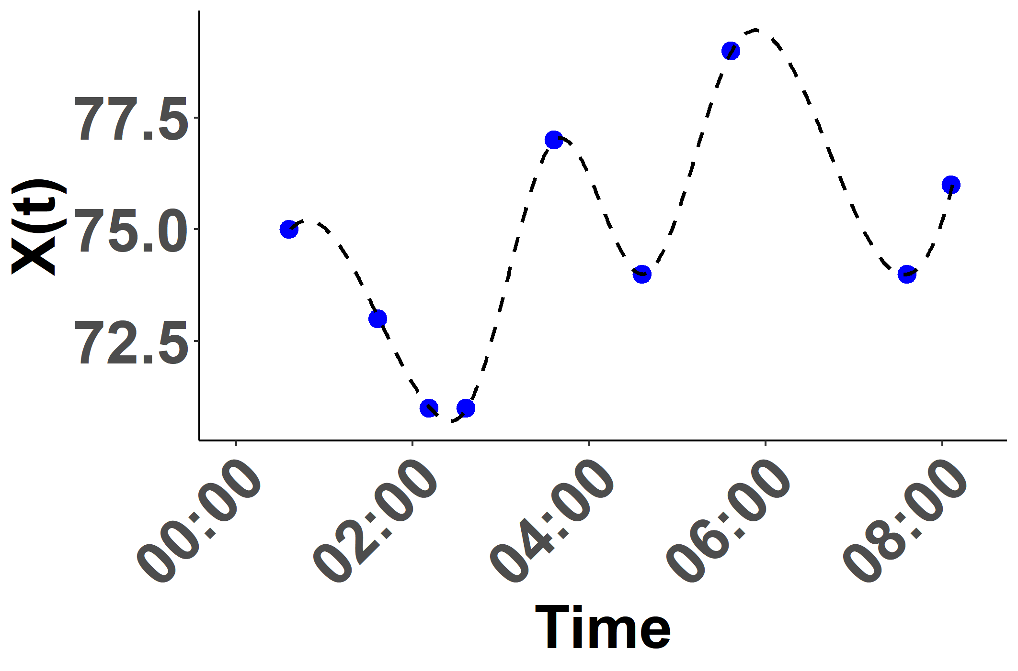
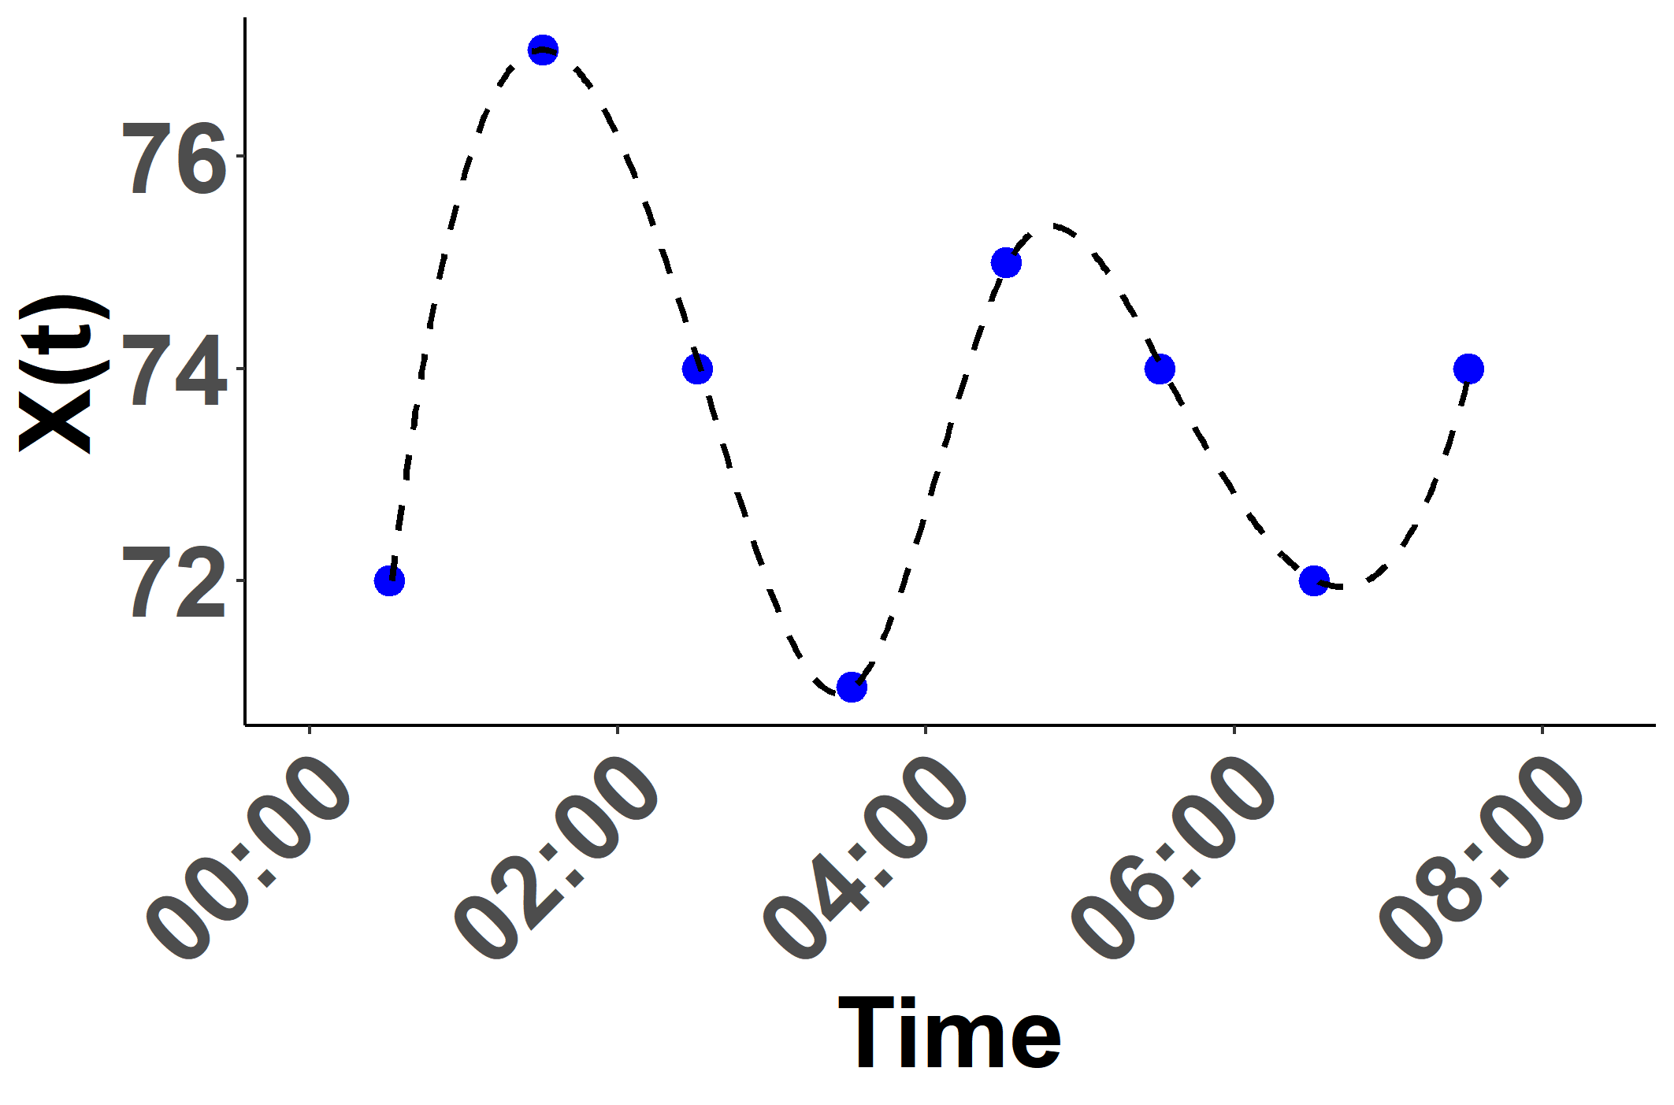
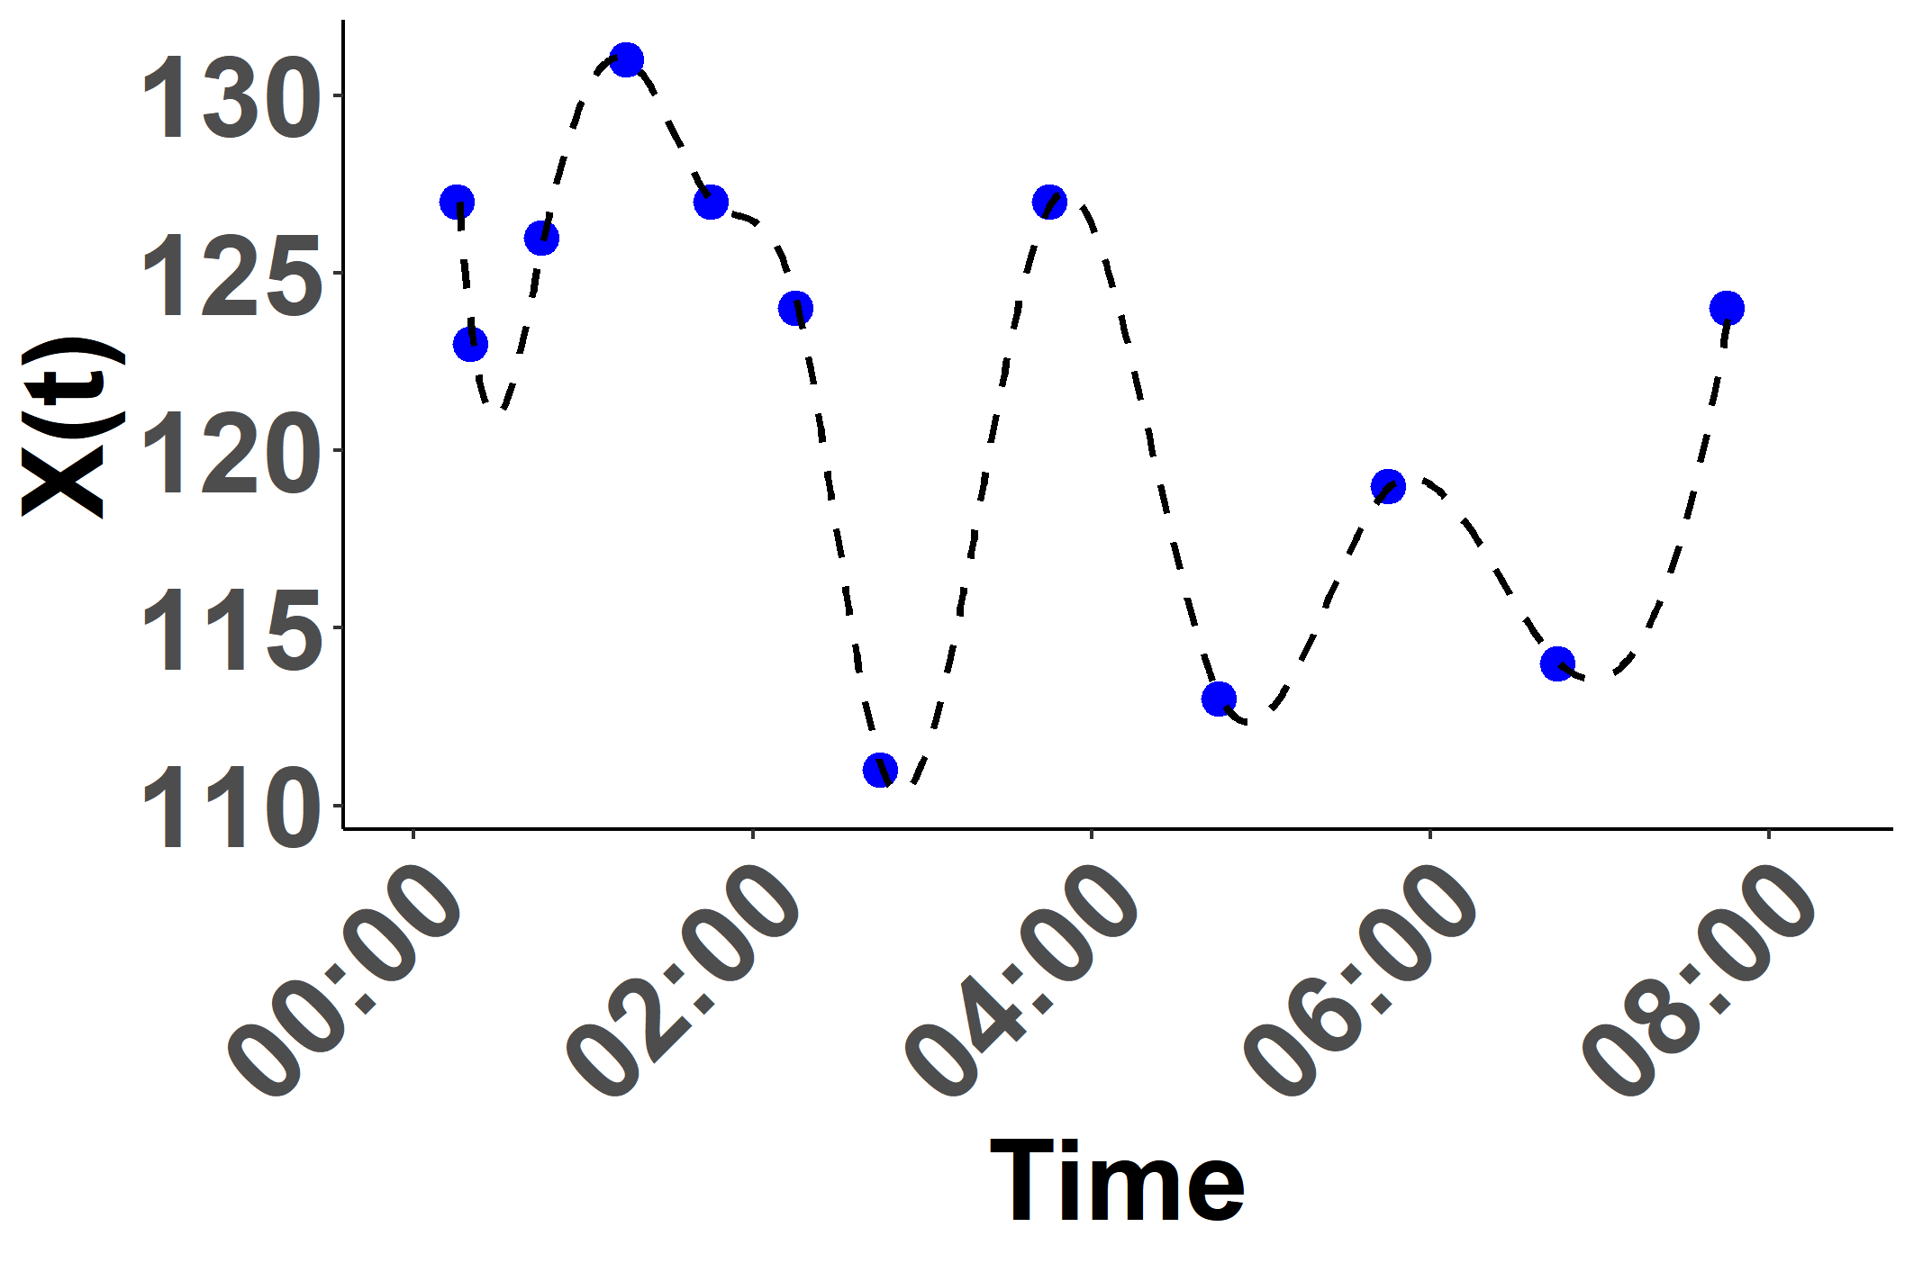
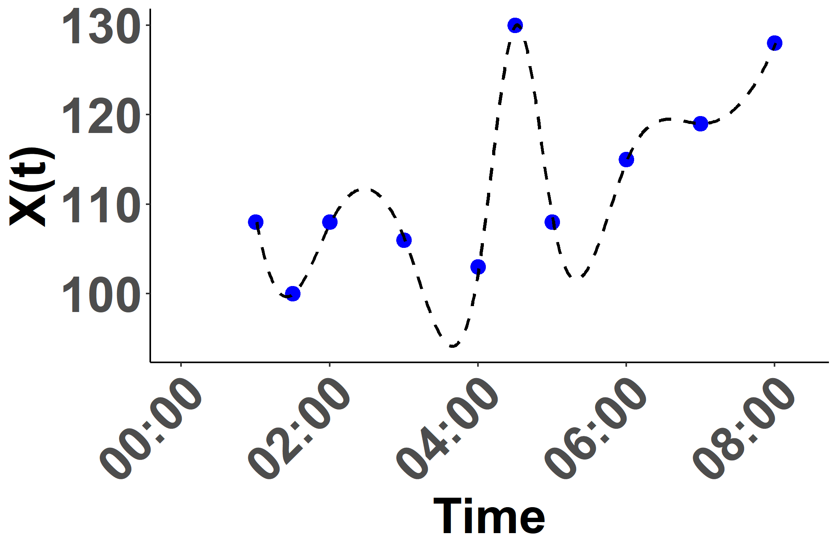

Slide 4
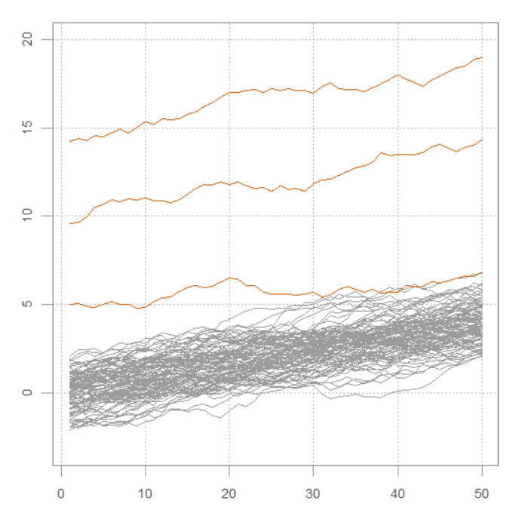
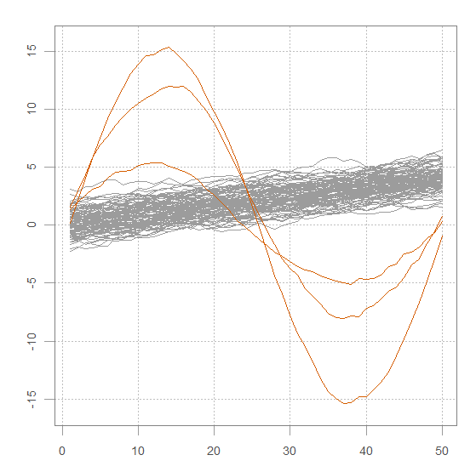
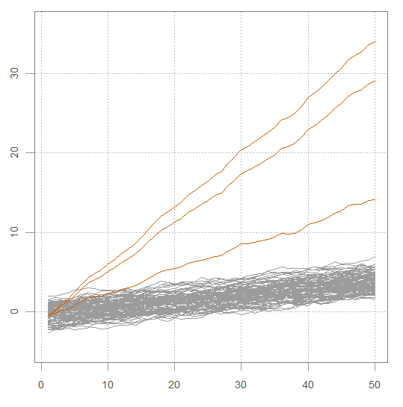
Outlier1
Outlier2
Outlier3
0.75
0.75
0.75
depth
0.50
depth
0.50
depth
0.50
0.25
0.25
0.25
0.00
0.00
0.00
MFPD
MFHD
MFDPD
MFSPD
MFPD
MFHD
MFDPD
MFSPD
MFPD
MFHD
MFDPD
MFSPD
depth methods
depth methods
depth methods

Slide 5
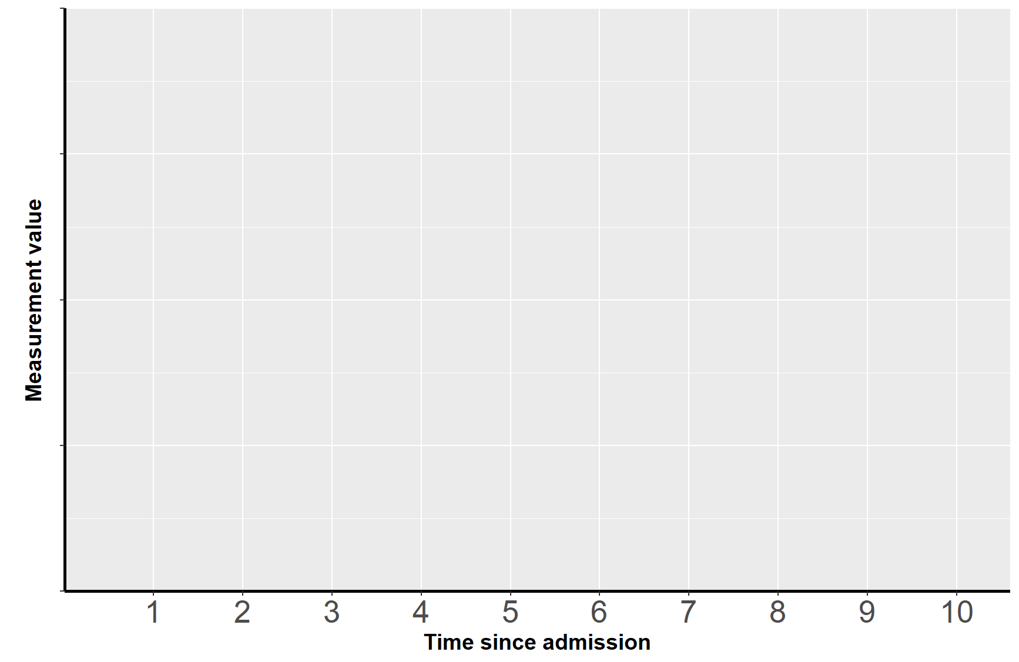
Type I
Type II
Type III
0

Slide 6
Type I
Type II
Type III
0

Slide 7



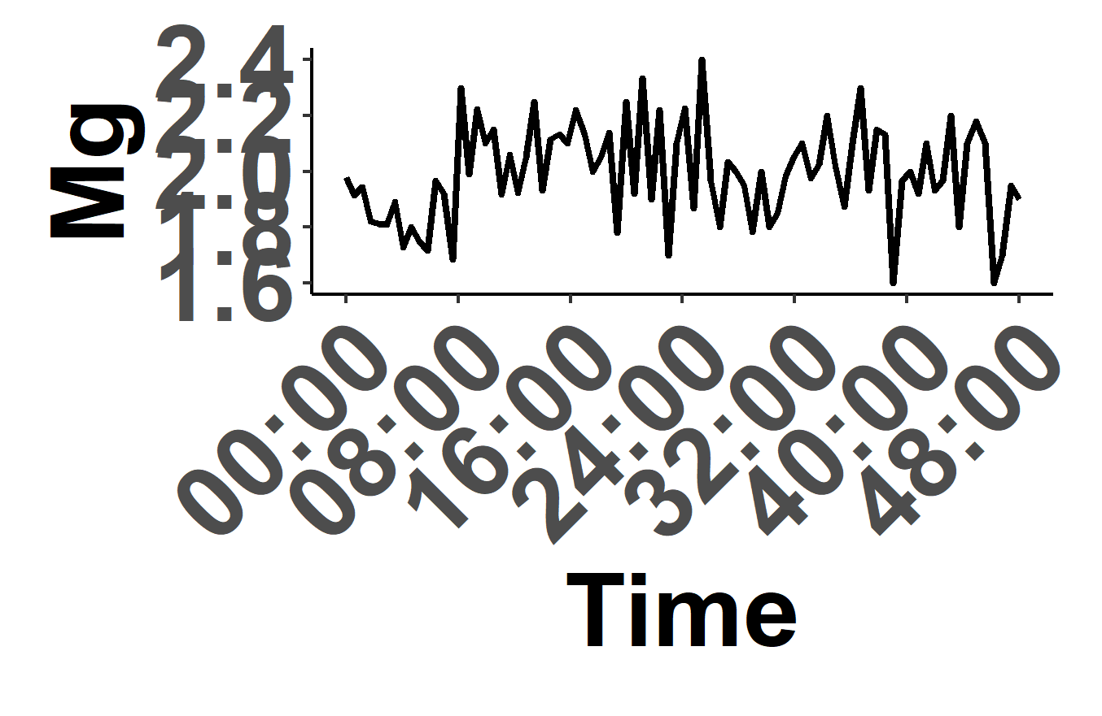
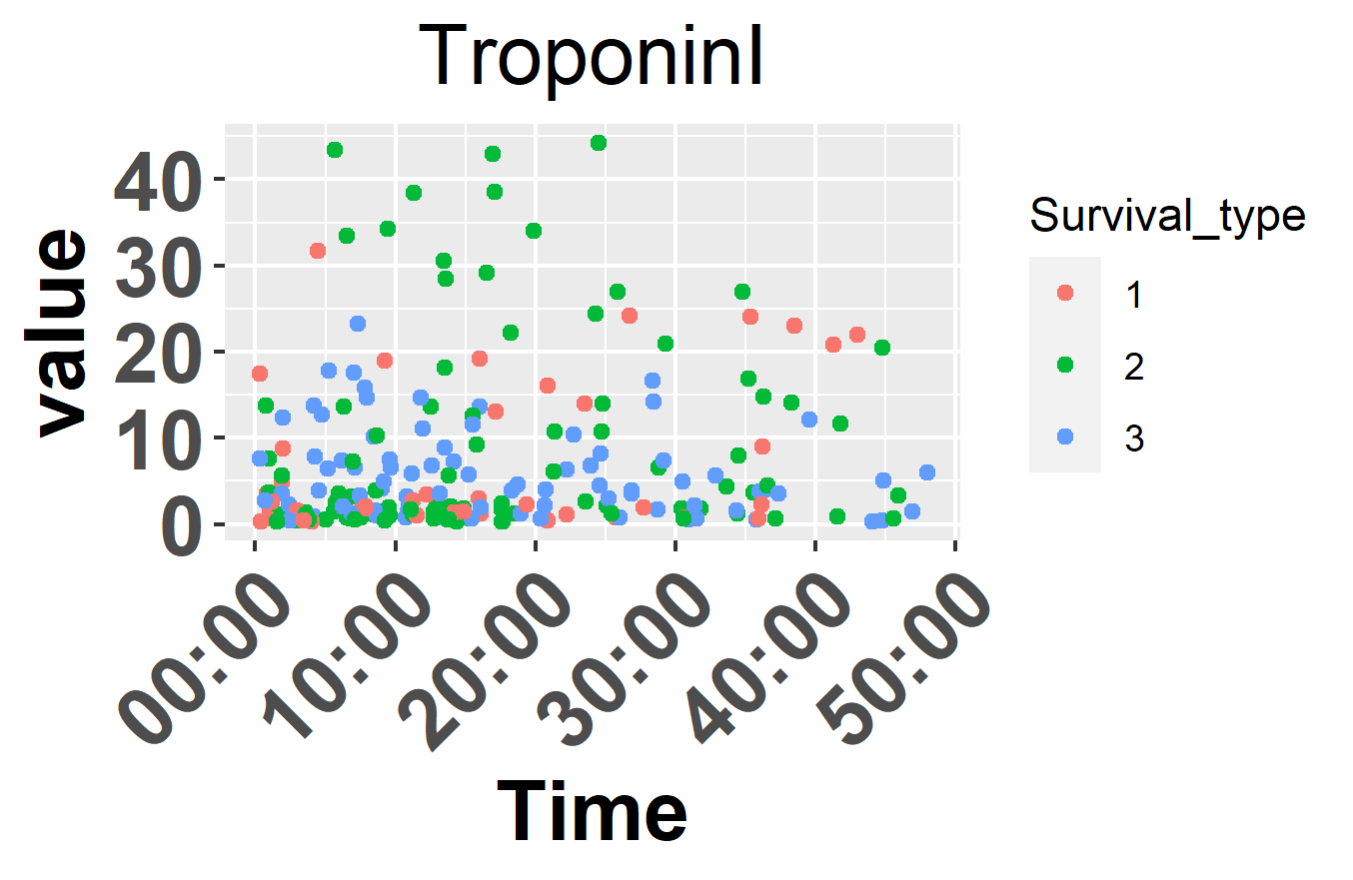


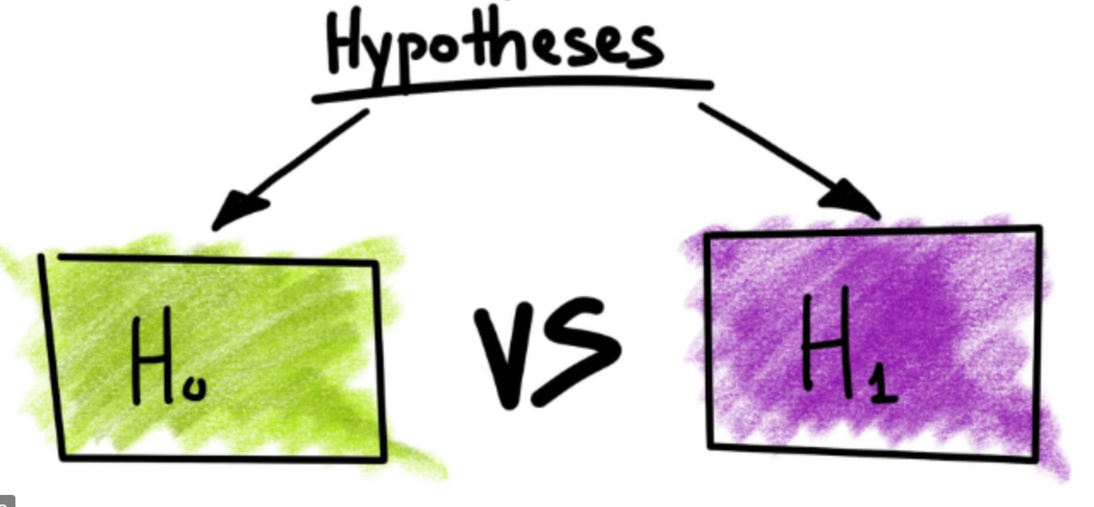


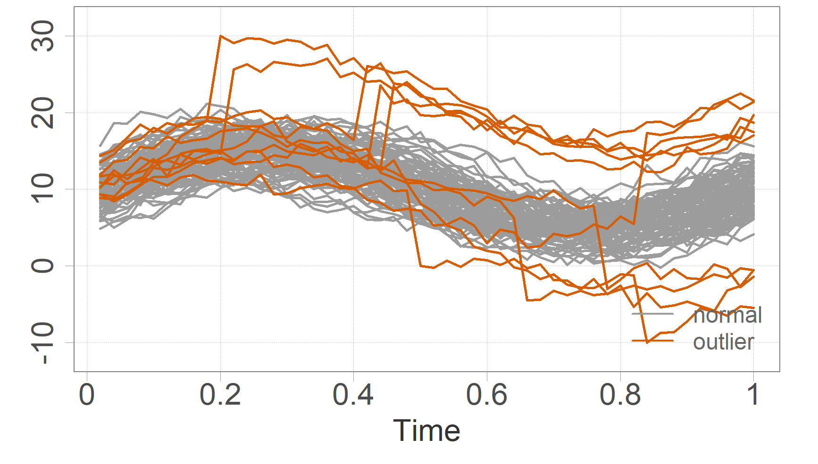

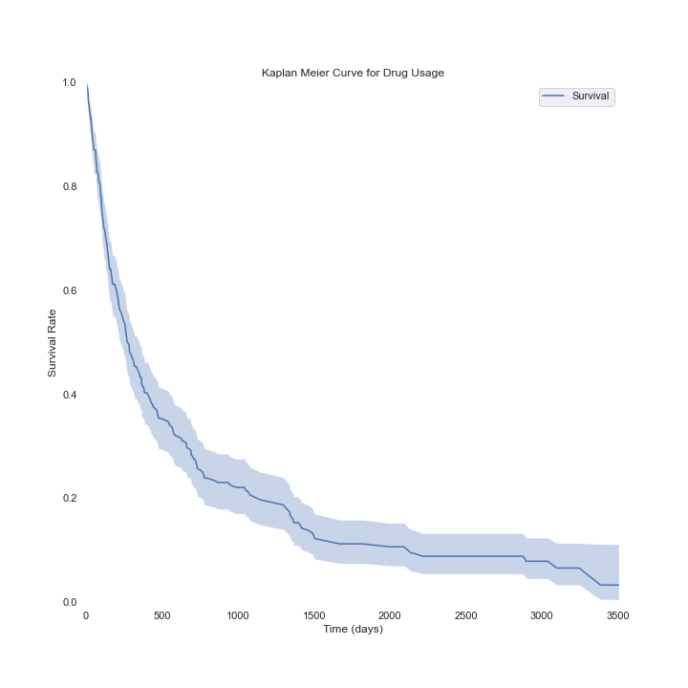
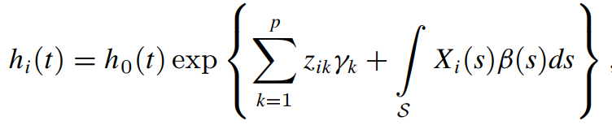
a: Data preprocessing
General descriptors
Age, Height, Gender, Weight, ICU Type
Extract
MIMIC II database
Pre-filtered data
(Age≥16, ICU Stay≥48hrs)
Time series physiologic variables
Vital signs
b: Univariate outlier detection
FPC Scores via PACE [45]
Order statistics
Test statistics
based on clean set
Test statistics
Intersection Set
One sparse, irregularly sampled variable
c: Adaptive imputation
△
△
One variable with outliers
(Using the dense case for illustration)
Expert analysis of the root causes
Outlier correction via function-on-function regression
d: Survival analysis
Survival curves
Functional Linear Cox Regression Model

Slide 8
△
△

Slide 9
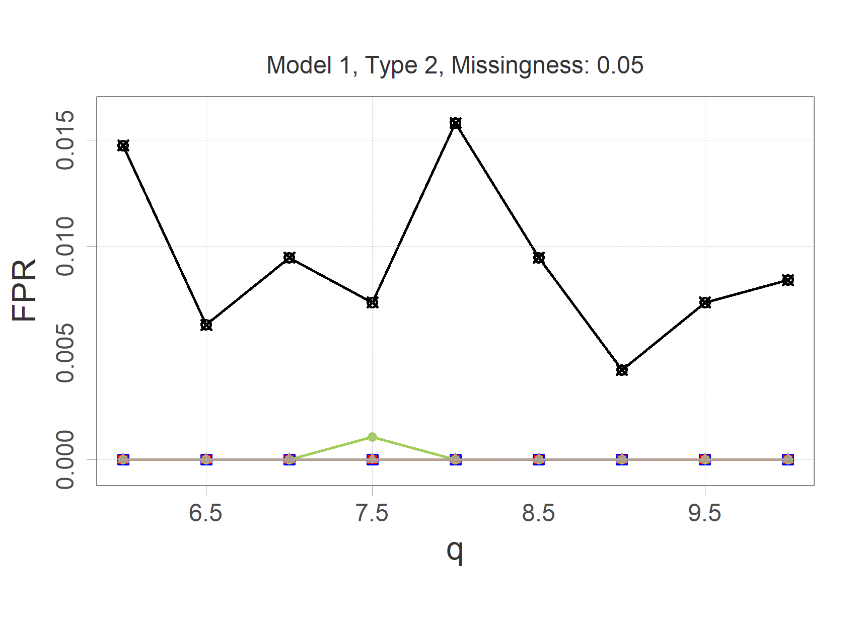
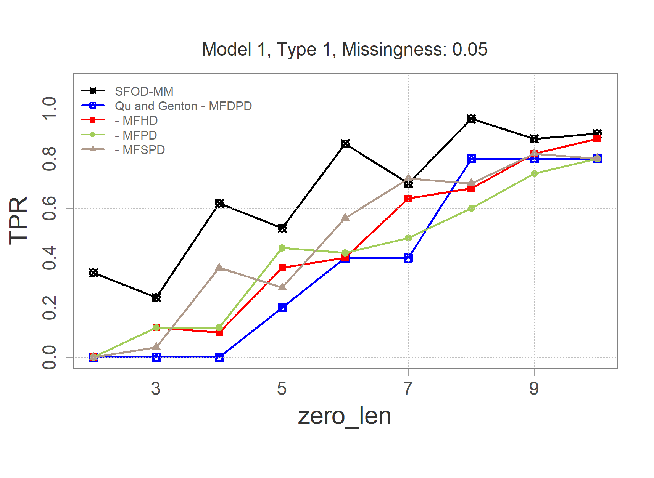
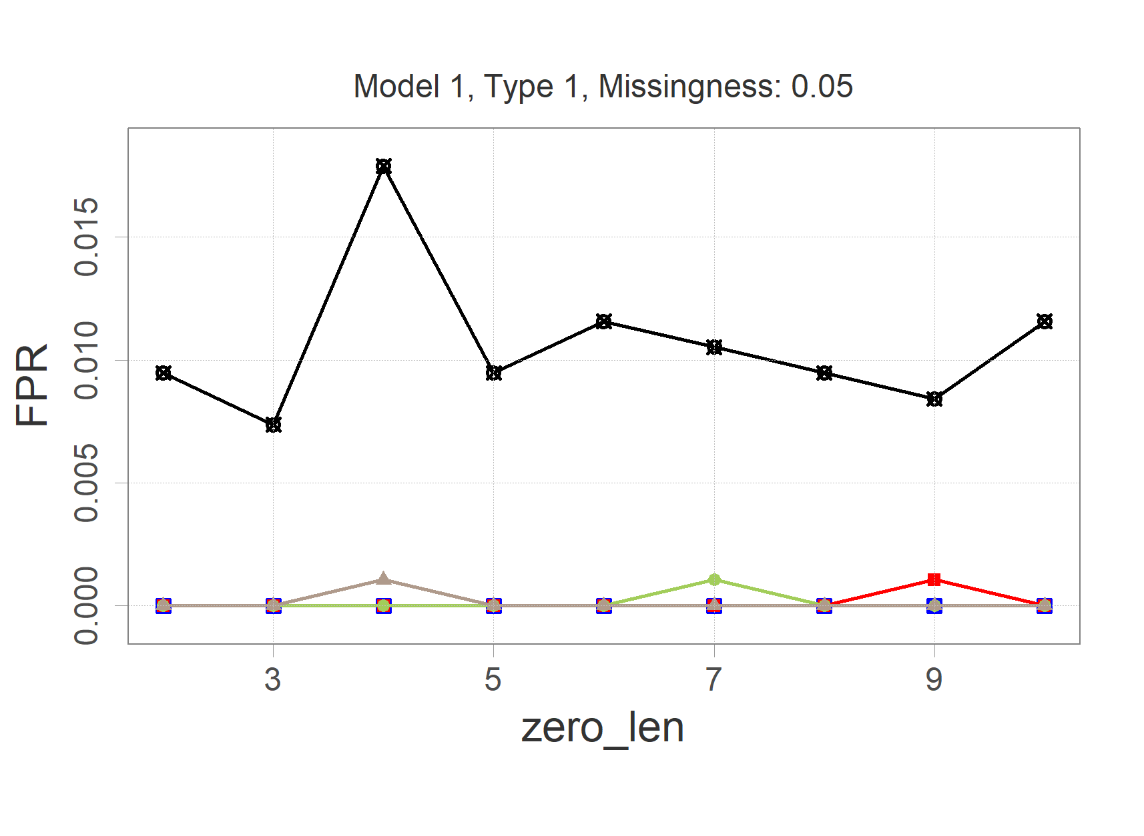
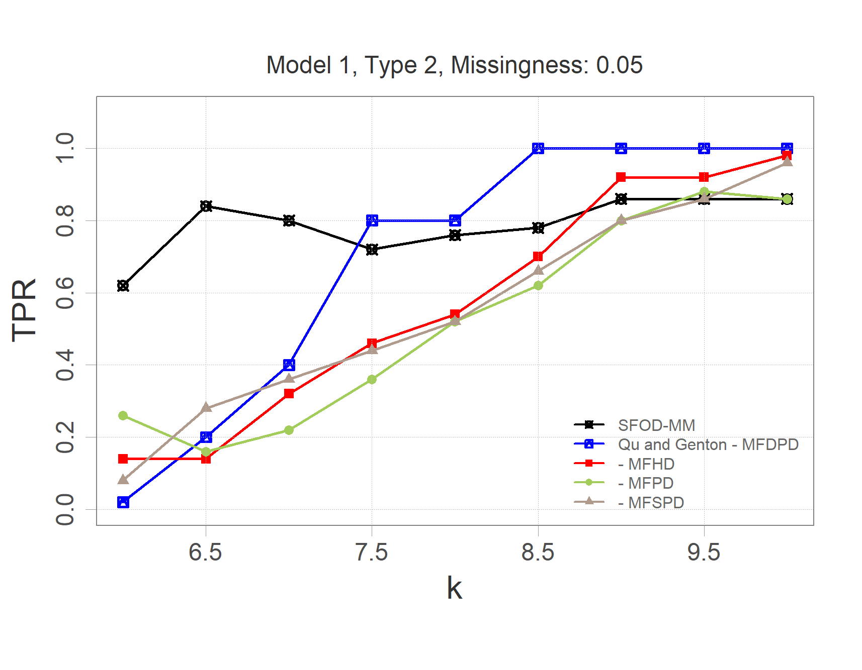
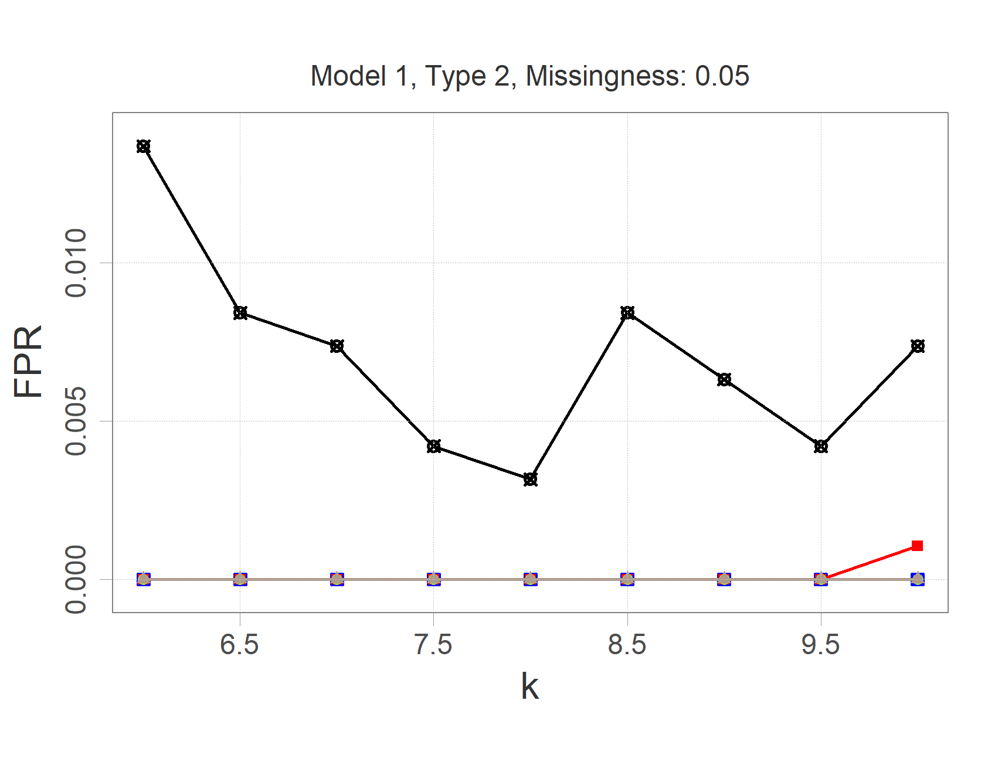
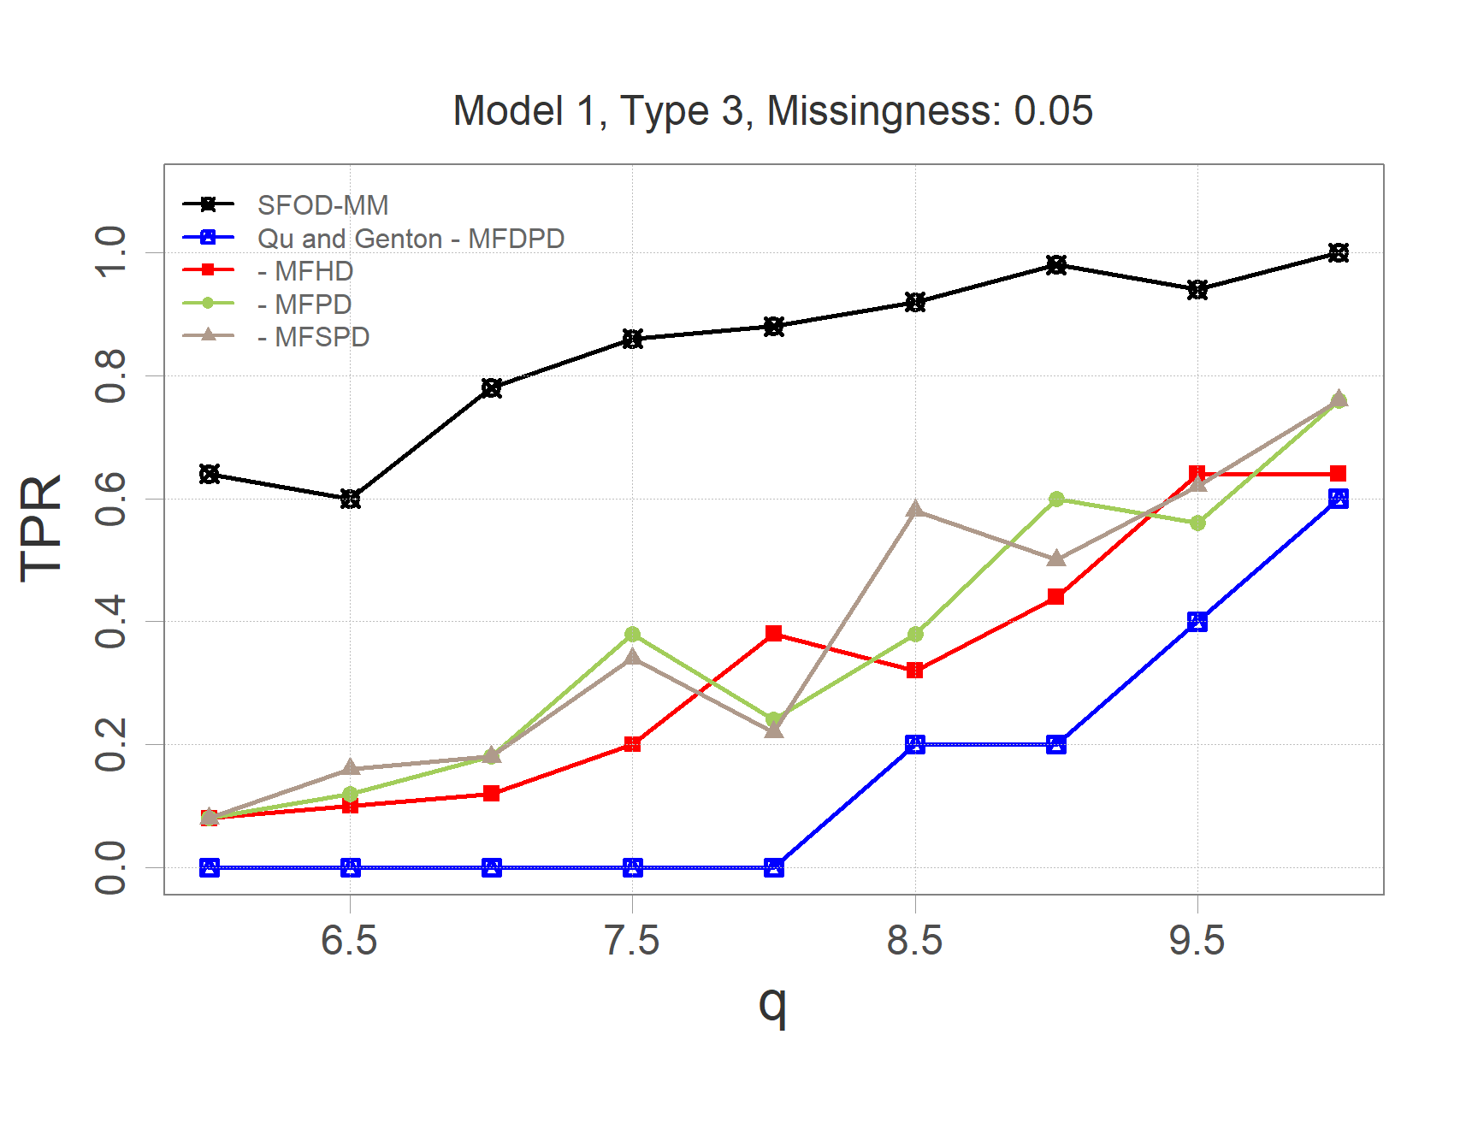
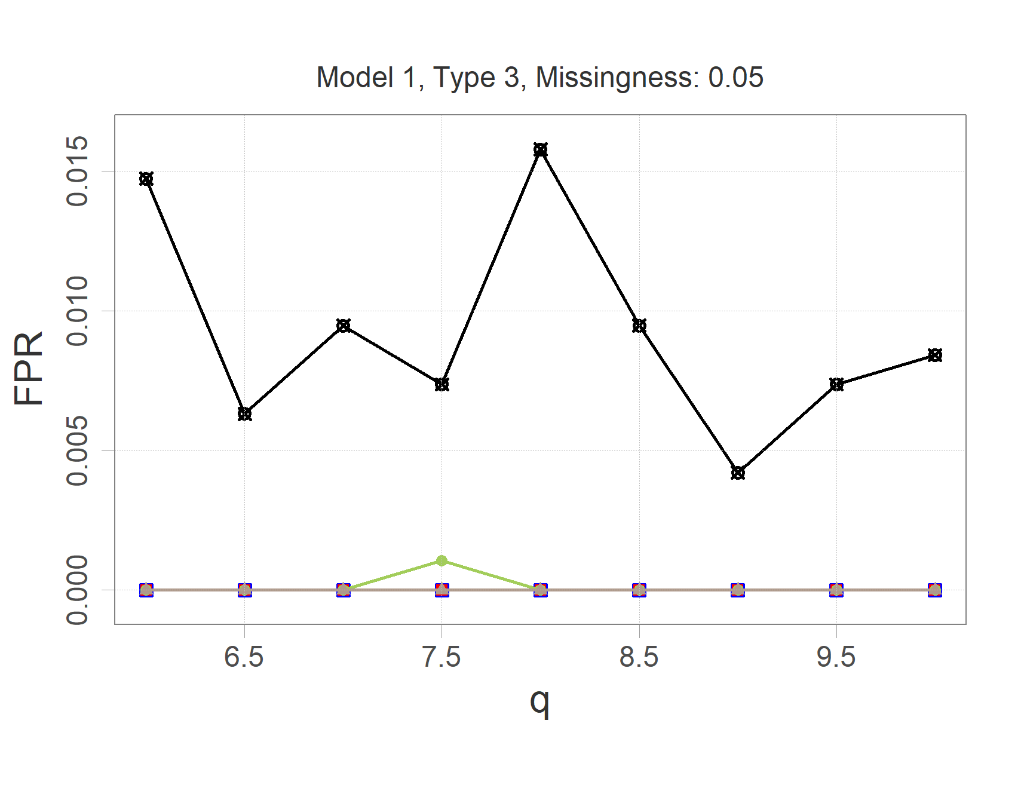
(a)
(b)
(c)
(d)
(e)
(f)

Slide 10
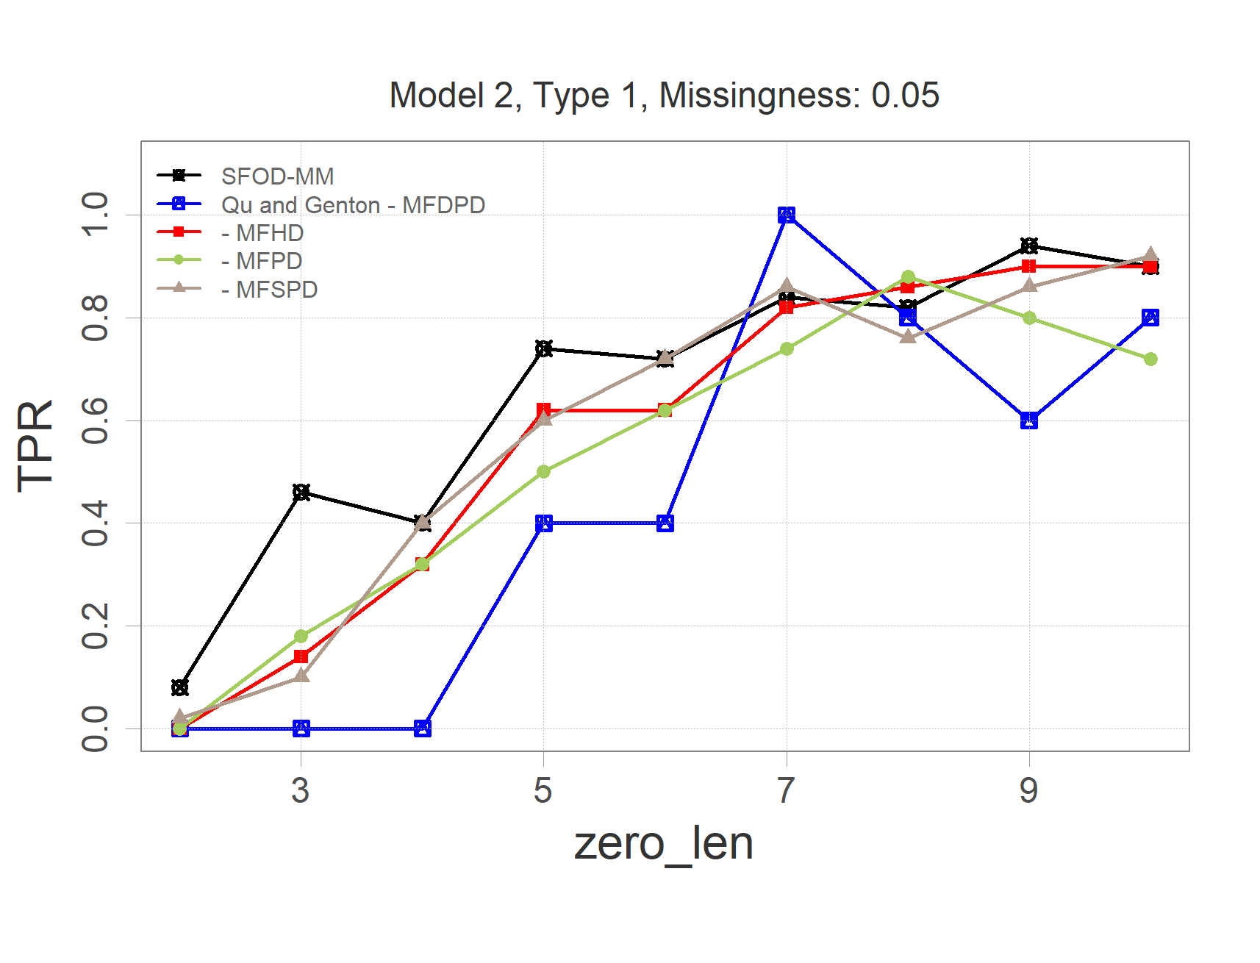
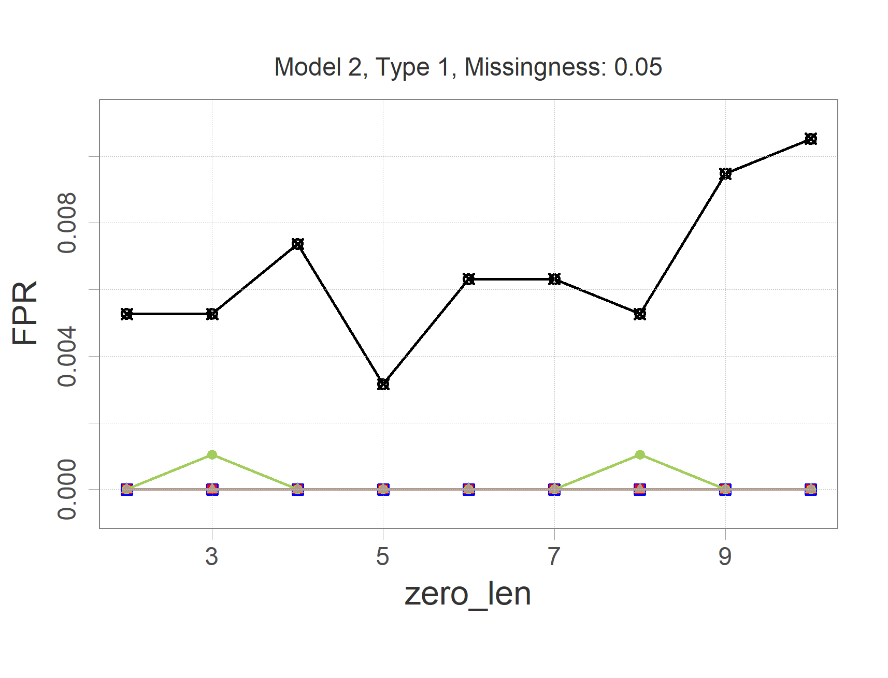
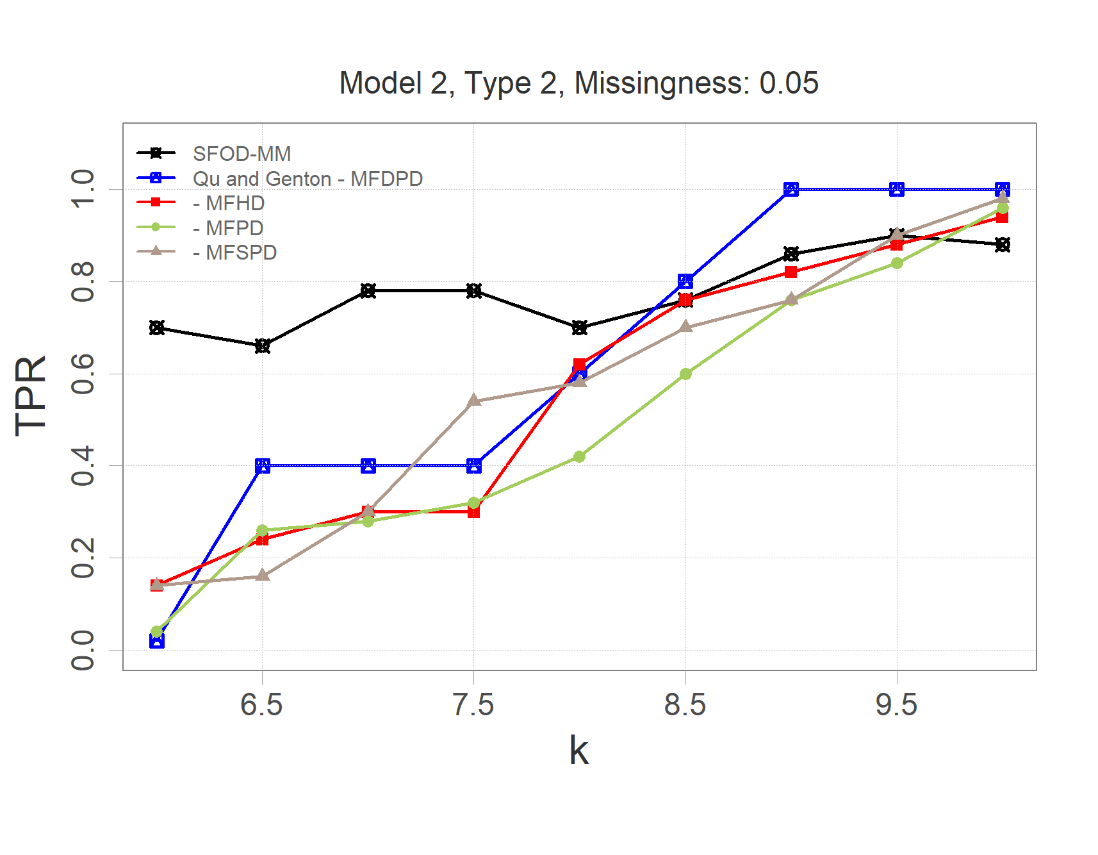
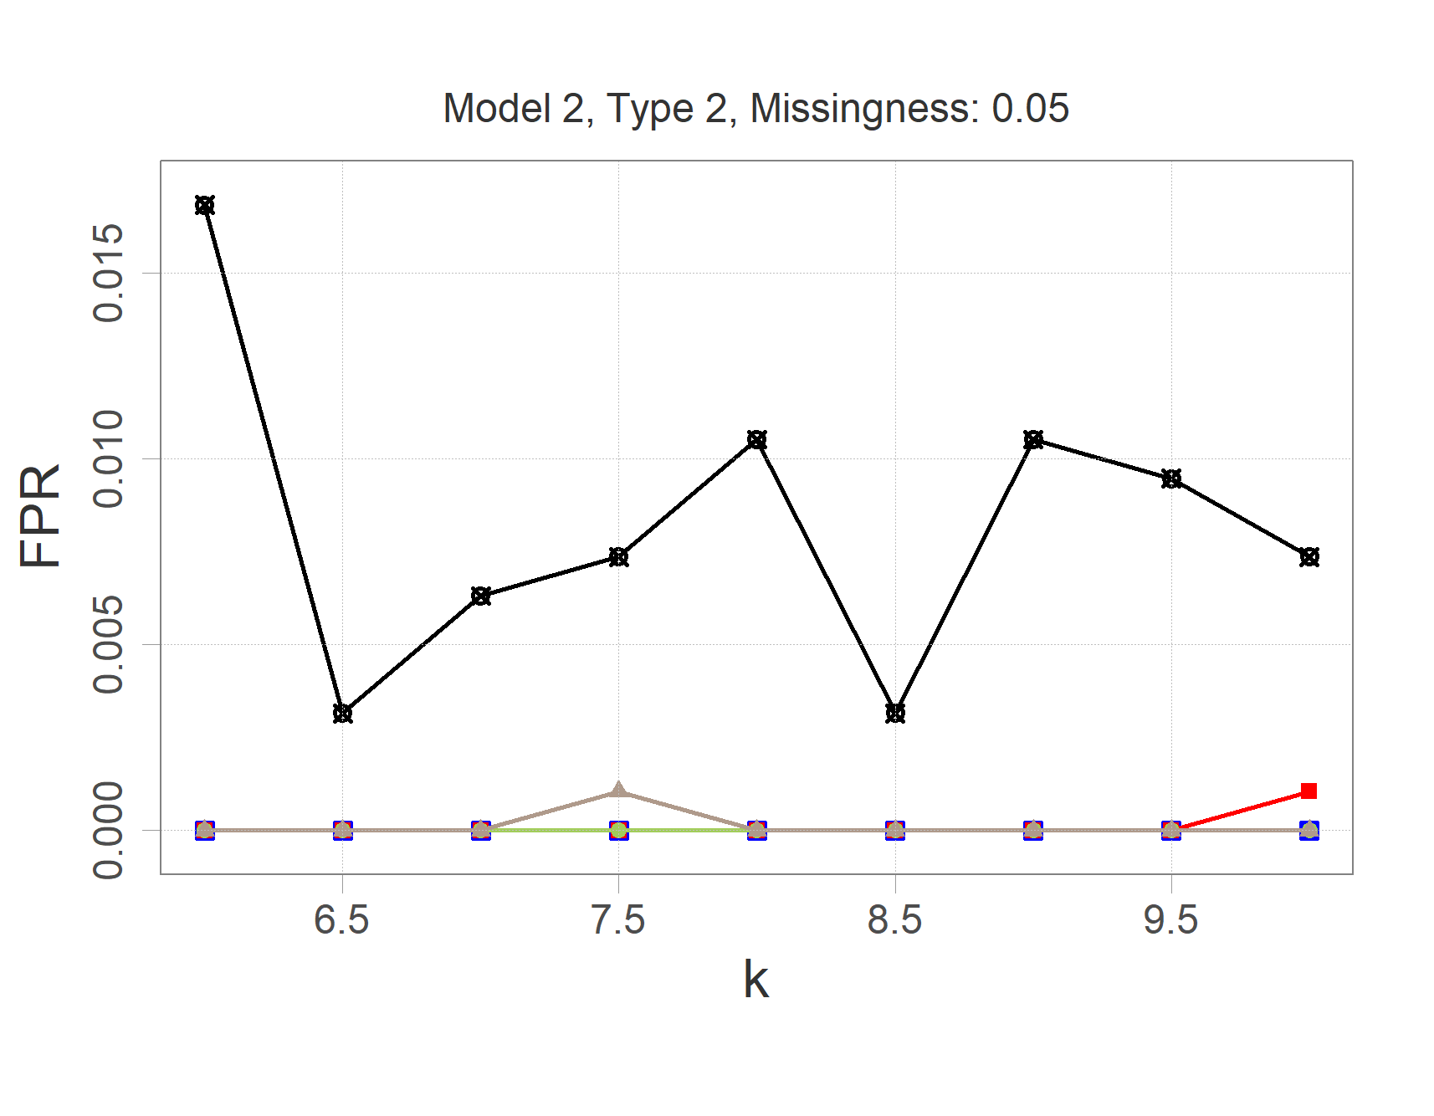
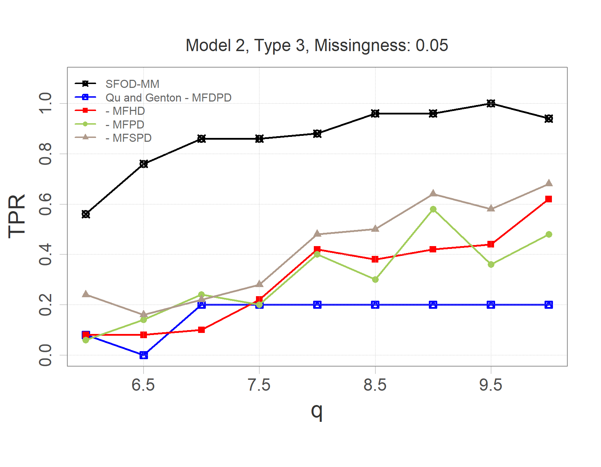
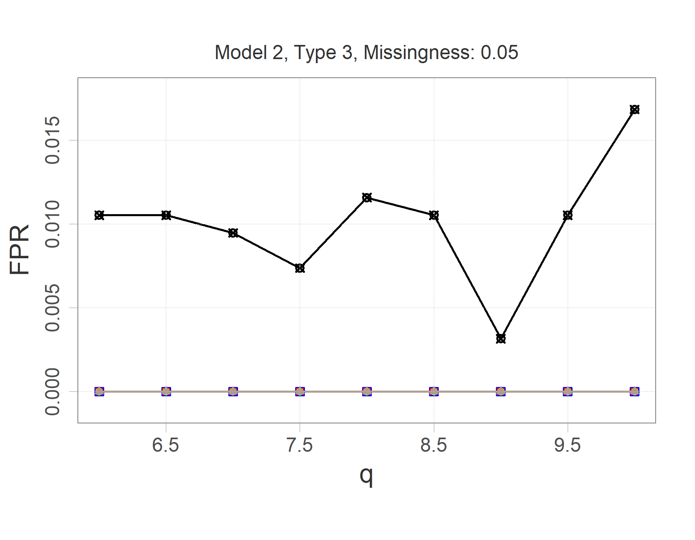
(a)
(b)
(c)
(d)
(e)
(f)

