Slide 1
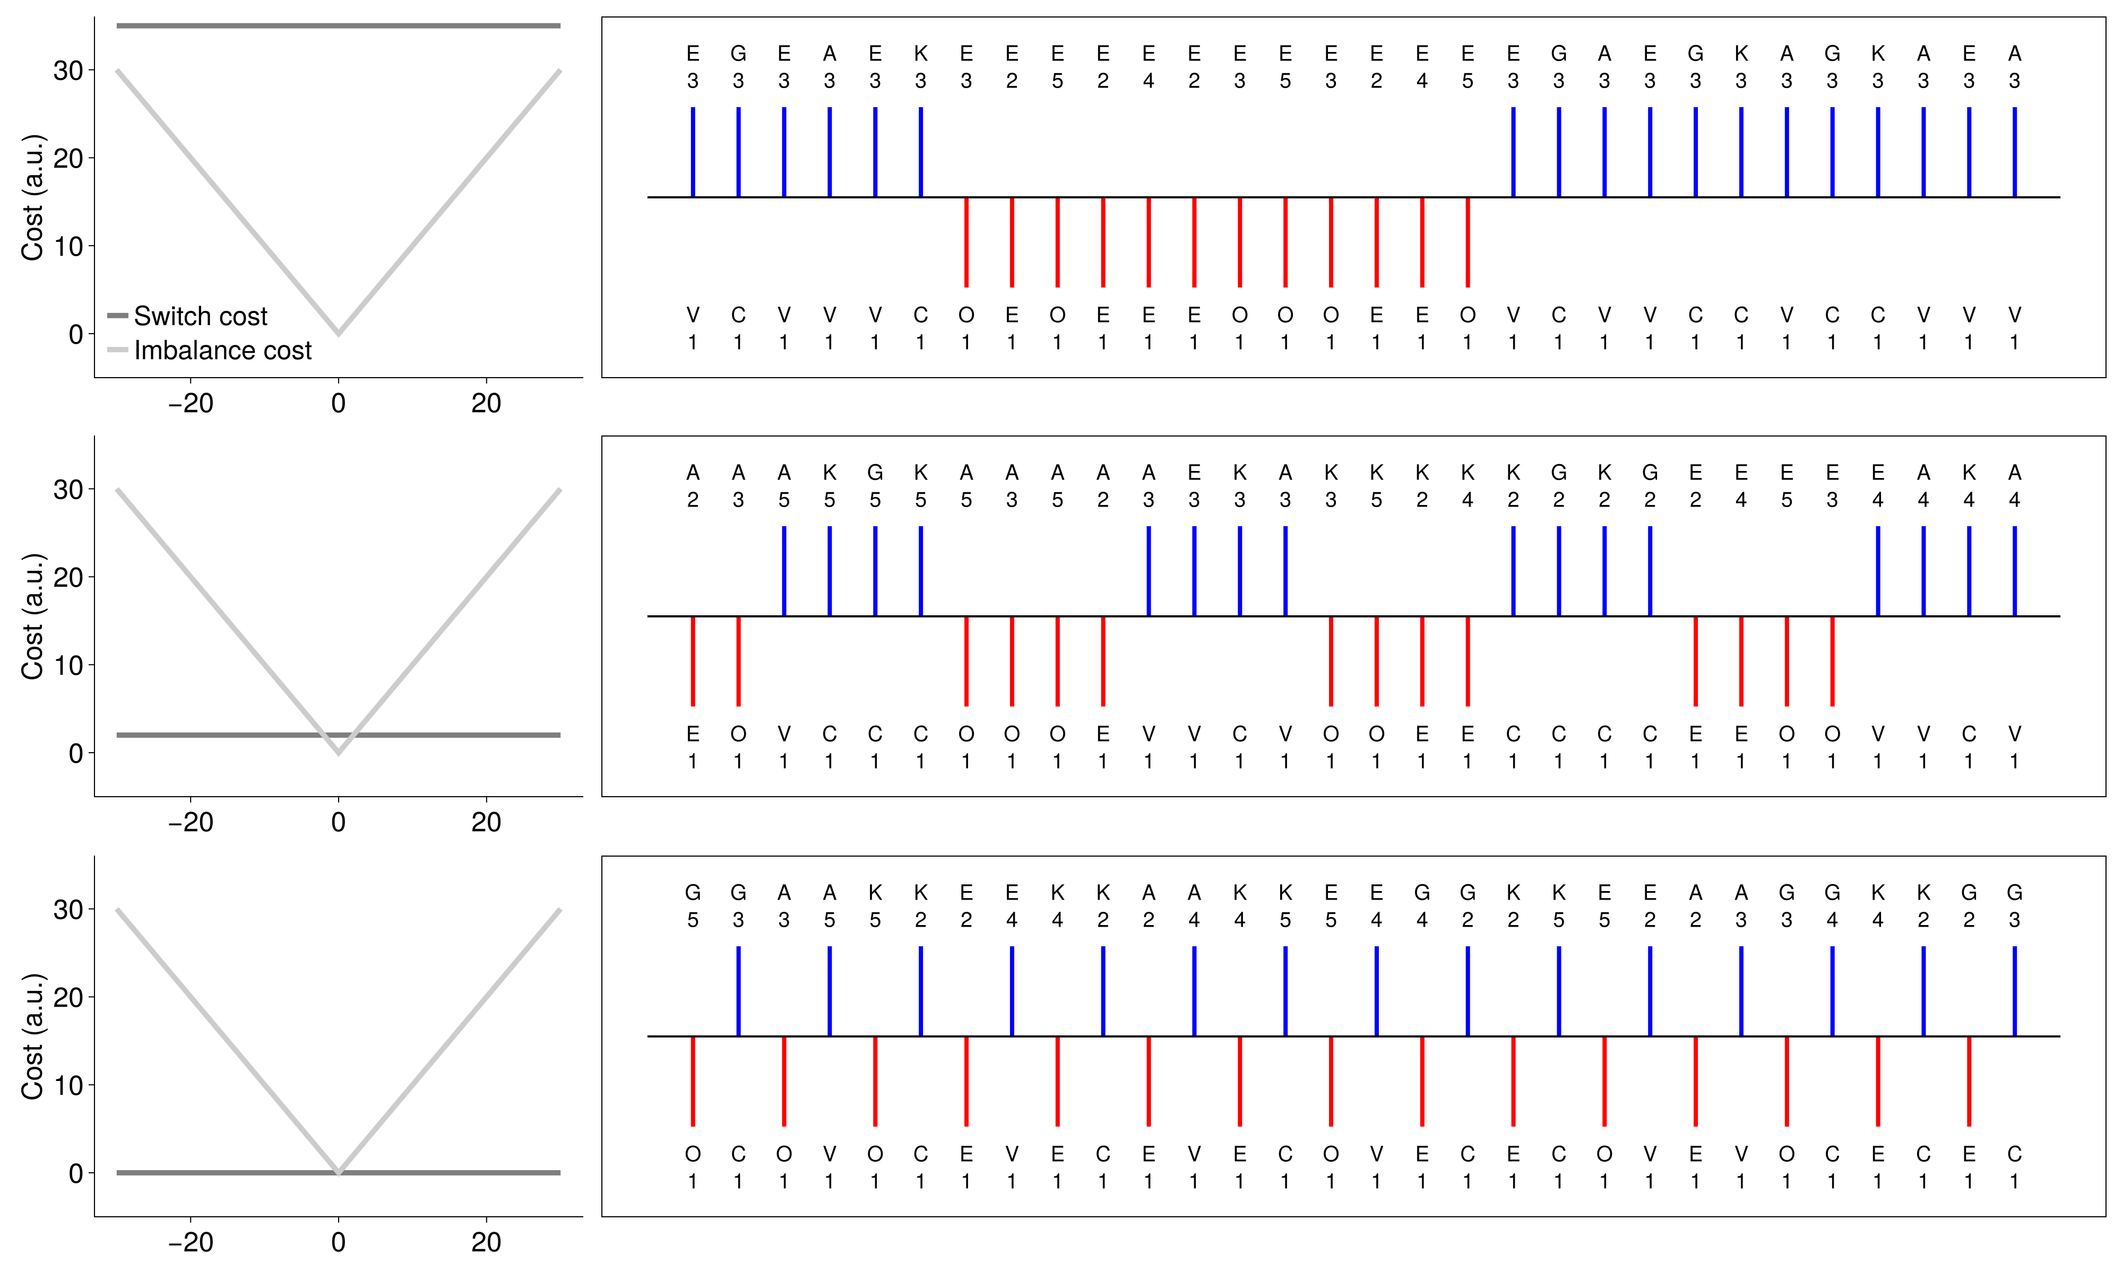

Theoretical proposal
FCDT response strategies as optimal policies under subjective cost functions
Rational analysis
Proof of principle (osf.io/6vspq) | Parameterized switch and task imbalance cost
Freiburg
Markov Decision Processes
$$\left(S,A,p\left(s_{1}\right), p\left(s_{t+1} | s_{t},a_{t}\right), r\left(s_{t},a_{t}\right)\right)$$
Subjective cost functions
Expected reward maximization
Bellman equation solution
Optimal response sequences
Notes:
For this, we adopt a rational analysis approach, where we start from the hypothesis that task switching emerges as optimal behavior under subjective cost functions.
Specifically, we use Markov Decision Processes as in the Freiburg project to describe the probabilistic task dynamics of the FCDT paradigm.
The essentials steps are then
To define parameterized subjective cost functions for the cognitive processes of task switching
Assuming that agents maximize their expected cumulative reward
Use the Bellman equation mechanics to evaluate optimal response sequences.
Comparing these optimal response sequences to observed behavior in turn allows inferring the subjective cost functions that people may rely on.
A proof-of-principle for this approach is presented in the proposal.
In this example, we used basic parameterized task switch and task imbalance cost functions.
Depending on the parameters of these functions, we can generate the empirically observed FCDT response strategies. Here
High task switch cost and low task imbalance cost result in blocking behavior.
Low task switch cost and high task imbalance cost result in response grouping behavior.

Slide 2
First-stage implementation
Application to Brüning, Manzey (2020) data subset (osf.io/x6n58)
Full theoretical and implementational details on GitHub, including an extensive report (.pdf)
Proof of principle shortcomings
  Generative simulations of restricted FCDT paradigm, no application to empirical data
  Reward-discounted infinite-horizon MDP approximation based on policy iteration
First-stage implementation advances
  Application to rich empirical data in the agentic behavioral modeling framework (Ostwald et al. (2026))
  Finite horizon MDP without reward discounting solved by backward induction
First-stage implementation shortcomings
  Focus on response data, not reaction times in a semi-MDP extension
  No consideration of dual-task efficiency or domain-specific cognitive processing
$⇒$ Technical advance ✓ Psychological-neurocognitive advance ✗

Slide 3
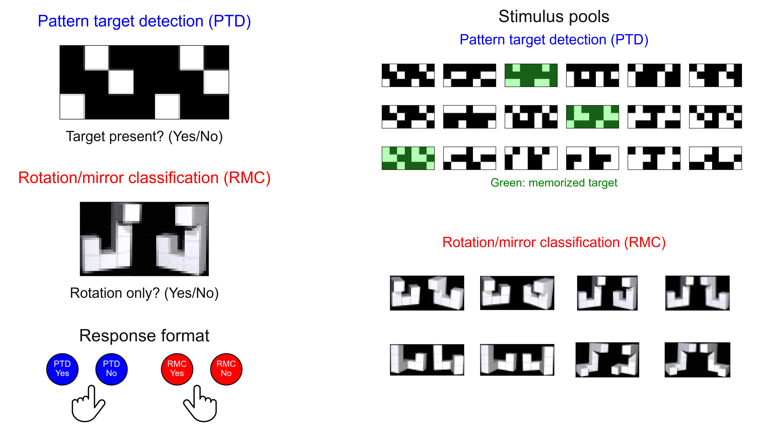
Experimental data
Instructions | Balanced task performance with high accuracy within a given time limit

Slide 4
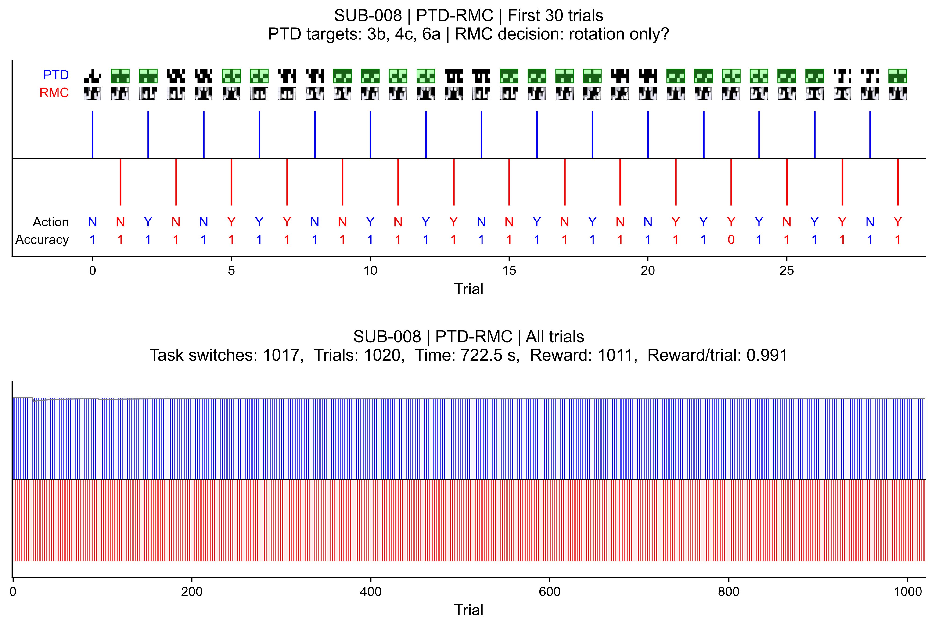
Experimental data

Slide 5
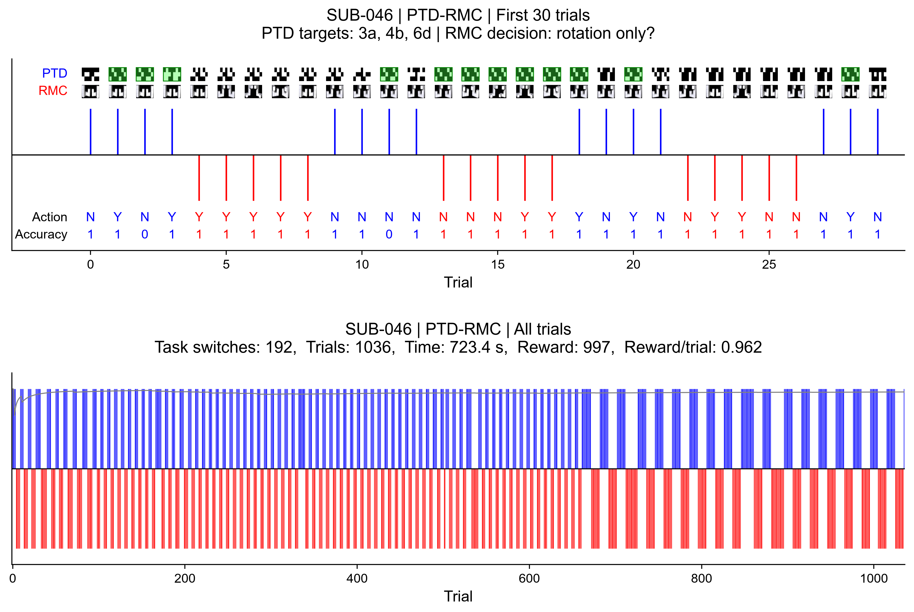
Experimental data

Slide 6
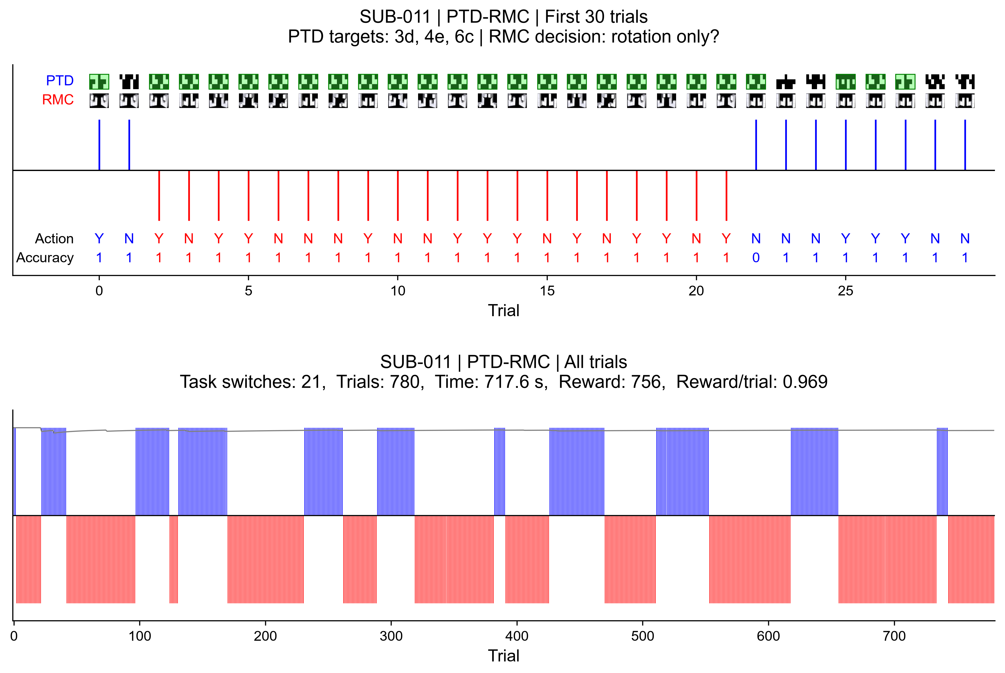
Experimental data

Slide 7











Agentic behavioral model
Data model $𝒟≔\left(𝒯,𝒜, p_{β,σ,τ}\left(a_{t} | s_{t}\right)\right)$
$$t=0,…,n$$
Task model
Agent model
$$𝒯≔\left(J,S,A,{R_{𝒯}}_{ }, p\left(s_{0}\right), p\left(s_{t+1} | s_{t},a_{t}\right),ϱ\right)$$
$$𝒜≔\left(J,ℳ_{χ},D,p_{β,σ}\left(d_{t} | s_{t}\right),ρ\right)$$
$$s_{t}≔(Stimuli,Label,Switch,Imbalance)$$
Reduced state $s_{t}^{χ}≔(Switch,Imbalance)$
Subjective reward function $ρ_{β,σ}\left(s_{t}^{χ},a_{t}^{χ}\right)$
State transition $p(s_{t+1}|s_{t},a_{t})$
Dynamic programming backward induction
Optimal action value functions $q_{χ,t}^{∗}$ and decisions $d_{χ,t}^{∗}$
Action lifting
Post-decision noise
Task reward$ρ(s_{t},a_{t})$
Action $a_{t}∼p_{β, σ,τ}(PTD/RMC, Yes/No|s_{t})$

Slide 8
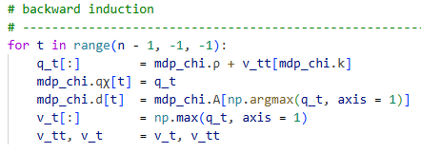


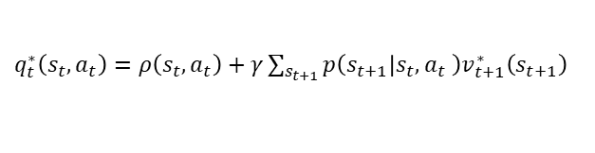


Dynamic programming backward induction
Subjective non-reduced reward function
$$ρ_{β,σ}:S×A→ℝ, \left(s,a\right)↦ρ_{β,σ}\left(s,a\right)≔ρ\left(s,a\right)+ρ_{β}\left(s,a\right)+ρ_{σ}(s,a)$$
Accuray reward $ρ\left(s,a\right) \text{Imbalance cost }ρ_{β}\left(s,a\right)≔−β ⋅|s^{4}+Δ(a)|$
$$\text{Switch cost} ρ_{σ}\left(s,a\right)≔−σ⋅⟦\left(s^{3}=1∧a∈A^{2}\right)∨\left(s^{3}=2∧A^{1}\right) ⟧$$
Backward induction $(γ≔1, v_{n}^{∗}≔0)$
For $t=n−1,…,0$
$q_{t}^{∗}\left(s_{t},a_{t}\right)=ρ\left(s_{t},a_{t}\right)+γ\sum_{s_{t+1}}{p\left(s_{t+1} | s_{t},a_{t} \right)v_{t+1}^{∗}\left(s_{t+1}\right) }$
$v_{t}^{∗}\left(s_{t}\right)=\max_{a_{t}∈A}{q_{t}^{∗}\left(s_{t},a_{t}\right)}$
$d_{t}^{∗}\left(s_{t}\right)=\underset{a_{t}∈A}{argmax}{q_{t}^{∗}\left(s_{t},a_{t}\right)}$

Slide 9
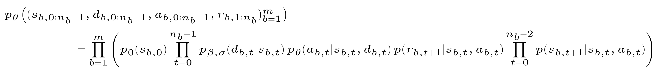
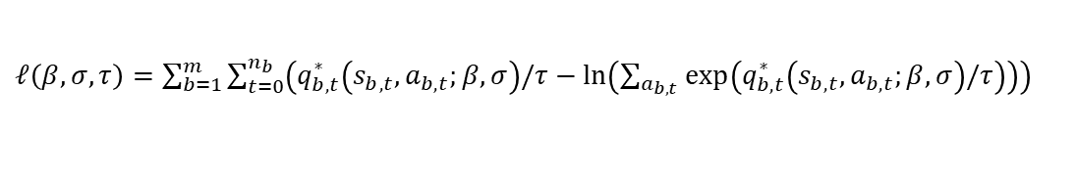
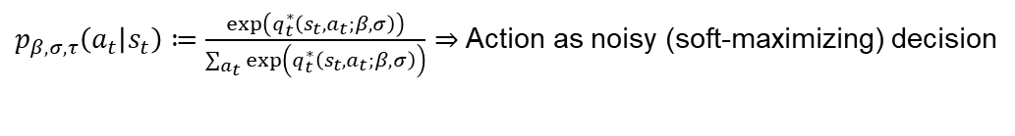
Sequential conditional log likelihood maximization
Data model
$p_{β,σ,τ}\left(a_{t} | s_{t}\right)≔\frac{exp\left(q_{t}^{∗}\left(s_{t},a_{t};β,σ\right)\right)}{\sum_{a_{t}}{exp\left(q_{t}^{∗}\left(s_{t},a_{t};β,σ\right)\right)}}⇒$ Action as noisy (soft-maximizing) decision
Agentic behavioral model ($b=block, t=trial, n_{b}=number of trials in b$ )
Sequential conditional log likelihood
$ℓ\left(β,σ,τ\right)=\sum_{b=1}^{m}{\sum_{t=0}^{n_{b}}{\left(q_{b,t}^{∗}\left(s_{b,t},a_{b,t};β,σ\right)/τ−\ln\left(\sum_{a_{b,t }}{\exp\left(q_{b,t}^{∗}\left(s_{b,t},a_{b,t};β,σ\right)/τ\right)}\right)\right) }}$
Adaptive Nelder-Mead optimization (scipy.optimize.minimize) with$\left(β^{\left(0\right)},σ^{\left(0\right)},τ^{\left(0\right)}\right)≔(0.01,0.1,0.3)$

Slide 10
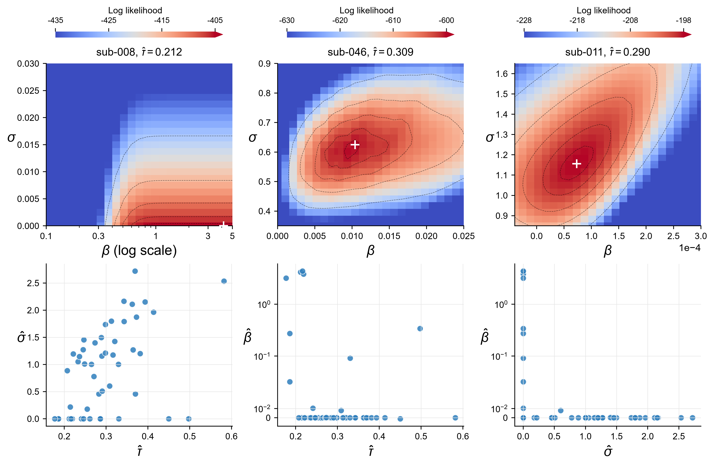
Model comparison and parameter estimates
$𝒜$had a higher BIC than a random choice model for all 49 participants (ΔBIC: 475.19 to 1374.70)
Sequential conditional
log likelihood Surfaces
(N = 3)
Parameter estimate
projections
(N = 49)
9
Notes:
BIC uses the log-likelihood-scale Schwarz definition in the project report. Participant-level ΔBIC values range from 475.19 to 1374.70.

Slide 11
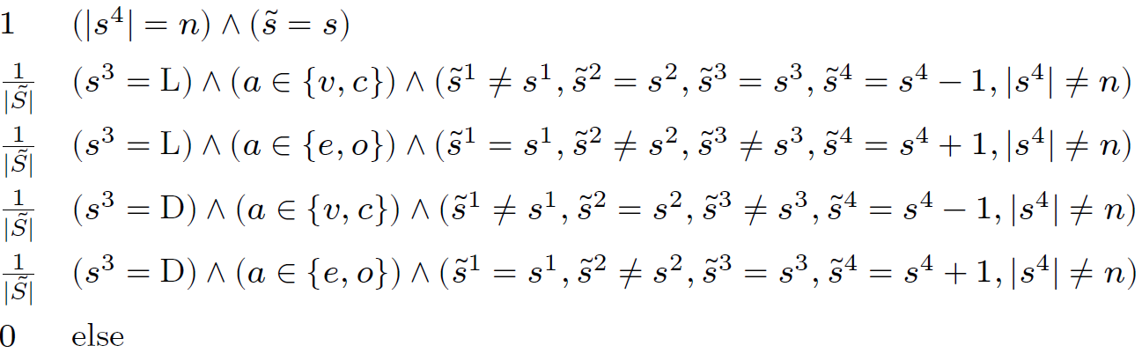
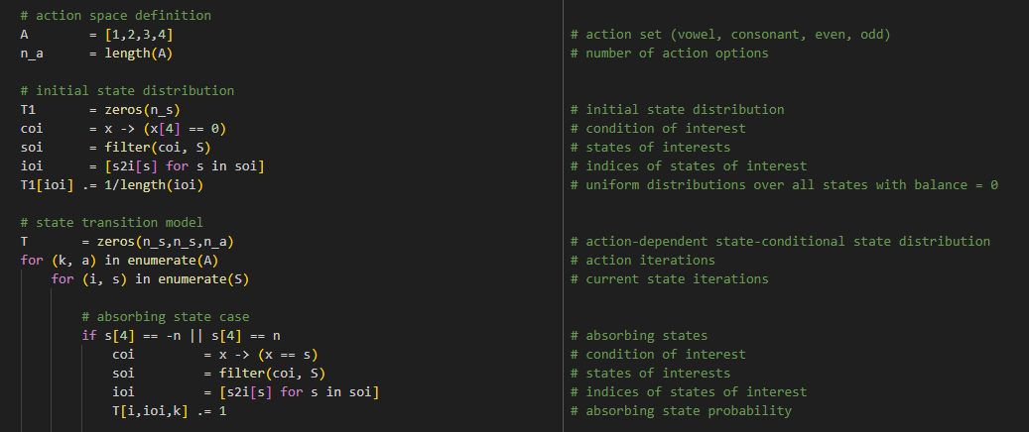

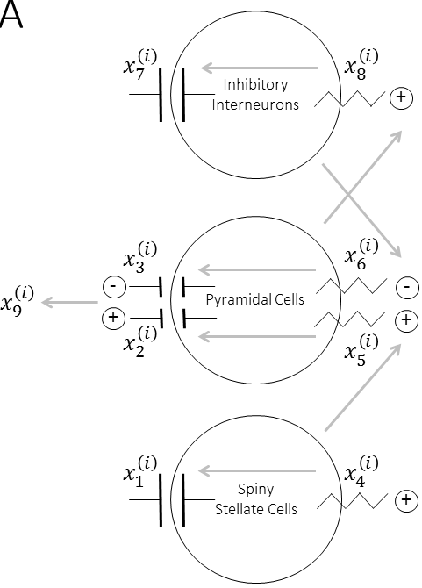
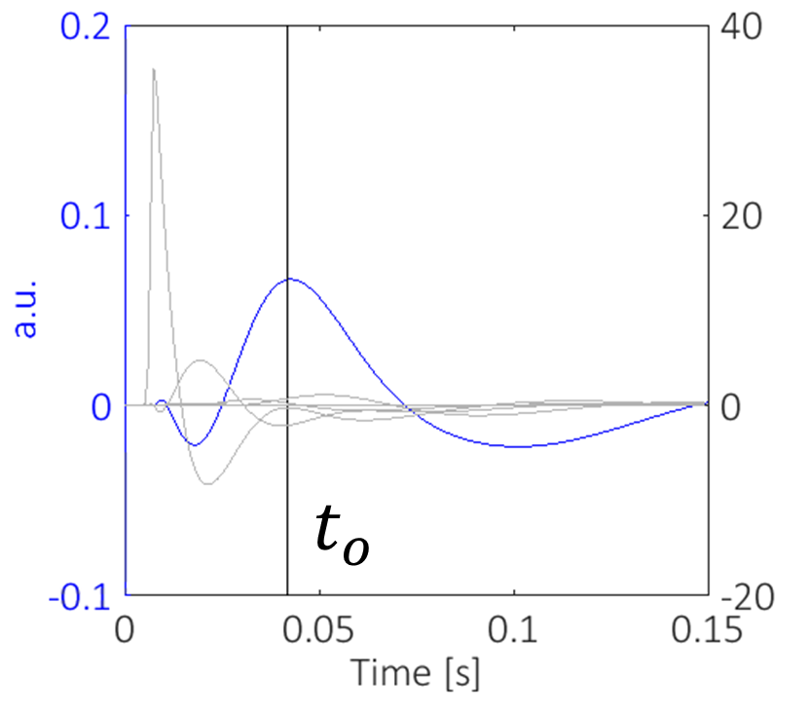
Theoretical work packages
Work Package 2.1 | Offline and online rational analysis
Error- and reward-sensitivity parameterization
Temporal, hierarchical, concurrent characteristics
Köln
Freiburg
Work Package 2.2 | Agent-based behavioral modeling
Statistical model embedding and inference
Model and parameter recovery validation
Tübingen
Work Package 2.3 | ERN and FRN integration
Neural mass and EEG forward model augmentation
Error/reward index-dependent effective connectivity
Notes:
In WP2.1
We want to further develop this theoretical approach with a particular focus on the online scenario.
We here also include the experimentally addressed error- and reward sensitivities, as we also exemplified in the proposal
We will generalize the framework to continuous time, account for hierarchical decision processes in collaboration with Cologne and address the potential benefits of concurrent stimulus processing in collaboration with Freiburg.
In WP2.2
We will embed the deterministic models developed in WP2.1 in an agent-based behavioral modeling framework that we have used extensively in recent years.
Finally, in WP2.3
We will integrate the individual EEG error- and reward-sensitivity measurements in the estimation of the parameterized agent-based models.
For this, we will augment the agents with neural mass models, where the error and reward sensitivities affect the connectivity between neural masses to generate differential ERPs
These ERP predictions can then, together with the behavioral data, be used to infer agent parameters - in a Bayesian sensor fusion sense.

