Slide 1



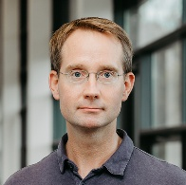

Project 3
Individual determinants of response strategy
formation in voluntary task switching
Doruntinë Zogaj
Jovita Brüning
Domenic Groh
Dirk Ostwald
Markus Ullsperger
What determines which strategy a person uses
when they can freely choose between tasks?
1
Notes:
We’re presenting project 3, which is located at Magdeburg University and Constructor University in Bremen
My name is Jovita Brüning and together with Doruntinë Zogaj, I will conduct the empirical part of Project 3, which I will briefly introduce today
Domenic Groh and Dirk Ostwald are the members of our team focusing on the theoretical objectives
Markus Ullsperger – unfortunately cannot be here today – but he’s our expert in decision making and neuroscience and advising on the neurophysiological measures
Our joint project focuses on how individuals form response strategies in voluntary task switching
So our central question is: What determines which response strategy a person develops when they have the freedom to choose between tasks?

Slide 2
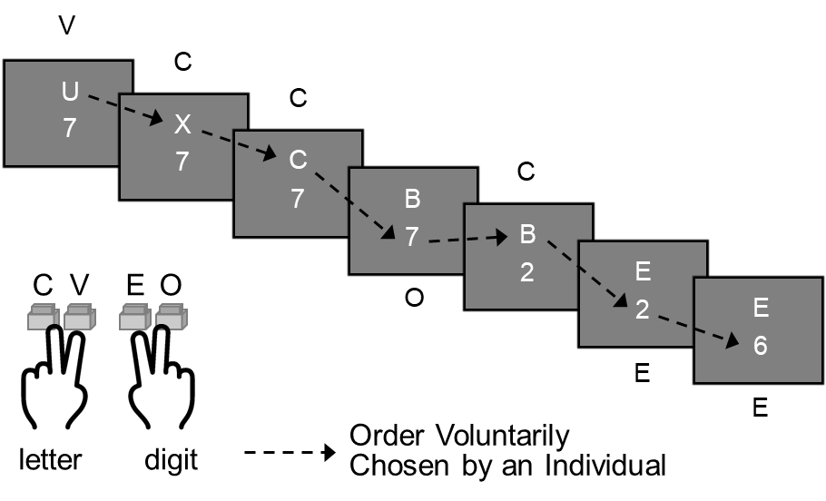
Empirical Background
Free Concurrent Dual Task (FCDT)
Two tasks stay visible
Choose freely when to switch
A response selects and performs a task
Brüning et al., 2020; Brüning et al., 2021; Damos et al., 1983; Reinert & Brüning, 2022; Reissland & Manzey, 2016
2
Notes:
In earlier work, we were interested in how people approach multiple task demands if they are free to choose which task to perform. Starting with a limited set of just two tasks, we found that they indeed develop different approaches.
To address this, we use the Free Concurrent Dual-Tasking paradigm (FCDT for short) as briefly introduced by the Cologne project
Here, participants work on two simultaneously visible threads of tasks, one typically requires participants to categorize letters the other one digits
Participants classify the letters as a vowel or consonant and the digits as odd or even, using separate response keys for the two tasks.
On each trial participants choose which task to perform and indicate to which category the respective stimulus belongs with the finger that is allocated to the respective category
Which allows to precisely track, which of the tasks is being responded to across a sequence of trials => and thus the sequence of the participant’s task choices
The sequence on the left shows an example of how a participant could approach the tasks:
In this case, after responding three times to the letter task, the participant performed one trial of the digit task, then returned to the letter task, before choosing to continue with the digit task.

Slide 3
Empirical Background
Free Concurrent Dual Task (FCDT)
Two tasks stay visible
Choose freely when to switch
A response selects and performs a task
Only the chosen task’s
stimulus changes
The other stimulus remains
available for advance processing
Maximize correct responses and balance performance across both tasks.
Brüning et al., 2020; Brüning et al., 2021; Damos et al., 1983; Reinert & Brüning, 2022; Reissland & Manzey, 2016
2
Notes:
Crucially, the stimuli are visible until a response is given => thus, there is no artificial timeout
The unchosen stimulus remains available. After a letter response, only the letter changes, while the digit remains on screen. After a digit response, only the digit changes.
Participants can therefore prepare the next task while still working on the current one, but the paradigm does not force them to use this preview.
Importantly, while participants are instructed to perform the tasks equally and as efficient as possible – that is to maximize correct responses – it is actually up to them how to achieve this

Slide 4
Empirical Background
FCDT response strategies
Single-task
Participants adhere to one of three strategies
responses letter task (T_{L})
responses digit task (T_{D})
Blocker
responses T_{L}
responses T_{D}
Reflect stable biases that occur independent of task features
Switcher
responses T_{L}
responses T_{D}
Strategies‘ efficiency changes depending on task characteristics
Response
Grouper
responses T_{L}
responses T_{D}
How can we explain the strategies’ formation?
Novel experimental work and theoretical approaches
Brüning et al., 2020; Brüning et al., 2021; Damos et al., 1983; Reinert & Brüning, 2022; Reissland & Manzey, 2016
3
Notes:
The same task setting allows different prototypical response patterns. Using this paradigm, we repeatedly and reproducibly found that participants adhere to one of three response strategies:
blocking, switching, or response grouping
One substantial group are Blockers, who complete long runs of one task before switching -> typically, they produce more than 10 trials and are accordingly classified as Blockers when their switch rate is below 10%.
Switchers interleave tasks more frequently, but their switch pattern is rather irregular. They choose to work on the other task approximately every three to seven trials.
Response groupers switch very frequently and prepare both task responses before releasing them in quick succession. That is, usually a seemingly long response is followed by an extremely fast one
For the planned experiments, we assess both the strategy categories and the underlying continuous response measures.
We observed the response strategies across different task combinations and across sessions, suggesting that they reflect stable biases that occur independent of the exact task features
Yet, their consequences for performance can change: a strategy that works well for one task combination may be less efficient for another
This raises the question of what drives these preferences in the first place => How can we explain the strategies’ formation?

Slide 5
Candidate Determinants of Strategy Formation
Objectives
Learning and error sensitivity
Motivation and reward sensitivity
Psychological traits, preferences, and cognitive ability
Empirical approach
Behavioral assessment of response strategies with experimental manipulations
EEG markers of error and reward sensitivity
Questionnaires for self-reported preferences, cognitive tasks
4
Notes:
We consider three sets of potential determinants. The first concerns learning and error sensitivity. People who learn the tasks efficiently may free up capacity for preparing and coordinating task switches, and sensitivity to their own errors could support this learning process.
Second, people may differ in how strongly rewards motivate them to change their bias in task choices. Our working hypothesis is that switching and response grouping may reflect a stronger motivation to maximize performance, whereas blocking may place more weight on minimizing coordination effort.
Beyond these mechanisms, we also ask whether more stable characteristics, such as psychological traits, multitasking preferences, and cognitive abilities, help explain these strategy differences.
To address these questions, we combine behavioral experiments with EEG markers of error and reward sensitivity, questionnaires, and measures of cognitive ability. This allows us to examine how individual characteristics interact with task conditions to shape strategy use. Let me now briefly walk you through the planned experiments.

Slide 6
WP 1.1: Learning Ability and Error Sensitivity
Exp 1a Strategy development
Exp 1b Task difficulty
Extended FCDT practice
Explore changes in response times,
errors and strategy use
Easy versus difficult
letter and color classifications
Test difficulty × strategy effects
EEG during FCDT and a separate flanker task; N = 90 per experiment
Key variables: response times, error rates, error-related negativity
Prediction: greater learning gains and larger ERN magnitude in switchers and response groupers.
5
Notes:
The first pair of experiments examines learning ability and error sensitivity, with ninety participants planned for each experiment.
In Experiment 1a, participants complete the standard FCDT procedure with two additional runs. This gives us more time to observe task acquisition and the development of efficient coordination.
Experiment 1b adds easier and more difficult stimulus discriminations to examine how task difficulty interacts with individual learning ability and strategy preference.
We will explore changes in reaction times and error rates across practice, together with changes in task choices in their response patterns.
We record EEG during the FCDT and then use a separate flanker task to obtain an independent measure of error sensitivity, the error-related negativity
The idea is that learning from errors may help participants acquire the tasks more efficiently, making frequent switching easier to coordinate => We therefore predict greater learning gains and a larger ERN magnitude in switchers and response groupers than in blockers.
[prediction refers to 1a: greater reductions in reaction times and errors; regarding 1b: will depend on 1a, but if efficient task acquisition supports frequent switching, increasing task difficulty should reduce switching particularly in switchers and response groupers, thereby narrowing the differences between strategy groups]
[Across both experiments, we can also examine midfrontal theta as a correlate of effort and beta lateralization before a response as a correlate of upcoming task selection.]

Slide 7
WP 1.2: Motivation and Reward Sensitivity
Exp 2a Global reward prospect
Exp 2b Bonus for switching
High or low reward for either task
Remain low / increase
Remain high / decrease
Reward for the alternative task
Bonus versus no bonus
for an explicit task switch
EEG during FCDT and a separate probabilistic learning task; N = 90 per experiment
Key variables: response times, error rates, switch rate, feedback-related negativity
Prediction: higher reward sensitivity (RewP) and stronger modulation of task choices by incentives in switchers and response groupers compared with blockers.
6
Notes:
Having examined learning and error sensitivity, we next ask how incentives influence task choices. Both experiments will comprise ninety participants and the preferred strategy will be first assessed at baseline.
Experiment 2a then varies the global reward prospect for correct responses, regardless of which task they choose.
Every five to fifteen responses, a cue indicates a high or low reward prospect.
This creates four reward conditions: remain low, increase, remain high, and decrease.
We expect stronger incentive effects on task choices in switchers and response groupers than in blockers. Specifically, increasing rewards should promote switching, whereas sustained high rewards should favor repetition.
Experiment 2b provides a more direct incentive. A colored frame signals that switching to the alternative task can earn a bonus.
Here, we compare bonus and no-bonus conditions to test whether explicit rewards can overcome a preferred response strategy.
We expect even blockers to increase switching, although less strongly than switchers and response groupers.
In addition to EEG during the FCDT, a probabilistic learning task provides an independent measure of reward sensitivity, including feedback-related ERP measures. The main outcome is how switch rates change as a function of incentive condition and baseline strategy. We will also assess multitasking efficiency.
[Visual color changes or frames also appear at baseline without the additional reward instructions, which helps separate incentive effects from visual changes.

Slide 8
WP 1.3: Personality, Preference, and Cognitive Ability
Motivation and preferences
Personality and capacity
Need for Cognition
Trait Persistence
Polychronicity
BIS/BAS
Big Five
Working memory capacity
Operation Span
Symmetry Span
Shared test battery across the whole experimental programme: 4 × 90 participants from 1.1 & 1.2 + 50 from the joint study → Planned N = 410
Prediction: higher switch rate is associated with higher need for cognition, persistence, polychronicity, and reward sensitivity.
7
Notes:
Alongside these experiments, we ask whether more stable individual characteristics help explain strategy preferences.
Participants in each of the four experiments therefore complete the same test battery in a second session. Including our contribution to the joint study with Freiburg, this gives us a planned total of 410 participants.
The battery covers motivation and multitasking preferences, including Need for Cognition, Trait Persistence, Polychronicity, and the BIS/BAS scales.
We also assess the Big Five, and use Operation Span and Symmetry Span to measure working memory capacity.
This allows us to examine whether the proposed motivational and cognitive differences relate to strategy categories and to continuous switch rates.
For example, our proposal predicts higher Need for Cognition and reward sensitivity among people who favor interleaving.
These analyses complement the experimental manipulations by addressing more persistent individual differences.

Slide 9
WP 3: Generalization across paradigms
Joint experiment with Project 2, Freiburg
The same participants complete both paradigms
FCDT
Continuous stimulus preview
Self-organized task switching
Waiting times between trials
Do switch frequencies and strategy preferences correspond?
Counterbalanced paradigm order:
50 participants from each study site → Planned N = 100
8
Notes:
Finally, the joint experiment with Project 2 in Freiburg asks whether these preferences generalize across paradigms.
One hundred participants will complete both FCDT and the self-organized task-switching paradigm in a counterbalanced order, using the same simple classification tasks.
The latter paradigm introduces waiting times and distinguishes local from global strategies.
We will test whether switch frequencies correlate and the strategies correspond across the two paradigms. This will show how far the individual differences extend beyond one task setting.
Together, these studies examine how strategy preferences develop, when they change, and how far they generalize across task settings. Dirk will now introduce the modeling approach that complements this empirical programme.
[The hypothesis is that FCDT interleaving corresponds more closely to a global strategy, whereas blocking corresponds more closely to a local strategy.]

Slide 10
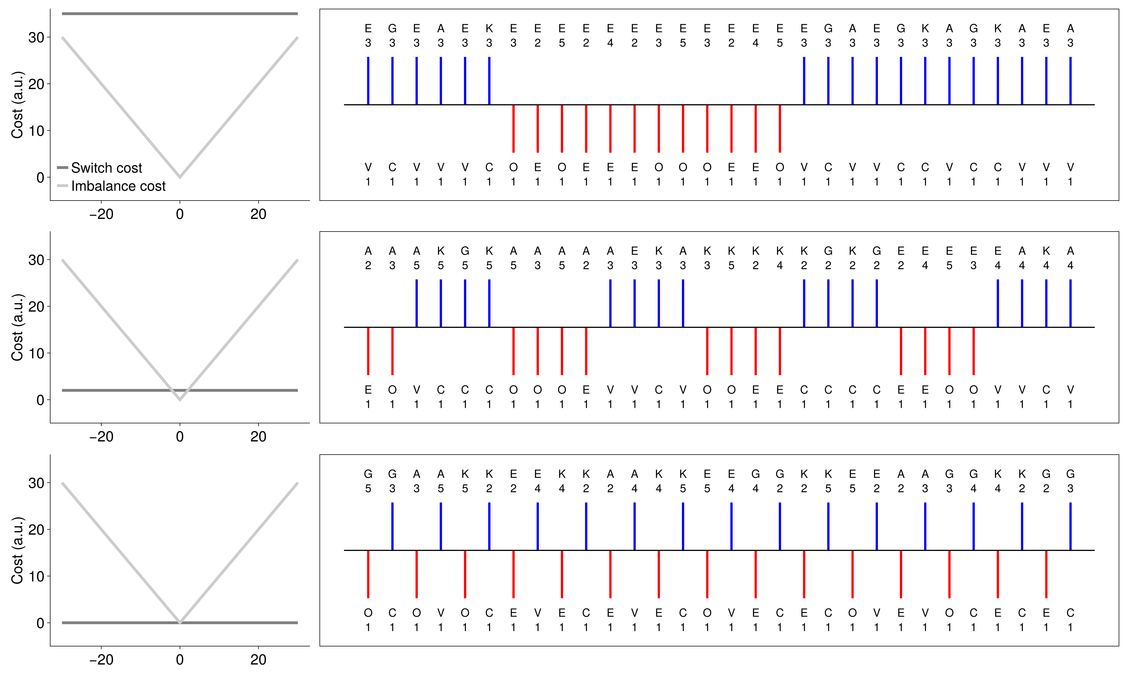

Theoretical proposal
FCDT response strategies as optimal policies under subjective cost functions
Rational analysis
Proof of principle (osf.io/6vspq) | Parameterized switch and task imbalance cost
Freiburg
Markov Decision Processes
$$\left(S,A,p\left(s_{1}\right), p\left(s_{t+1} | s_{t},a_{t}\right), r\left(s_{t},a_{t}\right)\right)$$
Subjective cost functions
Expected reward maximization
Bellman equation solution
Optimal response sequences

Slide 11
First-stage implementation
Application to Brüning, Manzey (2020) data subset (osf.io/x6n58)
Full theoretical and implementational details on GitHub, including an extensive report (.pdf)
Proof of principle shortcomings
  Generative simulations of restricted FCDT paradigm, no application to empirical data
  Reward-discounted infinite-horizon MDP approximation based on policy iteration
First-stage implementation advances
  Application to rich empirical data in the agentic behavioral modeling framework (Ostwald et al. (2026))
  Finite horizon MDP without reward discounting solved by backward induction
First-stage implementation shortcomings
  Focus on response data, not reaction times in a semi-MDP extension
  No consideration of dual-task efficiency or domain-specific cognitive processing
$⇒$ Technical advance ✓ Psychological-neurocognitive advance ✗

Slide 12
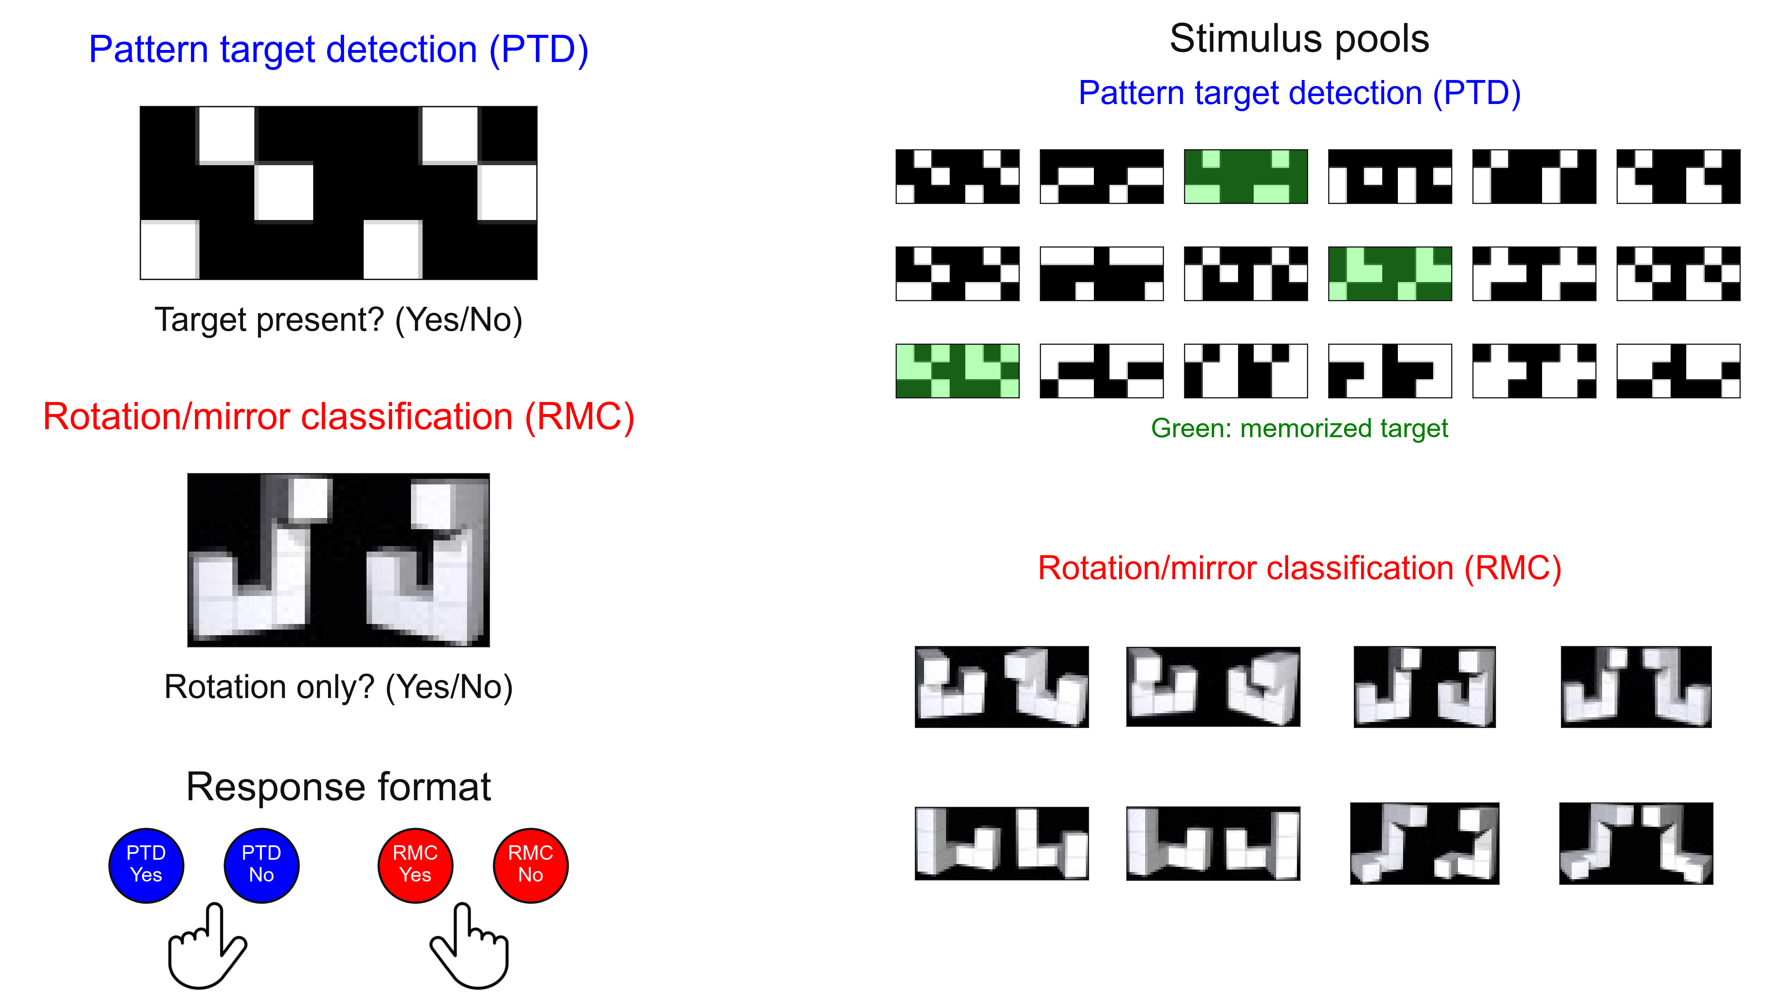
Experimental data
Instructions | Balanced task performance with high accuracy within a given time limit

Slide 13
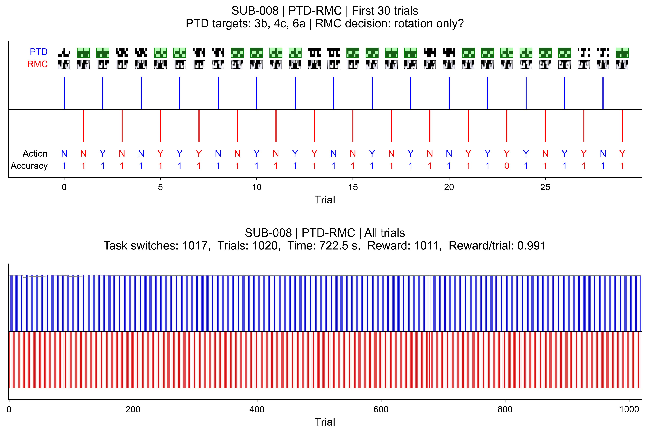
Experimental data

Slide 14
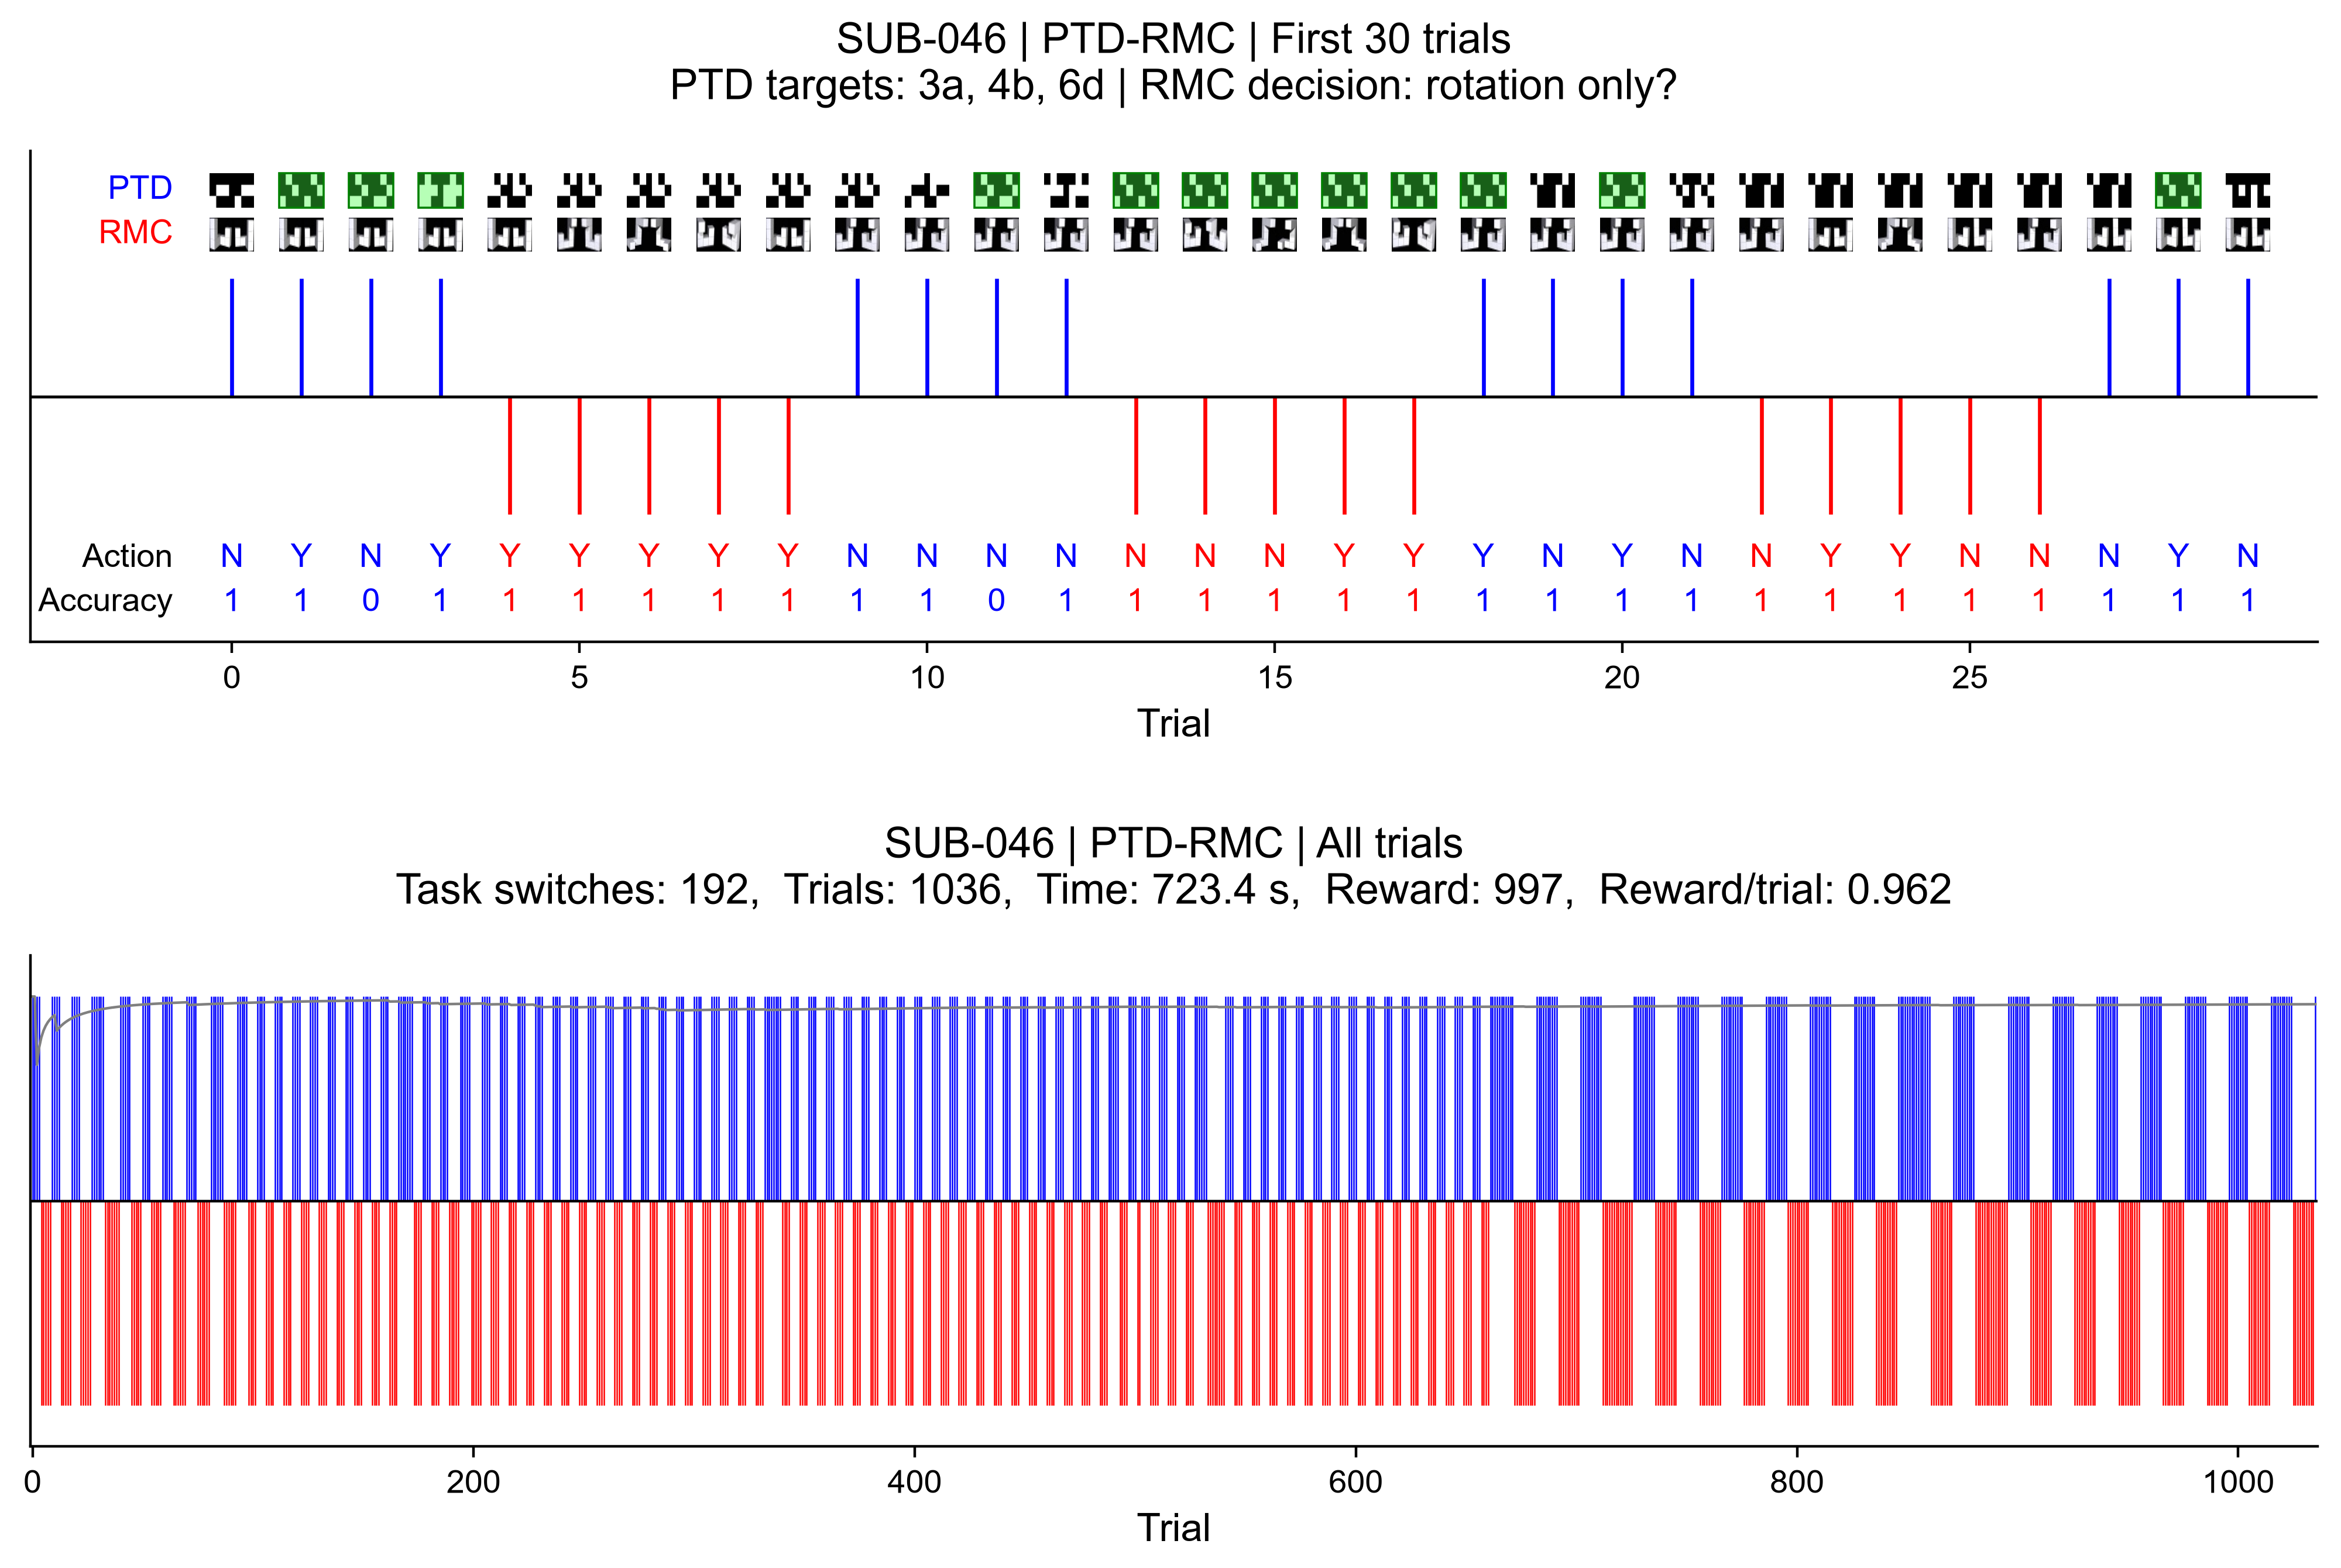
Experimental data

Slide 15
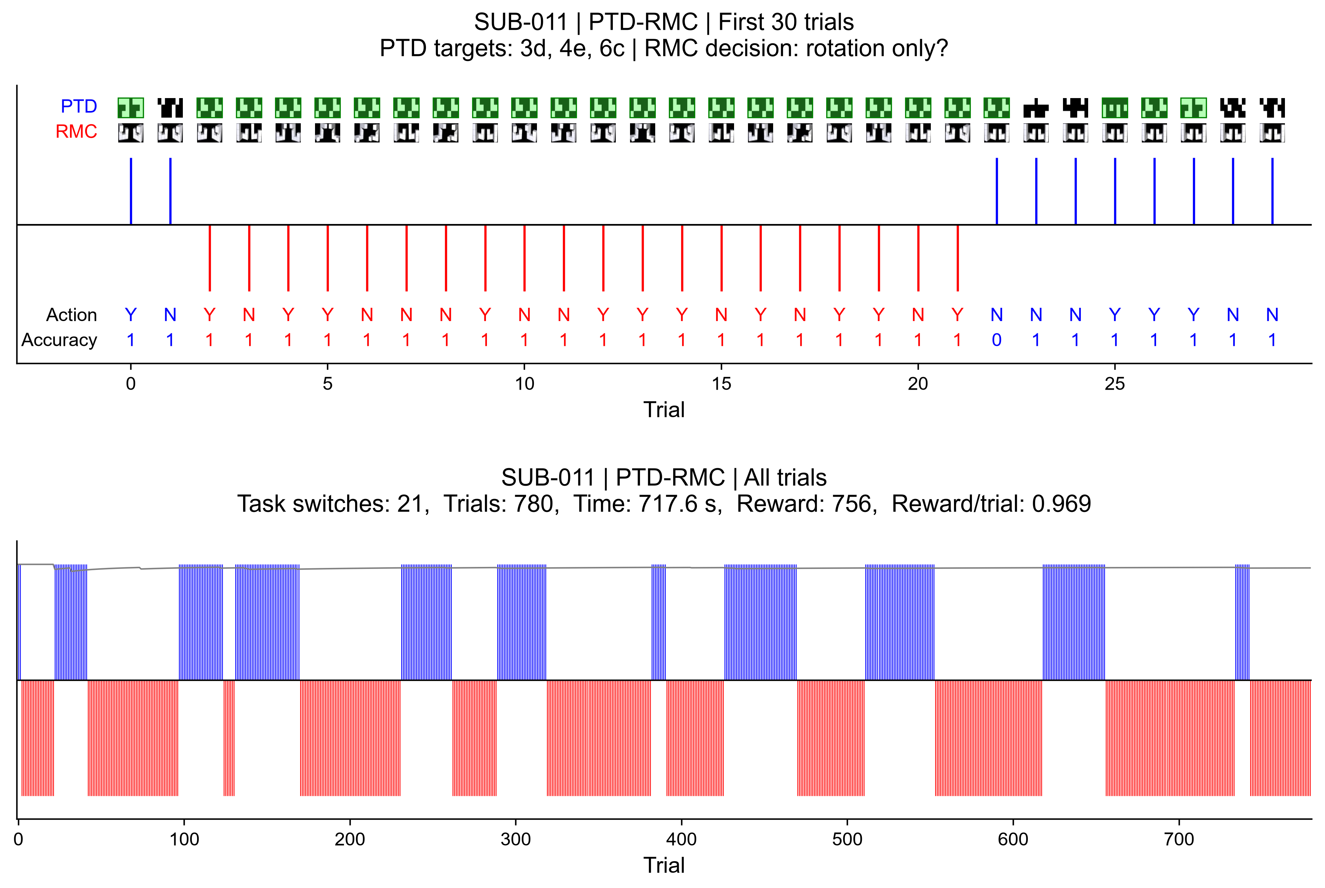
Experimental data

Slide 16











Agentic behavioral model
Data model $𝒟≔\left(𝒯,𝒜, p_{β,σ,τ}\left(a_{t} | s_{t}\right)\right)$
$$t=0,…,n$$
Task model
Agent model
$$𝒯≔\left(J,S,A,{R_{𝒯}}_{ }, p\left(s_{0}\right), p\left(s_{t+1} | s_{t},a_{t}\right),ϱ\right)$$
$$𝒜≔\left(J,ℳ_{χ},D,p_{β,σ}\left(d_{t} | s_{t}\right),ρ\right)$$
$$s_{t}≔(Stimuli,Label,Switch,Imbalance)$$
Reduced state $s_{t}^{χ}≔(Switch,Imbalance)$
Subjective reward function $ρ_{β,σ}\left(s_{t}^{χ},a_{t}^{χ}\right)$
State transition $p(s_{t+1}|s_{t},a_{t})$
Dynamic programming backward induction
Optimal action value functions $q_{χ,t}^{∗}$ and decisions $d_{χ,t}^{∗}$
Action lifting
Post-decision noise
Task reward$ρ(s_{t},a_{t})$
Action $a_{t}∼p_{β, σ,τ}(PTD/RMC, Yes/No|s_{t})$

Slide 17
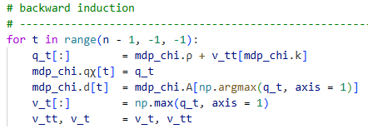


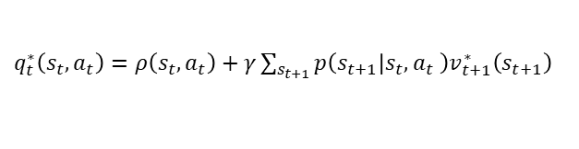


Dynamic programming backward induction
Subjective non-reduced reward function
$$ρ_{β,σ}:S×A→ℝ, \left(s,a\right)↦ρ_{β,σ}\left(s,a\right)≔ρ\left(s,a\right)+ρ_{β}\left(s,a\right)+ρ_{σ}(s,a)$$
Accuray reward $ρ\left(s,a\right) \text{Imbalance cost }ρ_{β}\left(s,a\right)≔−β ⋅|s^{4}+Δ(a)|$
$$\text{Switch cost} ρ_{σ}\left(s,a\right)≔−σ⋅⟦\left(s^{3}=1∧a∈A^{2}\right)∨\left(s^{3}=2∧A^{1}\right) ⟧$$
Backward induction $(γ≔1, v_{n}^{∗}≔0)$
For $t=n−1,…,0$
$q_{t}^{∗}\left(s_{t},a_{t}\right)=ρ\left(s_{t},a_{t}\right)+γ\sum_{s_{t+1}}{p\left(s_{t+1} | s_{t},a_{t} \right)v_{t+1}^{∗}\left(s_{t+1}\right) }$
$v_{t}^{∗}\left(s_{t}\right)=\max_{a_{t}∈A}{q_{t}^{∗}\left(s_{t},a_{t}\right)}$
$d_{t}^{∗}\left(s_{t}\right)=\underset{a_{t}∈A}{argmax}{q_{t}^{∗}\left(s_{t},a_{t}\right)}$

Slide 18
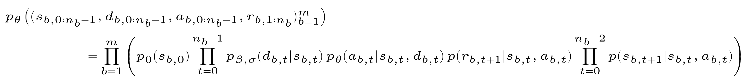
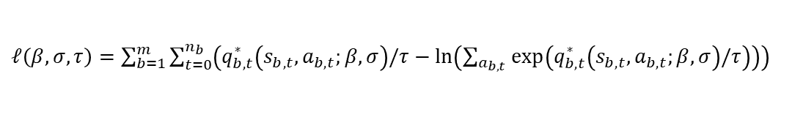
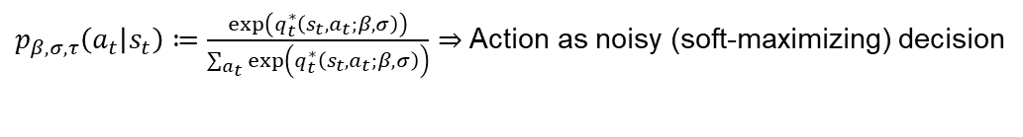
Sequential conditional log likelihood maximization
Data model
$p_{β,σ,τ}\left(a_{t} | s_{t}\right)≔\frac{exp\left(q_{t}^{∗}\left(s_{t},a_{t};β,σ\right)\right)}{\sum_{a_{t}}{exp\left(q_{t}^{∗}\left(s_{t},a_{t};β,σ\right)\right)}}⇒$ Action as noisy (soft-maximizing) decision
Agentic behavioral model ($b=block, t=trial, n_{b}=number of trials in b$ )
Sequential conditional log likelihood
$ℓ\left(β,σ,τ\right)=\sum_{b=1}^{m}{\sum_{t=0}^{n_{b}}{\left(q_{b,t}^{∗}\left(s_{b,t},a_{b,t};β,σ\right)/τ−\ln\left(\sum_{a_{b,t }}{\exp\left(q_{b,t}^{∗}\left(s_{b,t},a_{b,t};β,σ\right)/τ\right)}\right)\right) }}$
Adaptive Nelder-Mead optimization (scipy.optimize.minimize) with$\left(β^{\left(0\right)},σ^{\left(0\right)},τ^{\left(0\right)}\right)≔(0.01,0.1,0.3)$

Slide 19
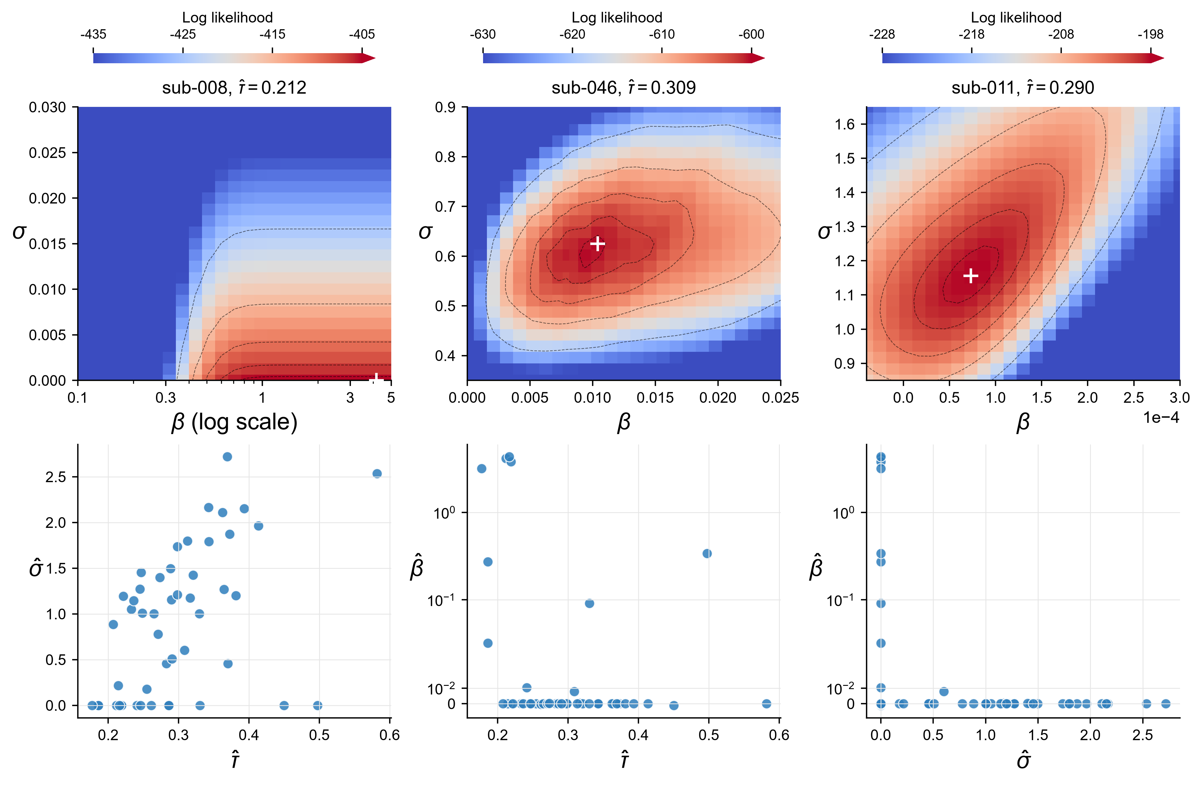
Model comparison and parameter estimates
$𝒜$had a higher BIC than a random choice model for all 49 participants (ΔBIC: 475.19 to 1374.70)
Sequential conditional
log likelihood Surfaces
(N = 3)
Parameter estimate
projections
(N = 49)
9
Notes:
BIC uses the log-likelihood-scale Schwarz definition in the project report. Participant-level ΔBIC values range from 475.19 to 1374.70.

Slide 20
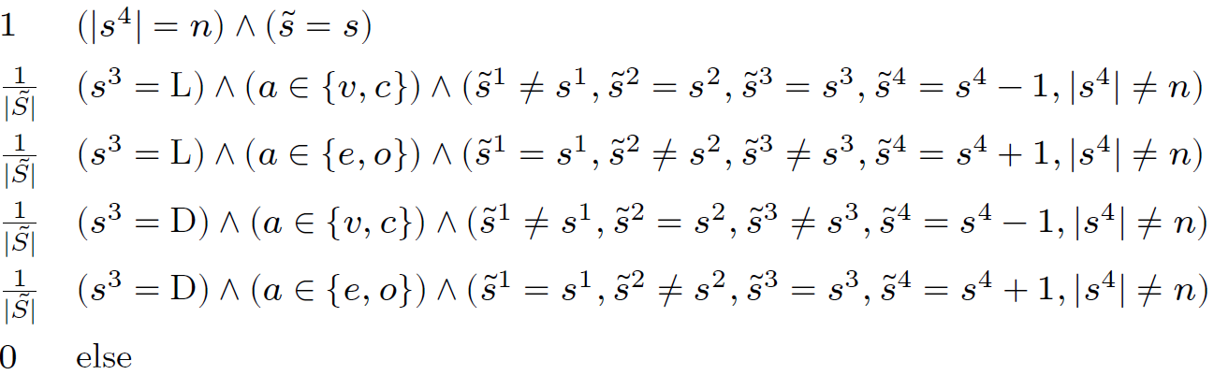
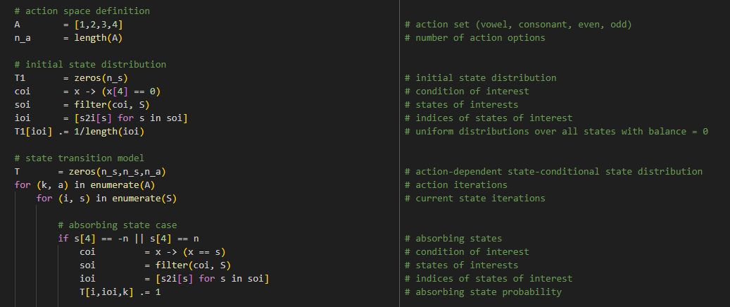

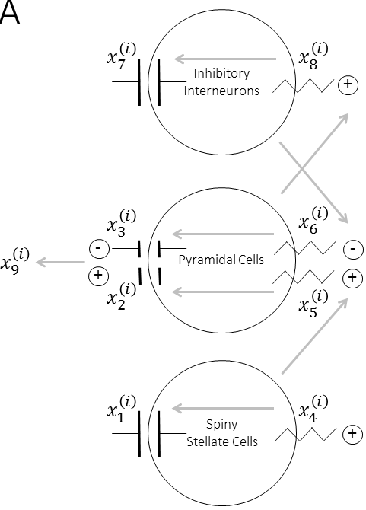
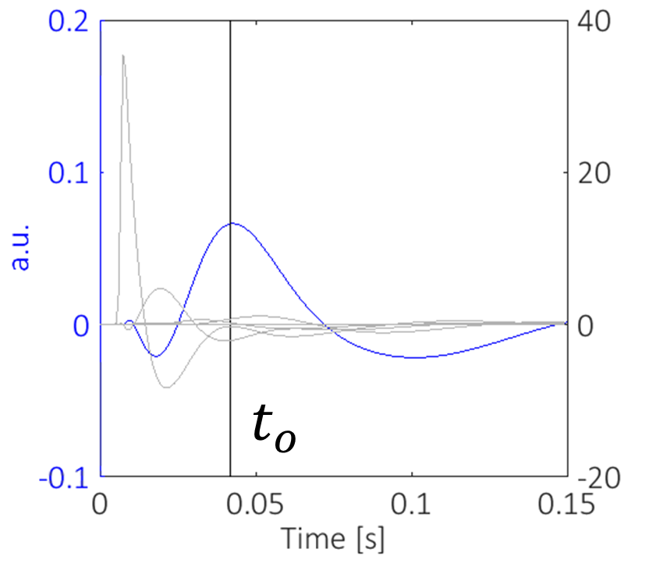
Theoretical work packages
Work Package 2.1 | Offline and online rational analysis
Error- and reward-sensitivity parameterization
Temporal, hierarchical, concurrent characteristics
Köln
Freiburg
Work Package 2.2 | Agent-based behavioral modeling
Statistical model embedding and inference
Model and parameter recovery validation
Tübingen
Work Package 2.3 | ERN and FRN integration
Neural mass and EEG forward model augmentation
Error/reward index-dependent effective connectivity
Notes:
In WP2.1
We want to further develop this theoretical approach with a particular focus on the online scenario.
We here also include the experimentally addressed error- and reward sensitivities, as we also exemplified in the proposal
We will generalize the framework to continuous time, account for hierarchical decision processes in collaboration with Cologne and address the potential benefits of concurrent stimulus processing in collaboration with Freiburg.
In WP2.2
We will embed the deterministic models developed in WP2.1 in an agent-based behavioral modeling framework that we have used extensively in recent years.
Finally, in WP2.3
We will integrate the individual EEG error- and reward-sensitivity measurements in the estimation of the parameterized agent-based models.
For this, we will augment the agents with neural mass models, where the error and reward sensitivities affect the connectivity between neural masses to generate differential ERPs
These ERP predictions can then, together with the behavioral data, be used to infer agent parameters - in a Bayesian sensor fusion sense.

Slide 21
Summary
Research questions
Computational mechanisms of experimentally established FCDT response strategies
Individual determinants of FCDT response strategy formation
Working hypotheses
Task switching as optimal behavior under individual subjective cost functions
Individual error and reward sensitivities as modulators of subjective cost
Research unit contributions
FCDT paradigm as experimental testbed for studying task switching behavior
Rational analysis perspective and agent-based neurobehavioral modeling
Notes:
In summary, in our project
We want to understand the computational mechanisms of FCDT response strategies and
We want to study the individual determinants of FCDT response strategy formation both experimentally and theoretically
Our working hypotheses are
That task switching behavior emerges as optimal behavior under subjective cost functions and
That individual error and reward sensitivity act as determinants of task-switching strategy formation
Our main contributions to the research unit are
On the experimental side, the FCDT paradigm as an experimental testbed for studying task switching behavior
On the theoretical side, a rational analysis perspective and
For integrating theory and experiment, an agent-based neurobehavioral modeling framework.

Slide 23
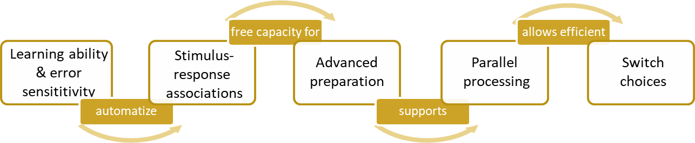
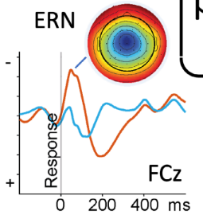
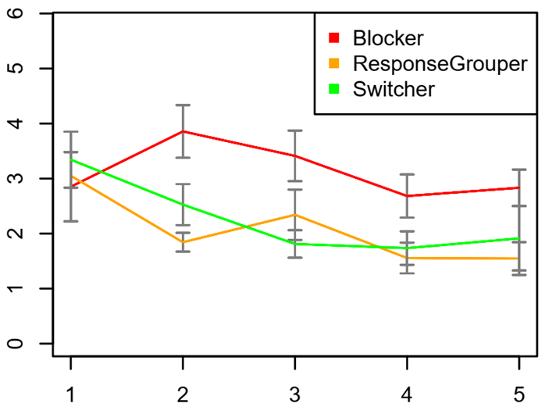
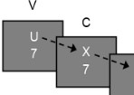
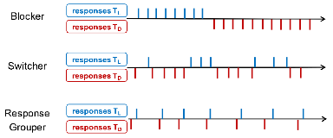
Empirical Objective 1: Influence of learning ability and error sensitivity on response strategy formation
Basic assumptions: ​
Switcher & Response grouper
Blocker
explore additional task information
performance maximization
exploit given task information
effort minimization
Work Package 1.1 – Experiment 1a, n = 90 participants
Performance-based Factors: response strategies, error sensitivity & learning ability
Behavioral Outcomes: Response times, Error Rates
EEG Outcomes: Error-related negativity
Expectations
Free Concurrent Dual-Tasking
Flanker
Task
RTs/ERs/ERN
←←→←←
Error Rates
Blocker
Switcher, Response grouper
Blocks
Ackerman, 1986; Brüning & Manzey, 2018; Brüning et al., 2021, Ramsey et al., 2003; Rogers & Monsell, 1995; Ullsperger et al., 2014
Notes:
Hypotheses: We expect that switchers and response groupers, compared to blockers, will show a greater reduction in RTs and ERs, along with a higher amplitude in the ERN, indicating stronger learning ability and error sensitivity, which supports such more demanding strategies characterized by higher switch frequencies. Differences between switchers and response groupers will be explored in this and the following experiments.
Q: How does an individual’s ability to reliably and efficiently acquire the FCDT stimulus-response mappings (i.e., learning ability and error sensitivity) determine the selection of response strategies + focus on error processing and sensitivity, examining EEG markers such as ERN and Pe (error-related positivity)
Sample: N=90 participants.
Design and procedure: extended FCDT paradigm (two additional runs to allow more time for task acquisition and training of efficient task coordination) + Flanker Task => participants' EEG will be recorded using 64 scalp electrodes at a 500 Hz sampling rate.
Planned analyses: We will compare response patterns in the FCDT paradigm between the three response strategy groups, focusing on reductions in reaction times (RTs) and error rates (ERs) to assess task-related learning abilities.
For EEG analysis: we will compare the amplitude of the ERN and Pe between groups using EEGLAB for second-level statistics (e.g., Fischer et al., 2016). Additionally, EEG data from the FCDT will be analyzed for correlates of cognitive effort, such as midfrontal theta activity (e.g., Zhu et al., 2021). As the tasks are mapped onto the left and right hands, pre-response beta power lateralization can serve as a correlate of a decision variable representing task selection (e.g., Rogge et al., 2022).

Slide 24

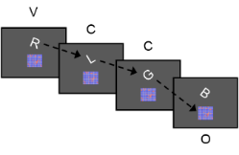
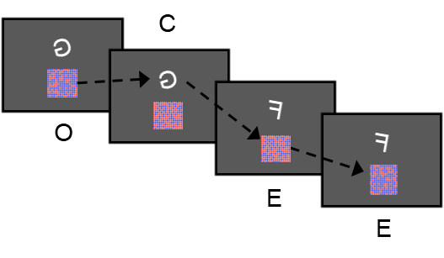
Empirical Objective 1: Influence of learning ability and error sensitivity on response strategy formation
Basic assumptions: ​
Switcher & Response grouper
Blocker
explore additional task information
performance maximization
exploit given task information
effort minimization
Work Package 1.1 – Experiment 1b, n = 90 participants
Performance-based Factors: response strategies, error sensitivity & learning ability
Behavioral Outcomes: Response times, Error Rates
EEG Outcomes: Error-related negativity
Expectations
Free Concurrent Dual-Tasking
RTs/ERs/ERN
Easy
Hard
Error Rates
Flanker
Task
Blocker
Switcher, Response grouper
←←→←←
Blocks
Ackerman, 1986; Brüning & Manzey, 2018; Brüning et al., 2021, Ramsey et al., 2003; Rogers & Monsell, 1995; Ullsperger et al., 2014
Notes:
Hypotheses: Will depend on Experiment 1a but we assume an interaction effect between task difficulty and response strategies on task choice. [probably, if interleaver possess a higher learning ability]
Q: A follow-up experiment will address task difficulty, investigating how varying levels of difficulty in stimulus-response mappings influence error sensitivity, response strategies, and subsequent task choices. Specifically, we will examine whether increased task difficulty amplifies EEG markers of error processing (ERN, Pe) and how individual differences in learning ability moderate these effects.
Sample: N=90 participants.
Design, procedure and planned analyses: Following the structure of Experiment 1a, with the key difference that task difficulty will be systematically manipulated using classification tasks of letters (i.e., minimal rotation (easy) vs. strong rotation (hard) of letters) and colors (i.e., clear majority (easy) vs. balanced (hard) number of red/blue dots in a color patch).

Slide 25
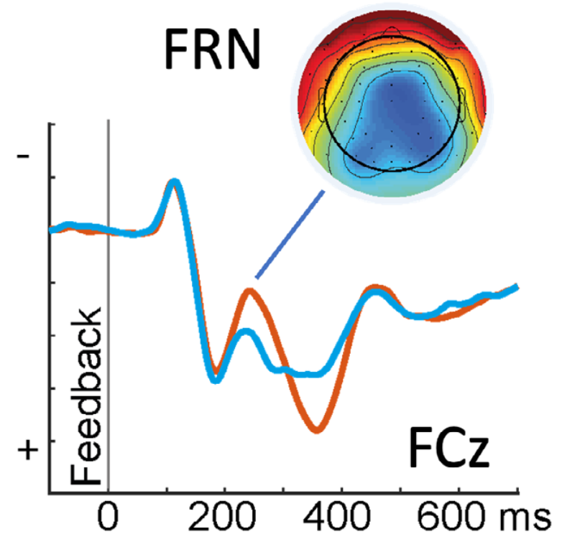
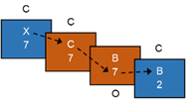

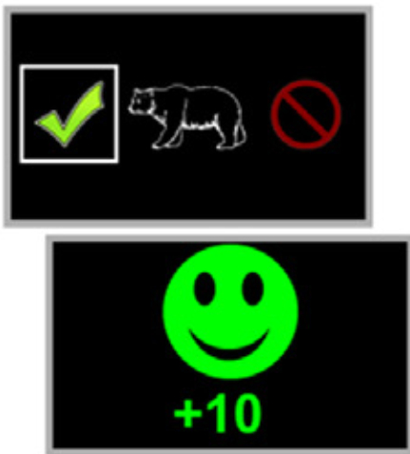
Empirical Objective 2: Relationship between response strategies, reward, and reward sensitivity
Basic assumptions: ​
Switcher & Response grouper
Blocker
explore additional task information
performance maximization
exploit given task information
effort minimization
Work Package 1.2 – Experiment 2a, n = 90 participants
Performance-based Factors:
response strategies & reward sensitivity
Behavioral Outcomes: RTs, ERs, Switch Rates
EEG Outcomes: Feedback-related negativity
Expectations
Free Concurrent Dual-Tasking
Switch Rates / FRN
Global
High vs. Low
Error Rates
Probabilistic learning
RewP
Blocker
Switcher, Response grouper
Blocks
Braem, 2017; Dreisbach & Fröber, 2019; Farmer et al., 2018; Fröber & Dreisbach, 2016; Shen & Chun, 2011; Ullsperger et al., 2024
Notes:
Hypotheses: We predict that switchers and response groupers will show higher reward sensitivity and, aiming to maximize performance, an increased switch rate when reward prospect increases, potentially accompanied by more parallel processing (reflected in higher fast switch rates). As previous research has shown that unchanged high rewards tend to encourage task repetitions rather than voluntary switches (e.g., Fröber & Dreisbach, 2016), an unchanged high reward may in turn promote less flexible response organization and more serial processing, leading to a reduced switch rate. Since blockers' task-choice behavior is generally quite stable and seems to be driven by effort minimization, we expect it to be minimally affected, if at all, by variations in reward prospect.
Q: This experiment investigates how stable vs. varying task-independent rewards influence chosen response strategies and the role of individual reward sensitivity.
Sample: N=90 participants.
Procedure: Participants first complete the classic FCDT categorization procedure with a global reward for correct responses. => Next, task-independent rewards will be introduced, where participants receive a high or low reward prospect that changes response locked every 5-15 trials, indicated by changing background colors (categorization phase will also include background color changes without instructions about reward magnitude, serving as a baseline).
Design: remain low, increase, remain high, decrease. EEG will be recorded during the reward variant of the FCDT, a flanker task (to capture error sensitivity) and a simple probabilistic learning task (to measure reward sensitivity, e.g., Kirschner et al., 2022).
Planned analyses: 4(remain low vs. increase vs. remain high vs. decrease) x 3(blocker vs. switcher vs. response grouper) ANOVA on the switch rate. The design will allow to compare the expected reward effects on the overall multitasking efficiency.

Slide 26
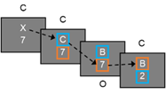

Empirical Objective 2: Relationship between response strategies, reward, and reward sensitivity
Basic assumptions: ​
Switcher & Response grouper
Blocker
explore additional task information
performance maximization
exploit given task information
effort minimization
Work Package 1.2 – Experiment 2b, n = 90 participants
Performance-based Factors:
response strategies & reward sensitivity
Behavioral Outcomes: RTs, ERs, Switch Rates
EEG Outcomes: Feedback-related negativity
Expectations
Free Concurrent Dual-Tasking
Switch Rates / FRN
Global
High vs. Low
Error Rates
Probabilistic learning
RewP
Blocker
Switcher, Response grouper
Blocks
Braem, 2017; Dreisbach & Fröber, 2019; Farmer et al., 2018; Fröber & Dreisbach, 2016; Shen & Chun, 2011; Ullsperger et al., 2024
Notes:
Hypotheses: We expect reward to significantly increase switch rates for switchers and response groupers, when switches are rewarded. Given the explicit reward for a task-switching decision, task-dependent rewards will likely also increase switch rates for blockers, but to a lesser extent. We expect these changes in switch rates to be related to the EEG measures of reward sensitivity. Moreover, upcoming switches will be predicted by beta power lateralization.
Q: Given the high stability of response strategies (Brüning et al., 2020; Reinert & Brüning, 2022), Experiment 2b will take an even more direct approach and examine the influence of task-dependent rewards on response strategies, comparing reward vs. no-reward conditions.
Sample: N=90 participants.
Design and procedure: Again, classic FCDT with a global reward for correct responses. => then informed that a trial-wise reward will be introduced in the FCDT paradigm indicated by a colored frame around the respective task stimulus, where they can receive a bonus for switching to the respective other task. This reward prospect will be given response locked after every 5-15 trials. The last performed task will also be surrounded by a frame to avoid mere saliency effects, with colors for switches vs. repetitions counterbalanced across participants. The categorization procedure will also include these frames without reward instructions, serving as a baseline. EEG will be recorded as in Experiment 2a.
Planned analyses: The interplay of response strategies and reward will be examined using a 2(bonus vs. no-bonus) x 3(blocker vs. switcher vs. response grouper) ANOVA on the switch rate. This design will also allow comparison of reward effects on multitasking efficiency.

Slide 27
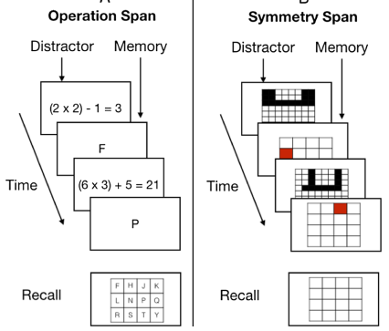

Empirical objective 3: Psychological traits affecting response strategies
Basic assumptions: ​
Switcher & Response grouper
Blocker
explore additional task information
performance maximization
exploit given task information
effort minimization
What determines the formation of an individual's natural preference? Why are some individuals more persistent / less flexible in (current) task performance than others?
→ Selective psychological test battery
Work Package 1.3 – Experiment 1a – 2b + 50% of joint experiment, n = 410 participants
Motivation & Effort
  Need for Cognition “I would prefer complex to simple problems.”
  Trait Persistence “If I decide to do something, I keep going until I reach my goal.”
  Behavioral activation system “It would excite me to win a contest”
Personality & Attitude
  Big Five (especially: conscientiousness, openness)
  Polychronicity “I would rather switch back and forth between several projects than concentrate my efforts on just one. ”
Cognitive ability
  Working memory capacity
Foster et al., 2014
Brüning & Manzey, 2018; Poposki & Oswald, 2010; Redick et al., 2016; Shenhav et al., 2013; Umemoto & Holroyd, 2016
Notes:
TODO: nur als bullet point an vorherigen
… identifying which of these shape responses strategy formation is our last empirical objective. We focus on three trait groups:
Addressing motivation and effort, we assess: Need for Cognition, Trait Persistence, Behavioral Activation System
Regarding Personality & Attitude: Big Five and Polychronicity
Like all projects, we also assess Working Memory Capacity as a key cognitive ability
Hypotheses: Individuals who favor switching and response grouping strategies appear to willingly exert greater cognitive effort, as evidenced by their frequent voluntary task switches. Since this behavior suggests a higher level of motivation to optimize performance continuously, we expect them to score higher on the Need for Cognition, Trait Persistence, and Polychronicity scales, reflecting their motivation to optimize performance (the latter in real-life situations). We also anticipate higher scores on the BAS system, indicating reward sensitivity, and on the Openness and Conscientiousness subscales of the Big Five, which are associated with trait persistence and need for cognition. In contrast, blockers, who avoid effortful task switching and may be less influenced by rewards, are expected to score lower on these scales and higher on the BIS system, reflecting a tendency to avoid effort or challenges.
Q: This WP will explore whether personality traits and WMC are related to response strategies using a selective psychological test battery.
Participants, design and procedure: Data collection will be integrated with WP 1.1, 1.2 and 3, extending these experiments (4 x N=90) and the data collected in WP 3 (N=50) with a second session, resulting in 410 participants. They will complete the BIS/BAS scales, Big5 questionnaire, Need for Cognition scale, Trait Persistence scale, and Multitasking Preference Inventory, as well as the Operation Span Task and the Symmetry Span Task (Unsworth et al., 2009; Redick et al., 2012), to assess WMC.
Planned analyses: Data analyses will proceed in two steps. First, differences between the response strategy groups will be tested using a between-subjects ANOVA for the respective tests. Second, a correlational approach will examine the relationship between switch rates and test scores.

Slide 28
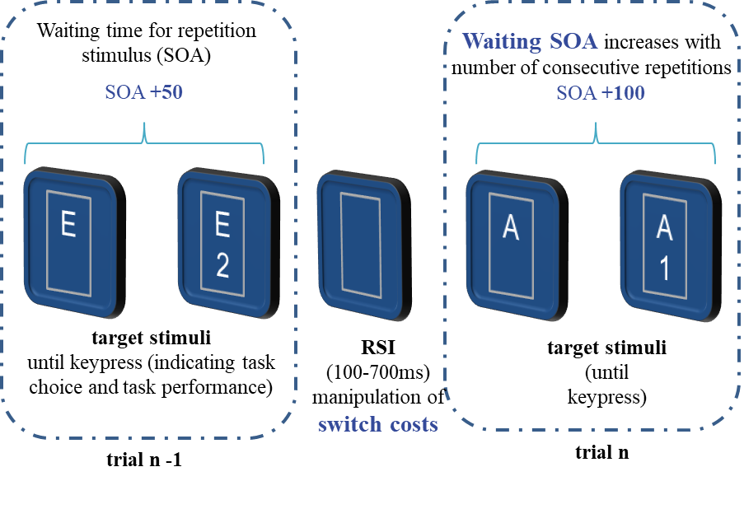
Empirical objective 3: Psychological traits affecting response strategies
Basic assumptions: ​
Switcher & Response grouper
Blocker
explore additional task information
performance maximization
exploit given task information
effort minimization
Does the variability in task-switch choice frequency in the FCDT paradigm extend to the self-organized task-switching paradigm?
→ Joint experiment with Freiburg
Work Package 3 – Collaboration with Project #2, n = 100 participants
Comparison of the influence of strategies on task choice across paradigms
Expectations
Magdeburg
Free Concurrent Dual-Tasking
Freiburg
Self-organized Tasking-Switching
Switching and response grouping ↔ global strategy:
Proactive task processing and performance maximization
Blockers ↔ local strategy:
Minimizing effort by switching only when necessary
Brüning et al., 2020; Brüning et al., 2021; Mittelstädt et al., 2018, 2019, 2021; Monno et al., 2021; Reinert & Brüning, 2022
Notes:
Hypotheses: We expect participants with higher switch frequencies in FCDT to also switch more in the self-organized task-switching paradigm, compared to those who switch less. Switching and response grouping should align with the global strategy, reflecting proactive task processing and performance maximization, while blockers should follow the local strategy, minimizing effort by switching only when necessary.
Q: Prior research (Monno et al., 2021) has distinguished between a local and a global task-processing strategy. The local strategy involves switching only when waiting times match switch costs, optimizing trial-by-trial performance. The global strategy prioritizes overall efficiency by switching earlier, despite initial switch costs. The latter reflects a proactive approach that maximizes performance across a sequence of trials by minimizing overall waiting times.
Sample, design and procedure: Participants (N=100, 50 of which are collected in Freiburg) will complete both paradigms in a counterbalanced order using the same simple classification tasks to isolate individual differences.
Planned analyses: To examine whether individual differences in switch frequency generalize, they will be correlated across paradigms. Strategy overlap will be assessed using a chi-squared test, comparing the proportion of participants classified as blockers or switchers/response groupers in FCDT to those using local or global strategies in the self-organized paradigm.

Slide 29
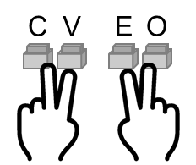
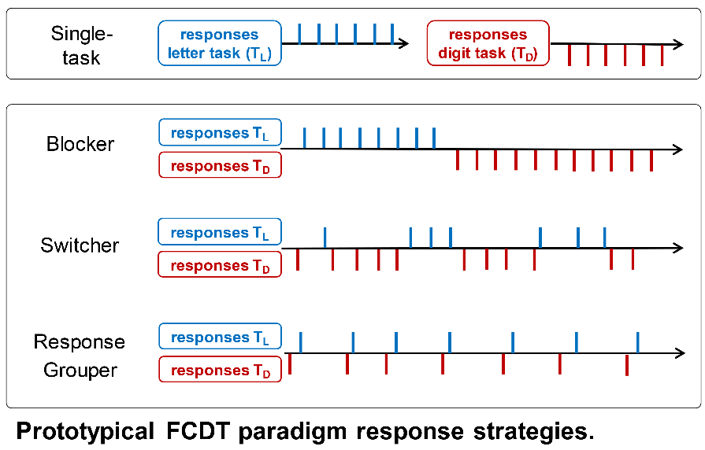
Response Strategies – Paradigm
Free Concurrent Dual-Tasking
Stimuli remain
until a task-specific keypress
Key press indicates task choice and task performance
Letter
V
Digit
C
Letter
Digit
U
C
7
X
7
C
C
7
B
7
B
2
E
O
2
E
6
Continuous presentation of non-chosen task allows for parallel processing (can be used as preview for self-initiated task switch)
E
E

Slide 30
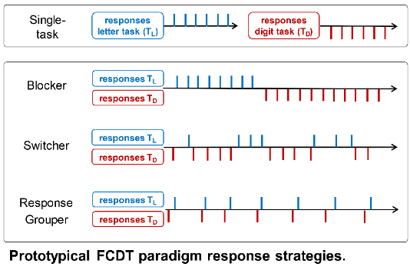
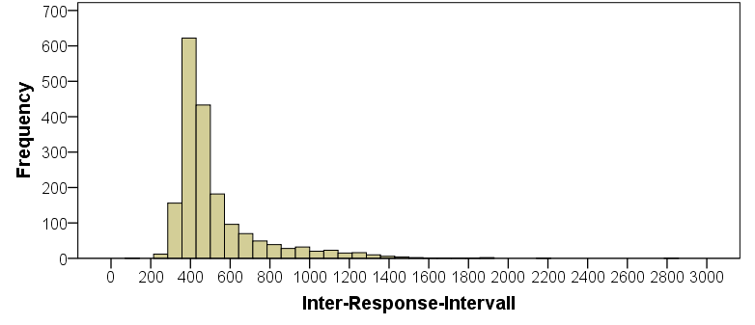
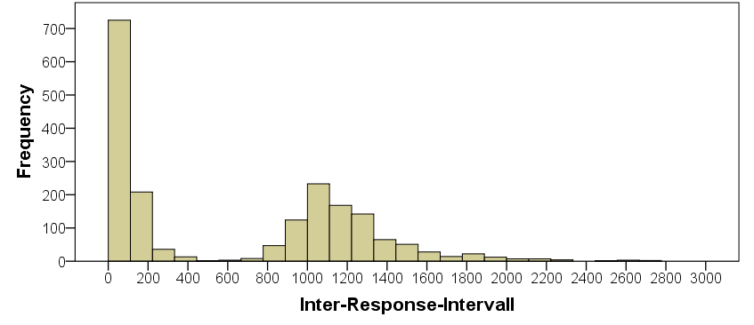
Response Strategies – Categorization
Blocker: Switch Rate < 10 %
Switcher: Switch Rate > 10 % & normally distributed response times in switch trials
Response Grouper: Switch Rate > 50 % & response times in switch trials show clear dichotomy
Example „Switcher“
Mean = 524.43
SD = 233.75
N = 1824
Example „Response Grouper“
Mean = 645.23
SD = 604.86
N = 1926

Slide 31
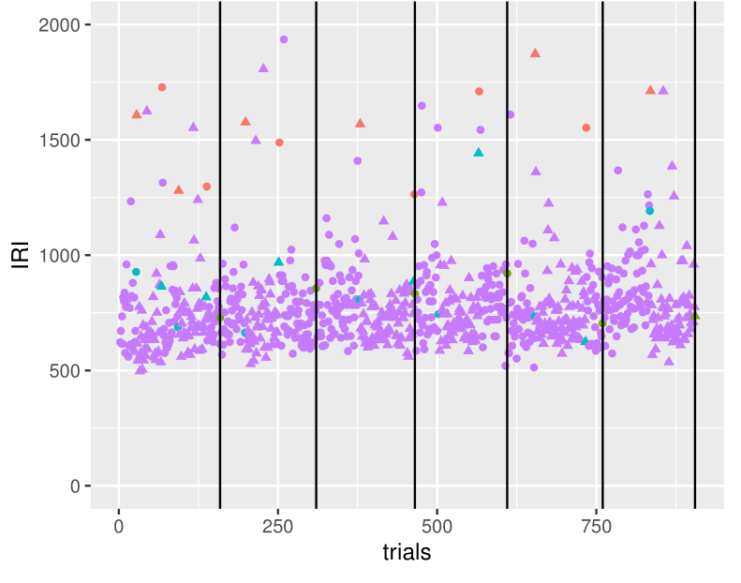
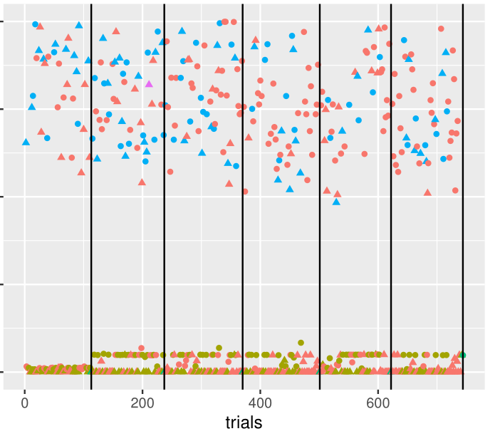
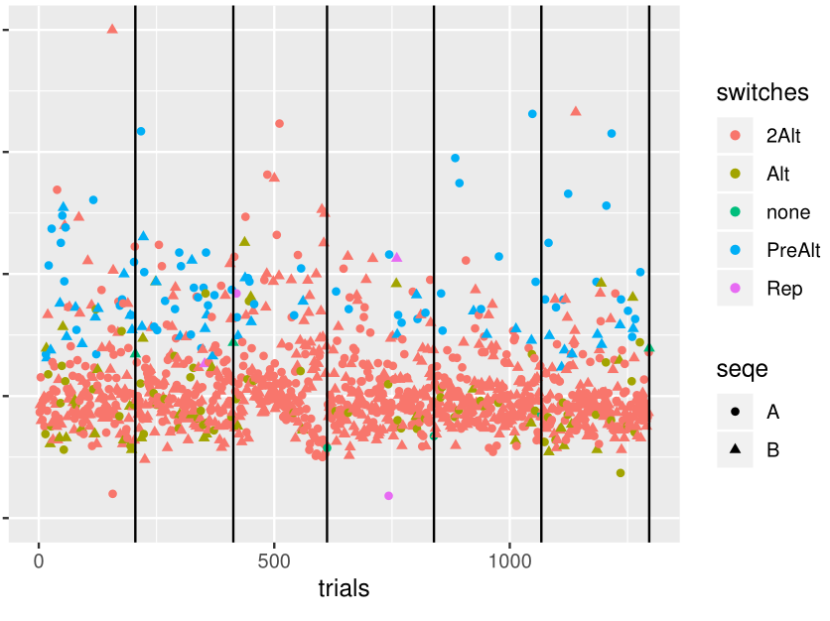
Response Strategies – Categorization
Blocker: Switch rate < 10%
Interleaver: Switch rate > 10%
Blocker
Response Grouper
Switcher
Trial Types
Switches
Repetitions
Tasks
Notes:
Each individual reaction corresponds to a data point or a reaction:
Purple = pure task repetitions
Blue = task repetitions before a change
Red & green = task changes

Slide 32
Response Strategies – Reliability
Grouper
n = 6
Grouper
n = 5
Grouper
n = 10
Grouper
n = 16
Blocker
n = 6
Blocker
n = 18
Blocker
n = 32
Switcher
n = 14
Blocker
n = 25
Switcher
n = 6
Switcher
n = 19
Switcher
n = 22
Reissland & Manzey, 2016, Exp. 2, Acta Psych
Brüning, Mückstein & Manzey, 2020, Exp. 1 JEP:HPP
Brüning, Mückstein & Manzey, 2020, Exp. 2
JEP: HPP
Brüning, Reissland & Manzey, 2021, Psy Res
Grouper
n = 9
Blocker
n = 17
Grouper
n = 47
Blocker
n = 43
Switcher
n = 22
Switcher
n = 27
Data from coop with groups from Freiburg and Halle (in prep)
Data from coop with Veit Kubik (in prep)

Slide 33





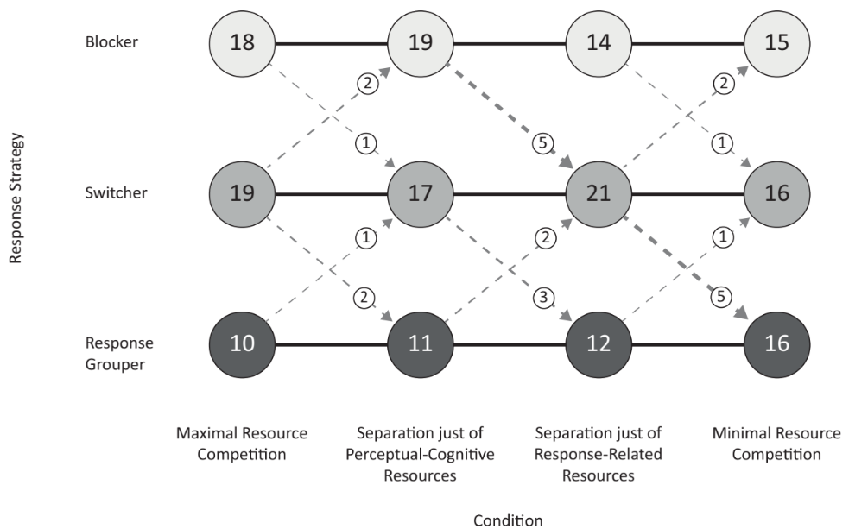
Response Strategies – Stability
Maximum Overlap of Ressource Demands
Encoupling of Processing Codes
Encoupling of Response Modality
Minimum Ressources-Overlap
3 5
3 5
K H
“red/green”
K H
“red/green”
Brüning, Mückstein & Manzey, 2020

Slide 34
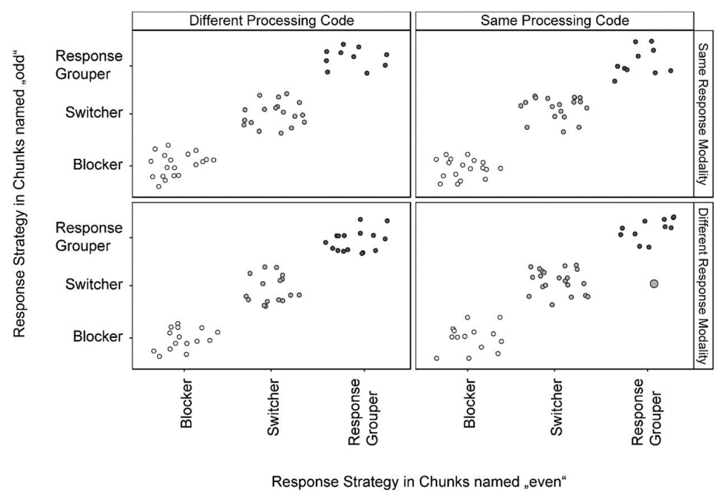
Response Strategies – Split-Half Reliability
Maximum Overlap of Ressource Demands
Encoupling of Processing Codes
Encoupling of Response Modality
Minimum Ressources-Overlap
3 5
3 5
K H
“red/green”
K H
“red/green”
Brüning, Mückstein & Manzey, 2020

Slide 35
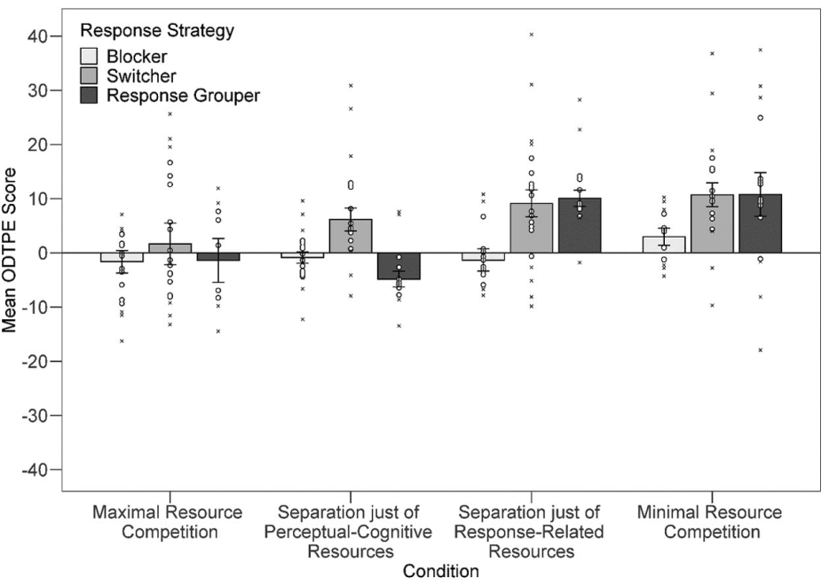
Response Strategies – Efficiency
Maximum Overlap of Ressource Demands
Encoupling of Processing Codes
Encoupling of Response Modality
Minimum Ressources-Overlap
3 5
3 5
K H
“red/green”
K H
“red/green”
Brüning, Mückstein & Manzey, 2020

Slide 36
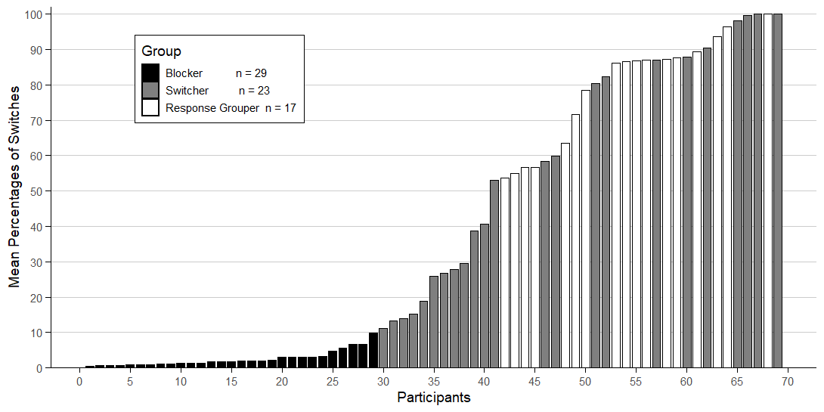
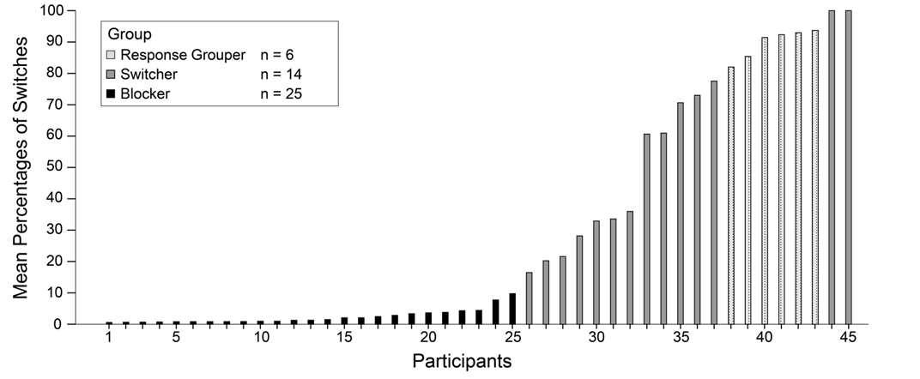
Response Strategies – Reliability

Slide 37
Overall Dual-Task Efficiency
Single-Task Performance: # correct responses in one minute
# responses Task A
# responses Task B
Single-Task
performance
Dual-Task
performance
Dual-Task Performance: # correct responses in two minutes
# responses Task A & Task B
Dual-Task Efficiency = 0 → neither benefits nor costs due to multitasking
# responses Task A & Task B
Dual-Task Efficiency > 0 → net benefits due to multitasking
# responses Task A & Task B
$ODTPE=100∗\left[0,5 ∗\frac{\left({nC}_{\text{A_dual}}\right)}{\left({nC}_{\text{A_single}}\right)} +0,5 ∗\frac{\left({nC}_{\text{B}\text{_dual}}\right)}{\left({nC}_{\text{B}\text{_single}}\right)}\right]−100$
Dual-Task Efficiency < 0 → net costs due to multitasking

Slide 38
Parallel Processing – the Fast Switch Logic
Identification of parallel processing
  Not directly visible
  Indication of parallel processing → fast switches:
  If the RT of a switch < 25-%-quantile of the RT in single-task performance, than it is a fast switch
  Precondition: no compensatory prolongation of the RT of the previous trials
B
Typical RT in single-tasks
Expected RT-pattern in case of serial processing
A
A
A
Switch costs
B
B
B
RT-pattern with fast switches → evidence for parallel processing
A
A
A
B
B
B

Slide 39
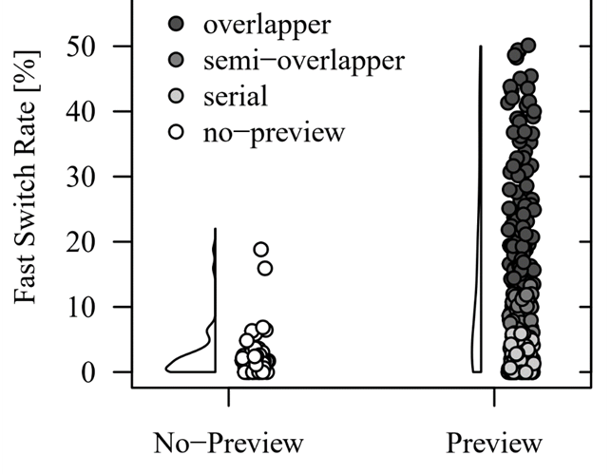
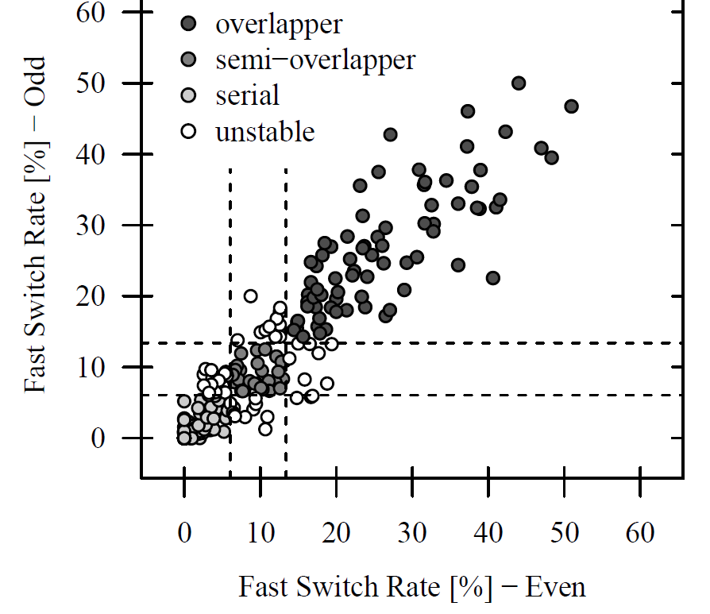
Intra-Session Stability of Processing Modes
  5 data sets of TSWP with letter and digit classification tasks (18-35y) = 249 participants
+3SD
+1SD
  Split-half reliability: r(247) = .94 [.92, .95]

Slide 41
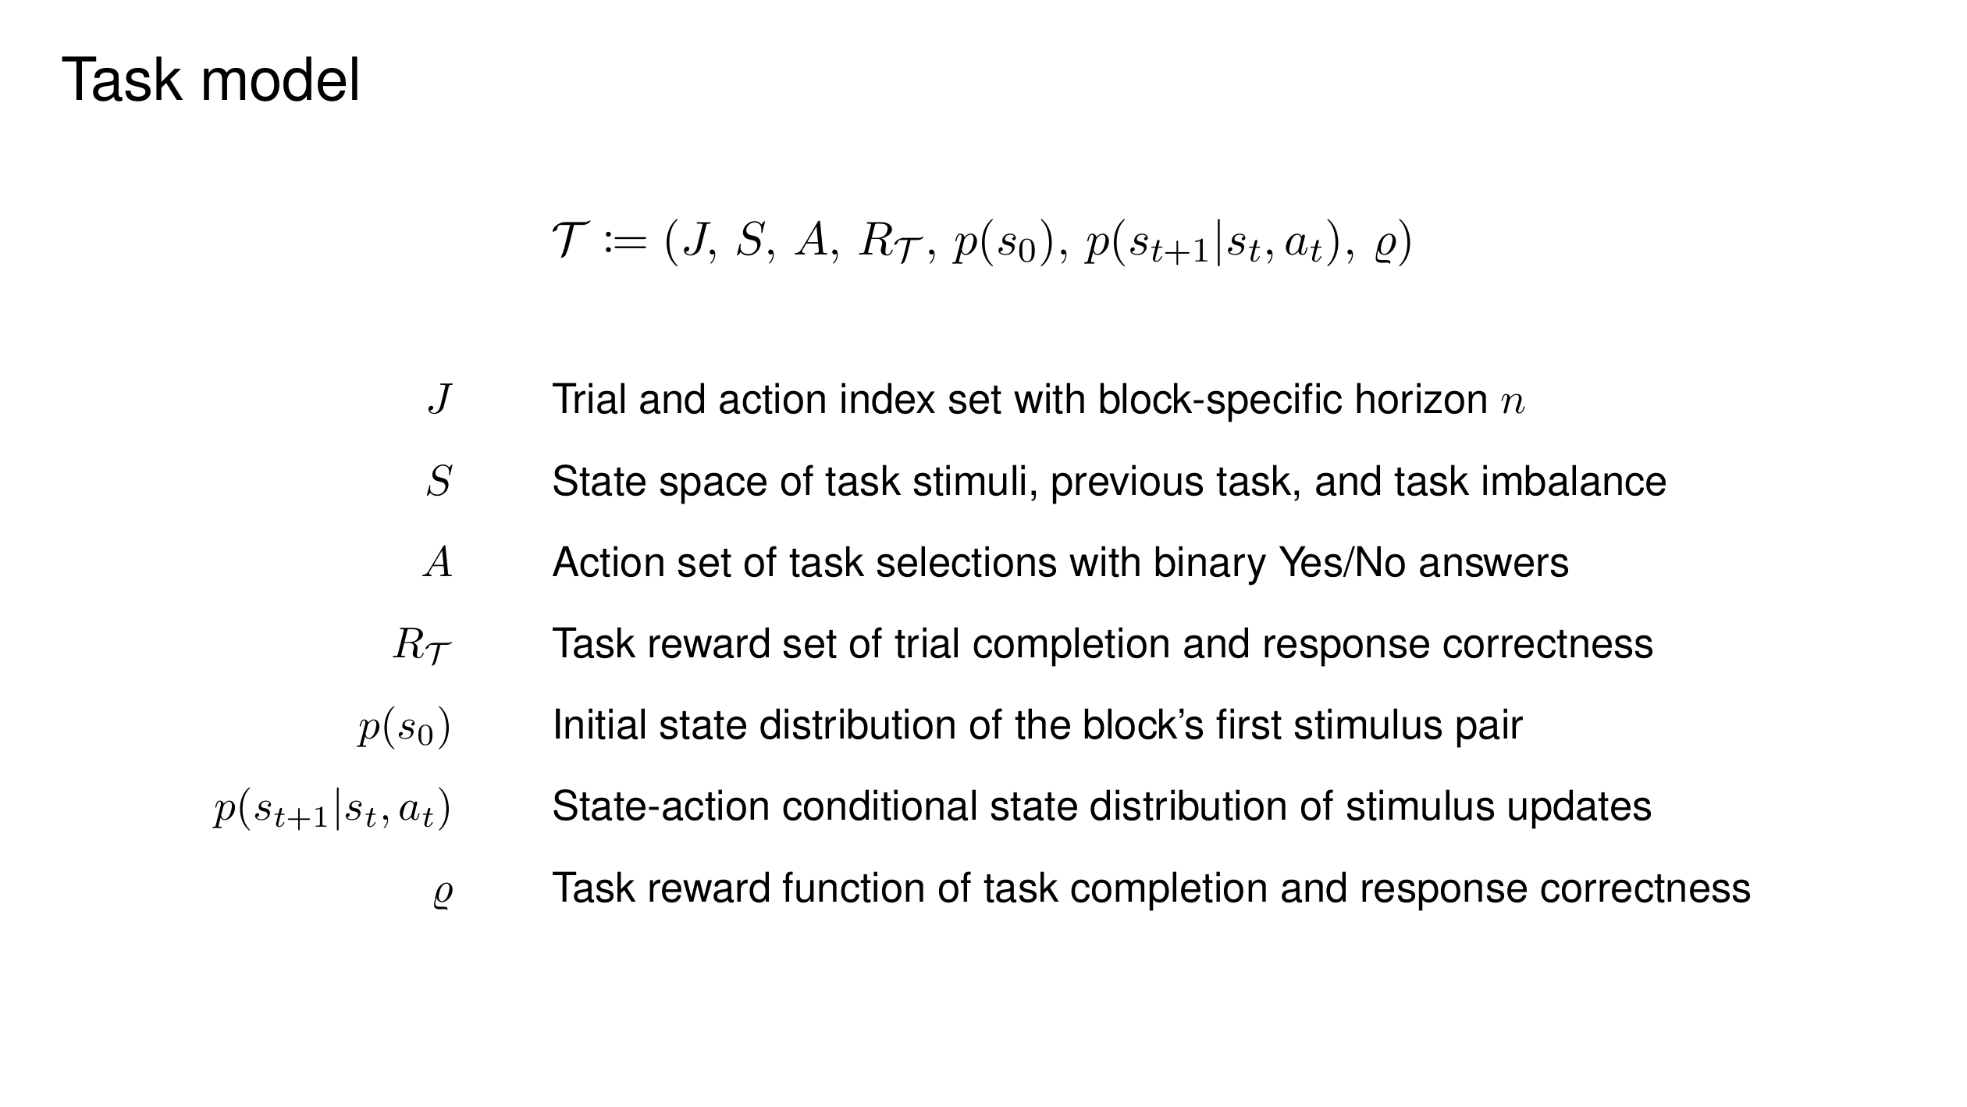

Slide 42
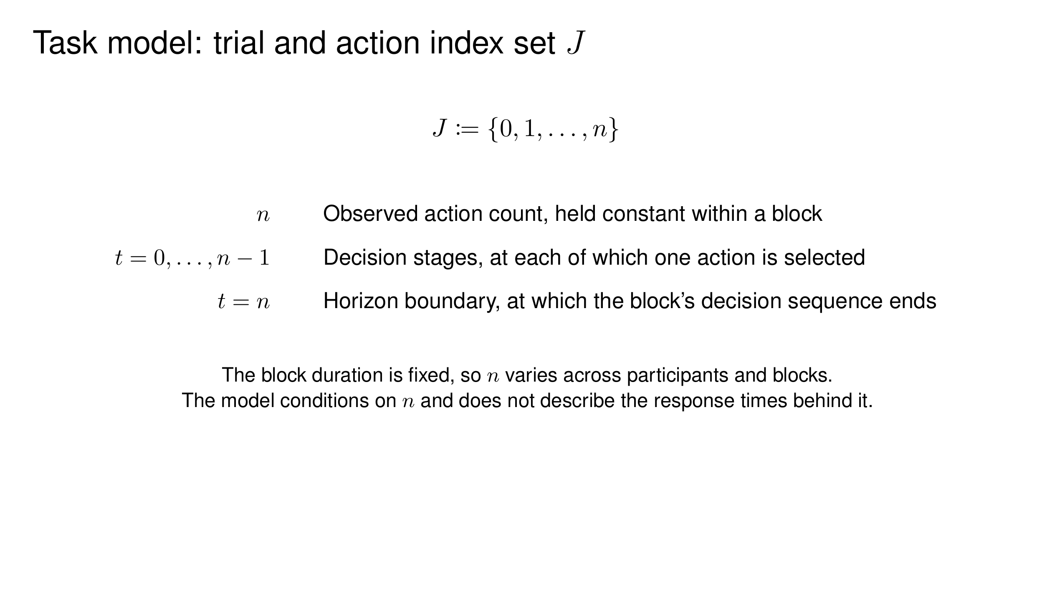

Slide 43
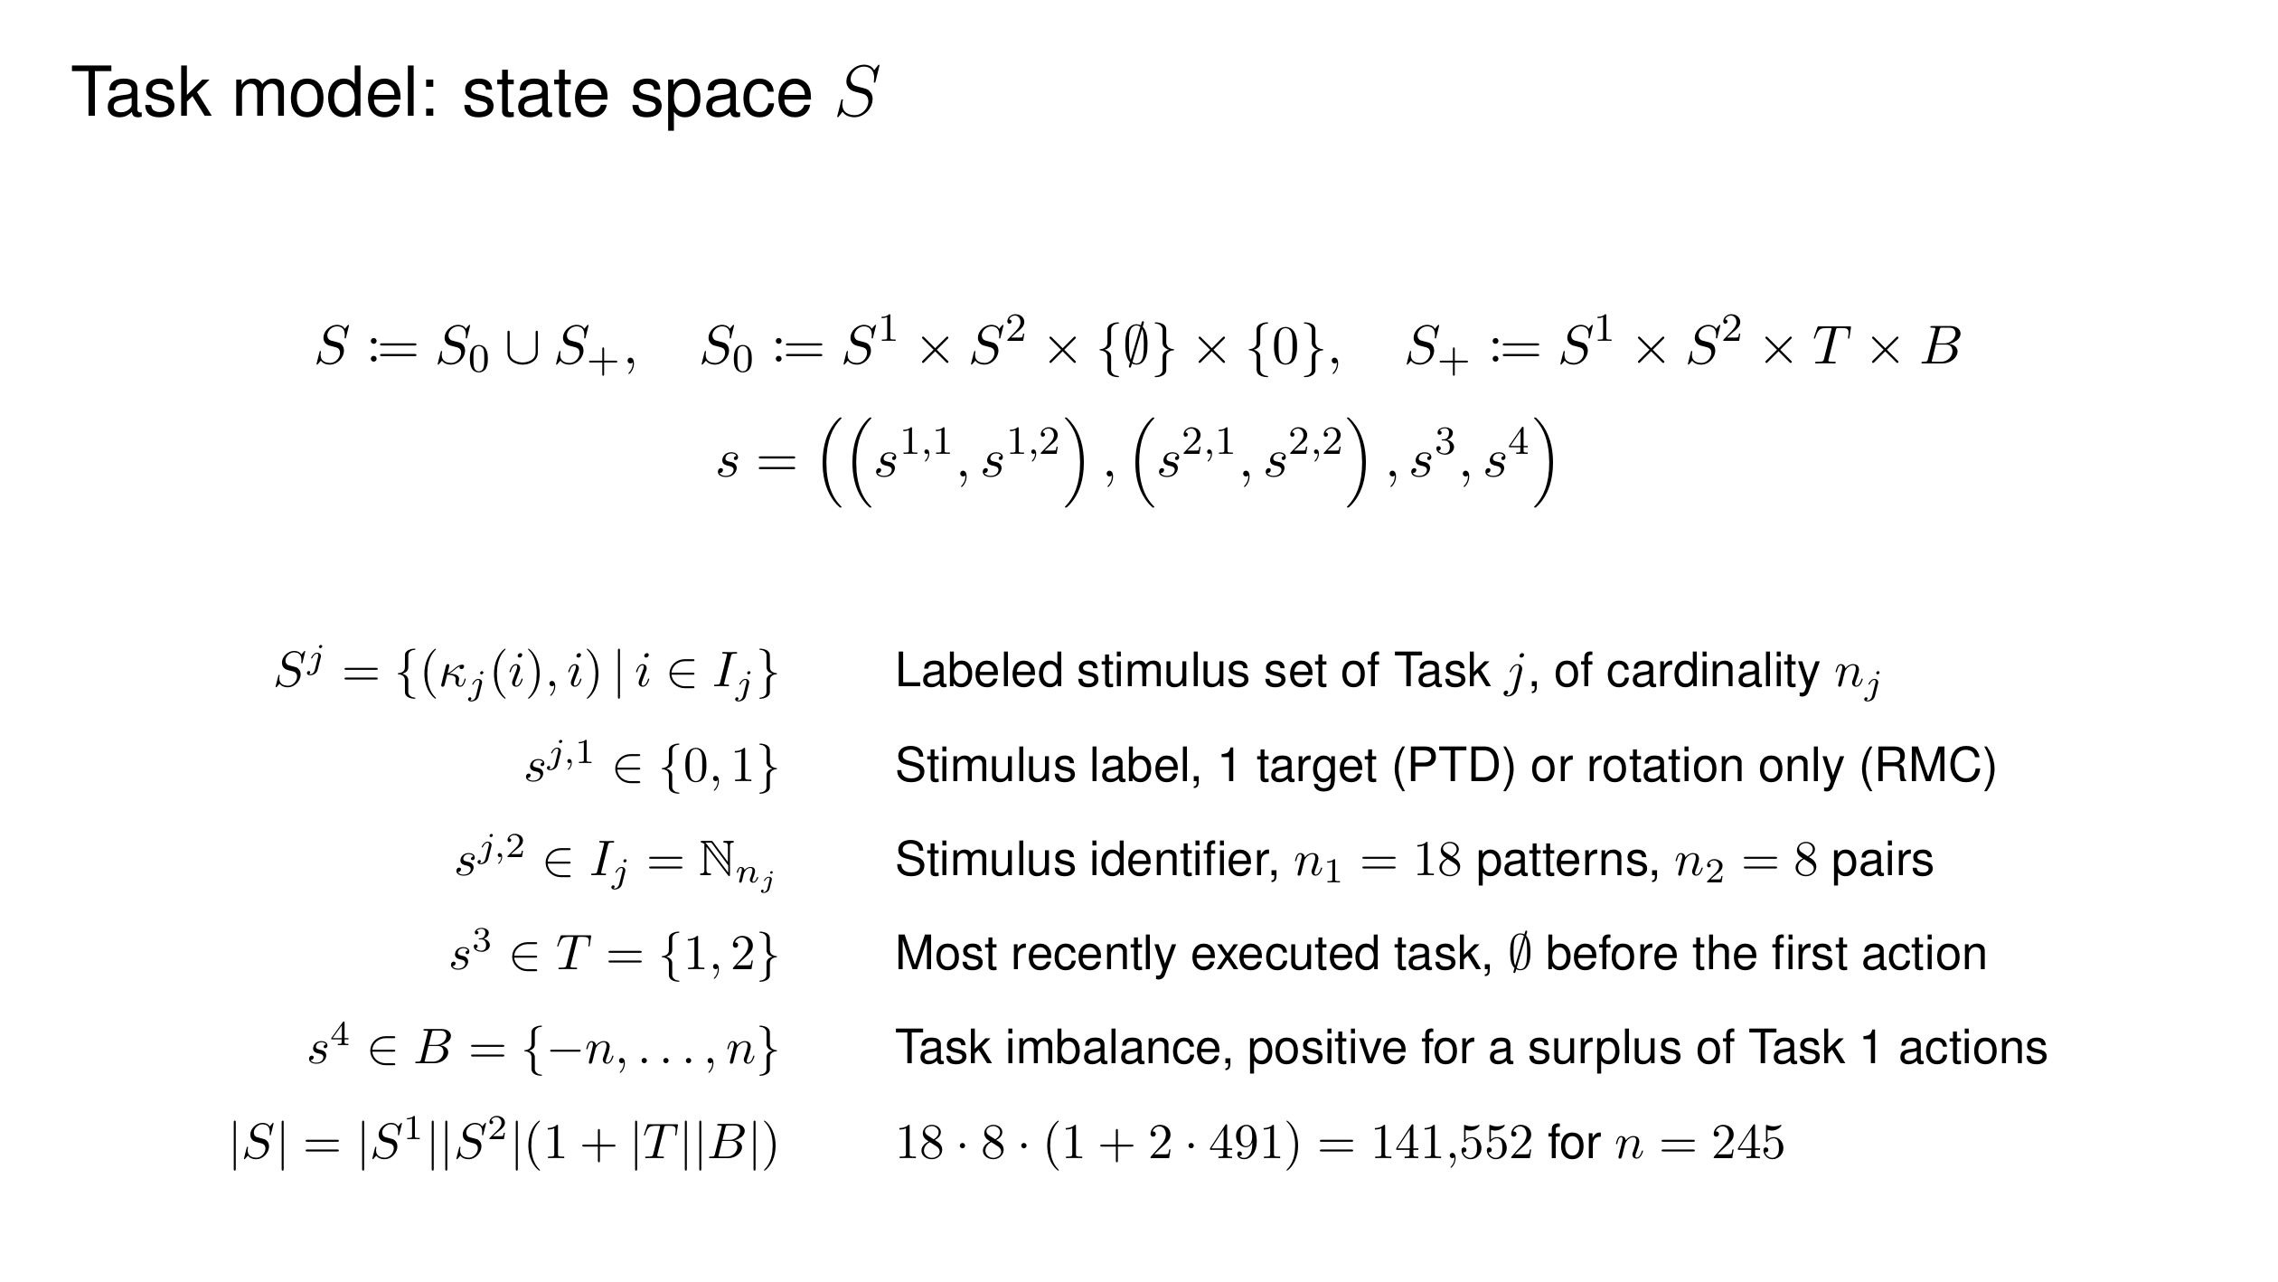

Slide 44
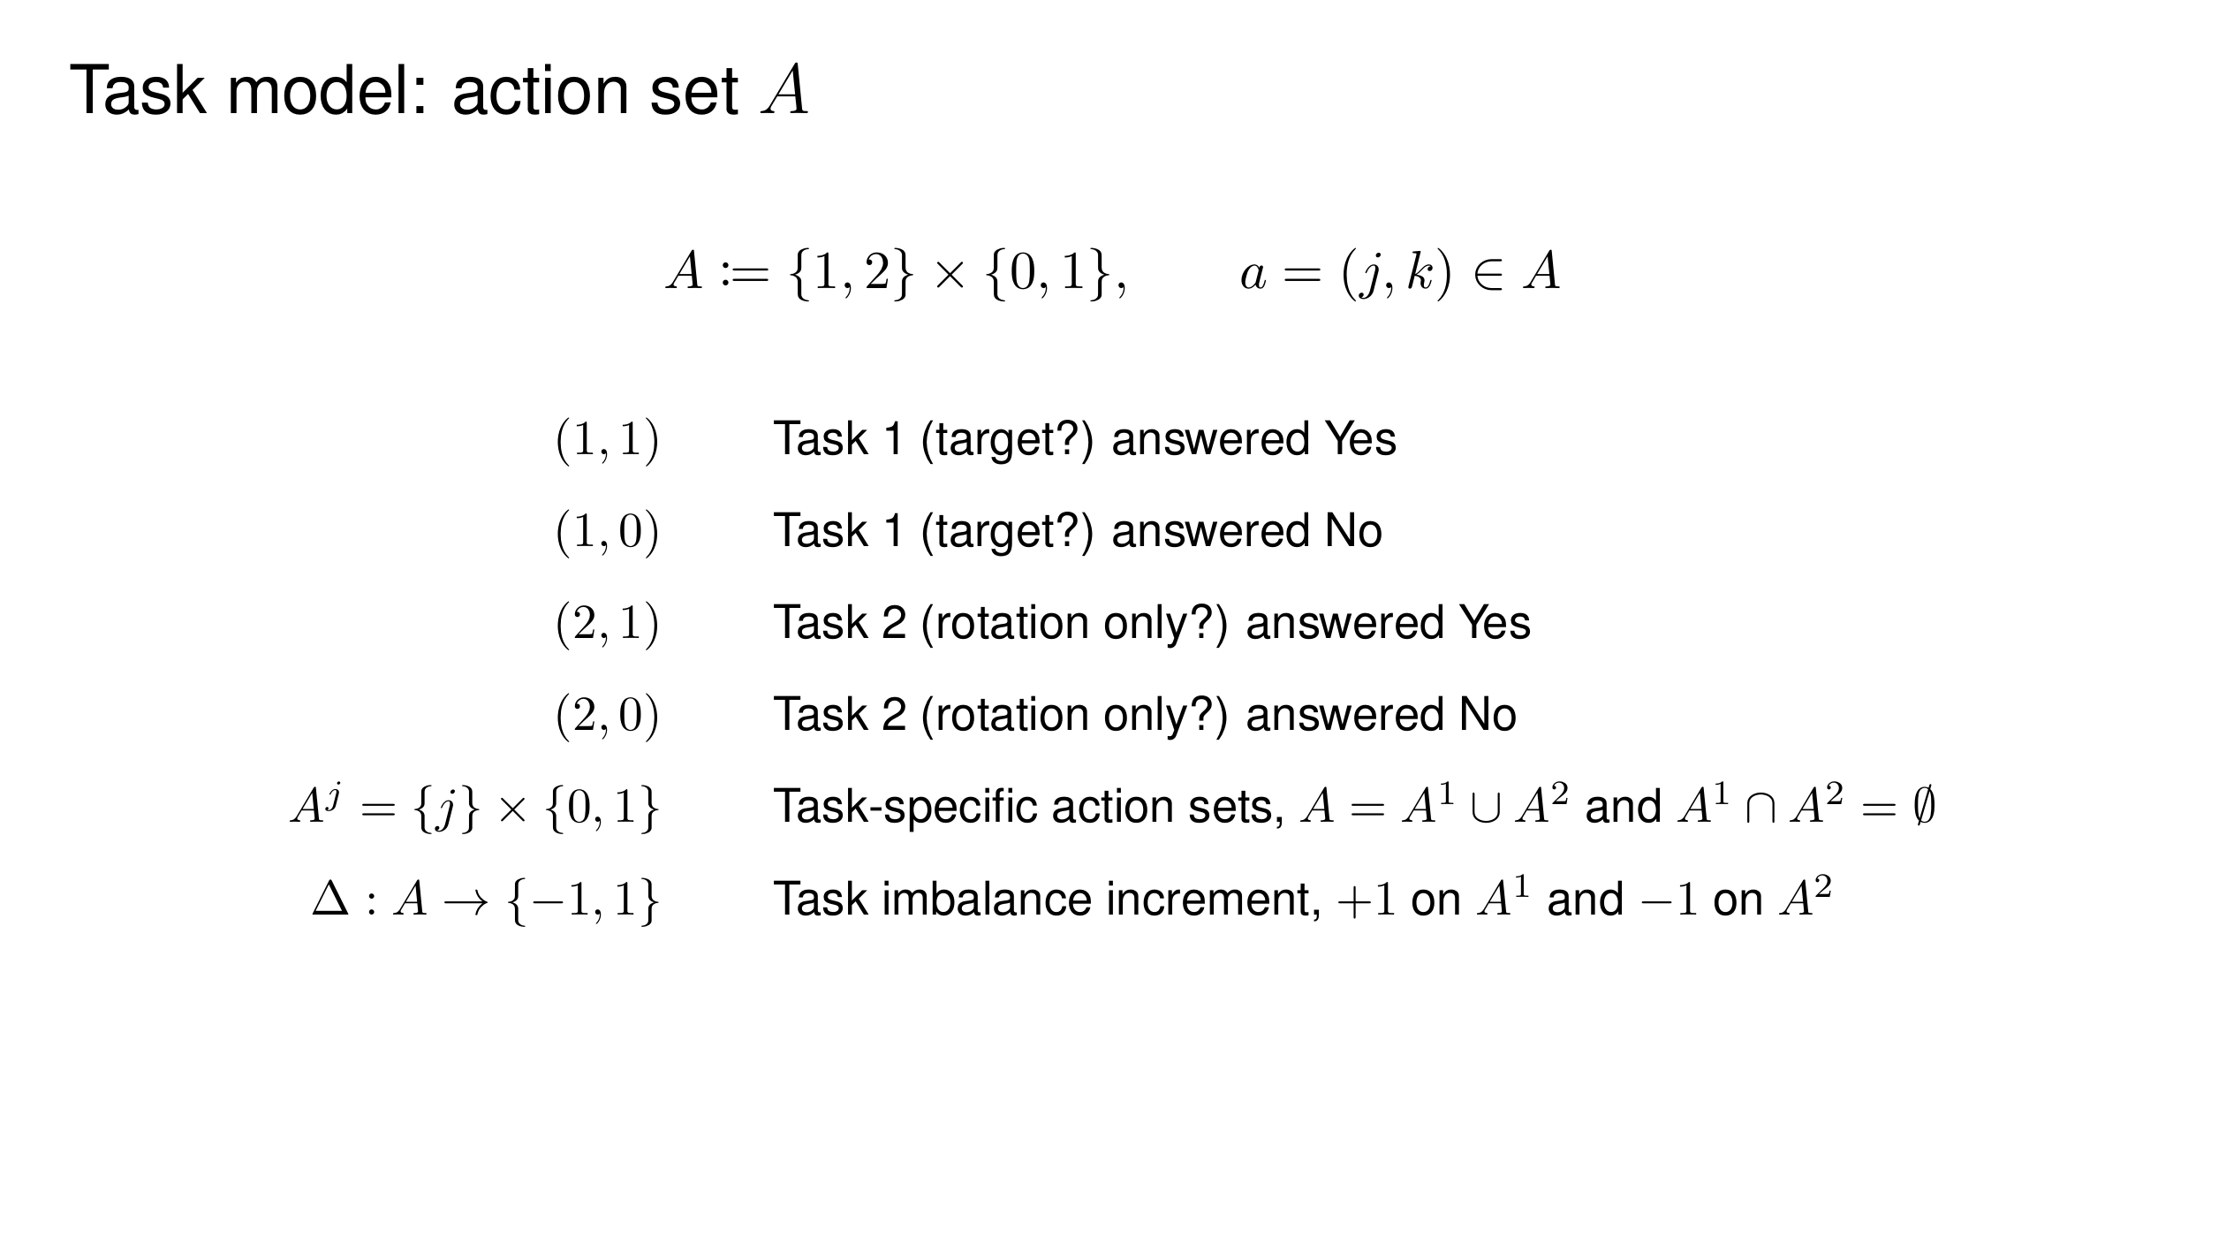

Slide 45
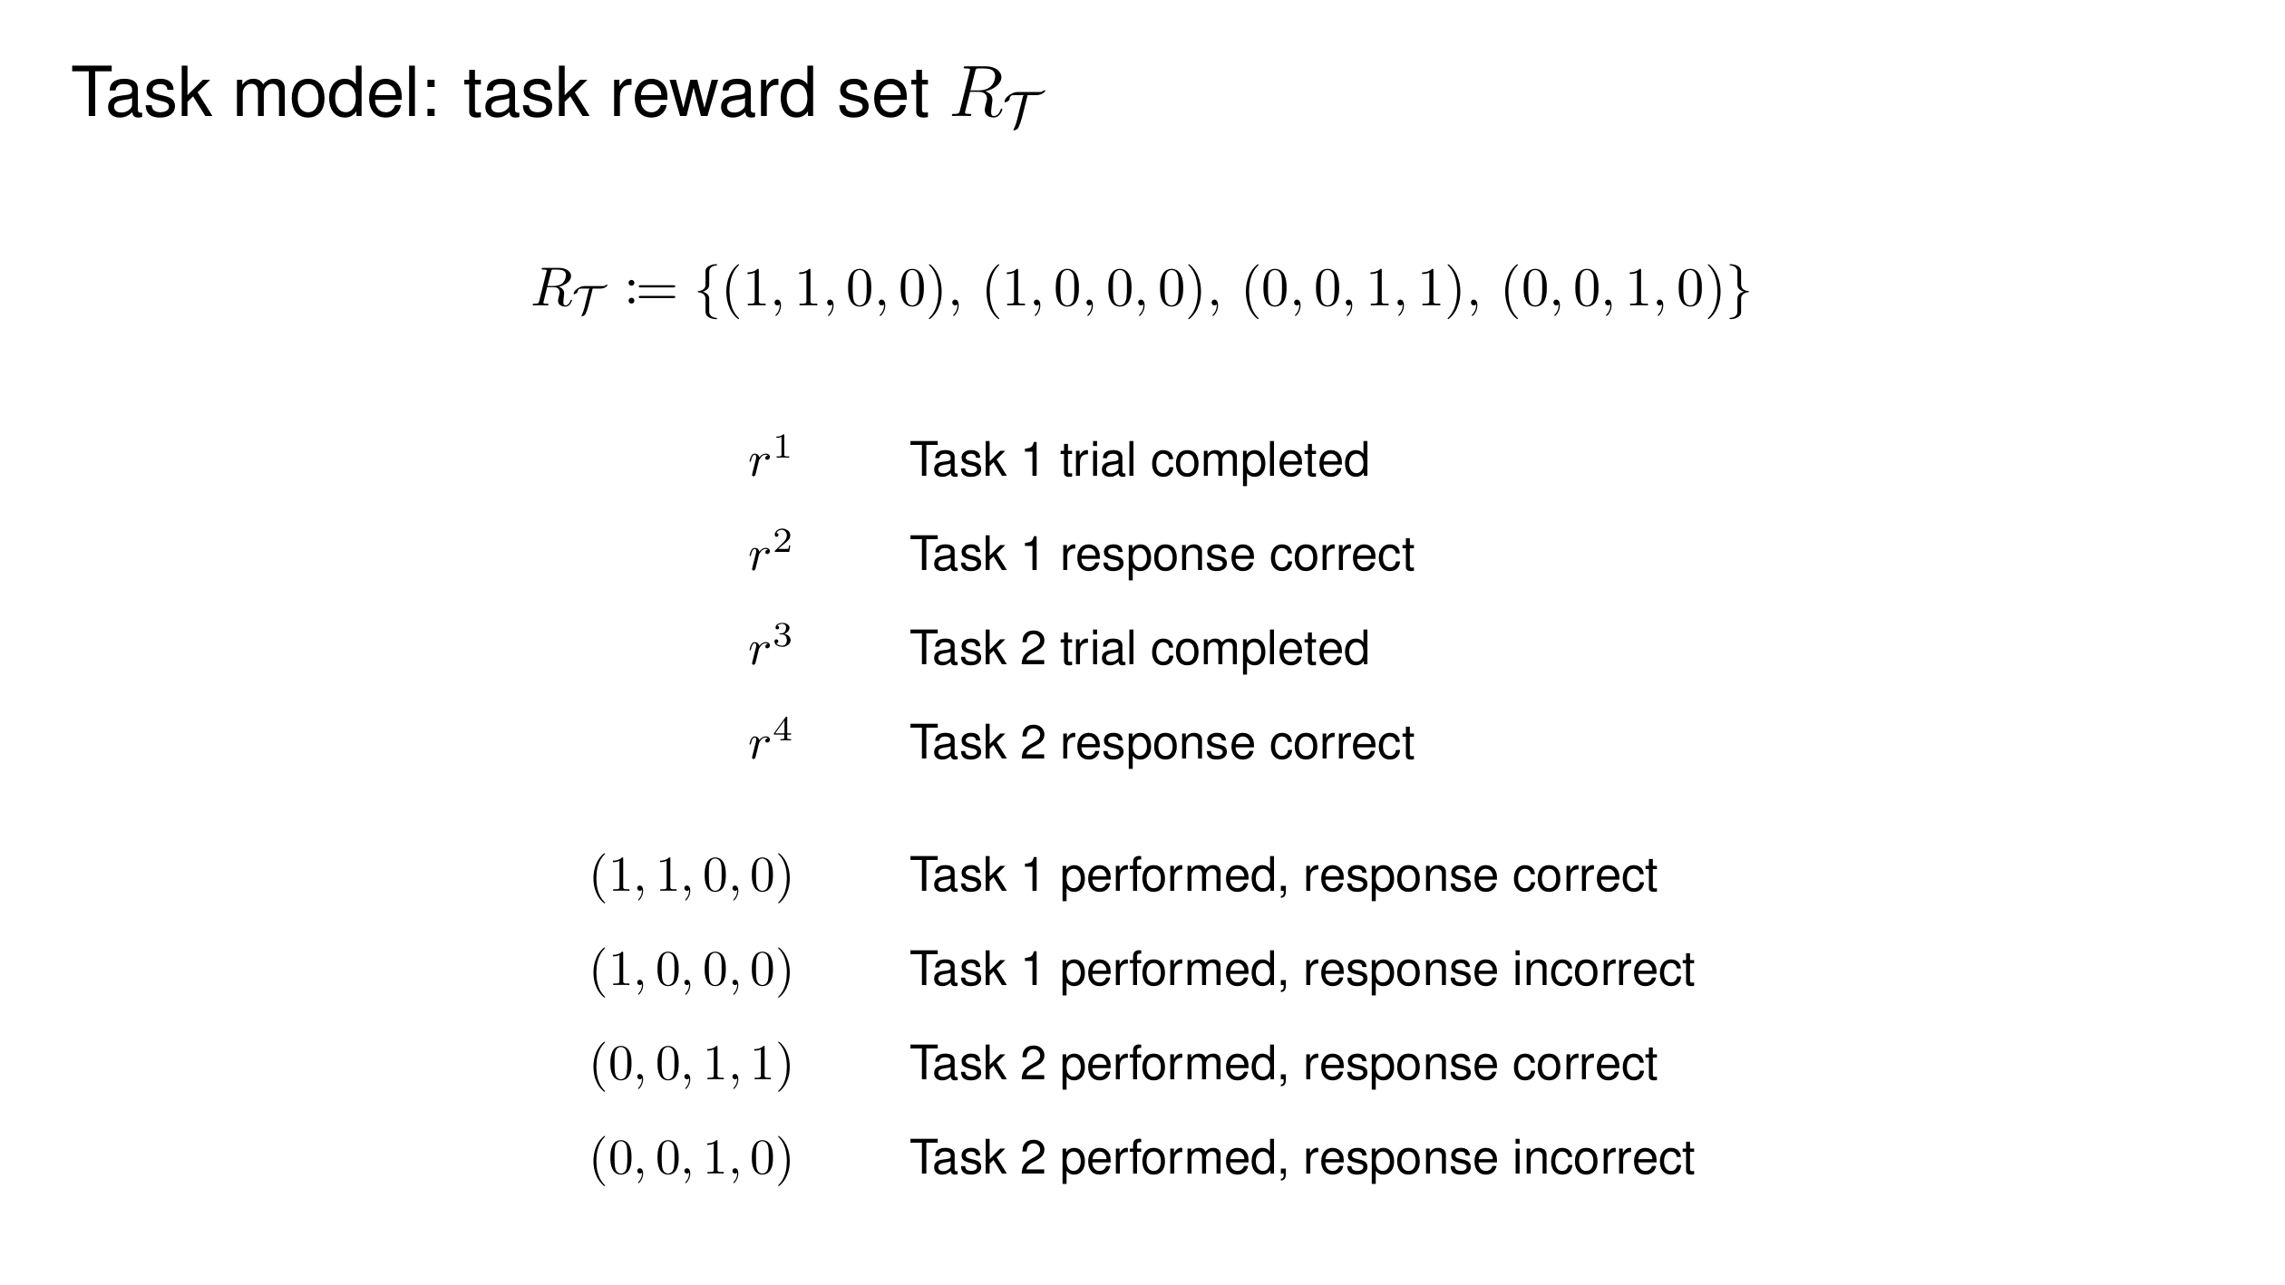

Slide 46


Slide 47


Slide 48


Slide 49


Slide 50


Slide 51


Slide 52


Slide 53


Slide 54


Slide 55


Slide 56


Slide 57


