Slide 1
FOR 6047 - Organization

Slide 2
Dorina Weichert,
Coordinating Post-Doc
My Tasks include:
Coordination of the Research Unit
  Managing Data, Code, Files
  Organizing Joint Meetings
Organization of the PhD program
Ensuring joint work, by:
  Joint PhD papers
  A Meta-Analysis in the Field of Voluntary Task-Switching
  Model Comparisons
  Writing a Benchmark List
  Organizing a Conference and a Special Issue
Placeholder for a Photo
Coordinating Post-Doc
PhD in Computer Science
Bachelor & Master in Mechanical Engineering
___________________________
German Sports University Cologne
Institute for Psychology
Department for Performance Psychology
Building VI, Room 121
P: +49 221/ 4982-5515
M: d.weichert@dshs-koeln.de
You can always reach out to me.
I‘m here to support you.

Slide 3

How to organize…
Organizing the Project

Slide 4
General Project Organization
Files, e.g.,:
  Proposals
  Slides and Documents from Joint Meetings
  Templates in Corporate Design
Meeting Organization
Communication
On sciebo:
https://dshs-koeln.sciebo.de/s/sW66sffkTTWKDbP
via DFN: https://terminplaner6.dfn.de/
Discord: https://discord.gg/Yt7vDDPTV
Mail → please contact Dorina if you‘re not in the mailing list

Slide 5
Sharing and Documenting your Experiments, Data & Code
Your Data
  FAIR Metadata
  Data itself (shareable .csv with all columns)
Your Code
Joint Literature Server
Depending on data type
  RDMO → use Tuebingen?
  Github and Sciebo → Please reach out to Dorina in case of large data (> 500 MB).
Github: https://github.com/FOR-6047/FOR_6047_Sandbox.git
Zotero group. You‘ll get an invitation by mail.
Notes:
Why mendeley?
Zotero not for groups with larger 300 MB, Citavi/Endnote $$,

Slide 6
Sharing and Documenting your Experiments, Data & Code
Your Publications, Data and Code
Documenting your project
Mentioning the FOR in your papers (mandatory!)
https://psycharchives.org/
Please preregister your experiments at prereg and do open science :.)
„Gefördert durch die Deutsche Forschungsgemeinschaft (DFG) – 564829065“
„funded by the Deutsche Forschungsgemeinschaft (DFG, German Research Foundation) – 564829065“
Notes:
Why mendeley?
Zotero not for groups with larger 300 MB, Citavi/Endnote $$,

Slide 7
Versioning your Code using Git(hub)

Slide 8
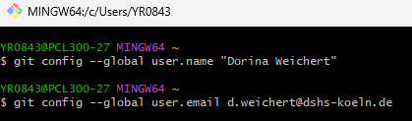
Git – first steps
Download the software from https://git-scm.com/install/ and install. Usually, default options work. If you have questions, reach out :.)
If installing for the first time, setup your user name and mail in your favourite shell, e.g. windows powershell, bash, .. (example in git bash):
Username and mail will be used when working collaboratively

Slide 9
Git – first steps
If not already done, create a free account on www.github.com, using the mail address you are also using as your global git credentials
Please let me know your username or the mail address you used, so I can invite you to the FOR 6047 organization

Slide 10
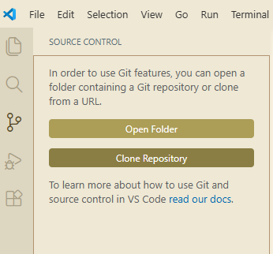


Git – first steps
In your IDE, e.g., VS Code, Rstudio, …, checkout https://github.com/FOR-6047/FOR_6047_Sandbox.git
Example in VS Code:
Select path on your local computer, download and open the repo

Slide 11
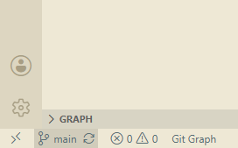
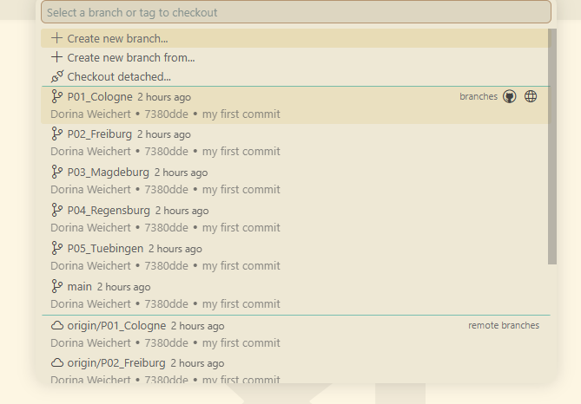
Fetch your git branch
Example in VS Code (continued):
On lower left:
In the arising menu, select the branch related to your subproject
Now all the changes you make are only tracked
with reference to your subproject

Slide 12
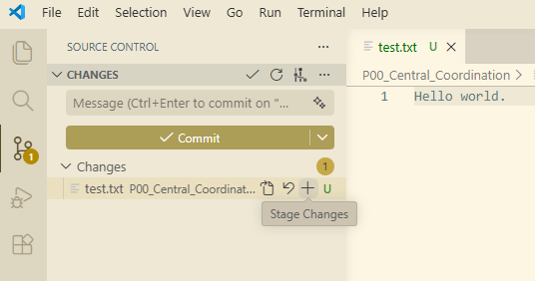
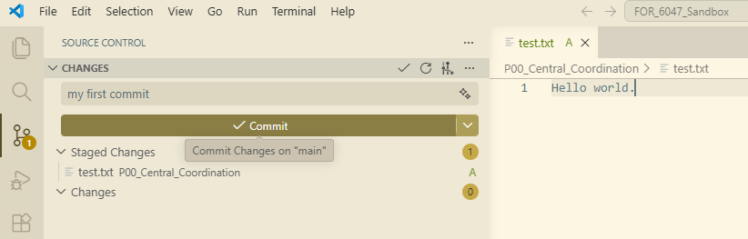
Git – first steps
On your local system, change a file.
If you want to keep the changes, stage them (you can select multiple files that all belong to a specific task)
Write a commit message shortly describing your changes and press commit: now, on your local system, all your changes are registered to git
Commit message

Slide 13
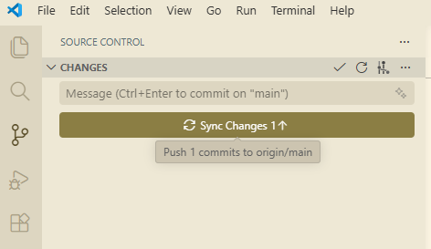
Git – first steps
If you know want to publish your changes for all users, push them
Now, the changes are „in the cloud“, but still on the subproject-related branch

Slide 14
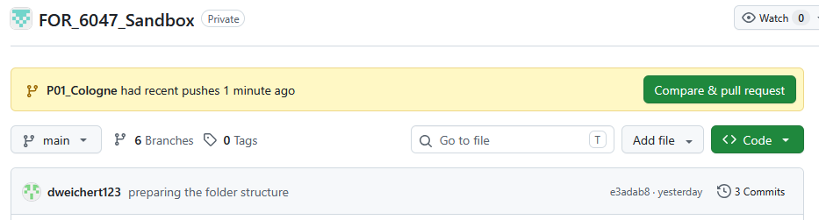
Git – first steps
If your changes are viable for the whole project, create a pull request:
On https://github.com/FOR-6047/FOR_6047_Sandbox login with your github account
Click on compare and create a pull request

Slide 15
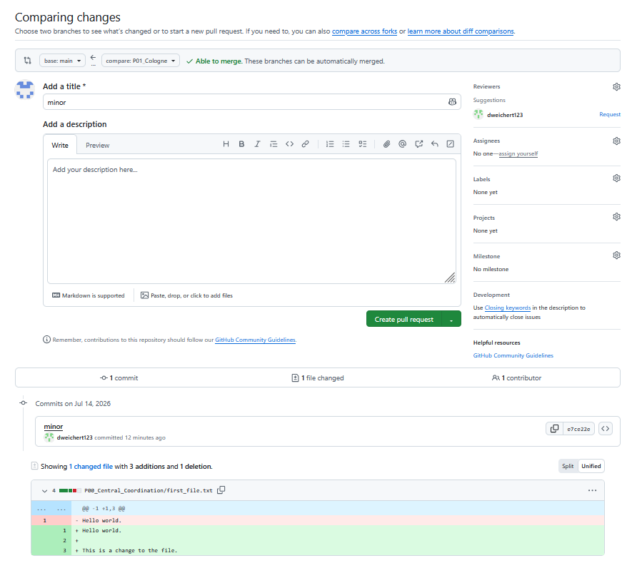
Git – first steps
1.
This will open another page. There are three important parts:
Check if „base“ is main and „compare“ your branch. This means that changes from your branch will be inserted into main.
Describe what you have done.
Check that dweichert123 is the suggested reviewer.
Below it shows what exactly has changed. Red: deletions, green: additions
2.
3.

Slide 16
Git – first steps
What happens next?
Dorina will review the changes in your pull request and merge it into the main branch.
Please do not do it yourself, but let a second set of eyes check the code.

Slide 17
Git – organization
Please commit your changes as fine-grained as necessary
(Proposal:) At the end of the week, (e.g. Friday, 2 pm), create the pull request, so I can merge everything as soon as possible

Slide 18
RDMO: Questions
Use RDMO from Uni Tuebingen (https://rdmo.dh-center.uni-tuebingen.de/)? X (Login via Orcid ID possible!)
  Contact (I think someone from Tuebingen should ask!): Digital Humanities Center, steve.kaminski@uni-tuebingen.de, is linked
OTH Regensburg (https://rdmo.oth-regensburg.de/)
Osnabrück (https://osnaplan.ub.uni-osnabrueck.de/)
Alternativ: selbst aufsetzen, aber benötigt Hard- und Software für Webserver, Zugriff auf Mailserver, …

Slide 19
RDMO setup TODOs (Dorina Slide)
IT department: ask for help OR at least for port for a Linux webserver and a Mail account
https://rdmo.readthedocs.io/en/latest/installation/index.html
Setup a RDMO on a Linux (web)server, so we can launch RDMO as a web service with a dedicated user account (works also with WSL2)
Install a database (Postgres, MySQL, or SQLite)
Setup Apache server
Configure Mail Server (RDMO needs to send E-Mails to its users)
Help and documentation:
  https://rdmo.readthedocs.io/en/latest/faq/index.html
  https://www.forschungsdaten.org/index.php/RDMO_FAQ

Slide 20
Login to our RDMO
Who? The PhD
When? update every ½ year 1 week before joint meeting (I‘ll check :.))
What? Document your data, e.g., what kind of data there is, who is responsible, …

Slide 21
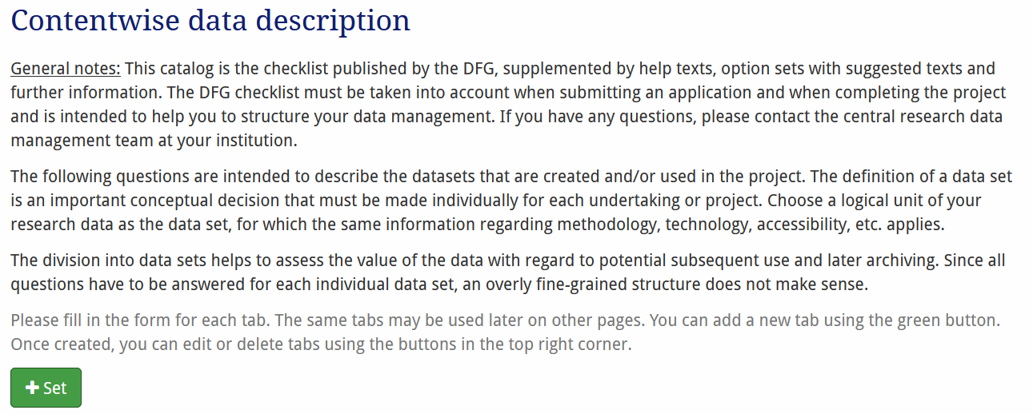
RDMO documentation
Proposal: one data set per subproject or is there more?

Slide 22
RDMO documentation – the form
Contentwise Data Description
  How does your project generate new data?
  Are existing data reused?
Technical Data Description
  Which data types in terms of data formats arise in your project?
  In what way is the data processed in your project?
  What is the anticipated data volume?
Documentation and Data Quality
  Documentation
    What approaches are being taken to describe the data in a comprehensible manner? (Proposal: datawiz (https://datawiz.leibniz-psychology.org/DataWiz/))
    What digital methods and tools (e.g. software) are required to use the data?
  Data Quality
    What measures are being adopted to ensure high data quality?
    Are quality controls foreseen and if so, how do they operate?

Slide 23
RDMO documentation – the form
Storage and technical protection measures during the project
  How are data stored and secured during the project duration?
  What is in place to address security of sensitive data during the project (access and use controls)?
Legal obligations and conditions
  Publication restrictions (Do you anticipate any implications or restrictions regarding subsequent publication or accessibility?)
  Scientific specifics (Are there any significant research codes or professional standards to be taken into account?)
  Legal restrictions
    How are aspects of use and copyright law as well as ownership issues considered?
    Which further legal specifics apply to the handling of research data in your project?

Slide 24
RDMO documentation – the form
Data exchange and long-term data accessibility
  Reuse
    Are these data suitable for subsequent use in other contexts?
    Which criteria are used to select research data to make them available for subsequent use by others?
    When are the research data available for use by third parties?
  Archival
    Are you planning to archive your data in a suitable infrastructure? How and where?
Responsibilities and Resources
  Responsibilities
    Who is responsible for adequate handling of the research data?
    Who is responsible for curating the data after the end of the project?
  Resources
    Which resources (costs, time or other) are required to implement adequate handling of research data within the project?

