Slide 1
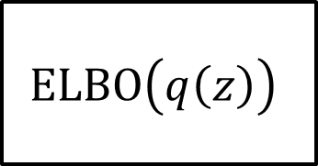


$$\ln{p(y)}=\ln{∫p(y,z)}dz$$
$$ELBO\left(q\left(z\right)\right)$$
$$KL(q(z)|\left|p\left(z | y\right)\right)$$

