Slide 1
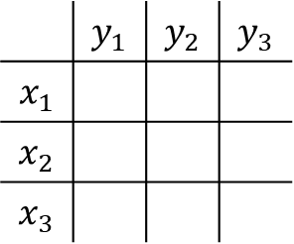
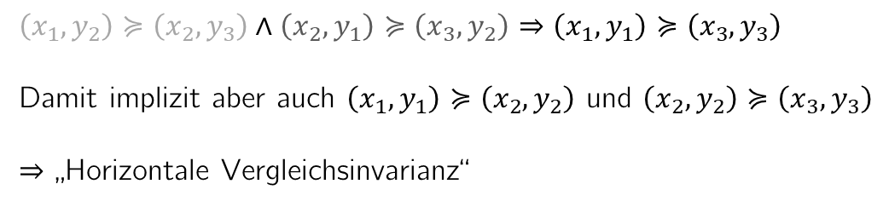
 | $$y_{1}$$ | $$y_{2}$$ | $$y_{3}$$
$$x_{1}$$
$$x_{2}$$
$$x_{3}$$
$\left(x_{1},y_{2}\right)≽\left(x_{2},y_{3}\right)∧\left(x_{2},y_{1}\right)≽\left(x_{3},y_{2}\right)⇒\left(x_{1},y_{1}\right)≽\left(x_{3},y_{3}\right)$
Damit implizit aber auch $\left(x_{1},y_{1}\right)≽\left(x_{2},y_{2}\right)$ und $\left(x_{2},y_{2}\right)≽\left(x_{3},y_{3}\right)$
$⇒$ „Horizontale Vergleichsinvarianz“

