Slide 1
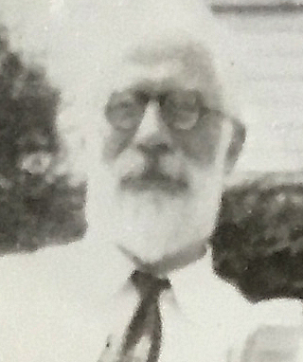
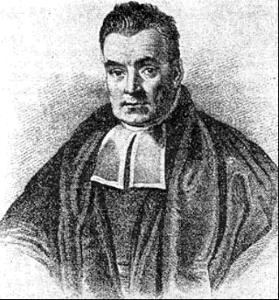
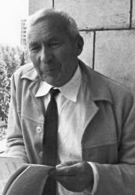
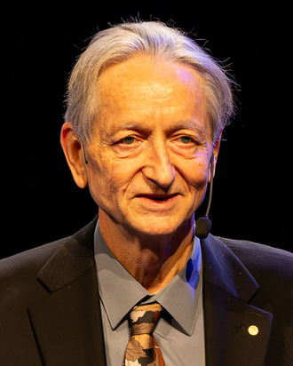
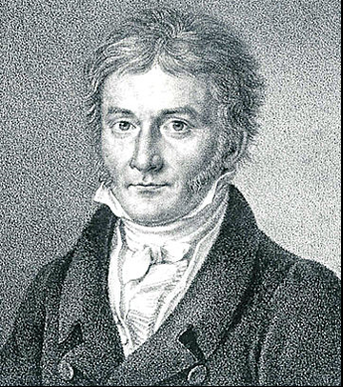
1920s
1948
1977
Late 1990s
Factor analysis
1925–1935
Information theory
Expectation maximization
Variational inference
Charles Spearman (1927)
Frequentist statistics
Claude E. Shannon
Dempster, Laird & Rubin
Jordan, Ghahramani,
2017
R. A. Fisher
Jaakkola & Saul (1999)
Transformers
Neyman & Pearson (1933)
Vaswani et al.
1763
Bayes’ theorem
2015
Thomas Bayes
1933
1962
1997
Deep learning
1922
Probability axioms
The Future of
“Statistics =
LeCun, Bengio & Hinton
Central limit theorem
A. N. Kolmogorov
Data Analysis
Data Science?”
2022
J. W. Lindeberg
John W. Tukey
C. F. Jeff Wu
ChatGPT
OpenAI
PROBABILITY AND STATISTICS
1946–1953
DATA SCIENCE
Monte Carlo & MCMC
Postwar Los Alamos
1986
2006–2007
Metropolis algorithm (1953)
Backpropagation
GPU computing / CUDA
Rumelhart, Hinton
NVIDIA
& Williams
ALGORITHMS
2012
AlexNet
Geoffrey Hinton
ImageNet breakthrough
1795 / 1805
1901
1967
Least squares
Principal components
1945
Nearest neighbours
Gauss / Legendre
Karl Pearson
Stored-program
Cover & Hart
1990s–2000s
architecture
Machine learning
John von Neumann
Support vector machines (1995)
Random forests (2001)
Carl Friedrich Gauss
DATA AND COMPUTING
1980
Gigabyte disk storage
1991
IBM 3380
Python
Guido van Rossum
1936
1970
1985
1989–1991
Universal computation
Relational databases
C++
World Wide Web
Alan Turing
E. F. Codd
Bjarne Stroustrup
Tim Berners-Lee
Notes:
Adapted from the user-provided page of Florian Huber, Introduction to Data Science (for not-yet-scientists), v0.13, Fig. 2.1. The two historical portraits are reproduced from that supplied figure. The traditional Bayes portrait is illustrative, not an authenticated likeness.
The three-strand layout is schematic and is not a proportional time axis or an assertion that all fields merge into a single method. The original first neural-network-machine milestone is omitted to leave room for the requested additions. The original generic 1920 CLT label is replaced by Lindeberg (1922). Gauss claimed earlier use of least squares in 1795; Legendre published in 1805.
Fisher is placed in 1925–1935, with Neyman–Pearson testing distinguished by its 1933 date. Monte Carlo emerged in the postwar Los Alamos setting, following wartime computational work, around 1946–1949. Markov chain Monte Carlo is represented by the 1953 Metropolis algorithm, not dated to WWII. Deep learning in 2015 refers to the landmark review and the field's prominence, not its invention. Random forests are dated to Breiman (2001), separately from SVMs (1995).
Sources for additions and corrections:
Fisher, The Design of Experiments (1935), preface also discussing Statistical Methods for Research Workers (1925): https://mimno.infosci.cornell.edu/info3350/readings/fisher.pdf
Neyman & Pearson (1933): https://doi.org/10.1098/rsta.1933.0009
Metropolis, The Beginning of the Monte Carlo Method (1987): https://mcnp-green.lanl.gov/pdf_files/Article_1987_LAS_Metropolis_125--130.pdf
Metropolis & Ulam (1949): https://doi.org/10.1080/01621459.1949.10483310
Metropolis et al. (1953): https://www.osti.gov/biblio/4390578
Cortes & Vapnik (1995): https://doi.org/10.1007/BF00994018
Breiman (2001): https://doi.org/10.1023/A:1010933404324
Rumelhart, Hinton & Williams (1986): https://www.cs.toronto.edu/~hinton/absps/naturebp.pdf
AlexNet (2012): https://proceedings.neurips.cc/paper/2012/hash/c399862d3b9d6b76c8436e924a68c45b-Abstract.html
LeCun, Bengio & Hinton, Deep learning (2015): https://www.nature.com/articles/nature14539
Vaswani et al. (2017): https://arxiv.org/abs/1706.03762
OpenAI, Introducing ChatGPT (30 November 2022): https://openai.com/index/chatgpt/
CUDA: https://developer.nvidia.com/blog/cuda-refresher-getting-started-with-cuda/ and https://developer.nvidia.com/content/cuda-toolkit-11-june-2007
ADDITIONAL SOURCES AND HISTORICAL CONTEXT
Factor analysis: placed in the 1920s through Charles Spearman's The Abilities of Man (1927), with roots in his 1904 work. This is a consolidation milestone, not a claim that factor analysis began in 1927. https://wellcomecollection.org/works/evdevd8m ; https://www.nature.com/articles/120181a0
John W. Tukey (1962), The Future of Data Analysis: https://doi.org/10.1214/aoms/1177704711
EM: Arthur P. Dempster, Nan M. Laird & Donald B. Rubin (1977): https://academic.oup.com/jrsssb/article/39/1/1/7027539
Variational inference: Michael I. Jordan, Zoubin Ghahramani, Tommi S. Jaakkola & Lawrence K. Saul (1999), An Introduction to Variational Methods for Graphical Models. The late 1990s label reflects modern graphical-model methodology, not the origin of variational or mean-field methods. https://people.eecs.berkeley.edu/~jordan/papers/variational-intro.pdf
Alan Turing (1936), On Computable Numbers, with an Application to the Entscheidungsproblem: https://www.cs.virginia.edu/~robins/Turing_Paper_1936.pdf
John von Neumann (1945), First Draft of a Report on the EDVAC: https://www.computerhistory.org/timeline/1945/ . The name identifies the report and associated architecture, not sole invention; Eckert, Mauchly and others also contributed.
C++ (1985) is the first commercial release, by Bjarne Stroustrup. Work began in 1979 and the name dates to 1983. https://www.stroustrup.com/bs_faq.html
Python (1991) is the first public release, by Guido van Rossum. https://docs.python.org/3/faq/general.html#why-was-python-created-in-the-first-place
World Wide Web: Tim Berners-Lee's proposal (1989), first browser/server (1990), and public announcement (1991). https://home.cern/science/computing/the-birth-of-the-web/ ; https://timeline-upgrade.web.cern.ch/timeline-header/90
PORTRAIT CREDITS
Fisher (1952): Barry Eagel, CC BY-SA 4.0. Cropped and resized. https://commons.wikimedia.org/wiki/File:Ronald_Aylmer_Fisher_1952.jpg ; https://creativecommons.org/licenses/by-sa/4.0/
Kolmogorov: Konrad Jacobs, copyright MFO, CC BY-SA 2.0 Germany. Cropped and resized. https://commons.wikimedia.org/wiki/File:Andrej_Nikolajewitsch_Kolmogorov.jpg ; https://creativecommons.org/licenses/by-sa/2.0/de/
Hinton (2024): Arthur Petron, CC BY-SA 4.0. Cropped and resized. The photo is not from the year of the milestone. https://commons.wikimedia.org/wiki/File:Geoffrey_E._Hinton,_2024_Nobel_Prize_Laureate_in_Physics.jpg ; https://creativecommons.org/licenses/by-sa/4.0/
These adapted portraits retain their respective Creative Commons licenses. Bayes and Gauss portraits are reproduced from the supplied reference figure.
Remaining milestones follow the supplied reference figure. Bibliographical sources above are hyperlinks for verification, not endorsements.

