Slide 1
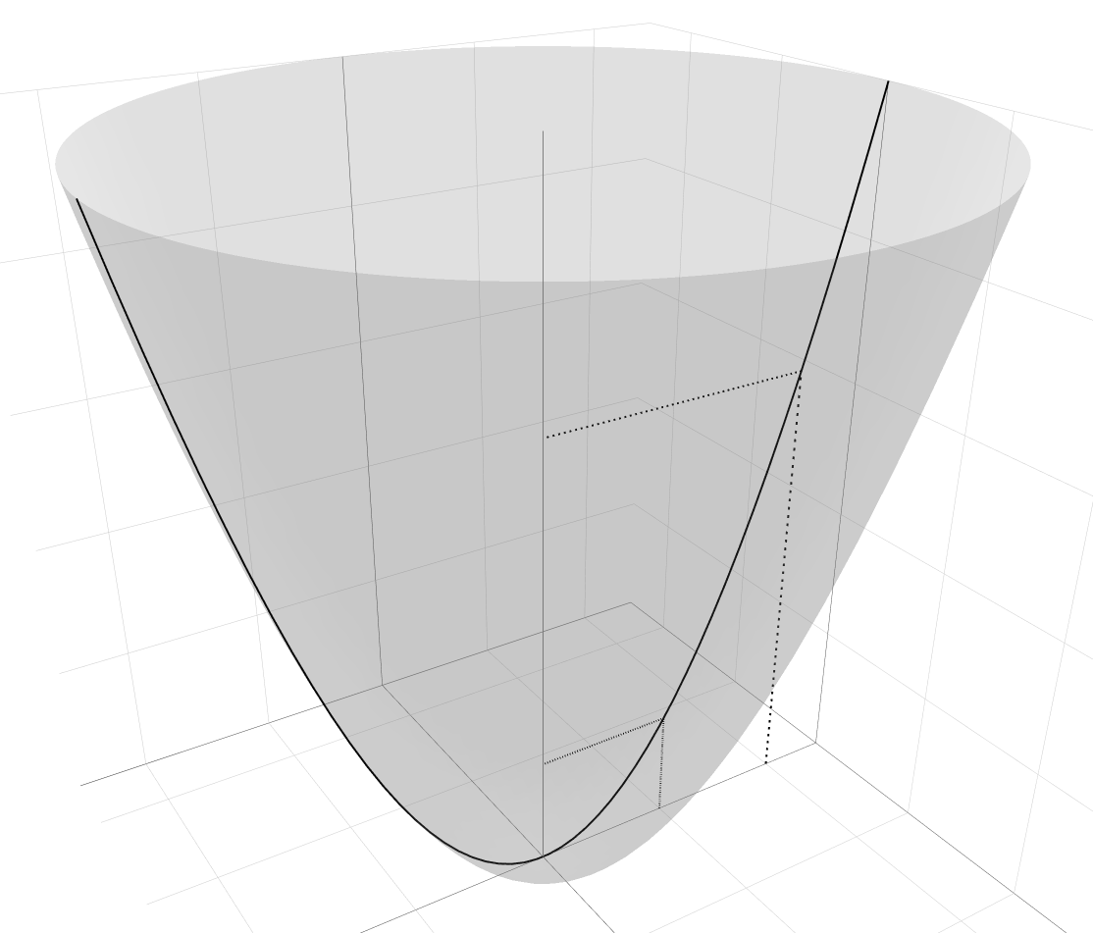











$$f\left(\left(x,y\right)\right)≔x^{2}+y^{2}$$
$${\tilde{f}}_{0}\left(x\right)≔x^{2}$$
$$f(a+he_{1})$$
$$f\left(a+he_{1}\right)−f\left(a\right)$$
$$e_{1}$$
$x$-Achse
$$he_{1}$$
$$f(a)$$
$$a+he_{1}$$
$$a$$
$y$-Achse

