Slide 1

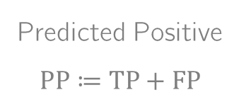


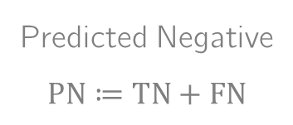

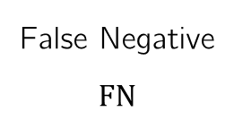
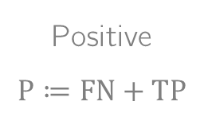
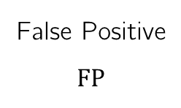
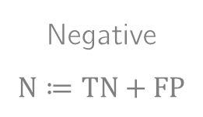


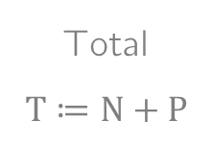
Prädiktion
$$f(x_{i})=0$$
$$f(x_{i})=1$$
True Negative
$$TN$$
False Positive
$$FP$$
Negative
$$N≔TN+FP$$
$$y_{i}=0$$
Wahres Label
False Negative
$$FN$$
True Positive
$$TP$$
Positive
$$P≔FN+TP$$
$$y_{i}=1$$
Predicted Negative
$$PN≔TN+FN$$
Predicted Positive
$$PP≔TP+FP$$
Total
$$T≔N+P$$

