Slide 1
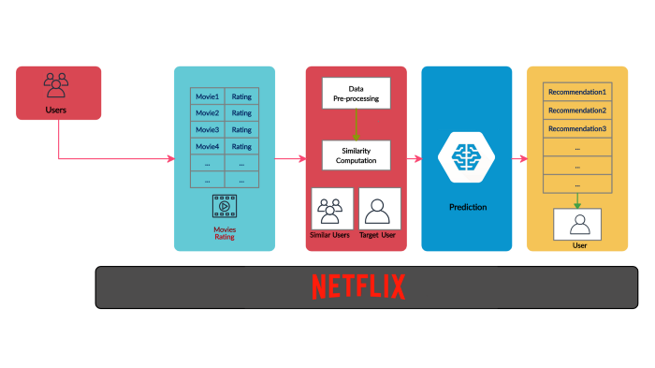





https://towardsai.net/

