Slide 1

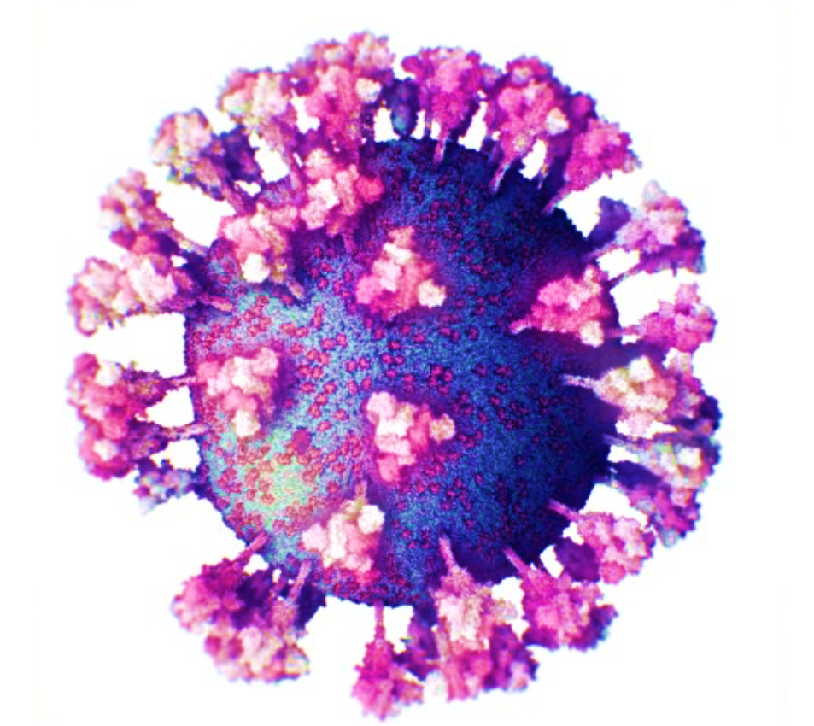



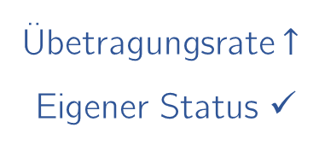
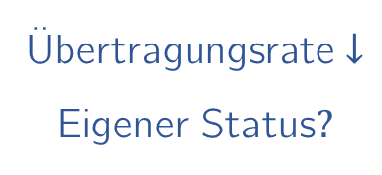
Übertragungsrate $↓$
Eigener Status$?$
Symptome
Übetragungsrate$↑$
Eigener Status ✓
Notes:
Situation: Exhibiting Corona Symptoms
Scenario I (= Trial Type I)
Two courses of action
Home quarantine, unreliable self-administered antigen test
Unobserved reward: Corona incidence $⇓$
Information: no certainty about personal status
$⇒$ a potentially lucrative, but non-informative course of action
Public transport, reliable medically administered PCR test
Unobserved reward: Corona incidence $⇑$
Information: certainty about personal status
$⇒$ a potentially detrimental, but informative course of action
Scenario II (= Trial Type II)
- Two courses of action
Home quarantine, highly reliable administered test by a medically trained relative
Unobserved reward: Corona incidence $⇓$
Information: high uncertainty about personal status
$⇒$ a potentially lucrative and informative action
Public transport, unreliably admintested antigen test by some newly trained person
Unobserved reward: Corona incidence $⇑$
- Information: no certainty about personal status
$⇒$ a potentially detrimental, and non-informative course of action

