Slide 1
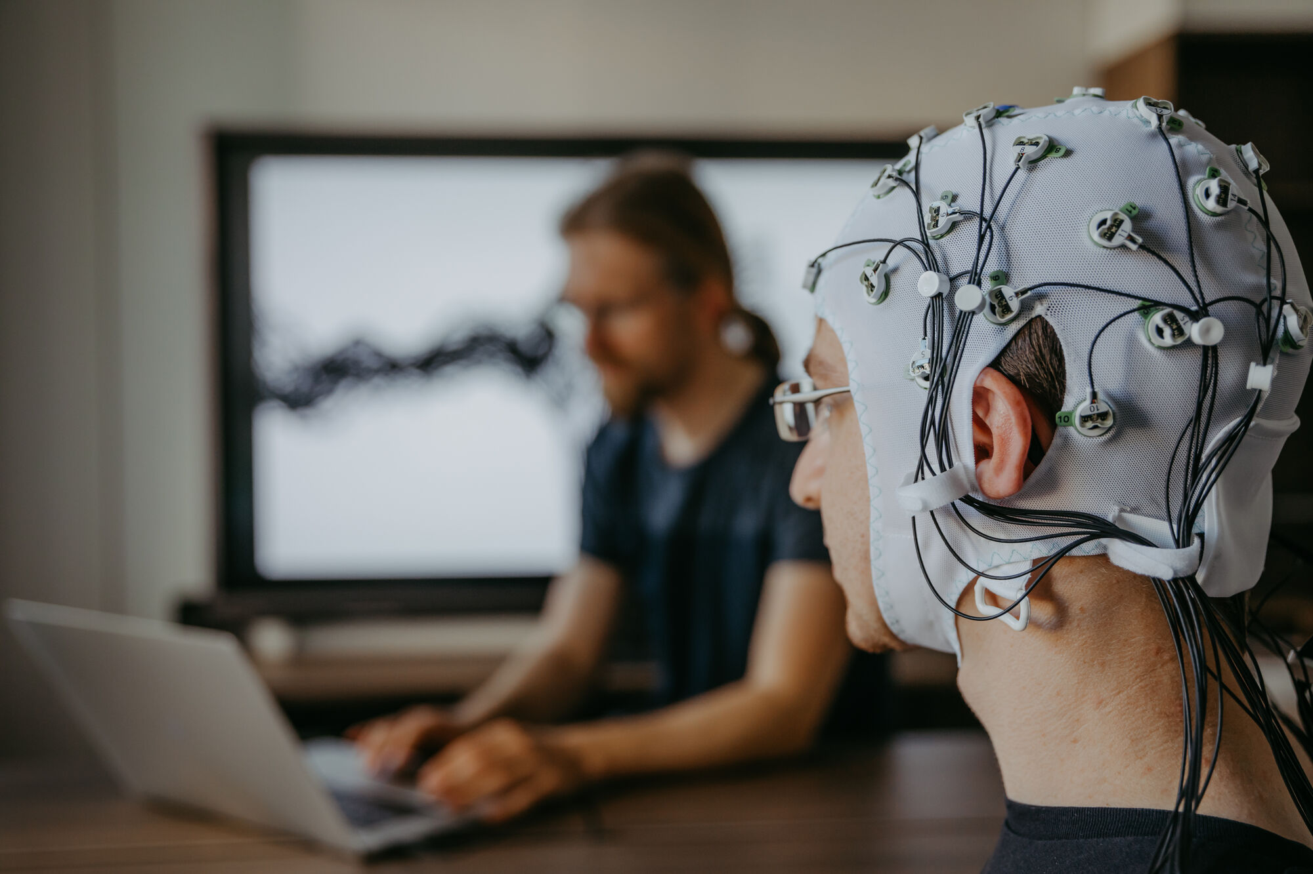
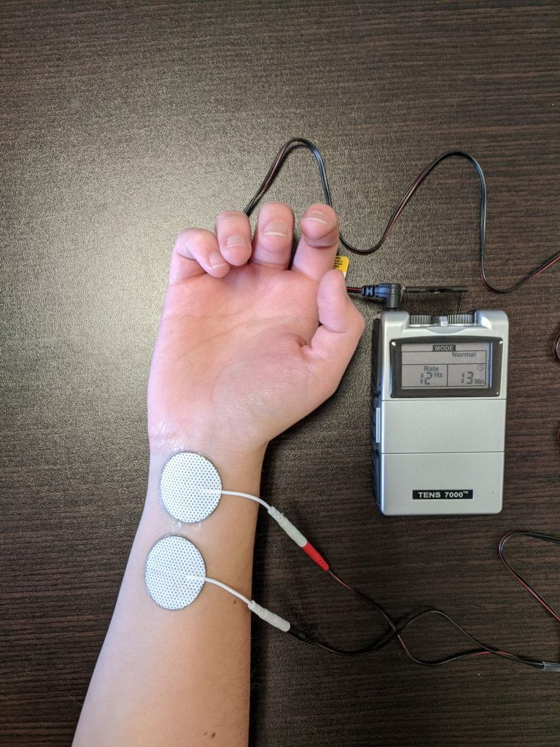
https://tics.wustl.edu/
https://easydb5.ovgu.de//

