Slide 1
The Battle of business Locations
Toronto

Slide 2

Location Criteria
Text
Competition
Development of neighbourhood
Income of neighbourhood
Traffic situation
…

Slide 3
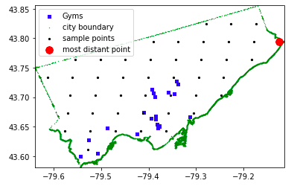
Example
Text

Slide 4
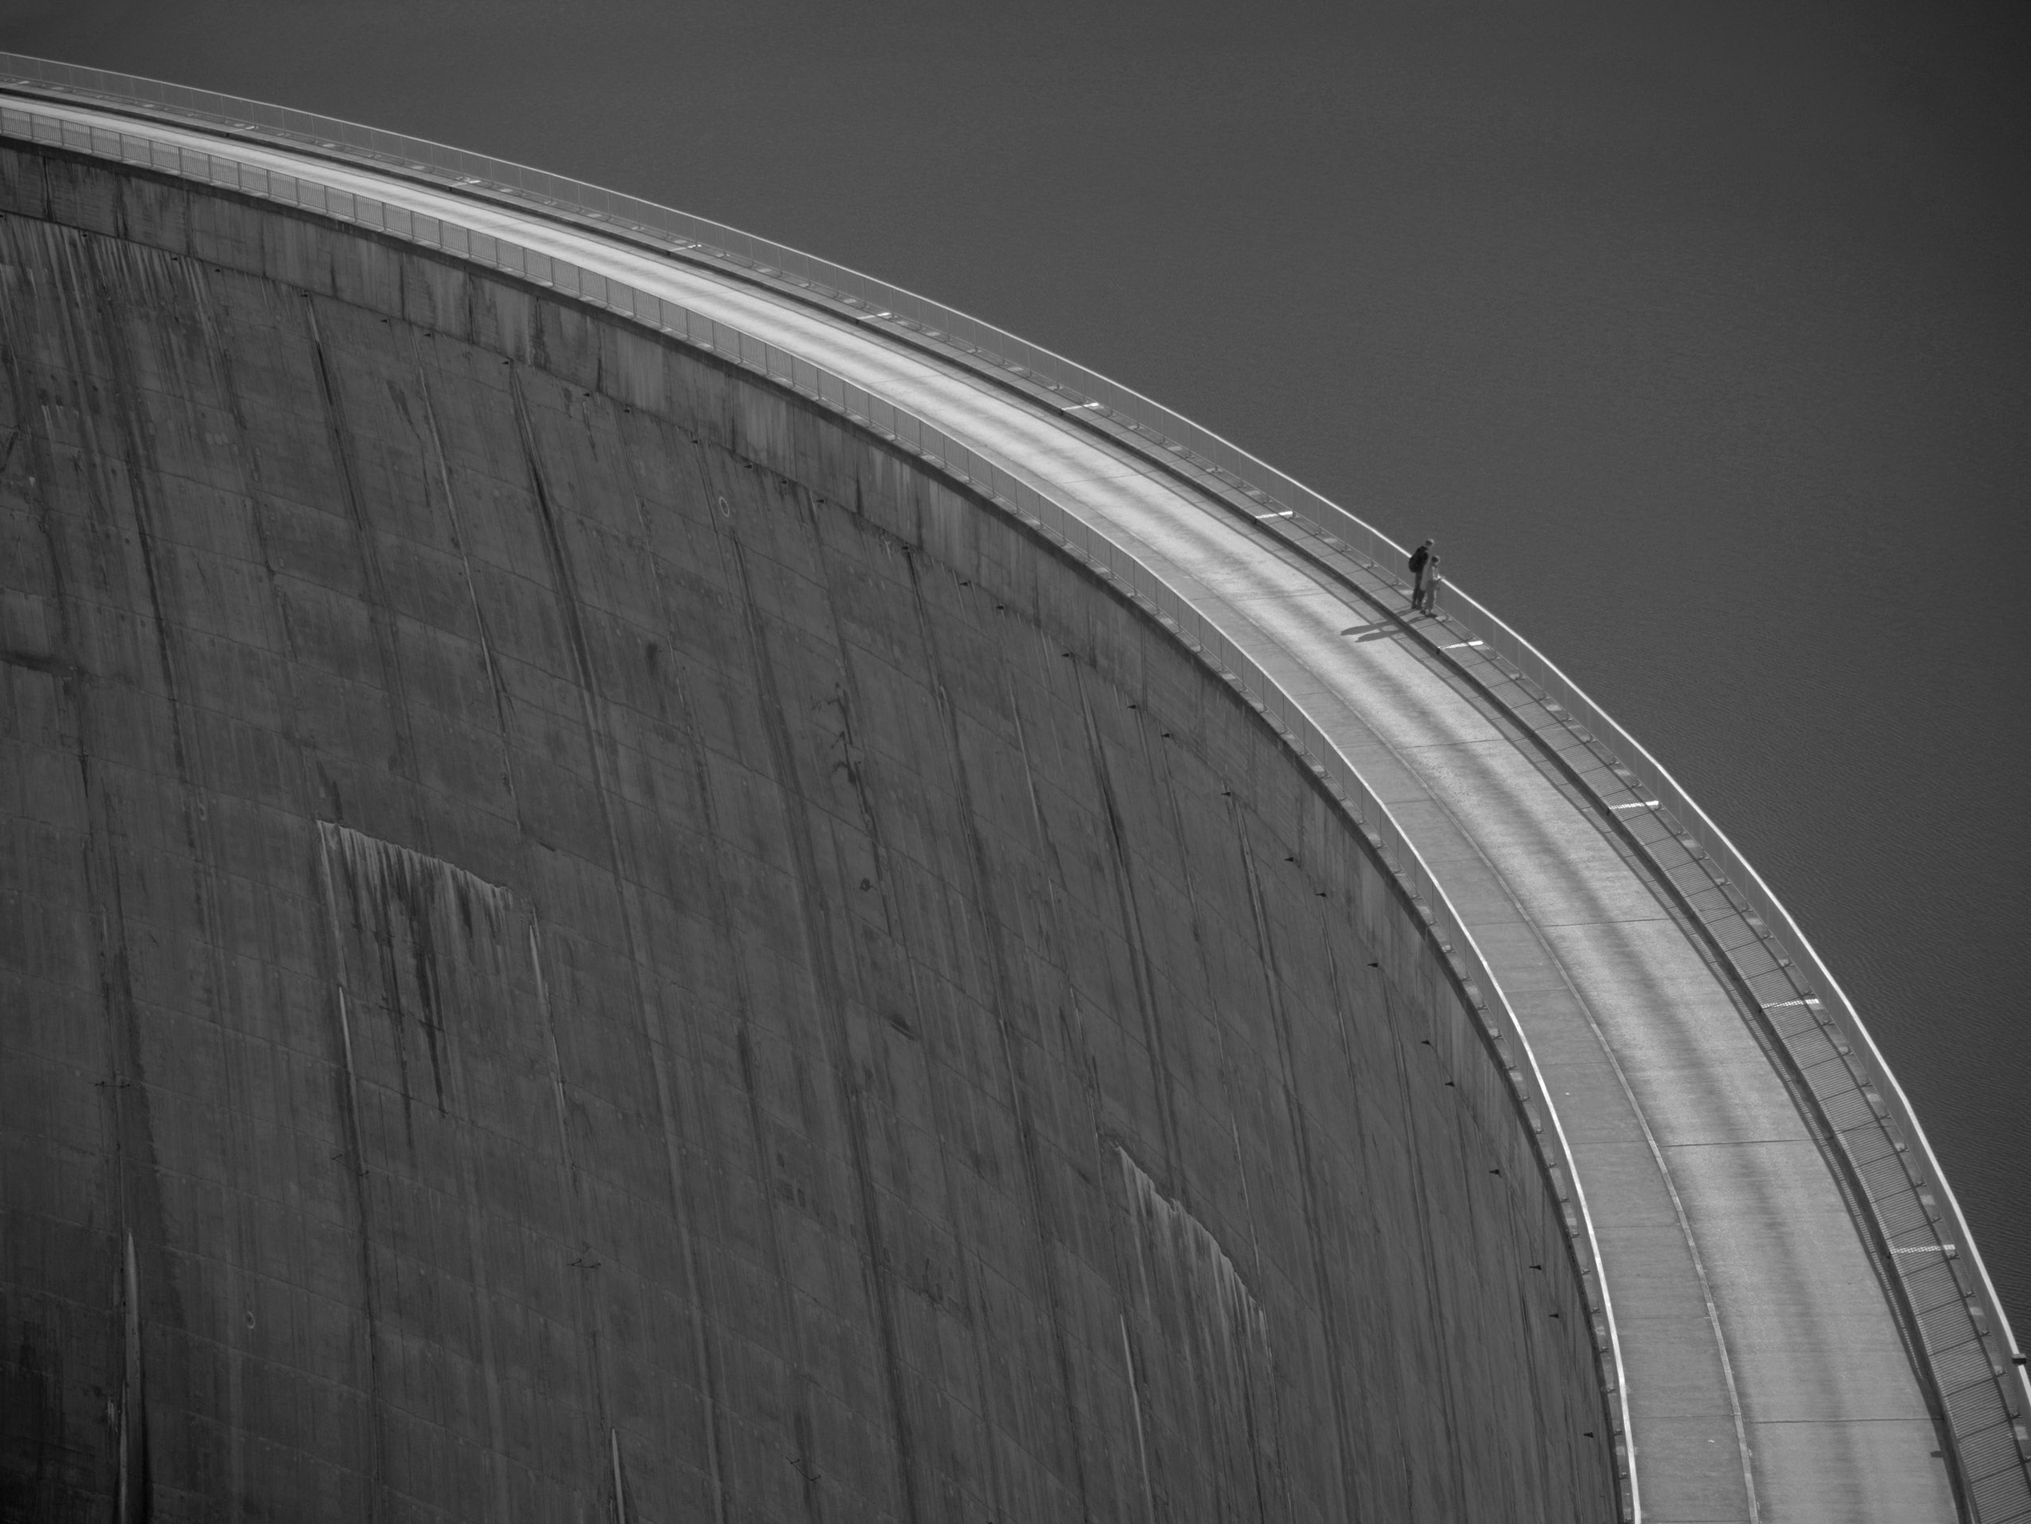
Thank you

