Slide 1
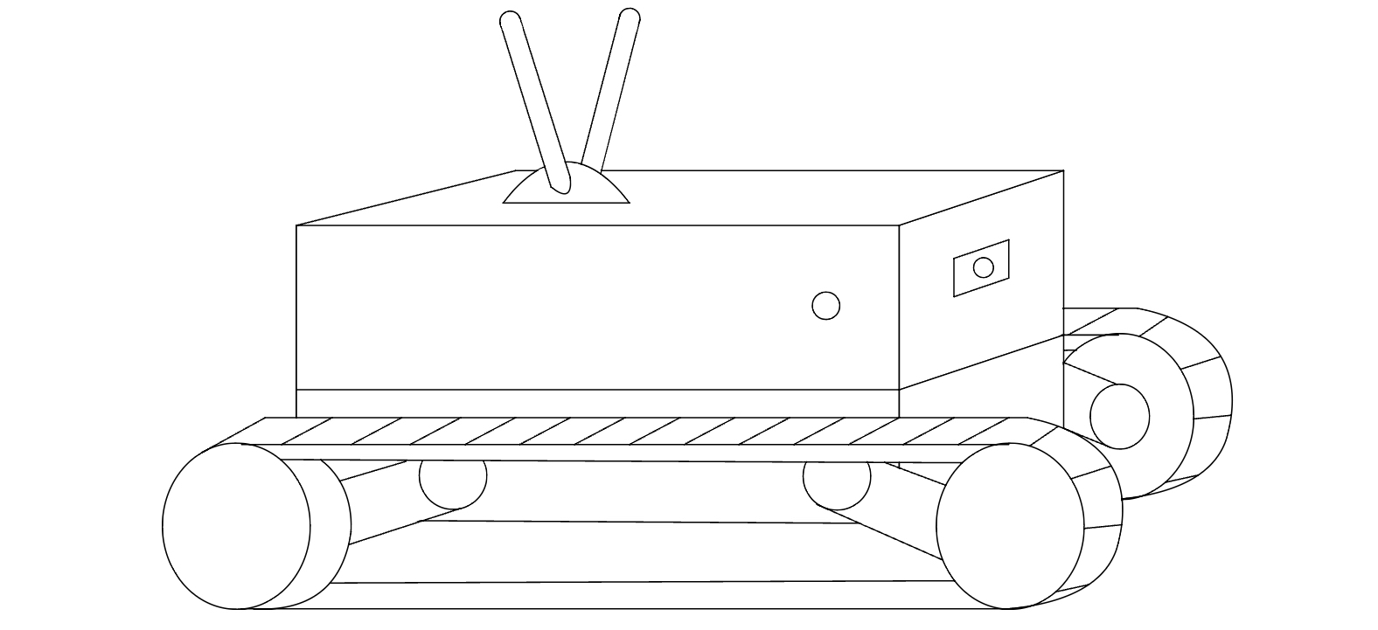
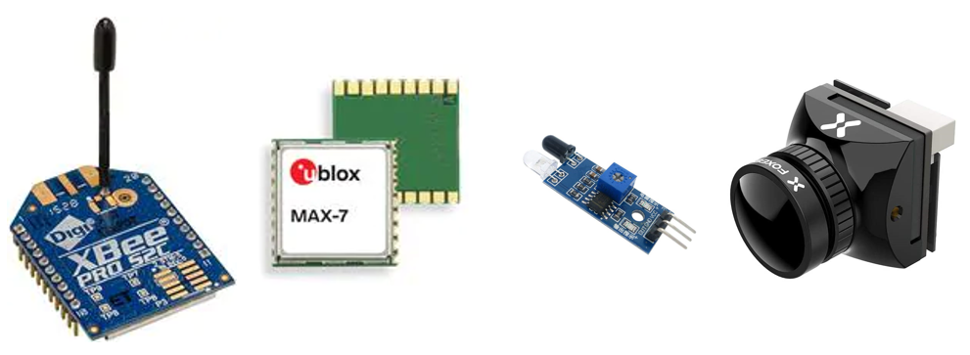
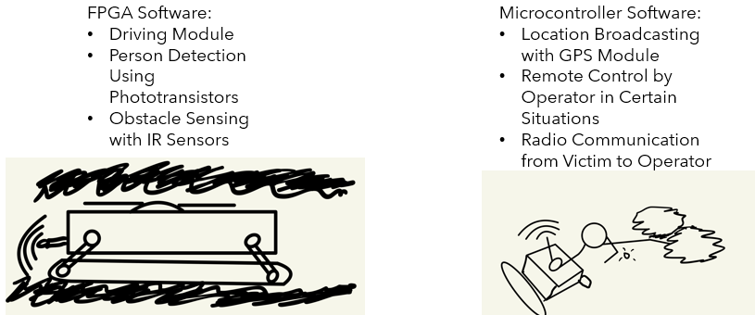
Search and Rescue Bot (SARB)
The rover will be able to fit into small spaces to find people or animals that are trapped or injured. Then the rover will emit an alert through radio frequencies to alert search and rescue teams. The teams can then access the rover’s camera and movement to get a better idea of the area that they need to get to.
The rover could be used by firefighters to find people in buildings that are near collapse.
The military could use the rovers to find troops that are injured.
Red Cross could use this in search and rescue.

Slide 2

Search and Rescue Bot (SARB)
Software Manager: Dirk Thieme
Hardware Manager: Erik Manis
Project Controller: Mohammed Ansari

Slide 3
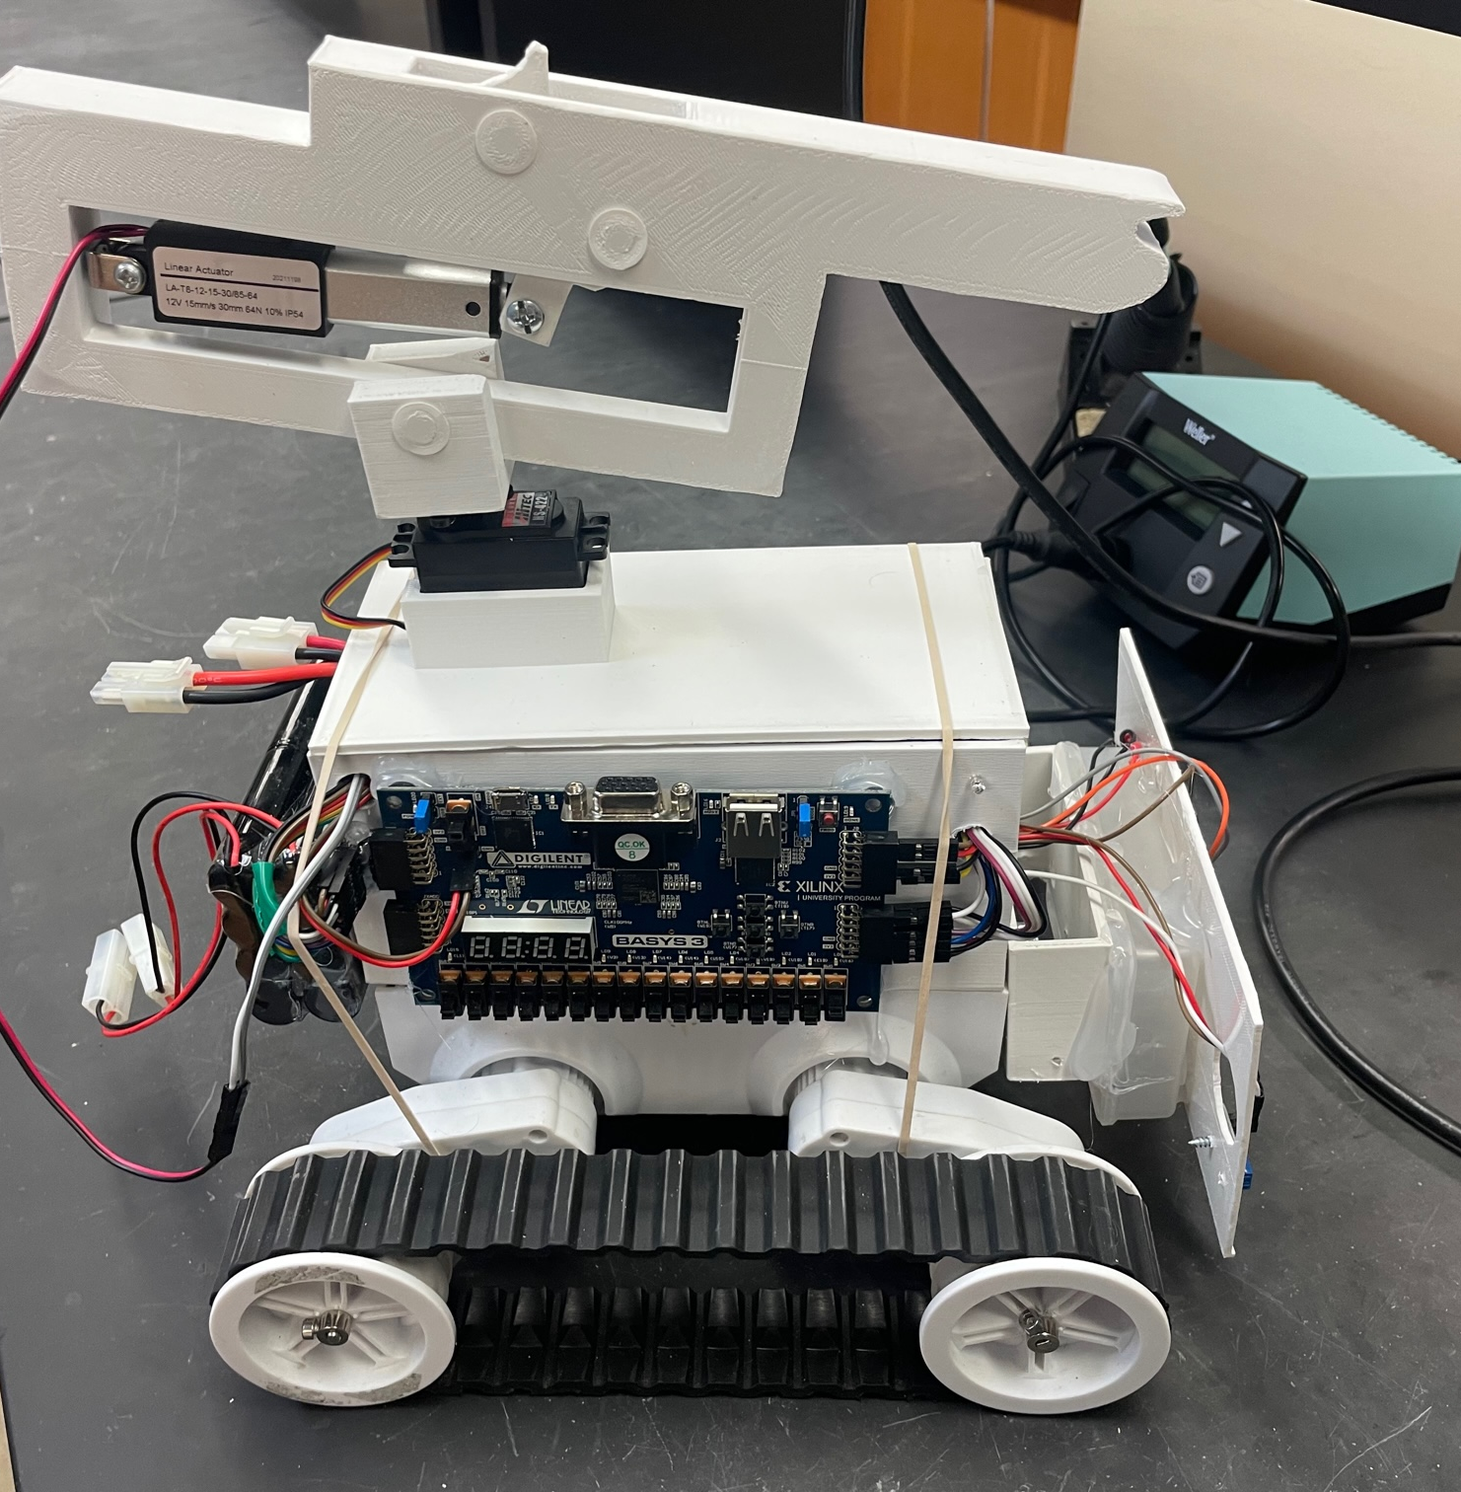
Project Description
The rover will be able to fit into small spaces to find people or animals that are trapped or injured. Then the rover will emit an alert through radio frequencies to alert search and rescue teams. The teams can then access the rover’s camera and movement to get a better idea of the area that they need to get to.

Slide 4
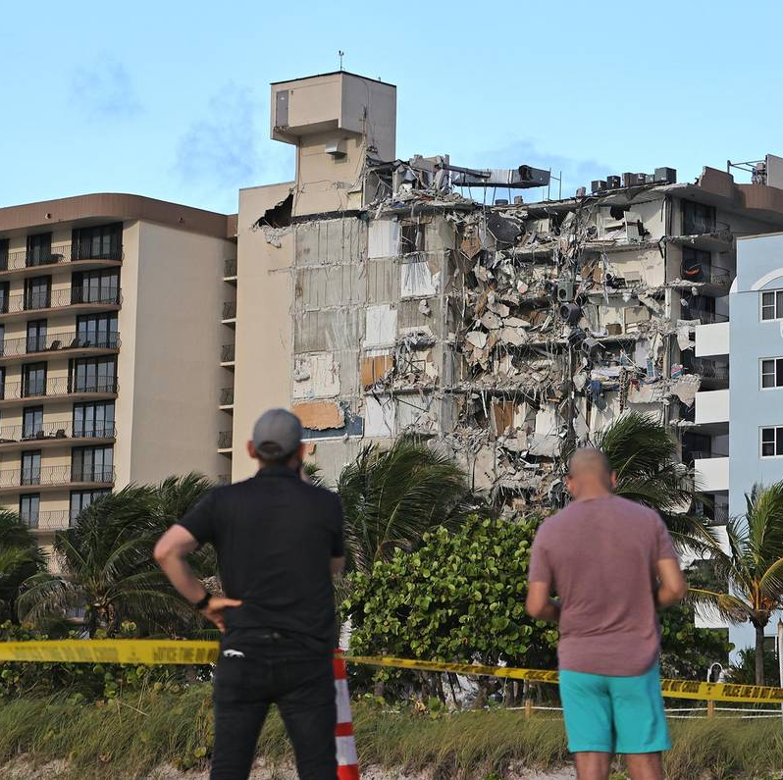
Project Opportunity
The rover could be used by firefighters to find people in buildings that are near collapse.
The military could use the rovers to find troops that are injured.
Red Cross could use this in search and rescue.

Slide 5
Project sketch

Slide 6
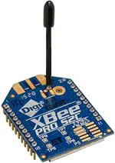
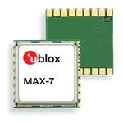
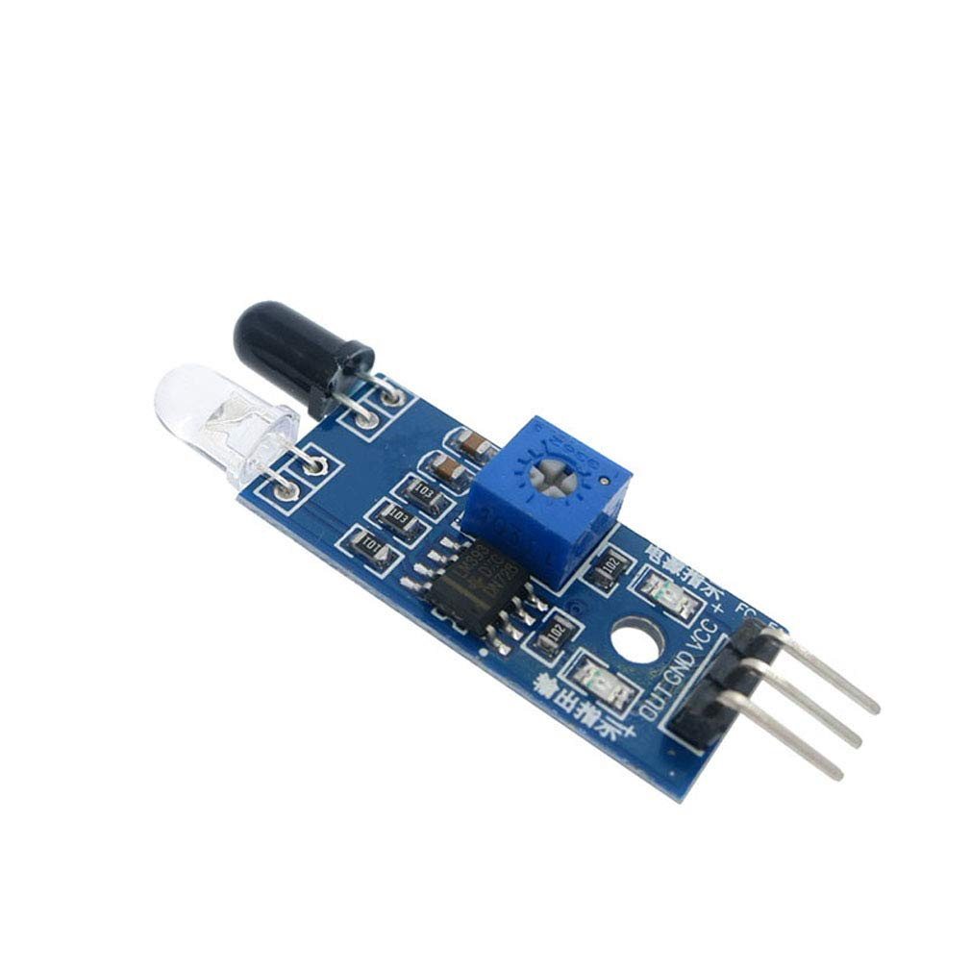
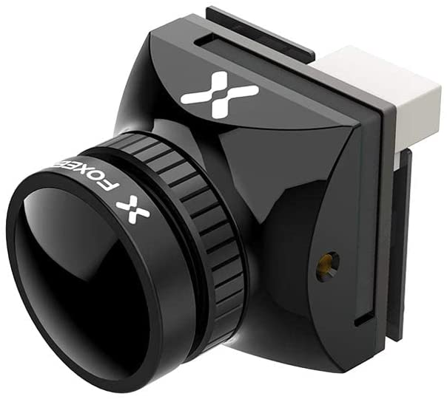
Hardware

Slide 7

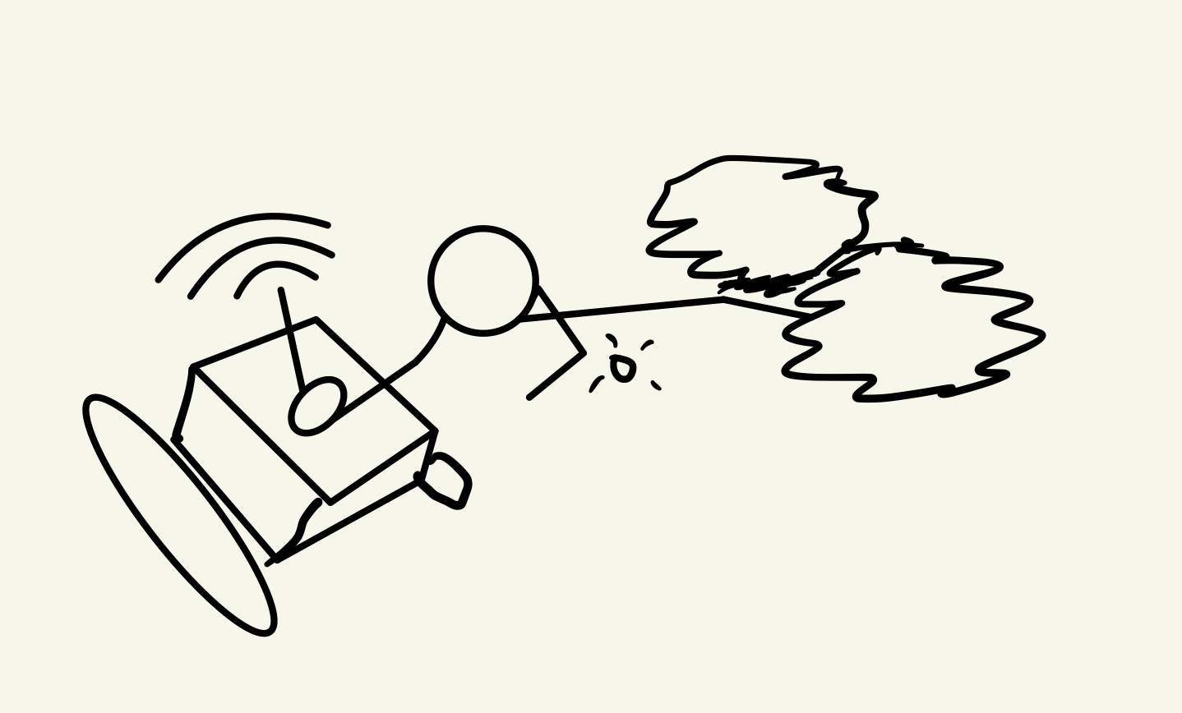
Software
FPGA Software:
Driving Module
Person Detection Using Phototransistors
Obstacle Sensing with IR Sensors
Microcontroller Software:
Location Broadcasting with GPS Module
Remote Control by Operator in Certain Situations
Radio Communication from Victim to Operator

Slide 8

Marketing
The market for this product will mostly be government related. Going to local fire departments and first responders and showing them tests of the product. For the military, show the product’s functionality to officers and how it could save soldiers in the field.

Slide 9
Gantt Chart

Slide 10
Budget

Slide 11
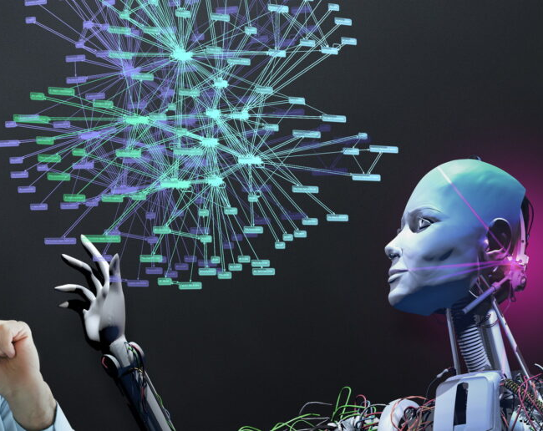
Questions
Software Manager: Dirk Thieme
Hardware Manager: Erik Manis
Project Controller: Mohammed Ansari
This Photo by Unknown author is licensed under CC BY.

