Slide 1

Group 3
Software Manager: Dirk Thieme
Hardware Manager: Erik Manis
Project Controller: Mohammed Ansari

Slide 2
Final Rover Project
Description
Objective

Slide 3
Project Opportunity

Slide 4
Project Sketch

Slide 5
Hardware and Software Approach

Slide 6
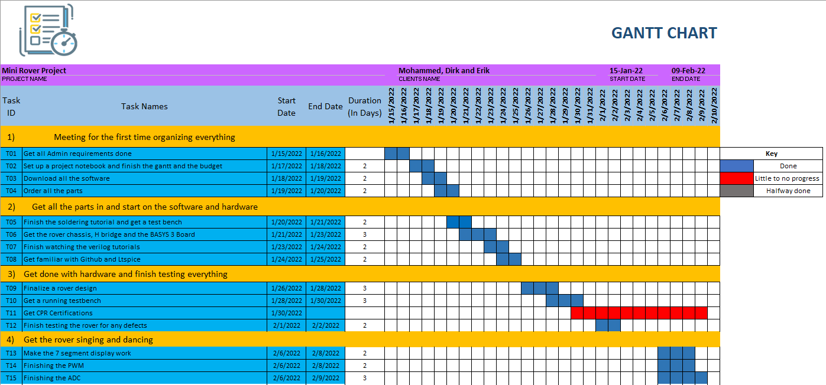
Gantt

Slide 7
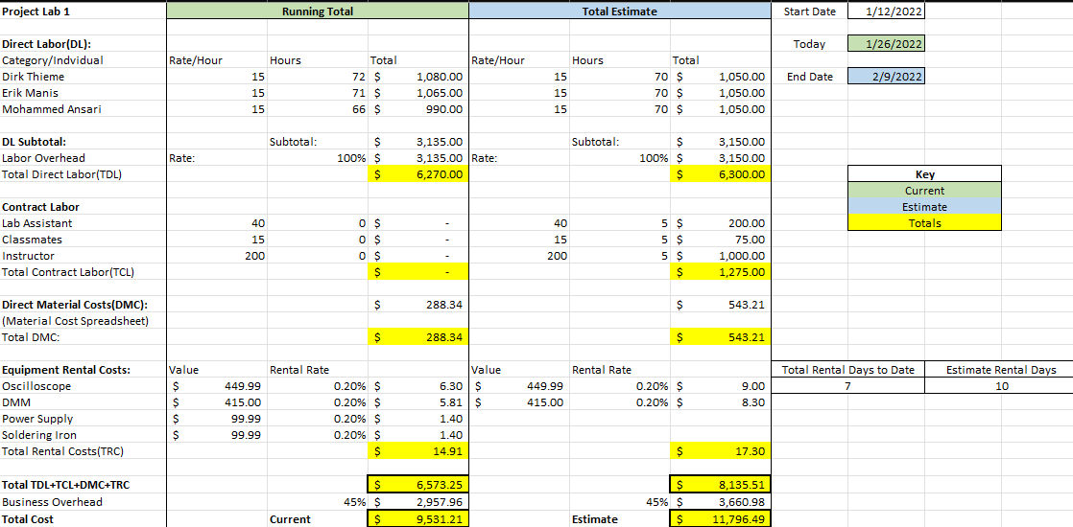
Overall Budget

Slide 8
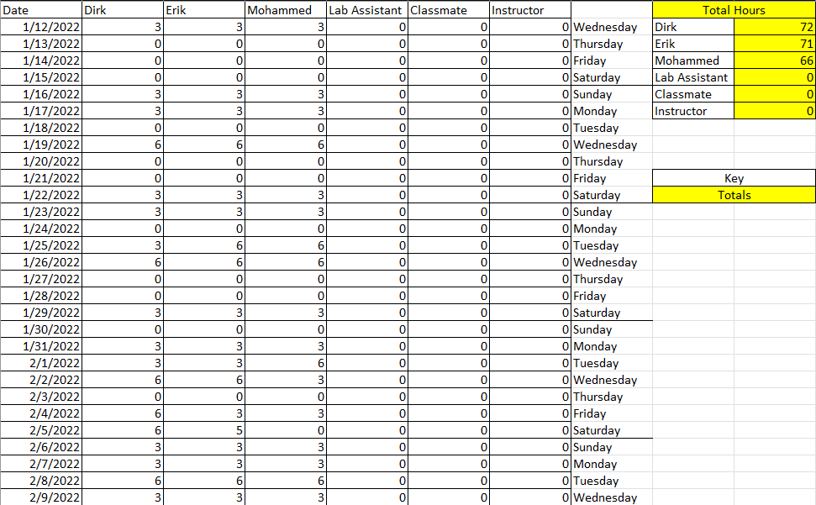
Labor Costs

Slide 9
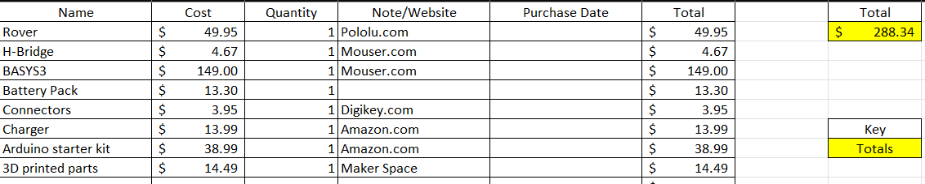
Material Costs

Slide 10

Questions
Software Manager: Dirk Thieme
Hardware Manager: Erik Manis
Project Controller: Mohammed Ansari
This Photo by Unknown author is licensed under CC BY.

