Slide 1

Group 3
Software Manager: Dirk Thieme
Hardware Manager: Erik Manis
Project Controller: Mohammed Ansari

Slide 2
The Drive By Project

Slide 3
The Drive By Project
Description
Objective

Slide 4
Project Opportunity

Slide 5
Project Sketch

Slide 6
Hardware and Software Approach

Slide 7
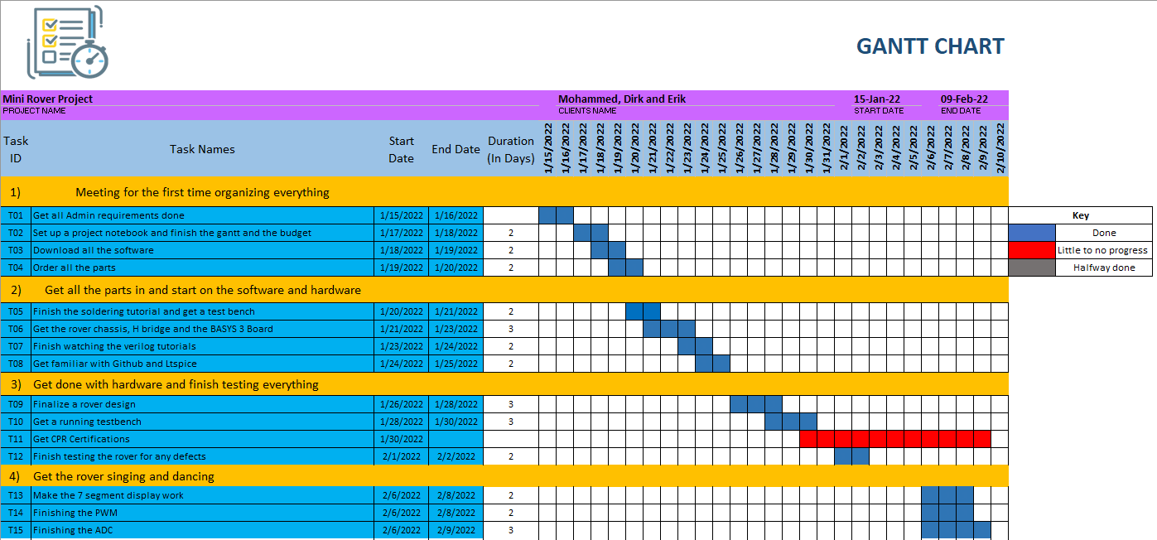
Gantt

Slide 8
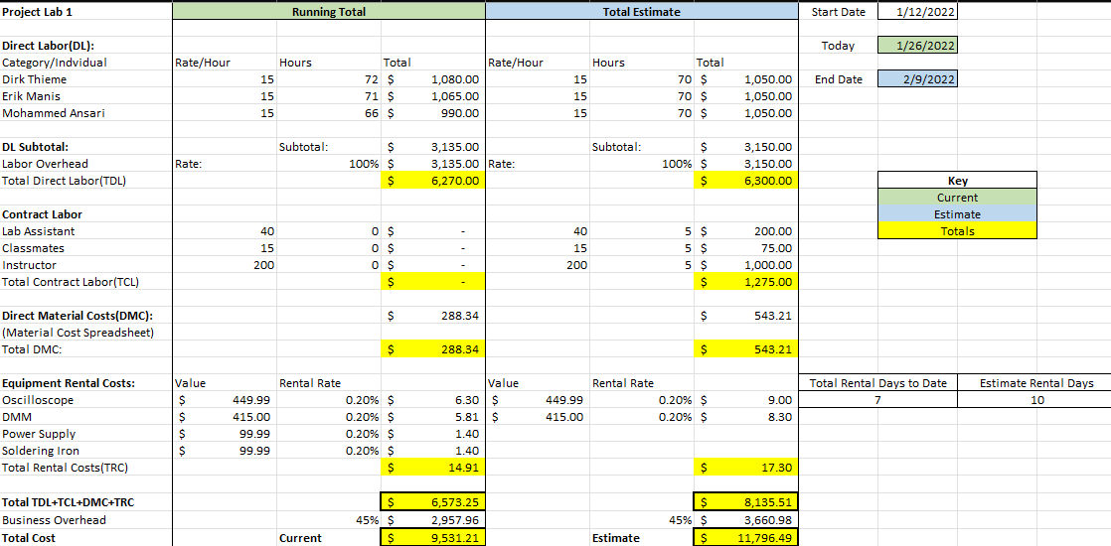
Overall Budget

Slide 9
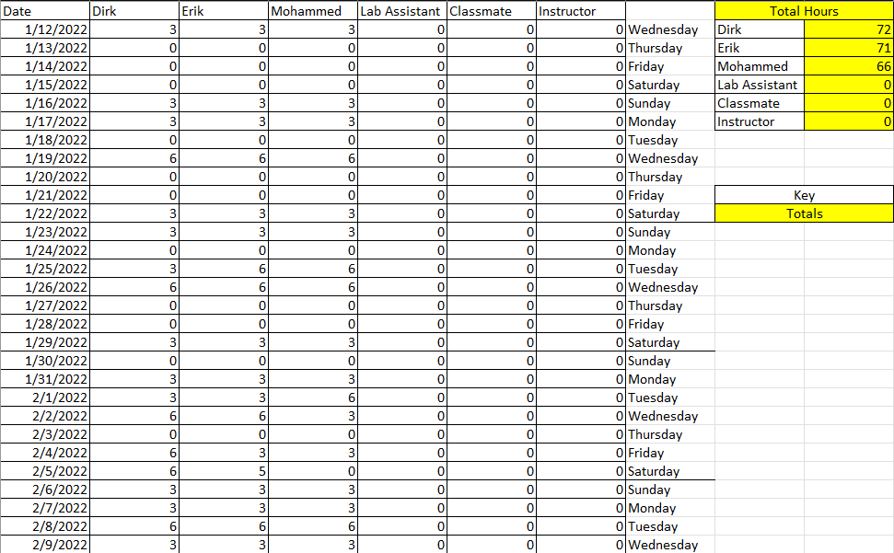
Labor Costs

Slide 10
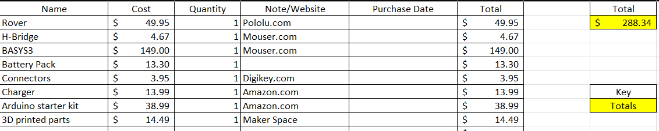
Material Costs

Slide 11

Questions
Software Manager: Dirk Thieme
Hardware Manager: Erik Manis
Project Controller: Mohammed Ansari
This Photo by Unknown author is licensed under CC BY.

