Slide 1
The Drive By Project Dirk Thieme, Erik Manis, and Mohammed Ansari

Slide 2

The Drive By Project
Software Manager: Dirk Thieme
Hardware Manager: Erik Manis
Project Controller: Mohammed Ansari

Slide 3
The Project Description & Objectives
Description
Objective

Slide 4
Project Opportunity

Slide 5
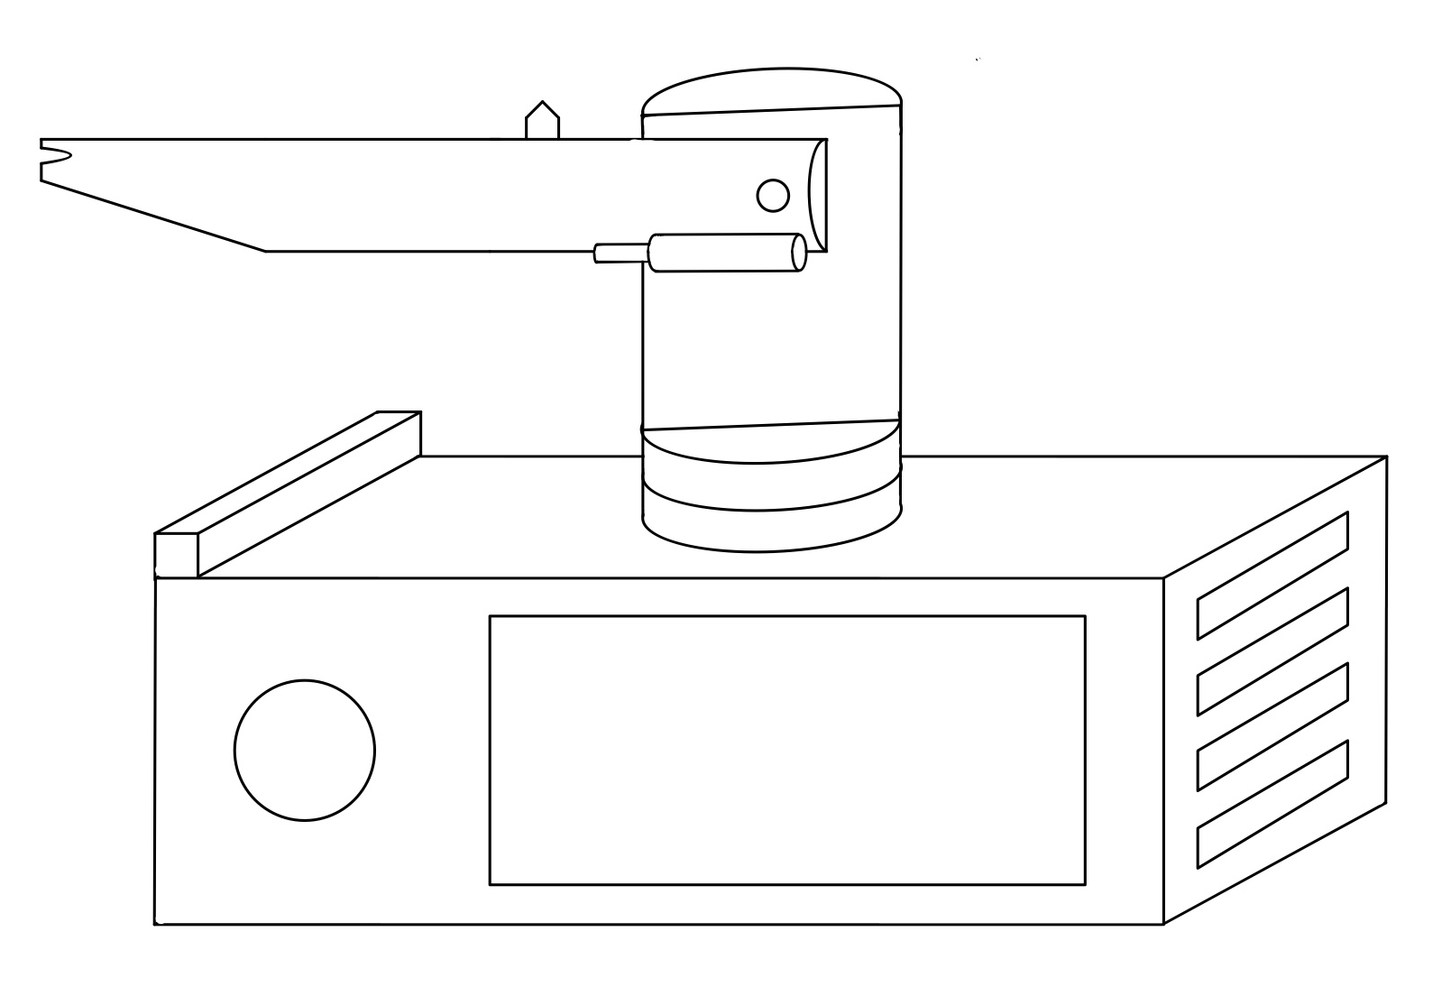
Project Sketch

Slide 6
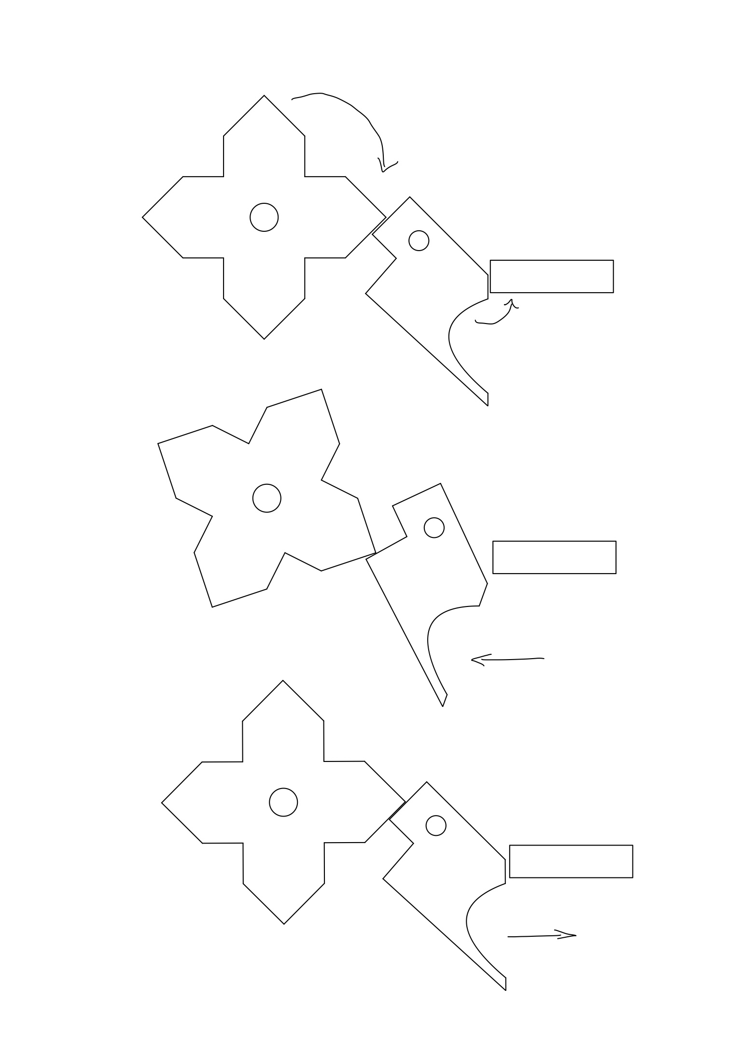
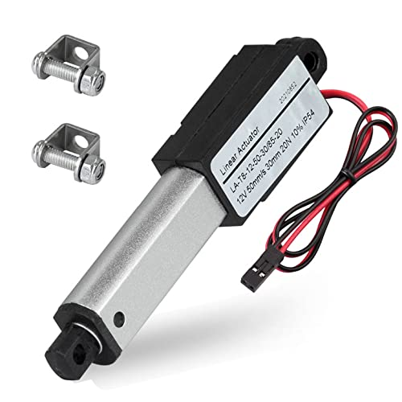
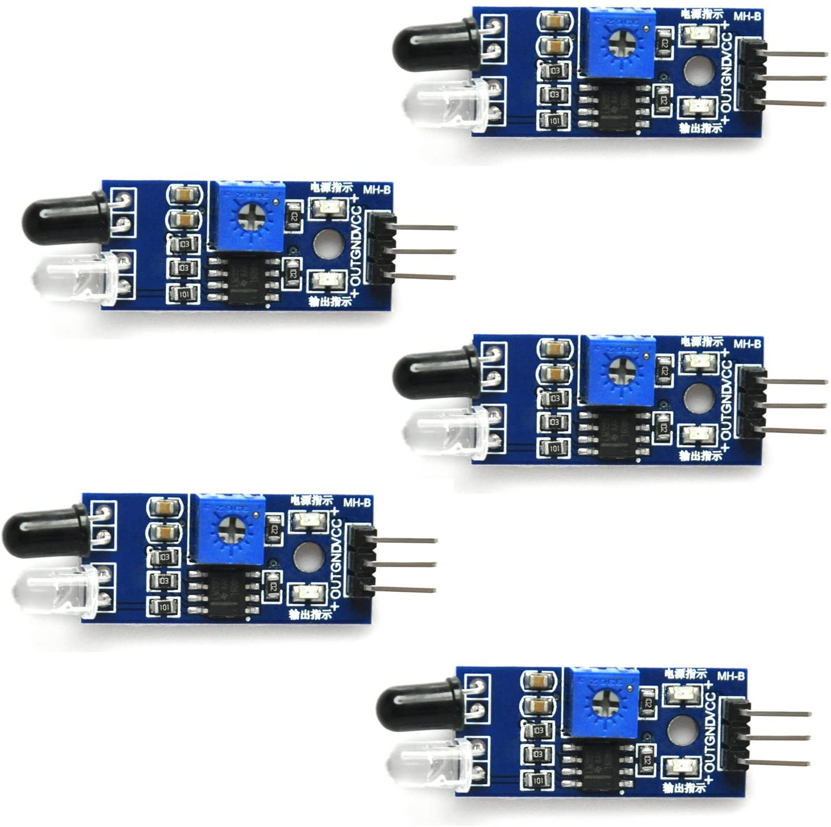
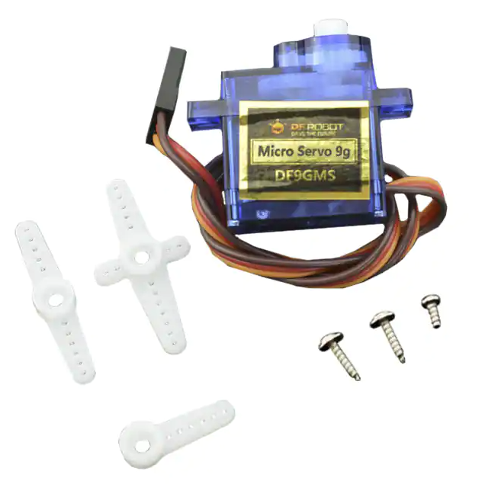
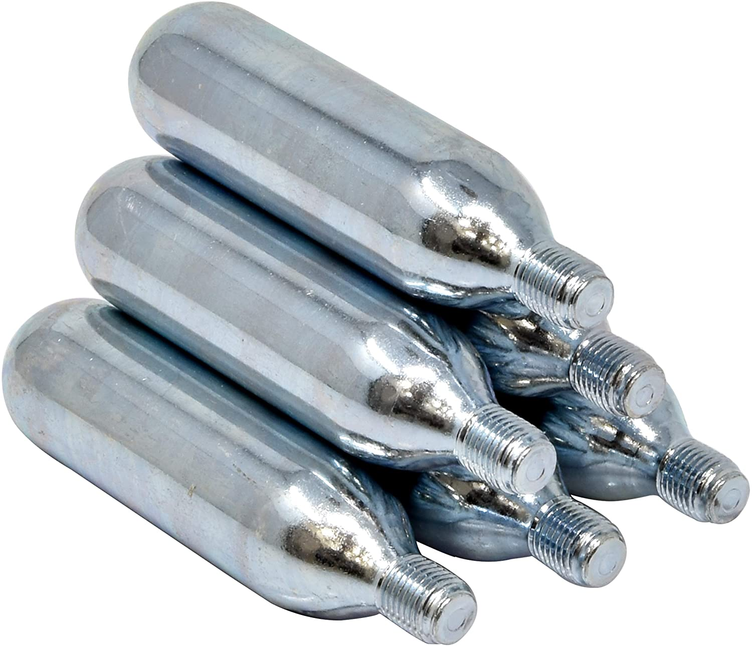
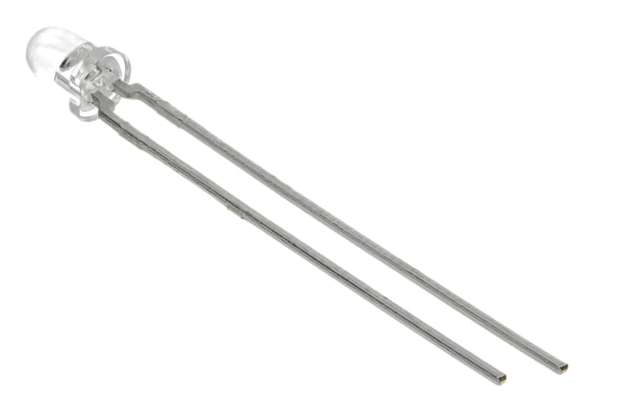
Hardware

Slide 7
Software

Slide 8
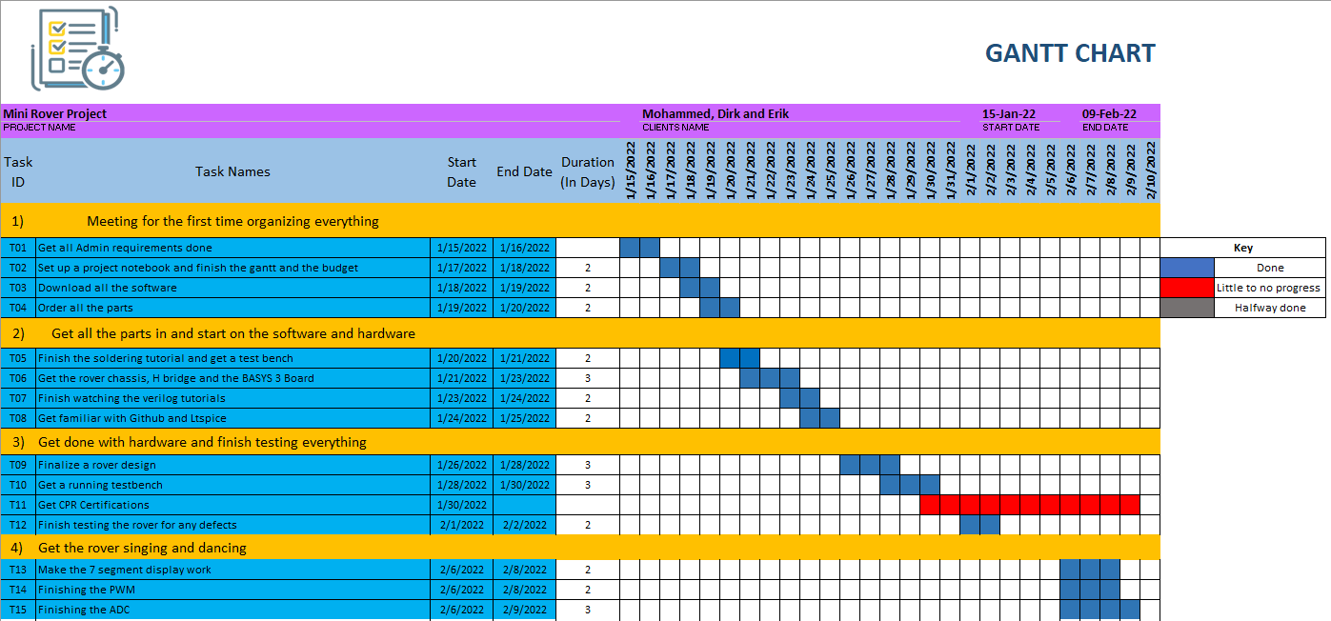
Gantt

Slide 9
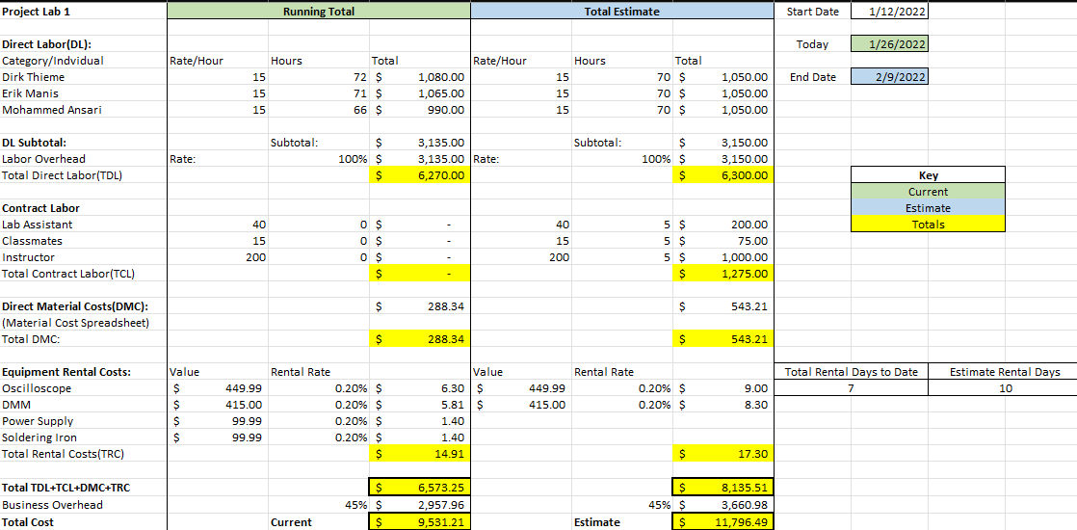
Overall Budget

Slide 10
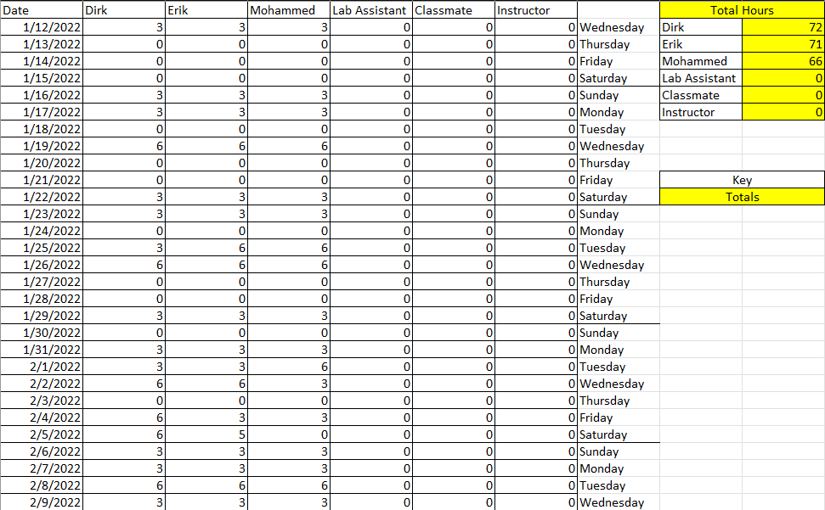
Labor Costs

Slide 11
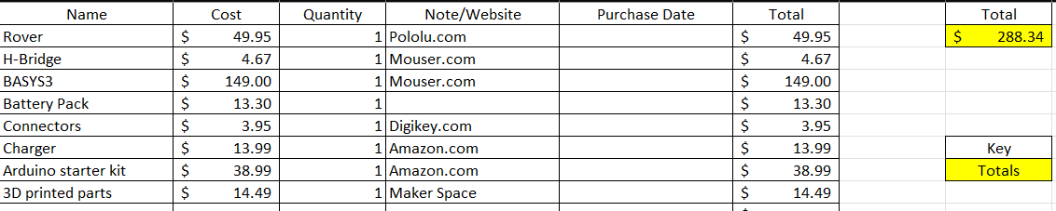
Material Costs

Slide 12

Questions
Software Manager: Dirk Thieme
Hardware Manager: Erik Manis
Project Controller: Mohammed Ansari
This Photo by Unknown author is licensed under CC BY.

