Slide 1
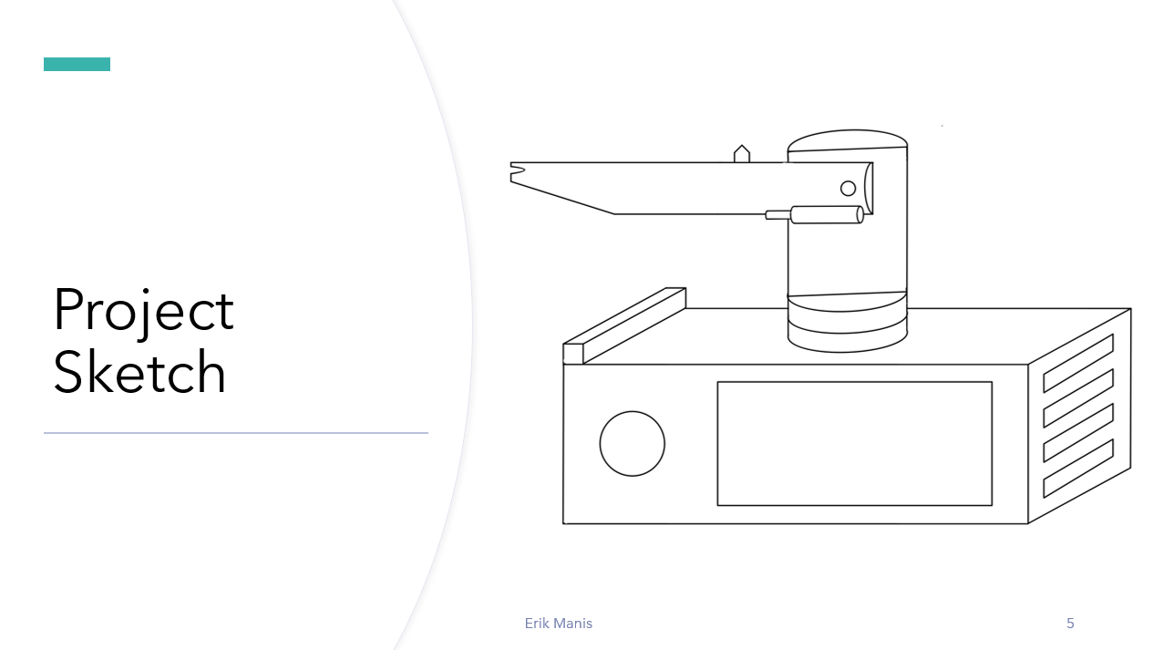
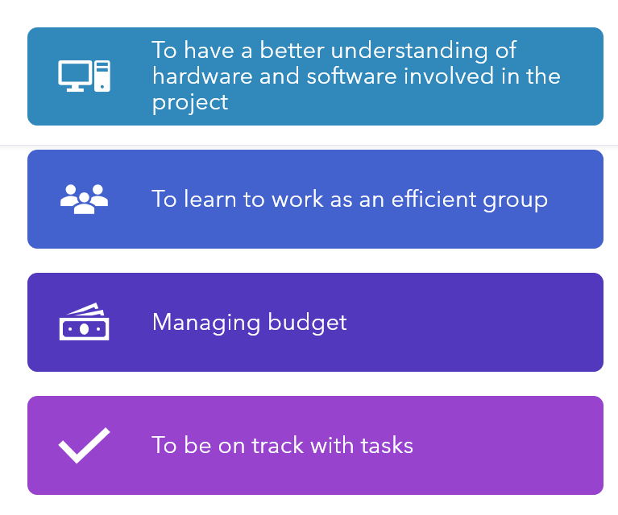
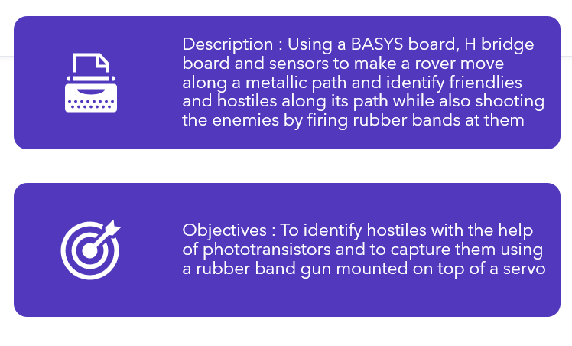
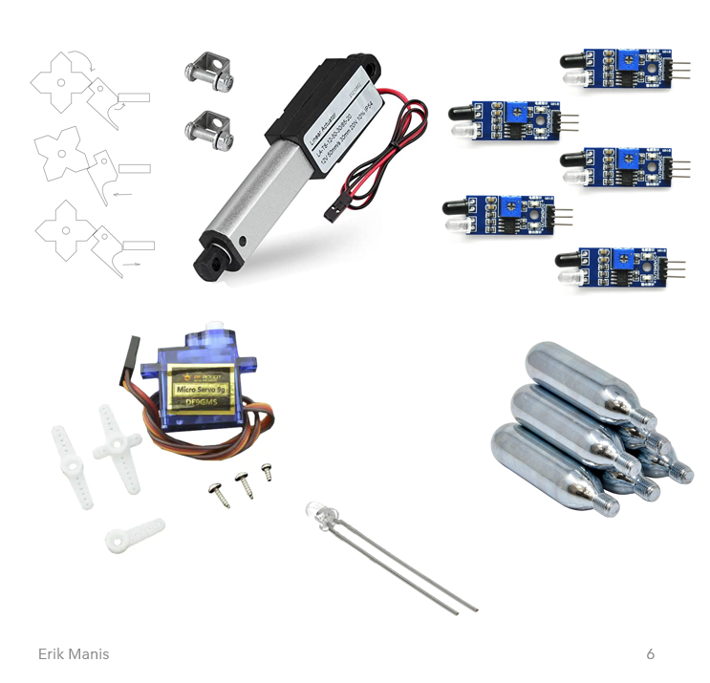
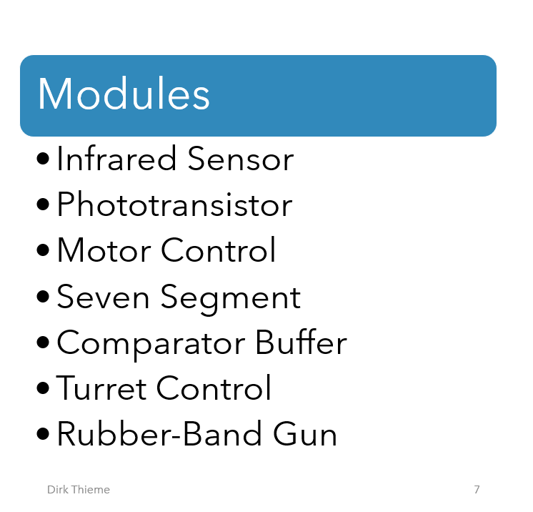
The Drive By Project Dirk Thieme, Erik Manis, and Mohammed Ansari

Slide 2

The Drive By Project
Software Manager: Dirk Thieme
Hardware Manager: Erik Manis
Project Controller: Mohammed Ansari

Slide 3
The Project Description & Objectives
Description : Using a BASYS board, H bridge board and sensors to make a rover move along a metallic path and identify friendlies and hostiles along its path while also shooting the enemies by firing rubber bands at them
Objectives : To identify hostiles with the help of phototransistors and to capture them using a rubber band gun mounted on top of a servo

Slide 4
Project Opportunity
To have a better understanding of hardware and software involved in the project
To learn to work as an efficient group
Managing budget
To be on track with tasks

Slide 5
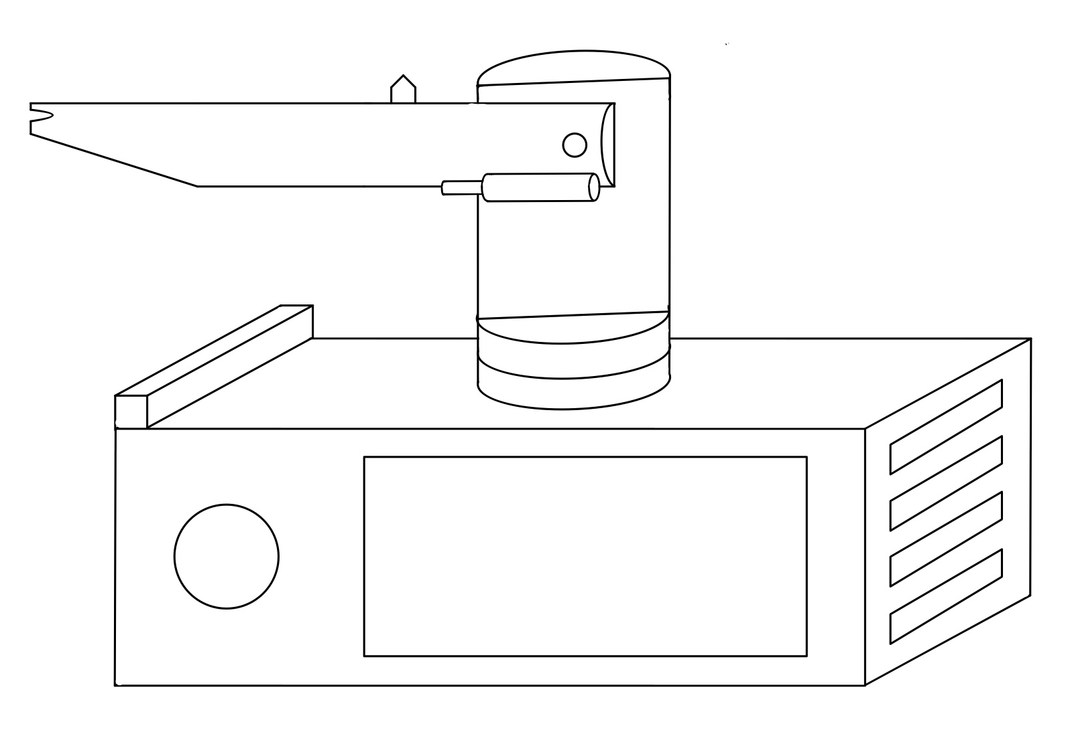
Project Sketch

Slide 6
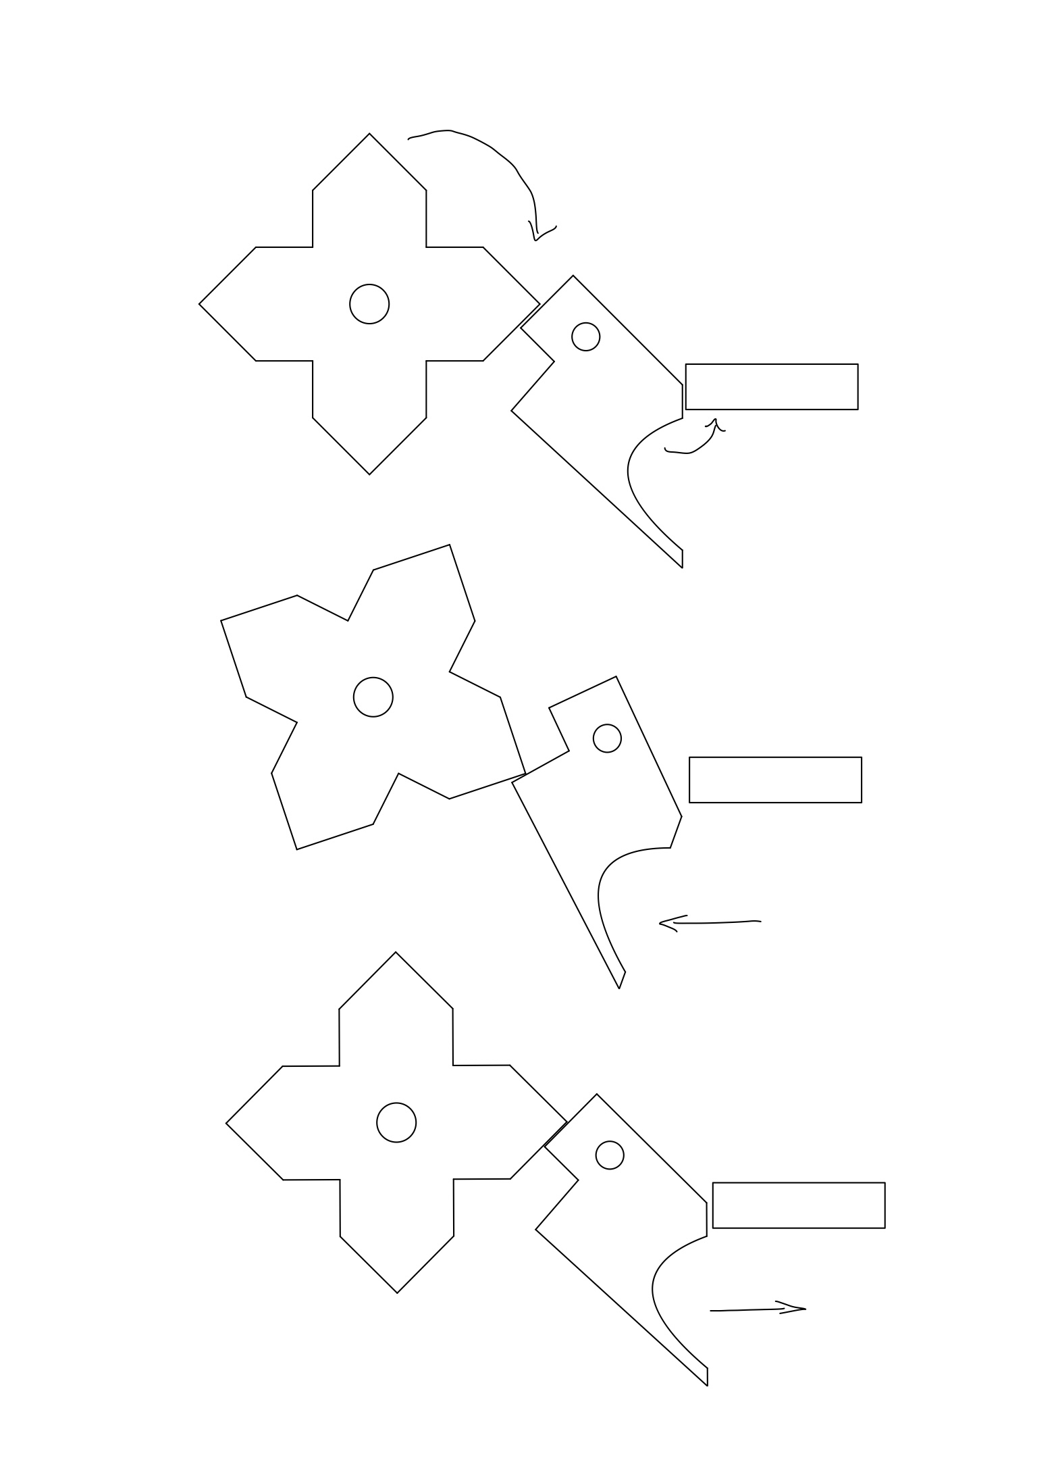
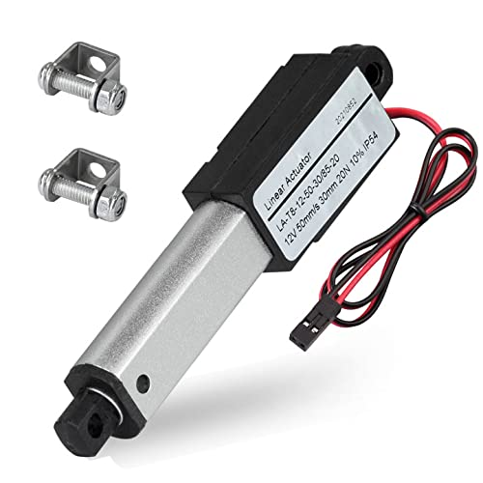
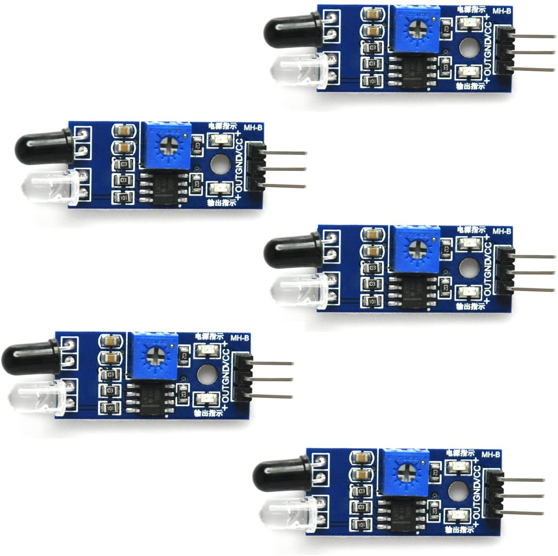
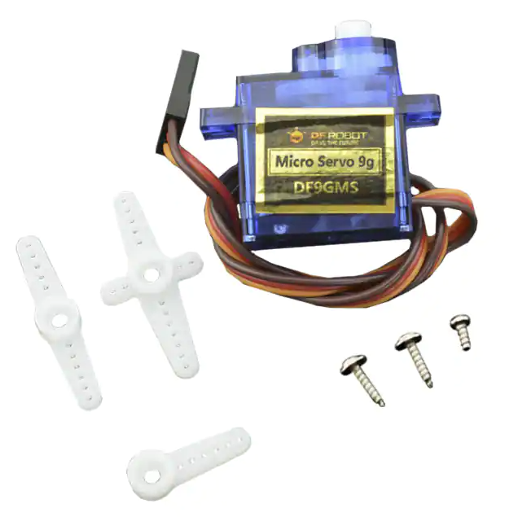
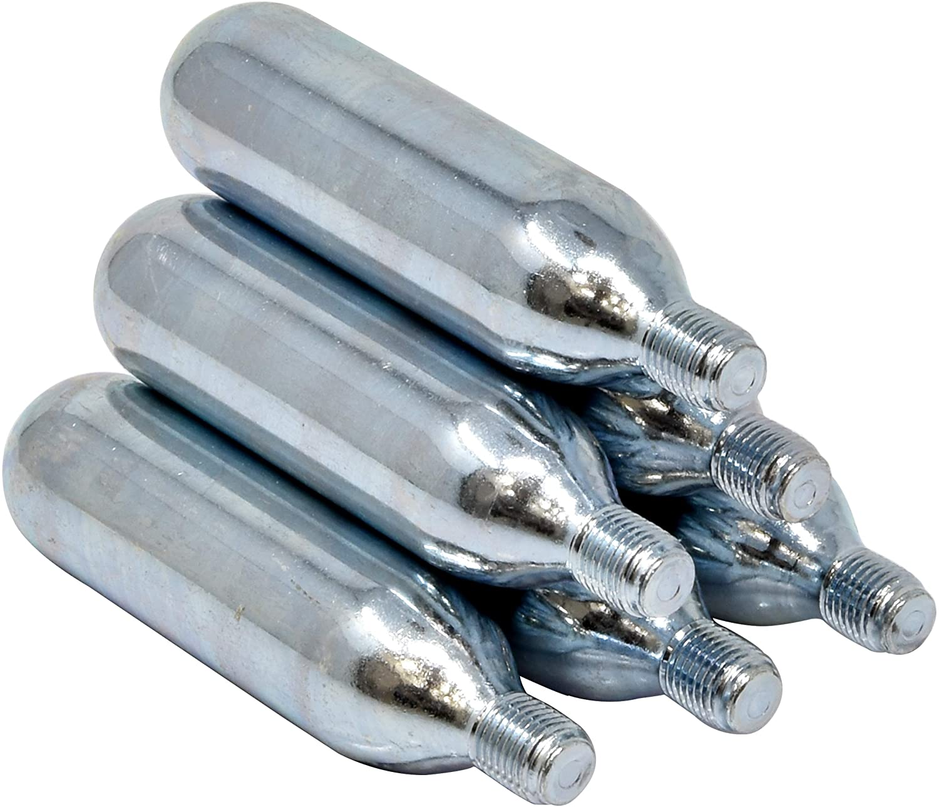
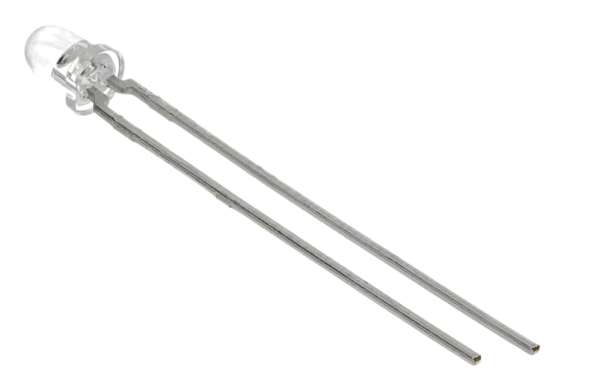
Hardware

Slide 7
Software
Modules
Infrared Sensor
Phototransistor
Motor Control
Seven Segment
Comparator Buffer
Turret Control
Rubber-Band Gun

Slide 8
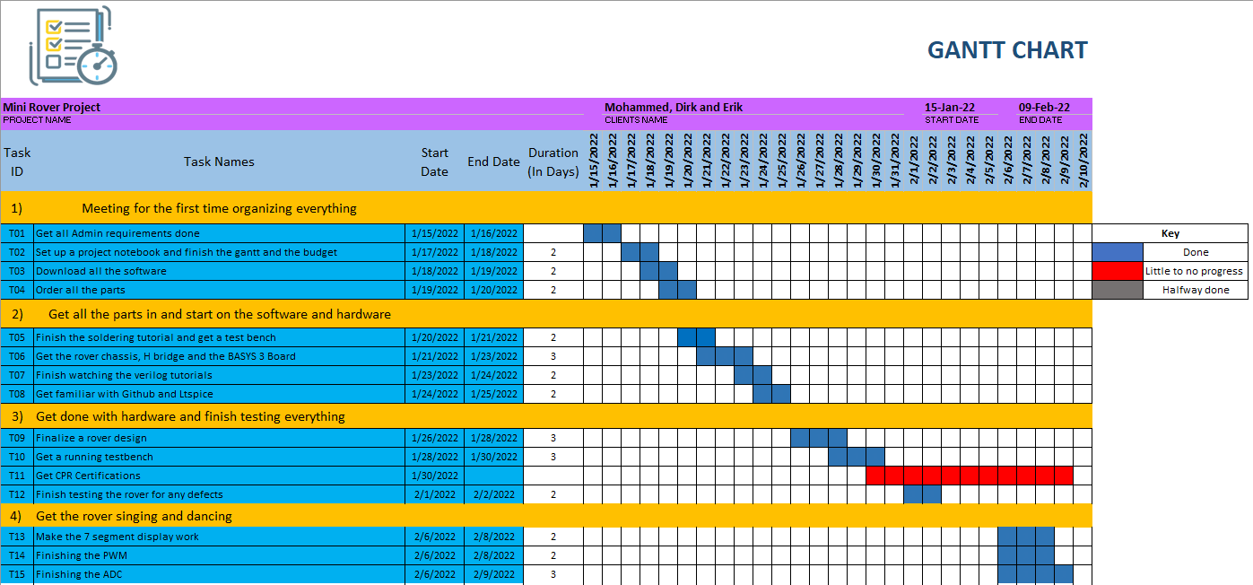
Gantt

Slide 9
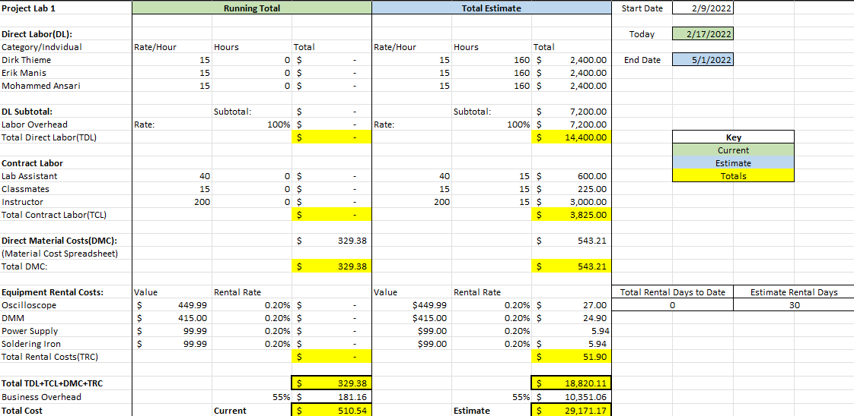
Overall Budget

Slide 10

Questions
Software Manager: Dirk Thieme
Hardware Manager: Erik Manis
Project Controller: Mohammed Ansari
This Photo by Unknown author is licensed under CC BY.

