Slide 1
Tutorial: Learning Bayesian Networks with R January 2018
Polina Suter
polina.minkina@bsse.ethz.ch

Slide 2
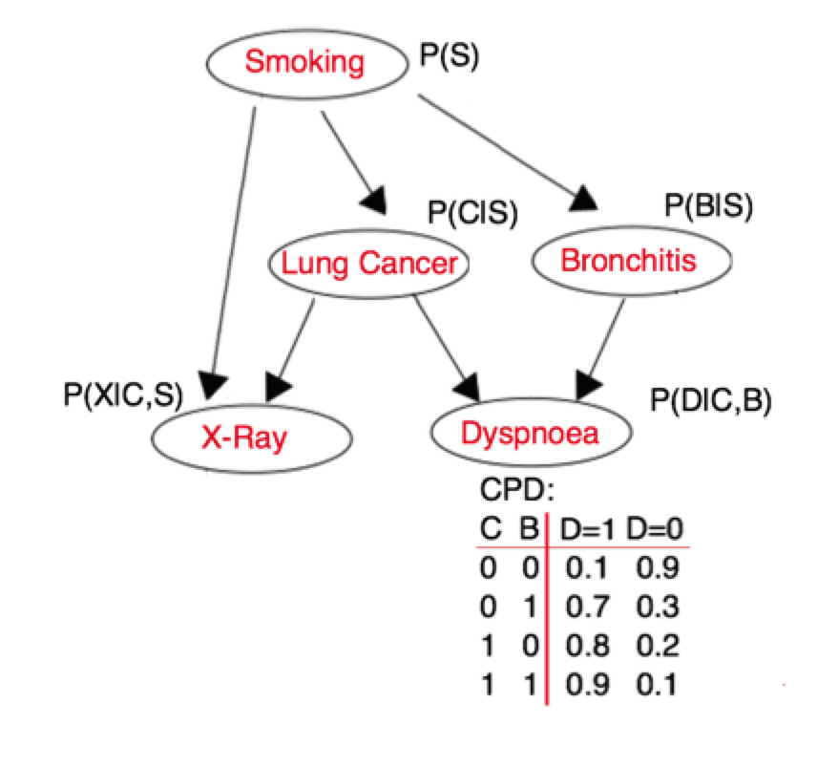
Bayesian Networks
G – Directed Acyclic Graph (DAG)
Nodes – random variables
Edges – conditional dependencies
CPD (conditional probability distribution) of node X:
P(X|parents(X))
Compact representation of joint distribution in a product form:
P(S,C,B,X,D)=P(S)P(C|S)P(B|S)P(X|C,S)P(D|C,B)
1+2+2+4+4=13 parameters instead of 2⁵=32

Slide 3
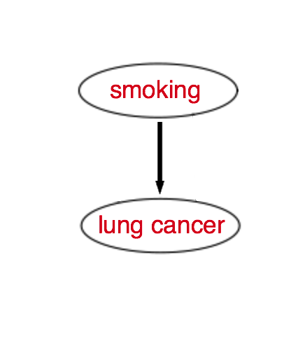
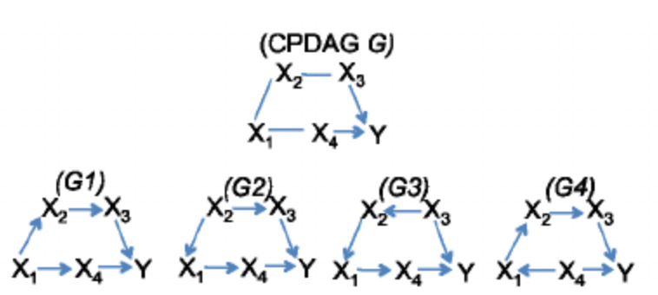
Learning BNs from observations/interventions
The gold standard for inferring causal links is intervention experiment however it is not always possible to perform one
Inferring BNs from observational data has some limitations:
For causal interpretation we assume there are no hidden confounders
Only equivalence class (CPDAG) can be inferred from observational data

Slide 4
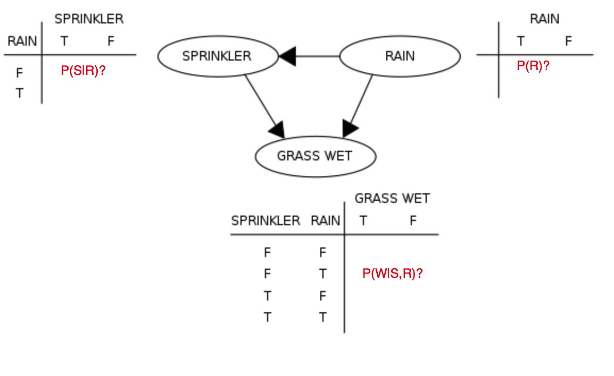
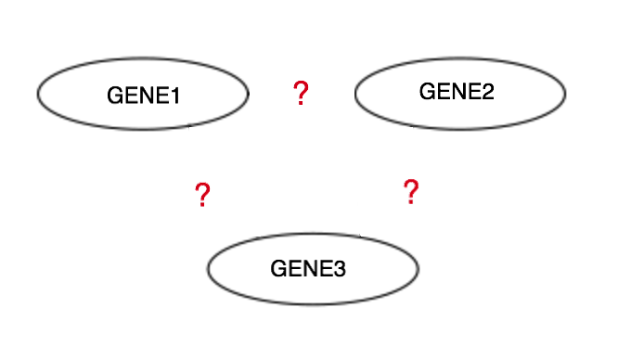
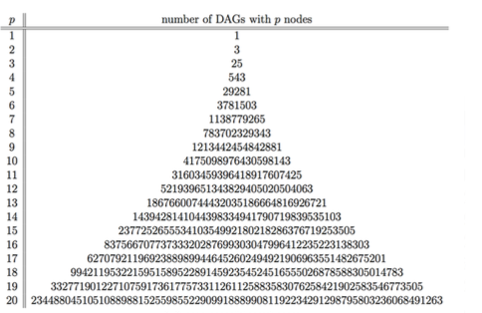
Learning BNs
Learn parameters Θ when structure G is known: ML, MAP
Learn graph G and parameters Θ
a)
b)
NP-hard

Slide 5
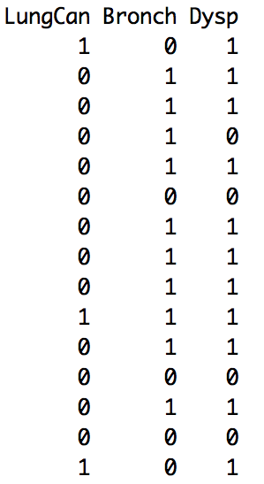
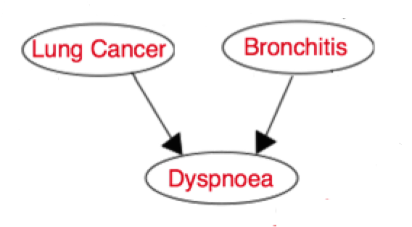
Likelihood
Observed data:
Network: G
LungCan = 0(no), 1(yes)
Bronch = 0(no), 1(yes)
Dysponea = 0(no), 1(yes)
L = P(G|D) = ?

Slide 6
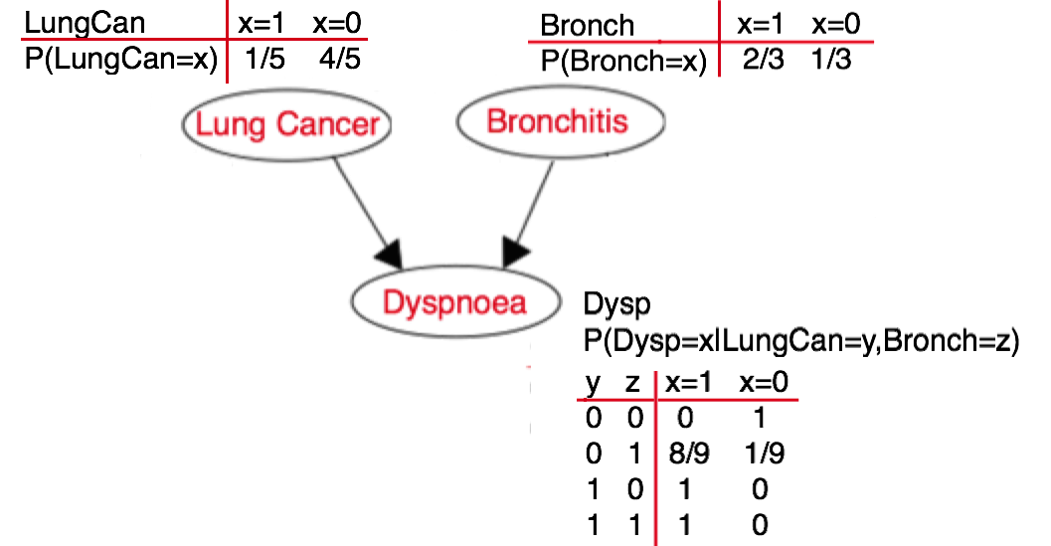
Likelihood
Observed data:
Calculating conditional probability tables:
L = P(G|D) =

Slide 7
Likelihood
Observed data:
Calculating conditional probability tables:
L = P(G|D) = -20.1932377 (see R-code)

Slide 8
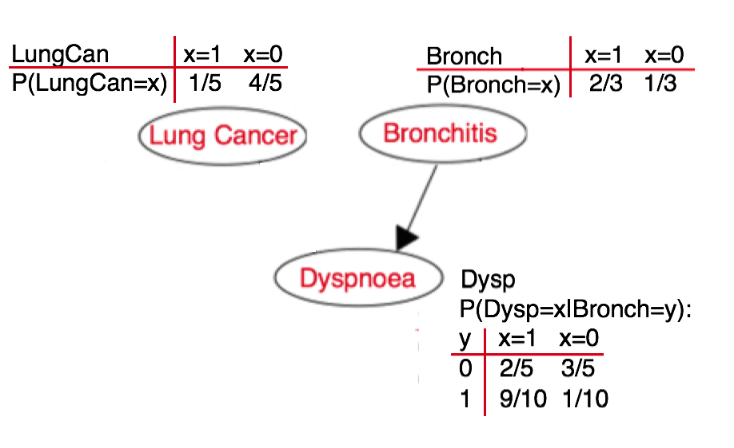
Likelihood
Observed data:
Network G₁
L = P(G|D) = = -23.6696369 (see R-code)

Slide 9
Learning BNs
Learn parameters Θ when structure G is known: ML, MAP
Learn graph G and parameters Θ
a)
b)
NP-hard

Slide 10
BN structure learning
Constraint-based algorithms #PC
start with a full graph
eliminate edges by performing conditional independence tests in a certain order
(!) prone to statistical testing errors
Search and Score algorithms #GES (greedy equivalent search)
score function: log likelihood/posterior
search strategy is usually greedy due to the size of the search space
(!) local optima problem
MCMC (Markov chain Monte Carlo) schemes
allow to obtain a sample from posterior distribution of graph given the data (rather than 1 single model)
avoid local optima problem
(!) convergence issues for structure MCMC

Slide 11
Learning BNs with R
R packages for learning BNs:
pcalg – PC algorithm, greedy equivalent search (GES) https://cran.r-project.org/web/packages/pcalg/pcalg.pdf
bnlearn – max-min hill climbing (MMHC), greedy search http://www.bnlearn.com/
BiDAG – a collection of MCMC methods for MAP search and sampling from posteriorhttps://cran.r-project.org/web/packages/BiDAG/BiDAG.pdf

Slide 12
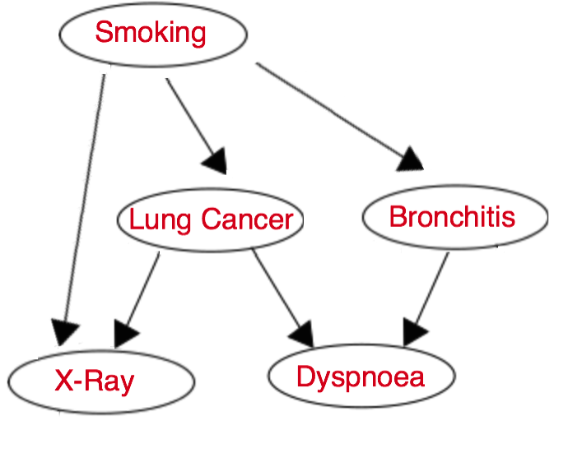
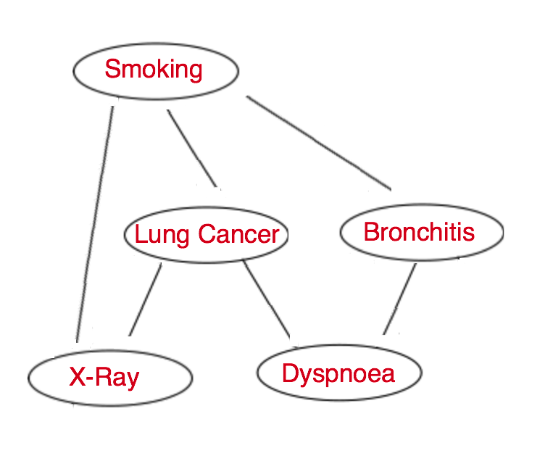
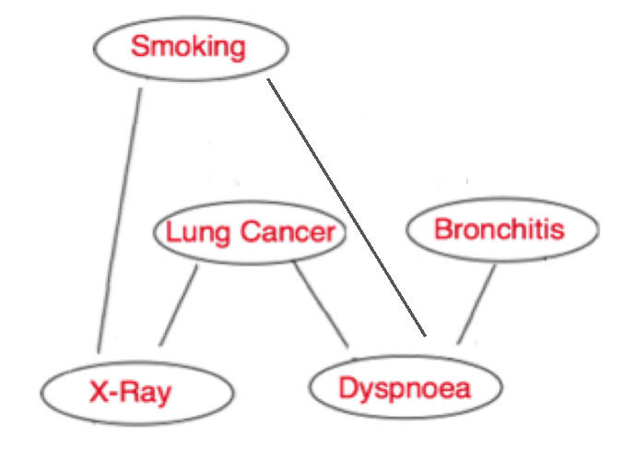
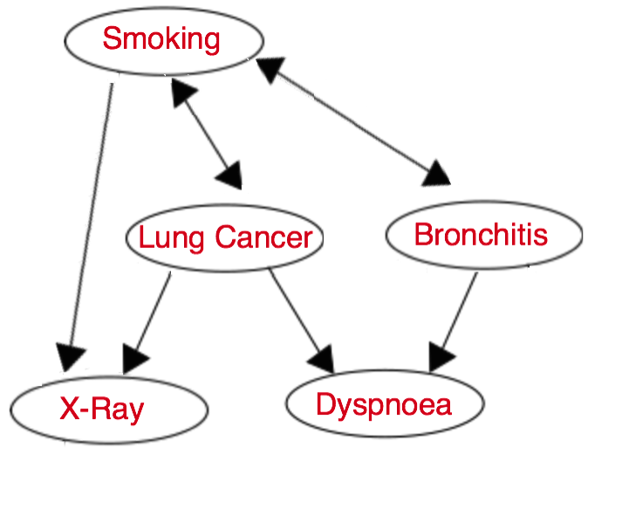
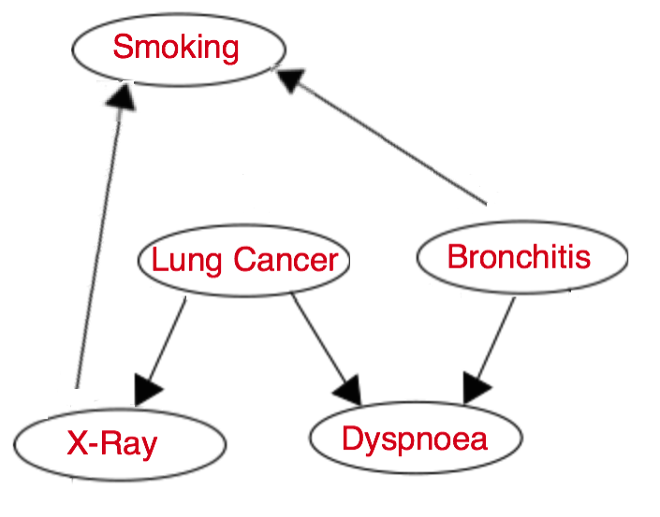
Comparing BNs to each other
Skeleton: TP, FP, TPR=TP/n.edges
CPDAG (equivalence class): SHD=FN+FP+EWD
Where EWD are edges with wrong directions
TP=4
FP=1
TPR=4/6=67%
T:
E:
SHD=3
TP=5
FP=0
TPR=5/6=83%
T:
E:

Slide 13
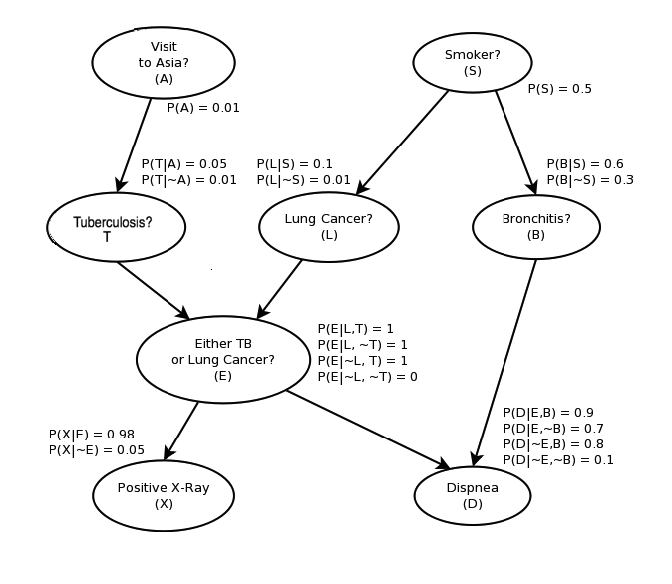
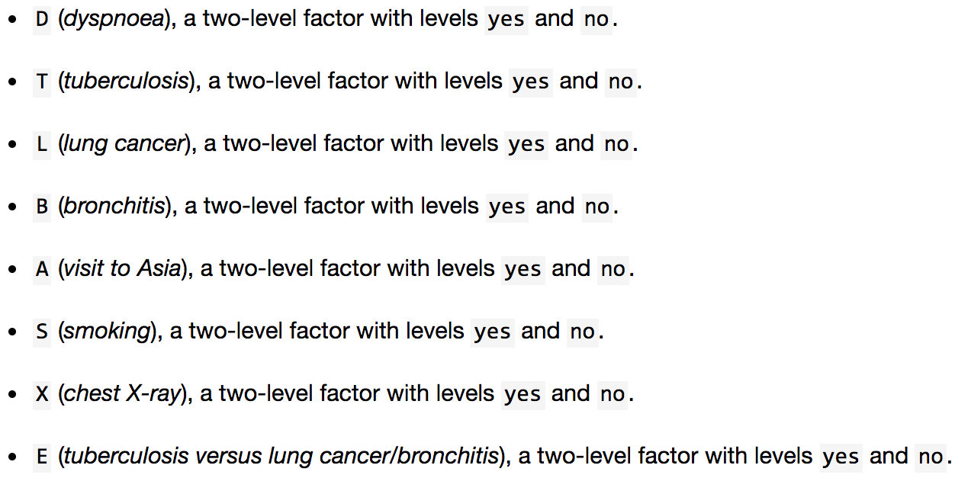
Asia dataset
a synthetic dataset from Lauritzen and Spiegelhalter (1988)
8 binary variables:
5000 observations
http://www.bnlearn.com/documentation/man/asia.html

Slide 14
Asia dataset, + R-code
Estimate equivalence class (CPDAG) from observational data using PC-algorithms and MCMC iterative scheme
What are the differences between estimates of 2 algorithms?
Compare estimated structures to the true DAG
Why was edge A->T missed by both algorithms?
Try the same with 500 observations instead of 5000
Did the results change?

Slide 15
n=100, see R-code
Generate random DAG with 100 nodes and data
Apply PC and MCMC algorithms for structure learning
Compare estimates to the true structure
Is there a significant difference between results of 2 algorithms?
Is there a significant difference between MAP estimate and sampling version of MCMC schemes?

Slide 16
References
Chickering, D. M. (2002). Optimal structure identification with greedy search. Journal of Machine Learning Research 3, 507–554.
Friedman, N. and D. Koller (2003). A Bayesian approach to structure discovery in bayesian networks. Machine Learning 50, 95–125.
Kalisch, M. and P. Bühlmann (2007). Estimating high-dimensional directed acyclic graphs with the PC-algorithm. Journal of Machine Learning Research 8, 613–636.
Kalisch, M., M. Mächler, D. Colombo, M. Maathuis, and P. Bühlmann (2012). Causal inference using graphical models with the R package pcalg. Journal of Statistical Software 47, 1–26.

