Slide 1
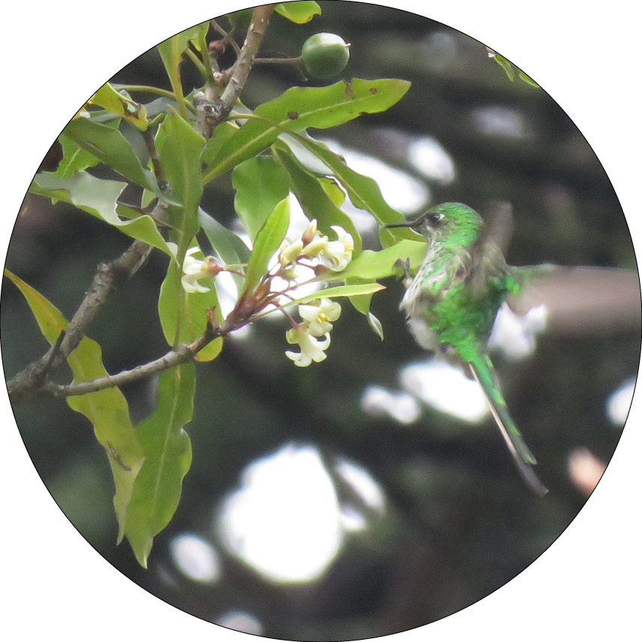
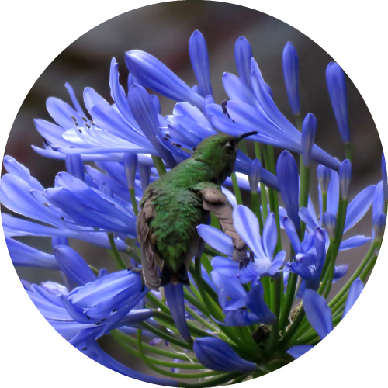
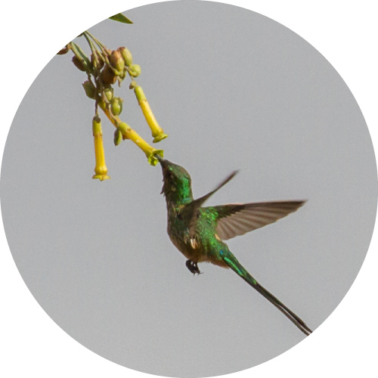
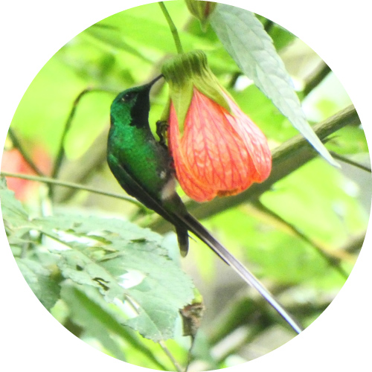
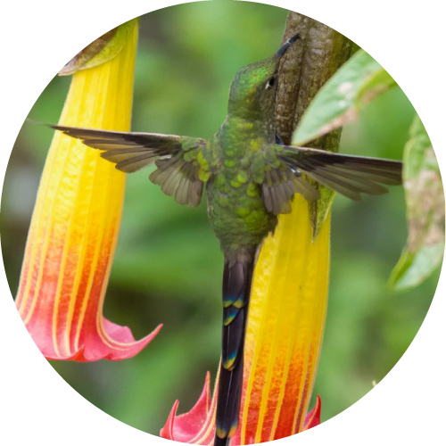
https://www.inaturalist.org/observations/33044598
a visit that cannot be classified (NA), near Pittosporum undulatum.
https://www.inaturalist.org/observations/31208388
thieving (T) from Agapanthus sp.
https://www.inaturalist.org/observations/4133555
Pollination (P) of Nicotiana glauca.
https://www.inaturalist.org/observations/25395388
Robbing (NR) Abutilon pictum.
Our manuscript-included photograph from Diego Emerson Torres, Secondary robbing (NR2) of Brugmansia sanguinea.

