Slide 1

CL-643
Course Project- Travelling salesman problem
By-
Siddharth Kashyap 210122058
Shreya Anand 210122056

Slide 2
Contents
Introduction
Problem Description
Variations of the problems covered
Approaches to solve
Metaheuristic Approach
Mathematical Programming Approach
Result
Conclusion

Slide 3
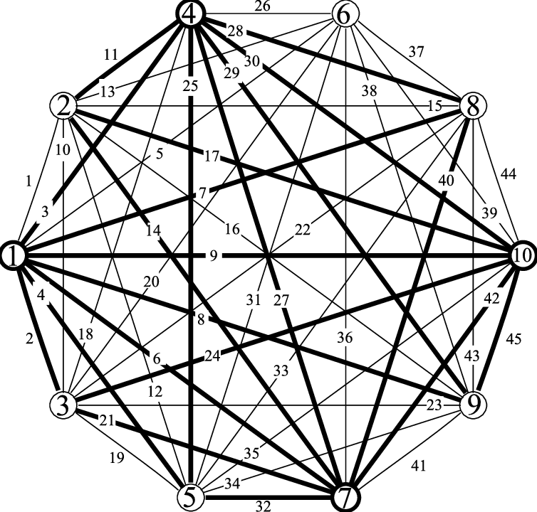
Introduction
Travelling salesman problem (TSP) found application in
Drilling problem of printed circuit boards(PCB).
Overhauling gas turbine
Xray-crystallography
Vehicle routing
The order-picking problem in warehouses
Fig1-A connected graph of 7 vertices

Slide 4
Past Work
Problem was first formulated in 1930, one of the most studied problems in optimization.
expressed the problem as an integer linear program and developed the cutting plane method it.
Padberg, Rinaldi and others managed to exactly solve instances with up to 2,392 cities, using cutting planes and branch and bound.
Fig1-A connected graph of 7 vertices

Slide 5
Problem Description
Travelling salesman problem (TSP)
Given-
Number of cities
Distance between each pair of cities (Assumption- every pair of cities is connected directly by at least one path).
There is a single salesman at the depot city (For this problem we have considered the depot city to be city 1).
Fig1-A connected graph of 7 vertices

Slide 6
Problem Description
Travelling salesman problem (TSP)
Conditions-
The salesman will start and end at the depot city.
Given N cities he will (N+1) days to complete the journey
Every city has to be visited exactly once and all N cities has to be visited.
Between every pair of cities he commutes he travels the minimum distance between that pair.
Total distance is the sum of distance travelled between pair of city in specific order. Our motive is to minimize it.
Fig1-A connected graph of 7 vertices

Slide 7
Variation
Single Objective- Constraint to condition described in the problem minimize the total distance for a single travelling salesman.
Multi-Objective- In addition to the previous problem description now the salesman has a more important objective to maximize profit. Every city he visits he sells the product to all residents but the Number of buyers in that city varies according to the day he visits. This is true for all cities, so the salesman has maximize profit first and then minimize the travelling cost.

Slide 8
Variation
Multiple Travelling Salesman- Extension to original problem keeping all constraints unchanged now number of salesmen can be variable, all salesmen start from the depot city and end at the depot city with objective to minimize total travelling distance adhering to all constraint to TSP additionally each salesman can travel at most specific number of city and it any salesman reached the depot city his journey ended and he cannot travel to any to any other city.

Slide 9
TRAVELLING SALESMAN PROBLEM
Single Travelling salesman Problem
Multiple Travelling salesman Problem
Mathematical Programming
Metaheurestic
CPP
Mathematical Programming
Metaheurestic
Single objective
Minimize cost
Single objective
Minimize cost
Multi objective
Maximizing profit
Minimize cost
Single objective
Minimize cost
Single objective
Minimize cost
Single objective
Minimize cost

Slide 10
Solution strategy: Single Travelling Salesman Prob.
Single Travelling salesman Problem
The described problem can be solved via-
Mathematical programming
Metaheuristic technique
Mathematical Programming
Metaheurestic
CPP
Single objective
Minimize cost
Single objective
Minimize cost
Multi objective
Maximizing profit
Minimize cost
Single objective
Minimize cost

Slide 11
Single TSP: Mathematical Programming
Decision variable-
x(I,J) set of binary decision variable of dimension N*N. The value of x(I,J) is 1 if we take the path from Ith city to Jth city.
u(i) set of binary decision variables of dimension N*1. Denotes the order of city which it is visited if u(i)<u(j) city I is visited before city J.
F- for calculation of the objective function

Slide 12

Single TSP: Mathematical Programming
Constraints
Exactly 1 departure from depot city and 1 arrival to depot city.
Each city will be visited exactly once.
Subtour elimination- The tour must not consist of smaller tours not connected to depot city.

Slide 13
Single TSP: Metaheuristic approach (Single objective)
Metaheuristic approach
Decision variable-
A row matrix of size N(number of cities) where each ith element denotes the city visited on ith day. For example for N=4 one feasible solution can be [1 2 4 3]. This denotes starting from 1(the depot city) we visit 2 on the 2nd day 4 on the 3rd day and 3 on the 4th day. Note- we have not included the return to depot city in the decision variable as it will be calculated explicitly and the first element of the decision variable will always be 1.
Extra space- we are initializing a visited matrix to keep track of city that we visited, for each city we visit we mark it visited.

Slide 14


Single TSP: Metaheuristic approach (Single objective)
Constraints
Every element in the decision variable should be an Integer from 1 to N.
Every element in the decision variable must appear exactly once.
Correction-
Before evaluation of the decision variable it is rounded to Nearest integer and bounded.
If during evaluation we encounter an already visited city we change the value to a city which is Not visited.
Fig2- Domain correction
Fig3- visit correction

Slide 15
Single TSP: Metaheuristic approach (Single objective)
Evaluation of Objective function
Due to the nature of the decision variable denoting the city travelled in sequential order. There are a total of N trips distance travelled I each trip is looked up with help of adj matrix and added to total.
Return from last visited city to depot city must be added to total.
Total distance travelled is our objective function;

Slide 16
Single TSP: Metaheuristic approach (Multi objective)
Metaheuristic approach
Decision variable-
A row matrix of size N(number of cities) where each ith element denotes the city visited on ith day. For example for N=4 one feasible solution can be [1 2 4 3]. This denotes starting from 1(the depot city) we visit 2 on the 2nd day 4 on the 3rd day and 3 on the 4th day. Note- we have not included the return to depot city in the decision variable as it will be calculated explicitly and the first element of the decision variable will always be 1.
Extra space- we are initializing a visited matrix to keep track of city that we visited, for each city we visit we mark it visited.

Slide 17
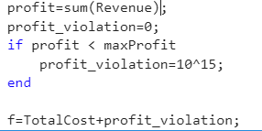
Single TSP: Metaheuristic approach (Multi objective)
Evaluation of maximum profit
After maximum profit calculation, it was passed in another round of metaheuristic technique to minimize the travelling cost.
Penalty is imposed while calculating travelling cost if set of decision variable produces less profit than maximum profit

Slide 18
Solution strategy: Multiple Travelling salesman Prob.
Multiple Travelling salesman Problem
The described problem can be solved via-
Mathematical programming
Metaheuristic technique
Mathematical Programming
Metaheurestic
Single objective
Minimize cost
Single objective
Minimize cost

Slide 19
Multiple TSP: Metaheuristic approach
Metaheuristic approach
Decision variable-
A row matrix of size M*N (number of cities) where each ith row denotes the ith salesmen and jth column denotes the city visited by ith salesman on jth day. The number of decision variables is N*M.
Extra space- we are initializing a visited matrix to keep track of city that we visited, for each city we visit we mark it visited.

Slide 20
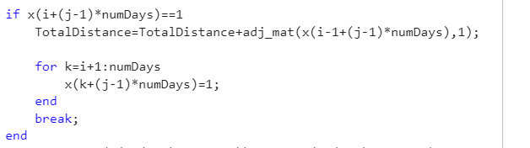
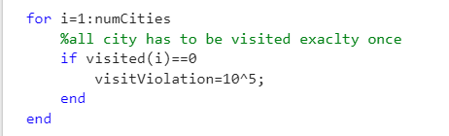
Multiple TSP: Metaheuristic approach
Constrains:
All corrections which were employed in single TSP are employed here, in addition, if a salesman returns to depot city, he cannot visit any other city anymore.
If all salesman completes their tour early without all city being visited for that penalty is imposed.
a salesman visits more cities than he was allowed to, for that penalty is imposed.
Fig4- visit constrain
Fig5- visit correction
Fig6 – allowed number of city constrain

Slide 21
Multiple TSP: Metaheuristic approach
•Evaluation of Objective function- Due to the nature of the decision variable denoting the city travelled in sequential order of days, distance can be calculated as
•Total distance will be sum of distance travelled by each salesman.

Slide 22
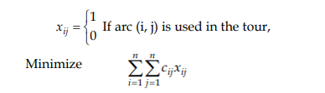
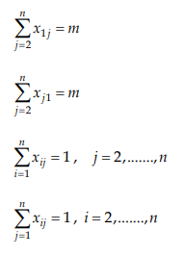
Multiple TSP: mathematical programming
The problem is also solved using mathematical programming techniques with the help of GAMS. Mixed integer programming has been solved to get the global optimal solution.
•C(i,j) is an adjacency table containing the distance between every pair of cities.
•n is the total number of cities.
•u(i) a variable keep track of the order of visit for all n. if u(i) < u(j) this implies city i is visited before city j.
•x(i.j) is a binary variable of N*N dimension
•F to store the total distance travelled along the journey.

Slide 23
Conclusion
In this report, we saw different ways to solve the Travelling salesman problem (TSP) and discussed about their outcomes and shortcomings.
A metaheuristic algorithm is a search method crafted to discover a robust solution to a complex optimization problem that proves challenging to solve optimally or is of black-box type.
Mathematical programming is used where it is possible to derive formulation of the problem and the optimality of the solution cannot be compromised.

Slide 24
Future Work
•Parallel and Distributed Computing: Advancements in parallel and distributed computing resulted in researchers to explore techniques to solve large-scale TSP instances more efficiently by distributing the computation across multiple processors or systems
•Multi-Objective TSP: Extending TSP to handle multiple conflicting objectives simultaneously. This involves optimizing not only for the shortest route but also considering other criteria such as cost, time, or environmental impact to attain to SDG goals.

Slide 25
Thank You!

