Slide 1

CL-643
Course Project- Travelling salesman problem
By-
Siddharth Kashyap 210122058
Shreya Anand 210122056

Slide 2
Contents
Introduction
Problem Description
Variations of the problems covered
Approaches to solve
Metaheuristic Approach
Mathematical Programming Approach
Result
Conclusion

Slide 3
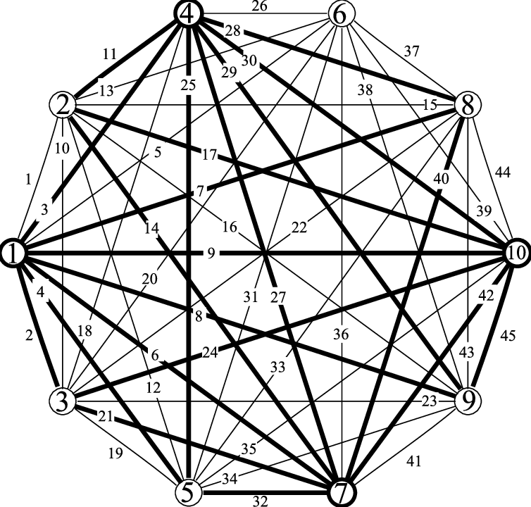
Introduction
Travelling salesman problem (TSP) found application in
Drilling problem of printed circuit boards(PCB).
Overhauling gas turbine
Xray-crystallography
Vehicle routing
The order-picking problem in warehouses
Fig1-A connected graph of 7 vertices

Slide 4
Past Work
Problem was first formulated in 1930, one of the most studied problems in optimization.
expressed the problem as an integer linear program and developed the cutting plane method it.
Padberg, Rinaldi and others managed to exactly solve instances with up to 2,392 cities, using cutting planes and branch and bound.
Fig1-A connected graph of 7 vertices

Slide 5
Problem Description
Travelling salesman problem (TSP)
Given-
Number of cities
Distance between each pair of cities (Assumption- every pair of cities is connected directly by at least one path).
There is a single salesman at the depot city (For this problem we have considered the depot city to be city 1).
Cost per unit distance
Fig1-A connected graph of 7 vertices

Slide 6
Problem Description
Travelling salesman problem (TSP)
Conditions-
The salesman will start and end at the depot city.
Given N cities he will (N+1) days to complete the journey
Every city has to be visited exactly once and all N cities has to be visited.
Between every pair of cities he commutes he travels the minimum distance between that pair.
(Sum of total distance travelled from the beginning till the end)*(cost per unit distance) is the cost.
Fig1-A connected graph of 7 vertices

Slide 7
Variation
Single Objective- Constraint to condition described in the problem minimize the cost of a single travelling salesman.
Multi-Objective- In addition to the previous problem description now the salesman has a more important objective to maximize profit. Every city he visits he sells the product to all residents but the Number of residents in that city varies according to the day he visits. This is true for all cities, so the salesman has maximize profit first and then minimize the travelling cost.

Slide 8
Variation
Multiple Travelling Salesman- Extension to original problem keeping all constraints unchanged now number of salesmen can be variable, all salesmen start from the depot city and end at the depot city with objective to minimize total travelling cost.

Slide 9
Solution strategy: Single Objective TSP
The described problem can be solved via-
Metaheuristic technique
Mathematical programming

Slide 10
Single Objective TSP: Metaheuristic approach
Metaheuristic approach
Decision variable-
A row matrix of size N(number of cities) where each ith element denotes the city visited on ith day. For example for N=4 one feasible solution can be [1 2 4 3]. This denotes starting from 1(the depot city) we visit 2 on the 2nd day 4 on the 3rd day and 3 on the 4th day. Note- we have not included the return to depot city in the decision variable as it will be calculated explicitly and the first element of the decision variable will always be 1.
Extra space- we are initializing a visited matrix to keep track of city that we visited, for each city we visit we mark it visited.

Slide 11


Single Objective TSP: Metaheuristic approach
Constraints
Every element in the decision variable should be an Integer from 1 to N.
Every element in the decision variable must appear exactly once.
Correction-
Before evaluation of the decision variable it is rounded to Nearest integer and bounded.
If during evaluation we encounter an already visited city we change the value to a city which is Not visited.
Fig2- Domain correction
Fig3- visit correction

Slide 12
Single Objective TSP: Metaheuristic approach
Evaluation of Objective function
Due to the nature of the decision variable denoting the city travelled in sequential order. There are a total of N trips distance travelled I each trip is looked up with help of adj matrix and added to total.
Return from last visited city to depot city must be added to total.
Total cost can be calculated as (Total Distance)*cost per unit distance which is our objective function;

Slide 13
Single Objective TSP: Mathematical Programming
Decision variable-
x(I,J) set of binary decision variable of dimension N*N. The value of x(I,J) is 1 if we take the path from Ith city to Jth city.
u(i) set of binary decision variables of dimension N*1. Denotes the order of city which it is visited if u(i)<u(j) city I is visited before city J.
F- for calculation of the objective function

Slide 14

Single Objective TSP: Metaheuristic approach
Constraints
Exactly 1 departure from depot city and 1 arrival to depot city.
Each city will be visited exactly once.
Subtour elimination- The tour must not consist of smaller tours not connected to depot city.
Fig3- visit correction

