Slide 1
The Submission Gamble
You are a reputable researcher mainly financed by the Lewis Carroll Foundation. You have just finished writing 3 articles and are about to submit them to publishers.
With your partner choose the best venue to publish each article by matching one journal card to each article card.
Each journal will accept only 1 article!
Time: 10 min.
Icon: Gambling by dDara from the Noun Project, https://thenounproject.com

Slide 2
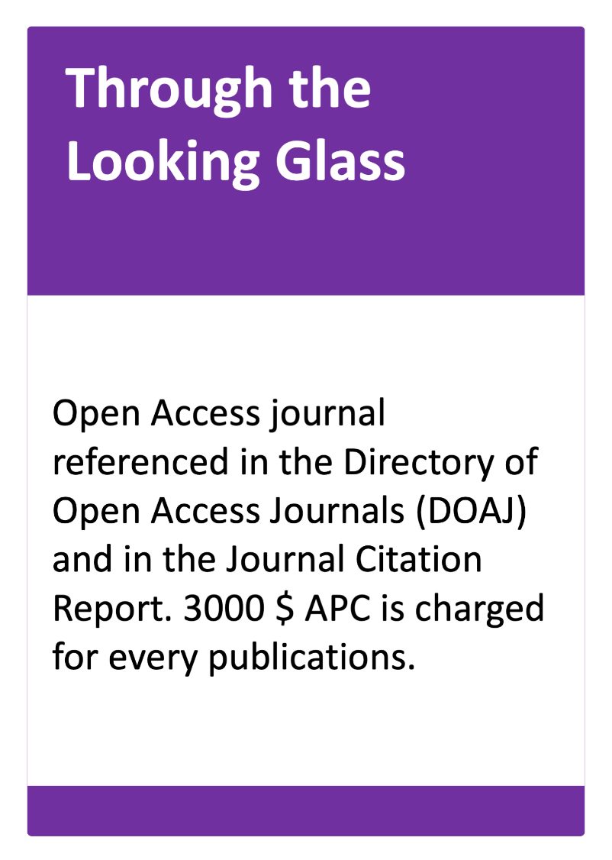
The Submission Gamble
Wonderland’s Rabbit genome analysis… | Congratulation! Your paper is accepted and the Lewis Carroll’s Fundation gives you a grant for the APC. | +2pt
Rabits in Wonderland… | Congratulation! Your paper is accepted and the Lewis Carroll’s Fundation gives you a grant for the APC. | +2pt
The rabbit genome sequence… | Congratulation! Your paper is accepted and the Lewis Carroll’s Fundation gives you a grant for the APC. | +2pt
Notes:
Who choosed to submit to this journal?
Which type of journal it is, according to the typology we have seen just before?
Gold OA journal

Slide 3
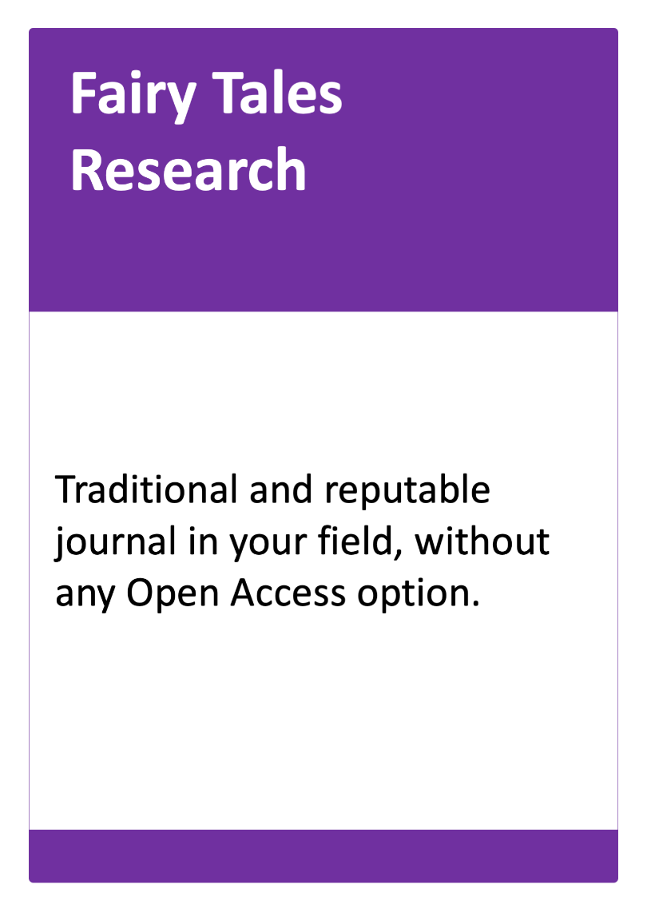
The Submission Gamble
Wonderland’s Rabbit genome analysis… | Your article is published, but as it is not immediately accessible for everyone, you go unnoticed by the Wonderland International Congress’ Chair. | +1pt
Rabits in Wonderland… | Your article is published, but as it is not immediately accessible for everyone, you go unnoticed by the Wonderland International Congress’ Chair. | +1pt
The rabbit genome sequence… | Your article is published, but as it is not immediately accessible for everyone, you go unnoticed by the Wonderland International Congress’ Chair. | +1pt
Notes:
Traditional journal

Slide 4
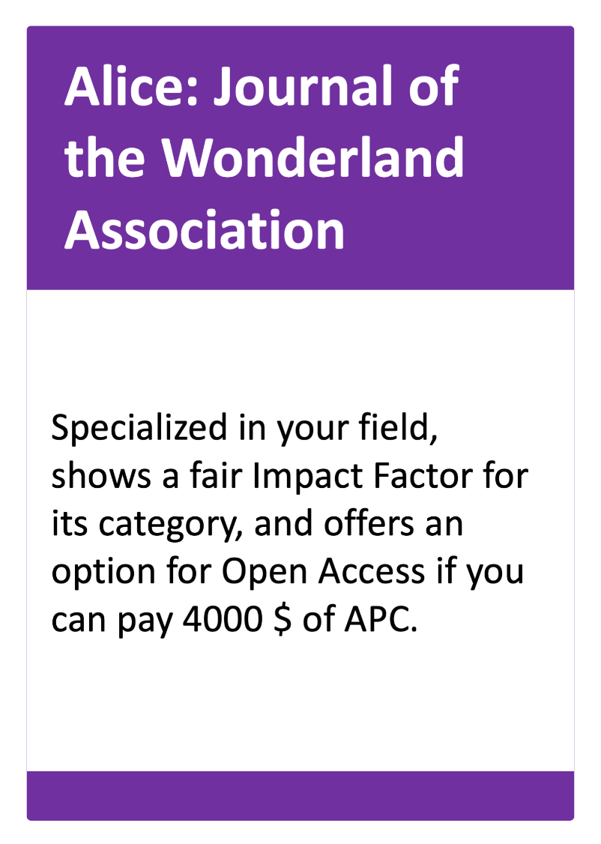
The Submission Gamble
Wonderland’s Rabbit genome analysis… | Your paper is accepted but you have to pay the 4000 $ out of your own pocket because your institution doesn’t fund publication in a hybrid journal. | +1pt
Rabits in Wonderland… | Your paper is accepted but you have to pay the 4000 $ out of your own pocket because your institution doesn’t fund publication in a hybrid journal. | +1pt
The rabbit genome sequence… | Your paper is accepted and fortunately one of your co-author’s institution has an agreement with the publisher and funds the publication. | +2pt
Notes:
Hybrid journal

Slide 5
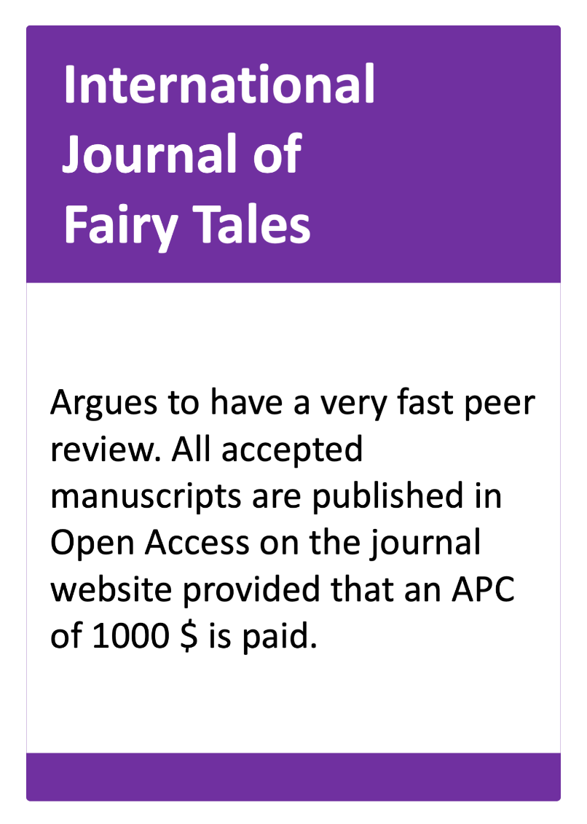
The Submission Gamble
Wonderland’s Rabbit genome analysis… | That’s a predatory publisher! Your article is published without any peer review and you are the shame of the community. | -2pt
Rabits in Wonderland… | That’s a predatory publisher! Your article is published without any peer review and you are the shame of the community. | -2pt
The rabbit genome sequence… | That’s a predatory publisher! Your article is published without any peer review and you are the shame of the community. | -2pt
Notes:
Predatory journal !!!

Slide 6
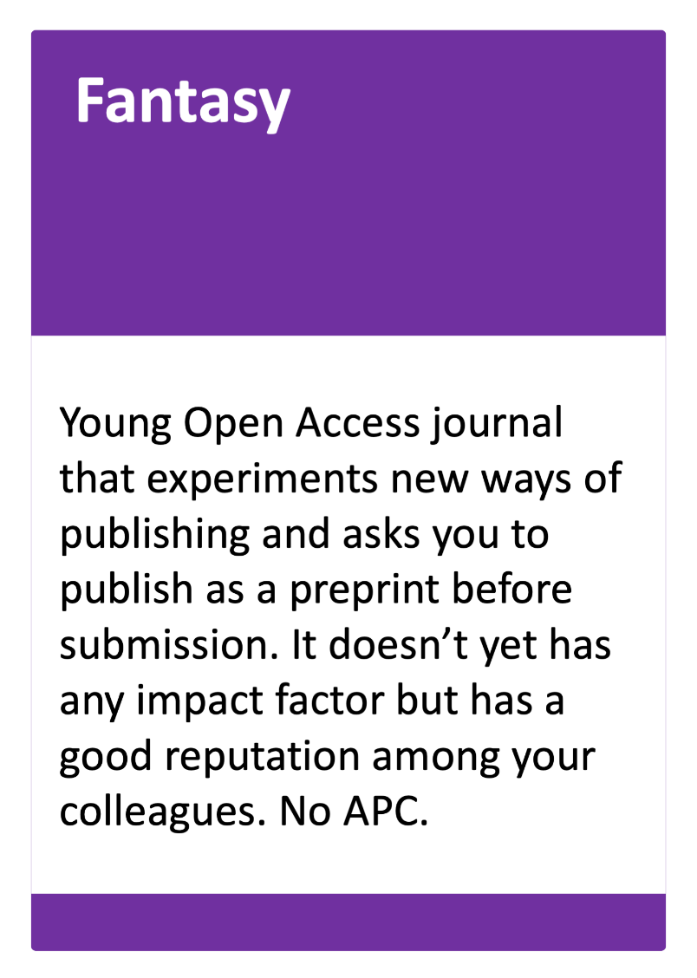
The Submission Gamble
Wonderland’s Rabbit genome analysis… | Convincing your co-authors wasn’t easy. But the paper is accepted and thanks to the deposit of the preprint, you have already been contacted by a colleague for a future collaboration on a project. | +2pt
Rabits in Wonderland… | Your paper is accepted and thanks to the deposit of the preprint, you have already been contacted by a colleague for a collaboration on a future project. | +2pt
The rabbit genome sequence… | Your co-authors do not approve your choice and you waste a month trying in vain to convince them. | -1pt
Notes:
Gold OA journal

Slide 7
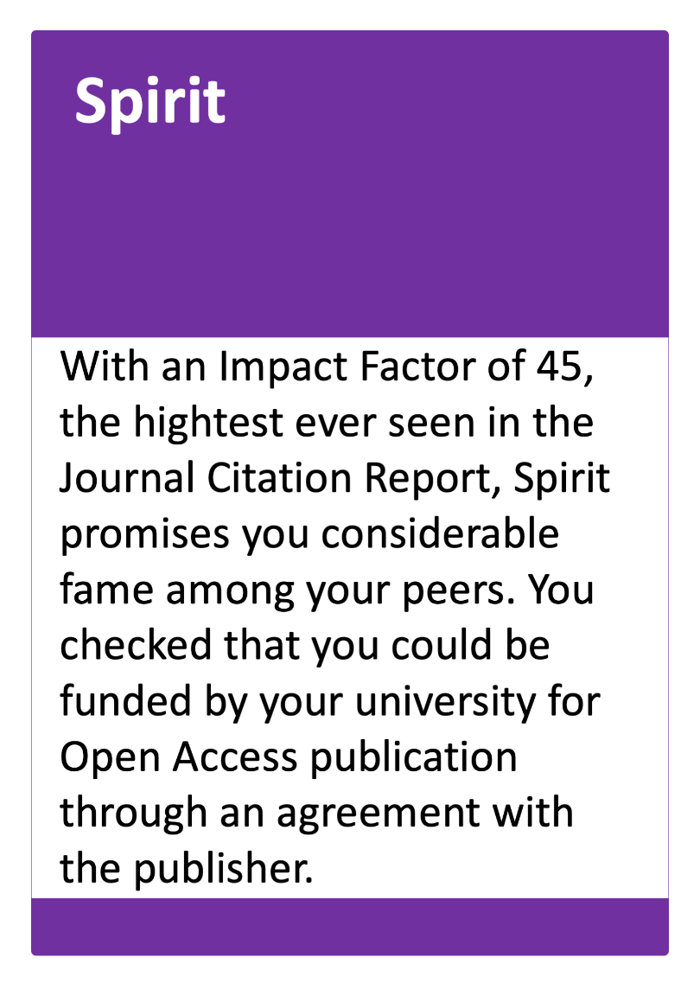
The Submission Gamble
Wonderland’s Rabbit genome analysis… | Unfortunately, your article was rejected. You have lost 3 months and must start the process again with another title. | -1pt
Rabits in Wonderland… | Unfortunately, your article was desk rejected because the journal doesn't accept literature reviews. You must start the process again with another title. | 0pt
The rabbit genome sequence… | Congratulations! Your article was accepted and finally published after 1 year of publishing process. | +3pt
Notes:
Hybrid (or Gold OA) journal

Slide 8

The Submission Gamble
Calculate your score:
>= 5 points | 1-4 points | <= 0 points
Congratulations! You have avoided all the pitfalls of scientific publishing. You have limited your expenses while privileging Open Access as much as possible. Your publications are expected to have a high impact. | Thanks to thoughtful choices, you have managed to publish all your articles. This experience will be useful to further optimize the impact of your next publications. | Were your choices too audacious? Did you lack luck or resources? Always carefully evaluate the journals to which you submit your articles and don't hesitate to seek advice from experienced colleagues or librarians.
Bibliothèque de l’UNIGE, 2023
Ce document est sous licence Creative Commons Attribution - Partage dans les mêmes conditions 4.0 International : http://creativecommons.org/licenses/by-sa/4.0/deed.fr.

