Slide 1
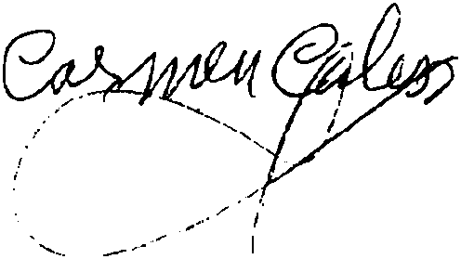
Pattern Recognition Techniques Off-line Signature Recognition

Slide 2
300 sets
16200 signatures
9 features
169 features attributes
511 combinations of features x 30 runs
8 classifiers
~ 100 running hours

Slide 3
Pre-processing
Crop Image
Thinning
Filling

Slide 4
Features Extraction
Referenced features:
Sixfold
Centroid
Best-fit
Tri-surface
Length
Modified Direction

Slide 5
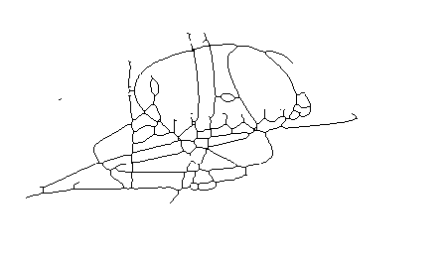
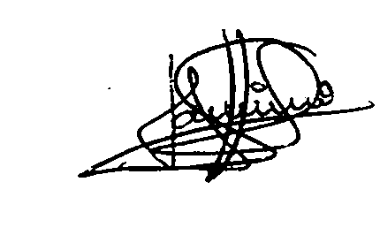
Features Extraction
New Ideas:
Stroke Feature
(thinned / original)

Slide 6
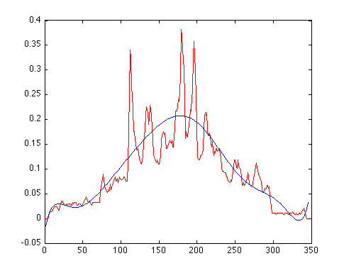
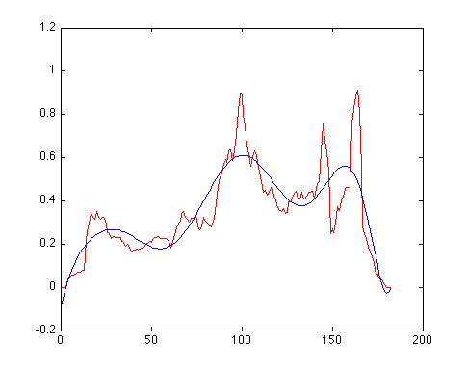
Features Extraction
New Ideas:
Histogram feature (polynomial approximation)

Slide 7
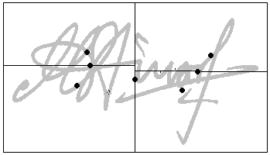
Features Extraction
New Ideas:
Splitting feature

Slide 8
Features Selection
Experimental Analysis
Statistically best (Kruskall-Wallis test):
'mdf' 'centroid’ 'length' 'sixfold' 'splitting‘: 86,20%
Mean best:
'mdf' 'centroid’ 'trisurface' 'length' 'sixfold' 'splitting‘: 86,28%

Slide 9
Features Selection
Automatic Methods
Covariance
Idea:
The least covariance of some feature with the others the most value it is.
Order feature values by ascending covariance

Slide 10
Features Selection
Automatic Methods
Mutual Information
Idea:
The least mutual information of some feature with the others the most value it is.
Order feature values by ascending mutual info

Slide 11
Features Selection
Automatic Methods
Covariance
Idea:
The least covariance of some feature with the others the most value it is.
Order feature values by ascending covariance

Slide 12
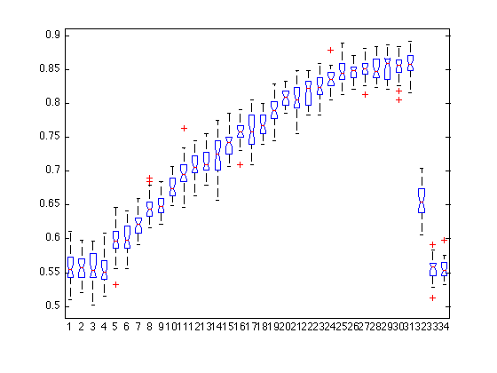
Features Selection
Automatic Methods Results: (Covariance)

Slide 13
Features Selection
Automatic Methods Results (Covariance)
Best Statistical Results (Kruskal-Wallis):
the least correlated 151 feature values, with an accuracy of 85.93%.

Slide 14
Features Selection
Automatic Methods Results (Mutual Info)
Best Statistical Results (Kruskal-Wallis):
very bad results: 61.38%.

Slide 15
Classifiers
Support Vector Machines
K-Nearest Neighbors
Radial Basis Function
Fisher Linear Discriminant
K-Means
Multi-Layer Neural Network
Naïve Bayesian Classifier
Template

Slide 16

Classifiers
Template Method
Probabilistic Classification Method
Map for both genuine and forged signatures
Bad results (around 70%)

Slide 17
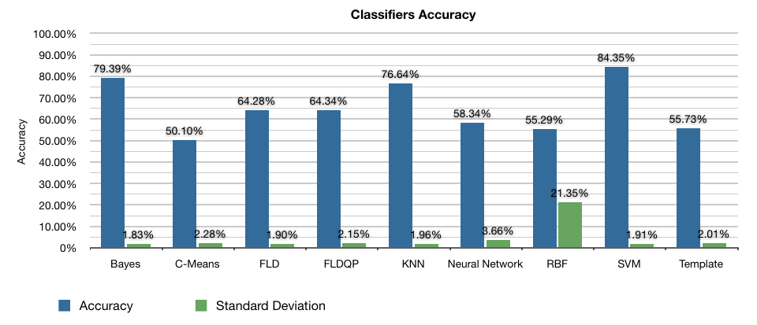
Classifiers Results
Accuracy

Slide 18
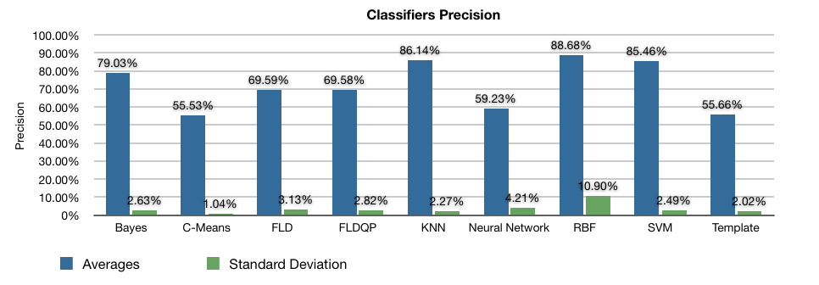
Classifiers Results
Precision

Slide 19
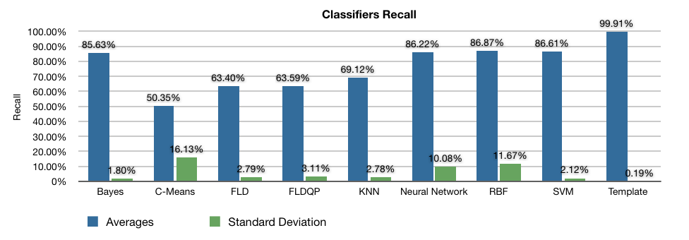
Classifiers Results
Recall

Slide 20
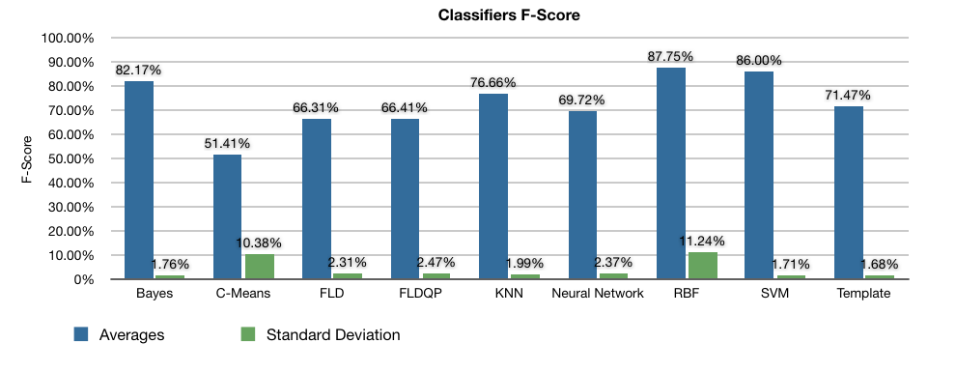
Classifiers Results
F-Score

Slide 21
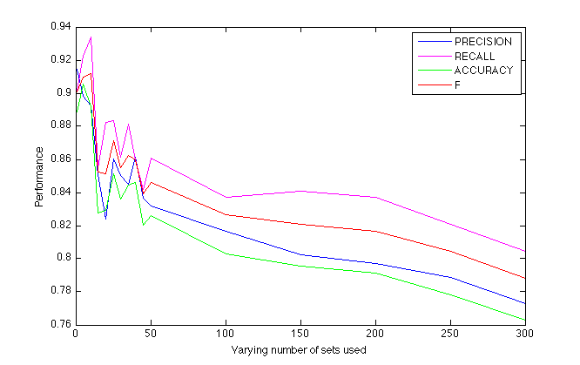
Dataset Size Analysis

Slide 22
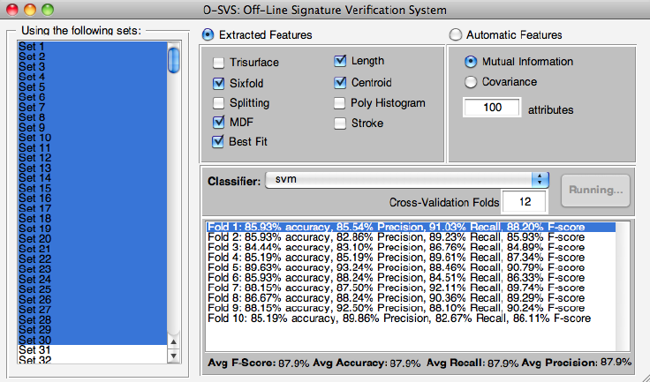
GUI

