Slide 1
Ray Tracer
Help Session

Slide 2
Outline
Introduction
ray
vec.h and mat.h
isect
Requirements
Tips and Tricks
Memory Leaks
Artifact Requirement
Ray Tracing Surface of Revolution
Using ply Models
Bells and Whistles

Slide 3
Ray Tracer
Given a ray “caster”, you have to implement:
  Shading (multiple parts)
  Reflection and Refraction
  Sphere Intersection
  Triangle Intersection
    Complex objects consist of a 3D mesh made up of triangles

Slide 4
ray
A 3D ray is a fundamental component of a ray tracer.
ray r(start position, direction, RayType)
  RayType, an enum, includes:
    VISIBILITY
    REFLECTION
    REFRACTION
    SHADOW
  Example:
    ray r(foo, bar, ray::SHADOW);
r.at(t) – direction of r * distance t
  Returns the end position of the ray r after going a distance of t from its start position

Slide 5
vec.h and mat.h
vec.h provides useful tools for 2D, 3D, and 4D vectors
  Easy Vector Construction – Vec3d x = Vec3d(0,0,0);
  Basic operators are overridden:
    + and – arthimetic, Vec3d v3 = v1 + v2;
    *, multiply by a constant, Vec3d v2 = 2*v1;
    *, dot product, double dot = v1 * v2;
    ^, cross product, Vec3d cross = v1 ^ v2;
  For other useful functionality, such as normalize(), length(), and iszero(), read vec.h for complete details
mat.h is very similar, but for matrix operations not heavily used in this project

Slide 6
isect
An isect represents the location where a ray intersects an object
Important member variables:
  const SceneObject *obj – the object that was intersected
  double t – the distance along the ray where it occurred
  Vec3d N – the normal to the surface where it occurred
  Vec2d uvCoordinates – texture coordinates on the surface [1.0, 1.0]
  Material *material – non-NULL if exists a unique material for this intersect
  const Material &getMaterial() const – return the material to use

Slide 7
Requirements
The following requirements need to be implemented:
  Sphere intersection
  Triangle intersection
  Blinn-Phong Specular-Reflection Model
  Multiple light sources
  Shadow attenuation
  Reflection
  Refraction

Slide 8
Requirement: Sphere Intersection
Fill in Sphere::intersectLocal in SceneObjects\Sphere.cpp
Return true if ray r intersects the canonical sphere (sphere centered at the origin with radius 1.0) in positive time
Set the values of isect i:
  i.obj = this
  i.setT (time of intersection)
  i.setN (normal at intersection)

Slide 9
Requirement: Triangle Intersection
Fill in TrimeshFace::intersectLocal in SceneObjects\trimesh.cpp
Intersect r with the triangle abc:
  Vec3D &a = parent->vertices[ ids [0] ];
  Vec3D &b = parent->vertices[ ids [1] ];
  Vec3D &c = parent->vertices[ ids [2] ];
Return true if ray r intersects the triangle
Need more help? See triangle intersection handout linked to on project website:
  http://www.cs.washington.edu/education/courses/cse457/handouts/triangle_intersection.pdf

Slide 10
Requirement: Blinn-Phong Specular-Reflection Model
Fill in Material::shade in material.cpp
Refer to the Ray Tracing lecture
To sum over the light sources, use an iterator as described in the comments of the code
CAUTION: If you are on the inside of an object, the object’s normal will point outside. For this case, you will need to flip the normal for any shading, reflection, or refraction.

Slide 11
Requirement: Multiple Light Sources
Fill in PointLight::distanceAttenuation in light.cpp (distance attenuation for directional light is done for you)
Use the alternative described in the ray tracing lecture where:
  a – constant term
  b – linear term
  c – quadratic term
These terms are defined in light.h

Slide 12
Requirement: Shadow Attenuation
Fill in DirectionalLight::shadowAttenuation and PointLight::shadowAttenuation in light.cpp
The ray tracing lecture shows you where to insert this factor into the Blinn-Phong equation (a_shadow for each light)
Rather than simply setting the attenuation to zero if an object blocks the light, accumulate the product of k_t’s for objects which block the light (use the prod function from vec.h)
Count each intersection with an object by the shadow ray (includes entering and exiting)
Extra Credit: Better shadow handling (caustics, global illumination, etc.)

Slide 13
Requirement: Reflection
Modify RayTracer::traceRay in RayTracer.cpp to implement recursive ray tracing, which takes into account reflected rays
See Shirley, et. al. and lecture slides

Slide 14


Requirement: Refraction
Modify RayTracer::traceRay in RayTracer.cpp to create refracted rays
Remember Snell’s law, watch out for total internal reflection, and consider the case when the ray is exiting a material into air (think about the direction of the normal)
You can test refraction with simple/cube_transparent.ray
Unlike reflection, this routine has several cases to consider:
  An incoming ray
  An outgoing ray
  Totally internally reflected ray
n_{glass}=1.5
n_{air}=1.0003

Slide 15
Tips and Tricks
Use the sign of the dot product r.getDirection() with i.N to determine whether you are entering or exiting an object
Don’t write too much code without testing!
  Lots of dependencies, you need to know what works to proceed
Use RAY_EPSILON (which is defined as 0.00001) to account for computer precision error when checking for intersections
RAY_EPSILON

Slide 16
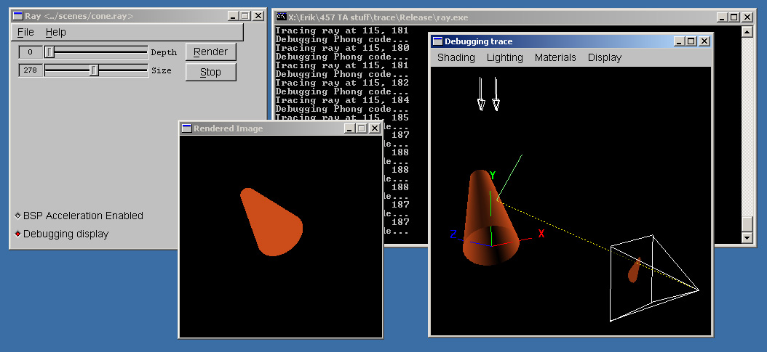
The Debugger Tool
USE THIS, IT WILL SAVE YOUR LIFE!
Shipped with skeleton code
Find out how to use it here:
  http://www.cs.washington.edu/education/courses/cse457/13sp/projects/trace/extra/debug.html

Slide 17
Memory Leaks
A memory leak can (and probably will) ruin your night hours before your artifact is due
To test, try to ray trace a complex model (the dragon) with depth 10, anti-aliasing, HUGE Image
Cause: not calling free after allocating memory
  Object constructors, vector (array) creation
Solution: free stuff!
  Call the “delete [object]” on ANYTHING you create that is temporary
    i.e. 3 byte temporary vectors in the rayTrace function
It is HIGHLY RECOMMENDED you have no memory leaks

Slide 18
Artifact Requirement
Draw a pretty picture!
One JPEG/PNG image traced with your Ray Tracer submitted for voting
Has to be a (somewhat) original scene
For each image submitted for voting, a short .txt description of the scene or special features
Examples of each bell/whistle implemented with an accompanying readme.txt specifying which image demonstrates which feature (and where/how)

Slide 19
Ray Tracing Surface of Revolution
Use this code snippet to write triangle mesh into a file:
  http://www.cs.washington.edu/education/courses/cse457/13sp/projects/trace/code/write_revolution_rayfile.c
Use this .ray file as a template
  http://www.cs.washington.edu/education/courses/cse457/13sp/projects/trace/code/revolution.ray
  It contains default lighting of modeler
  Replace polymesh{} part with your own surface of revolution
Render your new .ray file in tracer!

Slide 20
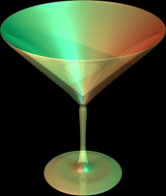
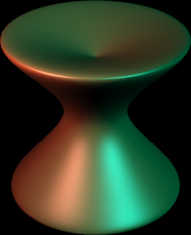
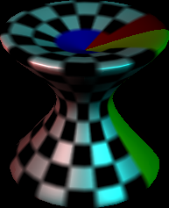
Sample Results
texture mapping

Slide 21
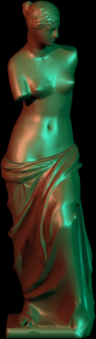
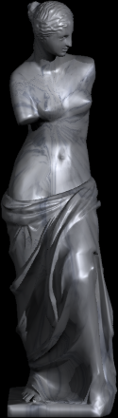
Using ply Models
ply is one of the standard formats for 3D models:
  http://en.wikipedia.org/wiki/PLY_(file_format)
There are a plethora of ply models available online
We provide a simple tool (ply2ray) that converts ply models into .ray files
  It is in your source folder, so check it out!
You still need to add lightning and material property

Slide 22
Comparison Tool
We will be using this tool (link on the course webpage) to evaluate your solution versus the sample. So you should check too !!
Demo of comparison tool

Slide 23
Bells and Whistles
TONS of awesome extra credit!
Anti-aliasing – A must for nice scenes (to render scenes without “jaggies”)
Interpolate trimesh material properties – will make them look nicer
Envrionment/Texture/Bump Mapping – Relatively easy ways to create complex and compelling scenes
Single Image Random Dot Stereograms
Depth of field, soft shadows, motion blur, glossy reflection – most images we’re used to seeing have at least one of these effects
NOTE: Please add control boxes for substantial ray tracing modifications so that required extension are easily gradable
  See sample solution style

Slide 24
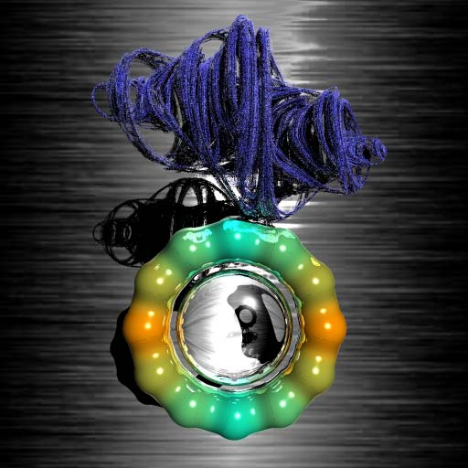
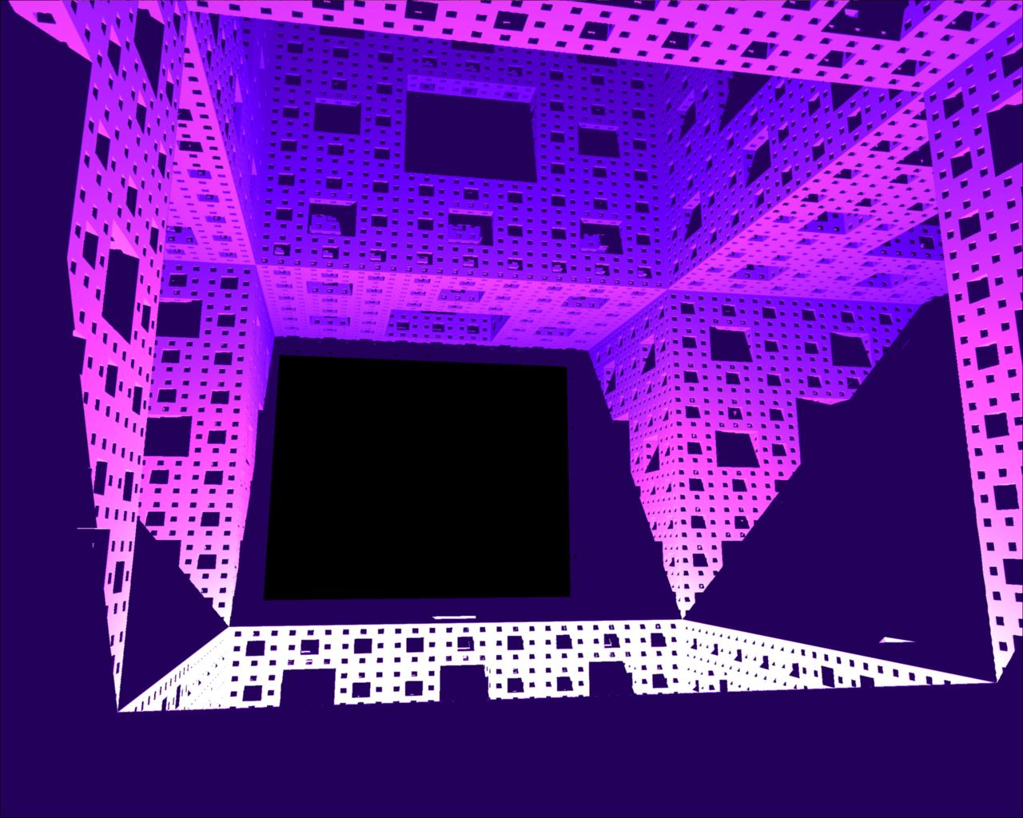
3D and 4D Fractals

Slide 25
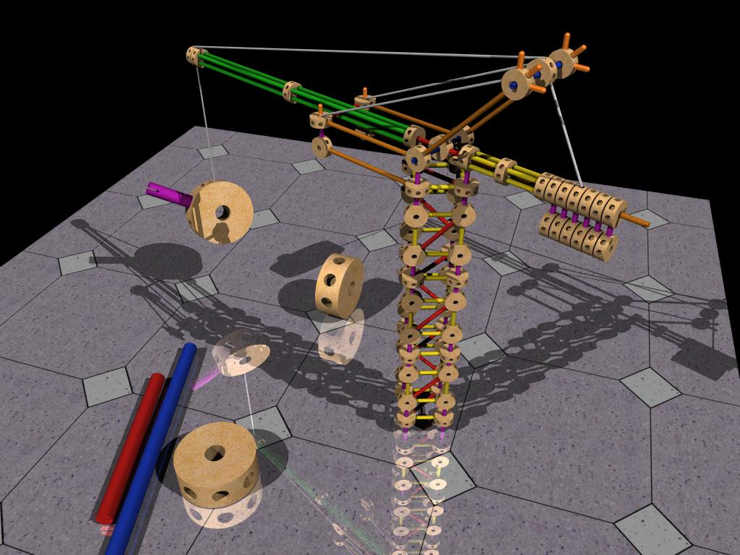
Constructive Solid Geometry
Allows for complex objects while still just intersecting simple primitives

