Slide 1
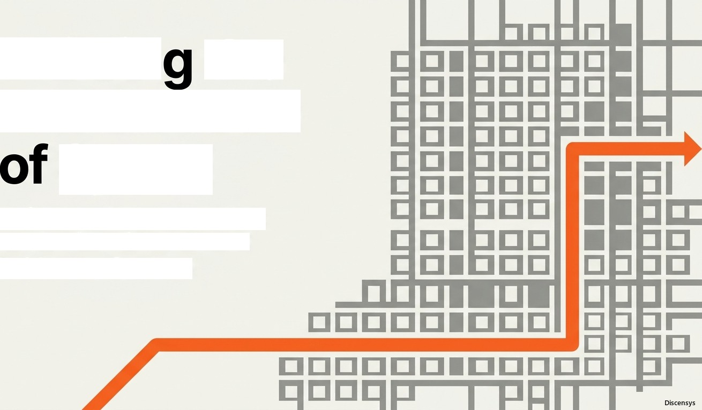
Buildin the Architecture
Speed
Defeating distance and disk mechanics with Redis and In-Memory Systems

Slide 2

Computation is Fast.
Fetching Data is the Bottleneck.
CPU Cache
Nanoseconds
Without caching, every request hits the database, causing infrastructure overload and latency spikes.
RAM (in-Memory)
Microseconds (Extremely Fast)
Caching defeats physical distance by holding data in high-speed RAM.
SSD Drive
seconds (Slower)
HDD Drive
Milliseconds (Much Slower)
Network Database

Slide 3
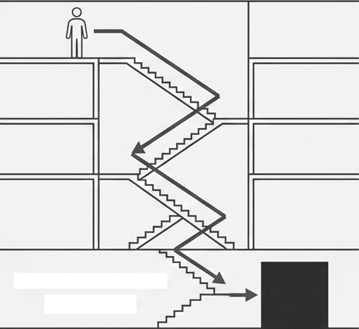

Defeating Distance: The Library Analogy
Without Cache (High Effort)
With Cache (Instant Access)
Front Desk (Redis)
Basement Archive (Database)
Every request queries the database.
The system does the heavy lifting every time.
Future requests read directly from memory.
The most popular data is immediately accessible.

Slide 4
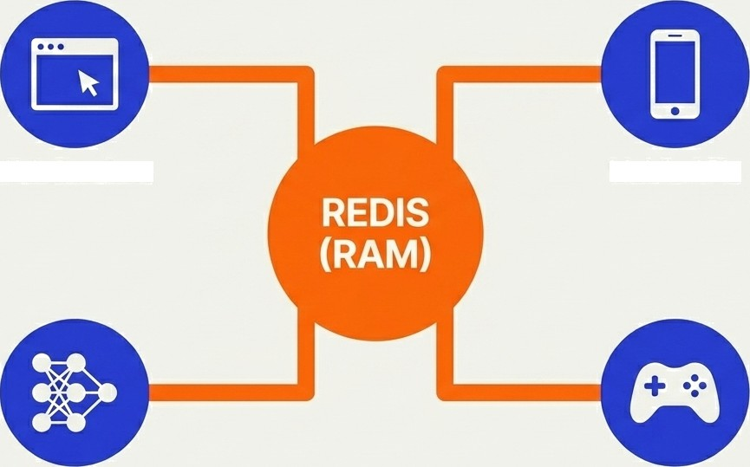
Bypassing the Disk with Redis
Direct Memory Access:
Stores data entirely
in RAM.
O(1) Operations: Highly optimized algorithmic speed.
Web Sessions
Mobile APIs
Event Loop:
Single-threaded design avoids locking.
Microsecond Latency: Bypasses disk I/O completely.
AI Embeddings
Gaming

Slide 5


The Mechanics of a Request: Hits and Misses
Scenario A: Cache Hit (Instant)
Data exists in memory. Returned immediately.
Scenario B: Cache Miss (The Tax)
Store for next time
First request is slow. Data is fetched from DB, stored in cache, making all future requests fast.

Slide 6





Matching Data Structures Application Needs
Redis is an in-memory data structure server, not just a simple key-value store.
STRINGS
Simple key-value pairs.
LISTS
Ordered
collections.
SETS
Unique unordered values.
HASHES
Objects with mapped fields.
SORTED SETS
Values ordered by a dynamic score.

Slide 7
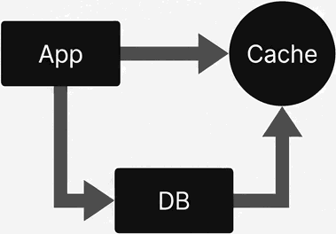
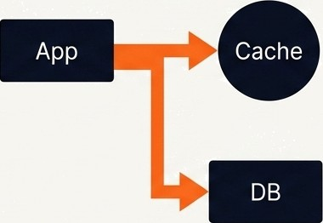
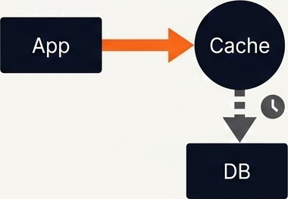
Strategic Pathways for Data Movement
Cache Aside (Lazy Loading)
Write Through
Write Back
Industry default. App | App writes to Cache and DB | App writes ONLY to RAM.
orchestrates between DB and | simultaneously. Cache is | Async sync to Database later.
Cache. Simple and efficient, | always updated, but write | Lightning-fast writes, but
but the first request is always | operations take slightly | carries a risk of data loss.
slow. | longer.

Slide 8
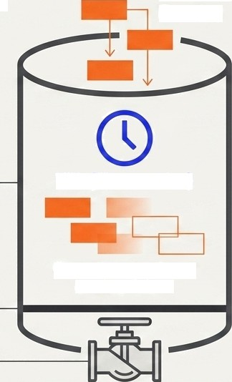
Managing Finite Memory: Expiration & Eviction
New Data Entering
Eviction Policies
LRU: Least Recently Used (Pushes out oldest unread data)
LFU: Least Frequently Used (Pushes out least popular data)
FIFO: First In, First Out
Random: Random removal
Finite RAM
TTL (Time to Live)
Organic expiration of
outdated data.
Memory Limit Floor
A cache that never forgets becomes a memory leak.
Eviction Policy

Slide 9

The Invalidation Paradox: The Danger of Stale Data
In-Memory Cache
(Redis)
Cache invalidation is notoriously difficult in distributed systems.
Source of Truth
(Database)
Item Price: $10
If the database updates, the cache must be explicitly purged.
Stale / Outdated
Solutions: Implement short TTLs and event-driven update architectures.
Updated

Slide 10
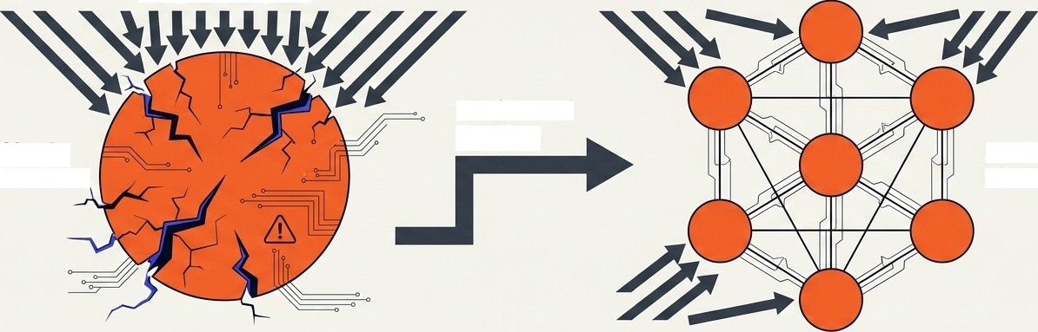



Breaking the Single-Node Limit with Clusters
Massive Traffic
Horizontal Scaling
Single
Node
Redis Cluster
Data Sharding
Memory is mathematically
partitioned across nodes.
Limitless Scale
Breaks the physical hardware limits of a single machine.
High Availability
Built-in fault tolerance if a single node fails.

Slide 11
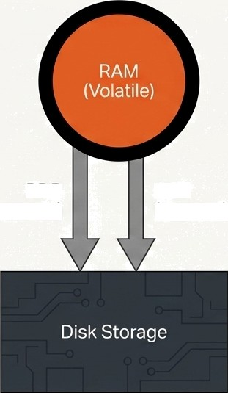
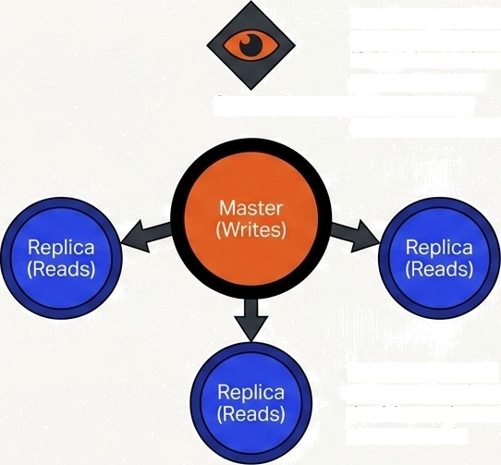
Ensuring Resilience in Volatile Memory
Disk Persistence (Crash Safety)
Replicas provide constant backups. If the Master burns down, Sentinel
Sentinel
automatically promotes a Replica.
RDB
(Snapshots)
AOF
(Append-Only Logs)
Replicas provide constant backups. If the Master burns down to disk.

Slide 12









Distinguishing Edge Delivery from Backend Memory
CDN (Content Delivery Network) |  | In-Memory Cache(Redis)
 | Edge Geography: Global content delivery. Asset Type: Stores static files (images, video, HTML). Location: Lives on edge servers physically close to the user's location. | Architectural Core: Application data caching. Asset Type: Stores dynamic database results, JSON, and session states. Location: Lives in backend memory directly next to the API and Database.
A CDN defeats physical distance for static assets. Redis defeats mechanical disk latency for dynamic data.

Slide 13
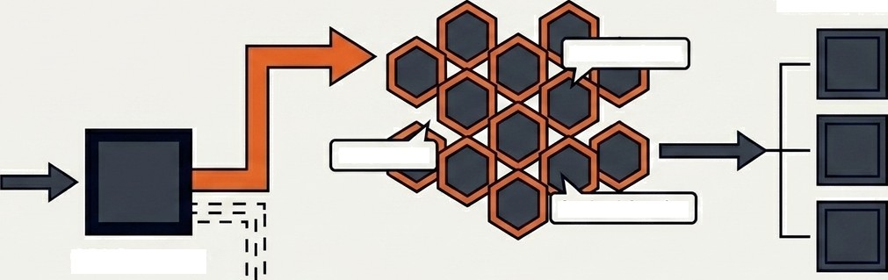







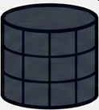
The Big Picture: Modern Production Architecture
Redis Cluster
Background
Worker Nodes
Session Store
Rate Limits
Cached Queries
H H
User Traffic
API Gateway
Continuously pulling from Redis Messaging Queues.
Architecture utilized by: Netflix, Uber, Discord, GitHub, X
Primary Database
Redis operates as the performance engine of the entire stack, not just a simple cache.

Slide 14




Avoiding Common Implementation Traps
Caching Everything RAM is a premium, expensive asset. Storing rarely accessed data wastes memory. Only cache what is frequently read. | Missing TTLs Failing to set a Time-To-Live on cached data creates an inevitable memory leak and serves permanently stale data to users.
Cache Thrashing Constant cache misses caused by poor invalidation logic. The system spends more time updating the cache than serving fast reads. | Distributed Complexity Underestimating the difficulty of multi-node coordination. A poorly configured cluster can lead to split-brain scenarios and data loss.

Slide 15
The 60-Second Blueprint for System Speed
Redis Hit/ Miss TTL
Eviction
In-Memory Engine (Bypassing mechanical disk 1/0) Request Flow (The Tax and the Dividend) Automated Expiration (Preventing stale data) Space Management (LRU / LFU dropping old data)
Cluster
Limitless Scale (Sharding memory across nodes)
) Persistence
) Crash Safety (RDB Snapshots and AOF Logs)
)

