Slide 1
Transcriptomic Profiling of Drug-Resistant Cancer Cells
Cisplatin resistance in ovarian cancer: differential expression, pathways & machine-learning biomarkers
Anushree Tyagi 23BCB0108 : Data & QC
Vivek Kumar 23BCB0137: DEGs & Biology
Solanki Nehal Shailesh 23BCB0076: ML & Biomarkers

Slide 2
Background & Objectives
• Ovarian cancer: platinum (cisplatin) is first-line; acquired resistance drives relapse.
• Resistance is multifactorial (epigenetic, metabolic, EMT, efflux, apoptosis evasion).
Objectives
• Identify DEGs between resistant and sensitive ovarian cancer cells.
• Validate DEGs across two independent GEO datasets.
• Characterize affected GO / KEGG pathways.
• Build ML classifiers and rank a candidate biomarker panel.
2

Slide 3
Data: Two Independent GEO Datasets
Attribute | GSE303889 | GSE283381
Cell line | SKOV-3 | OVCAR5
Resistance model | CDDP (chronic cisplatin) | Cis-R (repeated cisplatin)
Design | 3 Sensitive vs 3 Resistant | 3 Sensitive vs 3 Resistant
Platform | Illumina NovaSeq 6000 | Illumina NextSeq 500
Transcriptomic Profiling of Drug-Resistant Cancer Cells
3

Slide 4
Analytical Workflow
GEO datasets
(2 studies)
Preprocess
& QC
DESeq2
per dataset
Cross-dataset
validation
GO / KEGG
enrichment
ML biomarker
discovery
Transcriptomic Profiling of Drug-Resistant Cancer Cells
4

Slide 5
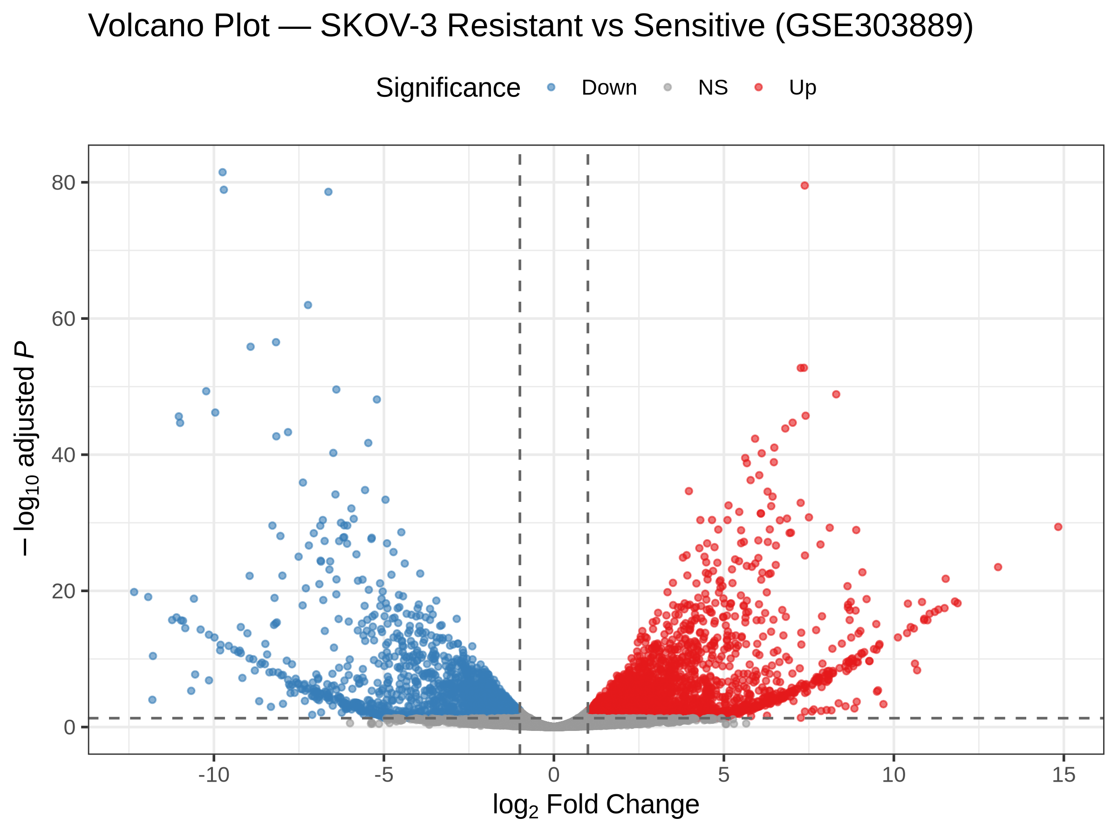
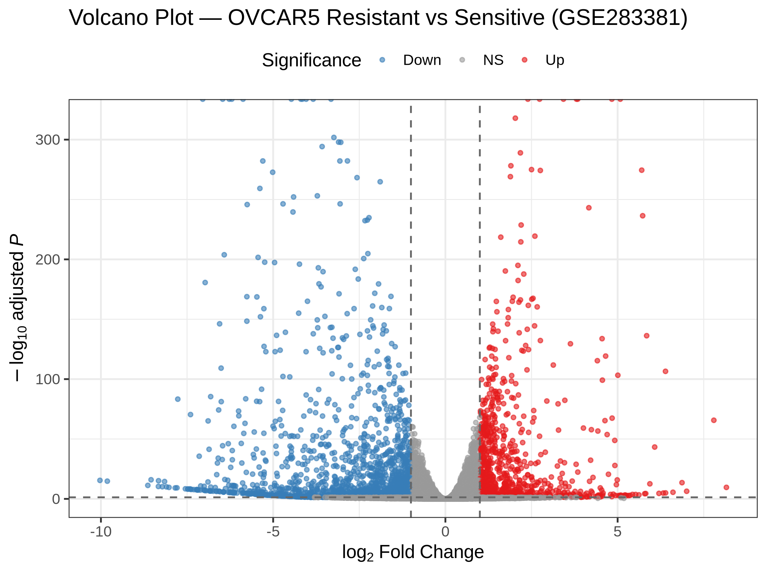
Differential Expression Results
• DESeq2, FDR < 0.05 and |log2FC| > 1 (Design ~ condition).
• SKOV-3 (GSE303889): 5,212 DEGs (2,983 up / 2,229 down).
• OVCAR5 (GSE283381): 2,572 DEGs (912 up / 1,660 down).
• 913 genes shared by both datasets (198 up / 220 down / 495 opposite).
• Extensive, dataset-specific reprogramming; low shared log2FC correlation (~ -0.04).
Transcriptomic Profiling of Drug-Resistant Cancer Cells
5

Slide 6
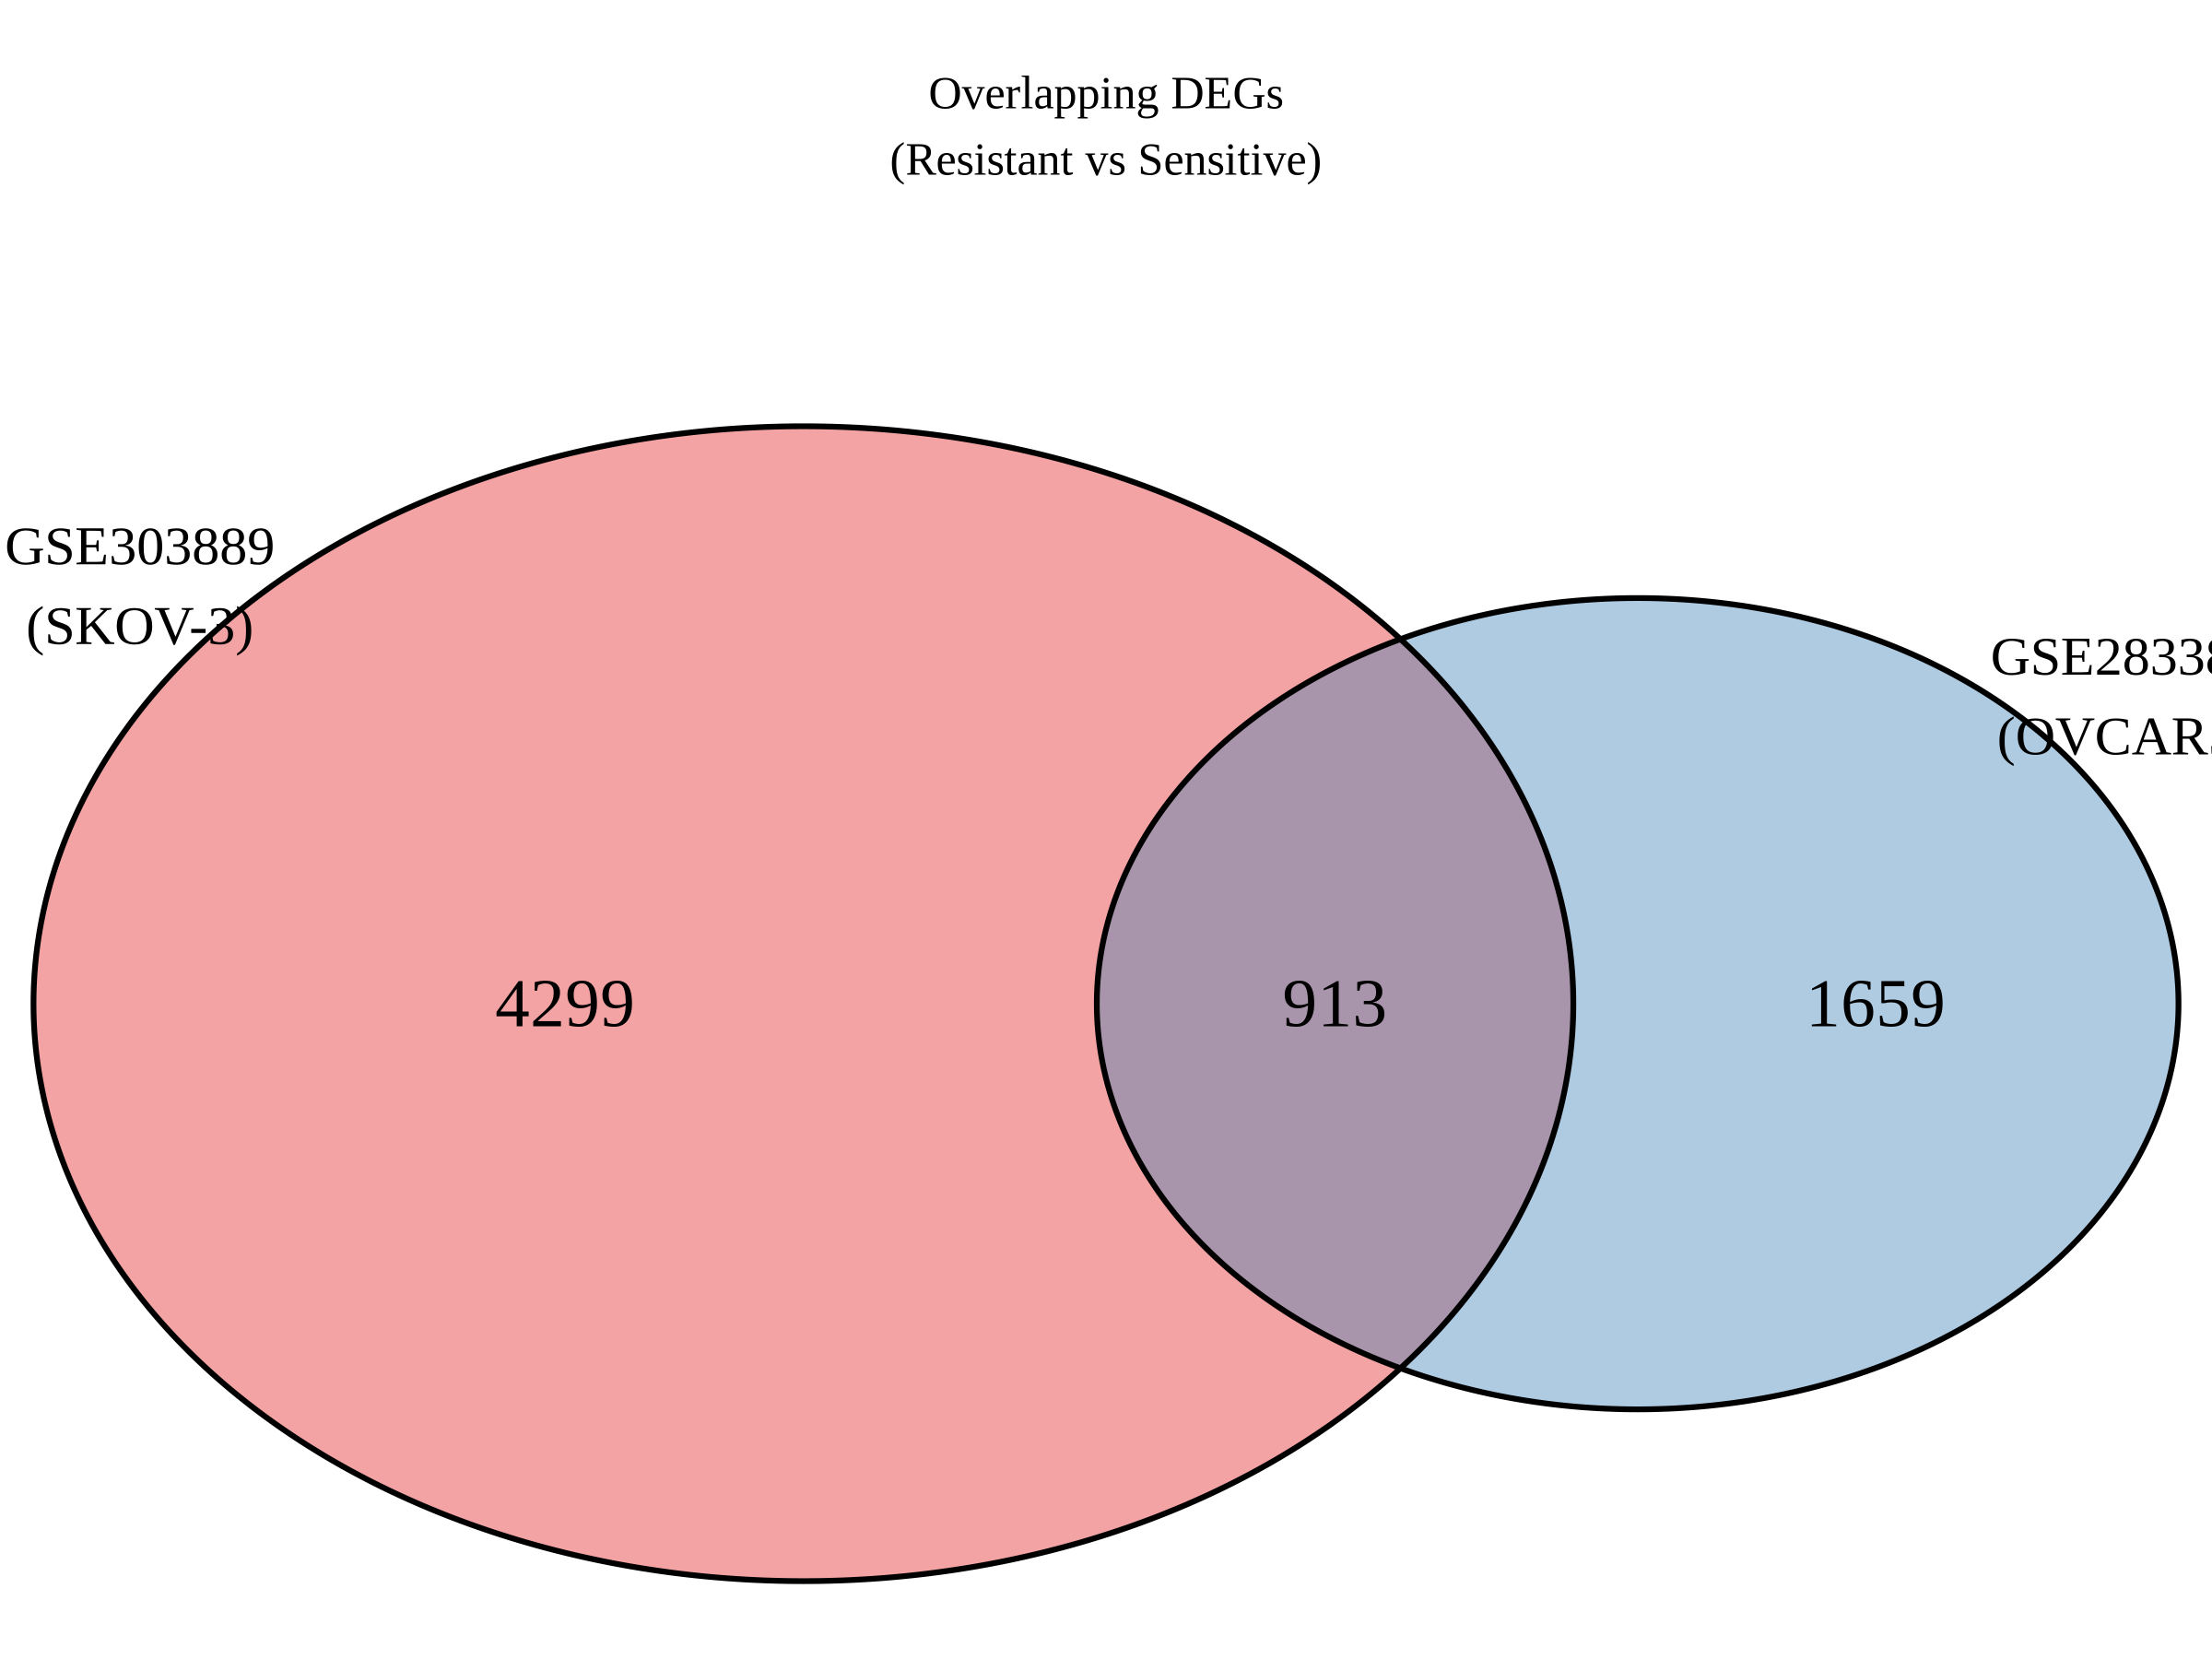
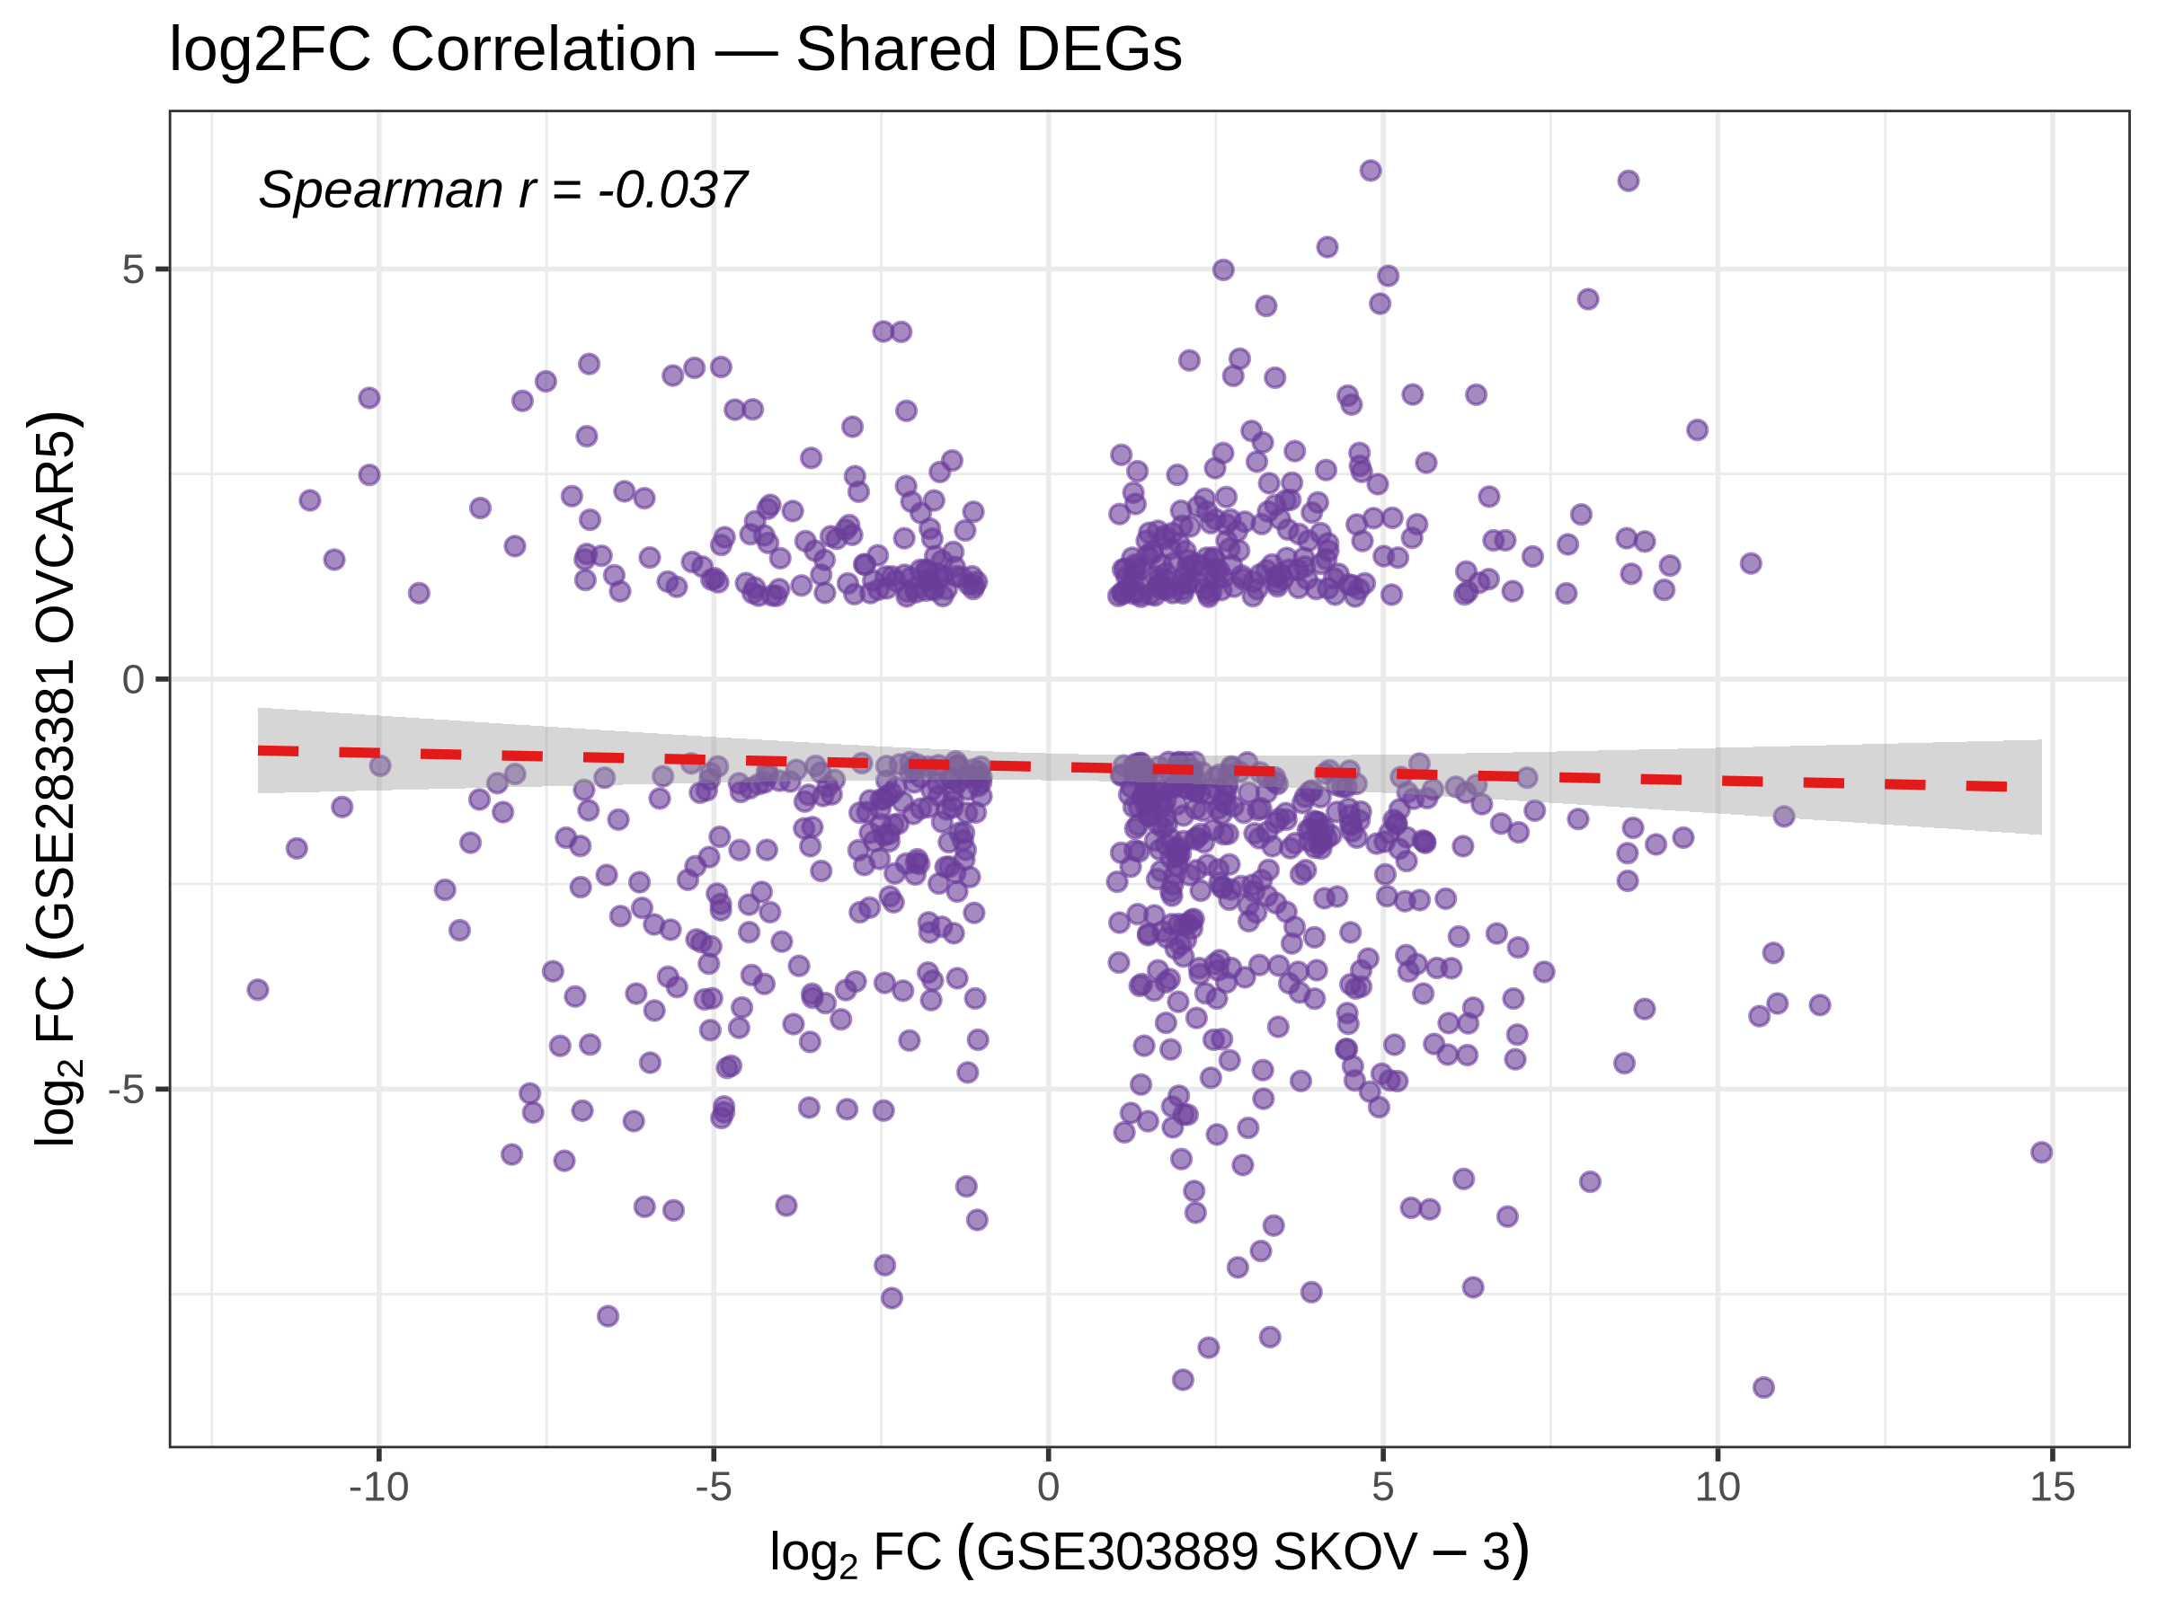
Cross-Dataset Validation
• 913 shared DEGs = core cross-dataset cisplatin-resistance signature.
• Distinct resistance mechanisms (KDM5 epigenetic vs pyrimidine metabolism).
• Shared signature highlights EMT / ECM biology.
• Consistently regulated genes = higher-confidence candidates.
6

Slide 7
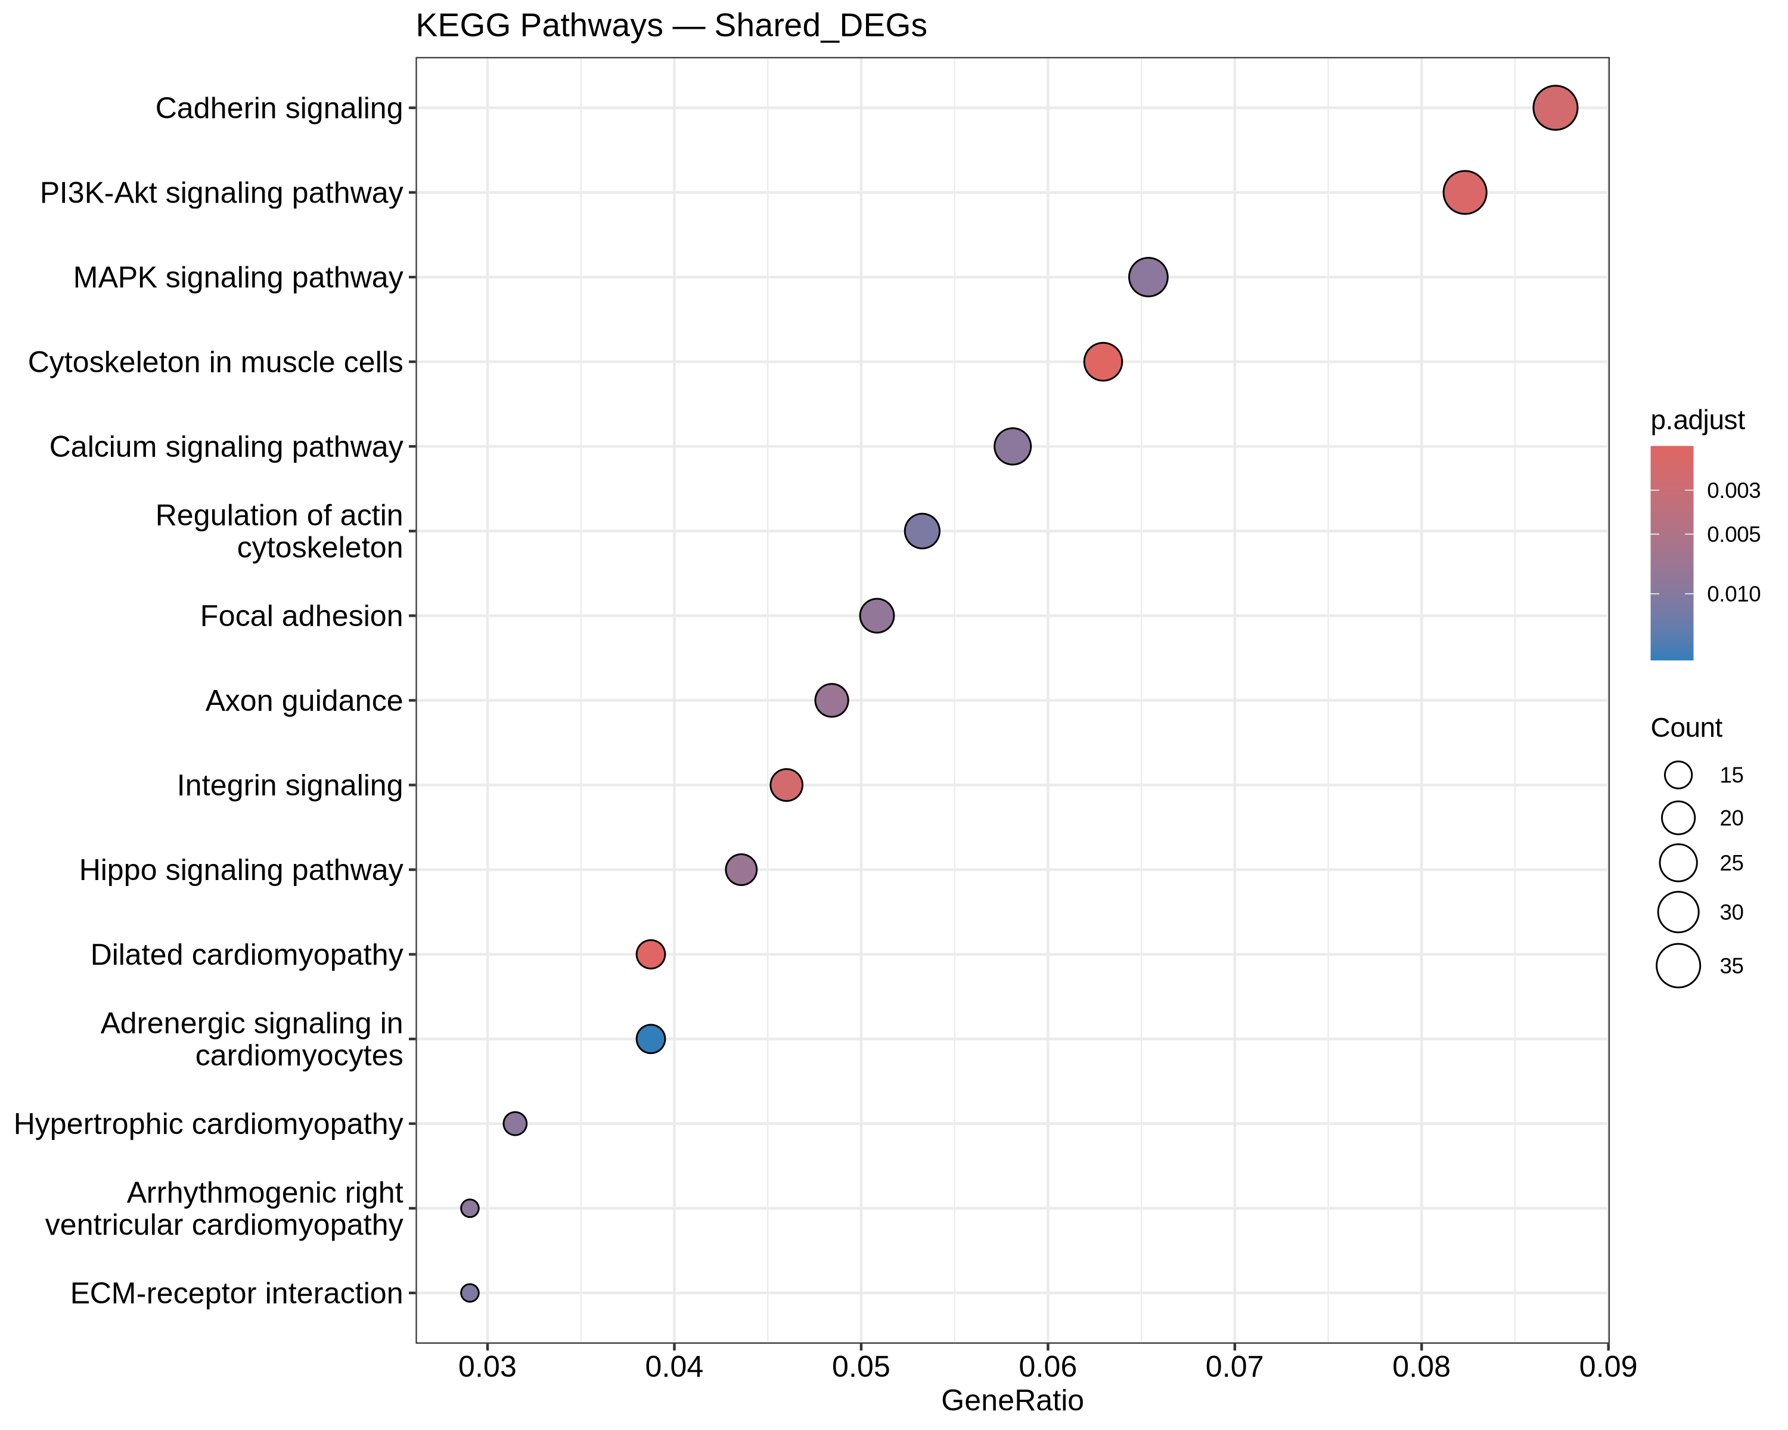
Functional Enrichment (GO / KEGG)
KEGG (shared DEGs):
  - PI3K-Akt signalling
  - Focal adhesion / Integrin signalling
  - Cadherin signalling
  - Cytoskeleton / ECM-receptor interaction
Transcriptomic Profiling of Drug-Resistant Cancer Cells
7

Slide 8
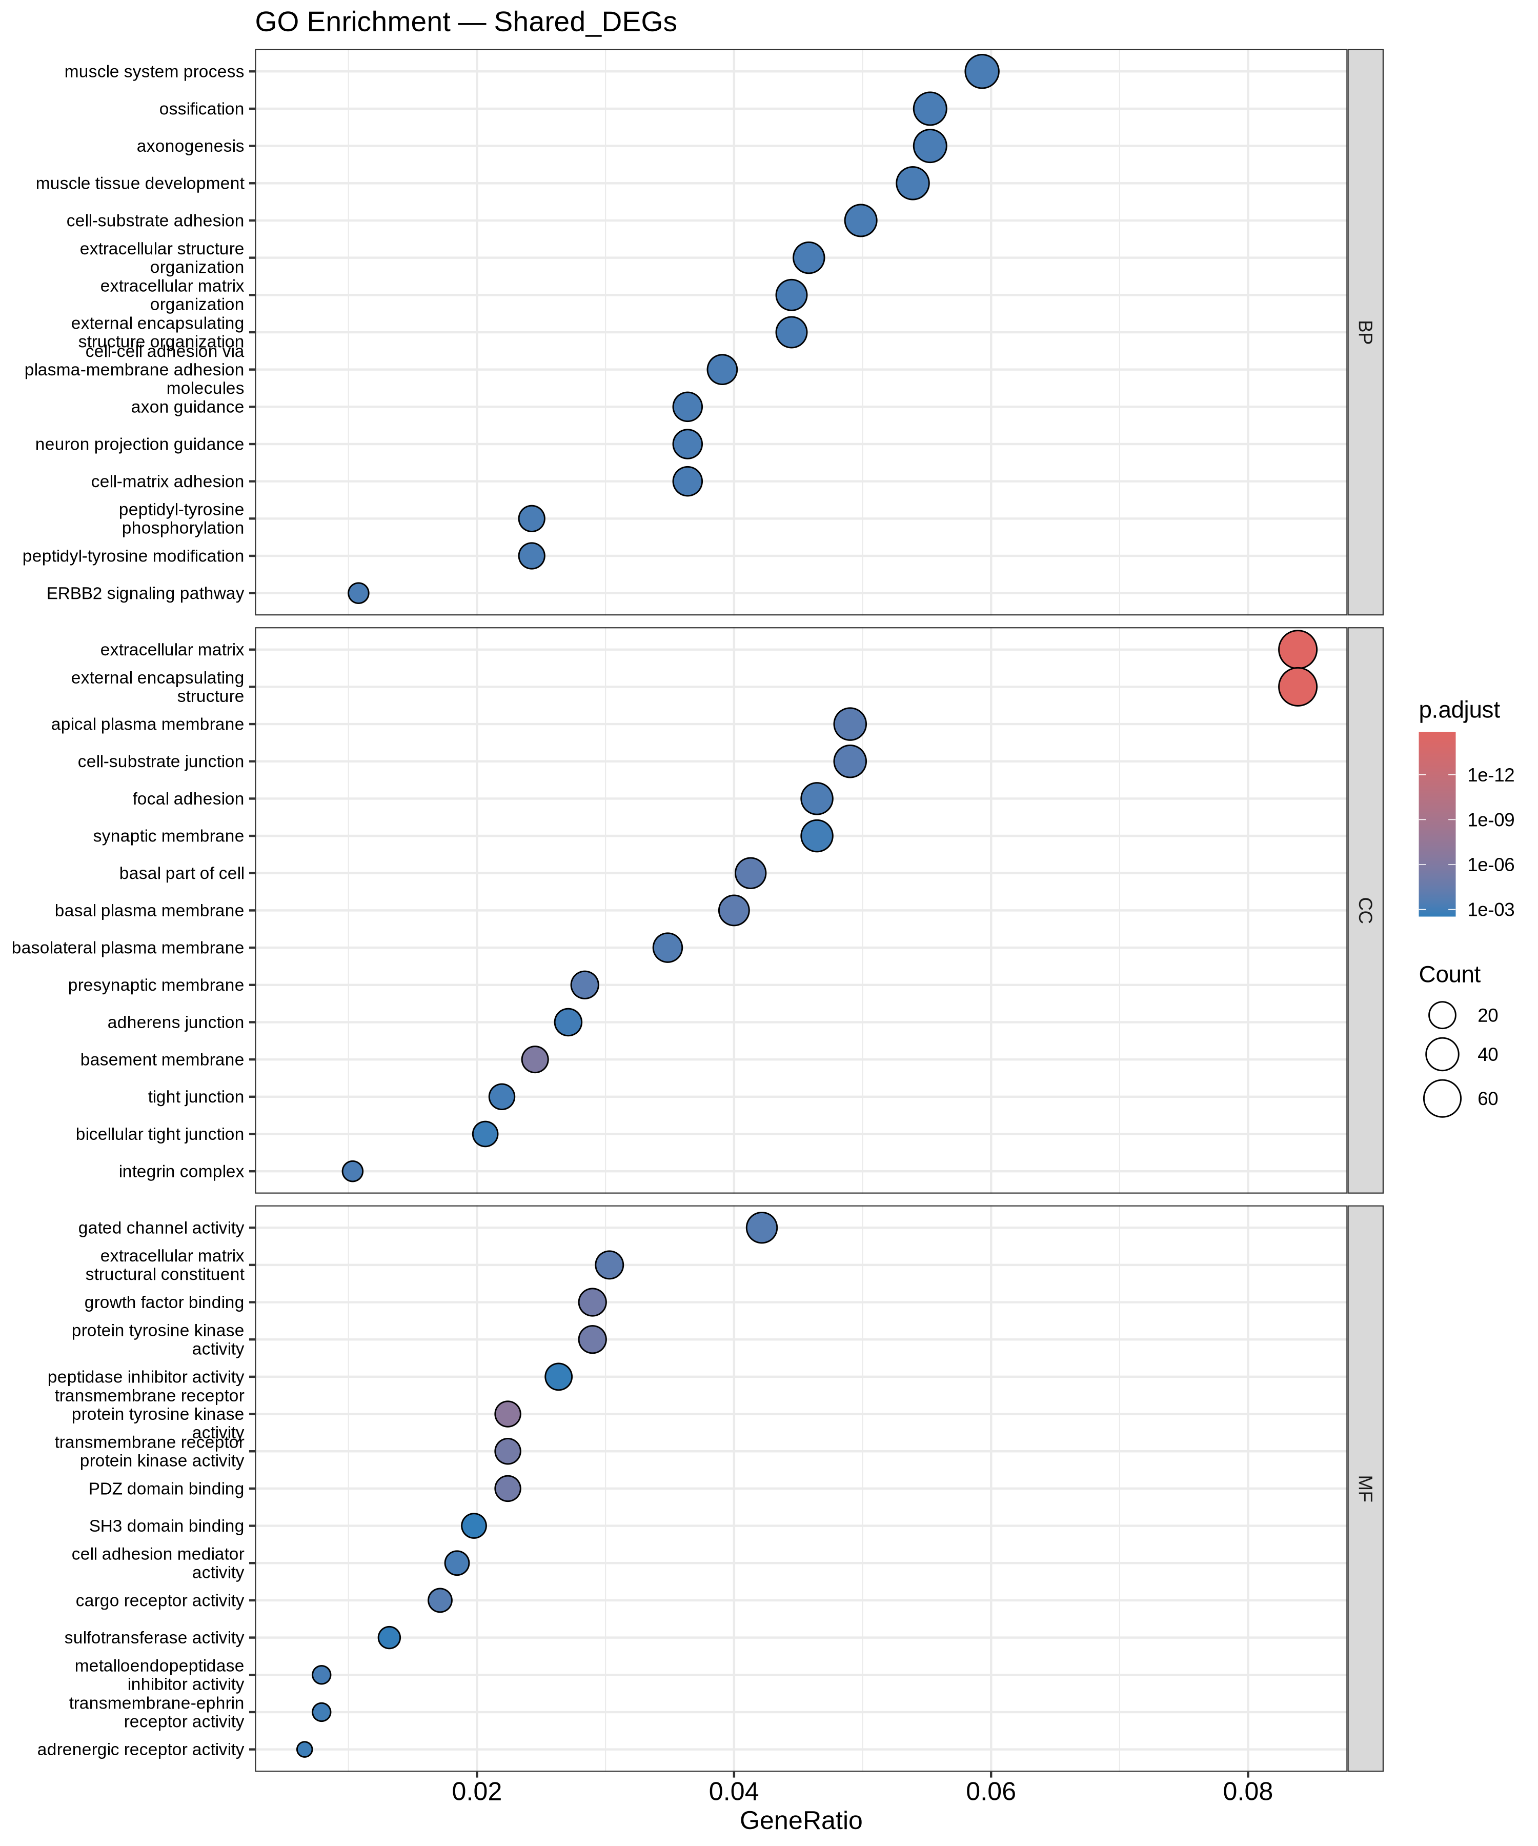
Functional Enrichment (GO / KEGG)
GO (shared DEGs):
  - Cell-substrate adhesion
  - Extracellular matrix organisation
  - Extracellular structure organisation
Transcriptomic Profiling of Drug-Resistant Cancer Cells
7

Slide 9
Biological Model of Resistance
• EMT (central): CDH1 down, EPCAM down, COL1A1/COL5A2/COL6A1 up, MMP14/MMP1 up.
• Inflammation: IL1A up / IL1B up (inflammasome).
• NDRG1 up — validated hub gene in 3 independent OC datasets.
• KYNU up — kynurenine/AhR immune evasion.
• SERPINE1 up — metastasis & resistance effector.
Cisplatin -> DNA damage -> inflammation -> ECM remodelling -> EMT -> RESISTANCE
Transcriptomic Profiling of Drug-Resistant Cancer Cells
8

Slide 10
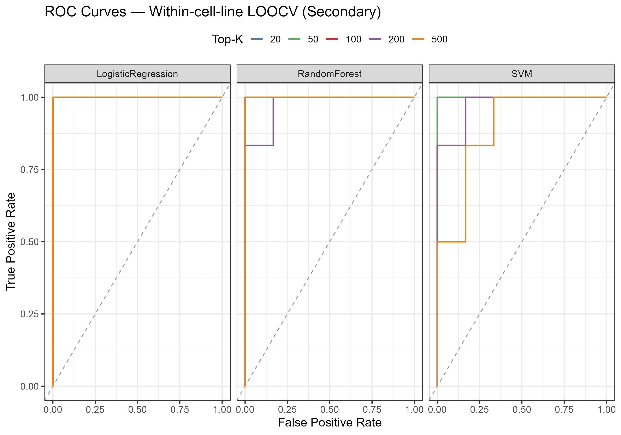
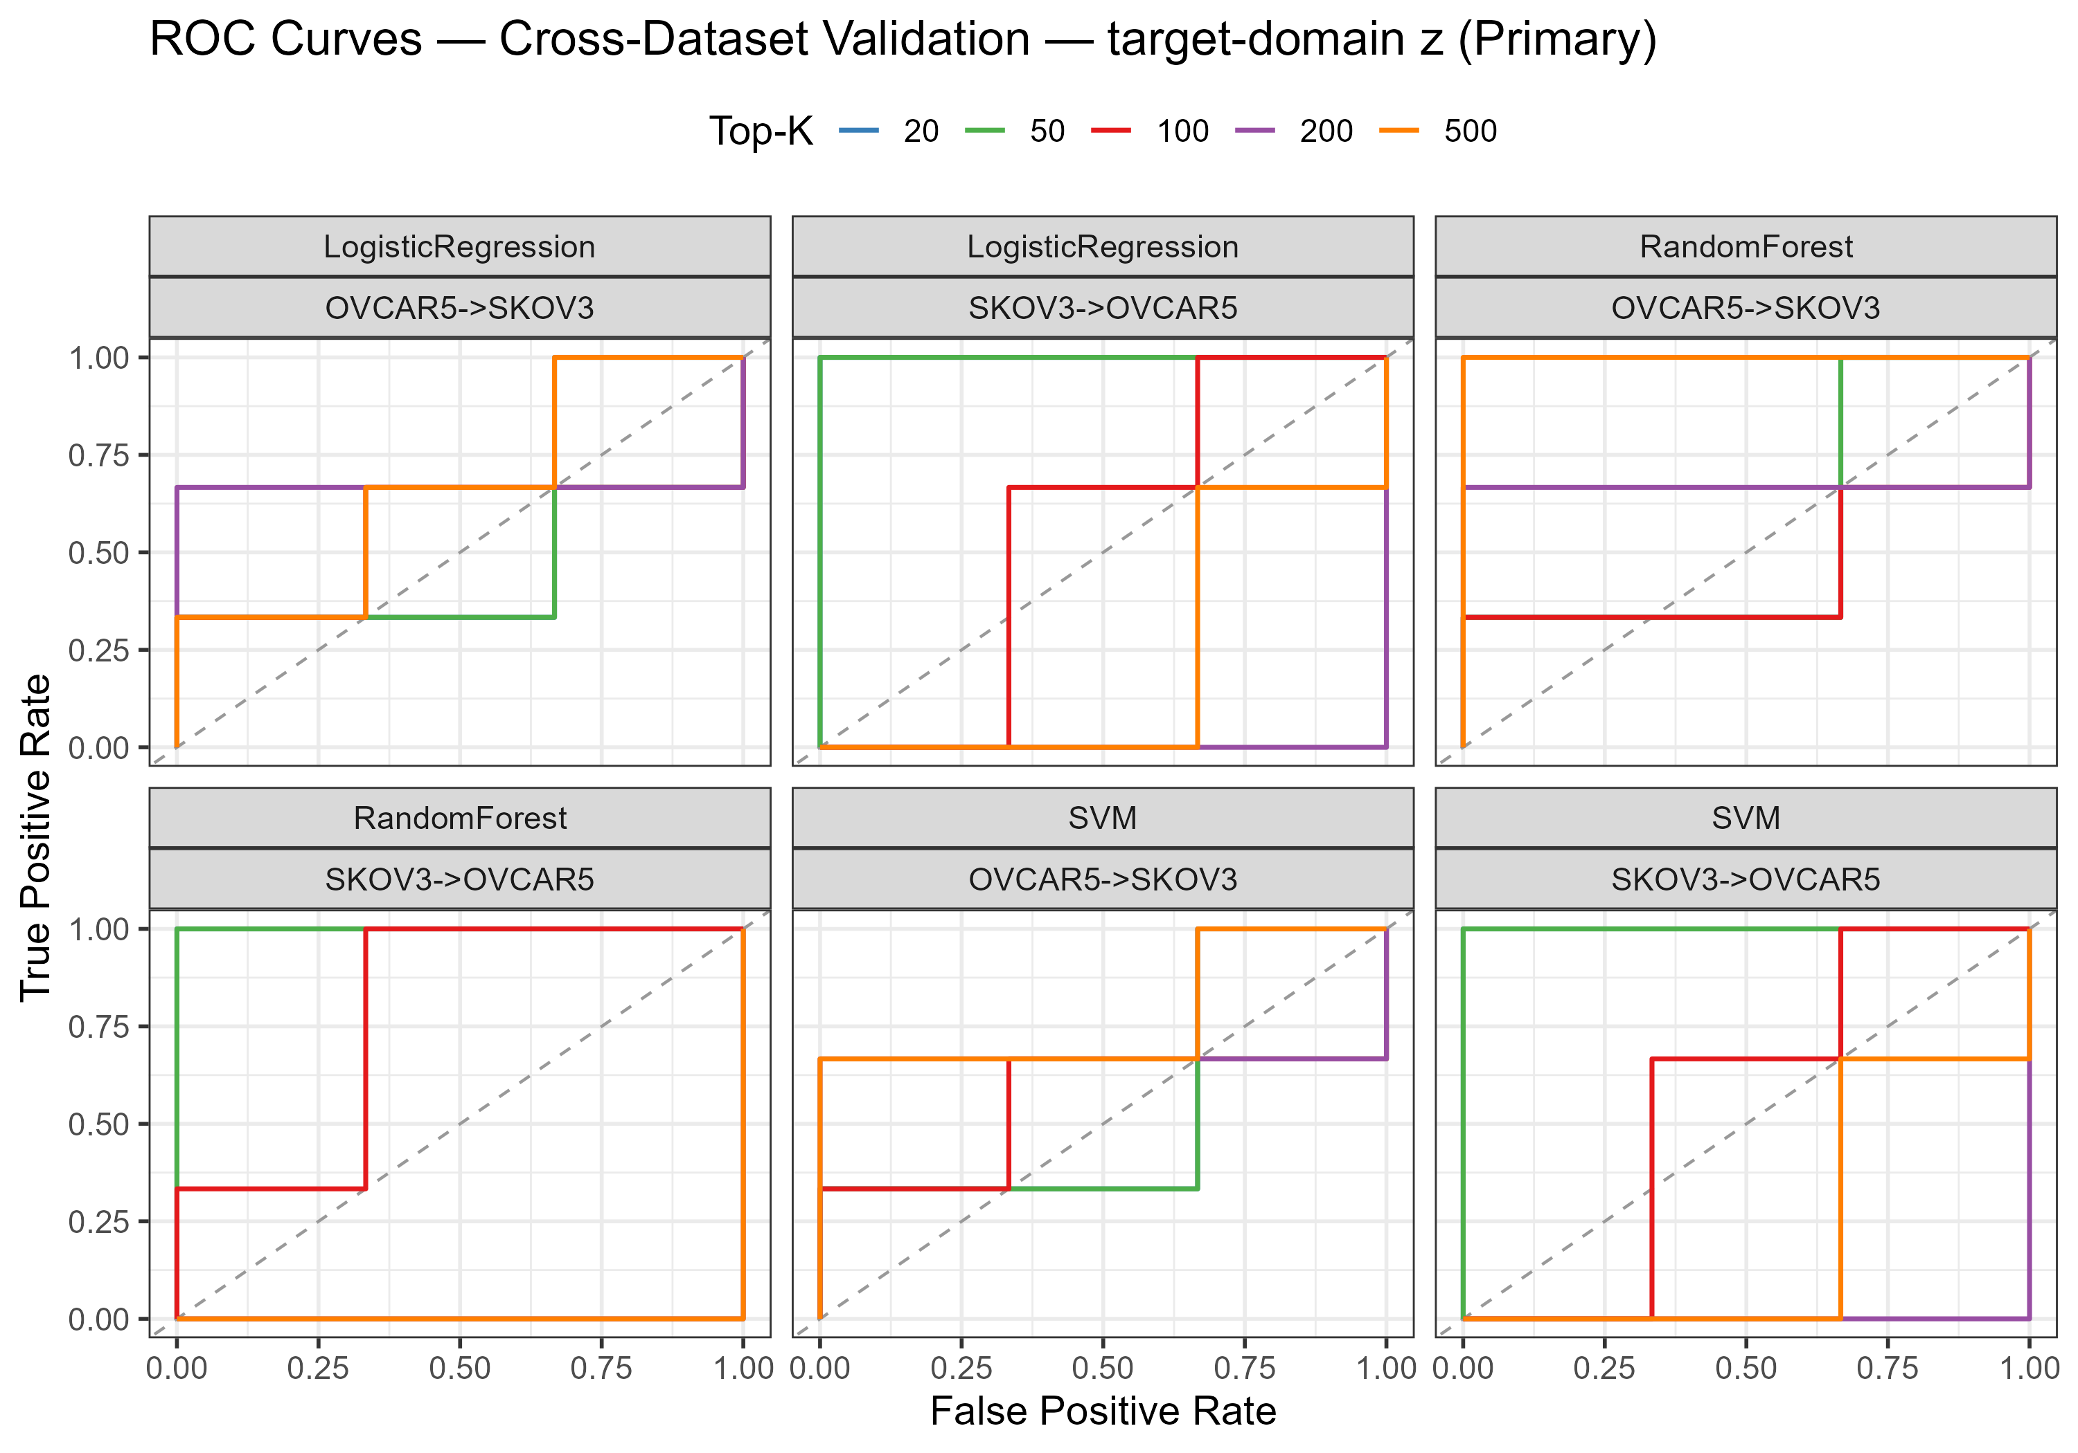
Machine Learning: Design & Results
• Full 57,357-gene space; LR (ridge), Random Forest, SVM radial.
• Nested top-K selection (K in {20,50,100,200,500}) — no test leakage.
• Within-cell-line LOOCV: Acc 0.833-1.000, AUC 0.889-1.000.
• External (target_z): SKOV3->OVCAR5 AUC 1.0 at K=20-50; reverse ~0.44-0.78.
• External (train_stats, leak-free): mean AUC ~0.61.
• Transfer is partial and asymmetric (n << p).
Transcriptomic Profiling of Drug-Resistant Cancer Cells
9

Slide 11
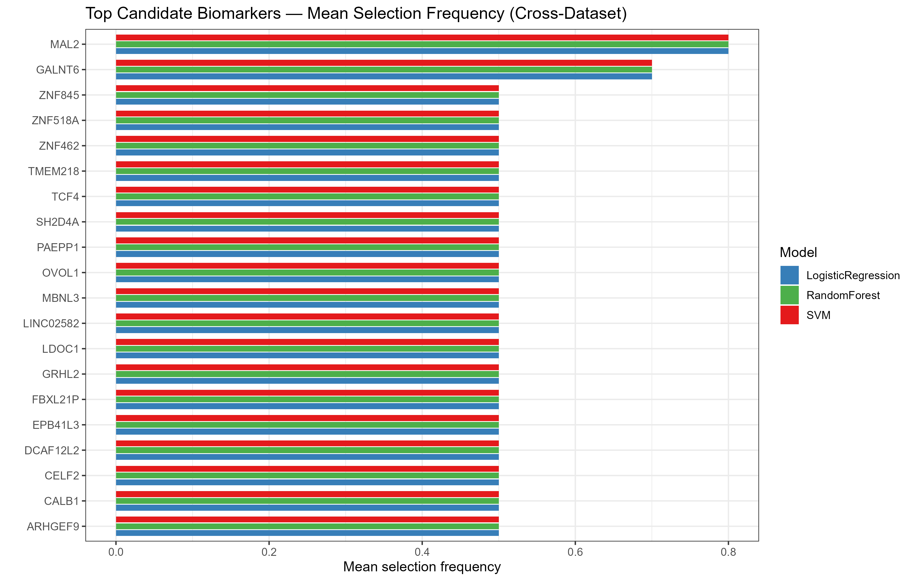
Candidate Biomarker Panel
• Ranked by cross-dataset selection frequency (models x K).
• Top candidates: MAL2, GALNT6, LDOC1, SH2D4A, FBXL21P,
  - EPB41L3, TMEM218, CALB1, LINC02582, CELF2 ...
• 30-gene exploratory panel for follow-up.
• NOT a clinically validated diagnostic panel.
Transcriptomic Profiling of Drug-Resistant Cancer Cells
10

Slide 12
Key Findings, Limitations & Conclusions
Key findings
• 913 shared DEGs; EMT and ECM remodelling dominate.
• PI3K-Akt, focal adhesion, integrin and cadherin pathways converge.
• ML works within a cell line; cross-dataset transfer is partial / asymmetric.
Limitations
• n = 12 (exploratory); n << p; normalisation choice matters.
Conclusions
• A reproducible end-to-end pipeline: GEO -> DESeq2 -> cross-validation -> GO/KEGG -> ML.
• Defines a core cisplatin-resistance transcriptomic signature with clear EMT/ECM biology.
• Provides an interactive dashboard and a candidate biomarker panel.
Transcriptomic Profiling of Drug-Resistant Cancer Cells
11

Slide 13
Thank You
Questions?

