Slide 1
Transcriptomic Profiling of Drug-Resistant Cancer Cells
Cisplatin resistance in ovarian cancer: differential expression, pathways & machine-learning biomarkers
Anushree Tyagi 23BCB0108 : Data & QC
Vivek Kumar 23BCB0137: DEGs & Biology
Solanki Nehal Shailesh 23BCB0076: ML & Biomarkers

Slide 2
Outline
• Background & Objectives
• Data & Methods
• Differential Expression Analysis
• Cross-Dataset Validation
• Functional Enrichment (GO / KEGG)
• Machine Learning & Biomarker Discovery
• Key Findings, Limitations & Conclusions
Transcriptomic Profiling of Drug-Resistant Cancer Cells
2

Slide 3
Background: Ovarian Cancer & Cisplatin Resistance
• Ovarian cancer is the most lethal gynaecologic malignancy; platinum-based chemotherapy (cisplatin) is first-line.
• Acquired platinum resistance underlies relapse and poor survival.
• Resistance is multifactorial: epigenetic reprogramming, metabolic rewiring, EMT, drug efflux, apoptotic evasion.
• Need reproducible transcriptomic signatures that generalise across independent resistance models.
Transcriptomic Profiling of Drug-Resistant Cancer Cells
3

Slide 4
Objectives & Scope
• Identify differentially expressed genes (DEGs) between cisplatin-resistant and sensitive ovarian cancer cells.
• Validate DEGs across two independent GEO datasets to reduce dataset-specific bias.
• Characterise the affected biological processes and signalling pathways (GO / KEGG).
• Build supervised classifiers and rank a compact candidate biomarker panel.
• Deliver a fully reproducible end-to-end bioinformatics + ML pipeline.
Transcriptomic Profiling of Drug-Resistant Cancer Cells
4
Notes:
Scope is exploratory biomarker discovery, not clinical validation (small n).

Slide 5
Data: Two Independent GEO Datasets
Attribute | GSE303889 | GSE283381
Cell line | SKOV-3 | OVCAR5
Resistance model | CDDP (chronic cisplatin) | Cis-R (repeated cisplatin)
Design | 3 Sensitive vs 3 Resistant | 3 Sensitive vs 3 Resistant
Platform | Illumina NovaSeq 6000 | Illumina NextSeq 500
Transcriptomic Profiling of Drug-Resistant Cancer Cells
5
Notes:
GSE303889 (SKOV-3, Yonsei, KDM5-mediated) and GSE283381 (OVCAR5, Northwestern, pyrimidine metabolism). 3 vs 3 replicates each, n=12.

Slide 6
Analytical Workflow
GEO datasets
(2 studies)
Preprocess
& QC
DESeq2
per dataset
Cross-dataset
validation
GO / KEGG
enrichment
ML biomarker
discovery
Transcriptomic Profiling of Drug-Resistant Cancer Cells
6
Notes:
GEO -> preprocess/QC -> DESeq2 per dataset -> cross-dataset validation -> parallel GO/KEGG and ML -> final panel.

Slide 7
Preprocessing & Quality Control
• Raw gene count matrices + sample metadata retrieved from NCBI GEO (2 datasets).
• Low-count filtering: retained genes with rowSums >= 10.
• DESeq2 size-factor normalisation; log2(CPM + 1) transform.
• Duplicate gene symbols collapsed (rowsum); intersect -> 57,357 shared genes.
• PCA and sample-clustering QC (seed 42 for reproducibility).
Transcriptomic Profiling of Drug-Resistant Cancer Cells
7

Slide 8
Differential Expression (DESeq2)
• Design: ~ condition; negative-binomial GLM, Wald test.
• Multiple testing: Benjamini-Hochberg FDR.
• Significance thresholds: FDR < 0.05 AND |log2 fold change| > 1.
• Outputs per dataset: full DEG table, up/down lists, volcano, MA plot, top-DEG heatmap.
• Reference level = Sensitive; contrast = Resistant vs Sensitive.
Transcriptomic Profiling of Drug-Resistant Cancer Cells
8

Slide 9
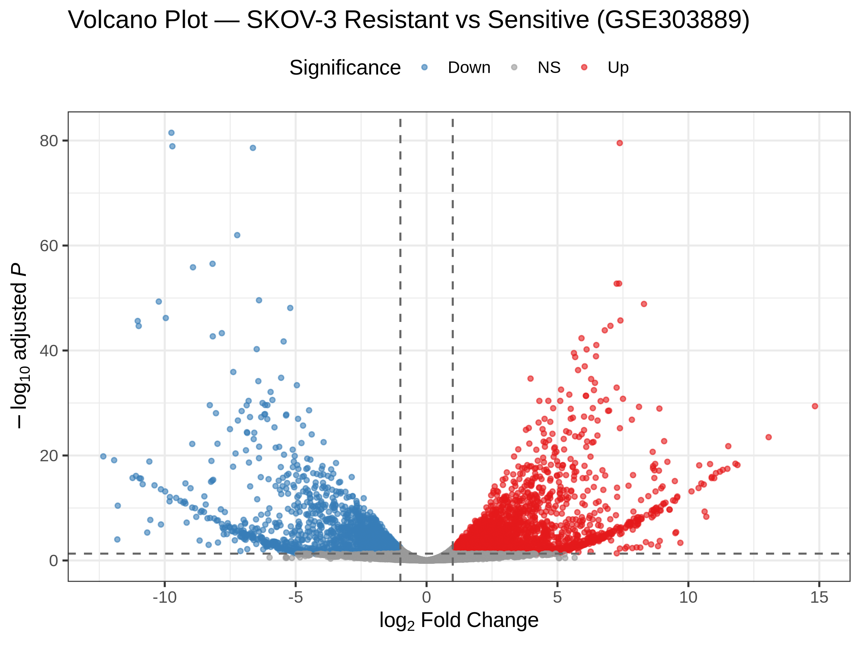
Dataset 1 (SKOV-3 / GSE303889) — DEG Results
• GSE303889: SKOV-3 parental vs KDM5-mediated CDDP-resistant cells.
• Total significant DEGs: 5,212
  - Up-regulated: 2,983
  - Down-regulated: 2,229
• Extensive transcriptomic reprogramming on resistance acquisition.
• Top down-regulated genes include CDH1 (E-cadherin) — EMT signal.
Transcriptomic Profiling of Drug-Resistant Cancer Cells
9

Slide 10
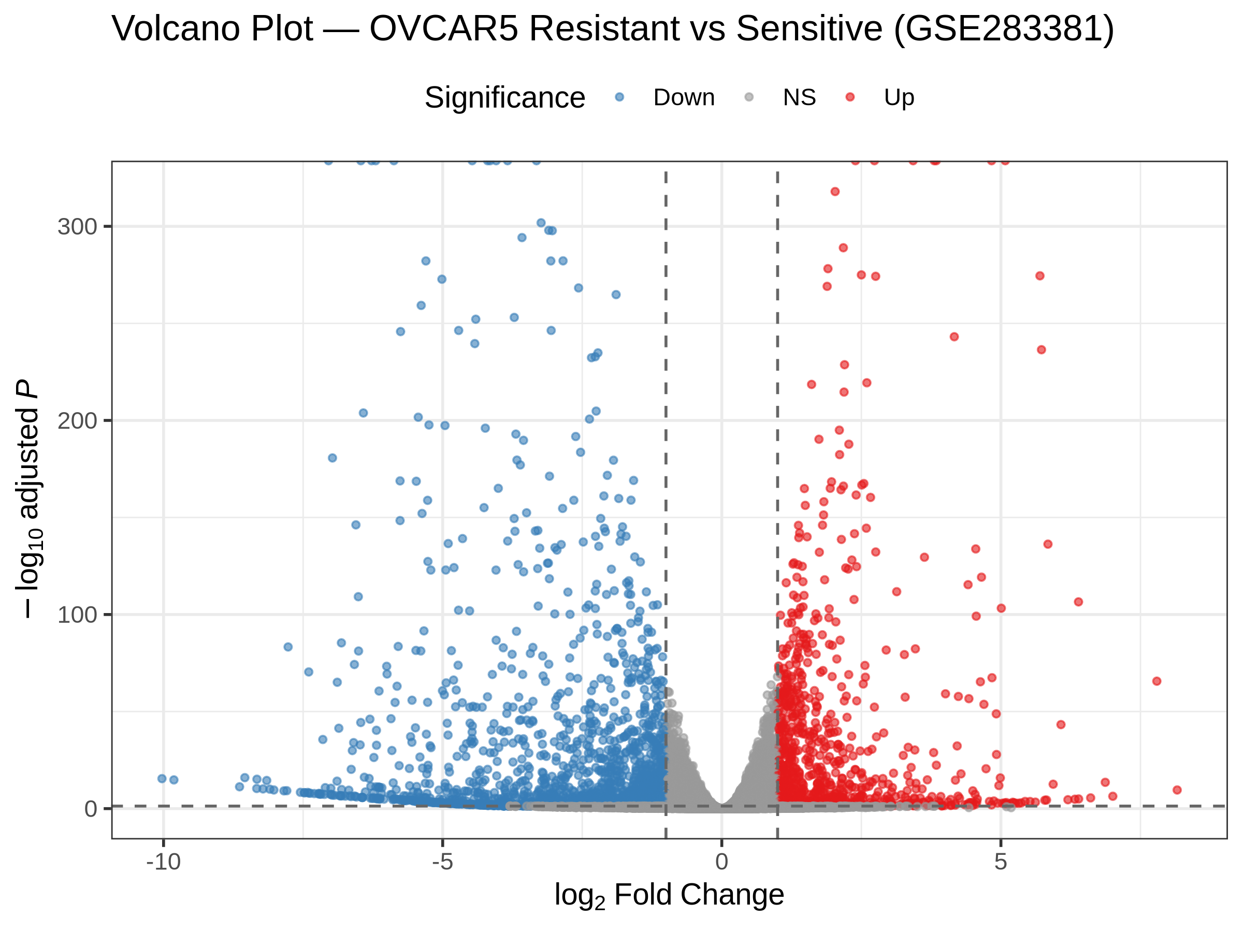
Dataset 2 (OVCAR5 / GSE283381) — DEG Results
• GSE283381: OVCAR5 cisplatin-sensitive (Cis-S) vs resistant (Cis-R).
• Total significant DEGs: 2,572
  - Up-regulated: 912
  - Down-regulated: 1,660
• Up-regulated inflammatory / ECM genes (IL1A, IL1B, COL genes).
• Distinct resistance mechanism vs Dataset 1.
Transcriptomic Profiling of Drug-Resistant Cancer Cells
10

Slide 11
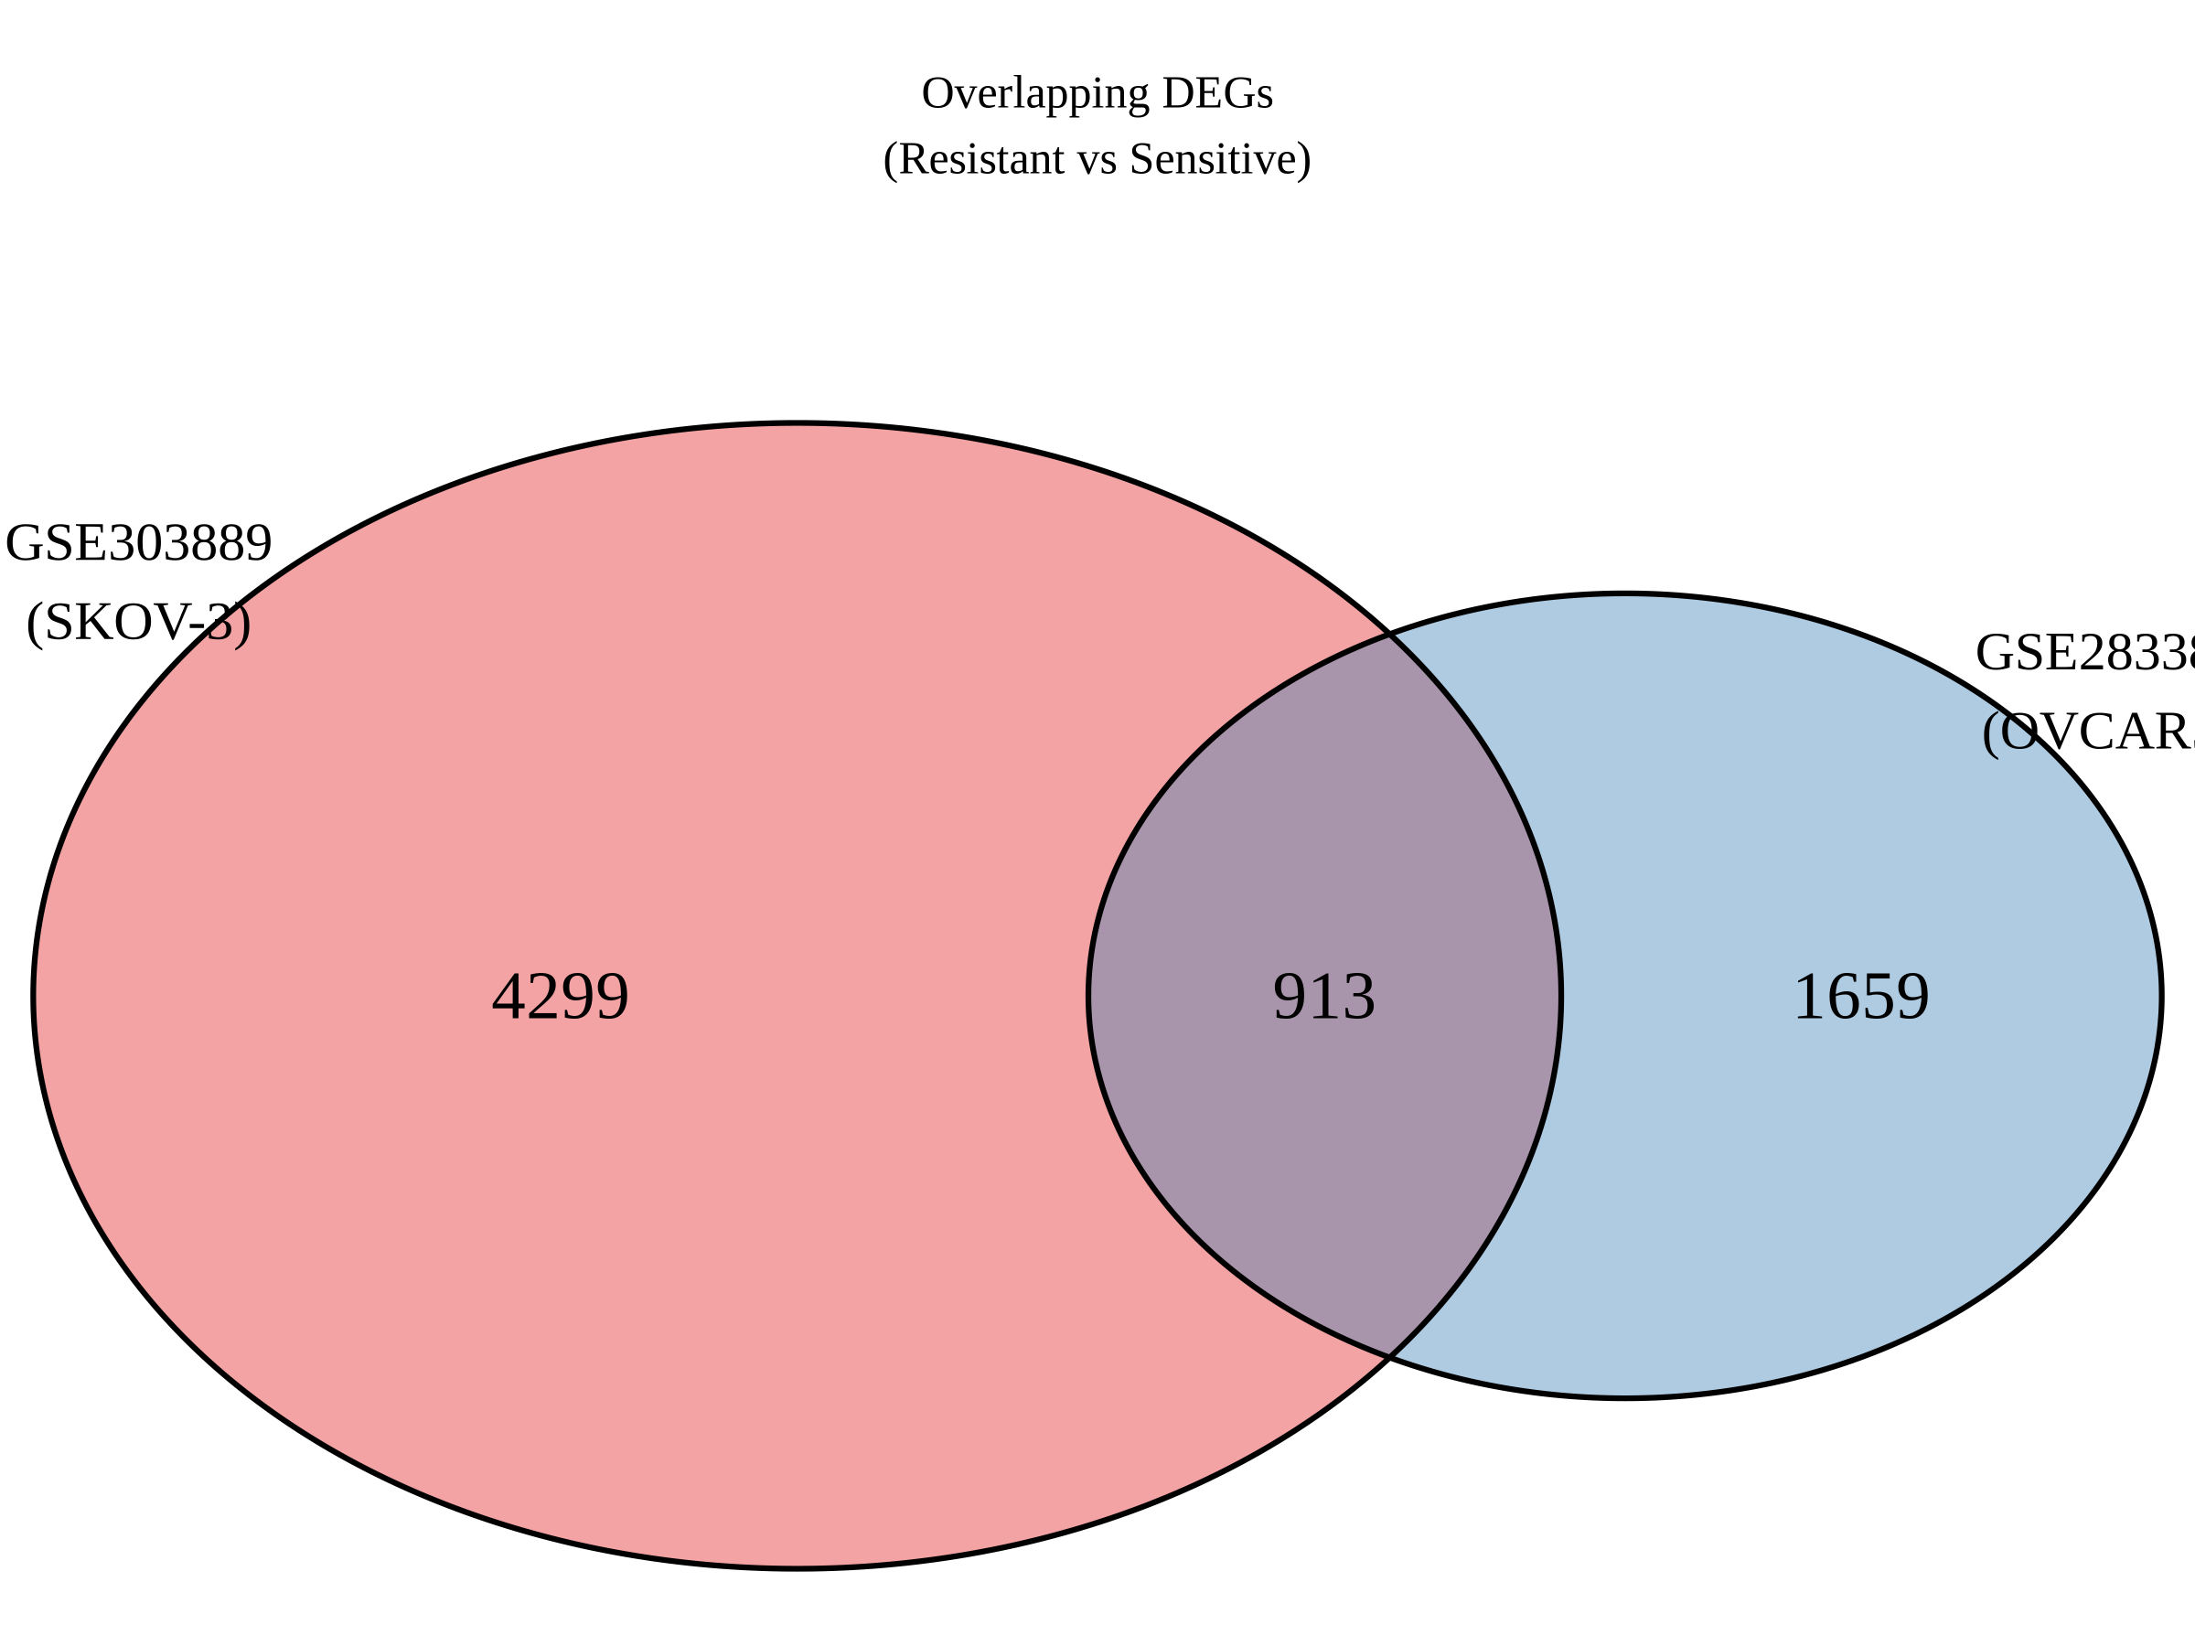
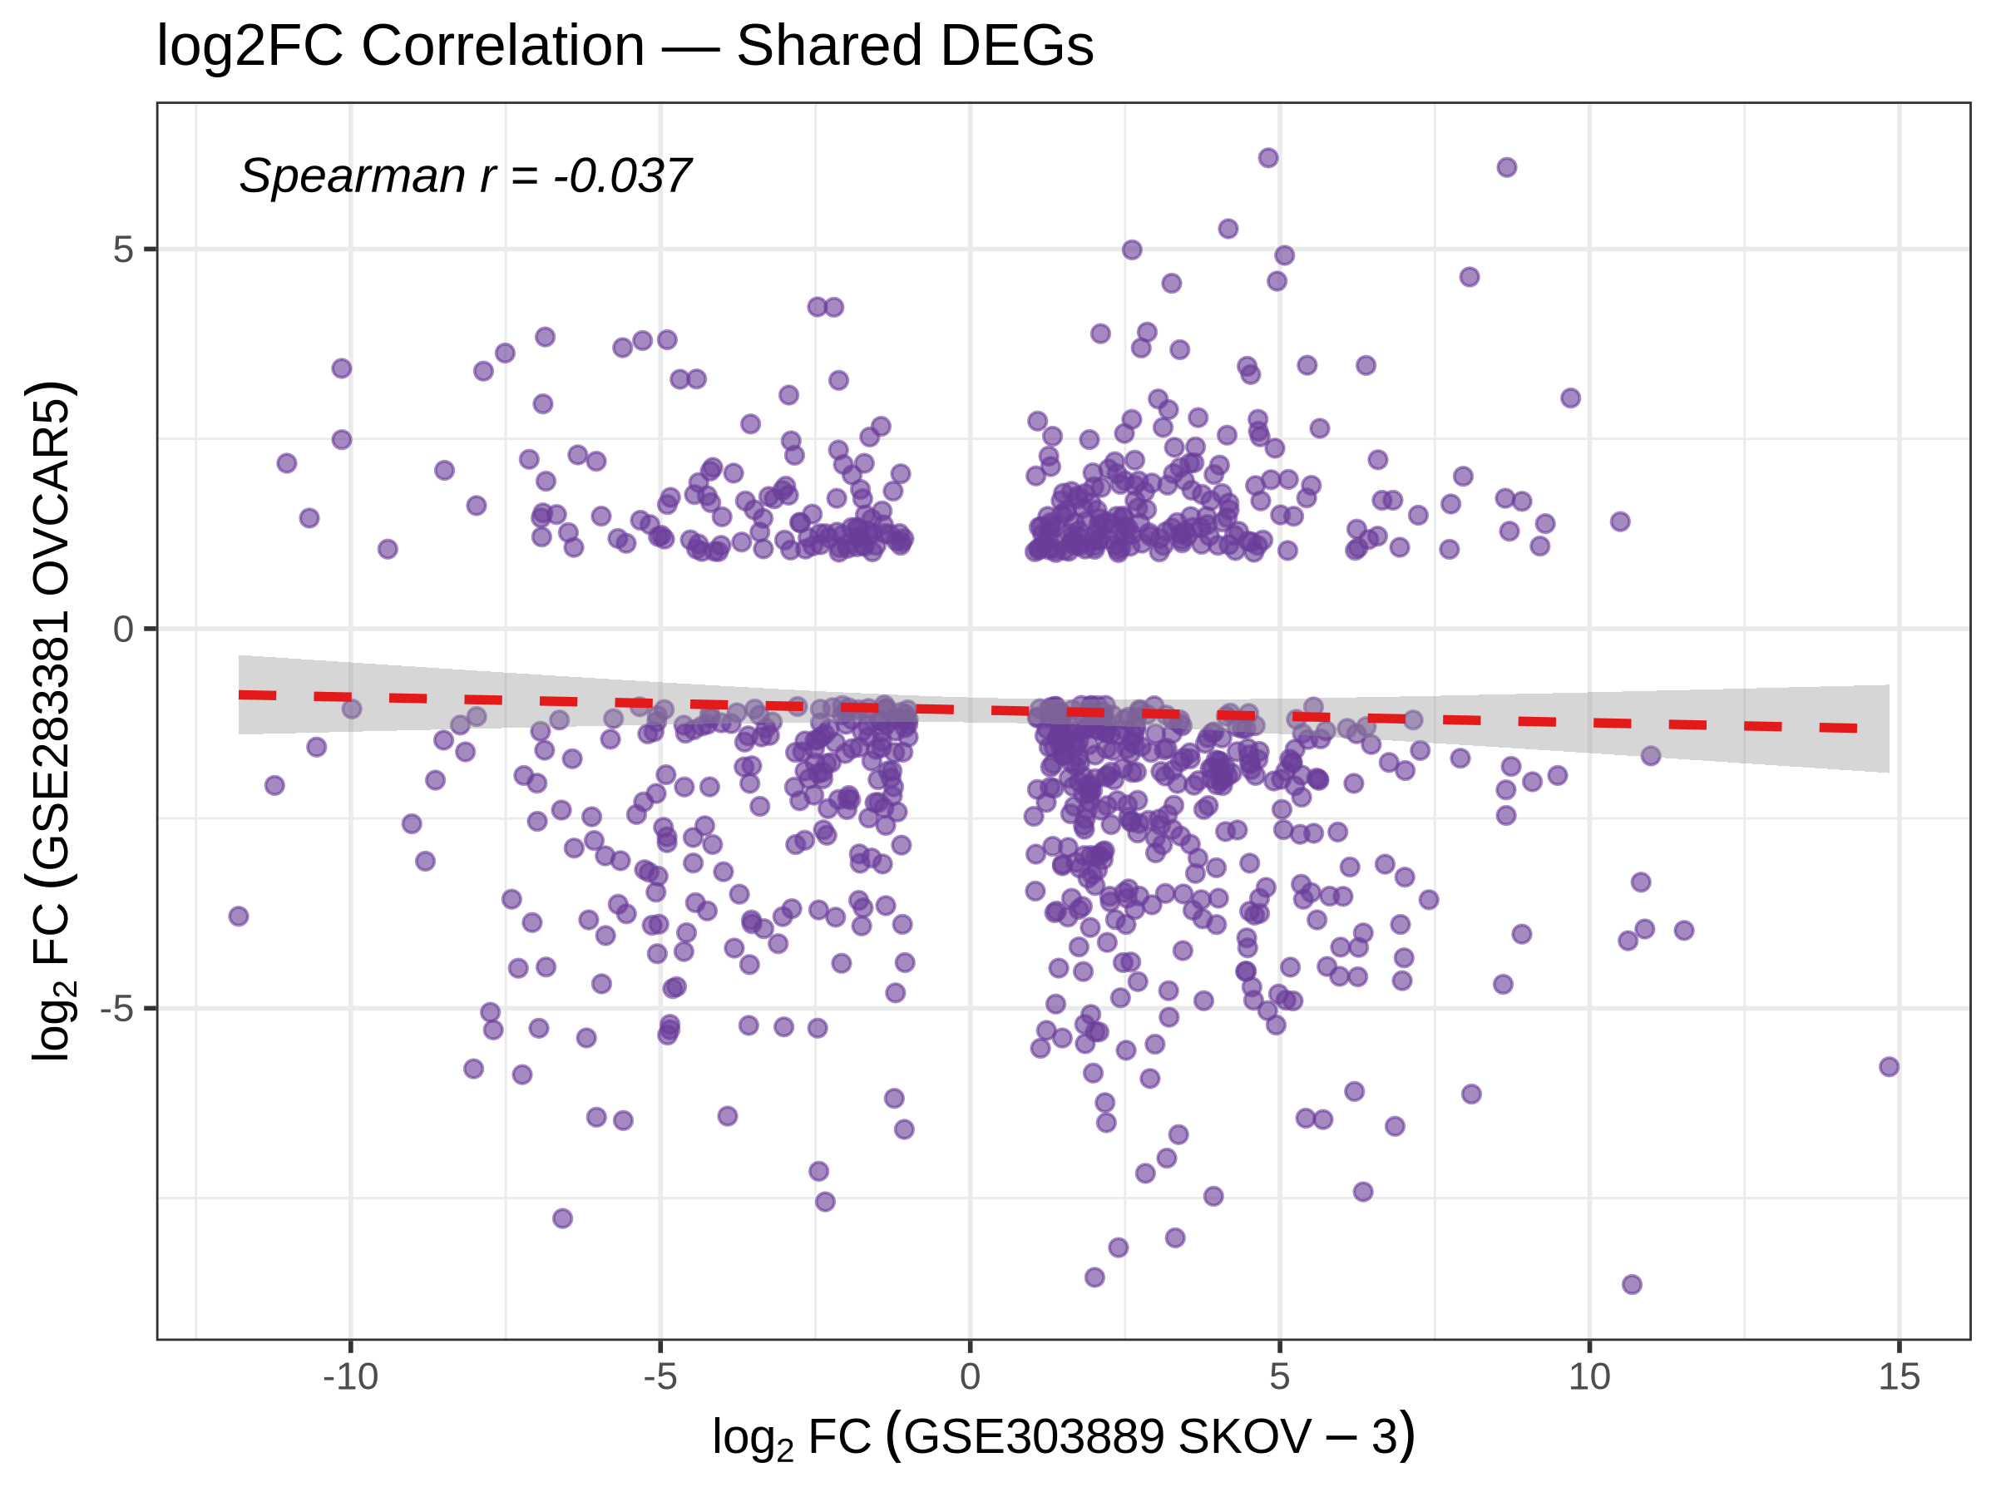
Cross-Dataset Validation
• 913 genes are differentially expressed in BOTH datasets (core signature).
  - 198 shared up-regulated
  - 220 shared down-regulated
  - 495 with opposite direction (cell-line-specific)
• Spearman correlation of shared log2FC ~ -0.04.
• Low correlation is expected: distinct resistance mechanisms (epigenetic vs metabolic).
Transcriptomic Profiling of Drug-Resistant Cancer Cells
11

Slide 12
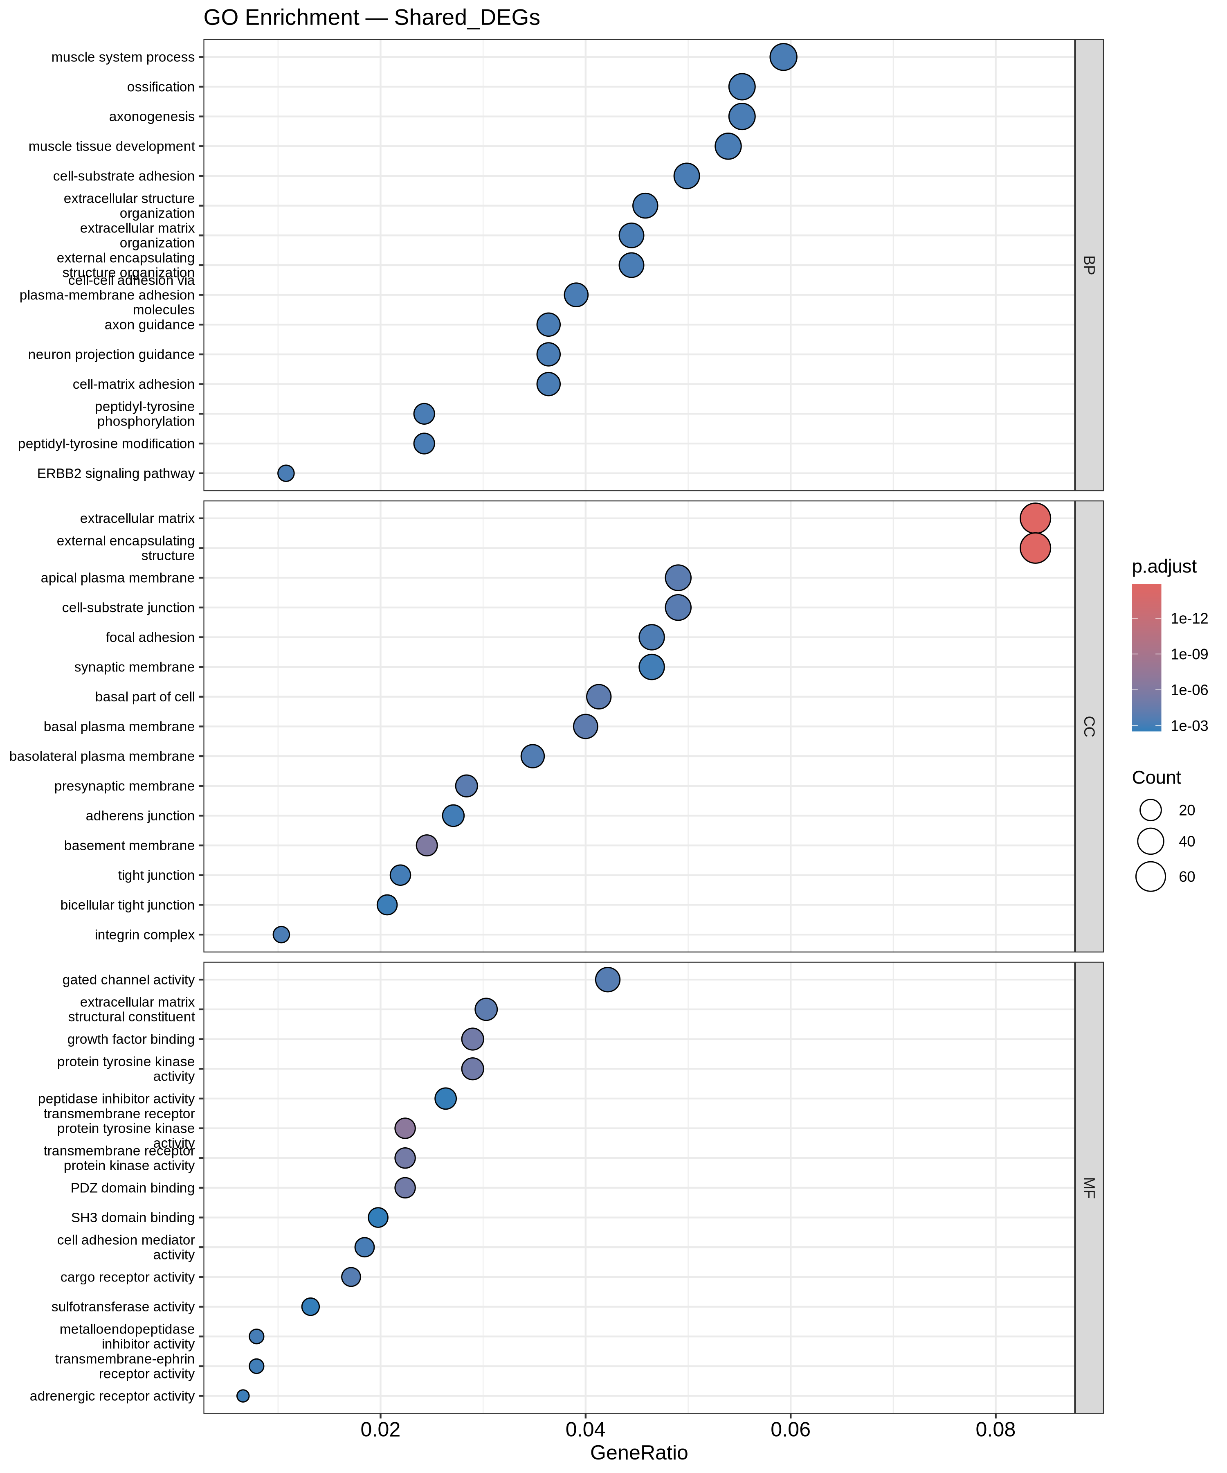
Functional Enrichment — Gene Ontology
• clusterProfiler enrichGO (BP focus), BH-adjusted, p < 0.05.
• Top enriched terms for shared DEGs:
  - Cell-substrate adhesion
  - Extracellular matrix organisation
  - Extracellular structure organisation
  - Ossification / axon guidance
• ECM and adhesion processes dominate — hallmark of EMT.
Transcriptomic Profiling of Drug-Resistant Cancer Cells
12

Slide 13
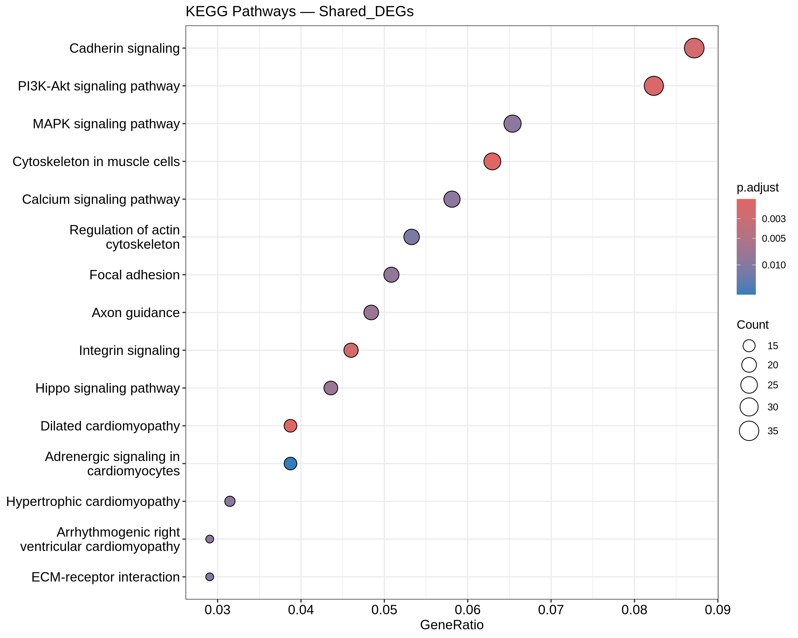
Functional Enrichment — KEGG Pathways
• enrichKEGG (hsa), BH-adjusted, p < 0.05.
• Convergent pathways in shared DEGs:
  - PI3K-Akt signalling
  - Focal adhesion / Integrin signalling
  - Cadherin signalling
  - Cytoskeleton / ECM-receptor interaction
  - Hippo signalling pathway
• Survival, adhesion and cytoskeletal remodelling converge on resistance.
Transcriptomic Profiling of Drug-Resistant Cancer Cells
13

Slide 14
Biological Model of Cisplatin Resistance
• EMT (central): CDH1 down, EPCAM down, COL1A1/COL5A2/COL6A1 up, MMP14/MMP1 up.
• Inflammation: IL1A up / IL1B up (NLRP3 inflammasome).
• NDRG1 up — validated hub gene across 3 independent OC datasets.
• KYNU up — kynurenine/AhR axis driving immune evasion.
• SERPINE1 up — metastasis & resistance effector.
Cisplatin -> DNA damage -> inflammation -> apoptosis evasion + ECM remodelling -> integrin/focal adhesion -> EMT -> RESISTANCE
Transcriptomic Profiling of Drug-Resistant Cancer Cells
14
Notes:
Literature-supported: Wani 2025, Ghosh 2022, Li 2021, Zhu 2024, J Ovarian Res 2025.

Slide 15
Machine Learning: Design & Leakage Control
• Feature space: full intersected matrix (12 samples x 57,357 genes), log2(CPM+1).
• Models: Logistic Regression (ridge/L2), Random Forest (ranger), SVM (radial).
• Nested feature selection: top-K by |t-statistic|, K in {20,50,100,200,500} — inside each training fold only.
• Fold-aware normalisation; two external schemes:
  - target_z (transductive, batch-corrected)
  - train_stats (strictly non-transductive, leak-free)
• Validation: within-cell-line LOOCV + leave-one-dataset-out external.
Transcriptomic Profiling of Drug-Resistant Cancer Cells
15
Notes:
No DEG pre-filtering: avoids test leakage. Deterministic via fixed seeds.

Slide 16
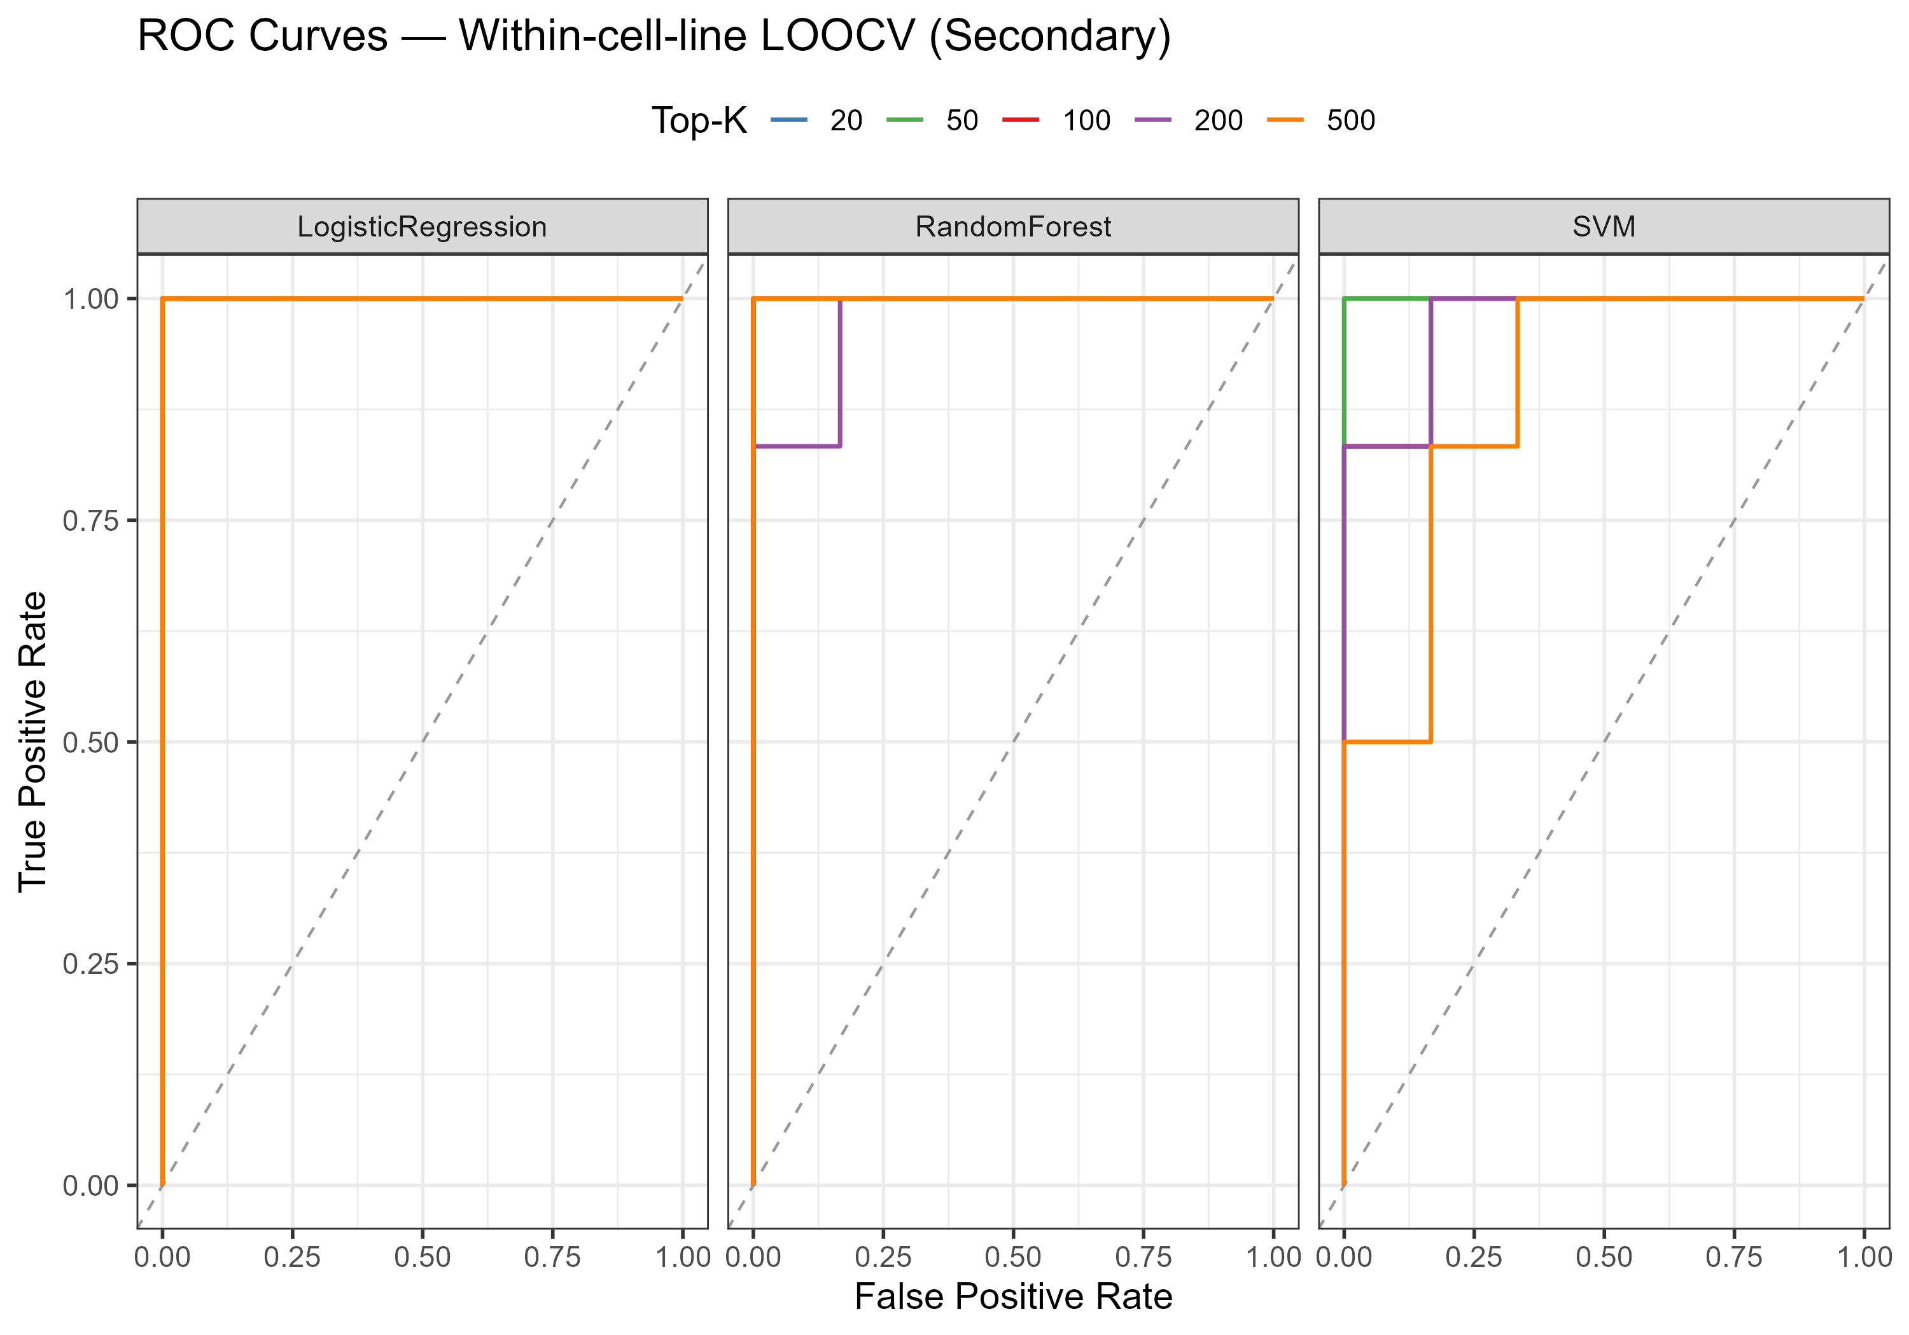
Within-Cell-Line LOOCV
• Leave-one-out inside each cell line (5 train / 1 test per fold).
• Preprocessing + feature selection recomputed per fold.
• Accuracy 0.833 - 1.000 | ROC-AUC 0.889 - 1.000.
• Phenotypes are almost trivially separable within a cell line.
• Likely optimistic: reflects within-study (batch) separation.
Transcriptomic Profiling of Drug-Resistant Cancer Cells
16

Slide 17
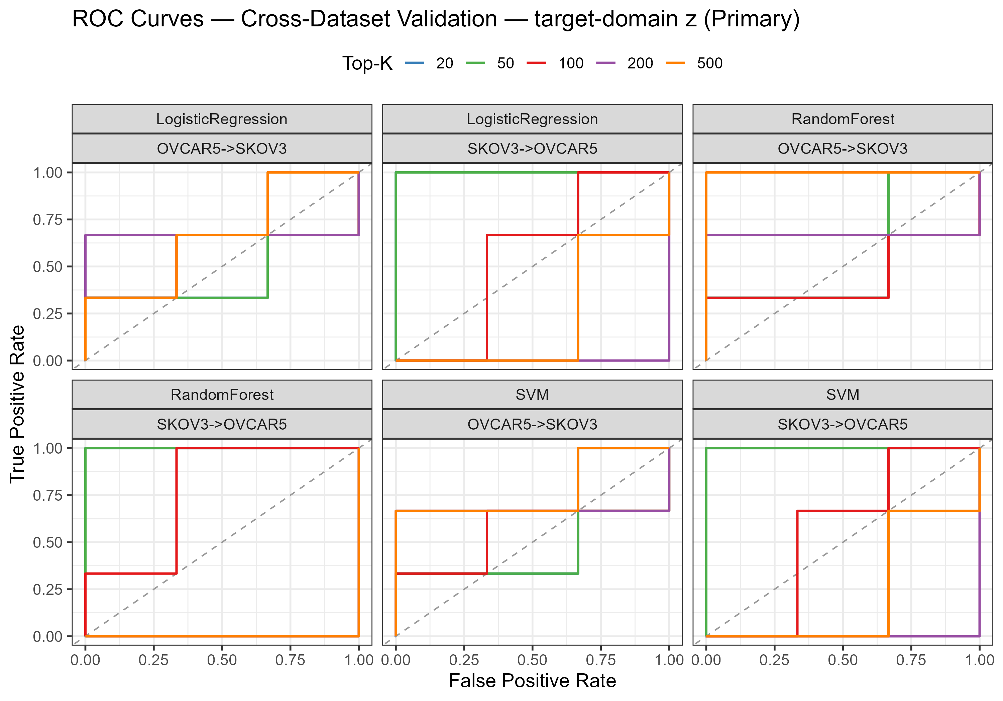
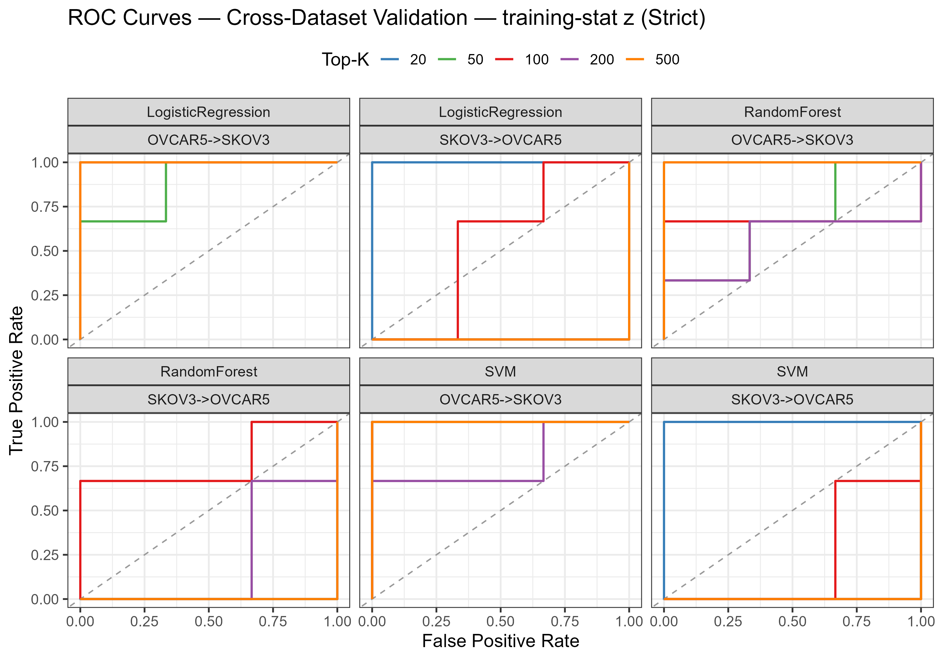
Cross-Dataset External Validation
• Train on one cell line (6), predict the other (6).
• target_z (batch-corrected):
  - SKOV3 -> OVCAR5: AUC 1.0 at K = 20-50
  - OVCAR5 -> SKOV3: AUC ~ 0.44 - 0.78 (near chance)
• train_stats (leak-free, strict): mean ROC-AUC ~ 0.61.
• Transfer is partial and strongly asymmetric; signal collapses as K grows (n << p).
Transcriptomic Profiling of Drug-Resistant Cancer Cells
17

Slide 18
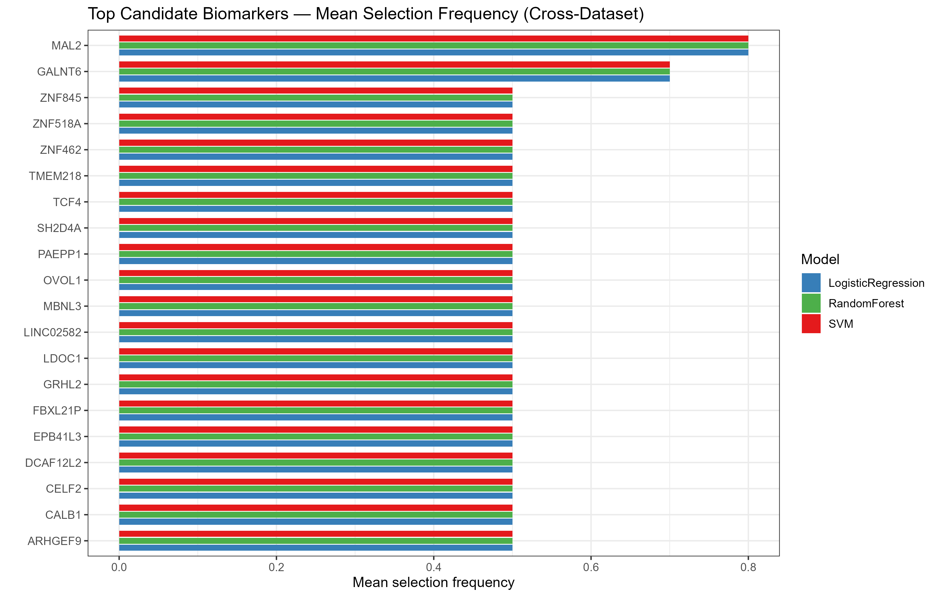
Candidate Biomarker Panel
• Ranked by cross-dataset selection frequency across models x K.
• Top candidates: MAL2, GALNT6, LDOC1, SH2D4A, FBXL21P,
  - EPB41L3, TMEM218, CALB1, LINC02582, CELF2 ...
• 30-gene exploratory panel (biomarker_panel.csv).
• Reflects the SKOV3->OVCAR5 direction; candidates for follow-up.
• NOT a clinically validated diagnostic panel.
Transcriptomic Profiling of Drug-Resistant Cancer Cells
18

Slide 19
Interactive Results Dashboard
• FastAPI backend (backend/app.py) serving the ML artifacts as a read-only REST API.
• Endpoints: /api/summary, /api/external, /api/metrics, /api/loocv,
  - /api/predictions/external, /api/biomarkers, /api/feature-importance
• Web dashboard with a normalisation toggle (target_z / train_stats),
  - AUC-by-K chart, external metrics table and prediction explorer
• Run: python backend/app.py -> http://127.0.0.1:8000/
Transcriptomic Profiling of Drug-Resistant Cancer Cells
19

Slide 20
Key Findings
• Extensive transcriptomic reprogramming: 5,212 DEGs (SKOV-3) and 2,572 (OVCAR5).
• 913 shared DEGs form a cross-dataset core cisplatin-resistance signature.
• EMT and ECM remodelling are the dominant shared mechanism.
• PI3K-Akt, focal adhesion, integrin and cadherin pathways converge on resistance.
• ML separates phenotypes within a cell line; cross-dataset transfer is partial and asymmetric.
• A 30-gene candidate panel (MAL2, GALNT6, ...) nominated for follow-up.
Transcriptomic Profiling of Drug-Resistant Cancer Cells
20

Slide 21
Limitations & Caveats
• Small sample size (n = 12; 6 per cell line) — exploratory, not clinical validation.
• n << p: large-K feature sets overfit; small K is required.
• Cross-dataset normalisation choice materially changes external results.
• Only the train_stats scheme is fully leak-free (mean AUC ~ 0.61).
• Two datasets share cancer type/drug but differ in resistance mechanism.
Transcriptomic Profiling of Drug-Resistant Cancer Cells
21

Slide 22
Conclusions & Future Work
Conclusions:
• A reproducible end-to-end pipeline: GEO -> DESeq2 -> cross-validation -> GO/KEGG -> ML.
• Defines a core cisplatin-resistance transcriptomic signature with clear EMT/ECM biology.
• Provides an interactive dashboard and a candidate biomarker panel.
Future work:
  - Add independent datasets / more replicates to stabilize cross-dataset generalization.
  - Batch-correction benchmarking (ComBat, quantile) and pathway-level ML features.
  - Experimental validation of MAL2, GALNT6, NDRG1 and the EMT axis.
Transcriptomic Profiling of Drug-Resistant Cancer Cells
22

Slide 23
Thank You
Questions?

