Slide 1
Transcriptomic Profiling of Drug-Resistant Cancer Cells
Cisplatin resistance in ovarian cancer: differential expression, pathways & machine-learning biomarkers
Team of 3 | Data & QC . DEGs & Biology . ML & Biomarkers

Slide 2
Abstract
• Ovarian cancer is the most lethal gynaecologic malignancy; cisplatin is first-line, but acquired resistance drives relapse.
• Integrated two independent RNA-seq datasets: GSE303889 (SKOV-3) and GSE283381 (OVCAR5), 3 vs 3 each (n = 12).
• DESeq2 (FDR < 0.05, |log2FC| > 1): 5,212 DEGs (SKOV-3); 2,572 DEGs (OVCAR5); 913 shared.
• Enrichment converged on ECM organisation, cell-substrate adhesion and PI3K-Akt / focal-adhesion / integrin / cadherin signalling; EMT dominant.
• ML: within-cell-line LOOCV ROC-AUC 0.889-1.000; cross-dataset transfer partial and asymmetric (strict leak-free mean AUC 0.61).
• 30-gene candidate panel (MAL2, GALNT6, ...) nominated for follow-up; exploratory given n = 12.
Transcriptomic Profiling of Drug-Resistant Cancer Cells
2

Slide 3
Introduction
Introduction
• Ovarian cancer: most patients present advanced; first-line = cytoreductive surgery + platinum (cisplatin) +/- taxane.
• Platinum forms DNA crosslinks -> apoptosis; intact DNA-damage response is central to cytotoxicity.
• Most patients relapse with platinum-resistant disease; resistance is the principal obstacle to survival.
Problem of acquired resistance
• Adaptive, polyclonal process: reduced uptake / increased efflux, enhanced DNA repair, altered apoptosis, epigenetic and metabolic rewiring, EMT / stemness.
• Mechanisms differ between models and patients -> single-dataset signatures do not reproduce.
• Need consistently dysregulated genes across independent models as robust biomarkers and targets.
Transcriptomic Profiling of Drug-Resistant Cancer Cells
3

Slide 4
Introduction (cont.)
Objectives
• Identify DEGs between cisplatin-resistant and sensitive ovarian cancer cells with DESeq2.
• Validate DEGs across two independent GEO datasets -> a consistent core signature.
• Characterise affected biology via GO and KEGG enrichment.
• Build supervised classifiers and evaluate leakage-free cross-validation.
• Rank a compact, interpretable candidate biomarker panel; deliver a reproducible pipeline + dashboard.
Scope and contributions
• Computational, hypothesis-generating study on public data; exploratory, not clinical validation.
• Cross-dataset core signature; nested (leakage-free) feature selection; honest external generalisation reporting.
Transcriptomic Profiling of Drug-Resistant Cancer Cells
4

Slide 5
Literature Review
Mechanisms
• Cisplatin: intra/inter-strand DNA crosslinks -> DNA-damage response -> apoptosis; resistance at every step (CTR1/SLC31A1 uptake, ABC efflux, DNA repair, apoptosis).
• EMT and ECM remodelling: CDH1 (E-cadherin) and EpCAM loss; collagen and MMP up-regulation; CDH1 promoter hypermethylation; reduced miR-29.
• Epigenetics: DNA-methylation drivers of acquired resistance; KDM5 histone demethylases maintain a drug-tolerant state.
• Metabolic rewiring: targetable de novo pyrimidine dependency in platinum-resistant disease (underpins the OVCAR5 model).
Transcriptomic Profiling of Drug-Resistant Cancer Cells
5

Slide 6
Literature Review (cont.)
Emerging themes and gap
• Inflammation / immune evasion: IL1A-IL1B inflammasome activation; tryptophan-kynurenine axis (KYNU -> AhR) suppresses anti-tumour immunity.
• Validated markers: NDRG1 (hub gene; knockdown inhibits resistant SKOV-3 proliferation); SERPINE1 (invasion/metastasis).
• Convergent pathways: PI3K-Akt, MAPK, focal adhesion / integrin, cadherin, p53.
• Cross-dataset validation and directional consistency increase confidence; single-dataset signatures are unstable.
• ML pitfalls: selection bias and preprocessing leakage in n << p settings.
• Gap: no single reproducible pipeline combining cross-dataset DEG validation + interpretable enrichment + leakage-controlled ML with honest external reporting.
Transcriptomic Profiling of Drug-Resistant Cancer Cells
6

Slide 7
Methodology - Data Sources
Attribute | GSE303889 (SKOV-3) | GSE283381 (OVCAR5)
Resistance model | CDDP (chronic cisplatin; KDM5) | Cis-R (repeated; pyrimidine dep.)
Groups | 3 sensitive vs 3 resistant | 3 sensitive vs 3 resistant
Platform | Illumina NovaSeq 6000 | Illumina NextSeq 500
Samples | 6 | 6
Transcriptomic Profiling of Drug-Resistant Cancer Cells
7

Slide 8
Methodology - Pipeline
Preprocessing and QC
• Gene-level counts + metadata per dataset; low-count filter rowSums >= 10; DESeq2 size-factor normalisation; log2(CPM + 1).
• Duplicate symbols collapsed (rowsum); datasets intersected -> 57,357 shared genes x 12 samples; PCA / clustering QC; seed 42.
Differential expression
• DESeq2, design ~ condition, negative-binomial GLM, Wald test; sensitive = reference.
• Significance: BH FDR < 0.05 and |log2 fold change| > 1.
Cross-dataset and enrichment
• Intersect DEG sets -> up / down / mixed; Spearman correlation of shared log2FC.
• clusterProfiler enrichGO (BP) and enrichKEGG (hsa), BH-adjusted p < 0.05.
Transcriptomic Profiling of Drug-Resistant Cancer Cells
8

Slide 9
Methodology - Machine Learning
Feature matrix and models
• Full 57,357-gene matrix (log2 CPM + 1), 12 samples; no DEG pre-filtering (avoids test leakage).
• Ridge logistic regression (glmnet), random forest (ranger, min.node.size = 1), radial SVM (e1071).
Validation and leakage control
• Within-cell-line LOOCV (5 train / 1 test); cross-dataset external (train one line, predict the other).
• Feature selection nested inside each training fold (top-K by |t-statistic|, K in {20,50,100,200,500}).
• Test normalisation: target_z (batch-corrected) vs train_stats (strictly non-transductive, leak-free).
Metrics and reproducibility
• Accuracy, precision, recall, F1, ROC-AUC; biomarkers ranked by cross-model selection frequency.
• R pipeline + FastAPI dashboard; deterministic (two runs byte-identical).
Transcriptomic Profiling of Drug-Resistant Cancer Cells
9

Slide 10
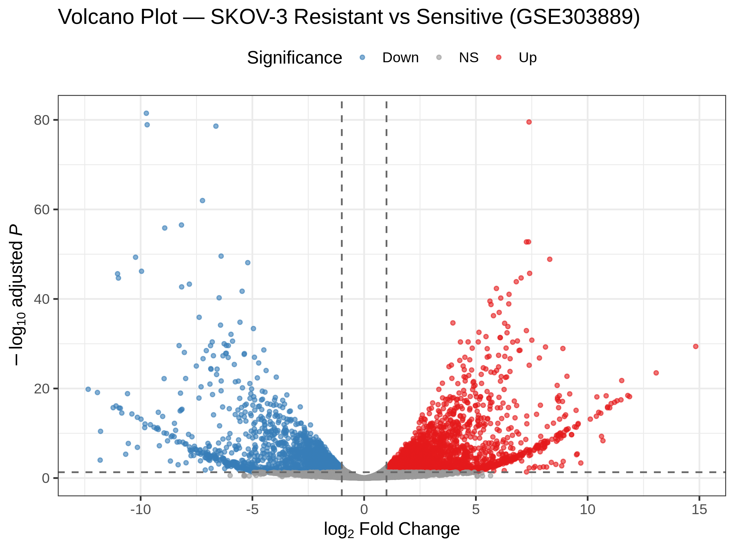
Analysis - Dataset 1 (SKOV-3)
• GSE303889: SKOV-3 parental vs CDDP-resistant (KDM5-associated).
• Genes tested: 22,372
• Significant DEGs: 5,212 (2,983 up / 2,229 down).
• Broad dispersion of up- and down-regulated genes -> extensive reprogramming.
• Heatmap separates sensitive vs resistant replicates cleanly.
• CDH1 (E-cadherin) down among top changes -> EMT-like shift.
Transcriptomic Profiling of Drug-Resistant Cancer Cells
10

Slide 11
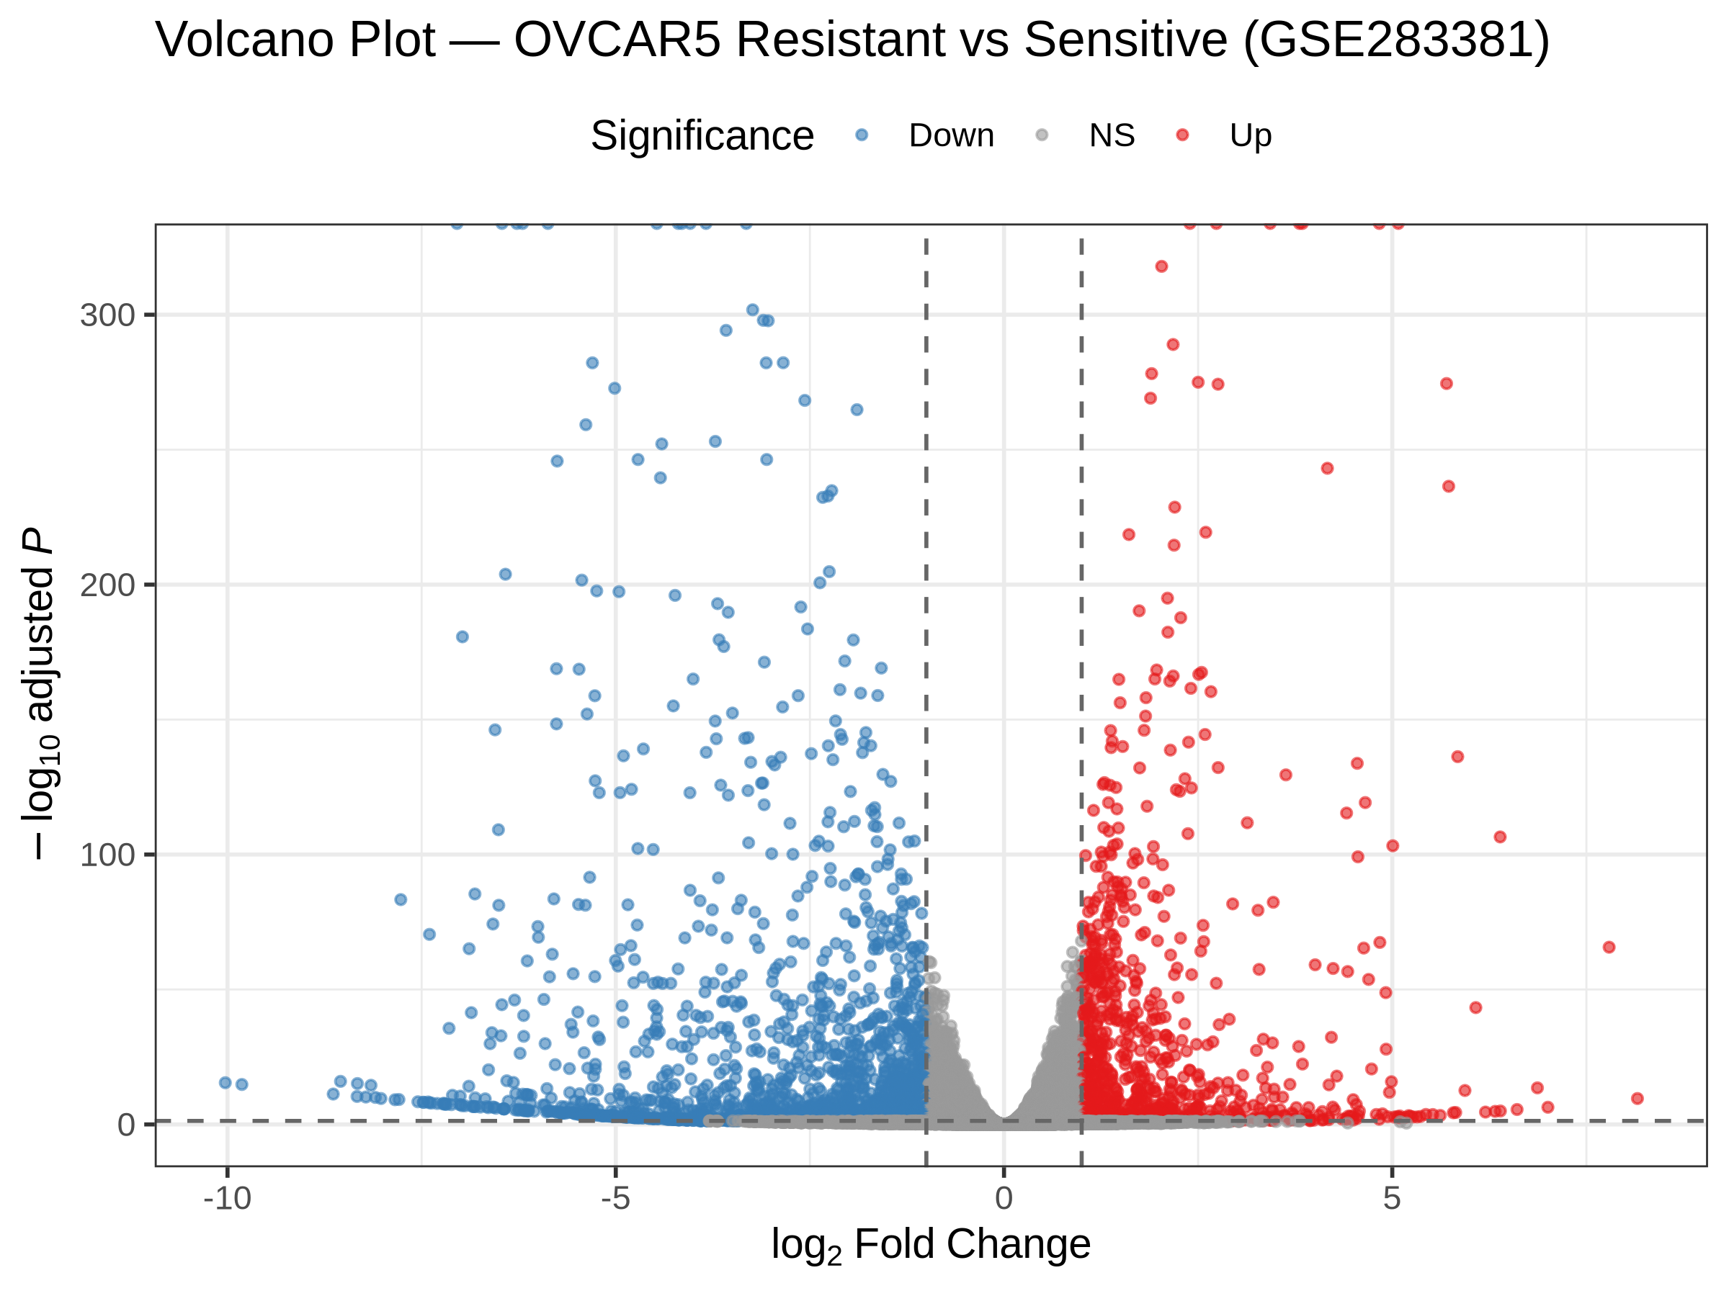
Analysis - Dataset 2 (OVCAR5)
• GSE283381: OVCAR5 Cis-S vs Cis-R (de novo pyrimidine dependency).
• Genes tested: 20,959
• Significant DEGs: 2,572 (912 up / 1,660 down).
• Top up-regulated genes include IL1A and IL1B (large log2FC) -> inflammatory component.
• Magnitude and composition differ from Dataset 1 (distinct resistance mechanism).
Transcriptomic Profiling of Drug-Resistant Cancer Cells
11

Slide 12
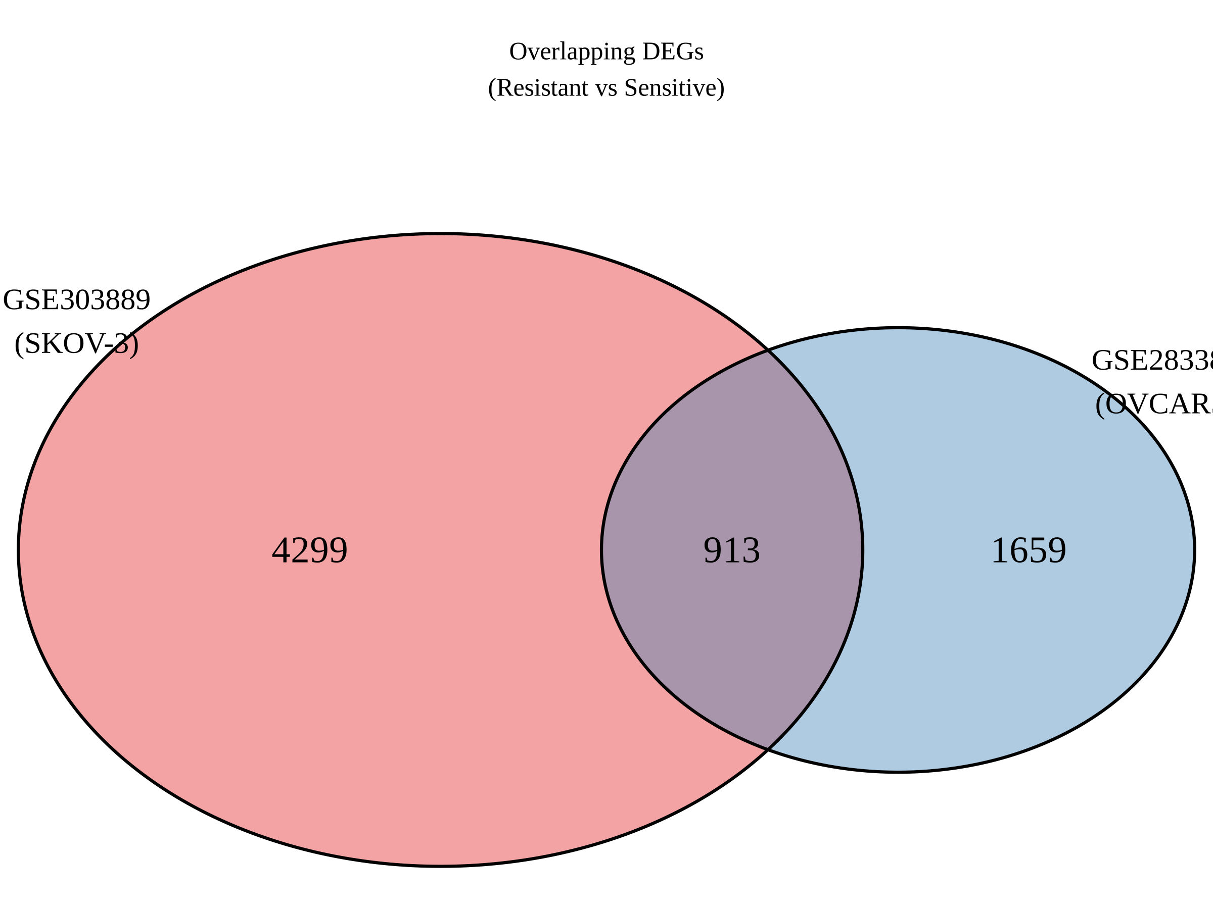
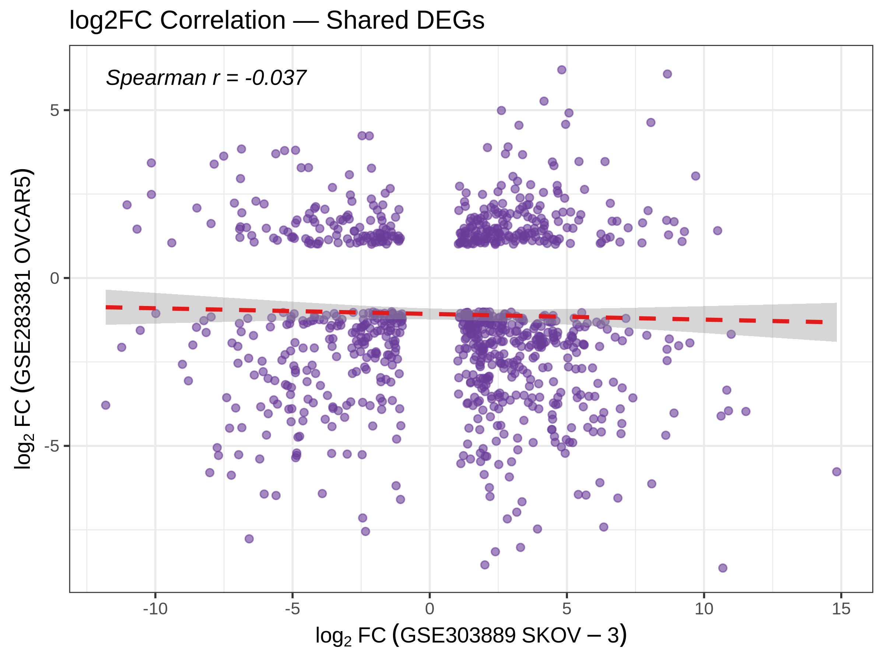
Analysis - Cross-Dataset Overlap
• 913 genes differentially expressed in BOTH datasets (core signature).
  - 198 up in both; 220 down in both; 495 opposite direction.
• Consistently regulated genes define a background-independent signature.
• Spearman correlation of shared log2FC ~ -0.04.
• Low correlation is biologically meaningful: the two models acquire resistance through different programmes.
Transcriptomic Profiling of Drug-Resistant Cancer Cells
12

Slide 13
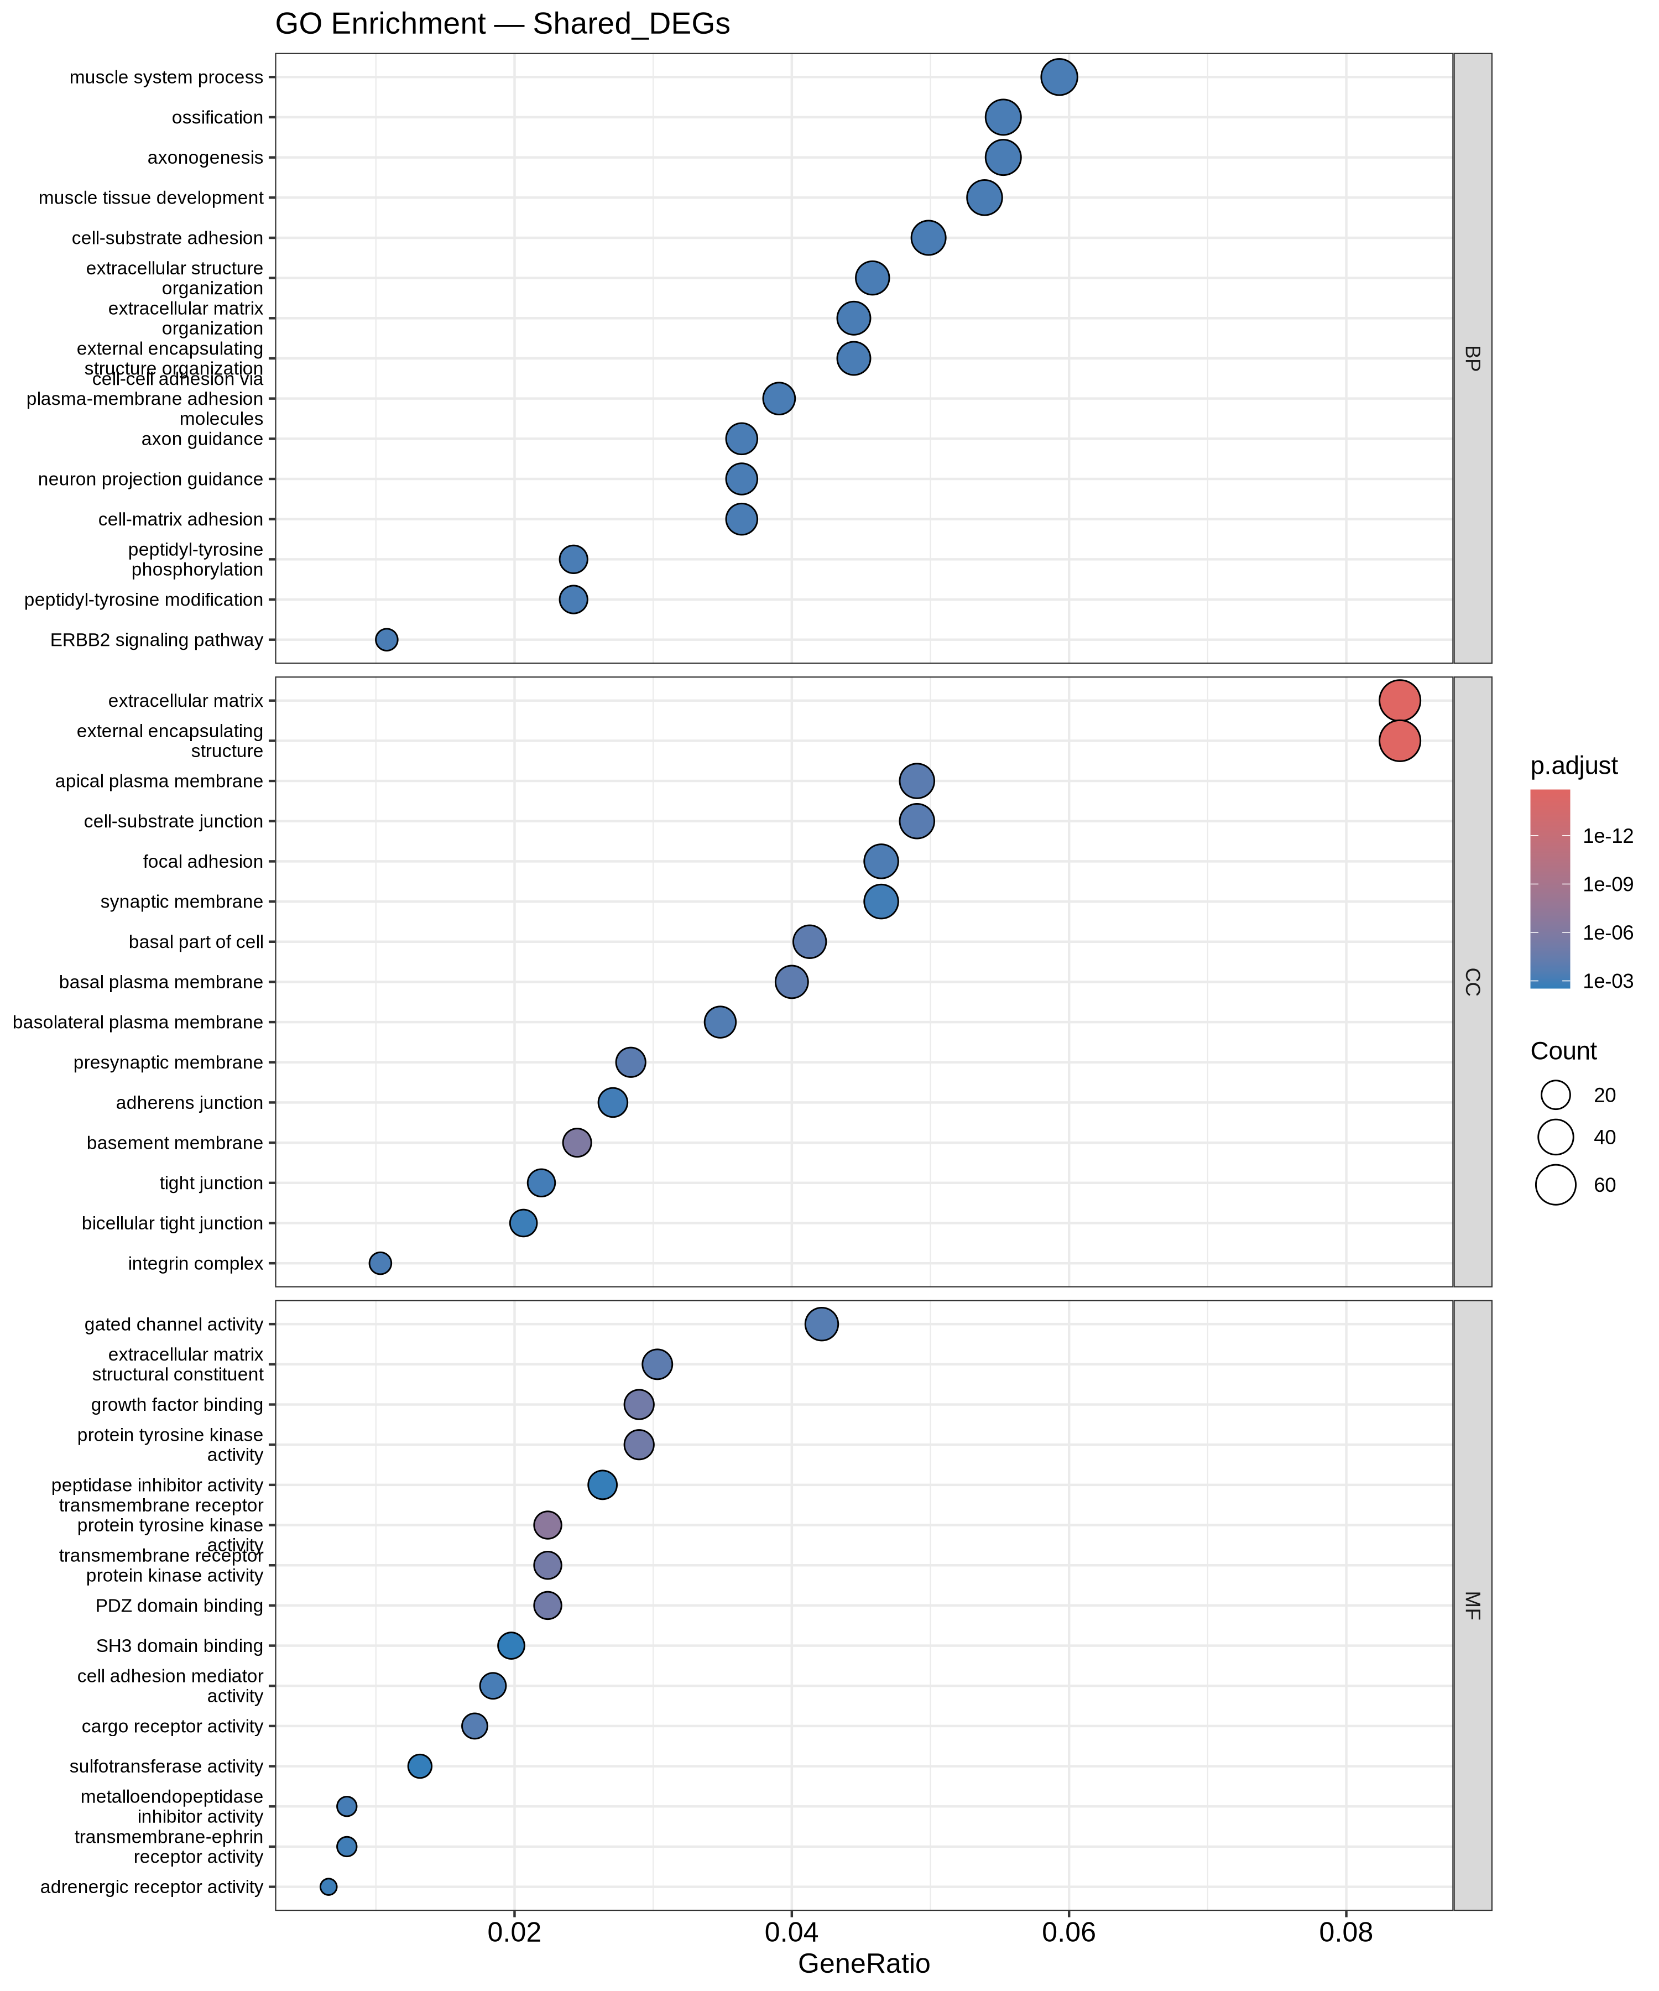
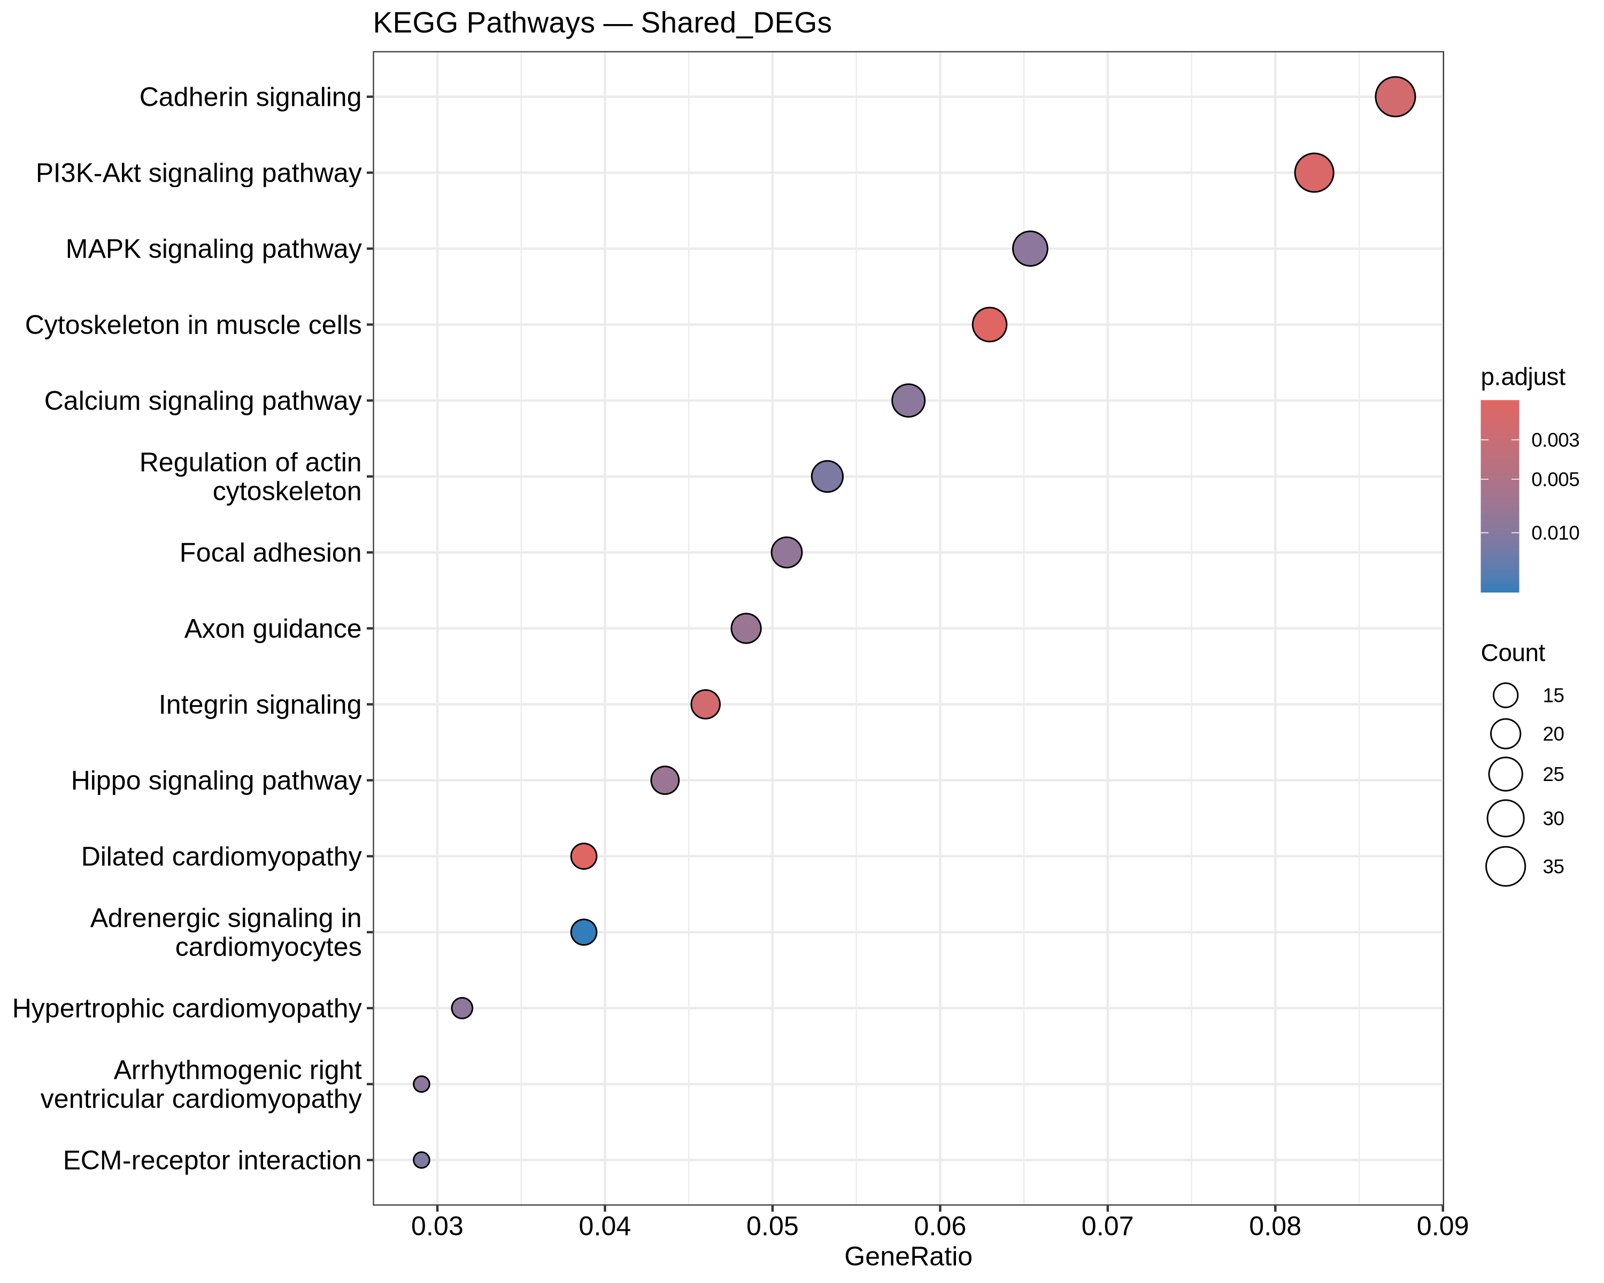
Analysis - Functional Enrichment
GO (shared DEGs)
• Cell-substrate adhesion; extracellular matrix organisation; extracellular structure organisation; ossification; axon guidance.
KEGG (shared DEGs)
• PI3K-Akt signalling; focal adhesion / integrin; cadherin signalling; cytoskeleton / ECM-receptor interaction; Hippo signalling.
• ECM, adhesion, survival and cytoskeletal remodelling converge on resistance -- hallmark of EMT.
Transcriptomic Profiling of Drug-Resistant Cancer Cells
13

Slide 14
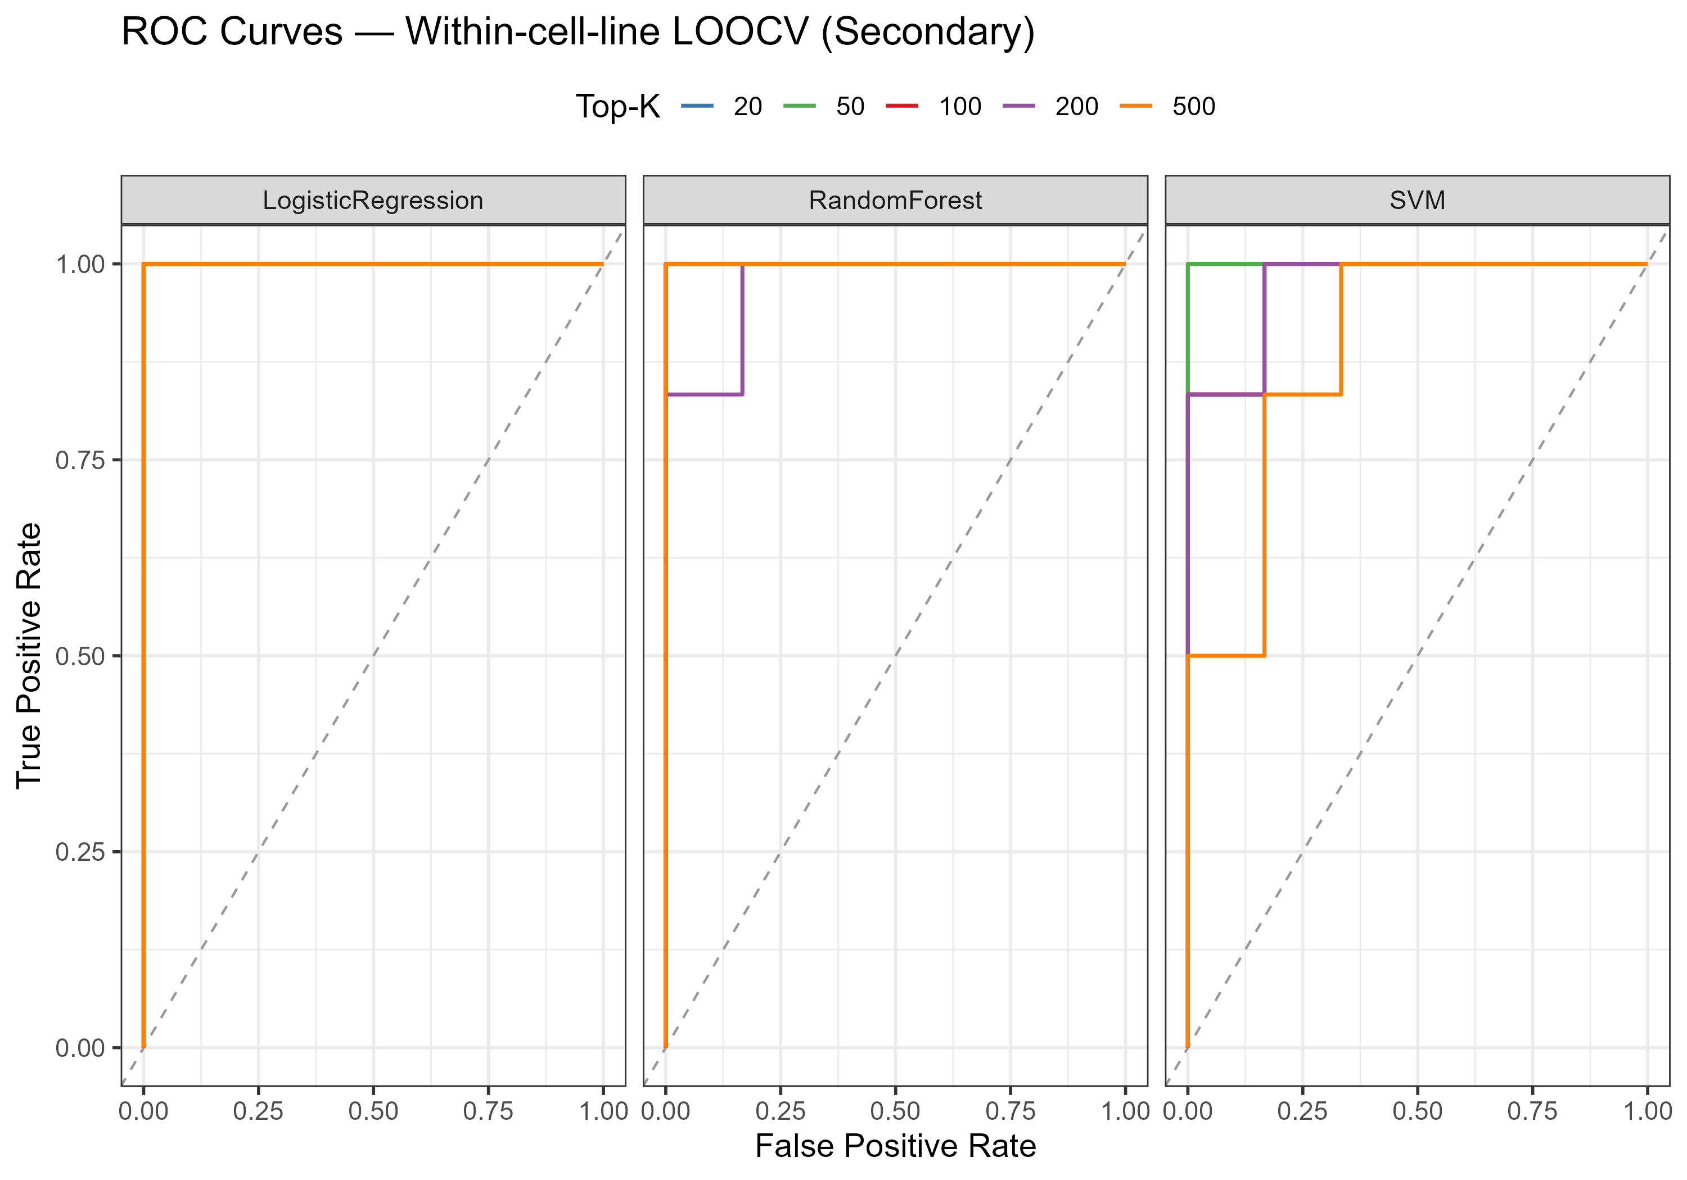
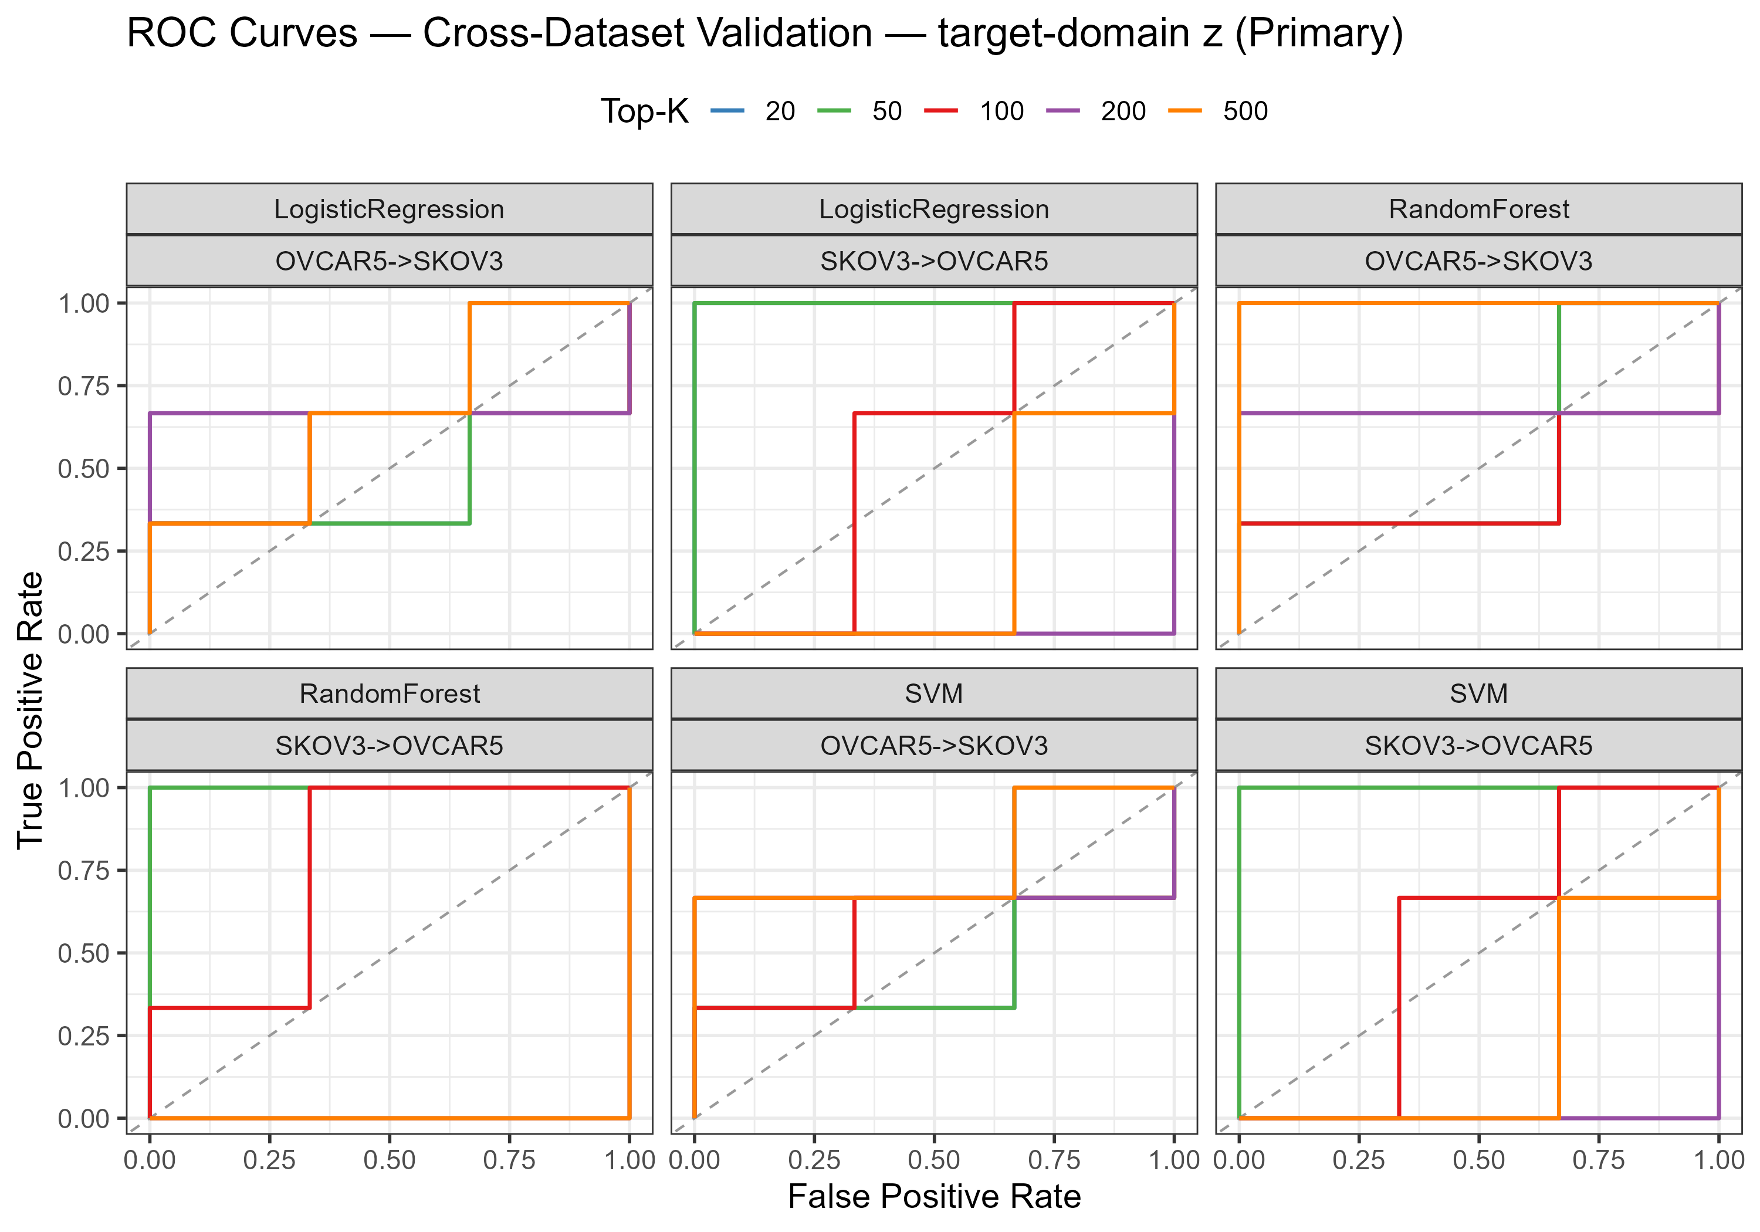
Analysis - Machine Learning
• Within-cell-line LOOCV: Accuracy 0.833-1.000, ROC-AUC 0.889-1.000.
  - Near-complete separation, but likely optimistic (cell-line background is highly separable).
• External, target_z (batch-corrected):
  - SKOV3 -> OVCAR5: AUC 1.0 at K = 20-50.
  - OVCAR5 -> SKOV3: AUC ~ 0.44-0.78 (near chance).
• External, train_stats (strict, leak-free): mean AUC 0.61.
• Transfer is partial, strongly asymmetric, and collapses as K grows (n << p overfitting).
Transcriptomic Profiling of Drug-Resistant Cancer Cells
14

Slide 15
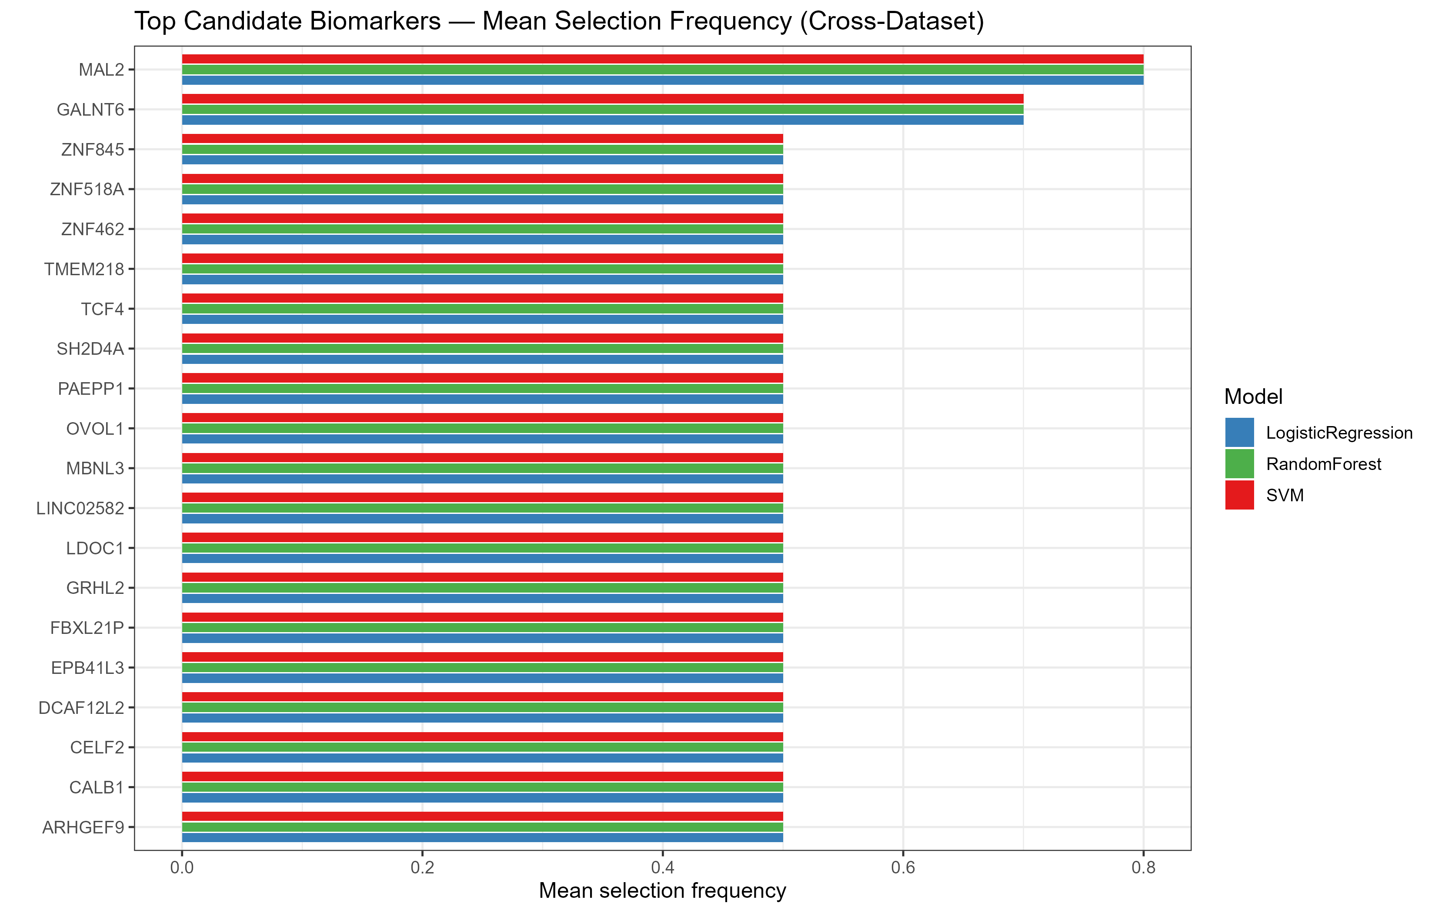
Analysis - Feature Importance
• Ranked by cross-dataset selection frequency across models x K.
• Top candidates: MAL2, GALNT6, LDOC1, SH2D4A, FBXL21P, EPB41L3, TMEM218, CALB1, ...
• MAL2 and GALNT6 most consistently selected, then LDOC1, SH2D4A, FBXL21P.
• Selection frequency dominated by the SKOV3 -> OVCAR5 direction.
• Best regarded as candidates for follow-up, not a validated directional signature.
Transcriptomic Profiling of Drug-Resistant Cancer Cells
15

Slide 16
Result - Differential Expression Summary
Dataset | Cell line | Genes tested | Significant DEGs | Up | Down
GSE303889 | SKOV-3 | 22,372 | 5,212 | 2,983 | 2,229
GSE283381 | OVCAR5 | 20,959 | 2,572 | 912 | 1,660
Transcriptomic Profiling of Drug-Resistant Cancer Cells
16

Slide 17
Result - Candidate Biomarker Panel
Rank | Gene | Selected (of 15 slots) | Mean |log2FC|
1 | MAL2 | 15 | 6.6
2 | GALNT6 | 15 | 6.0
3 | LDOC1 | 15 | 13.1
4 | SH2D4A | 15 | 11.9
5 | FBXL21P | 15 | 11.3
6 | EPB41L3 | 15 | 11.1
7 | TMEM218 | 15 | 10.9
8 | CALB1 | 15 | 9.7
9 | LINC02582 | 15 | 9.7
10 | CELF2 | 15 | 9.0
Transcriptomic Profiling of Drug-Resistant Cancer Cells
17

Slide 18
Discussion
Biological interpretation
• Shared signature = loss of epithelial adhesion (CDH1, EPCAM) + gain of ECM/mesenchymal components (COL1A1/5A2/6A1, MMP14) -> canonical EMT.
• OVCAR5 inflammatory axis (IL1A/IL1B); NDRG1 and KYNU provide literature-anchored nodes; SERPINE1 links to ECM remodelling and metastasis.
Proposed mechanism
• Cisplatin -> DNA damage + chronic inflammation + immune-evasive metabolism -> apoptosis evasion + ECM remodelling -> integrin/focal adhesion -> Wnt/beta-catenin -> EMT -> stable resistance (PI3K-Akt as survival node).
Transcriptomic Profiling of Drug-Resistant Cancer Cells
18

Slide 19
Discussion (cont.)
ML interpretation
• LOOCV near-perfect but reflects intrinsic cell-line separability (sanity check, not deployable).
• Cross-dataset transfer partial, asymmetric; strict leak-free mean AUC 0.61.
Literature, limitations and future work
• Findings align with established EMT / ECM / PI3K-Akt / integrin resistance biology; low cross-dataset correlation matches known heterogeneity.
• Limitations: n = 12 (exploratory); n << p; normalisation-dependent external results; cell lines miss tumour heterogeneity; no wet-lab validation.
• Future: add datasets/replicates; benchmark batch correction; pathway-level features; validate MAL2, GALNT6, NDRG1 and the EMT axis.
Transcriptomic Profiling of Drug-Resistant Cancer Cells
19

Slide 20
Conclusion
• Reproducible end-to-end transcriptomic + ML analysis of cisplatin resistance across two independent RNA-seq datasets.
• Cross-dataset validation isolated a core signature of consistently regulated genes.
• Enrichment converged on ECM remodelling, adhesion and PI3K-Akt / focal-adhesion / integrin / cadherin pathways, with EMT dominant.
• Classifiers separate phenotypes within a cell line, but cross-dataset transfer is partial, asymmetric and weakens under leak-free normalisation.
• A 30-gene candidate panel (MAL2, GALNT6, ...) plus NDRG1 nominated for follow-up.
• Deliverables: reproducible pipeline, publication-quality figures and an interactive dashboard, adaptable to other cancers/drugs/datasets.
Transcriptomic Profiling of Drug-Resistant Cancer Cells
20

Slide 21
References
[1] Cardenas H, Wang Y, Zhao G, Hao DX, Isac AM, Hernandez V, Kim U, Qiang W, Zhang HF, Matei D. Metabolic dependency on de novo pyrimidine synthesis is a targetable vulnerability in platinum-resistant ovarian cancer. Cancer Res. 2026;86(2):387–401. doi:10.1158/0008-5472.CAN-25-0043.
[2] Zhu Y, Chen X, Tang R, Li G, Yang J, Hong S. Comprehensive analysis of hub genes associated with cisplatin-resistance in ovarian cancer and screening of therapeutic drugs through bioinformatics and experimental validation. J Ovarian Res. 2024;17(1):142. doi:10.1186/s13048-024-01461-w.
[3] de Souza JC, Pimenta TM, Martins BDS, Padilha JMS, Butzene SMS, Marçal MG, Rangel LBA. Inflammasome activation contributes to cisplatin resistance in ovarian cancer. J Ovarian Res. 2025;18(1):294. doi:10.1186/s13048-025-01852-7.
[4] Alghamian Y, Soukkarieh C, Abbady AQ, Murad H. Investigation of role of CpG methylation in some epithelial mesenchymal transition gene in a chemoresistant ovarian cancer cell line. Sci Rep. 2022;12(1):7494. doi:10.1038/s41598-022-11634-6.
[5] Zeller C, Dai W, Steele NL, Siddiq A, Walley AJ, Wilhelm-Benartzi CS, Rizzo S, van der Zee A, Plumb JA, Brown R. Candidate DNA methylation drivers of acquired cisplatin resistance in ovarian cancer identified by methylome and expression profiling. Oncogene. 2012;31(42):4567–4576. doi:10.1038/onc.2011.611.
[6] Januchowski R, Świerczewska M, Sterzyńska K, Wojtowicz K, Nowicki M, Zabel M. Increased expression of several collagen genes is associated with drug resistance in ovarian cancer cell lines. J Cancer. 2016;7(10):1295–1310. doi:10.7150/jca.15371.
[7] Yu PN, Yan MD, Lai HC, Huang RL, Chou YC, Lin WC, Yeh LT, Lin YW. Downregulation of miR-29 contributes to cisplatin resistance of ovarian cancer cells. Int J Cancer. 2014;134(3):542–551. doi:10.1002/ijc.28399.
[8] Chen S, Yang G, Shi Q, Wan N, Lin R, Wang L, Hu X, Zhuang X, Yu L, Sui M. Frizzled 6 endows high-grade serous ovarian cancer with stem-like properties and chemoresistance. Mol Carcinog. 2024;63(10):2001–2012. doi:10.1002/mc.23789.
[9] Tersigni C, Onori M, Buzzonetti A, et al. Diagnostic performance of circulating EpCAM+ and CD45+ extracellular vesicles in platinum-sensitivity in high-grade serous ovarian cancer: a pilot study. J Ovarian Res. 2025;18(1):93. doi:10.1186/s13048-025-01656-9.
[10] Wang F, Yue QF, Zhang Y, Lei FL. Synergistic overcoming of cisplatin resistance in ovarian cancer by combined Astragalus membranaceus and cisplatin treatment: network pharmacology and experimental validation. BMC Complement Med Ther. 2025;25(1):337. doi:10.1186/s12906-025-05066-8.
Transcriptomic Profiling of Drug-Resistant Cancer Cells
21

Slide 22
References
[11] Velmurugan P, Parsanathan R, Shankari G, et al. Pharmacological modulation of the tryptophan-kynurenine pathway by the intervention of indoleamine 2,3-dioxygenase 2 (IDO2) and kynureninase (KYNU) in ovarian cancer. Curr Med Chem. 2026 (Epub). doi:10.2174/0109298673450210260701040244.
[12] Heng B, Bilgin AA, Lovejoy DB, et al. Differential kynurenine pathway metabolism in highly metastatic aggressive breast cancer subtypes: beyond IDO1-induced immunosuppression. Breast Cancer Res. 2020;22(1):113. doi:10.1186/s13058-020-01351-1.
[13] Mrkvicova A, Chmelarova M, Peterova E, Havelek R, Baranova I, Kazimirova P, Rudolf E, Rezacova M. The effect of sodium butyrate and cisplatin on expression of EMT markers. PLoS One. 2019;14(1):e0210889. doi:10.1371/journal.pone.0210889.
[14] Chiang YC, Chang MC, Chen PJ, Wu MM, Hsieh CY, Cheng WF, Chen CA. Epigenetic silencing of BLU through interfering apoptosis results in chemoresistance and poor prognosis of ovarian serous carcinoma patients. Endocr Relat Cancer. 2013;20(2):213–227. doi:10.1530/ERC-12-0117.
[15] Edgar R, Domrachev M, Lash AE. Gene Expression Omnibus: NCBI gene expression and hybridization array data repository. Nucleic Acids Res. 2002;30(1):207–210. doi:10.1093/nar/30.1.207.
[16] Barrett T, Wilhite SE, Ledoux P, et al. NCBI GEO: archive for functional genomics data sets—update. Nucleic Acids Res. 2013;41(Database issue):D991–D995. doi:10.1093/nar/gks1193.
[17] Love MI, Huber W, Anders S. Moderated estimation of fold change and dispersion for RNA-seq data with DESeq2. Genome Biol. 2014;15(12):550. doi:10.1186/s13059-014-0550-8.
[18] Wu T, Hu E, Xu S, et al. clusterProfiler 4.0: A universal enrichment tool for interpreting omics data. Innovation (Camb). 2021;2(3):100141. doi:10.1016/j.xinn.2021.100141.
[19] Yu G, Wang LG, Han Y, He QY. clusterProfiler: an R package for comparing biological themes among gene clusters. OMICS. 2012;16(5):284–287. doi:10.1089/omi.2011.0118.
[20] Kanehisa M, Goto S. KEGG: Kyoto Encyclopedia of Genes and Genomes. Nucleic Acids Res. 2000;28(1):27–30. doi:10.1093/nar/28.1.27.
Transcriptomic Profiling of Drug-Resistant Cancer Cells
22

Slide 23
References
[21] Friedman J, Hastie T, Tibshirani R. Regularization paths for generalized linear models via coordinate descent. J Stat Softw. 2010;33(1):1–22. doi:10.18637/jss.v033.i01.
[22] Wright MN, Ziegler A. ranger: A fast implementation of random forests for high dimensional data in C++ and R. J Stat Softw. 2017;77(1):1–17. doi:10.18637/jss.v077.i01.
[23] Meyer D, Dimitriadou E, Hornik K, Weingessel A, Leisch F. e1071: Misc Functions of the Department of Statistics, Probability Theory and Its Applications. R package.
[24] Blighe K, Rana S, Lewis M. EnhancedVolcano: Publication-ready volcano plots with enhanced colouring and labeling. R package (Bioconductor).
[25] Kolde R. pheatmap: Pretty Heatmaps. R package.
[26] Carlson M. org.Hs.eg.db: Genome wide annotation for Human. R package (Bioconductor).
[27] Varma S, Simon R. Bias in error estimation when using cross-validation for model selection. BMC Bioinformatics. 2006;7:91. doi:10.1186/1471-2105-7-91.
[28] Ambroise C, McLachlan GJ. Selection bias in gene extraction on the basis of microarray gene-expression data. Proc Natl Acad Sci USA. 2002;99(10):6562–6566. doi:10.1073/pnas.102102699.
[29] Guyon I, Elisseeff A. An introduction to variable and feature selection. J Mach Learn Res. 2003;3:1157–1182.
Transcriptomic Profiling of Drug-Resistant Cancer Cells
23

Slide 24
Thank You
Questions?

