Slide 1
CROSS-DATASET TRANSCRIPTOMICS · MACHINE LEARNING · CANDIDATE BIOMARKERS
Cross-Cohort Transcriptomic Signatures of Osimertinib Resistance in EGFR-Mutant NSCLC Cell Lines
A leakage-controlled bulk RNA-seq + machine-learning study — discovery GSE202859 (-OR) and validation GSE193258 (DTP)
2
36
1,112
1.00
GEO cohorts
labelled samples
consistent-gene signature
external ROC-AUC
Data: two AstraZeneca/Yale GEO cell-line studies · NCBI-uniform counts (HISAT2 + featureCounts, GRCh38.p13)

Slide 2
ABSTRACT
One paragraph, every number traceable to a table
▪ Osimertinib resistance in EGFR-mutant NSCLC is driven largely by NON-GENETIC chromatin/persister states — motivating a transcriptomic framing.
▪ Two harmonised GEO cohorts profile the SAME three cell lines (PC9, H1975, HCC827): discovery (parental vs chronic -OR) and independent validation (DMSO vs 3-week DTP), 9 vs 9 each.
▪ DESeq2 with ~ cell_line + condition on uniformly reprocessed NCBI counts yielded 2,785 and 4,852 significant DEGs; 1,112 are shared with the SAME direction → the validated signature.
▪ Biology: migration / ECM / cytoskeleton / developmental programs UP; ribosome, spliceosome, translation DOWN (NES up to -6.9) — a hypoproliferative persister phenotype.
▪ Pre-registered classifier (LogReg, K=50, selection+tuning inside folds, gated by cell line) transfers one-shot to the validation cohort: ROC-AUC 1.000 (CI 1.000-1.000), sensitivity 1.000.
▪ A 100-gene stability+selection+SHAP panel and a drug-withdrawal probe (P(Resistant): DTP 0.80 → 10-day washout 0.30) argue for state-like, partially reversible resistance.
1,112
consistent-gene signature
87%
of shared DEGs concordant
100
candidate biomarker panel
Rho 0.70-0.86
Python GSEA vs fgsea
Osimertinib-resistance transcriptomics · GSE202859 + GSE193258 · seed 42
2

Slide 3
INTRODUCTION
▪ Osimertinib = first-line, covalent 3rd-generation EGFR-TKI; response is deep but progression eventually occurs in essentially all patients.
▪ Progression is frequently NON-genetic: no new driver mutation — instead chromatin/state shifts (mSWI/SNF remodeling, drug-tolerant persisters, lineage plasticity).
▪ Single-cohort transcriptomics overfits dataset-specific artefacts; cross-dataset reproducibility requires identical sequencing-style counts, matched cell lines and honest ML.
▪ Cell-line systems give clean labels and controlled endpoints; the price is that conclusions stay exploratory — baked into the claim discipline.
OBJECTIVES
▪ Estimate per-cohort DEGs with genotype (cell line) as a blocking covariate
▪ Define a cross-dataset consistent resistance signature
▪ Characterise it with ORA + GSEA (two engines, concordance-checked)
▪ One-shot external validation under a pre-registered primary config, with bootstrap CIs on every metric
▪ Rank a candidate biomarker panel and probe reversibility on an excluded drug-withdrawal arm
Design principle: every decision pre-registered in docs/decisions.md (D1-D14) BEFORE the external cohort was touched.
Osimertinib-resistance transcriptomics · GSE202859 + GSE193258 · seed 42
3

Slide 4
LITERATURE REVIEW
Three anchors from the resistance field
de Miguel et al. 2023 — Cancer Cell
Criscione et al. 2022 — npj Precision Oncology
Blaquier et al. 2023 — Clin Cancer Research
▪ Discovery cohort's primary paper (GSE202859).
▪ mSWI/SNF (SMARCA4/A2) chromatin remodelling PROPS osimertinib resistance: EMT, epithelial differentiation, NRF2 oxidative-stress programs.
▪ SMARCA4/2 ATPase inhibition re-sensitises resistant models — resistance is state-like, not purely mutational.
▪ Validation cohort's primary paper (GSE193258).
▪ RNA/ATAC/ChIP landscape of 21-day DTP states in the same line panel.
▪ DTPs are transcriptionally distinct from cell-cycle shutdown; vulnerabilities flagged: MEK, TEAD, AURKB, BRD4.
▪ Review of the clinical resistance landscape: genetic (C797S, MET amp, bypass) vs non-genetic histologies.
▪ Frames why pan-transcriptomic, cross-model signatures matter for combination design.
Osimertinib-resistance transcriptomics · GSE202859 + GSE193258 · seed 42
4

Slide 5
LITERATURE REVIEW
The four method tricks this pipeline leans on
DESeq2 multi-factor design (Love 2014)
Negative-binomial GLM: condition effect estimated on all 18 samples while ~ cell_line swallows the 3-line genetic background.
ORA with an EXPLICIT universe (Kuleshov 2016; Reactome/KEGG/GO)
Hypergeometric needs a denominator; we use all genes in the gene-set source (D10) — conservative fold-enrichments, honestly logged.
Pre-ranked GSEA + exact fgsea (Subramanian 2005; Korotkevich 2019)
Whole-transcriptome ranking avoids DEG-list dichotomisation; Python permutation-null engine cross-checked by R fgsea multilevel engine.
Group-aware nested CV + one-shot external lock (Varma & Simon 2006)
Split by cell line; tune/select only inside training folds; pre-register the primary configuration BEFORE seeing the validation cohort.
Osimertinib-resistance transcriptomics · GSE202859 + GSE193258 · seed 42
5

Slide 6
METHODOLOGY
Cohort pairing — the reason this design is strong
 | Discovery — GSE202859 | Validation — GSE193258
Endpoint | Parental vs chronically-dosed -OR | DMSO vs 3-week osimertinib DTP
Sample size | 18 (9 Sensitive / 9 Resistant) | 18 (9 Sensitive / 9 Resistant)
Shared lines | PC9 · H1975 · HCC827 | PC9 · H1975 · HCC827 (+HCC2935 excluded)
Counts source | NCBI uniform (GRCh38.p13, Entrez) | NCBI uniform (same pipeline)
Platform | NovaSeq 6000 | HiSeq 4000
Excluded by policy | 34 (acute 24 h, SMARCA4 shRNA) | 42 (acute + washout arm, HCC2935)
Primary paper | de Miguel 2023 · PMID 37541244 | Criscione 2022 · PMID 36575215
Label policy: keep only clean endpoints (parental/DMSO = Sensitive; -OR/osi_DTP = Resistant). Every excluded sample keeps an explicit reason in coldata_all.csv.
Why it works: identical NCBI processing removes alignment/annotation batch; SAME cell lines in both cohorts control genetic background; the endpoint difference (-OR vs DTP) is a real distribution shift, handled and disclosed — never hidden.
Osimertinib-resistance transcriptomics · GSE202859 + GSE193258 · seed 42
6

Slide 7
METHODOLOGY
End-to-end pipeline (scripts/run_pipeline.py, seed 42)
R: fetch + metadata
R: QC + normalise
R: DE + overlap
NCBI counts -> Entrez->symbol (n_dup logged) -> keep/exclude reasons per sample
→
min_count 10; DESeq2 VST; per-cohort QC + PCA figures
→
~ cell_line + condition; FDR<0.05 & |LFC|>1; cross-cohort consistent set
Py: enrichment
Py: fgsea cross-check
Py: ML 04-08
GO-BP/KEGG/Reactome ORA (explicit universe) + pre-ranked GSEA; exported GMTs
→
Same ranks + same GMTs through R fgsea; concordance reported
→
Stability -> nested CV (group=cell line) -> locked external shot -> SHAP -> report
Every stage writes tables/figures to results/ and re-runs deterministically; leakage checklist (22 items) re-verified after the final run.
Osimertinib-resistance transcriptomics · GSE202859 + GSE193258 · seed 42
7

Slide 8
METHODOLOGY
The ML part in plain words
WHAT 'SAME-LINE LEAKAGE' WOULD DO
ONE OUTER FOLD (of 3, grouped by line)
▪ Random K-folds would put PC9 replicate #2 in TRAIN and PC9 replicate #3 in TEST.
▪ Replicates are near-clones → test folds are trivially predictable → inflated AUC.
PC9
TRAIN
H1975
TRAIN
CONTROLS ACTUALLY APPLIED
HCC827
TEST (outer)
▪ StratifiedGroupKFold(groups = cell line): a whole line rests in one fold.
▪ Feature selection + scaling + tuning inside TRAINING folds only.
▪ Bootstrap 95% CIs on every reported metric.
▪ External cohort touched exactly once, after model lock.
Inside each TRAIN side: inner grouped GridSearchCV picks hyper-params and the K-best feature set; then refit on TRAIN, predict TEST once. Repeat over folds → out-of-fold metrics that a NEW cell line would see.
Osimertinib-resistance transcriptomics · GSE202859 + GSE193258 · seed 42
8

Slide 9
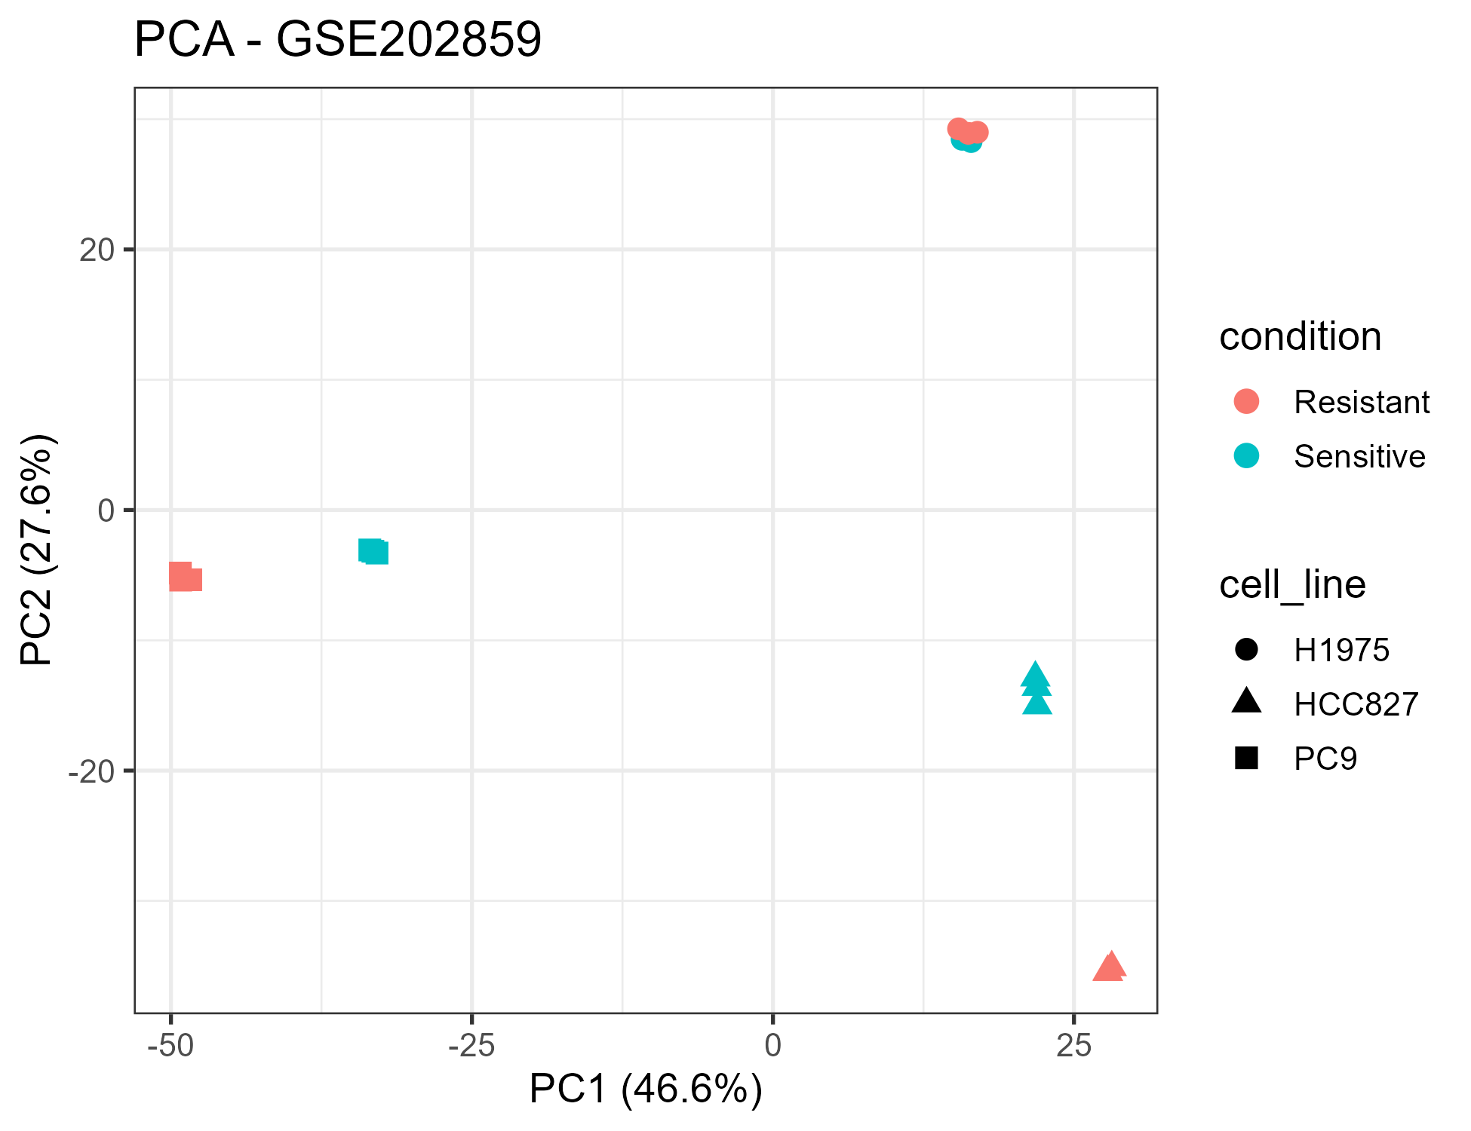
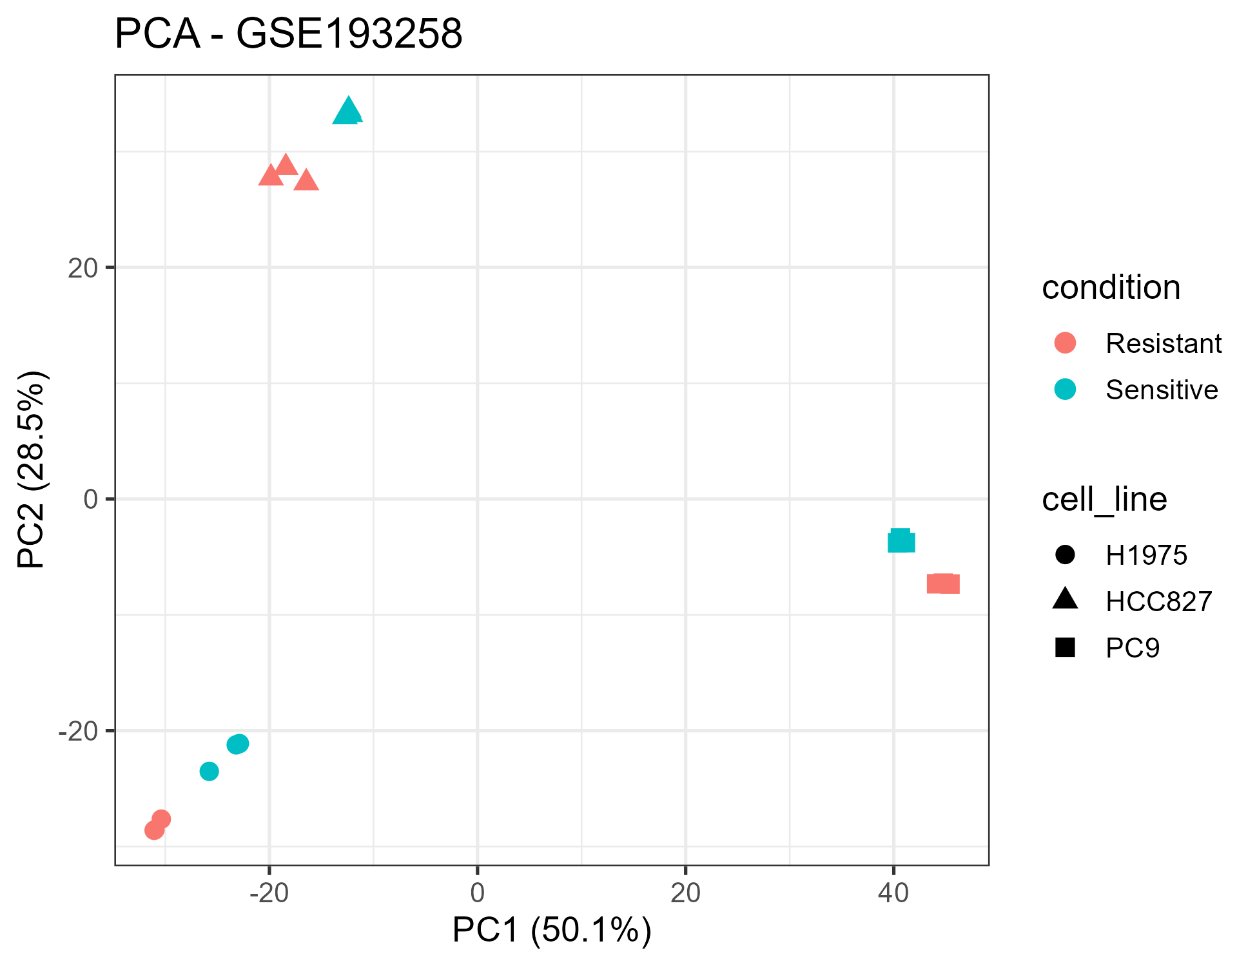
ANALYSIS
QC first: is the data even comparable?
Fig 1 · PCA — discovery GSE202859 (VST-normalised)
Fig 2 · PCA — validation GSE193258 (VST-normalised)
23,585 / 25,823
20-51 M
2,785 / 4,852
18 + 18
genes detected (disc / val)
reads per sample
significant DEGs (disc / val)
labelled samples kept
Osimertinib-resistance transcriptomics · GSE202859 + GSE193258 · seed 42
9

Slide 10
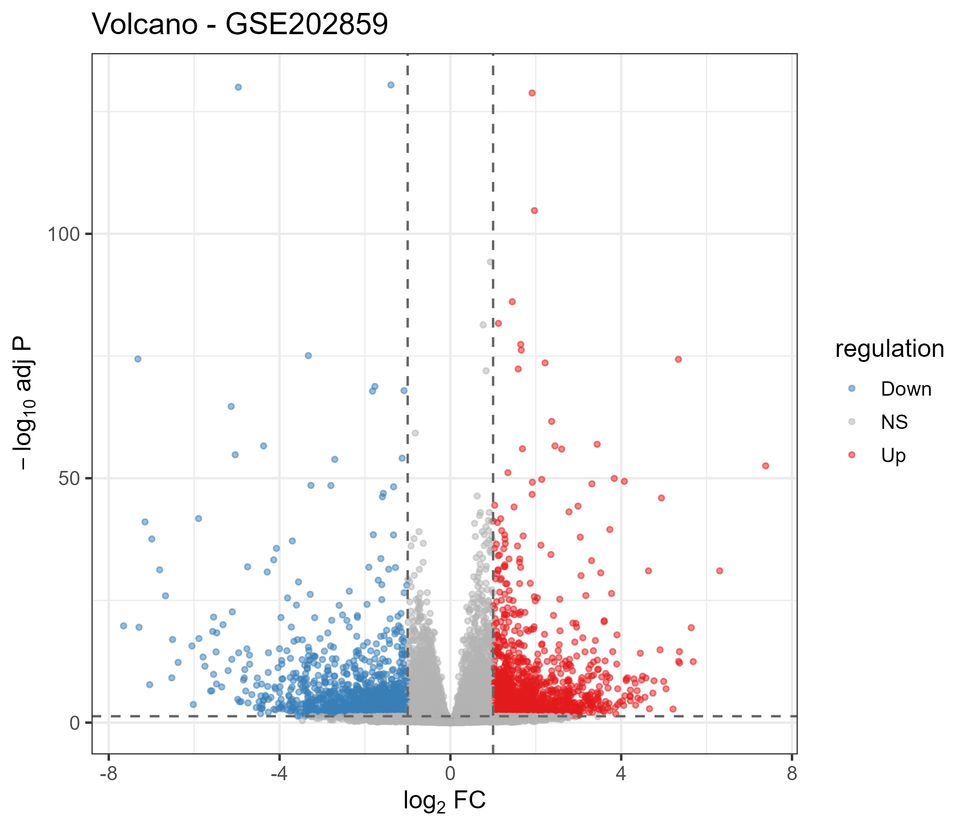
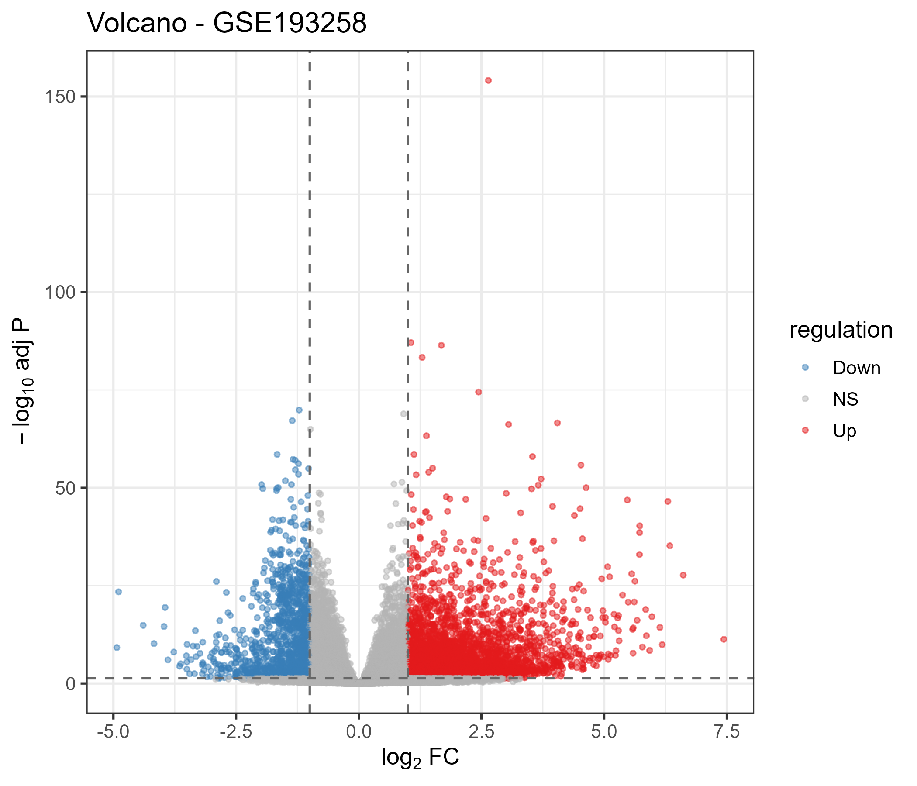
ANALYSIS
DESeq2 contrasts — full-transcriptome shifts, not a few markers
Fig 4 · Volcano — discovery (1,435 up / 1,350 down at FDR<0.05, |LFC|>1)
Fig 5 · Volcano — validation (3,651 up / 1,201 down)
7,000+ genes move
red = significant & direction-labelled
Osimertinib-resistance transcriptomics · GSE202859 + GSE193258 · seed 42
10

Slide 11
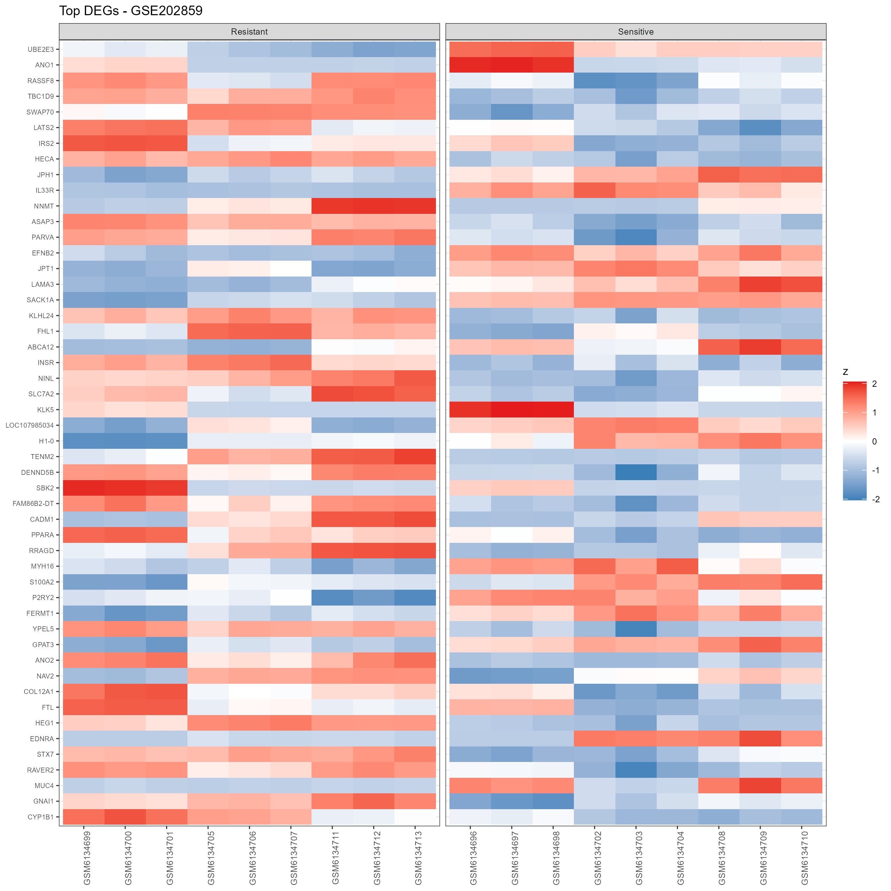
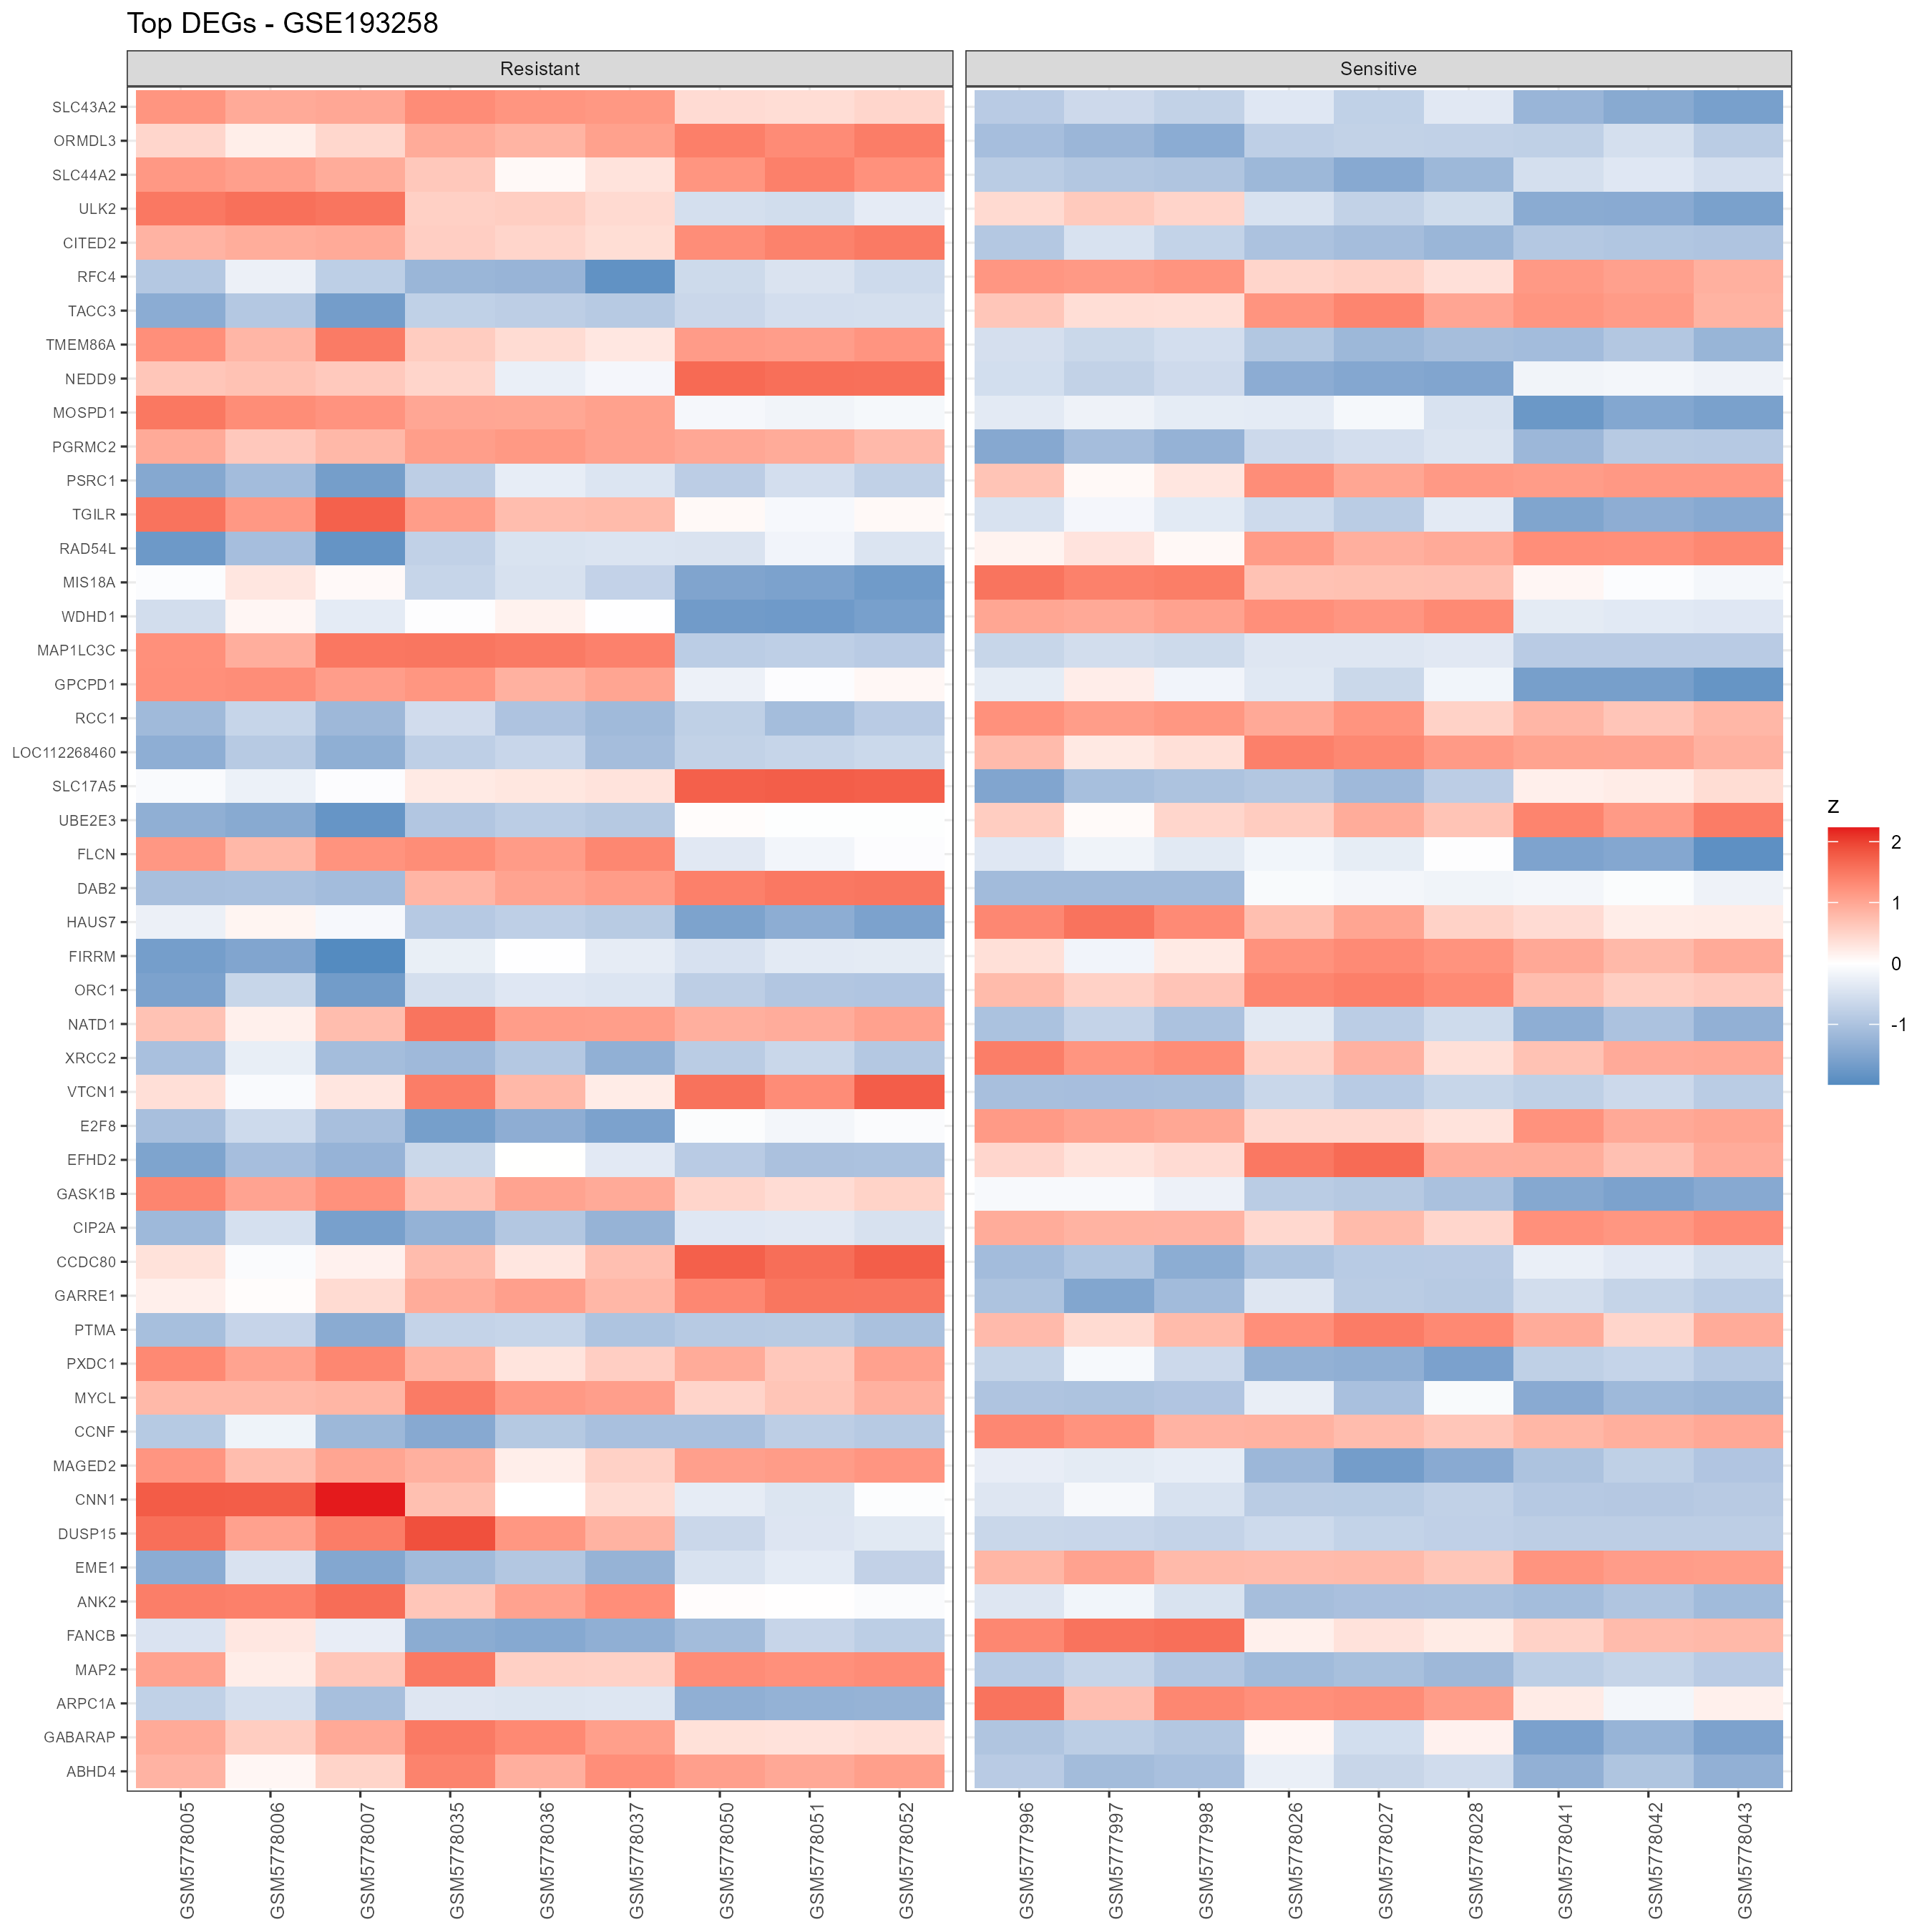
ANALYSIS
Top DEGs replicate cleanly across cohorts
Fig 6 · Top-DEG heatmap — discovery
Fig 7 · Top-DEG heatmap — validation
Block structure visible
samples cluster by line AND condition
Osimertinib-resistance transcriptomics · GSE202859 + GSE193258 · seed 42
11

Slide 12
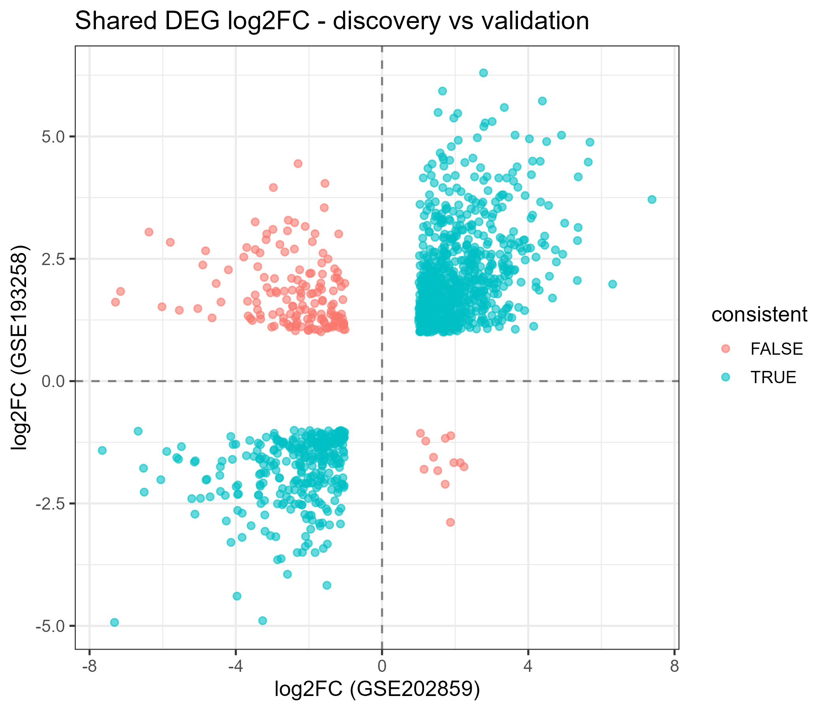
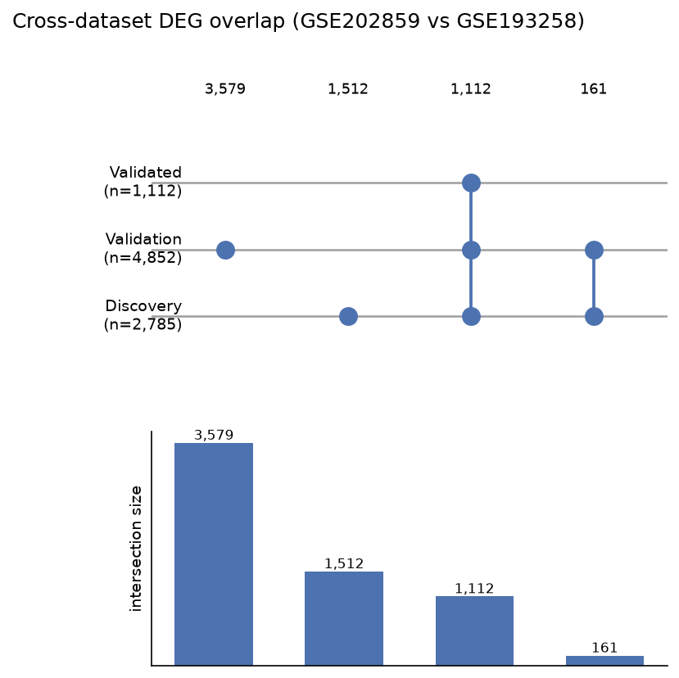
ANALYSIS
The signature is REPRODUCIBLE, not cohort-specific
Fig 8 · log2FC(log2FC) — effect sizes agree, not just directions
Fig 9 · UpSet decomposition of the overlap
1,273
1,112
161
ALIGNED
genes significant in BOTH
same direction (87%)
flipped (weaker, line-specific)
diagonal in Fig 8
Osimertinib-resistance transcriptomics · GSE202859 + GSE193258 · seed 42
12

Slide 13
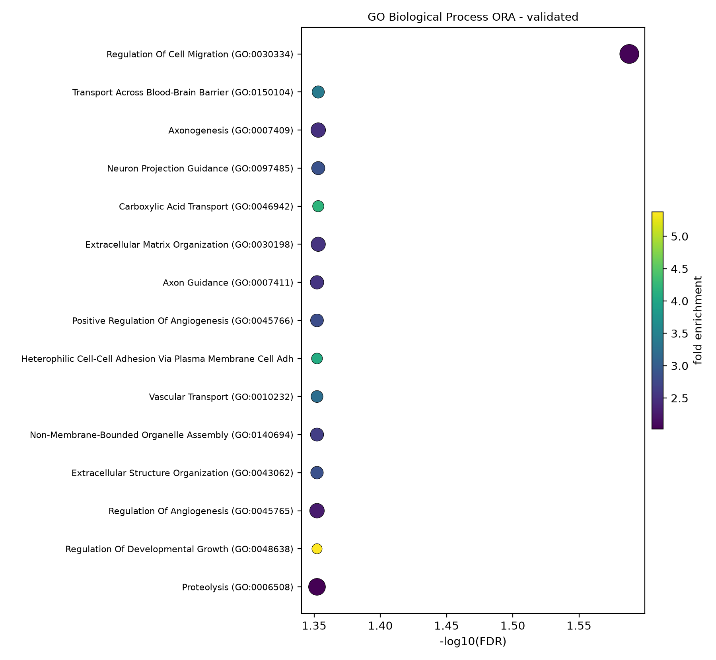
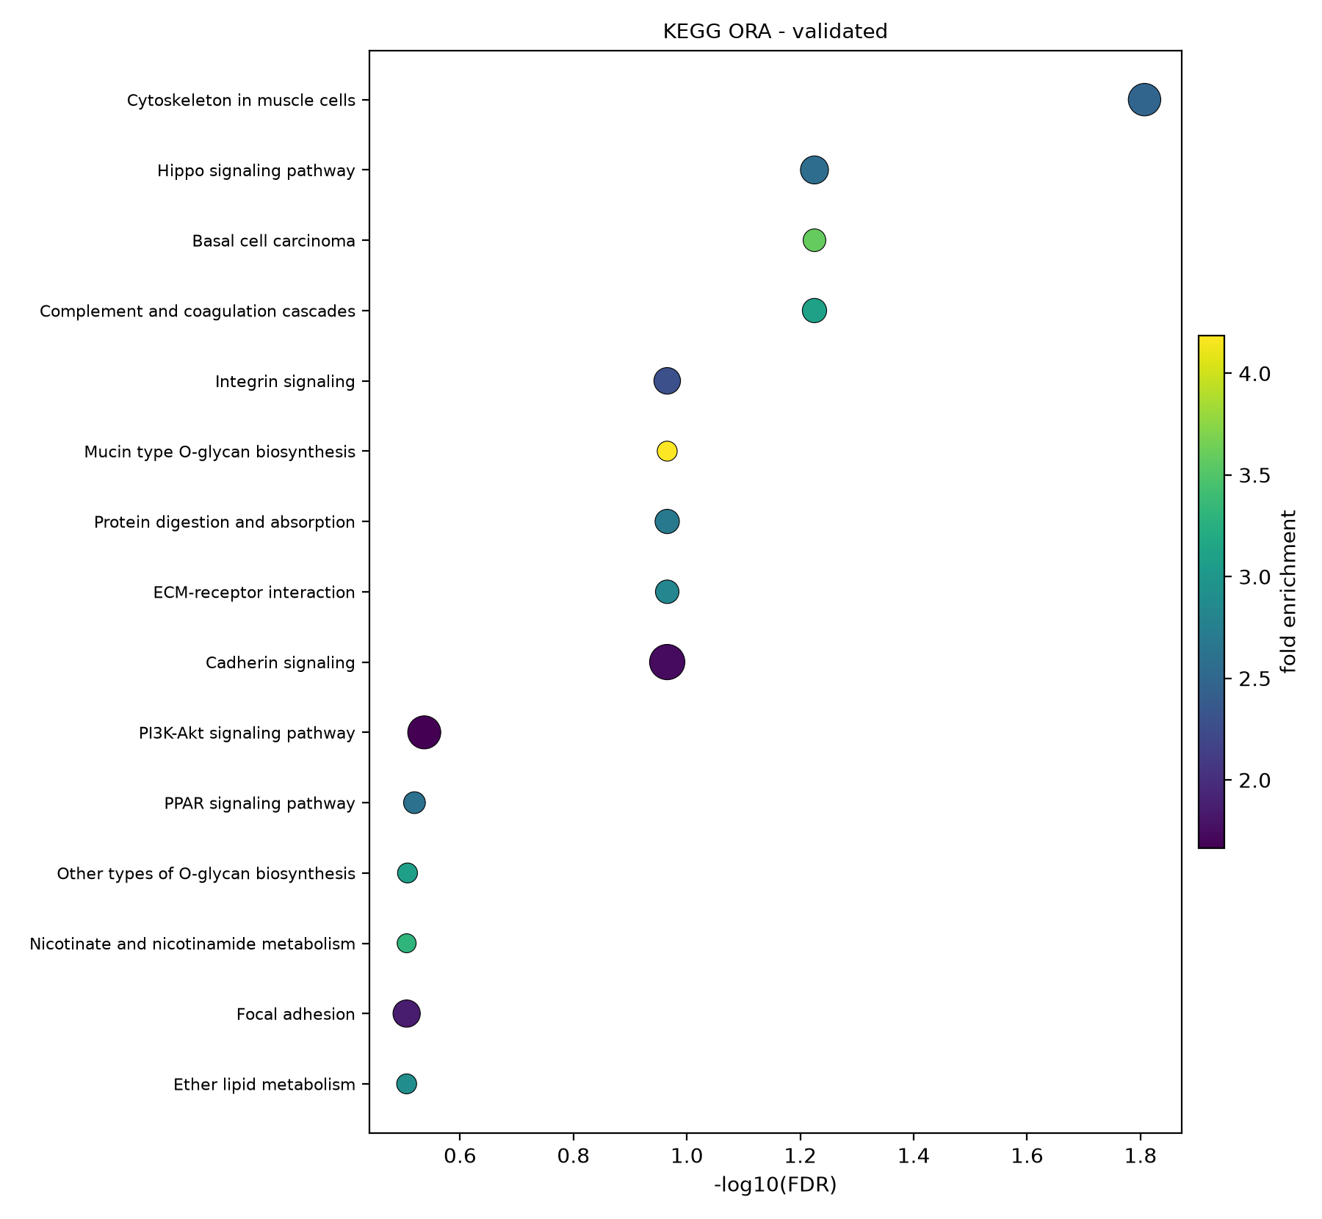
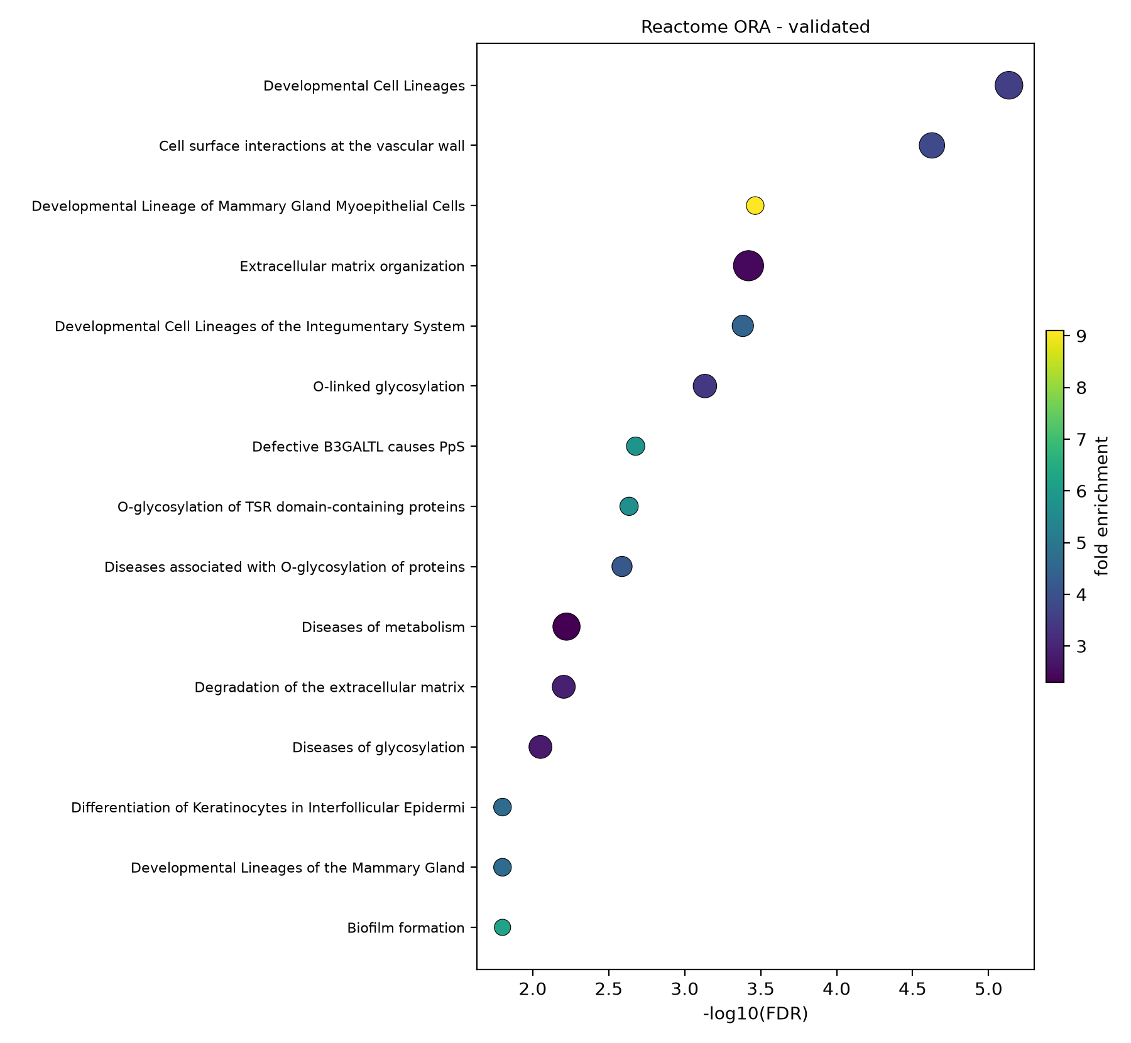
ANALYSIS
ORA of the validated signature (explicit background)
Fig 12 · Reactome
Fig 10 · GO Biological Process
Fig 11 · KEGG
Up: cell migration (FE 2.05), ECM organization (FE 2.53), cytokeratin/cytoskeleton (KEGG FE 2.48), developmental lineages (Reactome padj<0.001) · Down-side absent by construction (validated set is shared-direction).
Osimertinib-resistance transcriptomics · GSE202859 + GSE193258 · seed 42
13

Slide 14
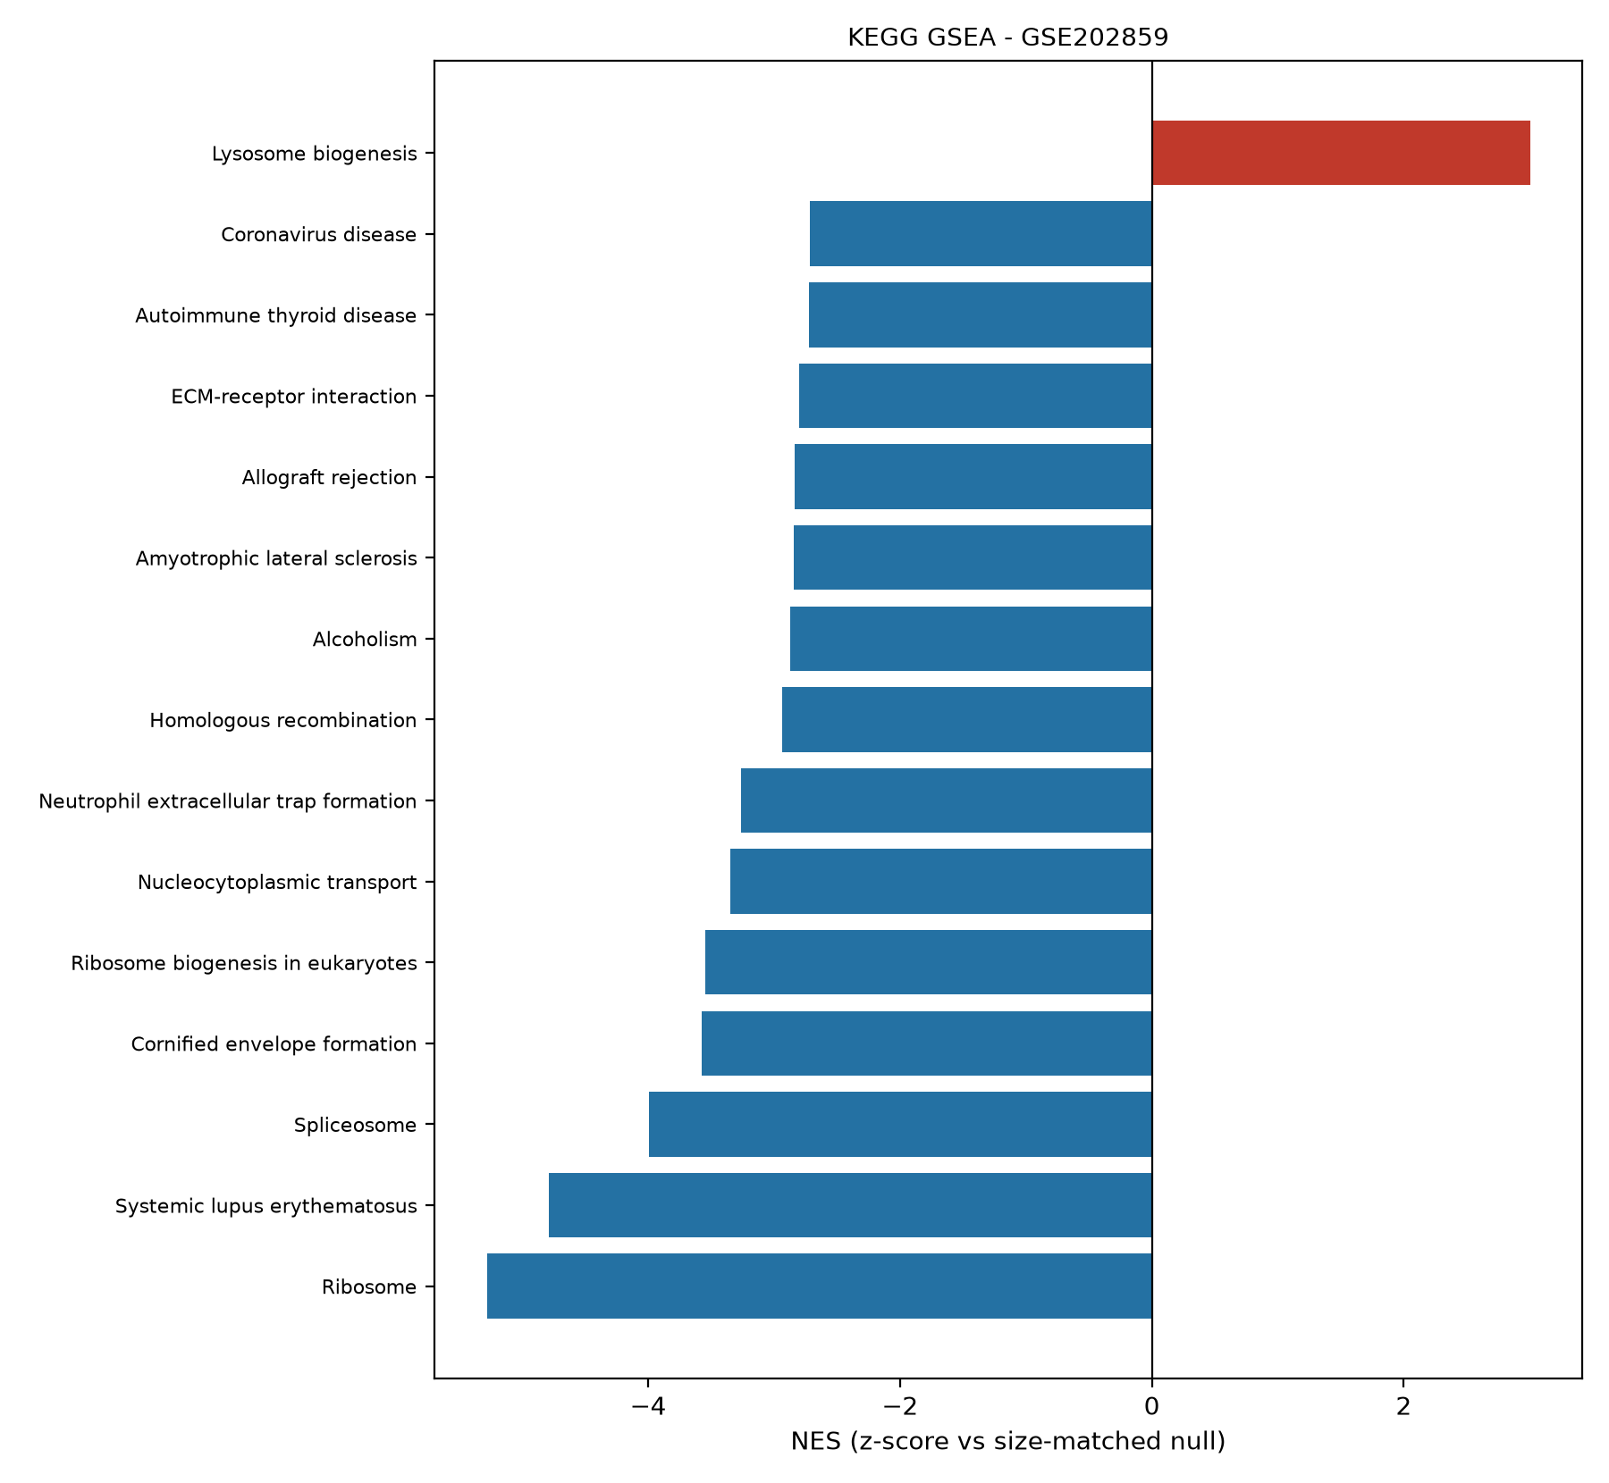
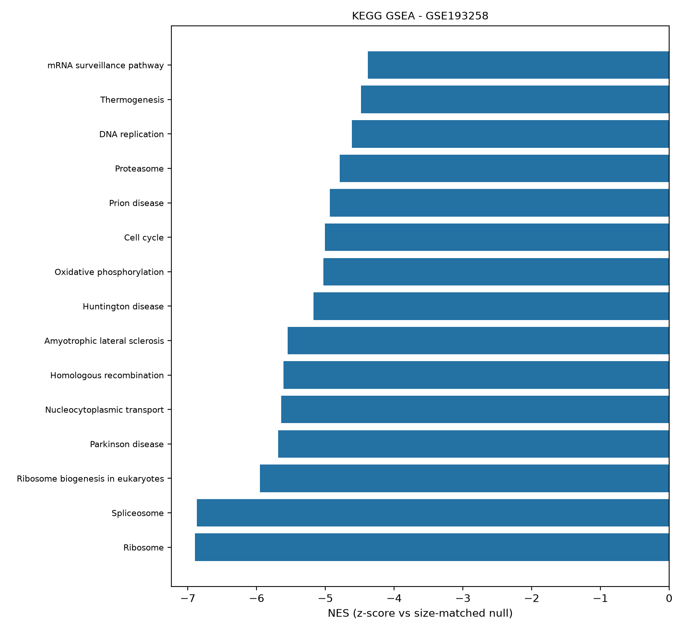
ANALYSIS
Pre-ranked GSEA: the loudest signal is a SHUTDOWN
Fig 20 · Running ES — discovery (Ribosome NES -5.28)
Fig 22 · Running ES — validation (Ribosome NES -6.89)
Ribosome
Spliceosome
Ribosome biogenesis
Persister state
NES -5.28 / -6.89
NES -3.99 / -6.87
NES -3.54 / -5.95
hypoproliferative, de-differentiated
Osimertinib-resistance transcriptomics · GSE202859 + GSE193258 · seed 42
14

Slide 15
ANALYSIS
Engine cross-check (D3): Python GSEA vs R fgsea
SAME ranked lists → SAME GMT files → two independent engines
▪ Python primary: size-bucketed permutation null (fast, approximate).
▪ R fgsea cross-check: exact multilevel p-values (bench-standard).
▪ Concordance = does the approximate null preserve the biology? Answer below.
ρ = 0.86
ρ = 0.70
ρ = 0.67
61-81%
NES — validation KEGG (347 sets)
NES — discovery KEGG (342 sets)
NES — discovery GO-BP (2,456 sets)
NES sign agreement
Read: strong hits concordant; tiny-|NES| sets flip sign freely (near-zero scores) → top-5 overlap partial (2-3 of 5). Influenced only by engine choice, never by the data — documented as a known nuance.
Osimertinib-resistance transcriptomics · GSE202859 + GSE193258 · seed 42
15

Slide 16
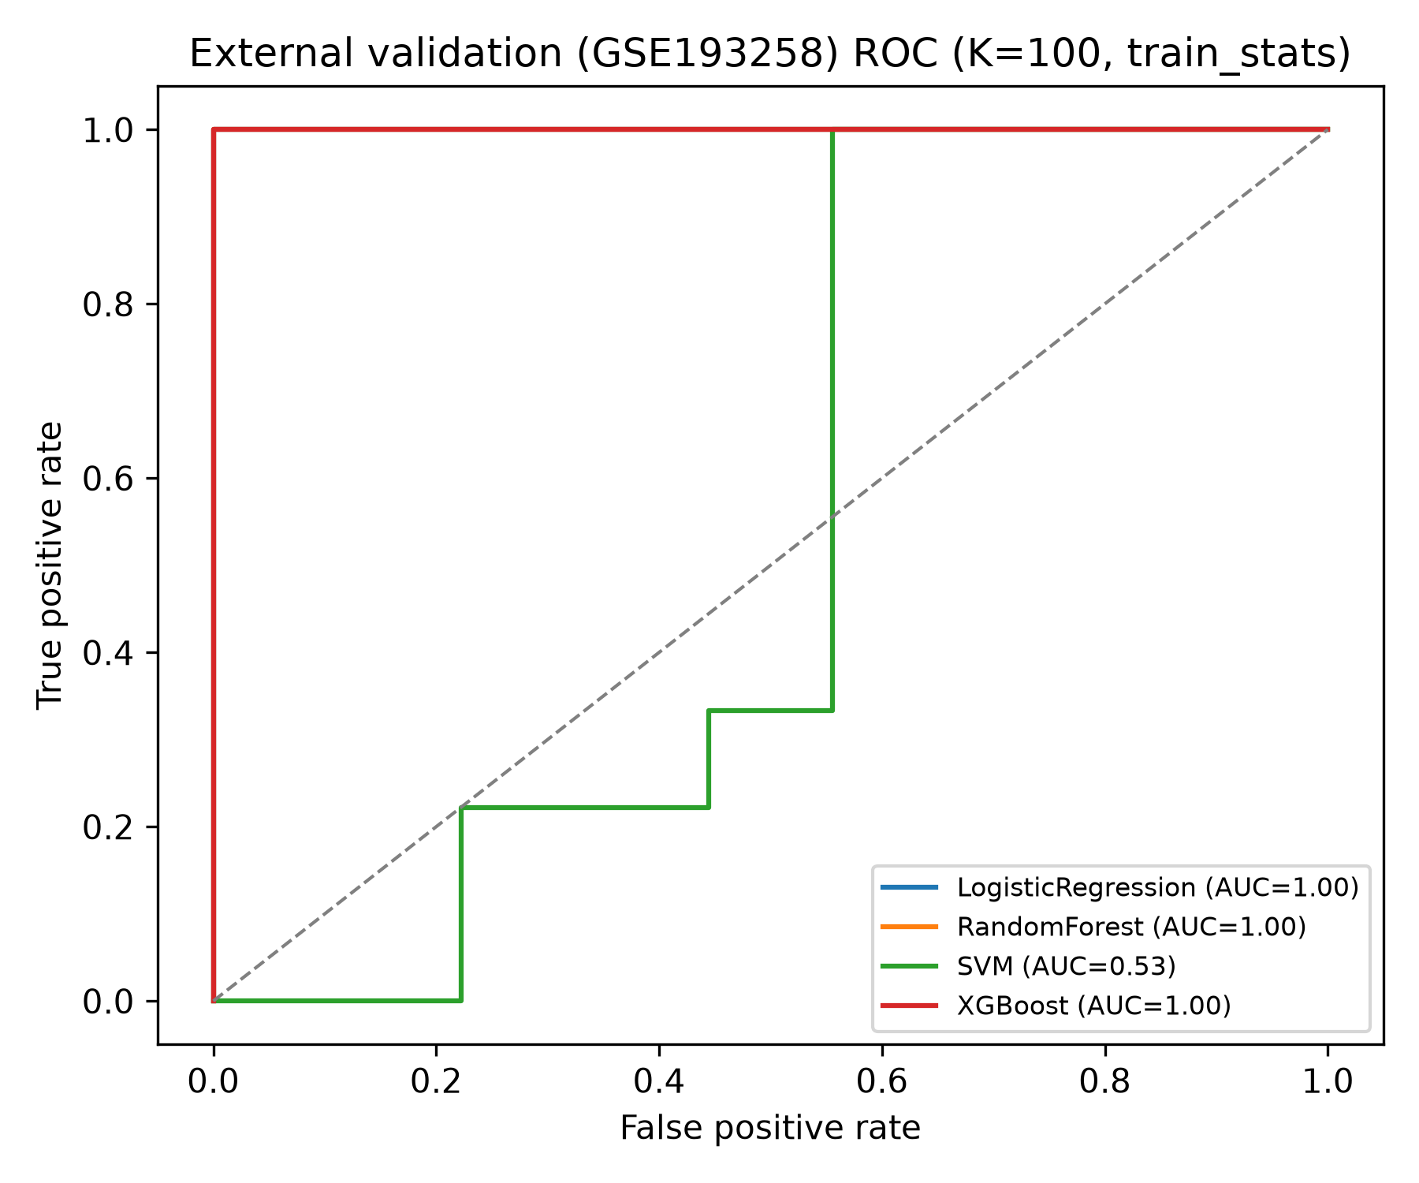
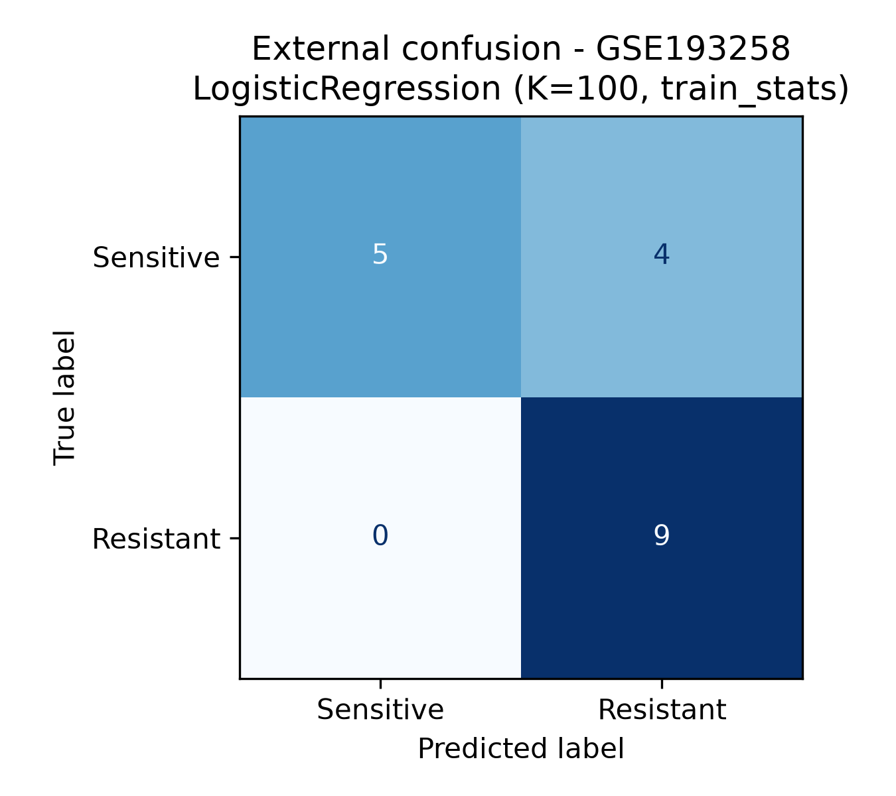
RESULTS
One-shot external validation (locked models, done once)
NUMBERS
▪ ROC-AUC 1.000 (1.000-1.000)
▪ PR-AUC 1.000
▪ Sens 1.000 — all 9 resistant called
▪ Spec 0.444 (4/9 sensitive above threshold)
▪ Brier 0.132 strict; 0.012 transductive bound
Fig 35 · Confusion @0.5
Fig 33 · ROC — LR K=50 (CI 1.000-1.000)
target_z (transductive) separation is PERFECT — reported only as an optimistic bound (D1), because it re-scales with the test cohort's own statistics.
Osimertinib-resistance transcriptomics · GSE202859 + GSE193258 · seed 42
16

Slide 17
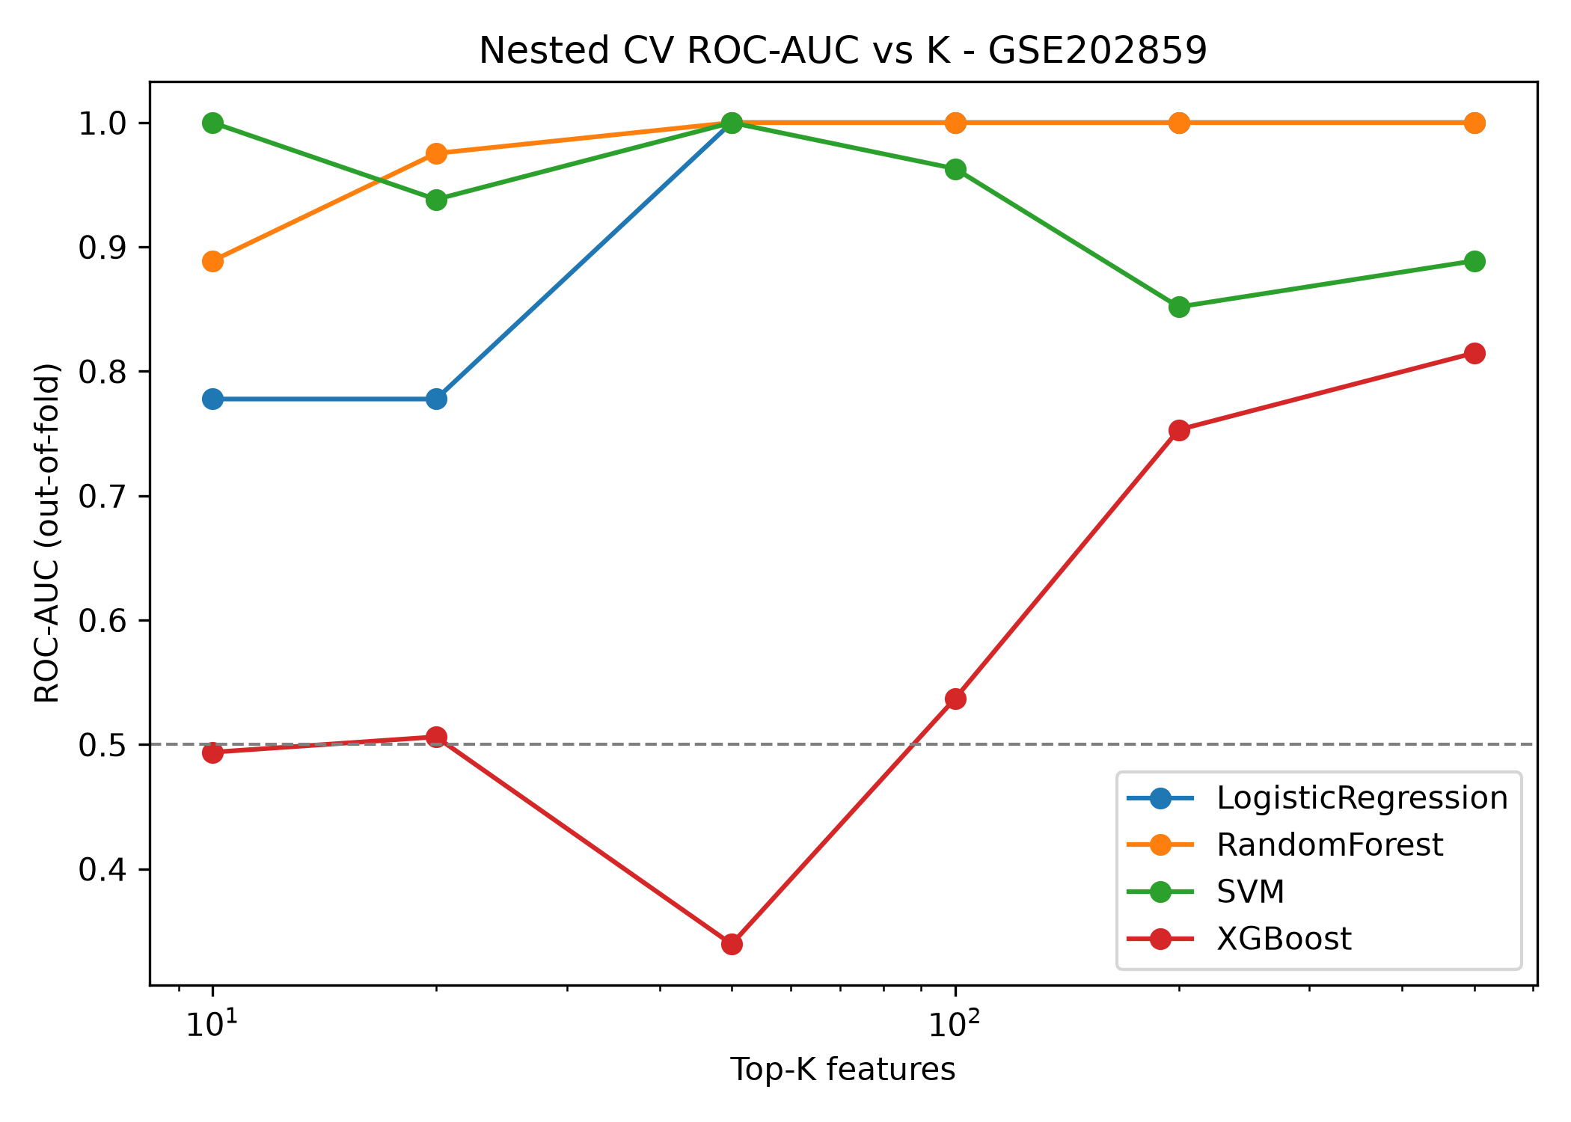
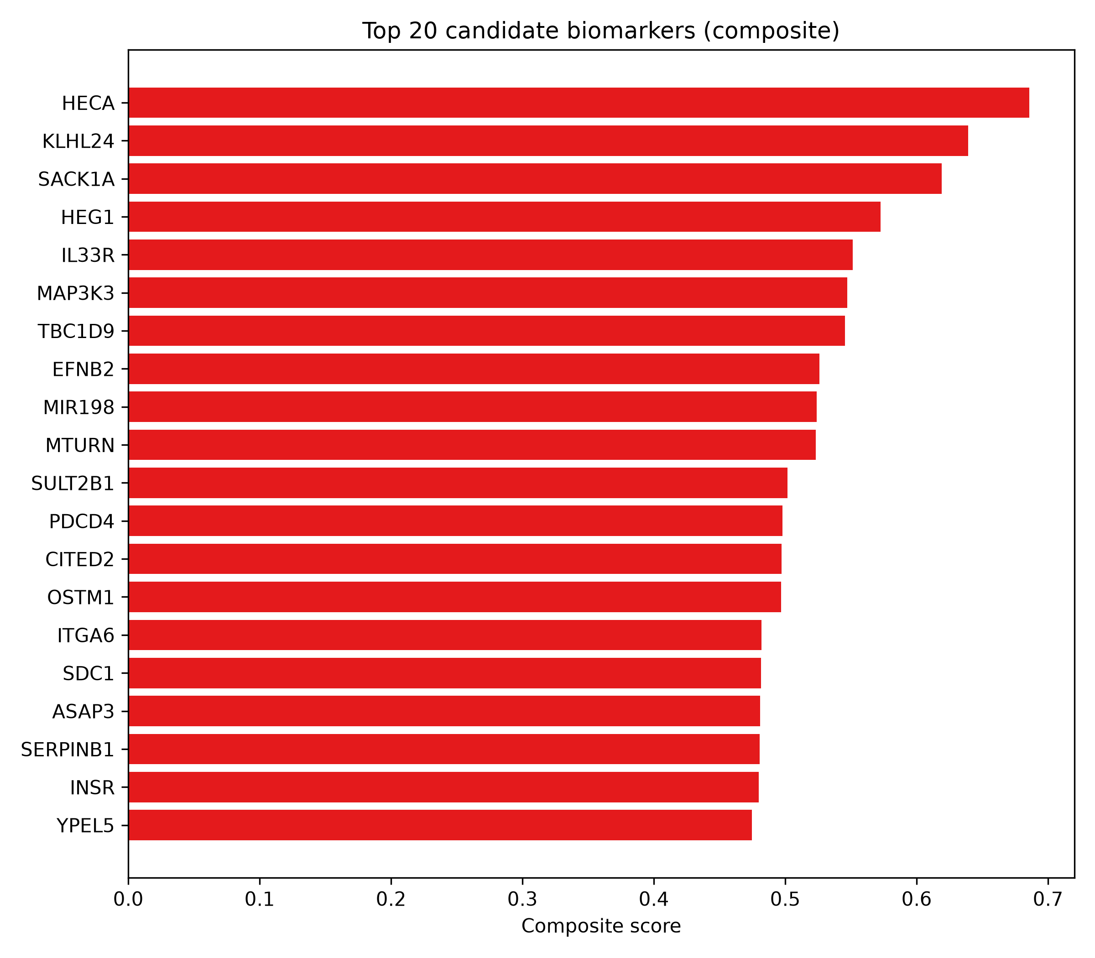
RESULTS
From 48 model x K cells to 100 candidate biomarkers
Fig 28 · AUC vs K — full exploratory surface (disc)
Fig 37 · Composite biomarker panel (stability+selection+SHAP)
Pre-registered primary = Logistic Regression K=50 (D2); every other cell shown with bootstrap CIs — no champion-cell cherrypicking.
Osimertinib-resistance transcriptomics · GSE202859 + GSE193258 · seed 42
17

Slide 18
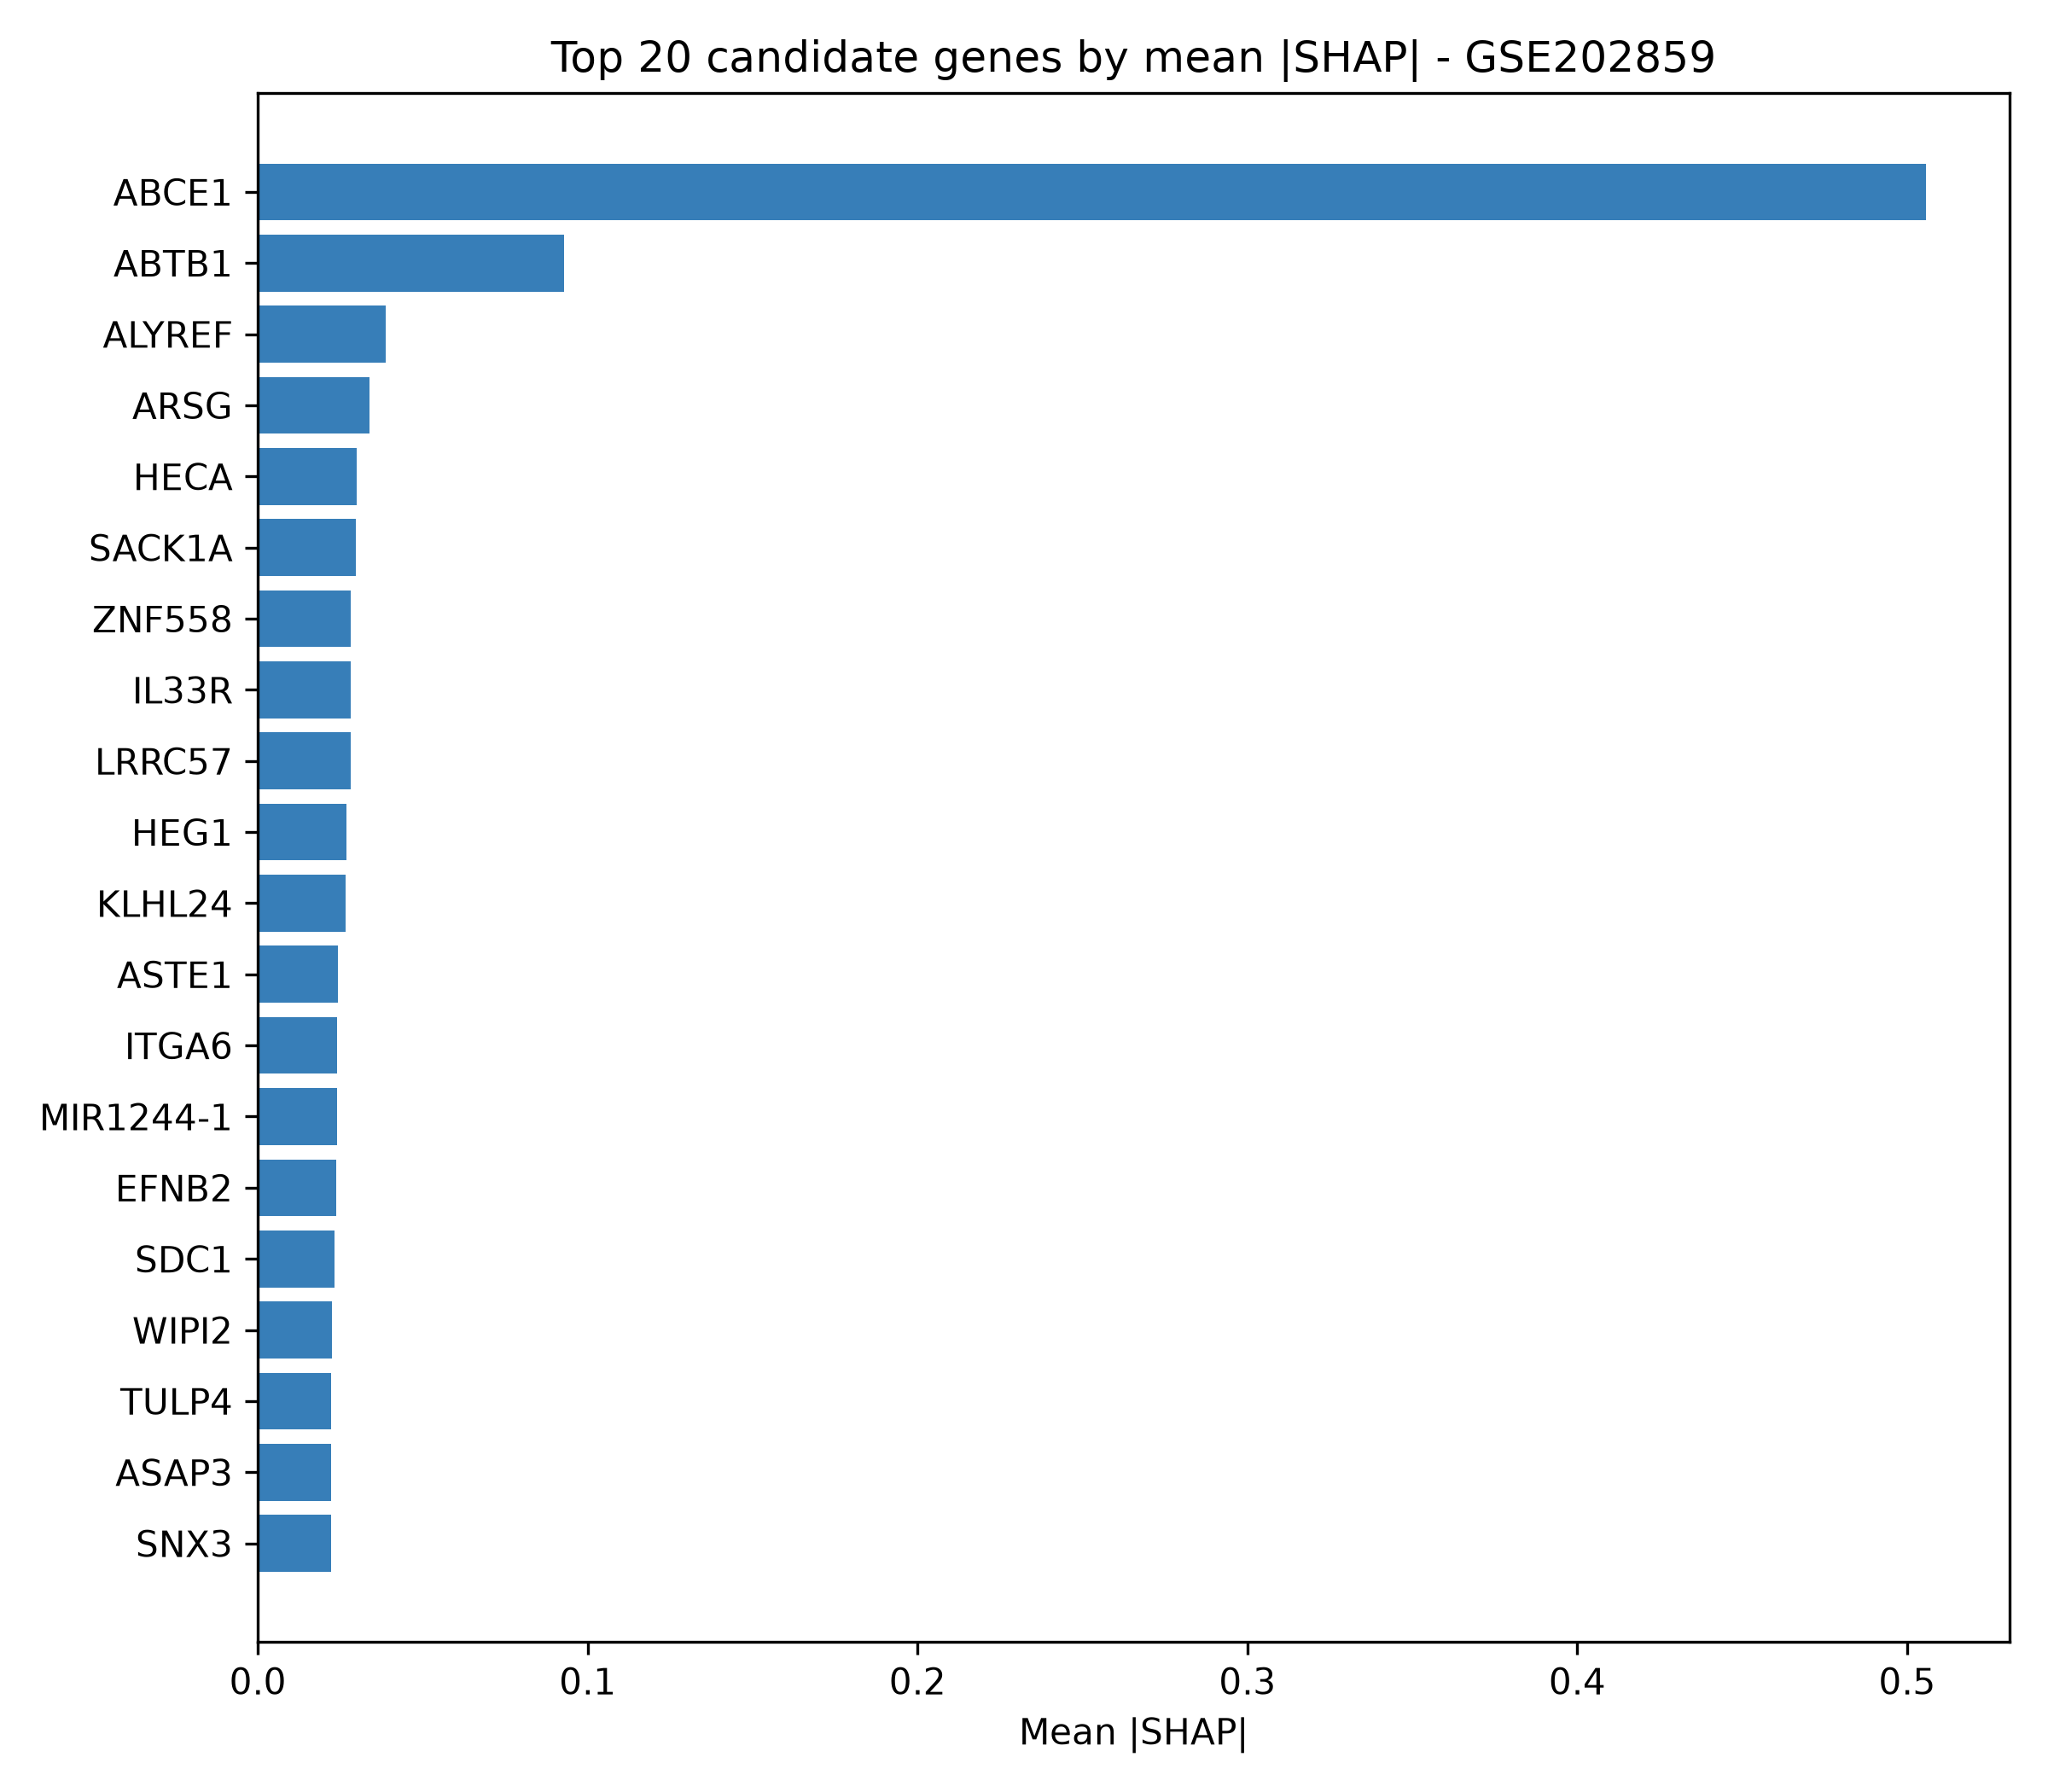
RESULTS
The head of the panel (stability = 1.000, nested-selection 0.44-0.83)
TOP-10 COMPOSITE-RANKED GENES
HECA · KLHL24 · SACK1A · HEG1 · IL33R · MAP3K3 · TBC1D9 · EFNB2 · MIR198 · MTURN
Claim discipline: candidates, not drivers. A few NCBI aliases (HECA, SACK1A, IL33R, MTURN) flagged for HGNC curation before any database deposit.
Fig 38 · SHAP attributions — tree interpreters (disc)
Osimertinib-resistance transcriptomics · GSE202859 + GSE193258 · seed 42
18

Slide 19
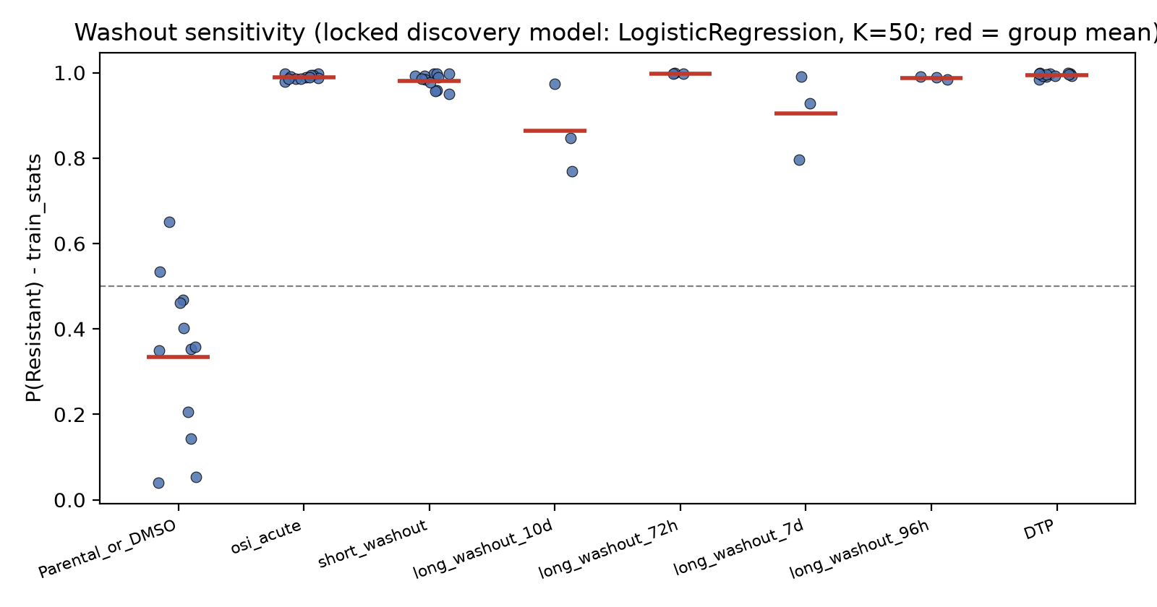
RESULTS
D7 · Drug-withdrawal probe: state-like, not mutation-like
P(Resistant) — transductive scheme
group | n | P(Res)
DMSO anchor | 12 | 0.05
osi_acute 24h | 12 | 0.68
DTP anchor | 12 | 0.80
washout 72h | 3 | 0.85
washout 96h | 3 | 0.65
washout 7d | 3 | 0.43
washout 10d | 3 | 0.30
Fig 39 · Locked LR K=50 applied to 42 excluded timecourse samples + 18 anchors
Strict scheme mirrors this gradient inside-cohort (anchors 0.34 / 0.99) — tables ship for both.
No accuracy claimed (D7). 10-day washout drifts to 0.30: partial reversal — consistent with persister-state biology.
Osimertinib-resistance transcriptomics · GSE202859 + GSE193258 · seed 42
19

Slide 20
DISCUSSION
What the two halves of the project agree on
BIOLOGY →
← ML
▪ Resistant cells look like LESS translation + MORE motility: ribosome/spliceosome strongly down; migration/ECM/lineage programs up.
▪ This is the persister (DTP) phenotype — slow-idling, plastic, chromatin-remodelled.
▪ Matches de Miguel's mSWI/SNF-EMT/NRF2 axis and Criscione's DTP landscape — our discovered enrichment patterns reproduce both.
▪ Ranking transfers perfectly (AUC 1.000): the two states are transcriptionally far apart — a fact there's no surprise about, and honest to show.
▪ Calibration does NOT transfer perfectly under strict scaling (specificity 0.444): the DTP vs -OR endpoint shift moves the sensitive distribution.
▪ Washout gradient in BOTH schemes says the learned signature tracks drug-exposure state in the expected direction — partially reversible.
Osimertinib-resistance transcriptomics · GSE202859 + GSE193258 · seed 42
20

Slide 21
DISCUSSION
Stated limitations — all individually acknowledged
n = 18 per cohort, 3 lines
every performance figure is exploratory; the wide specificity CI (0.11-0.78) is the honest symptom.
Endpoints differ (-OR vs DTP)
treated as a distribution shift, never hidden; calibration, not ranking, is what breaks.
Cell lines ≠ patients
no immune microenvironment, no patient dosing — no clinical claims.
One-shot external validation
model/threshold locked BEFORE the read; any post-lock change would invalidate the confirmatory value.
ORA universe choice
conservative per-source background (D10); moderate hits may be under-reported.
Symbol aliases in panel
HECA/SACK1A/IL33R/MTURN need HGNC curation before database deposition.
Osimertinib-resistance transcriptomics · GSE202859 + GSE193258 · seed 42
21

Slide 22
CONCLUSION — five take-homes
1
A 1,112-gene cross-cohort signature of osimertinib resistance (87% directional concordance) is robust across two independently produced studies.
2
Its biology is persister-like: translation machinery OFF, migration/ECM/lineage-plasticity programs ON (NES to -6.9).
3
Two GSEA engines (Python + fgsea) agree (rho 0.70-0.86) — the biology is not an implementation artefact.
4
A pre-registered, leakage-safe linear classifier transfers one-shot to an untouched cohort (ROC-AUC 1.000, sens 1.000; wide, honestly-reported specificity).
5
Drug withdrawal reverts the learned signal toward sensitive (0.80 → 0.30 by day 10): resistance here is state-like and partially reversible — a candidate-biomarker story, never a clinical one.
Osimertinib-resistance transcriptomics · GSE202859 + GSE193258 · seed 42
22

Slide 23
REFERENCES
▪ de Miguel FJ, et al. (2023) Cancer Cell 41(8):1516-1534.e9 — PMID 37541244 · DOI 10.1016/j.ccell.2023.07.005 · GSE202859 primary.
▪ Criscione SW, et al. (2022) npj Precision Oncology 6:95 — PMID 36575215 · DOI 10.1038/s41698-022-00337-w · GSE193258 primary.
▪ Blaquier JB, et al. (2023) Clin Cancer Res 29(18):3579-3591 — DOI 10.1158/1078-0432.CCR-22-1912.
▪ Love MI, Huber W, Anders S (2014) Genome Biology 15:550 — DESeq2.
▪ Subramanian A, et al. (2005) PNAS 102(43):15545-15550 — GSEA.
▪ Korotkevich G, et al. (2021) bioRxiv 060012 — fgsea.
▪ Kuleshov MV, et al. (2016) NAR 44(W1):W90-W97 — Enrichr GMT.
▪ Gillespie M, et al. (2022) NAR 50(D1):D697-D705 — Reactome.
▪ Kanehisa M, et al. (2023) NAR 51(D1):D587-D592 — KEGG.
▪ Barrett T, et al. (2013) NAR 41(D1):D991-D995 — NCBI GEO.
▪ Varma S, Simon R (2006) BMC Bioinformatics 7:91 — nested-CV bias.
▪ Pedregosa F, et al. (2011) JMLR 12:2825-2830 — scikit-learn.
▪ Chen T, Guestrin C (2016) KDD '16:785-794 — XGBoost.
▪ R Core Team (2024) R — statistical computing.
Pipeline provenance: scripts/01-03 (R) · 03b-08 (Python) · 02b/10 (D7 washout) · 09_upset · config/config.yaml · docs/decisions.md · results/reports/session_info.txt
Osimertinib-resistance transcriptomics · GSE202859 + GSE193258 · seed 42
23

