Slide 1
CS523 Final Project
Huu Viet Nguyen

Slide 2
Problem Statement
Need to analyze trends from Twitter? for example, #ETH hashtag.
Need for a Big Data pipeline.
Gather Data, Store Data, Analyze Data to discover Insights.
Fast, Fault-tolerant System solution.

Slide 3
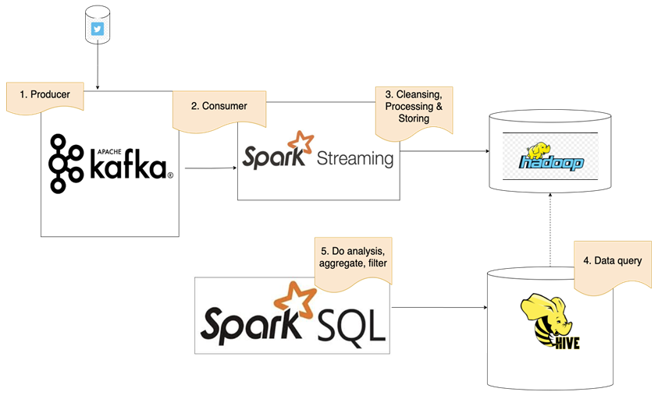
Architecture Diagram

Slide 4


Data Extraction Twitter API & Kafka Producer
Get Twitter keys and tokens
Read tweets and send to Kafka topics

Slide 5

Data Transformation Kafka Consumer & Spark Streaming
Create Streaming Context
Set Kafka Parameters
Prepare Data

Slide 6

Data Load Spark Streaming & HDFS
Save Data in HDFS

Slide 7
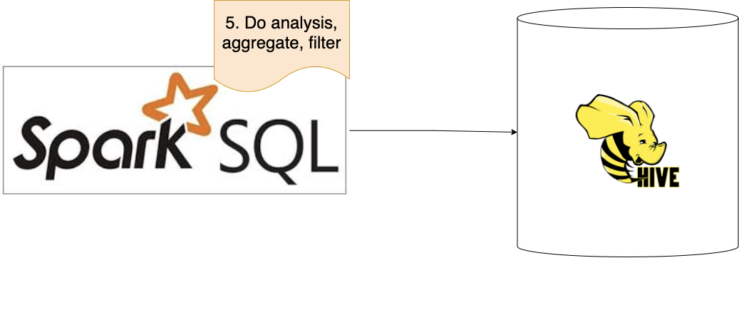
Data Analyse Spark SQL & Hive
SparkSession makes ready to work on Hive
Rolling data from HDFS and it ready for Hive
Preparing data with SQL
Aggregate data with SQL
Processing with SQL

Slide 8
Reference links
https://fastnforward.blog/create-twitter-app-java-kafka-producer-to-stream-twitter-data/
https://towardsdatascience.com/spark-streaming-for-beginners-a0170113e479
https://www.conduktor.io/kafka/how-to-install-apache-kafka-on-linux
https://medium.com/analytics-vidhya/twitter-streaming-with-apache-kafka-ea0e2f44181e
https://towardsdatascience.com/using-kafka-to-optimize-data-flow-of-your-twitter-stream-90523d25f3e8
https://developer.hpe.com/blog/spark-streaming-with-hbase/

Slide 9
THANK YOU!

