Slide 1
CS523 Final Project
Huu Viet Nguyen

Slide 2
Problem Statement
Need to analyze trends from Twitter? for example, #ETH hashtag.
Need for a Big Data pipeline.
Gather Data, Store Data, Analyze Data to discover Insights.
Fast, Fault-tolerant System solution.

Slide 3
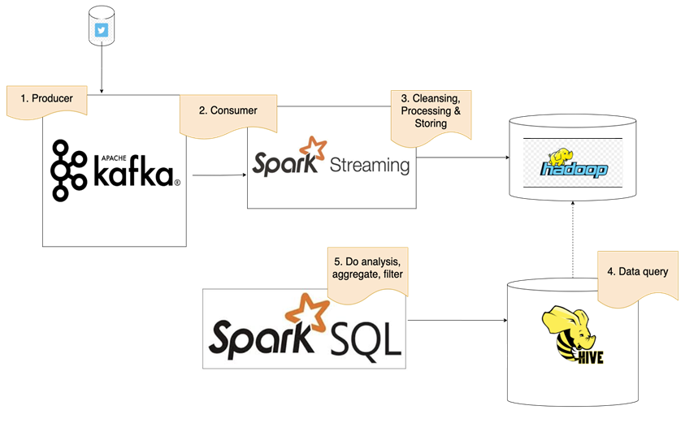
Architecture Diagram

Slide 4


Data Extraction Twitter API & Kafka Producer
Get Twitter keys and tokens
Read tweets and send to Kafka topics

Slide 5

Data Transformation Kafka Consumer & Spark Streaming
Create Streaming Context
Set Kafka Parameters
Prepare Data

Slide 6

Data Load Spark Streaming & HDFS
Save Data in HDFS

Slide 7
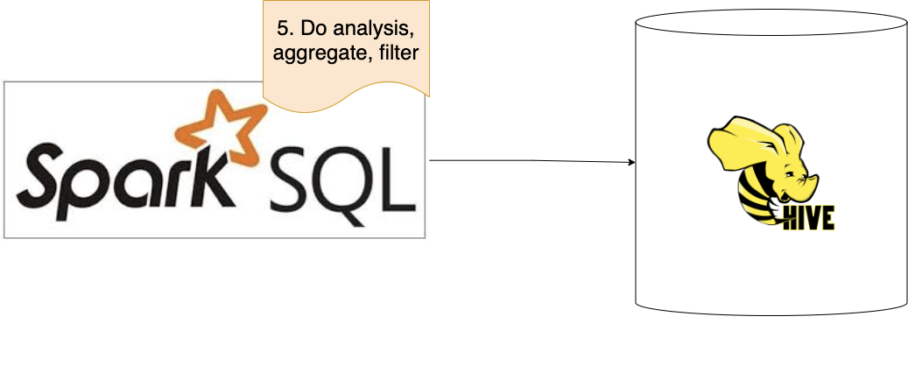
Data Analyse Spark SQL & Hive
SparkSession makes ready to work on Hive
Rolling data from HDFS and it ready for Hive
Preparing data with SQL
Aggregate data with SQL
Processing with SQL

Slide 8
THANK YOU!

