Slide 1
PCR
Immunology – Lab 1
Leonard Mada
Immunology. V Babes University of Medicine & Pharmacy. Timisoara

Slide 2
PCR: Introduction
Polymerase Chain Reaction:
Amplification of a specific DNA region using polymerase;
History:
Developed in 1983 – 1985; Nobel for Chemistry (1993);
Mullis & Fallona: Specific Enzymatic Amplification of DNA in vitro: The Polymerase Chain Reaction. (1986)
Veritasium: https://www.youtube.com/watch?v=zaXKQ70q4KQ

Slide 3
PCR: Exponential Amplification
…
…
…
…
Amplified Fragment
+
...
after 10 Cycles
…
2^10 = 1024 copies!
…
…
…

Slide 4
PCR: Characteristics
Advantages:
Rapid: 2 hours;
Simple: very simple lab procedures;
Apparatus: only 1 specialized device (thermocycler);
Reagents: + 2 primers (oligonucleotides) – must be synthesized;
Applications:
Selective amplification of DNA: eg. gene fragment;
Sequence: known or unknown; any organism;

Slide 5
PCR: Method
Steps:
Step 1: DNA Extraction (1 hour – hours)
Step 2: Amplification (PCR); (2 h)
Step 3: Visualization of amplified fragment; (1-2 h)
Variants:
RNA => rtPCR (reverse-transcription PCR);
Qantitative: qPCR / real-time PCR;

Slide 6
PCR: Method
Step 1: DNA Extraction
Source: blood, tissues, cell culture, bacteria, sputum, other;
Quantity: a few DNA molecules; (1 nano-g DNA)
Genome: DNA can be fragmented;
Extraction: Commercial kits (e.g. cell lysis, etc);
Variant: rtPCR (reverse transcription PCR)
RNA => revers-transcriptase => cDNA => dsDNA=> PCR;
Source: viral RNA or mRNA (transcriptomics);

Slide 7
PCR: Method
Step 2: Amplification
Exponential growth of amplified DNA fragment;
1 molecule => 2^30 molecules ≈ 1 billion;
Warning: cannot quantify initial quantity!
Variants:
rtPCR: RNA => revers-transcriptase => cDNA;
qPCR: quantitative PCR = real-time PCR;

Slide 8
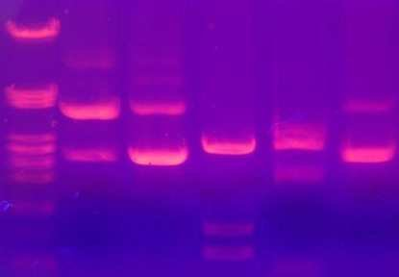
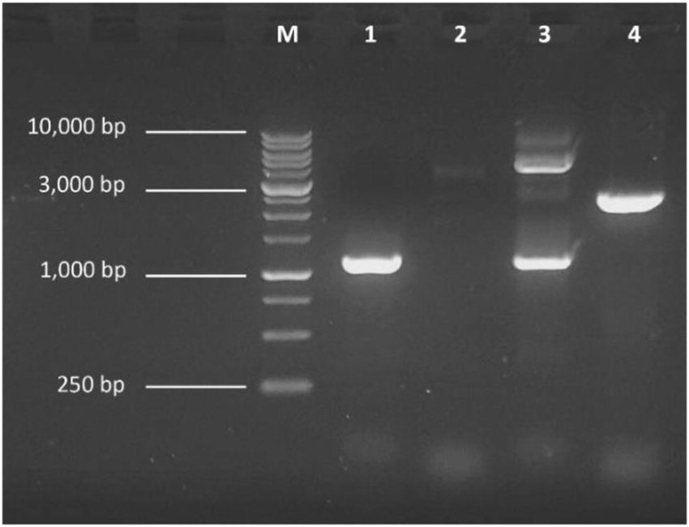
PCR: Method
Step 3: Visualization
Gel Electrophoresis: separation of DNA fragments; (1-2 h)
Agarose: 0.5% - 1% - 1.5%; (classic)
UV: ethidium bromide (carcinogen)!
DNA
Ladder

Slide 9
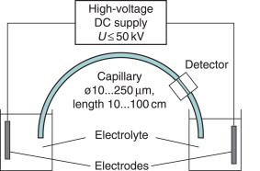
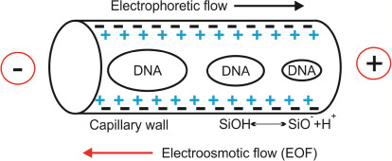
PCR: Method
Step 3: Capillary Electrophoresis
Primers marked w. fluorophore;
Fast: 10,000 V and more;
Minimal DNA quantity;

Slide 10
PCR: Method
Step 3: Visualization
Other methods:
Hybridization w. labeled probes (are similar to primers);
  Specific oligonucleotides: high specificity!
Radioactive labeling: auto-radiography; (rare)
  in general not necessary: sufficient amplification by PCR!
  PCR may be used to synthesize RX probes;

Slide 11
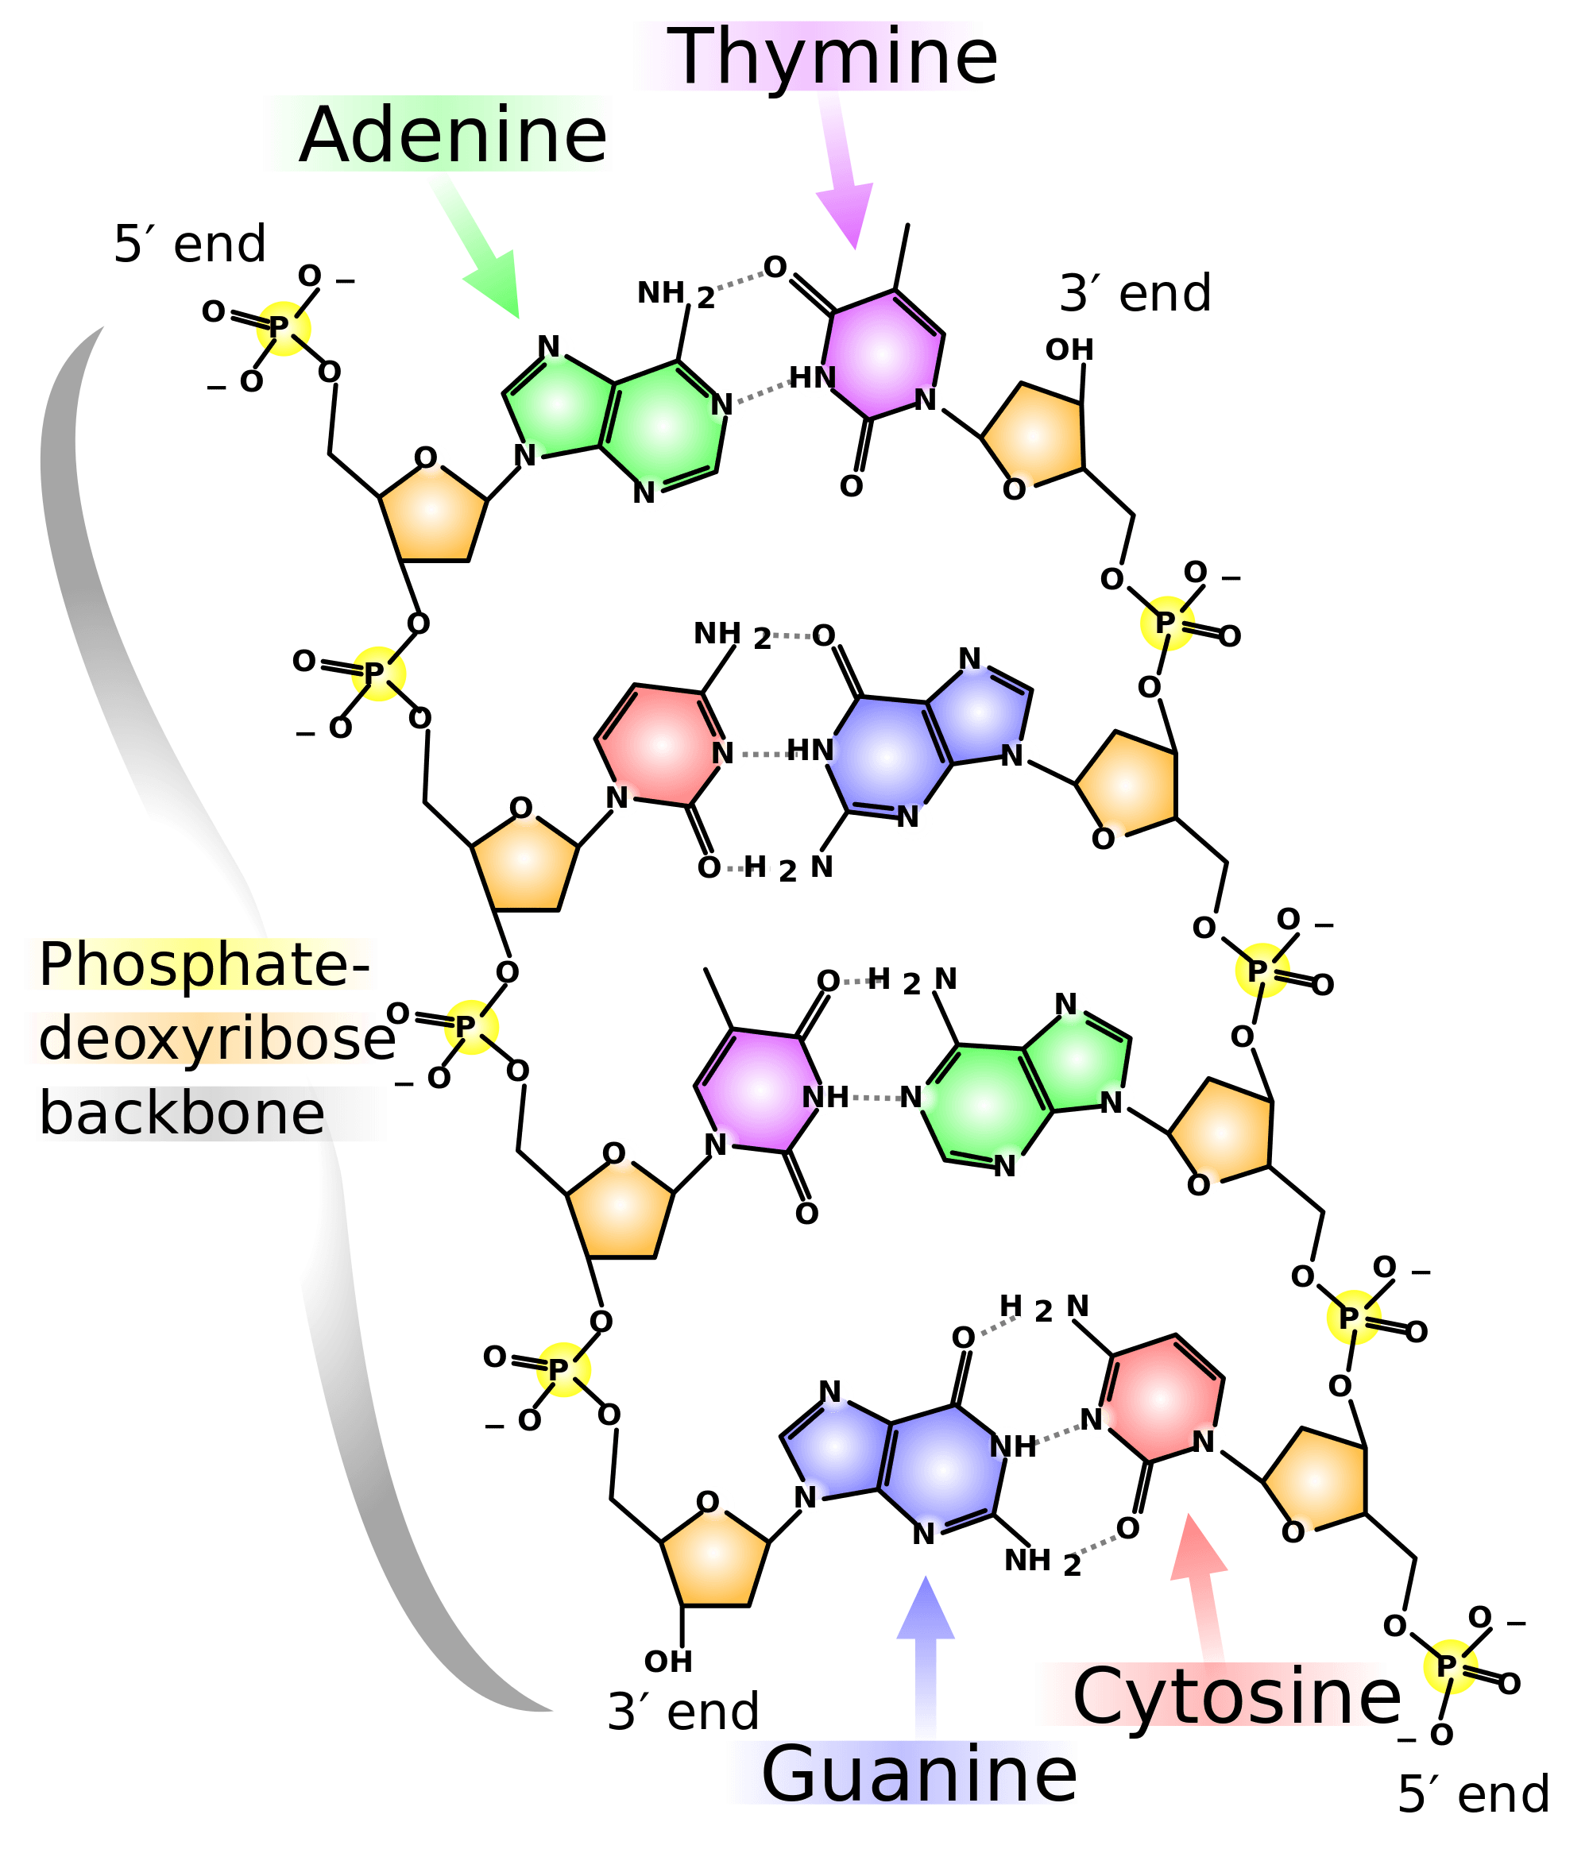
Biochemistry
Nucleotides:
Purines: G, A
Pyrimidines: C, T
Pairs: H-bonds
G C
A T

Slide 12
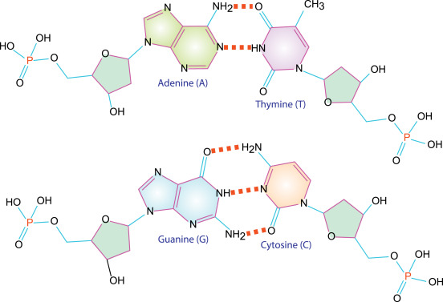
PCR: Base Pairs
Nucleotides:
A T
d-Ribose
G C
1’
Hydrogen bonds

Slide 13
PCR: DNA Structure
2 Complementary strands: G vs C, A vs T;
Orientation: 5’ => 3’
5’ 3’
DNA synthesis
G C G G C T G A G A G A
used as Template
C G C C G A C T C T C T
3’ 5’

Slide 14
PCR: Technique
PCR: 1 Cycle
Step 1: Denature DNA; 92 – 95º C;
Step 2: Hybridize primers; 40 – 65º C;
Step 3: Extend primers; 68 – 72º C;
Repeat cycle: 30 cycles;
Extra Steps:
Denaturation: 2 minutes (before Cycle 1);
Extension: 2 minute (after last Cycle);

Slide 15
PCR: Mechanism
P 2
Denaturing
Hybridizing
Elongation
Repeat
Annealing
Primer 1
Taq-Polymerase

Slide 16
PCR: Technique
Step 1: DNA Denaturing
Temperature: 92 – 95º C;
Duration: ~ 30 seconds;
Before first cycle: 1 – 2 minutes;
...G C G G C T G A G A G A...
...C G C C G A C T C T C T...

Slide 17
PCR: Technique
Step 1: DNA Denaturing
Temperature: 92 – 95º C;
Duration: ~ 30 seconds;
Before first cycle: 1 – 2 minutes;
Separation of the 2 strands
...G C G G C T G A G A G A...
...C G C C G A C T C T C T...

Slide 18
PCR: Technique
Step 2: Hybridization of Primers
Temperature: depends! (40 – 65º C)
Duration: ~ 30 seconds;
...G C G G C T G A G A G A...
C T C T C T P1
5’ 3’
3’ 5’
P2 G C G G
...C G C C G A C T C T C T...

Slide 19
PCR: Technique
Step 2: Hybridization of Primers
Temperature: depends! (40 – 65º C)
Duration: ~ 30 seconds;
Primers:
Excess in reaction mixture;
...G C G G C T G A G A G A...
C T C T C T P1
3’ 5’
C T C T C T P1
C T C T C T P1

Slide 20
PCR: Technique
Primers:
Length: 15 – 25 Nts;
Temperature: depends!
G+C: ~ 50%;
Synthesized chemically;
Suppliers on web;
Tm similar for both;
5’ 3’
...G C G G C T G A G A G A...
C T C T C T P1
3’ (5’)

Slide 21
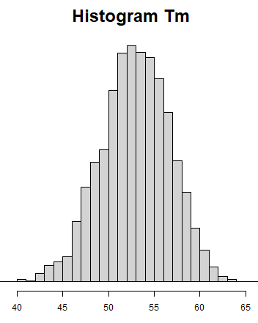
PCR: Primers
Tm of Primers: depends
Tm = melting temperature;
Sequence (neighboring Nt);
Ionic concentration!
G: 4
A: 4
C: 4
T: 4
NE Biolabs: Q5 60º C;
NE Biolabs: OneTaq 46º C;
Detailed formula: 61.5º C;
AAAACCCCGGGGTTTT
Tm (º C)

Slide 22
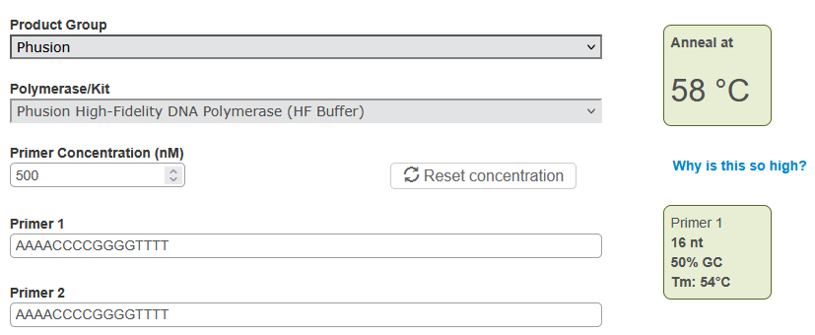
PCR: Primers
Temperature of Primers: depends
NE Biolabs
AAAACCCCGGGGTTTT
https://tmcalculator.neb.com/#!/main

Slide 23
PCR: Primer Problems
Problems / Troubleshooting:
NO amplified fragment:
  Hybridization T: too high;
  Other causes: NO genetic material, Pol-inhibitors?
Nonspecific amplification;
  Multiple fragments, blurred bands;
  Hybridization T: too low;
False Positives: DNA Contamination?
# Pol-inhibitors: e.g. phenol (used in extractions);

Slide 24
PCR: Technique
Polymerase:
Taq: most frequent;
Pfu, others;
Step 3: Elongation
Temperature: 72º C;
Duration: ~ 1 minute / kb;
...G C G G C T G A G A G A...
C T C T C T P1
Polymerase
P2 G C G G
...C G C C G A C T C T C T...

Slide 25
PCR: Polymerase Enzyme
Taq: most frequent
Thermophilus aquaticus: in “hot springs” (thermal water);
Temperature: 72º C (optimal: 75 – 80º C);
Rate: ~ 100 bp / s (at 72º C);
  only 60 bp / s (at 70º C);
Stability: T1/2 = 40 min (at 95º C);
  Drops rapidly at higher temperatures;
Other polymerases: Pfu (Pyrococcus furiosus);
NO proof-reading!
For proof-reading

Slide 26
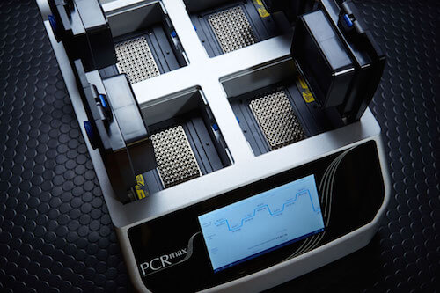
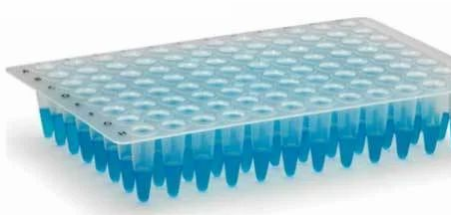
PCR: Thermocycler
Metallic plate:
Rapid changes of temperature!

Slide 27
PCR: Time to Run
PCR Cycle:
Step 1: Denaturation of DNA; 92 – 95º C; 30 s
Step 2: Hybridization of primers; 40 – 65º C; 30 s
Step 3: Extension of primers; 68 – 72º C; 1 min.
Repeat: 30 cycles;
Total Time: ~ 2 hours
30 * 2 min = 60 min;
additional + 5 min (pre-/post-) + pre-heating/cooling;

Slide 28
PCR: DNA Amplicon
Initially: Exponential amplification
Each cycle: doubling of product;
Repeat: 30 cycles => 2^30 ≈ 1 billion;
In time:
Leveling off: reagents are consumed;
Plateau: depletion of reagents (dNTP, primers);
Taq polymerase: activity drops after 30 cycles;
# Product = also called amplicon;

Slide 29
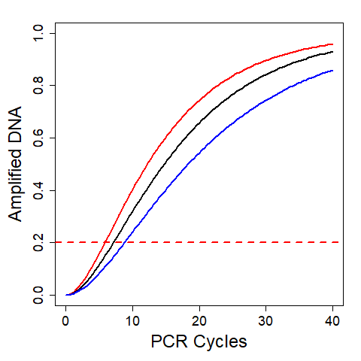
PCR: DNA Amplicon
In time:
Leveling off: reagents get consumed;
Plateau: depletion of reagents (dNTP, primers);
Taq polimerase: activity drops after 30 cycles;

Slide 30
PCR: Special Variants

Slide 31
PCR: Special Variants
Reverse Transcription PCR (rtPCR):
Step 0: Revers transcription;
RNA => cDNA => ds cDNA => PCR on DNA;
Applications:
Viral RNA: diagnosis of viral infections (ex. Covid, HCV);
Transcriptomics: active genes => mRNA;

Slide 32
PCR: Special Variants
Quantitative PCR (qPCR):
qPCR = Real Time PCR;
Starting Material: frequent mRNA
(rt-qPCR in Transcriptomics);
Principles:
Visualization of amplicon in real time;
Fluorophores: various types;

Slide 33
qPCR: Quantitative PCR
Quantifying DNA:
When to measure?
In time:
Leveling off: reagents consumed;
Plateau: reagents depleted (dNTP, primers);

Slide 34
qPCR: Quantitative PCR
Plateau
Quantifying DNA:
When to measure?
Continuously: Real-time
Detectable signal: when above threshold;
Cycle threshold (CT): number of cycles to cross threshold;
Weak initial signal
Threshold
Non-detectable

Slide 35
qPCR: Quantitative PCR
Principles:
Visualization of amplicon in real time;
Cycle threshold (CT):
number of cycles to cross threshold;
Fluorophores: various types;

Slide 36
Quantitative PCR
Fluorophores
SYBR Green:
Intercalates between DNA strands;
DNA Probes, FRET:
Primers marked w. fluorophore;
Spatial Proximity =>
Energy Transfer (ET);
dsDNA
nonspecific binding
Excitation
Emission
Donor
Acceptor
Navarro E et al. Real-time PCR detection chemistry. Clin Chim Acta. 2015

Slide 37
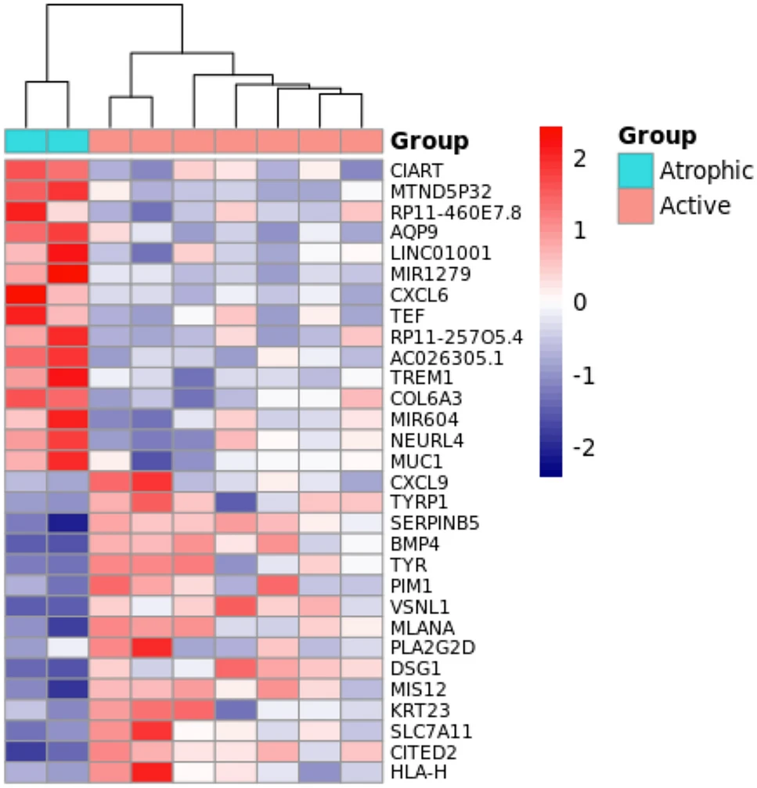
qPCR: Transcriptomics
Differential Gene Expression:
Upregulated genes;
Downregulated genes;
de Guimarães et al. Transcriptomics and network analysis highlight potential pathways in the pathogenesis of pterygium. (2022)

Slide 38
PCR: Applications

Slide 39
PCR: Applications
Medicine:
Diagnostics: genetic or infectious diseases;
Monitoring: quantifying HIV virus, genotyping;
Molecular Biology / Biotechnologies:
Multiple applications: cloning of genes, etc;
Forensics:
Identification of persons, paternity test, etc;

Slide 40
Forensics: Short Tandem Repeats
Short Tandem Repeats (STR):
Short DNA sequence: 2 – 6 bp, ex (GATA) or (TCTA);
Variable repetitions in population: 3 – 20 times;
Note:
each individual can be homozygot or heterozygot;
Subject 1
Subject 2
Subject 3
PCR
...

Slide 41
Forensics: Short Tandem Repeats
Short Tandem Repeats (STR):
Short DNA sequence: 2 – 6 bp, ex (GATA) or (TCTA);
Variable repetitions in population: 3 – 20 times;
Homozygot
3, 3
Subject 1
Heterozygot
3, 5
Subject 2

Slide 42
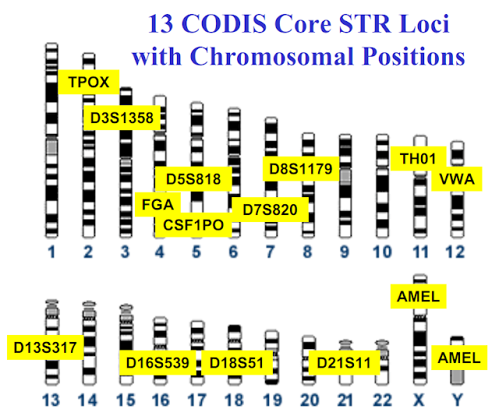
Forensics: Short Tandem Repeats
Loci:
FBI: 13 loci;
(meanwhile more)
Special 2: AMEL for Chr X, Y;
Many combinations homozygote & heterozygote;

Slide 43
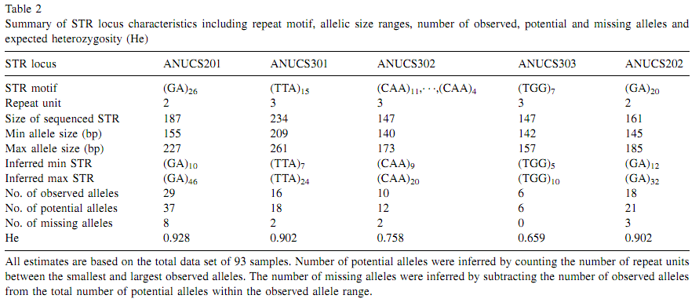
Forensics: Short Tandem Repeats
Supplementary Material (Example)
STR Loci in Plants (CS = Canabis sativa)
Gilmore S et al. (2003) Short tandem repeat (STR) DNA markers are hypervariable and informative in Cannabis sativa: implications for forensic investigations.

Slide 44
PCR: Other Applications
Metagenomics:
Analysis of bacterial communities;
E.g.: in dental plaques or the gut microbiota;
Genome Sequencing:
2 Methods;
Shotgun sequencing vs PCR-based sequencing;
Pang L et al. Metagenomic Analysis of Dental Plaque on Pit and Fissure Sites With and Without Caries Among Adolescents. Front Cell Infect Microbiol. 2021

Slide 45
Supplementary Material

Slide 46
Supplementary Material
Variability of Tm: Primers 4 x G, 4 x C, 4 x A, 4 x T
Tm: depends on explicit sequence;^{(*)}
AAAACCCCGGGGTTTT: 61.5º C
TGGCATGCTTCCAGAA: 60.0º C
CCAGGTTCGGCATATA: 55.0º C
AGTCGACATTCAGCTG: 52.0º C
CCAGGAGTCTACTAGT: 42.0º C
GTAGTCCGTACAGTAC: 40.1º C
Length:
Usually: 16–25 nucleotides;
* theoretical Tm computed using extended formula;

Slide 47
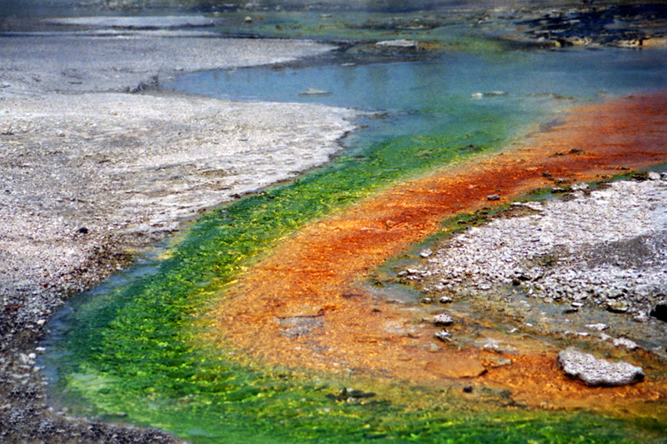
Supplementary Material
Hot springs:
Yellowstone
Thermophilus aquaticus

