Slide 1
Immunology Series
SARS-CoV-2
Immuno-Vaccinology
Leonard Mada
Immunology. V Babes University of Medicine & Pharmacy. Timisoara

Slide 2
Systematic Review: CoV-2
Contents:
Overview CoV-2
Literature: in-silico 2020 – 2025
Immuno-Informatics:
  Epitopes, Vaccines, Immuno-Simulations
Pharmacology
  Docking: Drugs, Phytocompounds

Slide 3
Overview: Human CoVs
Upper Respiratory Tract (URT):
Alpha-CoVs: 229E, NL63;
Beta-CoVs: OC43, KHU1;
15% of common colds: autumn/winter season;
Usually NO pneumonia;
Lower Respiratory Tract (LRT):
Beta-CoVs: SARS-CoV, SARS-CoV-2, MERS;

Slide 4
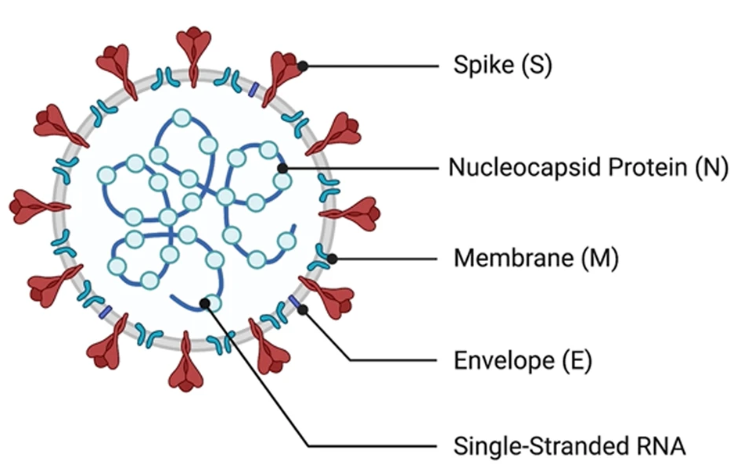
Overview: Human CoVs
Structure:
EM: crown-like shape (corona);
Enveloped;
Surface proteins:
Membrane protein (M);
Spike: > 1000 AA;
Envelope (E): < 100 AA;

Slide 5
Overview: Human CoVs
Neutralising Antibodies:
Only against: S, M, E; (*)
Cannot bind: N, NSPs;
Surface proteins:
Membrane protein (M);
Spike: > 1000 AA;
Envelope (E): < 100 AA;
Enveloped
* E may be too small (< 100 AA); also part of it is trans-membrane;

Slide 6
Overview: Human CoVs
Neutralising Antibodies:
Only against: S, M, E;
Cannot bind: N, NSPs;
Anti-N Abs:
Cell lysis => free N protein =>
=> Ig against linear N epitopes;
NO neutralisation!
May still be useful: Diagnostic assays; (#)
Enveloped
# But NOT as vaccine that induces antibodies;

Slide 7
Overview: Human CoVs
Genome:
Single stranded RNA;
Plus-sense RNA;
30 kb (single molecule);
Genes:
NSPs & Structural proteins;

Slide 8
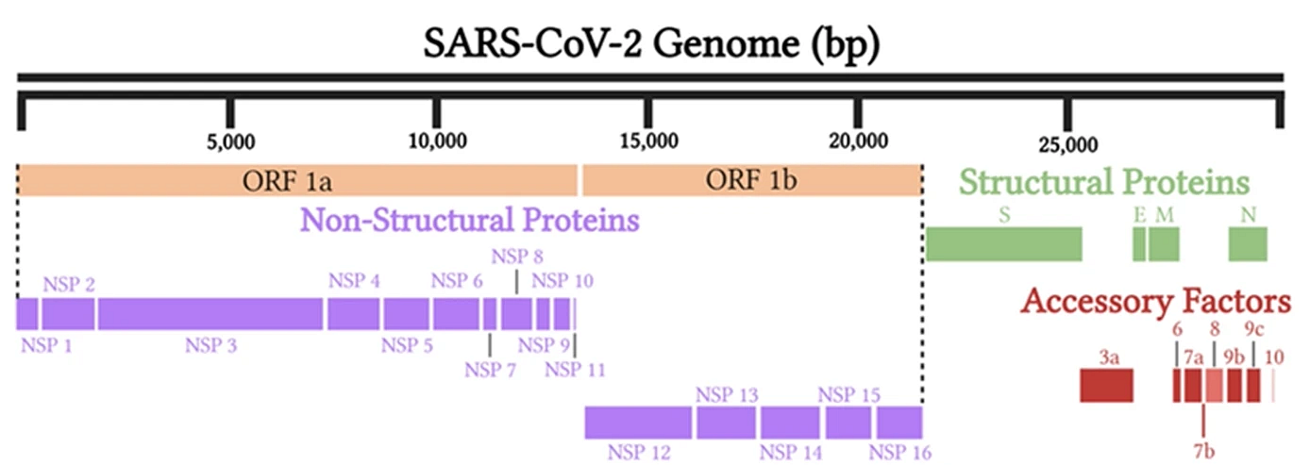
Overview: SARS CoV-2
Genome:
NSP: ORF1a/b Polyproteins, others (Accessory);
SP: S, E, M, N;
SP = Structural Proteins;

Slide 9
Overview: SARS CoV-2
Polyproteins: ORF1a/b
Cleaved by proteases: into 10 & 5 proteins;
Proteases:
Main Protease: Mpro;
Papain-Like Pro: PLpro;
Mpro = CLpro Chymotripsin-like

Slide 10
Literature Review: CoV-2
PubMed Query:
SARS CoV-2;
Immuno-informatics or in-silico;
Refinement:
Manually => Pharmacology, Vaccinology, Other;
NO loss of any articles;

Slide 11
Literature Review: CoV-2 / in-silico
PubMed Articles:
 | 2020 | 2021 | 2022 | 2023 2025
Total | 600 | 1,128 | 1,027 | 1,242
Vaccine | 90 | 107 | 89 | 312
Pharma | 339 * | 450 * | 276 * | ND
ND* | 70 * | 392 * | 612 * | ND
Difference: Other categories;
* Mostly Pharma (NO vaccine); ** ND: Not yet done;

Slide 12
Literature Review: CoV-2 / in-silico
PubMed Articles:
 | 2020 | 2021
Total Vaccinology | 90 | 107
Epitopes | 31 | 34
Vaccines # | 50 | 64
Other | 9 * | 9 *
# only in-silico; * Reviews, Immunology (related to vaccines);

Slide 13
Literature Review: CoV-2 / in-silico
PubMed Articles:
Journals # | 2020 | 2021
J Biomol Struct Dyn. | 8 | 33
Sci Rep, Front Immunol, Comput Biol Med, Molecules | 5 + 5 (2 + 1) | 8 + 5 8 + 7
Vaccines (Bas.), J Med Virol, Inform Med Unlock, F1000Res | 4 x 4 | (more Ph.) 5, 3, 3, 1
Preprints $ | 5+ | 5+
# in-silico Vacines & Epitopes; $ only PubMed (+ 1 other 2020);

Slide 14
Literature Review: CoV-2 / in-silico (only 2020)
Target Proteins:
S: 24 (only S) + 15 (in combination);
M: 16 (mostly in combination);
Others: N (12), E, NSPs;
Epitope types:
HLA-I, HLA-II;
LB: linear & discontinuous;

Slide 15
Literature Review: CoV-2 / in-silico (only 2020)
CoV-2 Genomes:
Single strain: possibly most; (*)
Consensus sequence from multiple strains;
Example PMID 32832263:
  Consensus: 475 strains;
  Epitopes: 13 HLA-I & 10 HLA-II;
  Source: S, M and other proteins;
* Not yet quantified;

Slide 16
Literature Review: CoV-2 / in-silico
Vaccine Construct:
CTL Epitopes;
HTL Epitopes;
B Epitopes;
Adjuvants: beta-Defensin, PADRE, other sequences;
Linkers: AAY, GPGPG, EAAAK, …;
Example:
PMID: 32962156
bDef – EAAAK – (CTL/AAY)35 – (HTL/GPGPG)21 – bDef
Total: 1057 aa;

Slide 17
Literature Review: CoV-2 / in-silico
Docking:
TLR: 3 & 4 most frequent (at least 23 & 14);
Other: TLR 2,5,7,8,9 (a few);
HLA molecules;
Constructs: ~ 100 aa – 1057 aa; (some heroic dockings)
Compare Hb: each chain 141 – 146 aa;

Slide 18
Literature Review: CoV-2 / in-silico
Docking:
TLRs & HLA;
Constructs: ~ 100 aa – 1057 aa; (some heroic dockings)
Compare Hb: each chain 141 – 146 aa;
Recommendations:
India & China should probably prioritize development of infrastructures for protein NMR;
Build first a solid foundation for protein structures;

Slide 19
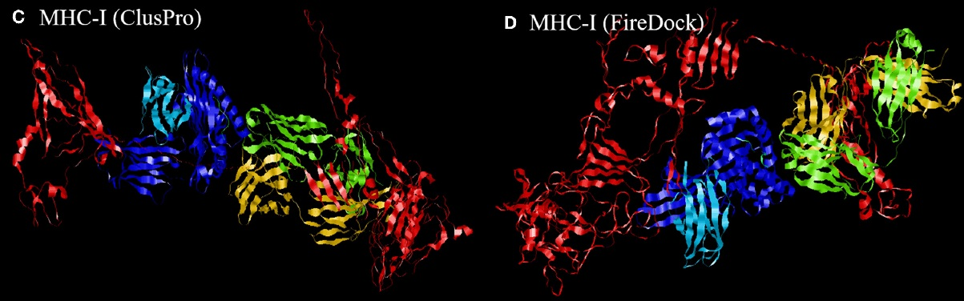
Literature Review: CoV-2 / in-silico
Docking: MHC-I + whole protein Vaccine
Red = Vaccine; Coloured = MHC-I;
PMID: 32849643; Front. Immunol. 2020;

Slide 20
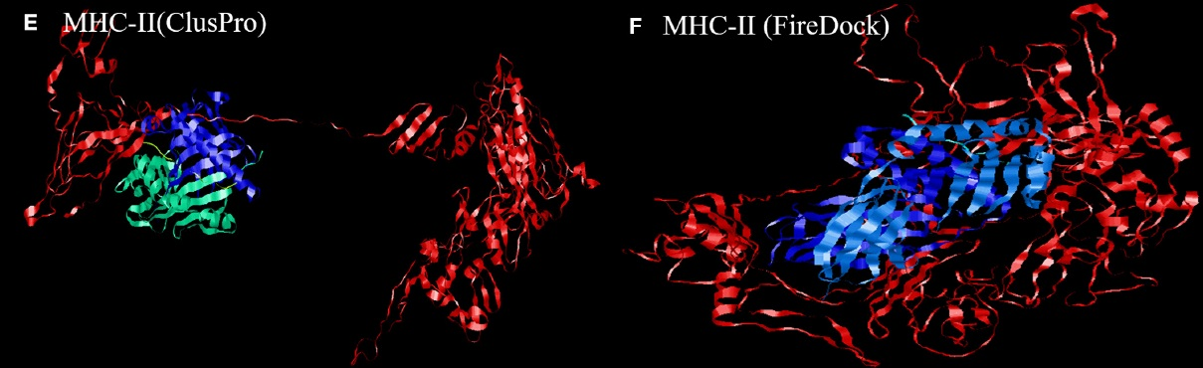
Literature Review: CoV-2 / in-silico
Docking: MHC-II + whole protein Vaccine
Red = Vaccine; Coloured = MHC-II;
PMID: 32849643; Front. Immunol. 2020;

Slide 21
Literature Review: CoV-2 / in-silico
Docking: MHC-I + whole protein Vaccine
Is it possible to dock almost any protein?
Interesting docking exercise;
Immunologically: absolute bollocks;
Frontiers in Immunology!
Red = Vaccine; Coloured = MHC-I;
PMID: 32849643; Front. Immunol. 2020;
For another example see: PMID 32616763; Sci Rep. 2020;

Slide 22
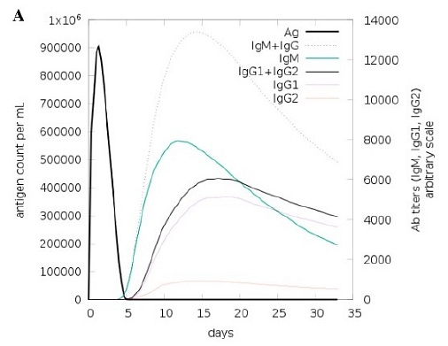
Literature Review: CoV-2 / in-silico
Immune Simulations:
C-ImmSim 10.1 (2020)
Ig sub-classes
Cells: Tc, Th, LB
Cytokines

Slide 23
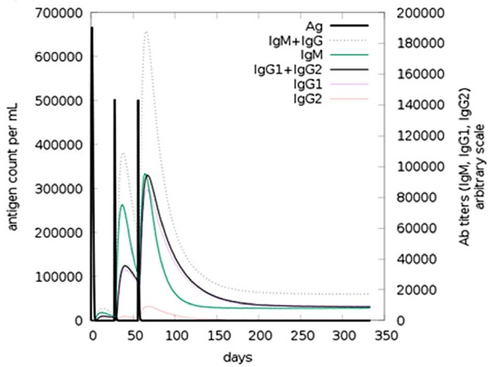
Literature Review: CoV-2 / in-silico
Immune Simulations: Antibodies
* Black = Antigen/Vaccine;

Slide 24
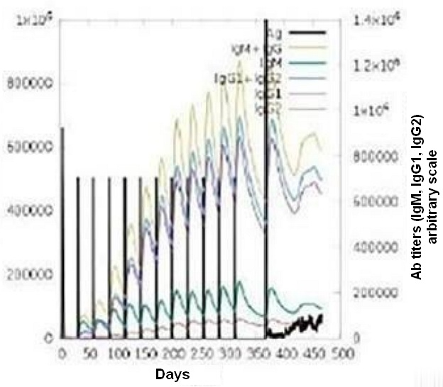
Literature Review: CoV-2 / in-silico
Immune Simulations: Antibodies after 12 x Vaccin!
Fig 1 - Heroic Vaccination Strategy!

Slide 25
Literature Review: CoV-2 / in-silico
Immune Simulations: Antibodies after 12 x Vaccin!
Only Pre-print:
12 x Vaccine;
Viral challenge afterwards;
Immuno-informatics approach for multi-epitope vaccine designing against SARS-CoV-2. bioRxiv 18-Aug-2020.
https://doi.org/10.1101/2020.07.23.218529;

Slide 26
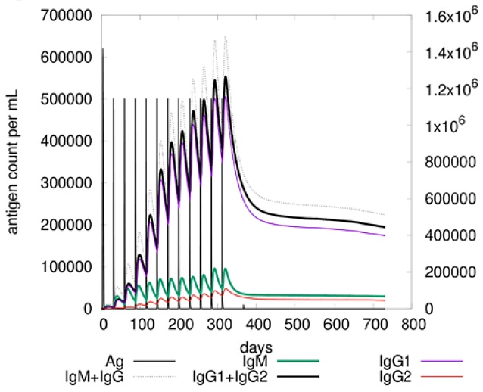
Literature Review: CoV-2 / in-silico
Immune Simulations: Antibodies after 12 x Vaccin!
BUT this is published:
12 x Vaccine;
Viral challenge afterwards;
A candidate multi-epitope vaccine against SARS-CoV-2. Sci Rep. 2020 Jul 2; 10.
https://doi.org/10.1038/s41598-020-67749-1;
Viral Challenge: probably small tick at 365 days;

Slide 27
Literature Review: CoV-2 / in-silico
Immune Simulations: Antibodies after 12 x Vaccin!
BUT this is published:
12 x Vaccine;
Recommendation:
Indian Gov can rehearse strategy to vaccinate each month the entire population for 12 consecutive months;
A candidate multi-epitope vaccine against SARS-CoV-2. Sci Rep. 2020 Jul 2; 10.
https://doi.org/10.1038/s41598-020-67749-1;

Slide 28
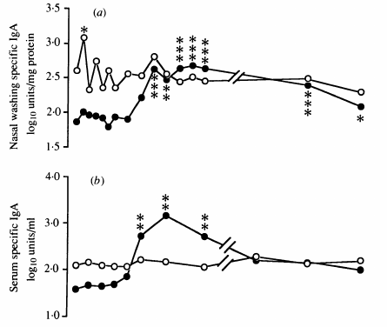

Literature Review: CoV-2 / in-silico
Real IgA: Mucosa vs Serum
Volunteers inoculated with CoV 229E:
Infected: 10;
Uninfected: 5
  Pre-existing IgA;
  Surge in Mucosal IgA;
In-silico Literature:
NO simulations of IgA!
Fig. 2a,b: Callow KA et al. The time course of the immune response to experimental coronavirus infection of man. 1990. PMID 2170159.

Slide 29
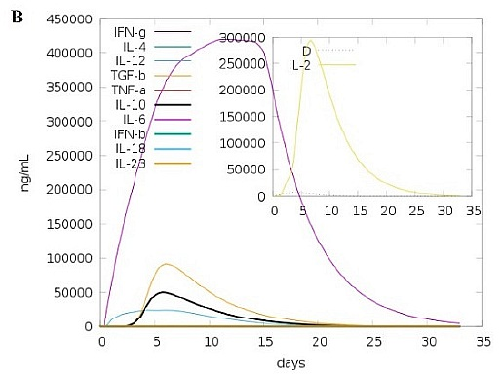
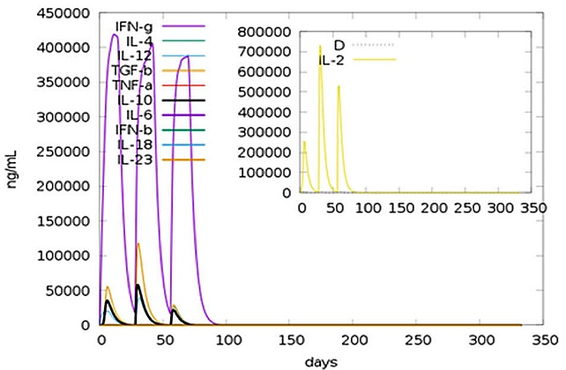
Literature Review: CoV-2 / in-silico
Immune Simulations: Cytokines

Slide 30
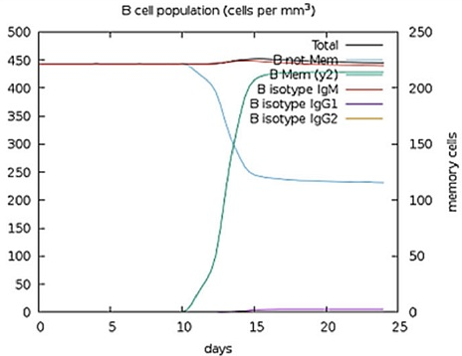
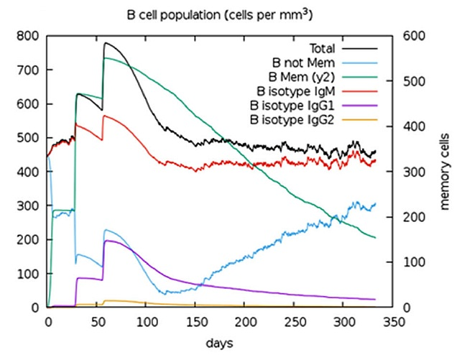
Literature Review: CoV-2 / in-silico
Immune Simulations: B Cells
TODO: Image with Vaccine at time = 0

Slide 31
Literature Review:
Recommendations: for PubMed & Journals
Mark articles with Caveat-Field:
  Docking Multi-Epitope vaccine with MHC-I or II: interesting docking exercise, but functionally completely irrelevant;
  12-Dose schedule: NO clinical utility;
  Conformational Epitopes in Vaccine: Neo-antigens => NO protection against original virus;
* NO need for retraction: may still be useful exercises to learn Immunology or test in-silico methods / tools;

Slide 32
Pharmacology: CoV-2
Pharmacology:
Majority of PubMed articles with “in-silico”

Slide 33
Pharmacology
PubMed Articles:
2020: 339 + most of remaining 70;
Drug-Repurposing & Drug-Libraries;
Natural-/Phytocompounds;
Molecular Docking:
Almost ALL articles;

Slide 34
Pharmacology
PubMed Articles:
2020: 339 + most of remaining 70;
Summary: based on ~ 50% of articles:
Phytocompounds: 240; (*)
Plants: 61; (*)
Drugs: 140;
* Final number may be x 2;

Slide 35
Pharmacology: Plants
Plants & Phytocompunds:
2020: 339 + most of remaining 70;
Phytocompounds: 240;
Plants: 61;
Drugs: 140;
Acacia senegal | Calendula officinals
Ammoides verticillata | Callophycus oppositifol.
Andrographis paniculata | Camellia sinensis
Annona muricata | Capsicum annuum
Artemisia annua | Castanosperm. australe
Asparagus racemosus | Caulerpa racemosa
Astragalus membranac. | Chenopodium quinoa
Brassica napus | Clerodendrum volubile
Broussonetia papyrifera | Crepis sancta
* Summary: based on ~ 50% of articles; final number may be x 2;

Slide 36
Pharmacology: Phytocompunds
Plants & Phytocompunds:
2020: 339 + most of remaining 70;
Phytocompounds: 240;
Plants: 61;
Drugs: 140;
iridoid | kazinol
isatin | lauruside
isoginkgetin | leupeptin
isoliquiritigenin | limonene
isomesuol | limonoid
jacalin | lividomycin
jamaicin | lupane
kaempferol | macaflavanone
kamalachalcone | maslinic acid
* Summary: based on ~ 50% of articles; final number may be x 2;

Slide 37
Pharmacology: Targets
Targets:
Main Protease (Mpro/CLpro): > 124;
PL-Protease: alone or in combination (few);
Polymerase (RdRp): > 11;
S or S/ACE2 complex: > 45;
Other: Methyltransferase, etc.

