Slide 1
Threads, Tasks and More
Concurrency and Asynchrony in .NET

Slide 2
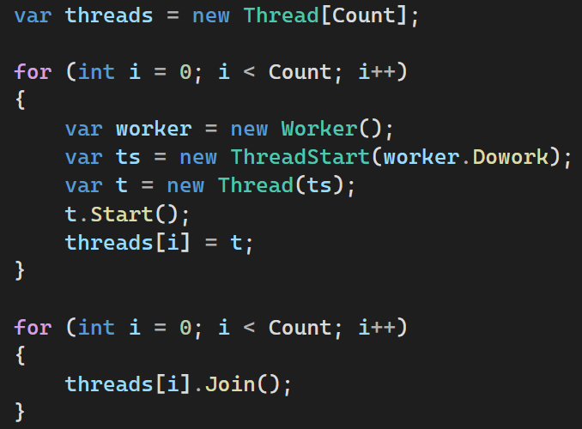
Threads

Slide 3
Threads
“As soon as you type new Thread(), it’s over; your project already has legacy code.”
-Stephen Cleary
Concurrency in C# Cookbook

Slide 4
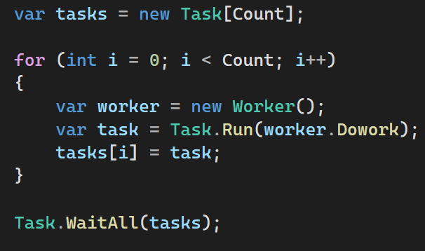
Tasks
Can return results
Can propagate exceptions
Use a Thread Pool
Make async programming easy

Slide 5
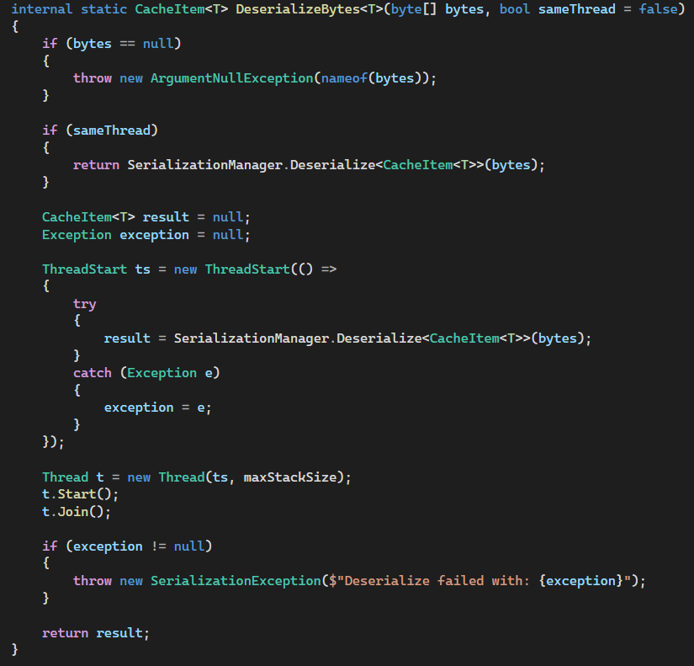
Rare exception to the rule

Slide 6
Asynchronous Code
Definition:
A form of concurrency that uses futures to avoid unnecessary threads
‘Futures’ in .NET are Task and Task<T>
While executing, the original thread is not blocked and can do other work

Slide 7
Asynchronous Code
Definition:
A form of concurrency that uses futures to avoid unnecessary threads
‘Futures’ in .NET are Task and Task<T>
While executing, the original thread is not blocked and can do other work
There Is No Thread (stephencleary.com)

Slide 8
Asynchronous Code
Used for code that does I/O
Not used for purely CPU / Memory bound work

Slide 9
async keyword
Enables use of await inside a method
Viral in nature

Slide 10

async keyword
Enables use of await inside a method
Viral in nature
It’s async all the way down…

Slide 11
async methods
Execute synchronously until the first await keyword is encountered
“go async” at the first await, establishing a continuation
Code after the await will execute when the async operation eventually completes – possibly on a different thread

Slide 12
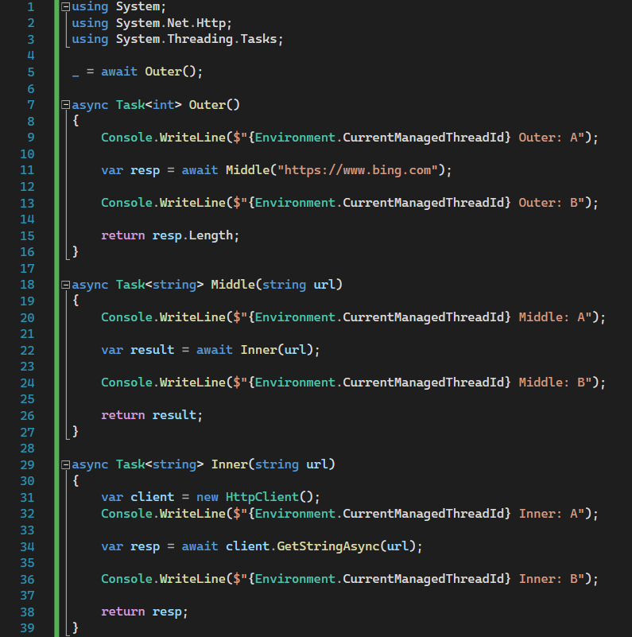

Slide 13
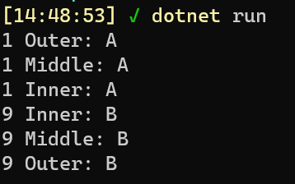

Slide 14
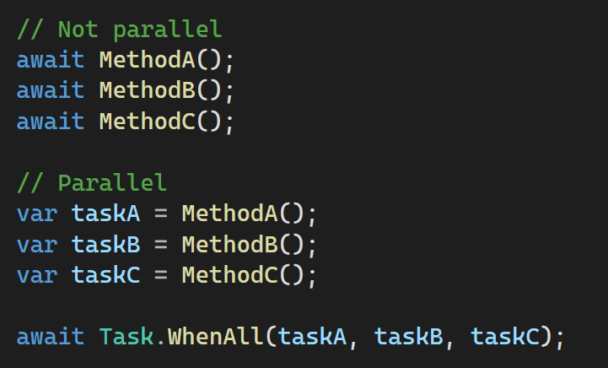

Slide 15

Mixing async and sync

Slide 16
Mixing async and sync
Don’t!

Slide 17
Mixing async and sync
Don’t!
.Result and .Wait() make the code synchronous
Ties up the thread, defeating the purpose

Slide 18
Mixing async and sync
Can lead to deadlocks
Use ConfigureAwait(false) in library code

Slide 19
Mixing async and sync
Can lead to deadlocks
Use ConfigureAwait(false) in library code
Basic explanation of deadlock: await triggers the async operation and it captures the current synchronization context. When the async call is ready to complete, it will execute on that context. If the context requires that everything executes on a single thread (UI scenario), it will wait to be able to execute on that thread. If that thread has called .Result or .Wait() on the async task, that call is blocking until the async task completes. But the async task can’t complete – because the thread it needs to execute on is blocking waiting for it to complete. We are at an impasse – classic deadlock.

Slide 20
Async isn’t free

Slide 21
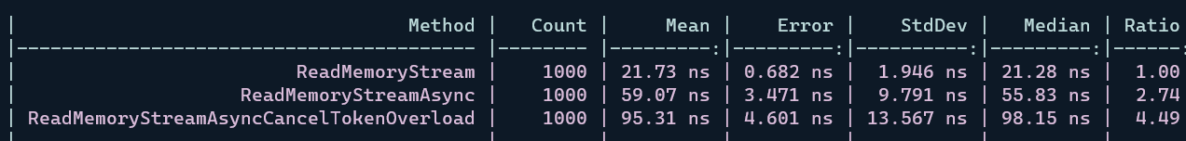
Async isn’t free

Slide 22

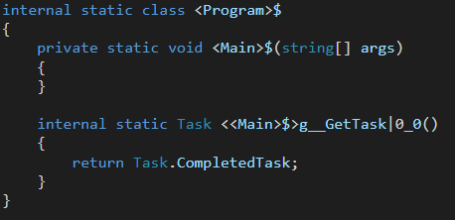

Async isn’t free

Slide 23
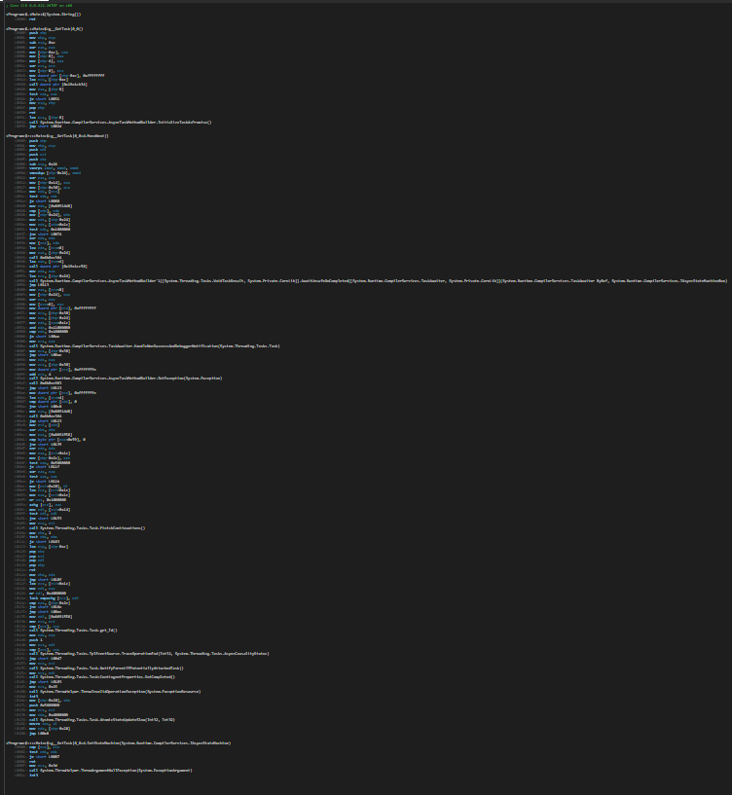

Async isn’t free

Slide 24
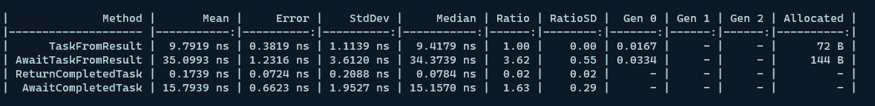
Async isn’t free

Slide 25
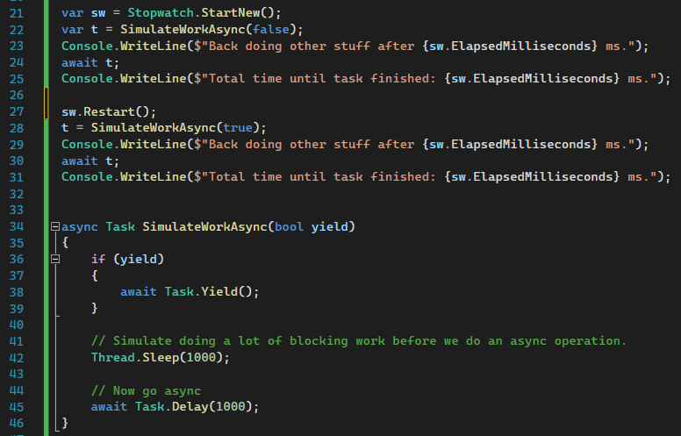
Task.Yield()

Slide 26
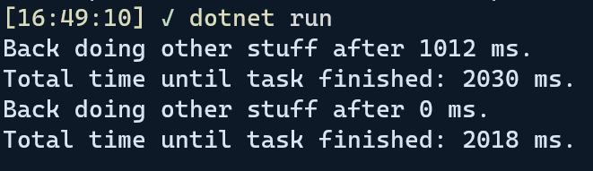
Task.Yield()

Slide 27
The Thread Pool

Slide 28
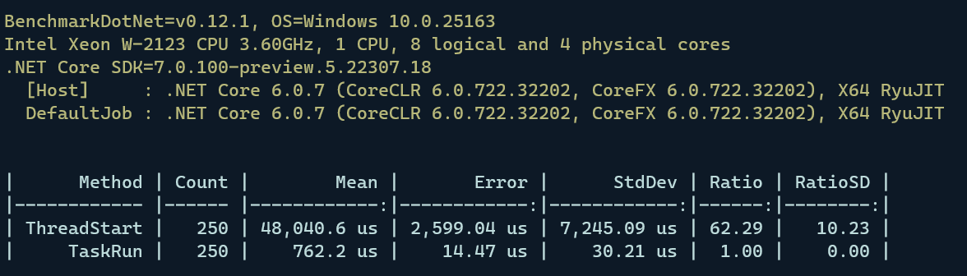
The Thread Pool

Slide 29
The Thread Pool
Tuned for CPU bound work
Tries to avoid adding new threads

Slide 30
Thread Pool and Async Demo

