Slide 1
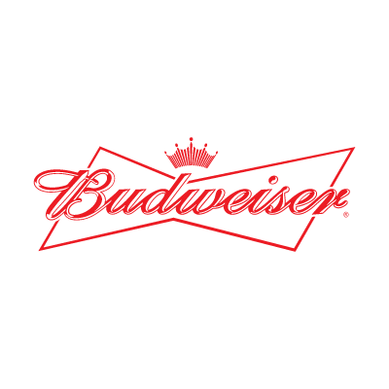

Exploratory Analysis of Brewery and Beer Data Sets
Customer: Budweiser
Presenters: Adam Alidra and Cameron Stewart

Slide 2
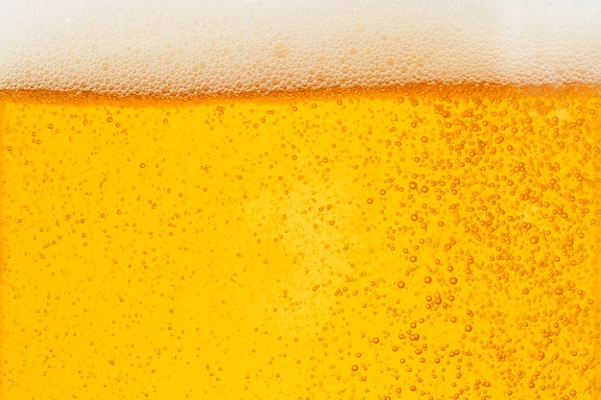

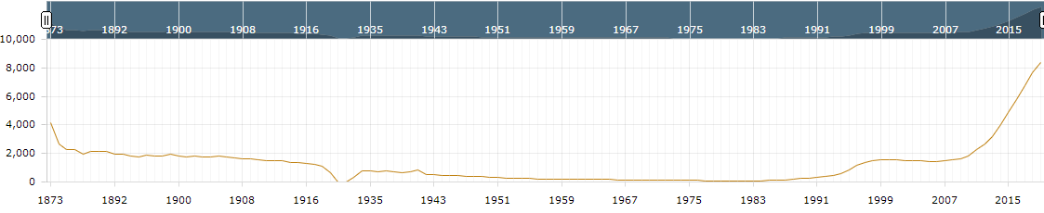
Executive Summary
Key Notes on provided Beer and Brewery Data Sets
The Breweries listed are all US Breweries and all Beers listed are Craft Beers
The data references 51 states (Washington D.C. included as a ‘state’)
High level findings on the broader US Brewery and Craft Beer Market from public data
U.S. beer volume sales down 2% in 2019, while craft brewer sales continued to grow at rate of 4% by volume¹
Craft brewer sales reached 13.6% of the U.S. beer market by volume¹
Historical U.S. Brewery Count¹
¹https://www.brewersassociation.org/statistics-and-data/national-beer-stats/#:~:text=Summary,grew%20the%20most%20for%20taprooms.

Slide 3
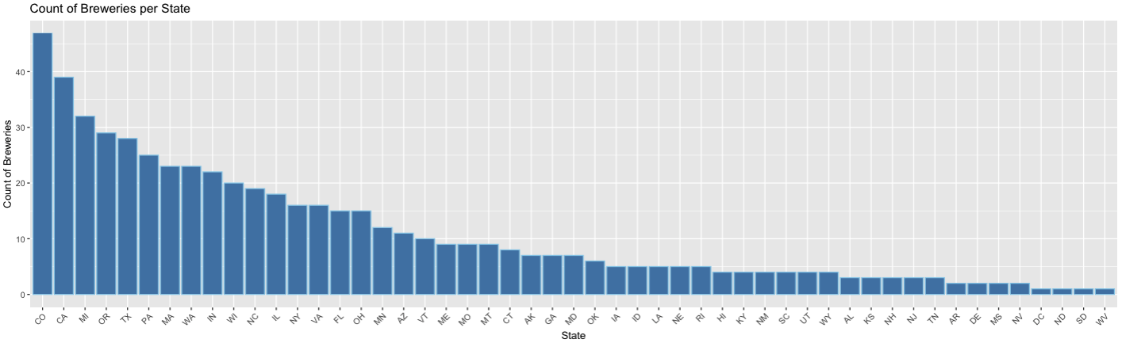
Breweries by the Numbers
Findings
558 Total Breweries listed in the Breweries data set
Top 25% of states contain over 60% of the Breweries
CO and CA have the most Breweries in total

Slide 4
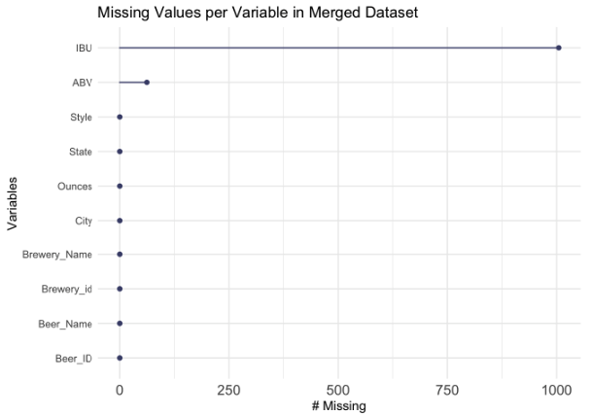
Analyzing Missing Values
Findings
No NA values in Breweries data set
Merged data sets produce a combined 1067 NA values (all of which are found in the Beer data set)
1005 NA values are from the IBU column
62 NA values are from the ABV column

Slide 5
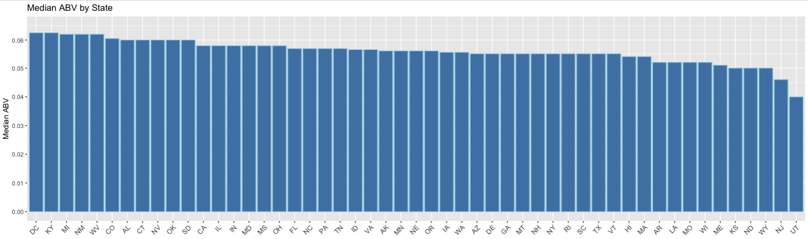
Median ABV by State
Findings
DC and KY are tied for the highest ABV at 6.25%
UT has the lowest median ABV by a significant margin at 4.00%
84% of states have a median ABV between 5% - 6% (inclusive)

Slide 6
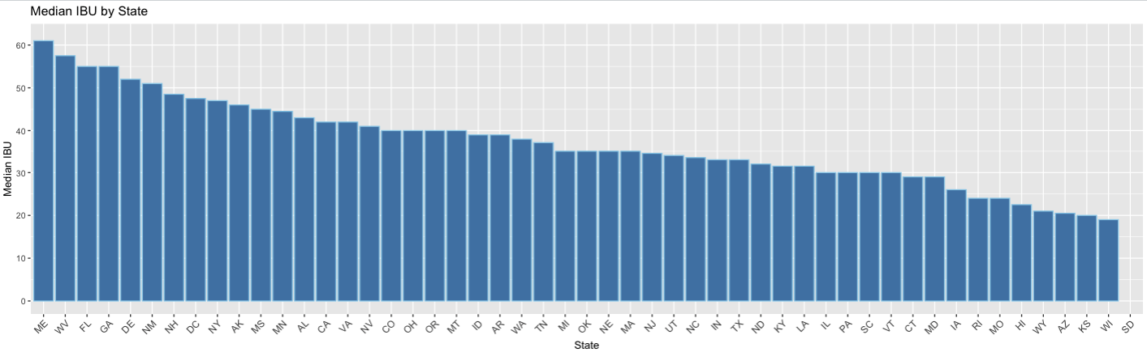
Median IBU by State
Findings
ME has the highest median IBU
WI has the lowest median IBU
SD has no IBU data in the provided data sets (shown without bar below)

Slide 7
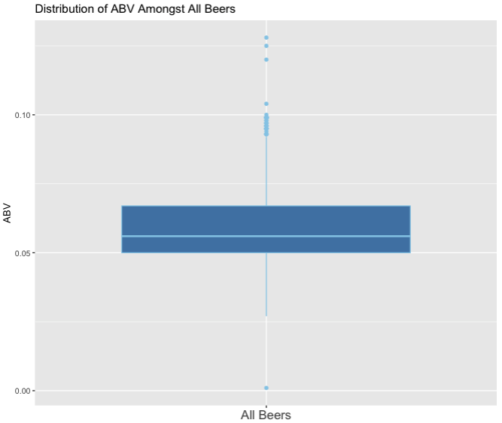
Maximum Values and ABV Distribution
Maximum Values
Oregon’s Bitter Bitch Imperial IPA has the highest IBU of 138
Colorado’s Lee Hill Series Vol. 5- Belgian Style Quadrupel Ale has the highest ABV at 12.8%
ABV Distribution Findings
The box plot is slightly right skewed which signifies higher dispersion in ABV in Q3 and Q4
Median ABV amongst all analyzed beers is 5.6%
There are significantly more outliers at the higher end of ABV than the lower end
Small subset of ABV outliers in top quartile hovering at or just below 10% ABV

Slide 8
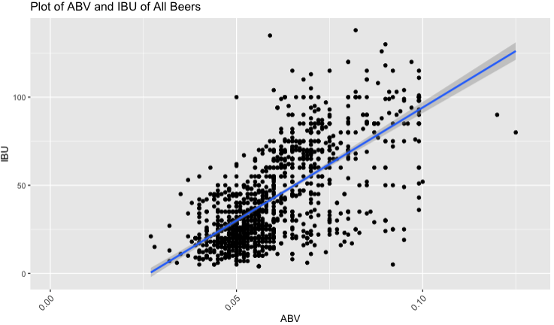
ABV to IBU Relationship
Findings
As ABV increases (x-axis), the IBU value (y-axis) also tends to increase showing a moderate relationship (R = 0.67)
45% of the variability in IBU can be explained by ABV (and vice versa)
Further investigation into to the effect of Style on ABV and IBU variables would likely improve prediction capability

Slide 9
THANK YOU!
ARE THERE ANY QUESTIONS?

