Slide 1
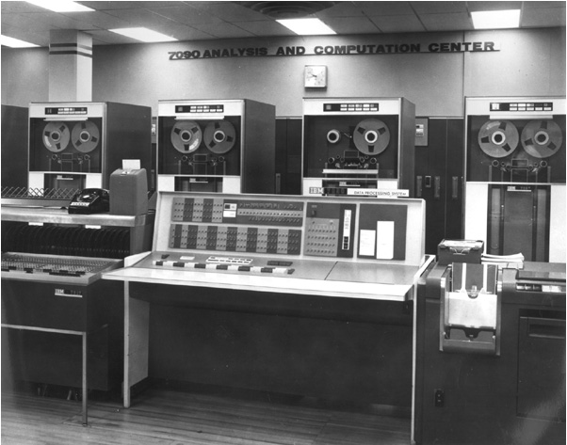
A historical perspective
The 1960s: the birth of bioinformatics
  High-level computer languages
  Protein sequence data
  Academic access to computers
Margaret Oakley Dayhoff
  First protein database
  First program for sequence assembly
IBM 7090 computer

Slide 2
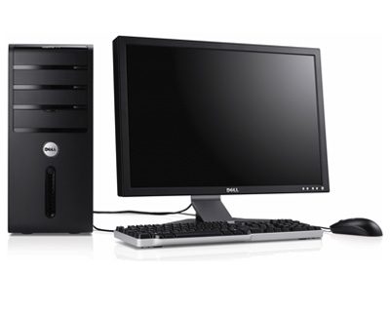
Comparison
32 Kbytes RAM
2.18 µHz
$2,900,000 in 1960
1 GB RAM
2.4 GHz
$1100 in 2013

Slide 3

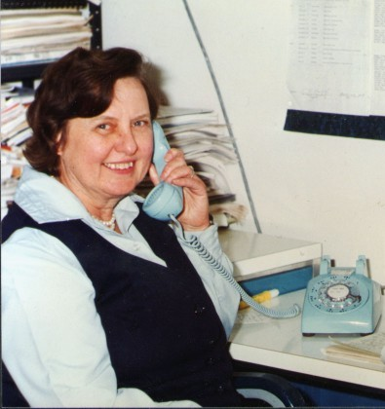
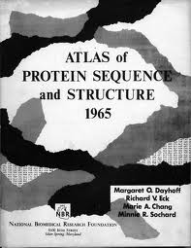
Mother of Bioinformatics
Dr. Margaret Okaley Dayhoff
(1925-1983) was a pioneer in the use of computers in chemistry and biology. Her work was multi-disciplinary and used her knowledge of chemistry, mathematics, biology and computer science to develop an entirely new field. She is credited today as a founder of Bioinformtics. Dr. Dayhoff was the first woman in the field of Bioinformatics . She was also the first woman to hold office in the Biophysical Society, serving first as Secretary and later as President.

Slide 4
Milestones-I
1965 | Atlas of protein Sequence and Structure by Margaret Dayhoff
1970 | Protein Data Bank established Brookhaven National Laboratory
1970 | First sequence alignment algorithm, Needleman and Wunsch
1974 | First protein structure prediction algorithm, Chou and Fasman
1978 | Bioinformatics was coined
1982 | GenBank made public
1985 | FASTA algorithim, William Pearson

Slide 5
Milestones-II
1988 | National Centre for Biotechnology Information (NCBI) created at NIH/NLM
1990 | BLAST, Stephen Altschul
1995 | First bacterial genomes completely sequenced (Haemophilus influenzae)
1996 | Yeast genome completely sequenced
1998 | Worm genome completely sequenced
2001 | Working draft of the human genome sequence published.
2002 | First draft of mouse genome
2000+ | Microarrays, HTS, NGS ...

Slide 6
Resource Centres
The National Centre for Biotechnology Information (NCBI)
  As a part of National Library of Medicine
  Tools : BLAST, Entrez, GenBank, PubMed
  Other databases: dbEST, dbSNP, dbSTS, MMDB, UniGene, SAGE, LocusLink, RefSeq, Taxonomy, CGAP, GeneMap
European Bioinformatics Institute (EBI)
  ChEMBL, Ensembl, Enzyme Portal, Europe PubMed, IntAct, Pfam, WormBase, UniProt
  Tools: FASTA, InterProScan, Kalign, Mafft, T-Coffee

Slide 7
www.ncbi.nlm.nih.gov
Created in 1988 as part of the National Library of Medicine at NIH
  Establish public databases
  Support research in computational biology
  Develop software tools for sequence analysis
  Disseminate biomedical information

Slide 8
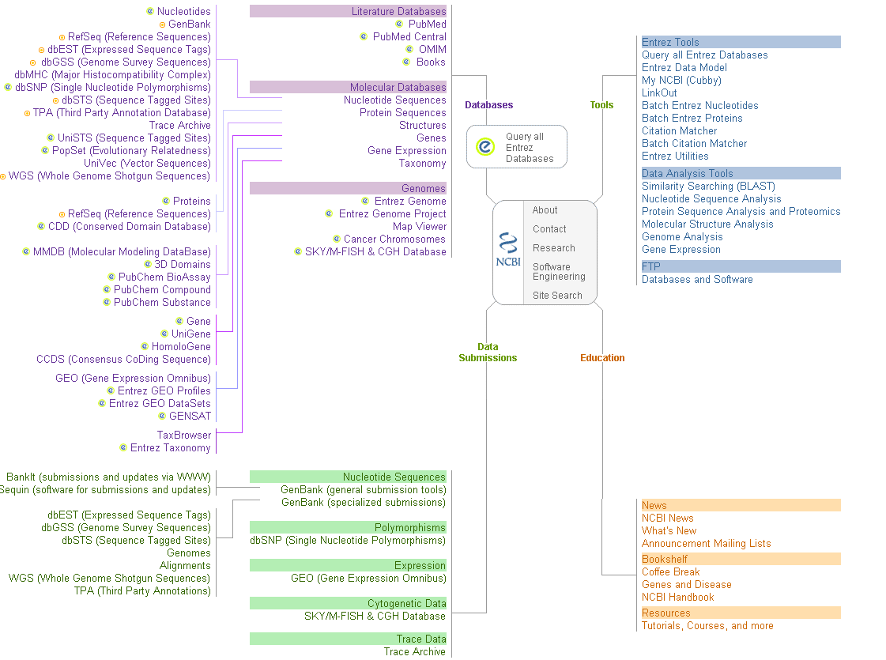

Slide 9
What are databases?
Structured collection of data is called database
  Consist of basic units called record or entries
  Each record consist of fields, which hold predefined data related to the record
  Database management systems (DBMSs) are specially designed applications that interact with the user and database itself to capture and analyze data
  Well-known DBMSs include MySQL, PostgreSQL, SQLite, Microsoft SQL Server, Mircosoft Access and Oracle

Slide 10
Database illustration
A catalogue
Indexed files
SQL
Grep
Oracle
MySQL
SQLite
MS Access
Unix text files
Query system
GenBank flat file
PDB file
EMBL file
Book
Storage system
Data

Slide 11
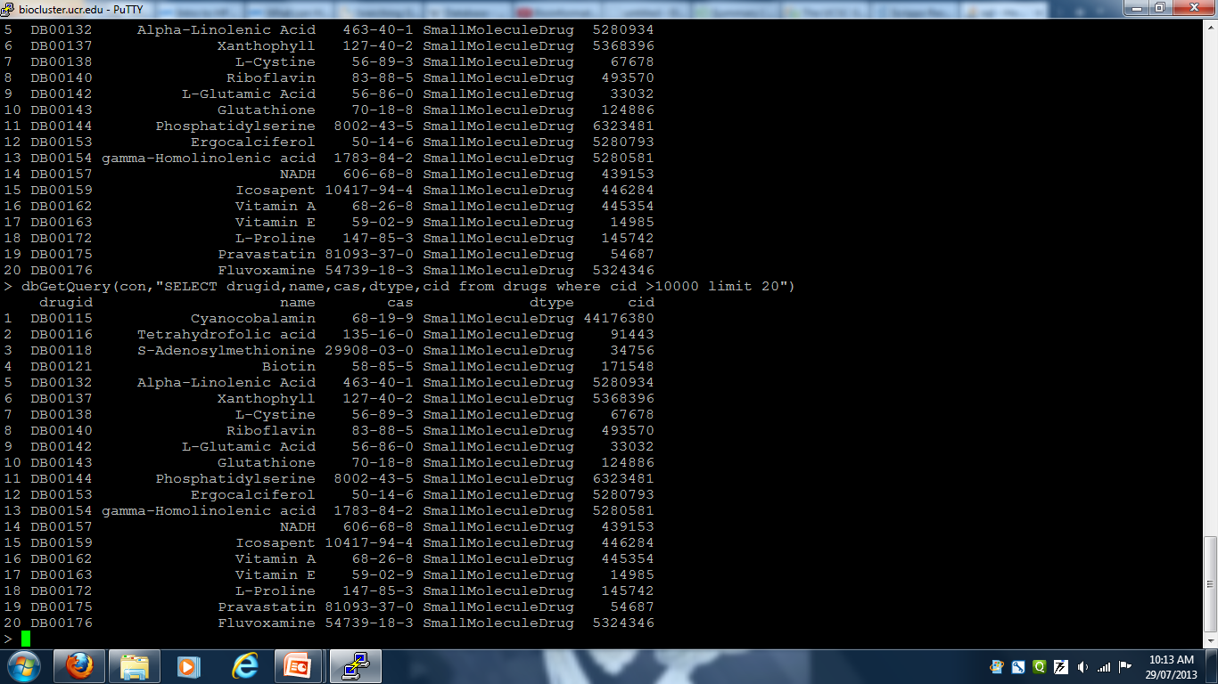
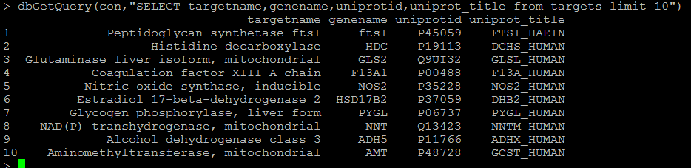
Databases: an simple example

Slide 12
Biological Databases
Primary databases
  Original submission by experimentalists
  Content is controlled by submitter
  Example: GenBank, DDBJ, EMBL, PIR, SNP
  Derivative databases
  Human curated
  Example: SWISS-PROT, NCBI ReFSeq, GEO datasets
  Computationally derived
  Example: UniGene, TrEMBL

Slide 13
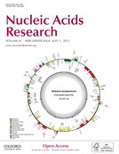
Nucleic Acids Research Database issue
The Molecular Biology Database Collection: 2003 update
  Andreas D. Baxevanis
  The 2013 Nucleic Acids Research Database Issue and the online Molecular Biology Database Collection
  Galperin et al.

Slide 14
Primary VS Derivative Databases
ACGTGC
RefSeq
C
C
GA
GA
Labs
ATT
GA
GA
C
ATT
C
TATAGCCG
AGCTCCGATA
CCGATGACAA
TATAGCCG
ACGTGC
Genome
Assembly
ATTGACTA
CGTGA
Curators
TTGACA
Updated
continually
by NCBI
TTGACA
TTGACA
ACGTGC
CGTGA
ACGTGC
TATAGCCG
CGTGA
ATTGACTA
TATAGCCG
TATAGCCG
ATTGACTA
ATTGACTA
CGTGA
ATTGACTA
ATTGACTA
ATT
TATAGCCG
TATAGCCG
TATAGCCG
TATAGCCG
TATAGCCG
TTGACA
C
GenBank
GA
UniGene
Updated ONLY
by submitters
AT
C
C
C
C
ATT
GA
GA
GA
GA
ATT
ATT
ATT
GA
GA
GA
GA
ATT
C
C
C
ATT
C
Algorithms
Notes:
~11,000 sequences are submitted per day.

Slide 15
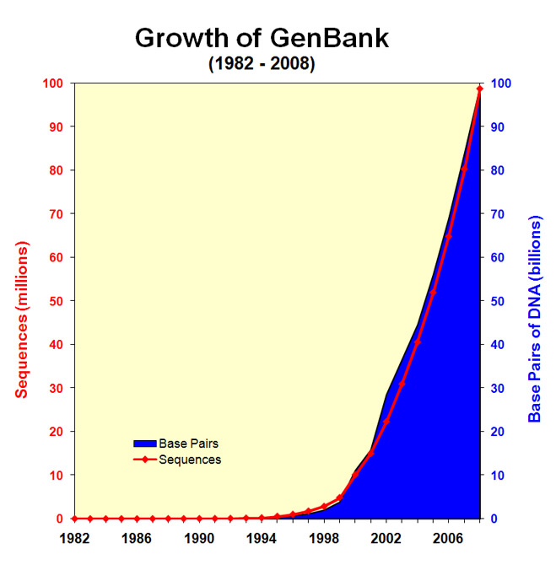
“We are swimming in a rapidly rising sea of data...
how do we keep from drowning?”
— Roos (2001). Science. 291:1260

Slide 16
GenBank – Primary Sequence DB
Nucleotide only sequence database
Archival in nature
  Reflective of submitter point of view
  Redundant
  Direct submissions (traditional records)
  Batch submissions
  FTP accounts (genome data)
  Collaboration
    DNA Databank of Japan (DDBJ)
    European Molecular Biology laboratory (EMBL) Database

Slide 17
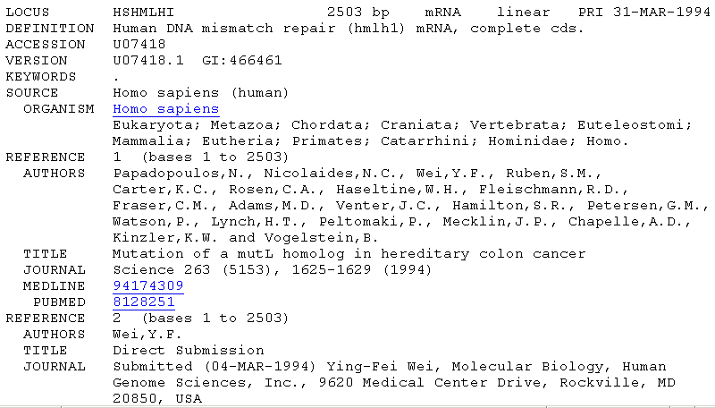
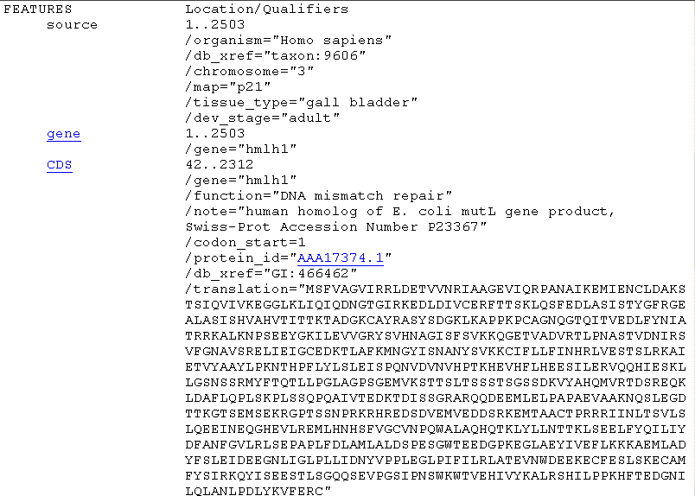
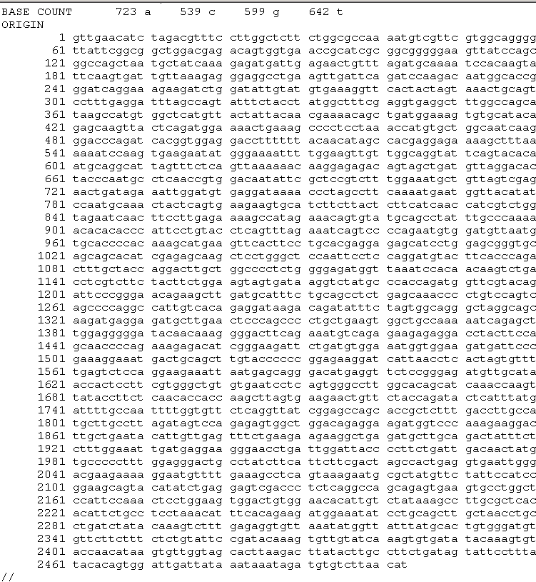
GenBank file format
Accession
Stable
Reportable
Universal
ACCESSION U07418
VERSION U07418.1 GI:466461
Version
Tracks changes in sequence
GI number
NCBI internal use
well annotated
the sequence is the data

Slide 18
Collaborating Databases
NIH
Entrez
NCBI
GenBank
Submissions
Updates
Submissions
Updates
EMBL
DDBJ
CIB
EBI
NIG
Submissions
Updates
SRS
EMBL
getentry
Notes:
NIG – national institute of genetics

Slide 19
Ensemble and Ensemble Genomes
Ensembl provides a genome browser with information such as gene sequence, splice variants, sequence polymorphisms, comparative analysis and sequences implicated in gene regulation for mostly vertebrate organism
EBI and Wellcome Trust Sangar Institute
Ensemble release 64 (September 2011), 58 species supported
Ensemble Genomes extend the Ensembl system to the invertebrate metazoa, protists, bacteria, plant and fungi
Since 2009 Ensemble Genomes. It can be accessed through web, BioMart Tools and Perl.

Slide 20
Protein Sequence Repositories
PIR-PSD
  National Biomedical Research Foundation
  Non redundant, expertly annotated
SWISS-PROT (1986)
  Swiss Biotechnology Institute
  Best annotated
  TrEMBL (1996)
  Automatic CDS translations from EMBL
  Highly redundant, many inaccuracies
  Not all experimentally determined
Genpept
  CDS from GenBank entries
Notes:
PIR-PSD:
Object relational database
Classification of protein sequences based on super family

Slide 21
Protein Sequence Repositories
Uniprot (2003)
  UniProt (Universal Protein Resource) is a central repository of protein sequence and function created by joining the information contained in Swiss-Prot, TrEMBL, and PIR.
Data in UniProt is primarily derived from coding sequence annotations in EMBL (GenBank/DDBJ) nucleic acid sequence data.
UniProt is a Flat-File database just like EMBL and GenBank

Slide 22
Further Reading
Concepts, Historical Milestones and the Central Place of Bioinformatics in Modern Biology: A European Perspective

Slide 23
Assignment
Pl. find out Genomic resources at EBI beside Ensembl and Ensembl Genomes.
  Prepare a short report (max. 1000 words)
              OR
              Pl. read “Integrating biological databases” by Lincoln D. Stein
  Prepare a short report (max 1000 words)

