Slide 1
Basics of
Bioinformatics
Introduction

Slide 2
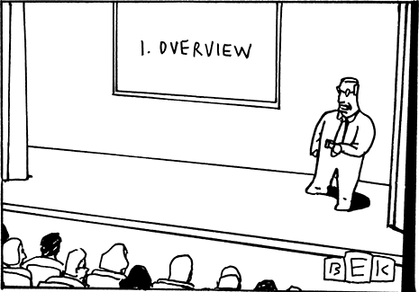
Introduce yourself
Course Overview and Assessment
Introduction to Bioinformatics
Careers and PhD options
Skills required
Salary statistics
Assignment
“First, I want to give you an overview of what I will tell you over and over again during the entire presentation”
stevensonfinancialmarketing.files.wordpress.com

Slide 3

Expected outcomes
Appreciation of bioinformatics
Familiarity with available resources
Experience in implementing and using simple algorithms
Current state of the art techniques in bioinformatics
Trained in a new computer language
nrepp.samhsa.gov

Slide 4

Brainstorming
In groups of two please discuss the
following:
  Definition
  What does bioinformatics has to do with biology?
  What does bioinformatics has to do with CS?
  What are the possible applications?
  Any special tool you would like to learn

Slide 5
Bioinformatics? Application of techniques from computer science for biological investigation and discovery
Computer Science
Bioinformatics
Biology
Sequence analysis and genome annotations
Prediction of protein structures
Comparative genomics
Molecular modeling
Evolution, phylogeny and linkage
Drug discovery

Slide 6
Bio in Bioinformatics
Massive amount of data: too much for manual analysis.
  Still a plenty of genomes need to be sequenced thus a way is needed to deal with “junk data”.
  Next generation sequencing projects have resulted in huge amounts of raw data that must be stored, manipulated and analyzed.
  Simulations of biological systems
  Design and re- engineering of new biological entities

Slide 7
Informatics in Bioinformatics
Provides computer science with new challenges with clear bio-medical significance
Complex and large datasets are sometimes very noisy with hidden patterns
Biological solutions be used to inspire new computational tools and methods
  Neural networks, Simulated Annealing ...

Slide 8
Interesting quotes
What computer science is to molecular biology is like what mathematics has been to physics ...
Larry Hunter, ISMB’94
Molecular biology is becoming an information science
  Leory Hood, RECOMB’00

Slide 9
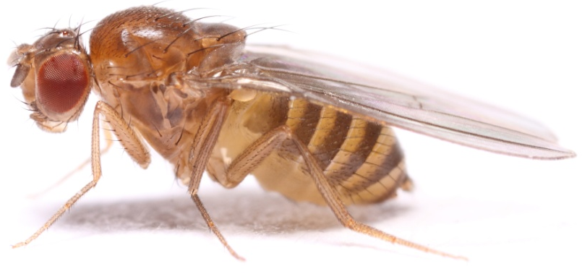
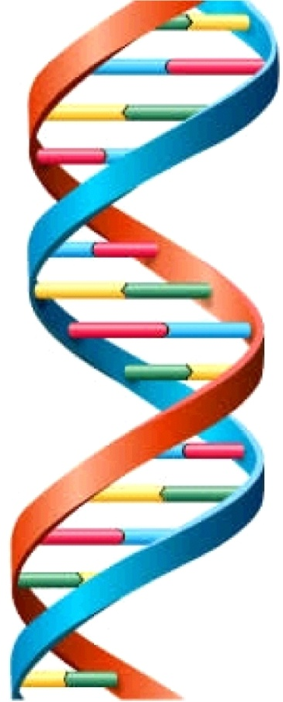
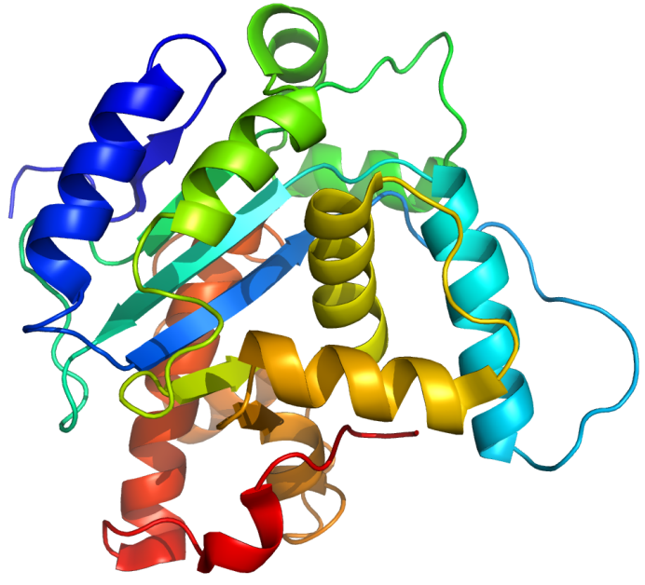

Introduction to Biology
Genotype
Protein
Phenotype
Notes:
http://www.youtube.com/watch?v=eZfyWdHnzR0

Slide 10
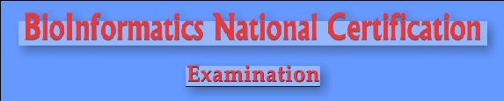
PhD options
BINC
  Bachelor & Post graduate students with degrees in Science
  All the successful candidates will be awarded with a Research fellowship if they are interested in pursuing PhD in India.
  Advertisement (usually in November)
  http://binc.scisjnu.ernet.in/

Slide 11


CSIR/DBT NET
http://csirhrdg.nic.in/
GATE
http://www.gate.iitb.ac.in/gate2013/
Other way is to be Research Associate in a lab you want to work or PhD exams

Slide 12


PhD abroad
In Australia you need
  IELTS bandscore 7 in each out of 9
  Research proposal
  Publications (at least 1)
  In USA you need
  TOFEL and GRE score
  Research proposal
  Publications will help
  Statement of purpose

Slide 13
Career Opportunities
Sequence assembly and analysis
Database design and maintenance
Novel algorithms and tool development
Data Mining
Drug Discovery
Machine learning
System Biology
List goes on …
Wipro, Reliance, Satyam, TCS and companies like Accelrys and IBM Life Sciences and Tessella offer good employments to the bioinformatics candidates.

Slide 14
Commercial sector
Big Pharma –Accept PhD and MSc entry. Normally assigned to projects and work within defined teams. Defined career structure (group leaders, project managers etc)
Spin-out/Small Biotech – Accept PhD and MSc
  entry. However more freedom and variety. A degree of ‘maintenance’ work is to be expected
  IT Giants – Accept PhD and MSc entry. Excellent coding skills required.

Slide 15

Salary statistics
According to the U.S. Bureau
of Labor Statistics (BLS), the
median annual salary for
biological scientists, including bioinformatics scientists, was about $71,000 in 2011.
According to PayScale.com, however, the median salary for biotechnology research scientists with bioinformatics knowledge was much higher, Rs. 1,500,000 per year as of March 2013.
morticianresource.com

Slide 16
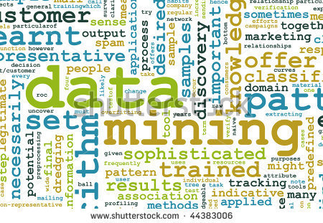
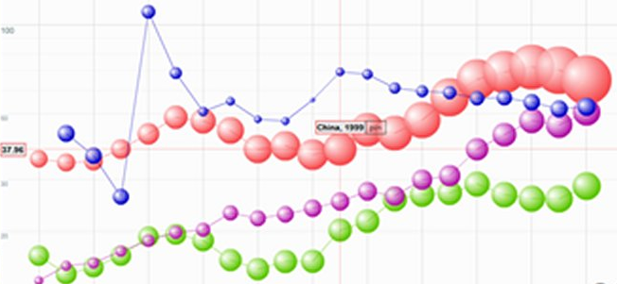
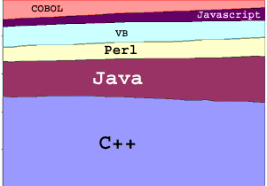
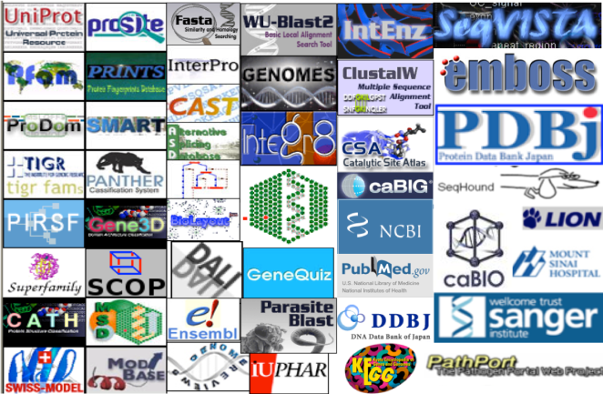
Essential skills for a bioinformaticist
Expertise in data mining
Good data visualization skills
Computer languages
Working knowledge of biology
Bioinformatics resources
Bioinformatics tools
Multitasking
Communicative

