Slide 1
NCBI BLAST Services
Taken from NCBI tutorials

Slide 2
Using BLAST
Basics of using NCBI BLAST
Using the Web Interface
  Improved organism and filter options
New Services
  Primer BLAST
  Align 2 Sequences Integration
  COBALT – protein multiple alignment
  Needleman-Wunsch Global Alignment tool

Slide 3
Basic Local Alignment Search Tool
Widely used similarity search tool
Heuristic approach based on Smith Waterman algorithm
Finds best local alignments
Provides statistical significance
All combinations (DNA/Protein) query and database.
  DNA vs DNA
  DNA translation vs Protein
  Protein vs Protein
  Protein vs DNA translation
  DNA translation vs DNA translation
www, standalone, and network client

Slide 4
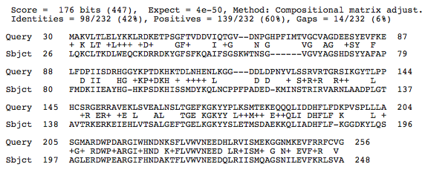
Local Alignment Scoring: Protein
Number of Chance Alignments = 4 X 10⁻⁵⁰
K
K +5
K
E +1
Q
F -3
Gap
(11 + 5(1)= -16

Slide 5
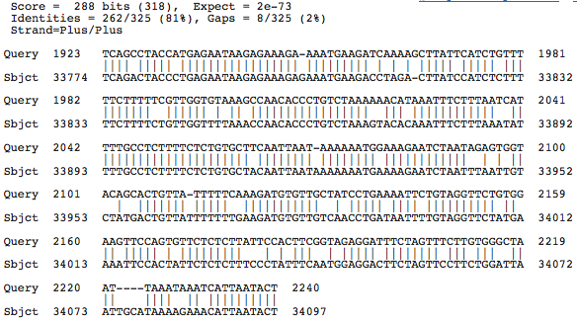
Local Alignment Scoring: Nucleotide
Number of Chance Alignments = 2 X 10⁻⁷³
Match=+2
Mismatch=-3
Gap
-(5 + 3(2))= -11

Slide 6
BLAST and BLAST-like programs 1
Traditional BLAST (formerly blastall) nucleotide, protein, translations
  blastn nucleotide query vs. nucleotide database
  blastp protein query vs. protein database
  blastx nucleotide query vs. protein database
  tblastn protein query vs. translated nucleotide database
  tblastx translated query vs. translated database
Megablast nucleotide only
  Contiguous megablast
    Nearly identical sequences
  Discontiguous megablast
    Cross-species comparison

Slide 7
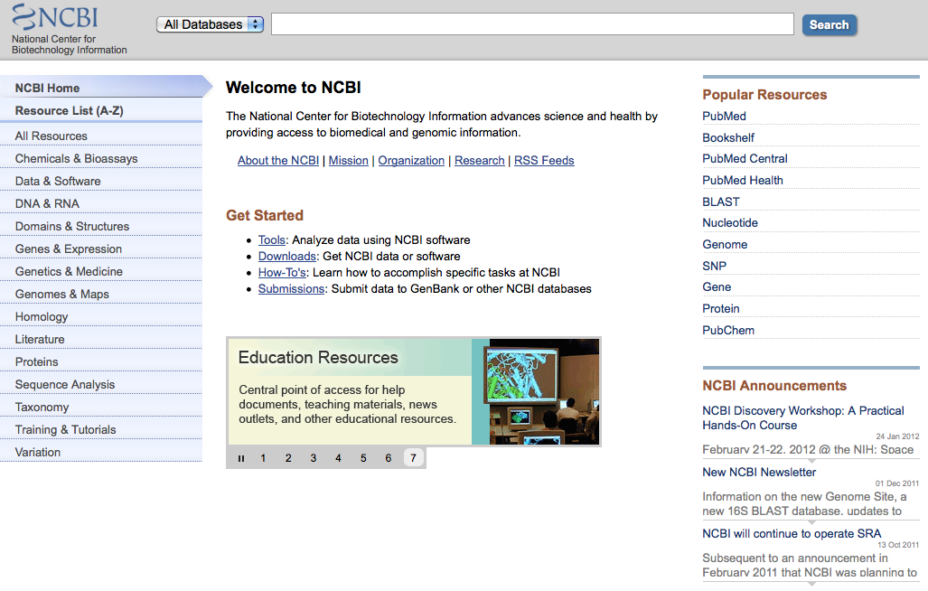
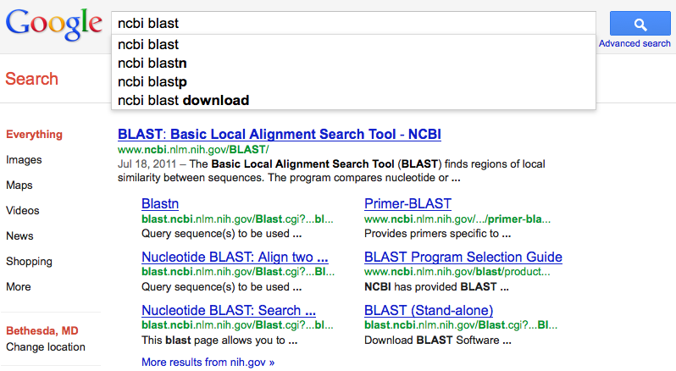
Web Access: www.ncbi.nlm.nih.gov
Notes:
NCBI homepage. Logo will take you back to home page.
About NCBI provides introduction to the NCBI and contains basic information on genetics and bioinformatics.

Slide 8
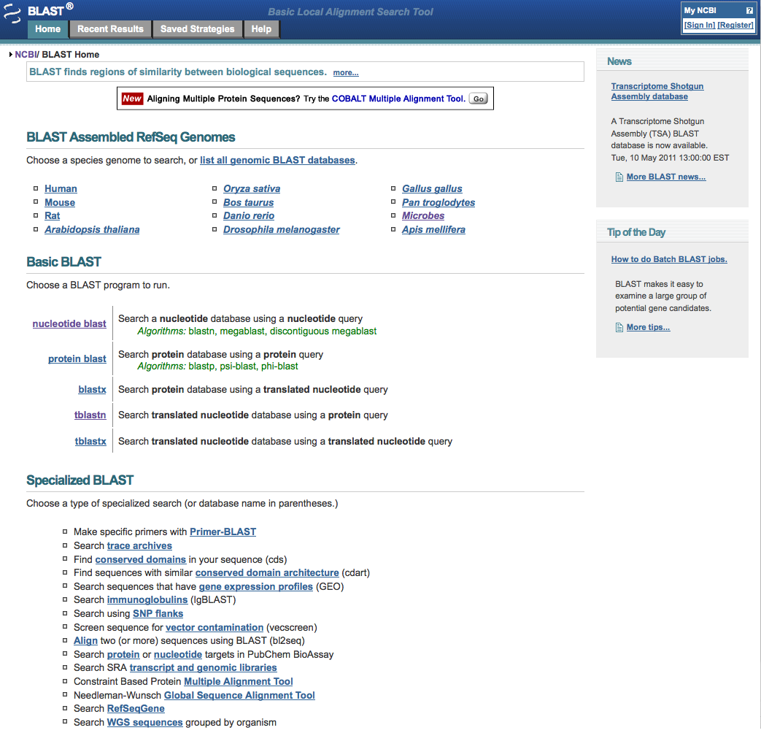
The BLAST homepage
http://blast.ncbi.nlm.nih.gov/

Slide 9
Basic BLAST: Databases

Slide 10
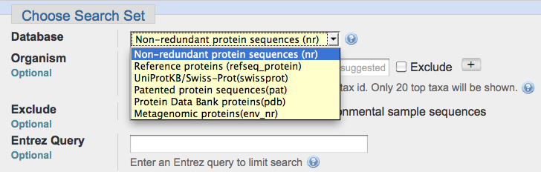
Non-redundant protein
nr (non-redundant protein sequences)
  GenBank CDS translations
  NP_, XP_ refseq_protein
  Outside Protein
    PIR, Swiss-Prot, PRF
    PDB (sequences from structures)
pat protein patents
env_nr metagenomes (environmental samples)
Services
blastp
blastx

Slide 11
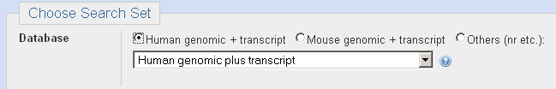
Nucleotide Databases: Human and Mouse
Megablast, blastn service
Human and mouse genomic and transcript now default
Separate sections in output for mRNA and genomic
Direct links to Map Viewer for genomic sequences

Slide 12
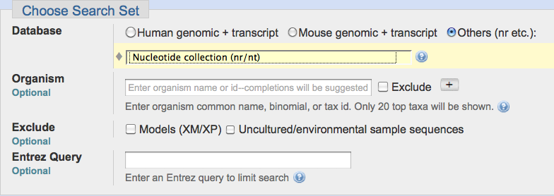
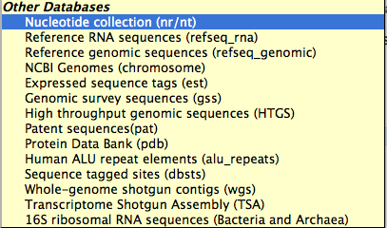
Nucleotide Databases
Services
blastn
tblastn
tblastx

Slide 13
Nucleotide Databases
Databases are mostly non-overlapping
nr (nt)
  Traditional GenBank
  NM_ and XM_ RefSeqs
    refseq_rna
NCBI Genomes
  NC_ RefSeqs
  GenBank Chromosomes
dbest
  EST Division
    non-human, non-mouse ests
htgs
  HTG division
gss
  GSS division
wgs
  whole genome shotgun contigs
tsa
  transcriptome shotgun assembly
16S microbial
  Selected 16S sequences (targeted loci)

Slide 14
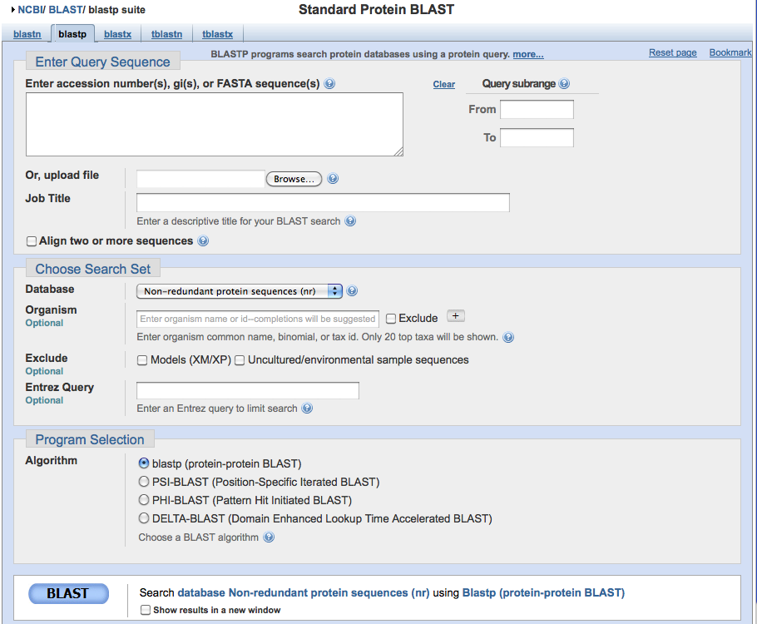
Universal Form: Protein

Slide 15
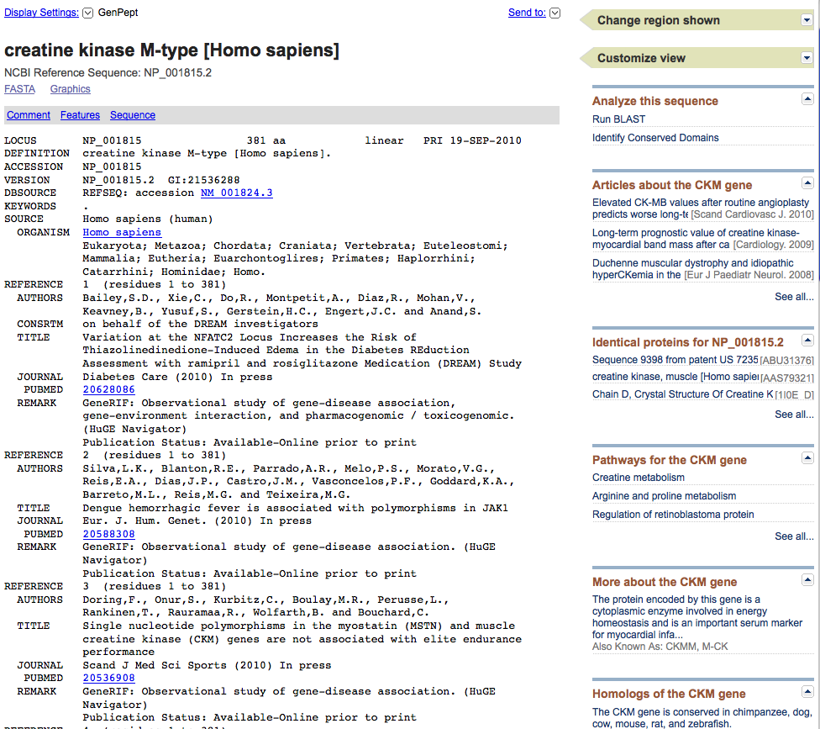
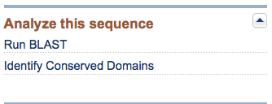
Discovery option: Entrez protein record
Analysis Tools
PubMed Citations
Identical Proteins
Discovery Column
Reference Sequences
Gene Record
HomoloGene Cluster

Slide 16
BLAST extensions and improvements
PrimerBlast – primer designer / specificity checker
COBALT – Protein Multiple Alignment tool
Integration / expansion of BLAST 2 Sequences
Global Alignment (Needleman-Wunsch)

Slide 17
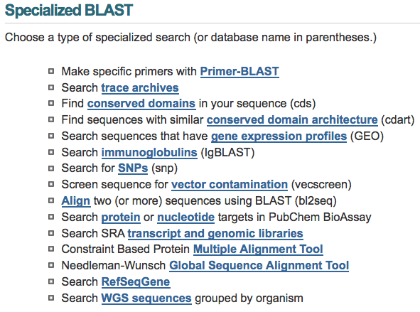
Specialized BLAST Pages

