Slide 1
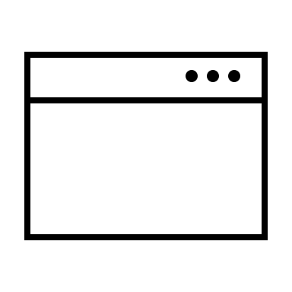
Document Lifecycle Management System (DLMS) Architecture
Innovation Lab
Front end
Back end
Browser
UI
(React & NodeJS)
API Server
(Typescript)
Mongo
DB
Component Library
State machine
Document schema
User profile & auth
Legend
User Profile Service
User Auth Service
Customizable
Reusable code

