Slide 1

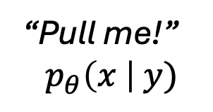
Drawing
effect
elevate
may
Fork
null
daytime
ears
Pencil
all
comma
yes
Eyebrow
the
queue
pot
Globe
world
left
row
Spinning
order
monkey
below
Fancy
night
arrow
of
Joking
zoo
tonight
tags
Definitive
ok
before
bug
Limited
guidance
for
discrete
Mustard
candle
makes
rain
“Pull me!”
$$p_{θ}\left(x \right| y)$$
Drawing
effect
elevate
may
Fork
null
daytime
ears
Pencil
all
comma
yes
Eyebrow
the
queue
pot
Globe
world
left
row
Spinning
order
monkey
below
Fancy
night
arrow
of
Joking
zoo
tonight
tags
Definitive
ok
before
bug
Controllable
discrete
diffusion
models
Mustard
candle
makes
rain
Drawing
effect
elevate
may
Controllable
discrete
diffusion
models
Pencil
all
comma
yes
Eyebrow
the
queue
pot
world
left
row
Globe
Spinning
order
monkey
below
Fancy
night
arrow
of
Joking
zoo
tonight
tags
Definitive
ok
before
bug

