Slide 1
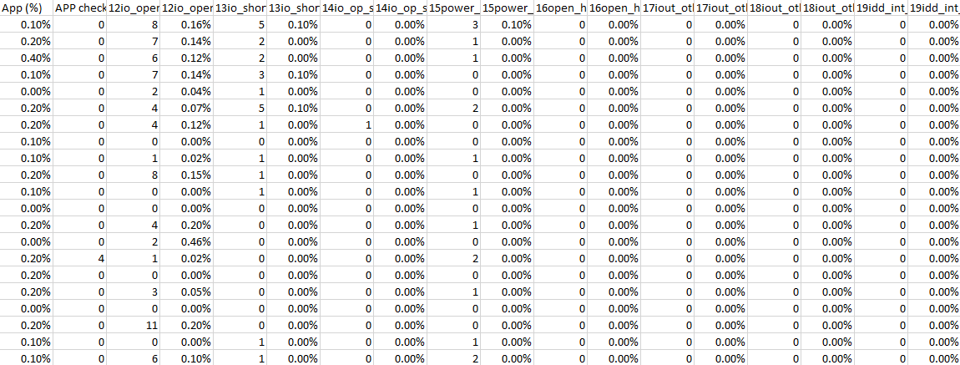
Original Raw Data
The original test raw data is not readable because they’re from several lots and wafers.

Slide 2
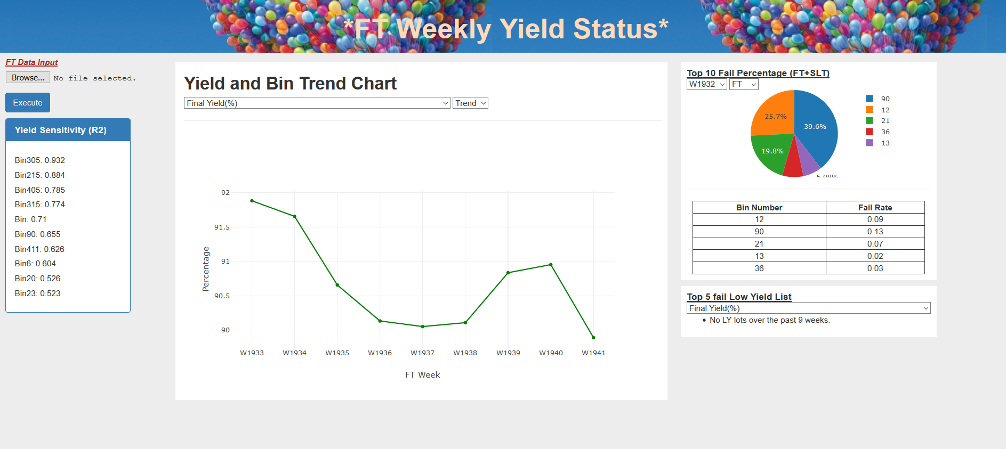
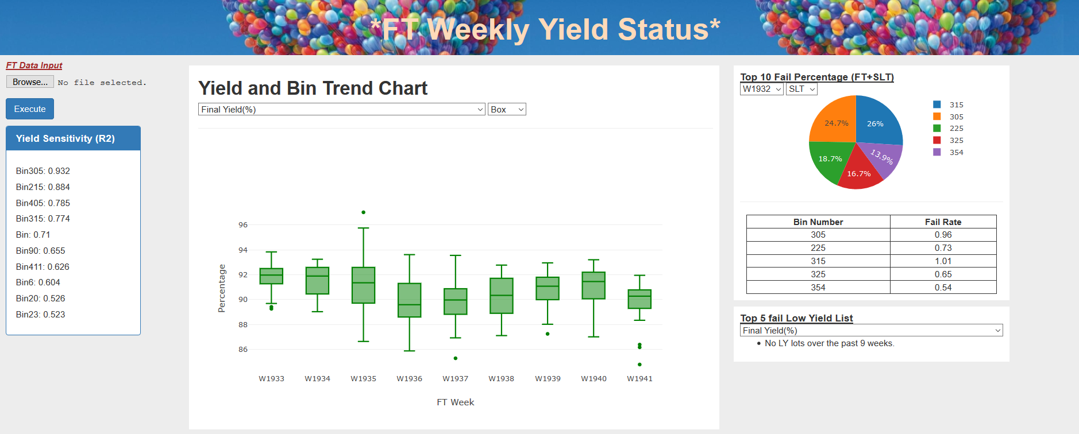
Trend Chart and Top Fails Summary

