Slide 1
Safety First
IOS App for Northeastern shuttle booking
by Disha Akarte

Slide 2
Application Design Features
Database designed using MySQL
Apache Tomcat used as local server
IOS App designed using Xcode
Java at the backend for server side development

Slide 3
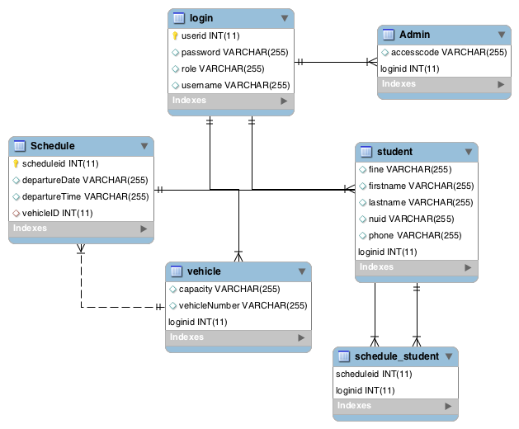
Database Design

Slide 4
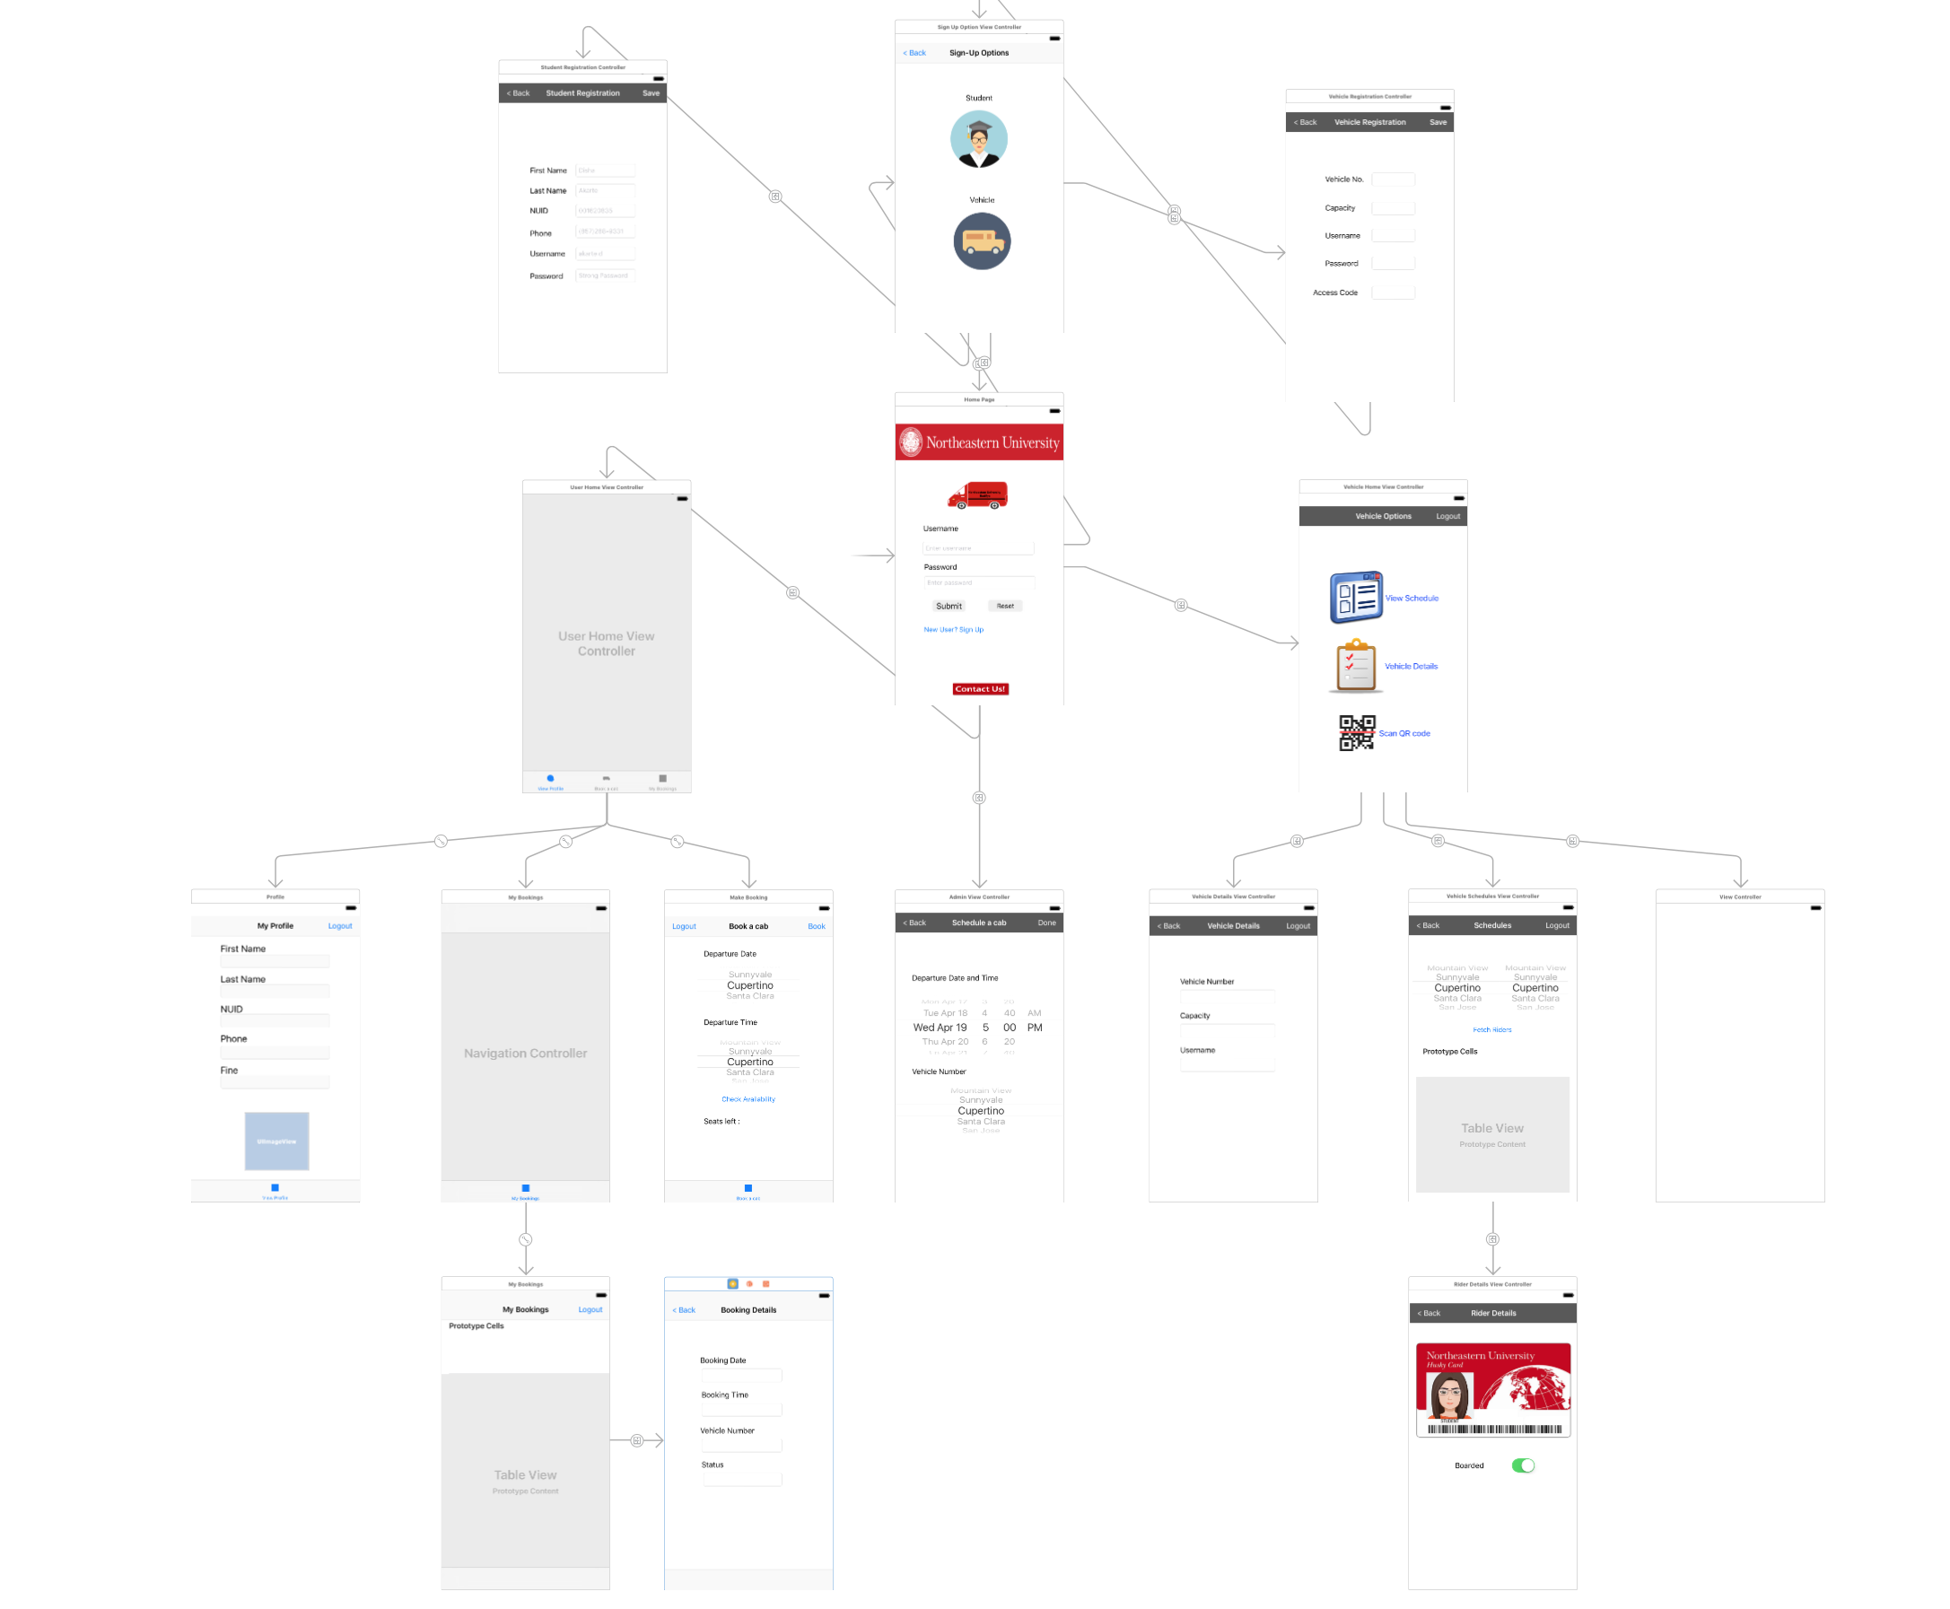
IOS Storyboard

Slide 5
Functionality
Real time utility application for booking the University shuttle in order to avoid wait times by students
Application has 3 roles : Admin, Student & Vehicle
Parsed JSON data sent to the server and received from server
Used Core Image Filter to generate bar code from NSString
Used AV Foundation framework to implement bar code scanner
Implemented calling functionality from the app

Slide 6
Demo

