Slide 1

CSC2038: Practical 07 Structure Charts and Wireframes on Range of Devices for All System Users TEAM Activity
Notes:
The Team should start this practical by the team considering different devices on which the content may be accessed.
The tram should then assign users and/or devices as agreed by the team to team members.
If the Team have decided to have a mobile phone as one of their devices then Team members assigned by the team to this device and particular user, should create a Structure Chart for the screens of the assigned users based on a mobile phone.
If the team have created a Structure Chart for this device then they must build a wireframe based on the chart structure.
The team should then build interactive wireframes for the content of the assigned users based on a mobile phone.
A team member may be assigned to develop all the wireframes for a particular user.
Remember that these screens are for a mobile phone device and therefore the interactive wireframes should reflect if the mobile phone is in landscape or portrait mode.
Do not delete the phone templates, e.g. if you are only designing for portrait mode, then leave landscape mode blank or if you are not designing for a mobile phone device, then leave the template blank.
This is an interactive wireframe so no colour in the prototype design.
The team should duplicate this slide to include all interactive wireframe designs the teams system requires.
If the team are developing wireframes for Tablets and/or Smart Watches, then they should complete the relevant Structure Chart and Wireframe section of the PowerPoint template.
When the team have completed all templates which they considered relevant for their device range and finalised the edits, they should merge all the material into one PowerPoint and share the final PowerPoint with all team members.
Each team member must upload a copy of the finalised PowerPoint to Canvas under the assignment portal for Practical 07.
REMEMBER to tidy your team workspace before leaving the lab in preparation for other users.

Slide 2
Introducing the Team
Notes:
It is good practice to introduce your team in a presentation. The next slide will request an image of each team member along with some requested details about them.

Slide 3

<Team Number & Name>
<Name>
<Email>
<Pathway>
<Name>
<Email>
<Pathway>
<Name>
<Email>
<Pathway>
<Name>
<Email>
<Pathway>
<Name>
<Email>
<Pathway>
<Name>
<Email>
<Pathway>
Notes:
Complete the Template with your team number and give your team a name.
Provide a picture of each team member along with their Name, Email Address and Pathway

Slide 4
User Mobile Screens Structure Charts
Notes:
DO NOT DELETE THIS SLIDE

Slide 5
User: <Name User Persona>
Team: <Number & Name of Team >
Team Member: <Name of Team Member>
Notes:
DO NOT DELETE THIS SLIDE
Each team member should be assigned users and/or devices as agreed by the team.
If the Team have decided to have a mobile phone as one of their devices then Team members assigned by the team to this device and particular user, should create a Structure Chart for the screens of the assigned users based on a mobile phone.
The team should duplicate this slide so that all Structure Charts required by the teams system may be included.

Slide 6
User Mobile Screens Interactive Wireframes
Notes:
DO NOT DELETE THIS SLIDE

Slide 7
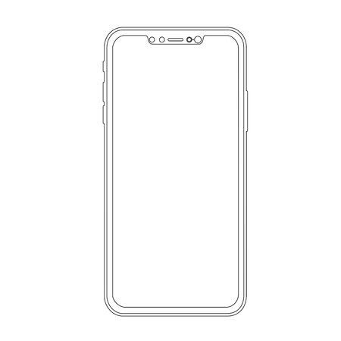
User: <Name User Persona>
Team: <Number & Name of Team >
Team Member: <Name of Team Member>
Notes:
DO NOT DELETE THIS SLIDE
If the team have created a Structure Chart for this device then they must build a wireframe based on the chart structure.
The team should then build interactive wireframes for the content of the assigned users based on a mobile phone.
A team member may be assigned to develop all the wireframes for a particular user.
Remember that these screens are for a mobile phone device and therefore the interactive wireframes should reflect if the mobile phone is in landscape or portrait mode.
Do not delete the phone templates, e.g. if you are only designing for portrait mode, then leave landscape mode blank or if you are not designing for a mobile phone device, then leave the template blank.
This is an interactive wireframe so no colour in the prototype design.
The team should duplicate this slide to include all interactive wireframe designs the teams system requires.

Slide 8
User Tablet Screens Structure Charts
Notes:
DO NOT DELETE THIS SLIDE

Slide 9
User: <Name User Persona>
Team: <Number & Name of Team >
Team Member: <Name of Team Member>
Notes:
DO NOT DELETE THIS SLIDE
Each team member should be assigned users and/or devices as agreed by the team.
If the Team have decided to have a tablet as one of their devices then Team members assigned by the team to this device and particular user, should create a Structure Chart for the screens of the assigned users based on a tablet.
The team should duplicate this slide so that all Structure Charts required by the teams system may be included.

Slide 10
User Tablet Screens Interactive Wireframes
Notes:
DO NOT DELETE THIS SLIDE

Slide 11
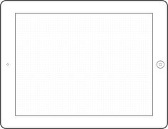
User: <Name User Persona>
Team: <Number & Name of Team >
Team Member: <Name of Team Member>
Notes:
DO NOT DELETE THIS SLIDE
If the team have created a Structure Chart for this device then they must build a wireframe based on the chart structure.
The team should then build interactive wireframes for the content of the assigned users based on a tablet.
A team member may be assigned to develop all the wireframes for a particular user.
Remember that these screens are for a tablet device and therefore the interactive wireframes should reflect if the tablet is in landscape or portrait mode.
Do not delete the tablet templates, e.g. if you are only designing for portrait mode, then leave landscape mode blank or if you are not designing for a tablet device, then leave the template blank.
This is an interactive wireframe so no colour in the prototype design.
The team should duplicate this slide to include all interactive wireframe designs the teams system requires.

Slide 12
User Smart Watch Screens Structure Charts
Notes:
DO NOT DELETE THIS SLIDE

Slide 13
User: <Name User Persona>
Team: <Number & Name of Team >
Team Member: <Name of Team Member>
Notes:
DO NOT DELETE THIS SLIDE
Each team member should be assigned users and/or devices as agreed by the team.
If the Team have decided to have a smart watch as one of their devices then Team members assigned by the team to this device and particular user, should create a Structure Chart for the screens of the assigned users based on a smart watch.
The team should duplicate this slide so that all Structure Charts required by the teams system may be included.

Slide 14
User Smart Watch Screens Interactive Wireframes
Notes:
DO NOT DELETE THIS SLIDE

Slide 15
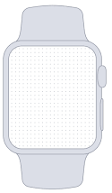
User: <Name User Persona>
Team: <Number & Name of Team >
Team Member: <Name of Team Member>
Notes:
DO NOT DELETE THIS SLIDE
If the team have created a Structure Chart for this device then they must build a wireframe based on the chart structure.
The team should then build interactive wireframes for the content of the assigned users based on a smart watch.
A team member may be assigned to develop all the wireframes for a particular user.
Remember that these screens are for a smart watch device.
Do not delete the smart watch templates, e.g. if you are not designing for a smart watch, then leave the template blank.
This is an interactive wireframe so no colour in the prototype design.
The team should duplicate this slide to include all interactive wireframe designs the teams system requires.

