Slide 1
Predicting Bazel Build Times
with Machine Learning
UE24CS352A Machine Learning, Mini-Project
Team: Deepak & Manaswin
Reproducing, auditing and improving Nadeem & Raza, Stanford CS229

Slide 2
The problem
• Bazel is incremental: a commit only re-runs the build actions whose inputs changed, so a build costs anything from under a second to tens of seconds.
• Task: predict the CPU time of the build that follows a commit, using only what is known before building, i.e. which files the commit changed.
• Use: CI schedulers can batch or prioritise builds; developers are warned that a change is expensive.
• The paper: linear regression on two categorical features (most common path prefix and file type, plus their cross) over 500 builds.
• Our goal: reproduce it, audit it, improve it.
2

Slide 3
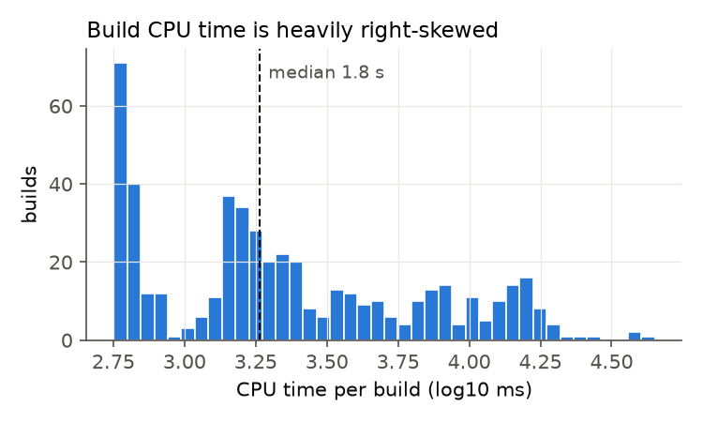
Data: 500 real Bazel builds
• 500 consecutive commits of bazelbuild/bazel (2021); each built with bazel build //src:bazel-dev, CPU time read from the Build Event Protocol.
• Target: median 1.8 s, mean 4.3 s, max 44.9 s; heavily right-skewed, so we model log(CPU time).
• Recovered the full list of changed files for all 500 commits from git, and actionsExecuted from the BEP files.
• Split as in the paper: builds 1-300 train, 301-400 validation, 401-500 test.
3

Slide 4
Auditing the original code
• Test bug: test_model() builds a new, untrained regressor, so every test prediction is 0 (RMSE 7,459 ms, the flat test line in the paper).
• Substring bugs: '.c' matches .cc and .css, '.h' matches .html, '.js' matches .json; a commit with no listed type defaults to JAVA; 'tools/' matches every com/google/devtools/ path.
• Reproduced paper model: test ρ = 0.09, no better than predicting the mean (RMSE 5,876 vs 5,807 ms).
• Off-by-one: history was walked backwards with a warm cache, so build i re-does the work of the files changed by commit i-1, not by commit i.
4

Slide 5
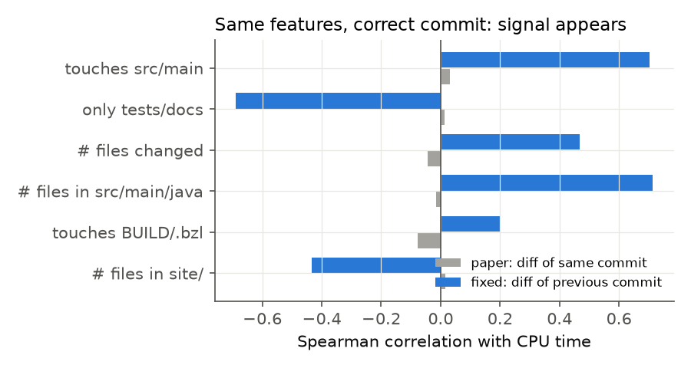
The alignment fix: the signal appears
• Same features, shifted by one commit.
• touches src/main: ρ 0.03 to 0.70.
• only tests/docs: ρ 0.01 to -0.69.
• Data provenance mattered more than the choice of model.
5

Slide 6
Features and models
• Diff features (32): changed files per source area and per type (by real extension), log #files, log lines added/deleted, flags touches src/main, only tests/docs, touches BUILD/.bzl.
• Size features (8): total and largest bytes and imports/#includes of the changed files, overall and for Java and C/C++, read from git in the state before the commit (the version the build compiles).
• Models: ridge, random forest, gradient boosting (Huber loss) on log CPU time; first (cold-cache) build excluded.
• Feature set and model chosen together on validation RMSLE only; test scored once.
• 100 test builds are few, so feature sets are also compared by paired 5-fold CV repeated 20 times.
6

Slide 7
Results on the test set (builds 401-500)
Model | RMSE ms | MAE ms | ρ | AUC > 5 s
Paper's test code (untrained) | 7,459
Predict training mean | 5,807 | 4,352 | 0.00 | 0.50
Paper model reproduced | 5,876 | 4,394 | 0.09 | 0.55
Diff features, paper alignment | 6,362 | 3,822 | -0.05 | 0.45
Diff features, fixed alignment | 4,954 | 2,744 | 0.82 | 0.85
+ size features (final) | 5,143 | 2,811 | 0.81 | 0.83
• The final model cuts MAE by 36% against the paper's model and flags builds over 5 s with AUC 0.83.
• Validation chose the size features; on these 100 test builds they are slightly behind diff-only, a gap well inside the fold-to-fold spread (next slide).
7

Slide 8
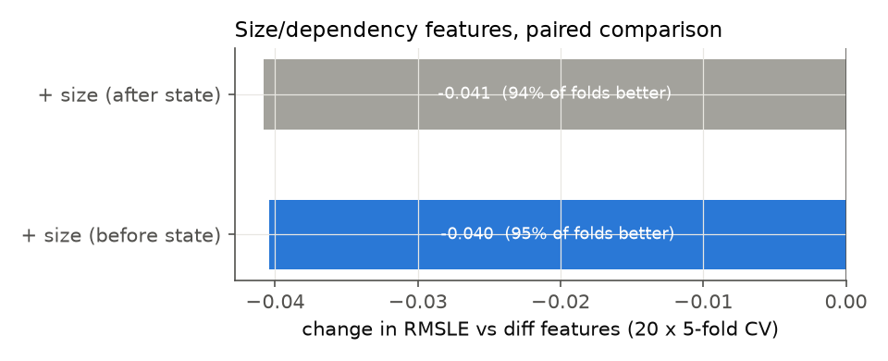
Cross-validation: the size features help consistently
5-fold CV, 499 builds | RMSE ms | ρ
Paper features (SGD) | 5,315 ± 728 | -0.00
Diff features | 4,709 ± 834 | 0.78
+ size features (final) | 4,210 ± 701 | 0.80
• Paired on identical folds (20 x 5): RMSLE -0.040, RMSE -468 ms, ρ +0.027.
• Better in 95% of 100 folds and in 20 of 20 repetitions.
• Before and after file state give the same gain.
8

Slide 9
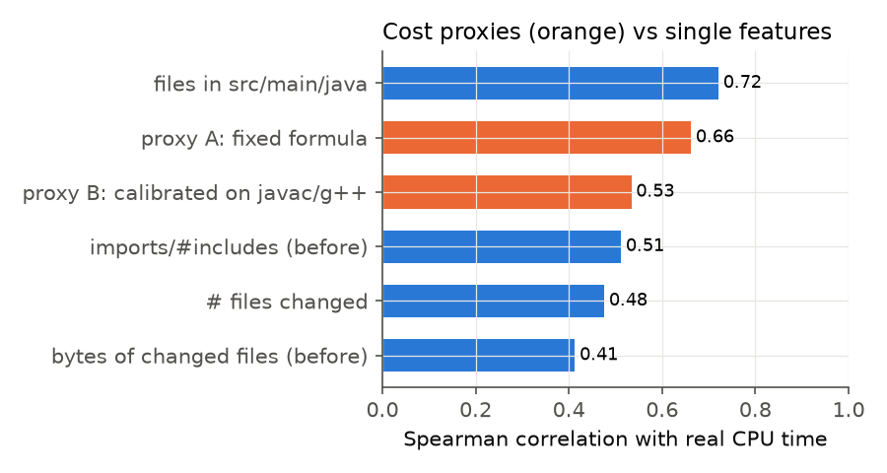
Do hand-built cost estimates work?
• Two proxies from a companion project that mined all 47k Bazel commits, where no real build time exists.
• A: fixed language and directory weights, ρ 0.66.
• B: fitted on measured javac/g++ compile times, ρ 0.53.
• Both lose to one learned feature, files in src/main/java (ρ 0.72), and do not help as model inputs.
9

Slide 10
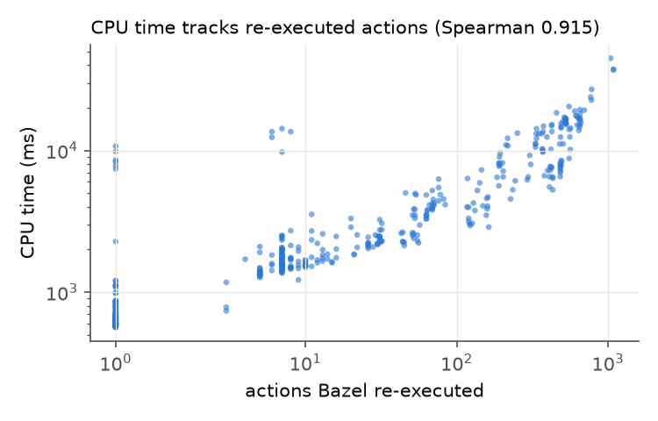
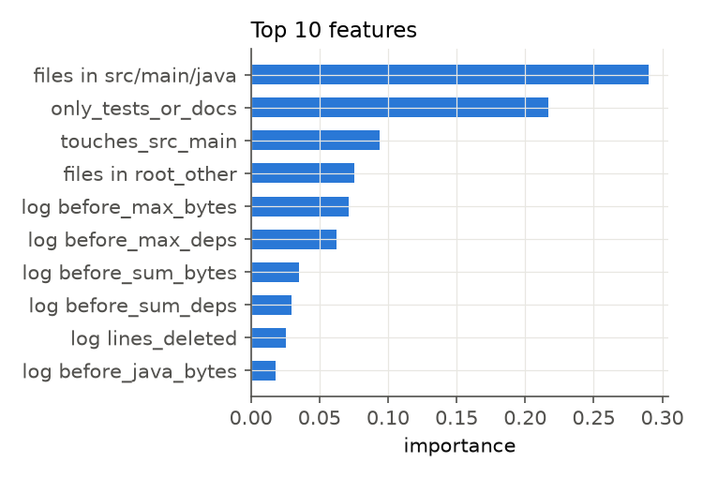
What drives CPU time
• CPU time tracks the number of actions Bazel re-runs (ρ 0.92); 149 builds re-ran a single action.
• Which area a change touches matters most; how large the changed files are adds a smaller, consistent gain.
10

Slide 11
Live demo: src/predict.py
$ python src/predict.py --row 407
Predicted CPU time : 6572 ms -> EXPENSIVE (large part of the graph rebuilds)
Actual CPU time : 27056 ms -> EXPENSIVE (large part of the graph rebuilds)
$ python src/predict.py --row 415
Predicted CPU time : 544 ms -> CHEAP (near no-op rebuild)
Actual CPU time : 594 ms -> CHEAP (near no-op rebuild)
$ python src/predict.py --files site/docs/install.md
Predicted CPU time : 707 ms -> CHEAP (near no-op rebuild)
• Also works on a real commit: --repo <bazel clone> --commit <sha> (computes size features from git).
• With only a file list the sizes are unknown, so it says so and uses the diff-features model.
11

Slide 12
Conclusions and limitations
• The paper's model has no signal; three bugs and an off-by-one alignment explain why.
• Fixed alignment + richer features: test ρ 0.81, MAE 36% lower, CV ρ 0.80.
• Size and dependency features of the changed files give a consistent gain in paired CV.
• Hand-built cost formulas are weaker than learned features.
• Limitations: 500 builds, one machine, one target; 100 test builds cannot separate models a few percent apart; the largest rebuilds are under-predicted.
• Next: reverse-dependency counts from bazel query 'rdeps(...)', and more builds.
12

Slide 13
Who did what
Deepak
Manaswin
• Recovered the 500 commit diffs and BEP metrics
• Audit: test bug, substring bugs, off-by-one alignment
• Diff features, SGD re-implementation, models
• Training pipeline, figures, demo CLI, first write-up
• Size and dependency features (scripts/size_features.py)
• Companion project: 47k-commit mining and two cost proxies, incl. measured compile-time calibration
• Proxy validation, paired repeated CV, joint feature-set selection
• Demo support for size features; updated README, write-up and slides
13

