Slide 1


Quantum Machine Learning for Conspicuity Detection in Production
Womanium Quantum+AI Project 2024
Created by Team: QuantumNinjas
Team Member Name: Disha Mondal
About Me: I am an undergraduate student from India pursuing BTECH in Computer Science & Engineering.
Team Repository Link: Click Here

Slide 2

Introduction
This presentation provides an overview of a project focused on using quantum machine learning techniques for optimizing production processes through conspicuity detection. The project, a collaboration between Fraunhofer and Womanium, explores the application of hybrid quantum computing and artificial intelligence to enhance industrial efficiency and quality control.
The project aims to leverage the unique capabilities of quantum computing and machine learning to improve conspicuity detection in production environments. By combining the power of quantum algorithms with classical data analysis, the team seeks to develop innovative solutions that can identify anomalies and optimize production workflows.
Womanium Quantum+AI Project

Slide 3

Task 1 - Familiarization with Pennylane
Quantum Computing Basics
Hands-on Practice
The team explored fundamental concepts of quantum computing, including quantum circuits and single-qubit operations, through the Pennylane Codebook tutorials.
The team engaged in hands-on exercises, implementing quantum algorithms and circuits to solidify their knowledge and prepare for the subsequent tasks.
1
2
3
Multi-Qubit Systems
The team delved into the interactions and behaviors of multi-qubit systems, gaining a deeper understanding of quantum algorithms and their practical implementations.
Womanium Quantum + AI Project

Slide 4

Womanium Quantum+AI Project
Task 1 Overview:
This slide provides an overview of the team's progress in exploring the Pennylane framework and gaining a foundational understanding of quantum computing principles.
Objective: To familiarize oneself with the Pennylane framework and quantum computing basics.
Materials Used: Pennylane Codebooks, including "Introduction to Quantum Computing," "Single-Qubit Gates," and "Circuits with Many Qubits."
Progress and Learnings: Completed the tutorials and documented key insights and code implementations. Gained a foundational understanding of quantum computing principles.
Link to Project Notebook: Click here

Slide 5
Womanium Quantum+AI Project
Task 2 - Variational Classifier
Objective: To implement and understand the workflow of a variational classifier in quantum machine learning.
Source: Variational Classifier Tutorial
Link to Project Notebook: Click here
Key Steps:
Data Encoding
Variational Circuit
Measurement and Classification
The team learned how to translate classical data into quantum states, a crucial step in the quantum machine learning workflow.
They designed a customizable quantum circuit with adjustable parameters, enabling the model to learn from the encoded data.
The team extracted useful information from the quantum system and used it to make predictions, completing the variational classifier implementation.

Slide 6


Womanium Quantum+AI Project
Task 3 - Quanvolutional Neural Networks
1
Data Preprocessing
The team prepared the MNIST dataset for quantum processing, ensuring the data was in a format suitable for the Quanvolutional Neural Network (QNN) implementation.
2
Quanvolutional Layers
They applied quantum convolutional layers to the data, leveraging the unique properties of quantum circuits to extract relevant features for image classification.
3
Classifier
The team used the extracted features to train a classifier, comparing the performance of the QNN with classical convolutional neural networks.

Slide 7

Task 3 Overview:
Objective: To explore and implement Quanvolutional Neural Networks (QNNs) using the MNIST dataset.
Source: Quanvolutional Neural Networks Tutorial
Important Steps and Observations:
The role of quantum circuits in feature extraction.
Comparison of QNNs with classical convolutional networks.
Link to Project Notebook: Click here
Womanium Quantum+AI Project

Slide 8


Womanium Quantum+AI Project
Task 4 - Quantum Machine Learning Model for Sine Function
Discretization
The team divided the interval [0, 2π] into discrete points, using the sine values at these points as labels for the quantum machine learning model.
Model Development
They created a quantum circuit to predict the sine values, leveraging the unique properties of quantum systems to learn the underlying function.
Visualization
The team visualized the predicted sine values alongside the actual values, demonstrating the effectiveness of the quantum machine learning model.

Slide 9
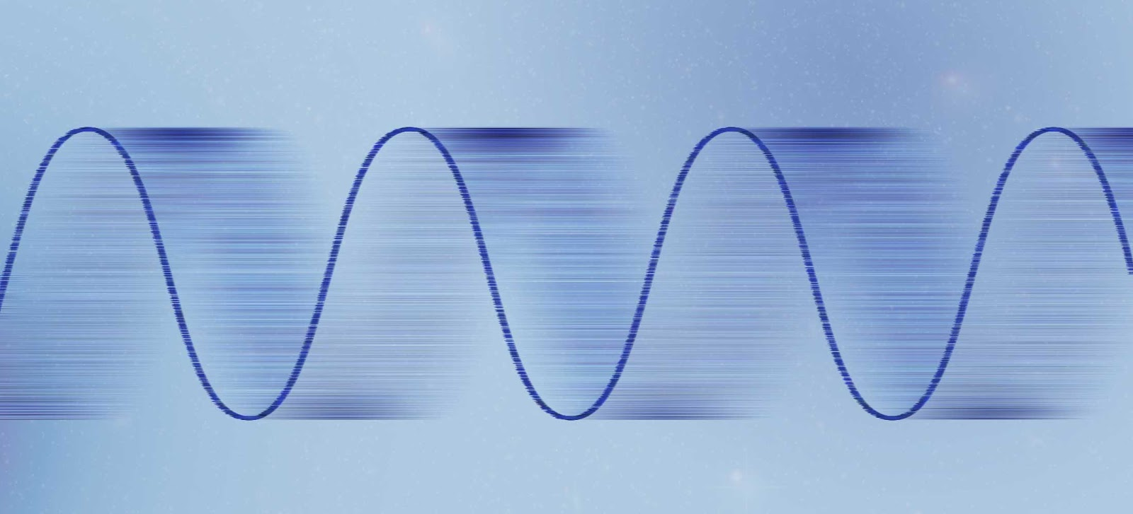
Task 4 Overview:
Objective: To develop a quantum machine learning model to learn the sine function.
Materials Used: Quantum Sine Function Notebook
Methodology:
Discretization: Dividing the interval [0, 2π] into discrete points.
Labeling: Using sine values at these points as labels.
Model Development: Creating a quantum circuit to predict sine values.
Results:
Successful implementation of the model.
Visualization of predicted vs. actual sine values.
Link to Project Notebook: Click here
Womanium Quantum+AI Project

Slide 10




Task 5 - Industrial Dataset (Not Completed)
Objective: To implement a QML model for detecting defective parts using a real-world dataset.
Time Constraints
Technical Challenges
Potential Next Steps
Due to time limitations, the team was unable to complete the implementation of a quantum machine learning model for the real-world industrial dataset.
The team encountered technical challenges that prevented them from fully implementing the model for the industrial dataset within the given timeframe.
The team plans to continue exploring the industrial dataset, focusing on data preprocessing and model implementation to detect defective parts using quantum machine learning techniques.
Womanium Quantum+AI Project

Slide 11




Conclusion
Womanium Quantum+AI Project
Achievements
Insights
Future Directions
The team made significant progress in understanding and implementing quantum machine learning techniques, as demonstrated by the successful completion of the previous tasks.
The team gained valuable insights into the potential of quantum computing and its applications in real-world scenarios, such as optimizing production processes through conspicuity detection.
The team plans to continue exploring quantum machine learning, with the goal of applying these techniques to solve more complex problems and contribute to the advancement of the field.

Slide 12

Womanium Quantum+AI Project
References
Pennylane Documentation
The team relied heavily on the Pennylane documentation and tutorials to understand the framework and implement the various tasks.
Relevant Papers
The team reviewed relevant research papers and resources to stay up-to-date with the latest developments in quantum machine learning.
Project Resources
The team utilized the provided links and resources, including the project notebooks, to guide their work and progress.
Please note that Womanium logo has been used to extend my gratitude. The rest of the images have been AI generated using Playground 2.5.

Slide 13
Womanium Quantum+AI Project
Thank you for your attention!

